Slide 1
♥
MEDPREDICT
MedPredict
AI-Powered Cardiovascular Risk Assessment
Bridging Data and Care with Machine Learning
Predictive Analytics | Random Forest Classification | Clinical Decision Support

Slide 2
The Problem
Why Traditional Risk Assessment Falls Short
⏱
Manual Risk Assessment
≡
Data Overload
Clinicians rely on standard charts (Framingham, ASCVD) that are time-consuming and don't adapt to individual patient profiles.
Electronic health records contain vast amounts of data; human experts cannot process all features simultaneously.
▣
Static Models
!
Lack of Early Warning
Conventional risk scores are based on population averages and ignore new risk factors or variable interactions.
Without predictive analytics, high-risk patients are often identified only after symptoms appear.
MedPredict
2

Slide 3
Architecture
System Architecture & Data Flow
1
2
3
4
5
User Input
→
Preprocessing
→
Feature Engineering
→
ML Classification
→
Result & Dashboard
Patient demographic & clinical data (age, gender, BP, cholesterol, smoking) via web form
Handle missing values, normalise numerical features, encode categorical variables
Generate derived features (BMI, age-risk interaction); select via statistical tests
Random Forest / ensemble trained on labelled data (e.g. UCI Heart Disease dataset)
Risk score, confidence, feature-contribution chart, recommendations, PDF export
External Entities
P
Patient
D
Doctor
A
Admin
Submits health data, views personal risk
Reviews predictions, manages patient records
Oversees system usage, generates aggregate reports
MedPredict
3

Slide 4
Platform Design
System Modules
Five independently developed and maintained modules power the MedPredict platform
M1
M2
M3
User Interface
Data Preprocessing
Feature Engineering
Flask-based web app with role-based login (Admin, Doctor, Patient). Dashboards with charts, risk meters, and appointment scheduling.
Cleans input data: handles missing values, scales numeric features, encodes categories (e.g. One-Hot encoding).
Combines raw features with derived metrics (BMI, BP category, age groups). Selects top features via Random Forest importance.
M4
M5
ML Classification
Reporting & Analytics
Random Forest / XGBoost trained on a heart disease dataset. Probability scores and class output, persisted with joblib.
Generates risk meters, feature-contribution charts, trend graphs over time, and PDF reports for doctors and patients.
MedPredict
4

Slide 5
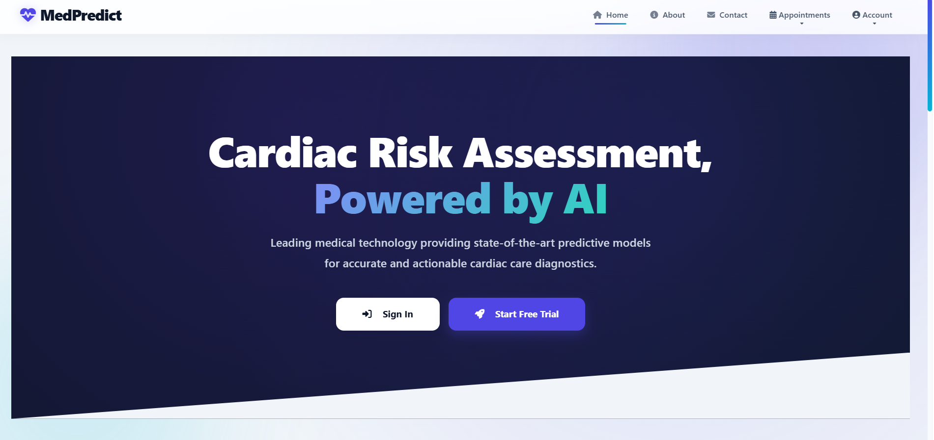
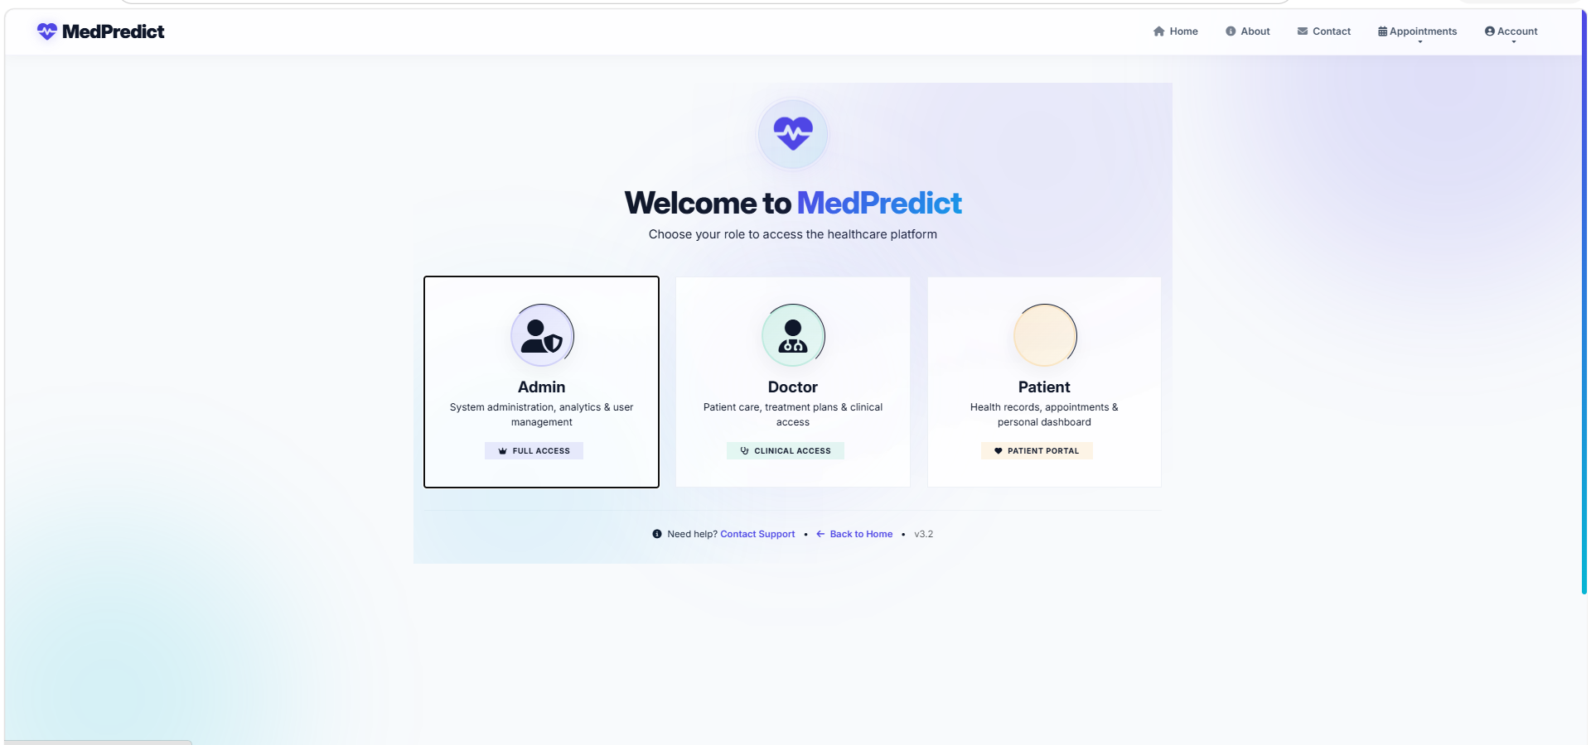
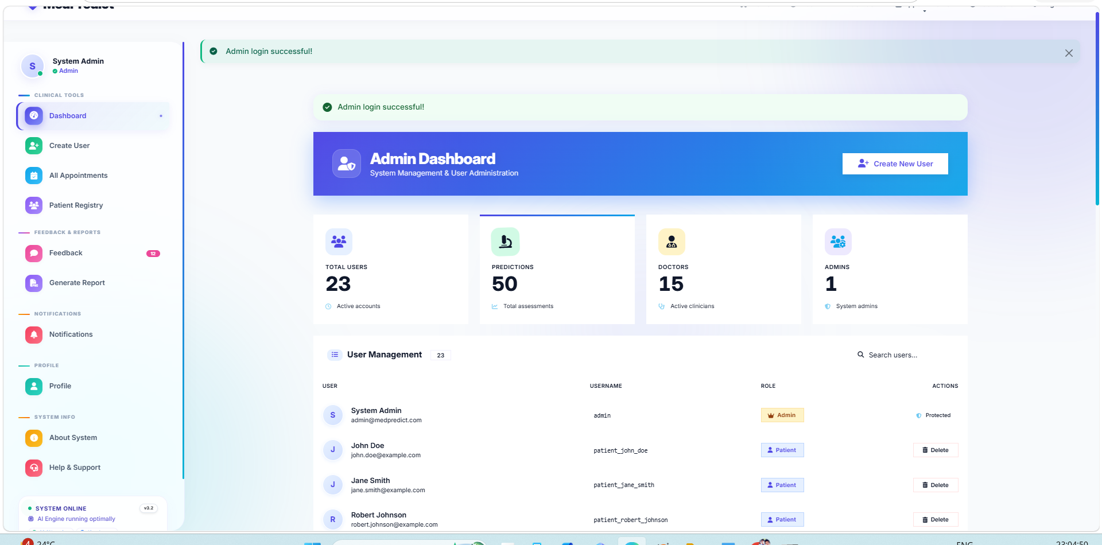
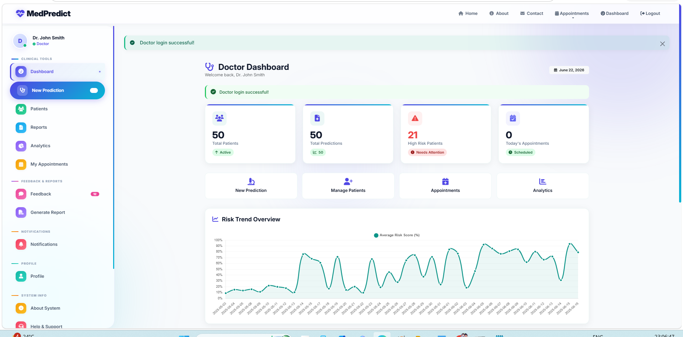
Product Tour
Sample Screens
Landing Page
Login Choice
Admin Dashboard
Doctor Dashboard
Navigation and role selection
Admin, Doctor & Patient portals
Users, predictions & doctors overview
Risk trends & high-risk patients
Also included: Appointment booking/confirmation and the Prediction Form for instant risk scoring with recommendations.
MedPredict
5

Slide 6
Conclusion
Proven Impact, Built for Trust
>90% Accuracy
Hybrid Signal Fusion
Ensemble machine learning (Random Forest) achieves high accuracy in predicting cardiovascular risk, surpassing traditional risk calculators.
Combining clinical features with derived behavioral signals (smoking, physical activity) yields richer predictive power.
Interpretable by Design
Real-World Impact
The web interface empowers doctors to make data-driven decisions and patients to understand their health status.
Early risk identification enables preventive care, reduces hospital admissions, and improves patient outcomes.
MedPredict
6

Slide 7
Roadmap
Future Enhancements
Deep Learning
Replace Random Forest with LSTM or Transformer models to capture temporal patterns from longitudinal EHR time series.
1
Wearable Integration
Connect to real-time data from smartwatches (heart rate, activity) for continuous risk monitoring.
2
Multi-lingual & Explainable AI
Add support for regional languages and use SHAP/LIME to provide patient-friendly explanations.
3
Adaptive Retraining
Feedback loop where new patient outcomes automatically retrain the model, keeping it current with population trends.
4
MedPredict
7

Slide 8
♥
Thank You
MedPredict — Bridging Data and Care
Thank you for your attention!

