Slide 1
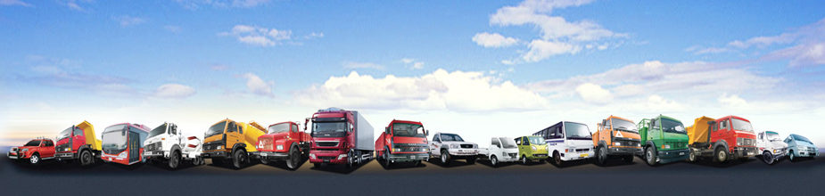
TATA MOTORS

Slide 2
DETAILS ON THE COMPANY
COMPANY NAME: TATA MOTORS LIMITED
TICKER SYMBOL: TTM (Nasdaq)
HEADQUATERS: Mumbai, Maharashtra, India
YEAR OF INCORPORATION: 1945
NUMBER OF SHARES OUTSTANDING: 649.61 Millions
NUMBER OF EMPLOYEES: 66,593(2014)
INDUSTRY: Automobile (commercial vehicles, public vehicles)
CHIEF EXECUTIVE OFFICER AND CHAIRMAN: Cyrus Pallonji Mistry
FOUNDER: J.R.D TATA

Slide 3
INDUSTRY OVERVIEW MACROECONOMIC FACTORS
Tata motors is the leader in commercial vehicles in each segment, and among the top three in passenger vehicles with winning products in the compact, midsize car and utility vehicle segments. It is the worlds fourth largest truck manufacturer and the worlds second largest bus manufacturer.
It has played a key role in the automobile industry with a contribution of 17.19% in both commercial as well as passenger vehicles. They have improved the quality of life of the communities that they serve globally, through long-term stakeholder value creation based on Leadership with Trust.
Tata company or enterprise operates independently under the guidance and supervision of its own board of directors and shareholders. There are 30 publicly-listed Tata enterprises with a combined market capitalisation of about $113.09 billion (as on 16 September 2015).
Tata Motors is also expanding its international footprint, established through exports since 1961. The company's commercial and passenger vehicles are already being marketed in several countries in Europe, Africa, the Middle East, South East Asia, South Asia, South America, Australia, CIS and Russia. It has franchisee/joint venture assembly operations in Bangladesh, Ukraine, and Senegal.

Slide 4
PEST ANALYSIS
A PEST analysis is a business measurement tool which is used to assess the market for a business or organizational unit.
PEST is an acronym for Political, Economic, Social and Technological factors.
PEST analysis describes a framework of macro-environmental factors used in the environmental scanning component of strategic management.
P-Political
E-Economic
S-Social
T-Technological

Slide 5
POLITICAL
Current legislation, future legislation and international legislation
Ecological or environmental issues
Government policies
Regulatory bodies and processes
Trading policies
Pressure groups
Wars, conflicts, threats of military invasions
Funding, grants and initiatives
Pricing regulations
Taxation policies
Trade regulations and tariffs

Slide 6
ECONOMIC
Home economy situation & overseas economies and trends
General taxation issues
Seasonality or weather issues
Market and trade cycles
Specific industry factors
End user drivers
Interest and exchange rate
International trade/ monetary issues

Slide 7
SOCIAL
Lifestyle trends
Demographics
Consumer attitudes and opinions
Media views
Law changes affecting social factors
Brand, company, technology image
Consumer buying patters
Fashion and role models
Major events and influences
Buying access and trends
Religious factors
Advertising and publicity

Slide 8
TECHNOLOGICAL
Competing technology development
Research funding
Associated/dependent technologies
Replacement technologies/ solutions
Maturity of technology
Manufacturing maturity and capacity
Information and communications
Consumer buying mechanisms
Technology legislation
Innovation potential
Technology access, licensing, patents
Intellectual property issues
Global communications

Slide 9
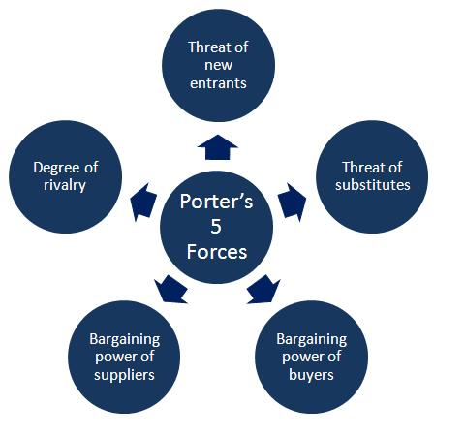
PORTER’S FIVE FORCES MODEL

Slide 10
THREAT OF NEW ENTRANTS
Profitable markets that yield high returns will attract new firms. This results in many new entrants, which eventually will decrease profitability for all firms in the industry unless the entry of new firms can be blocked by some barriers.
The following factors can have an effect on how much of a threat new entrants may pose:
Government policy
Capital requirements
Absolute cost
Cost disadvantages independent of size, economies of scale
Economies of product differences
Product differentiation
Switching costs
Expected retaliation
Access to distribution
Customer loyalty

Slide 11
THREAT OF SUBSTITUTE PRODUCTS/SERVICES
The existence of products outside of the realm of the common product boundaries increases the propensity of customers to switch to alternatives. Example: One car maybe a substitute of another.
Potential Factors:
Buyer propensity to substitute
Relative price performance of substitute
Buyer switching costs
Perceived level of product differentiation
Number of substitute products available in the market
Ease of substitution
Substandard product
Quality depreciation
Availability of close substitute

Slide 12
BARGAINING POWER OF CUSTOMERS
Buyers are sensitive to price changes. Bargaining power is high when there are many alternatives and it is low when buyers act independently.
Potential factors:
Buyer concentration to firm concentration ratio
Degree of dependency upon existing channels of distribution
Bargaining leverage, particularly in industries with high fixed costs
Buyer switching costs relative to firm switching costs
Buyer information availability
Force down prices
Availability of existing substitute products
Differential advantage (uniqueness) of industry products
The total amount of trading

Slide 13
BARGAINING POWER OF SUPPLIERS
Suppliers of raw materials, components, labor, and services (such
as expertise) to the firm can be a source of power over the firm when there are few substitutes.
Potential factors are:
Supplier switching costs relative to firm switching costs
Degree of differentiation of inputs
Impact of inputs on cost or differentiation
Presence of substitute inputs
Strength of distribution channel
Supplier concentration to firm concentration ratio
Employee solidarity (e.g. labor unions)
Supplier competition

Slide 14
DEGREE OF RIVALRY
For most industries the intensity of competitive rivalry is the major determinant of the competitiveness of the industry.
Potential factors:
Sustainable competitive advantage through innovation
Competition between online and offline companies
Level of advertising expense
Powerful competitive strategy
Firm concentration ratio
Degree of transparency

Slide 15
Swot analysis
A SWOT analysis (alternatively SWOT matrix) is a structured planning method used to evaluate the strengths, weaknesses, opportunities and threats involved in a project or in a business venture.
S- STRENGTH
W- WEAKNESS
O- OPPURTUNITY
T- THREATS

Slide 16
TATA MOTORS SWOT ANALYSIS
STRENGTH BRAND EQUITY, CAPTURE OVER INDIAN MARKETS, CUSTOMER LOYALTY GLOBALLY RENOWNED FOR CV SOUND PRESENCE IN ASIAN MARKETS STRONG PARENT BASE | WEAKNESS MINIMUM PRESENCE IN EUROPEAN AND US MARKETS POOR TECHNICAL BASE AS COMPARED TO GLOBAL LEADERS . CONFINED TO COST FOCUS STRATEGY
THREATS HUGE INVESTMENTS FOR JLR CAN TAKE THE COMPANY TO INCUR LOSSES. TATA NANO SINGUR PLANT CONTROVERSY CAN HAMPER REVENUES THE CONFLICT OF STRATEGIES | OPPURTUNITIES EXPOSURE TO WESTERN MARKETS THROUGH JLR POTENTIAL RISE IN PROFITABILITY TATA NANO CREATING NEW MARKETS

Slide 17
RATIO ANALYSIS
EBT MARGIN:
EBT Margin shows company’s earnings before tax as a percentage of net sales.
EBT Margin= Earnings before tax(EBT)/Sales volume.
Since the EBT Margin is decreasing drastically finally becoming negative, it may mean a bigger competition and a risk of Company’s bankruptcy.
In this case we observe that Tata Motors is in a disadvantageous position as compared to its competitors.
YEARS | FY-2011 | FY-2012 | FY-2013 | FY-2014 | FY-2015
EBT Margin | 5% | 2% | 0% | -3% | -11%
TATA MOTORS | MAHINDRA | FORD | GM
-11% | 7.86% | 3.69% | 4.79%

Slide 18
Ratio analysis
RETURN ON ASSETS: It is an indicator of how profitable a company is relative to its total assets. It gives an idea as to how efficient, management is at using its assets to generate income.
ROA= net income/ total assets
Over the years, efficiency of using assets by management to generate income has reduced.
As compared to Mahindra, Tata motors is lagging behind in using assets to generate income. Ford and GM are also in an advantageous position as compared to Tata motors.
YEARS | FY-2011 | FY-2012 | FY-2013 | FY-2014 | FY-2015
ROA | 14% | 14% | 10% | 7% | 1%
TATA MOTORS | MAHINDRA | FORD | GM
1% | 5.67% | 1.73% | 2.49%

Slide 19
RATIO ANALYSIS
RETURN ON EQUITY: ROE is a ratio that provides investors insight into how efficiently a company is managing the equity that shareholders have contributed to the company.
ROE= Net income/shareholders’ equity
Decreasing ROE shows that company’s profit generated by shareholders’ money is reducing. Thus shareholders are in greater risk than before.
Tata Motors is in the worst position in this case as compared to its competitors
YEARS | FY-2011 | FY-2012 | FY-2013 | FY-2014 | FY-2015
ROE | 25% | 21% | 18% | 12% | 2%
TATA MOTORS | MAHINDRA | FORD | GM
2% | 21.57% | 13.92% | 12.29%

Slide 20
RATIO ANALYSIS
ASSET TURNOVER RATIO- It is used as an indicator of the efficiency with which a company is deploying its assets for generating revenue.
Asset Turnover= sales/ total assets
Assets turnover ratio is more or less the same for previous years.
The ratio’s show that Tata motors is deploying its assets for generating revenue in a better way than its three competitors.
YEARS | FY-2011 | FY-2012 | FY-2013 | FY-2014 | FY-2015
assets turnover ratio | 1.359864615 | 1.773918963 | 1.34108523 | 1.018378755 | 1.039347733
TATA MOTORS | MAHINDRA | FORD | GM
1.03 | 0.9 | 0.66 | 0.84

Slide 21
RATIO ANALYSIS
CURRENT RATIO: It is the financial ratio that measures whether or not a firm has enough resources to pay its debts over the next twelve months.
Current ration= Current assets/current liabilities
Since the current ratio is less than 1, the company is not in good financial health.
Mahindra, Ford and GM are in better financial well being than Tata Motors.
YEARS | FY-2011 | FY-2012 | FY-2013 | FY-2014 | FY-2015
Current Ratio | 0.55 | 0.45 | 0.41 | 0.39 | 0.56
TATA MOTORS | MAHINDRA | FORD | GM
0.56 | 1.44 | 3.03 | 1.22

Slide 22
RATIO ANALYSIS
DEBT TO EQUITY: It is a financial ratio indicating the relative proportion of shareholders equity and debt used to finance a company’s assets.
Debt equity ratio= total liabilities/ shareholders’ equity
Increasing D/E ratio is indicating that the amount of debt the company is using to finance its assets relative to the amount of value represented in shareholders’ equity is rising.
Tata motors, Mahindra and GM are more or less in the same position while in case of Ford more outsiders loan has been taken to finance the assets
YEARS | FY-2011 | FY-2012 | FY-2013 | FY-2014 | FY-2015
DEBT TO EQUITY RATIO | 0.732308242 | 0.561753084 | 0.746601136 | 0.757841533 | 1.353190626
TATA MOTORS | MAHINDRA | FORD | GM
1.35 | 1.09 | 4.18 | 1.11

Slide 23
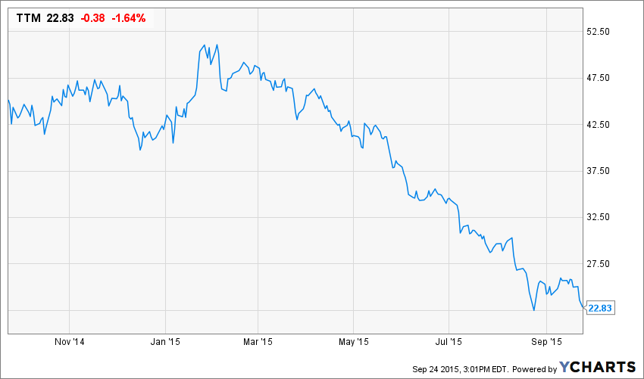
HISTORICAL STOCK PERFORMANCE (year-to-date)

Slide 24
ANALYST RECOMMENDATIONS AND REVISIONs
Linear Scale(1-5) | Last Year | 3 months ago | 2 months ago | 4 weeks ago | Latest
1) BUY | 24 | 18 | 18 | 18 | 17
2) OUTPERFORM | 30 | 24 | 25 | 24 | 25
3) HOLD | 11 | 4 | 5 | 6 | 6
4) UNDER PERFORM | 4 | 1 | 1 | 2 | 2
5) SELL | 1 | 1 | 1 | 0 | 0
NO OPINION | 0 | 0 | 0 | 0 | 0

Slide 25
THANK YOU for humble beginnings.......
-RAKMA MEHRA
and
RUMAANI UDGATA
-Mentees,
Mentored Research(ERI)

