Slide 1
Lead Assignment
import pandas as pd import numpy as np import warnings
warnings.filterwarnings('ignore') import matplotlib.pyplot as plt import seaborn as sns
Lead_data = pd.read_csv("C:\\Users\\Sagar.bhattacharya\\Downloads\\ Leads.csv")
Lead_data.head()
Prospect ID Lead Number Lead
Origin |  | \
0 7927b2df-8bba-4d29-b9a2-b6e0beafe620 API 1 2a272436-5132-4136-86fa-dcc88c88f482 |  |  |  |  |  |  |  |  | 660737 660728
API 2 8cc8c611-a219-4f35-ad23-fdfd2656bd8a |  |  |  |  |  |  |  |  | 660727 | Landing | Page
Submission 3 0cc2df48-7cf4-4e39-9de9-19797f9b38cc |  |  |  |  |  |  |  |  | 660719 | Landing | Page
Submission 4 3256f628-e534-4826-9d63-4a8b88782852 |  |  |  |  |  |  |  |  | 660681 | Landing | Page
Submission
Lead Source Do Not |  |  |  |  |  | Email |  | Do Not Call | Converted | TotalVisits |  | \
0 Olark Chat |  |  |  |  |  | No |  | No | 0 | 0.0
1 Organic Search |  |  |  |  |  | No |  | No | 0 | 5.0
2 Direct Traffic |  |  |  |  |  | No |  | No | 1 | 2.0
3 Direct Traffic |  |  |  |  |  | No |  | No | 0 | 1.0
4 Google |  |  |  |  |  | No |  | No | 1 | 2.0
 | Total | Time | Spent | on | Website |  |  | Page Views | Per Visit | ... \
0 |  |  |  |  | 0 |  |  |  | 0.0 | ...
1 |  |  |  |  | 674 |  |  |  | 2.5 | ...
2 |  |  |  |  | 1532 |  |  |  | 2.0 | ...
3 |  |  |  |  | 305 |  |  |  | 1.0 | ...
4 |  |  |  |  | 1428 |  |  |  | 1.0 | ...
Get updates |  |  | on DM | Content |  |  | Lead Profile |  | City | \
0 |  |  |  | No |  |  | Select |  | Select
1 |  |  |  | No |  |  | Select |  | Select
2 |  |  |  | No |  |  | Potential Lead |  | Mumbai
3 |  |  |  | No |  |  | Select |  | Mumbai
4 |  |  |  | No |  |  | Select |  | Mumbai
0
1
Asymmetrique Activity Index Asymmetrique Profile Index \
02.Medium 02.Medium
02.Medium 02.Medium

Slide 2
2 | 02.Medium | 01.High
3 | 02.Medium | 01.High
4 | 02.Medium | 01.High
Asymmetrique Activity Score Asymmetrique Profile Score
0 | 15.0 | 15.0
1 | 15.0 | 15.0
2 | 14.0 | 20.0
3 | 13.0 | 17.0
4 | 15.0 | 18.0
\
0
1
2
3
4
I agree to pay the amount through cheque \
No No No No No
0
1
2
3
4
A free copy of Mastering The Interview Last Notable Activity
No No Yes No No
Modified Email Opened Email Opened
Modified Modified
[5 rows x 37 columns]
Lead_data.describe()
Lead Number
Website count
Converted
TotalVisits
Total Time Spent on
\
9240.000000 9240.000000 9103.000000
9240.000000
mean 617188.435606
487.698268
0.385390
3.445238
std 23405.995698
0.486714
4.854853
548.021466
min 579533.000000
0.000000
0.000000
0.000000
25% 596484.500000
0.000000
1.000000
12.000000
50% 615479.000000
0.000000
3.000000
248.000000
75% 637387.250000
1.000000
5.000000
936.000000
max 660737.000000
1.000000 251.000000
2272.000000
count
Page Views Per Visit Asymmetrique Activity Score \ 9103.000000 5022.000000

Slide 3
mean | 2.362820 |  | 14.306252
std | 2.161418 |  | 1.386694
min | 0.000000 |  | 7.000000
25% | 1.000000 |  | 14.000000
50% | 2.000000 |  | 14.000000
75% | 3.000000 |  | 15.000000
max | 55.000000 |  | 18.000000
 | Asymmetrique Profile | Score
count | 5022.000000
mean | 16.344883
std | 1.811395
min | 11.000000
25% | 15.000000
50% | 16.000000
75% | 18.000000
max | 20.000000
Lead_data.info()
<class 'pandas.core.frame.DataFrame'> RangeIndex: 9240 entries, 0 to 9239 Data columns (total 37 columns):
# Column Dtype
Non-Null Count
0 Prospect ID
9240 non-null
object
1 Lead Number
9240 non-null
int64
2 Lead Origin
9240 non-null
object
3 Lead Source
9204 non-null
object
4 Do Not Email
9240 non-null
object
5 Do Not Call
9240 non-null
object
6 Converted
9240 non-null
int64
7 TotalVisits
9103 non-null
float64
8 Total Time Spent on Website
9240 non-null
int64
9 Page Views Per Visit
9103 non-null
float64
10 Last Activity
9137 non-null
object
11 Country
6779 non-null

Slide 4
object
Specialization object
How did you hear about X Education object
What is your current occupation object
What matters most to you in choosing a course object
Search object
Magazine object
Newspaper Article object
X Education Forums object
Newspaper object
Digital Advertisement object
Through Recommendations object
Receive More Updates About Our Courses object
Tags object
Lead Quality object
Update me on Supply Chain Content object
Get updates on DM Content object
Lead Profile object
City object
Asymmetrique Activity Index object
Asymmetrique Profile Index object
Asymmetrique Activity Score float64
Asymmetrique Profile Score float64
I agree to pay the amount through cheque object
A free copy of Mastering The Interview object
Last Notable Activity
7802 non-null
7033 non-null
6550 non-null
6531 non-null
9240 non-null
9240 non-null
9240 non-null
9240 non-null
9240 non-null
9240 non-null
9240 non-null
9240 non-null
5887 non-null
4473 non-null
9240 non-null
9240 non-null
6531 non-null
7820 non-null
5022 non-null
5022 non-null
5022 non-null
5022 non-null
9240 non-null
9240 non-null
9240 non-null

Slide 5
object
dtypes: float64(4), int64(3), object(30) memory usage: 2.6+ MB
Lead_data.shape (9240, 37)
# check for duplicate
Lead_data.duplicated(subset = ['Prospect ID'], keep = False).sum()
0
Lead_data.duplicated(subset = ['Lead Number'], keep = False).sum() 0
No duplicate values in Prospect ID and Lead Number
Clearly Prospect ID & Lead Number are two variables that are just indicative of the ID number of the Contacted People & can be dropped.
EXPLORATORY DATA ANALYSIS
Data Cleaning & Treatment:
#dropping Lead Number and Prospect ID since they have all unique values
Lead_data.drop(['Prospect ID', 'Lead Number'], 1, inplace = True)
#Converting 'Select' values to NaN.
Lead_data = Lead_data.replace('Select', np.nan)
Lead_data.nunique()
Lead Origin | 5
Lead Source | 21
Do Not Email | 2
Do Not Call | 2
Converted | 2
TotalVisits | 41
Total Time Spent on Website | 1731
Page Views Per Visit | 114
Last Activity | 17
Country | 38
Specialization | 18
How did you hear about X Education | 9
What is your current occupation | 6
What matters most to you in choosing a course | 3
Search | 2
Magazine | 1

Slide 6
Newspaper Article X Education Forums Newspaper
Digital Advertisement Through Recommendations
Receive More Updates About Our Courses Tags
Lead Quality
Update me on Supply Chain Content Get updates on DM Content
Lead Profile City
Asymmetrique Activity Index Asymmetrique Profile Index Asymmetrique Activity Score Asymmetrique Profile Score
I agree to pay the amount through cheque A free copy of Mastering The Interview Last Notable Activity
dtype: int64
# Dropping unique valued columns
2
2
2
2
2
1
26
5
1
1
5
6
3
3
12
10
1
2
16
Lead_data= Lead_data.drop(['Magazine','Receive More Updates About Our Courses','I agree to pay the amount through cheque','Get updates on DM
Content','Update me on Supply Chain | Content'],axis=1)
#checking null values in each rows
Lead_data.isnull().sum()
Lead Origin | 0
Lead Source | 36
Do Not Email | 0
Do Not Call | 0
Converted | 0
TotalVisits | 137
Total Time Spent on Website | 0
Page Views Per Visit | 137
Last Activity | 103
Country | 2461
Specialization | 3380
How did you hear about X Education | 7250
What is your current occupation | 2690
What matters most to you in choosing | a course 2709
Search | 0
Newspaper Article | 0
X Education Forums | 0
Newspaper | 0
Digital Advertisement | 0
Through Recommendations | 0
Tags | 3353

Slide 7
Lead Quality |  | 4767
Lead Profile |  | 6855
City |  | 3669
Asymmetrique | Activity Index | 4218
Asymmetrique | Profile Index | 4218
Asymmetrique | Activity Score | 4218
Asymmetrique | Profile Score | 4218
A free copy of Mastering The Interview Last Notable Activity
dtype: int64
# % of null value
0
0
round(100*(Lead_data.isnull().sum())/len(Lead_data.index),2)
Lead Origin |  | 0.00
Lead Source |  | 0.39
Do Not Email |  | 0.00
Do Not Call |  | 0.00
Converted |  | 0.00
TotalVisits |  | 1.48
Total Time Spent on Website |  | 0.00
Page Views Per Visit |  | 1.48
Last Activity |  | 1.11
Country |  | 26.63
Specialization |  | 36.58
How did you hear about X Education |  | 78.46
What is your current occupation |  | 29.11
What matters most to you in choosing a | course | 29.32
Search |  | 0.00
Newspaper Article |  | 0.00
X Education Forums |  | 0.00
Newspaper |  | 0.00
Digital Advertisement |  | 0.00
Through Recommendations |  | 0.00
Tags |  | 36.29
Lead Quality |  | 51.59
Lead Profile |  | 74.19
City |  | 39.71
Asymmetrique Activity Index |  | 45.65
Asymmetrique Profile Index |  | 45.65
Asymmetrique Activity Score |  | 45.65
Asymmetrique Profile Score |  | 45.65
A free copy of Mastering The Interview |  | 0.00
Last Notable Activity |  | 0.00
dtype: float64
#dropping cols with more than 45% missing values
Lead_data = Lead_data.drop(['Asymmetrique Profile Score','Asymmetrique Activity Score','Asymmetrique Profile Index','Asymmetrique Activity

Slide 8
Index','Lead Profile','Lead Quality','How did you hear about X Education',],axis =1)
Lead_data.shape (9240, 23)
#checking null values percentage
round(100*(Lead_data.isnull().sum()/len(Lead_data.index)), 2)
Lead Origin |  | 0.00
Lead Source |  | 0.39
Do Not Email |  | 0.00
Do Not Call |  | 0.00
Converted |  | 0.00
TotalVisits |  | 1.48
Total Time Spent on Website |  | 0.00
Page Views Per Visit |  | 1.48
Last Activity |  | 1.11
Country |  | 26.63
Specialization |  | 36.58
What is your current occupation |  | 29.11
What matters most to you in choosing a | course | 29.32
Search |  | 0.00
Newspaper Article |  | 0.00
X Education Forums |  | 0.00
Newspaper |  | 0.00
Digital Advertisement |  | 0.00
Through Recommendations |  | 0.00
Tags |  | 36.29
City |  | 39.71
A free copy of Mastering The Interview |  | 0.00
Last Notable Activity |  | 0.00
dtype: float64
There is a huge value of null variables in some columns as seen above. But removing the rows with the null value will cost us a lot of data and they are important columns. So, instead we are going to replace the NaN values with 'not provided'. This way we have all the data and almost no null values. In case these come up in the model, it will be of no use and we can drop it off then.
Lead_data['Specialization'] = Lead_data['Specialization'].fillna('not provided')
Lead_data['City'] = Lead_data['City'].fillna('not provided') Lead_data['Tags'] = Lead_data['Tags'].fillna('not provided') Lead_data['What matters most to you in choosing a course'] = Lead_data['What matters most to you in choosing a course'].fillna('not provided')
Lead_data['What is your current occupation'] = Lead_data['What is your current occupation'].fillna('not provided')

Slide 9
Lead_data['Country'] = Lead_data['Country'].fillna('not provided') Lead_data.info()
<class 'pandas.core.frame.DataFrame'> RangeIndex: 9240 entries, 0 to 9239 Data columns (total 23 columns):
# Column Non-Null Count
Dtype
0 Lead Origin
9240 non-null
object
1 Lead Source
9204 non-null
object
2 Do Not Email
9240 non-null
object
3 Do Not Call
9240 non-null
object
4 Converted
9240 non-null
int64
5 TotalVisits
9103 non-null
float64
6 Total Time Spent on Website
9240 non-null
int64
7 Page Views Per Visit
9103 non-null
float64
8 Last Activity
9137 non-null
object
9 Country
9240 non-null
object
10 Specialization
9240 non-null
object
11 What is your current occupation
9240 non-null
object
12 What matters most to you in choosing a course 9240 non-null object
13 Search
9240 non-null
object
14 Newspaper Article
9240 non-null
object
15 X Education Forums
9240 non-null
object
16 Newspaper
9240 non-null
object
17 Digital Advertisement
9240 non-null
object
18 Through Recommendations
9240 non-null
object
19 Tags
9240 non-null
object

Slide 10
20 City
9240 non-null
object
21 A free copy of Mastering The Interview
9240 non-null
object
22 Last Notable Activity
9240 non-null
object
dtypes: float64(2), int64(2), object(19) memory usage: 1.6+ MB
#checking null values percentage
round(100*(Lead_data.isnull().sum()/len(Lead_data.index)), 2)
Lead Origin |  | 0.00
Lead Source |  | 0.39
Do Not Email |  | 0.00
Do Not Call |  | 0.00
Converted |  | 0.00
TotalVisits |  | 1.48
Total Time Spent on Website |  | 0.00
Page Views Per Visit |  | 1.48
Last Activity |  | 1.11
Country |  | 0.00
Specialization |  | 0.00
What is your current occupation |  | 0.00
What matters most to you in choosing a | course | 0.00
Search |  | 0.00
Newspaper Article |  | 0.00
X Education Forums |  | 0.00
Newspaper |  | 0.00
Digital Advertisement |  | 0.00
Through Recommendations |  | 0.00
Tags |  | 0.00
City |  | 0.00
A free copy of Mastering The Interview |  | 0.00
Last Notable Activity |  | 0.00
dtype: float64 Lead_data.shape (9240, 23)
Categorical Attributes Analysis:
Lead_data['Country'].value_counts()
India
not provided United States
United Arab Emirates Singapore
Saudi Arabia
6492
2461
69
53
24
21

Slide 11
United Kingdom | 15
Australia | 13
Qatar | 10
Bahrain | 7
Hong Kong | 7
France | 6
Oman | 6
unknown | 5
Canada | 4
South Africa | 4
Nigeria | 4
Kuwait | 4
Germany | 4
Sweden | 3
Ghana | 2
Uganda | 2
Italy | 2
Bangladesh | 2
Philippines | 2
China | 2
Netherlands | 2
Belgium | 2
Asia/Pacific Region | 2
Russia | 1
Kenya | 1
Liberia | 1
Denmark | 1
Sri Lanka | 1
Switzerland | 1
Vietnam | 1
Tanzania | 1
Malaysia | 1
Indonesia | 1
Name: Country, dtype: | int64
def slots(x): category = ""
if x == "India": category = "India"
elif x == "not provided": category = "not provided"
else:
category = "outside india"
return category
Lead_data['Country'] = Lead_data.apply(lambda x:slots(x['Country']), axis = 1)
Lead_data['Country'].value_counts()

Slide 12
India
not provided
6492
2461
outside india 287
Name: Country, dtype: int64
# Since India is the most common occurence among the non-missing values we can impute all not provided values with India
Lead_data['Country'] = Lead_data['Country'].replace('not provided','India')
Lead_data['Country'].value_counts()
India
outside india
8953
287
Name: Country, dtype: int64
# Checking the percent of lose if the null values are removed round(100*(sum(Lead_data.isnull().sum(axis=1) > 1)/Lead_data.shape[0]),2)
1.48
Lead_data = Lead_data[Lead_data.isnull().sum(axis=1) <1]
# Rechecking the percentage of missing values
round(100*(Lead_data.isnull().sum()/len(Lead_data.index)), 2)
Lead Origin |  | 0.0
Lead Source |  | 0.0
Do Not Email |  | 0.0
Do Not Call |  | 0.0
Converted |  | 0.0
TotalVisits |  | 0.0
Total Time Spent on Website |  | 0.0
Page Views Per Visit |  | 0.0
Last Activity |  | 0.0
Country |  | 0.0
Specialization |  | 0.0
What is your current occupation |  | 0.0
What matters most to you in choosing a | course | 0.0
Search |  | 0.0
Newspaper Article |  | 0.0
X Education Forums |  | 0.0
Newspaper |  | 0.0
Digital Advertisement |  | 0.0
Through Recommendations |  | 0.0
Tags |  | 0.0
City |  | 0.0
A free copy of Mastering The Interview |  | 0.0
Last Notable Activity |  | 0.0
dtype: float64

Slide 13
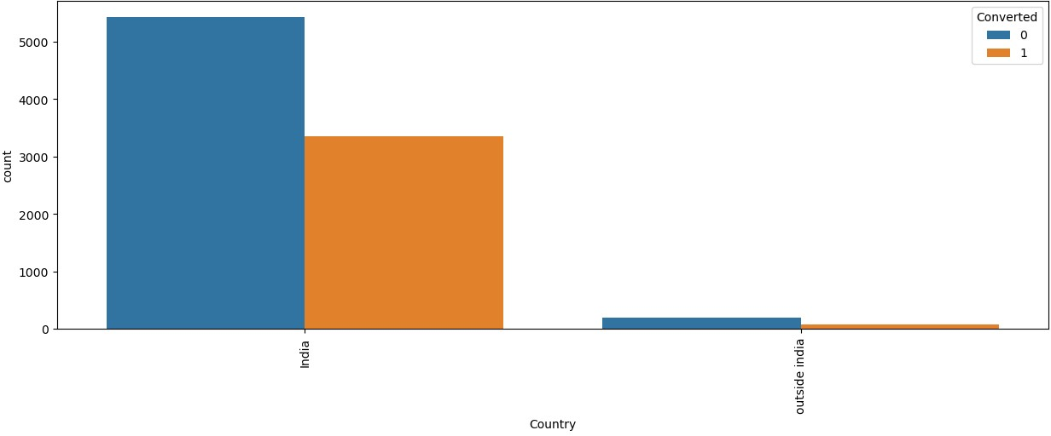
Lead_data.shape
(9074, 23)
#plotting spread of Country columnn after replacing NaN values
plt.figure(figsize=(15,5)) s1=sns.countplot(Lead_data.Country, hue=Lead_data.Converted) s1.set_xticklabels(s1.get_xticklabels(),rotation=90) plt.show()
As we can see the Number of Values for India are quite high (nearly 97% of the Data), this column can be dropped
#creating a list of columns to be droppped
cols_to_drop=['Country']
#checking value counts of "City" column
Lead_data['City'].value_counts(dropna=False)
not provided | 3575
Mumbai | 3177
Thane & Outskirts | 745
Other Cities | 680
Other Cities of Maharashtra | 446
Other Metro Cities | 377
Tier II Cities | 74
Name: City, dtype: int64
#plotting spread of City columnn
plt.figure(figsize=(10,5)) s1=sns.countplot(Lead_data.City, hue=Lead_data.Converted) s1.set_xticklabels(s1.get_xticklabels(),rotation=90) plt.show()

Slide 14
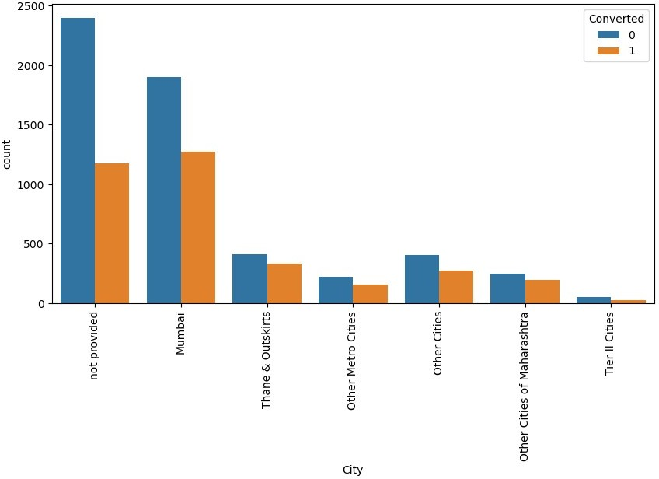
plt.figure(figsize = (20,40))
plt.subplot(6,2,1) sns.countplot(Lead_data['Lead Origin']) plt.title('Lead Origin')
plt.subplot(6,2,2) sns.countplot(Lead_data['Do Not Email']) plt.title('Do Not Email')
plt.subplot(6,2,3) sns.countplot(Lead_data['Do Not Call']) plt.title('Do Not Call')
plt.subplot(6,2,4) sns.countplot(Lead_data['Country']) plt.title('Country')
plt.subplot(6,2,5) sns.countplot(Lead_data['Search']) plt.title('Search') plt.subplot(6,2,6)
sns.countplot(Lead_data['Newspaper Article']) plt.title('Newspaper Article')

Slide 15
plt.subplot(6,2,7)
sns.countplot(Lead_data['X Education Forums']) plt.title('X Education Forums')
plt.subplot(6,2,8) sns.countplot(Lead_data['Newspaper']) plt.title('Newspaper')
plt.subplot(6,2,9) sns.countplot(Lead_data['Digital Advertisement']) plt.title('Digital Advertisement')
plt.subplot(6,2,10) sns.countplot(Lead_data['Through Recommendations']) plt.title('Through Recommendations')
plt.subplot(6,2,11)
sns.countplot(Lead_data['A free copy of Mastering The Interview']) plt.title('A free copy of Mastering The Interview') plt.subplot(6,2,12)
sns.countplot(Lead_data['Last Notable Activity']).tick_params(axis='x', rotation = 90) plt.title('Last Notable Activity')
plt.show()

Slide 16
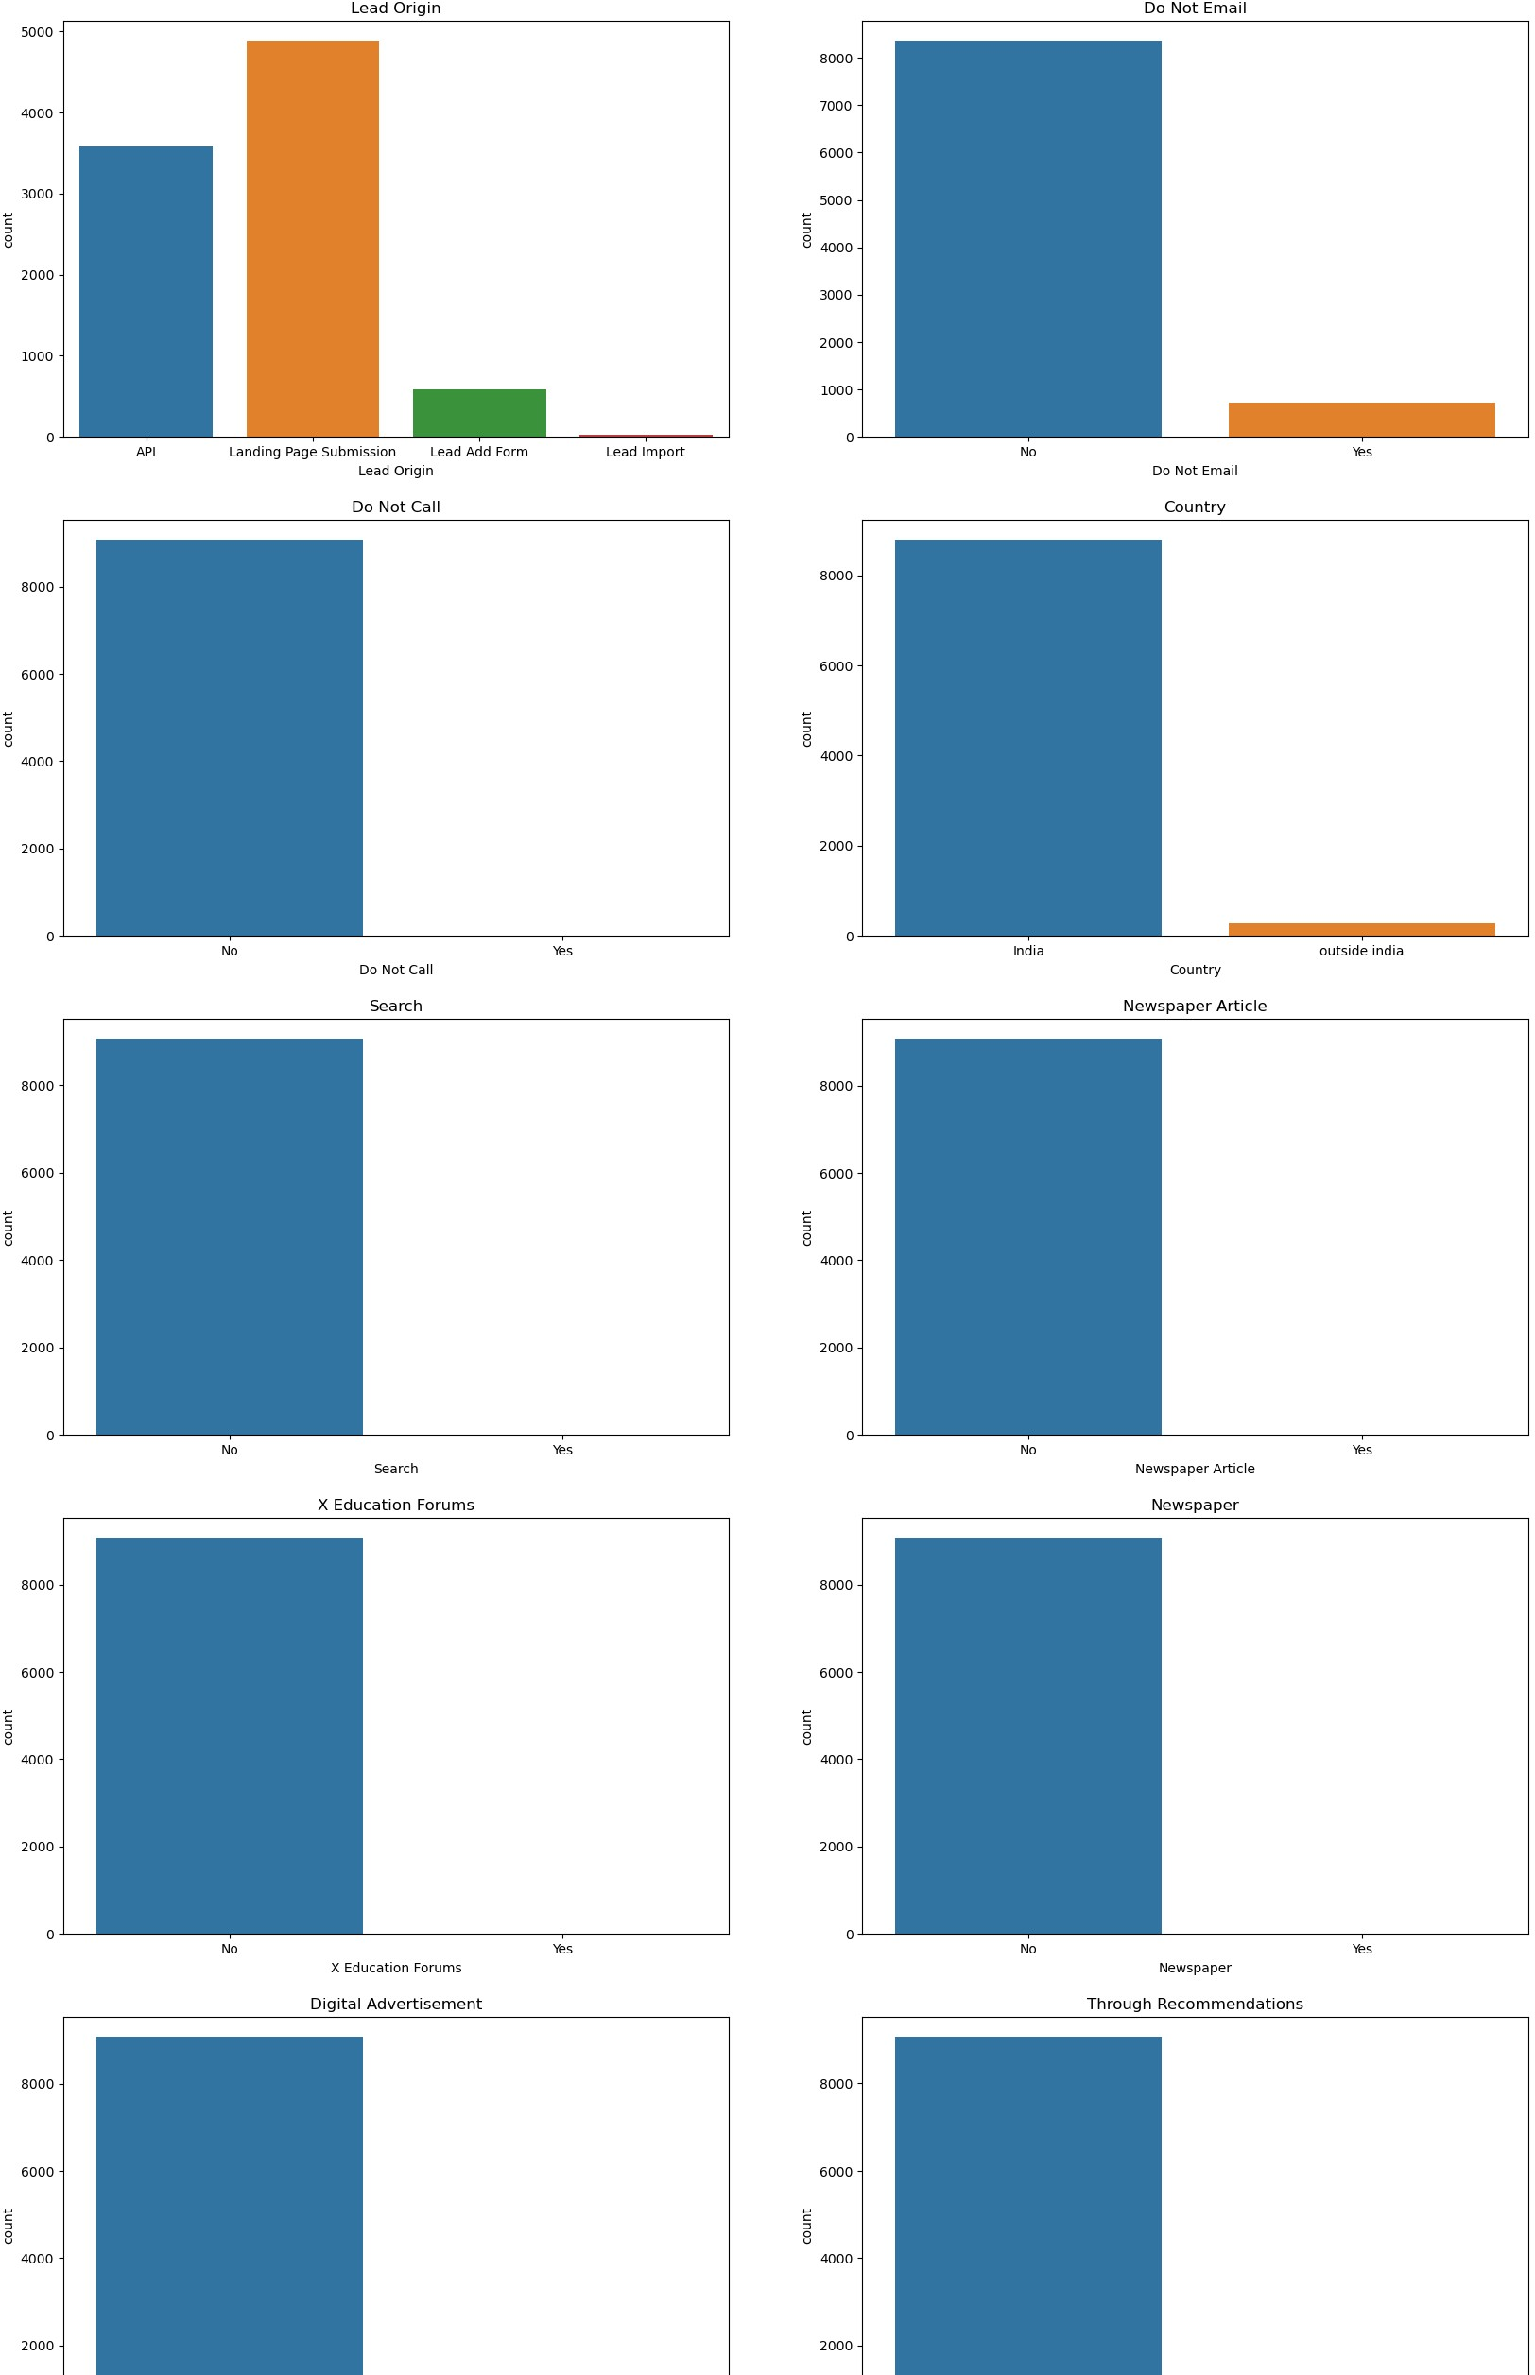

Slide 17
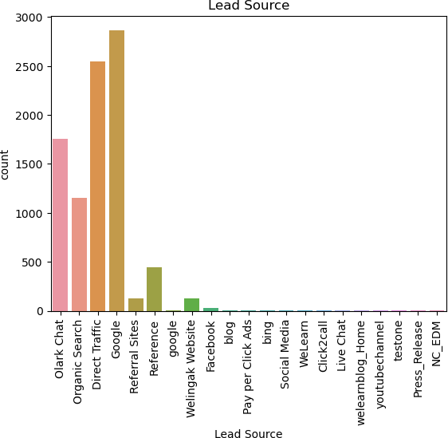
sns.countplot(Lead_data['Lead Source']).tick_params(axis='x', rotation
= 90)
plt.title('Lead Source') plt.show()
plt.figure(figsize = (20,30)) plt.subplot(2,2,1)
sns.countplot(Lead_data['Specialization']).tick_params(axis='x', rotation = 90)
plt.title('Specialization') plt.subplot(2,2,2) sns.countplot(Lead_data['What is your current
occupation']).tick_params(axis='x', rotation = 90) plt.title('Current Occupation') plt.subplot(2,2,3)
sns.countplot(Lead_data['What matters most to you in choosing a course']).tick_params(axis='x', rotation = 90)

Slide 18
plt.title('What matters most to you in choosing a course') plt.subplot(2,2,4)
sns.countplot(Lead_data['Last Activity']).tick_params(axis='x', rotation = 90)
plt.title('Last Activity') plt.show()

Slide 19
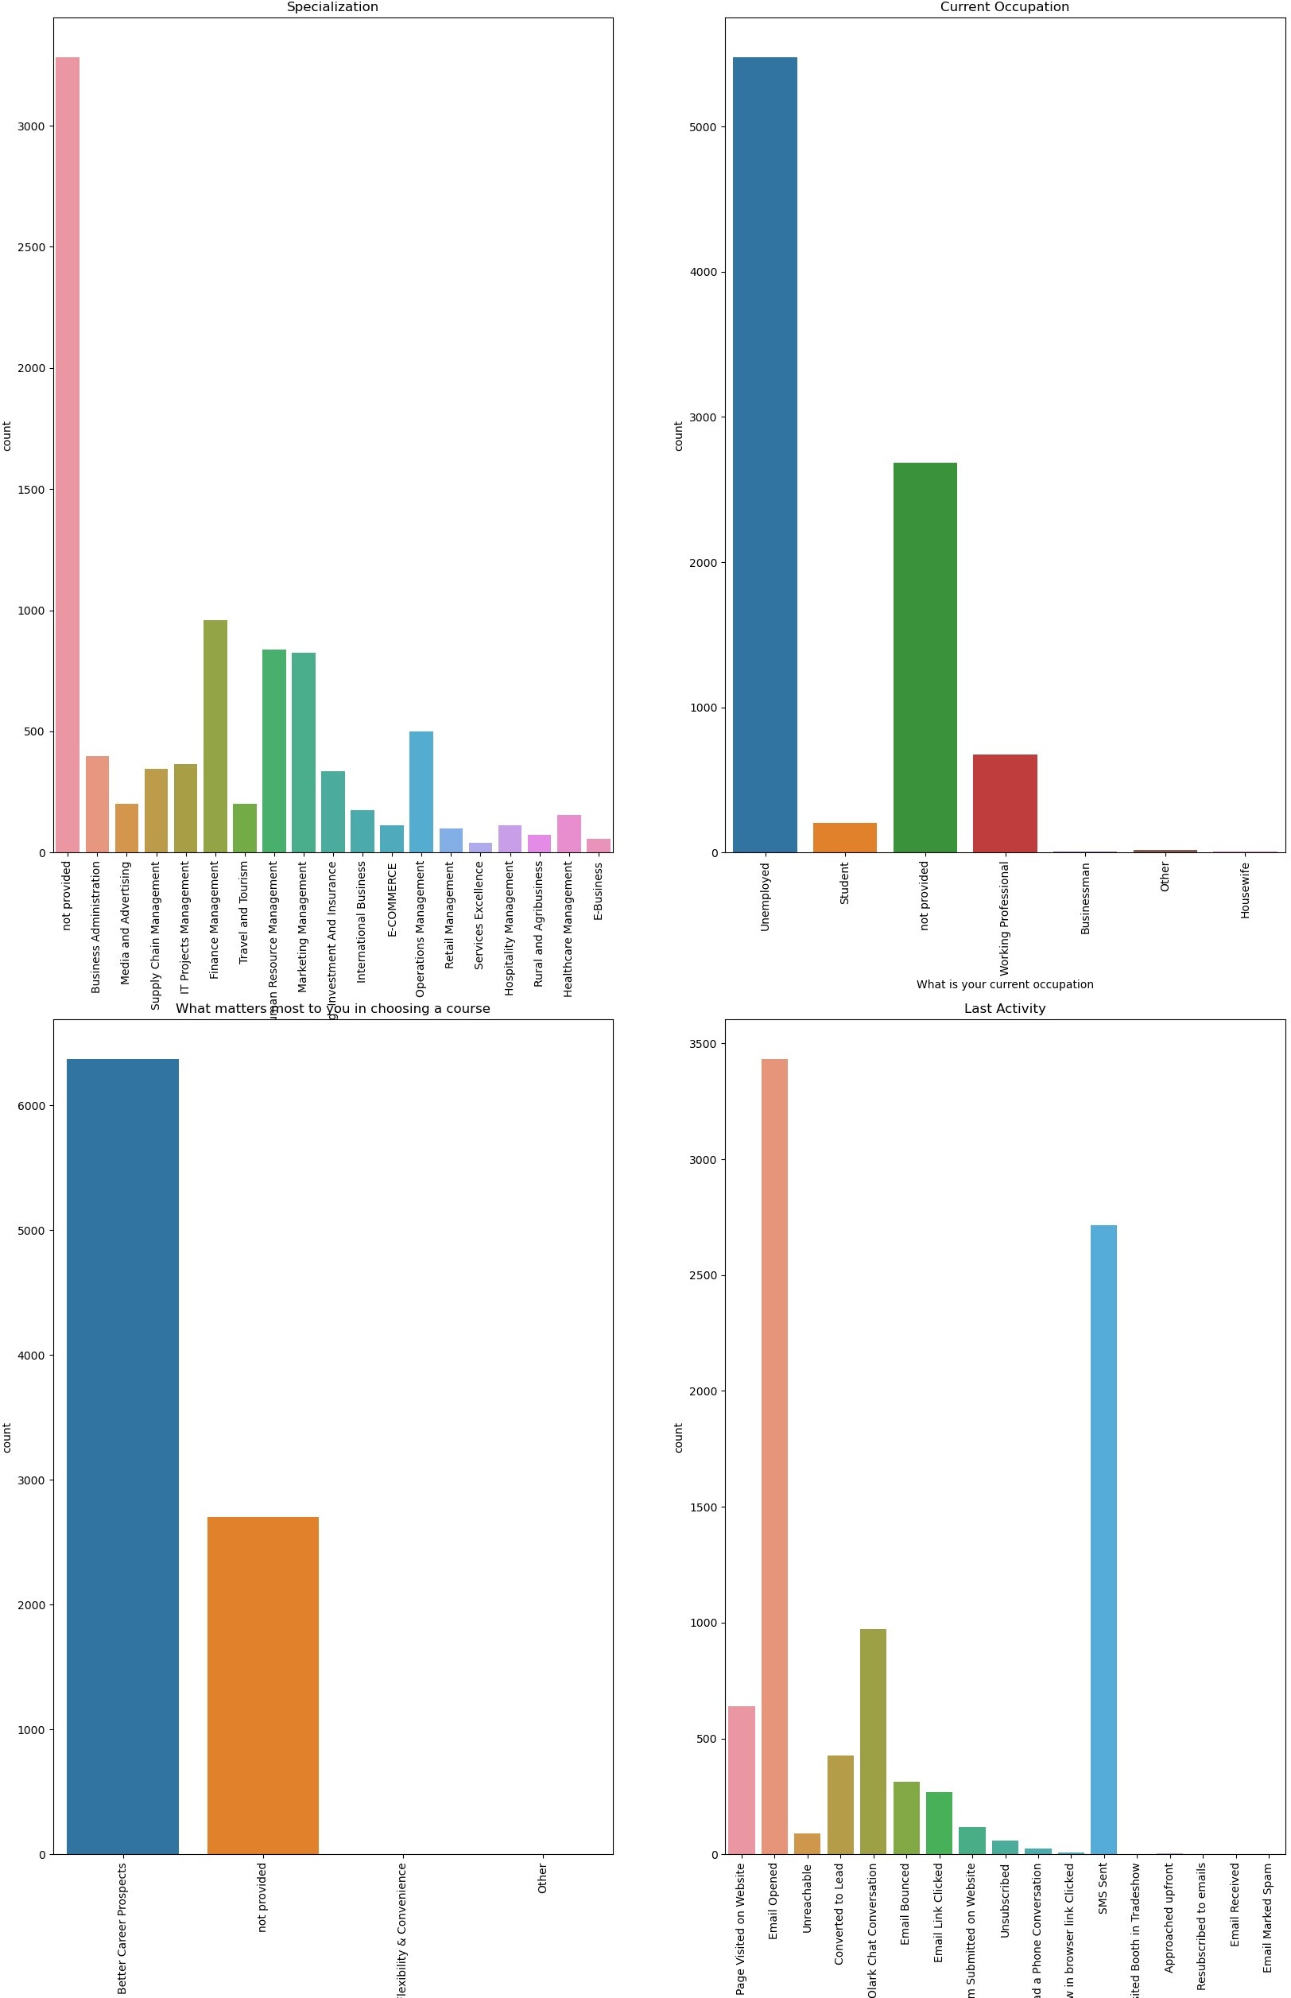

Slide 20
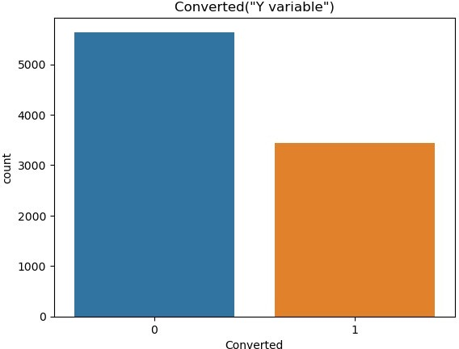
sns.countplot(Lead_data['Converted']) plt.title('Converted("Y variable")') plt.show()
Numerical Variables
plt.figure(figsize = (10,10)) plt.subplot(221)
plt.hist(Lead_data['TotalVisits'], bins = 200) plt.title('Total Visits')
plt.xlim(0,25)
plt.subplot(222)
plt.hist(Lead_data['Total Time Spent on Website'], bins = 10) plt.title('Total Time Spent on Website')
plt.subplot(223)
plt.hist(Lead_data['Page Views Per Visit'], bins = 20) plt.title('Page Views Per Visit')
plt.xlim(0,20) plt.show( )

Slide 21
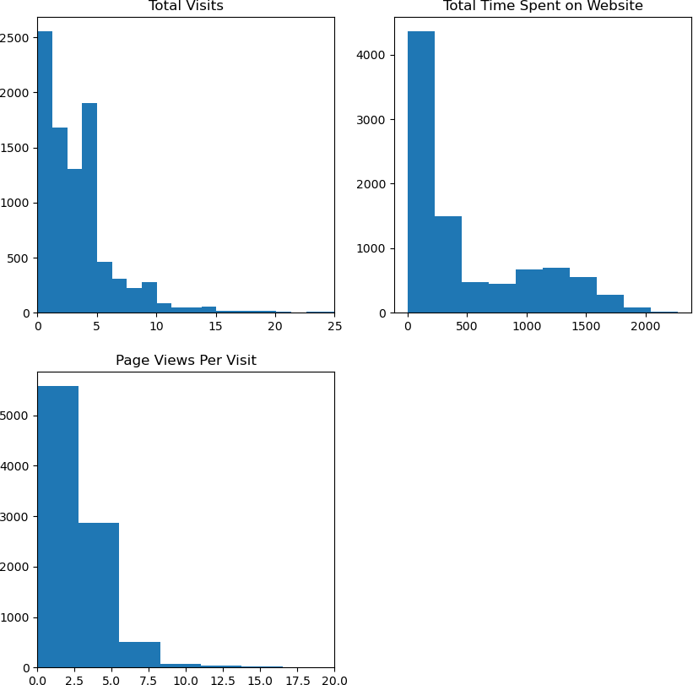
Relating all the categorical variables to Converted
plt.figure(figsize = (10,10))
plt.subplot(2,2,1)
sns.countplot(x='Lead Origin', hue='Converted', data= Lead_data).tick_params(axis='x', rotation = 90) plt.title('Lead Origin')
plt.subplot(2,2,2)
sns.countplot(x='Lead Source', hue='Converted', data= Lead_data).tick_params(axis='x', rotation = 90) plt.title('Lead Source')
plt.show()

Slide 22
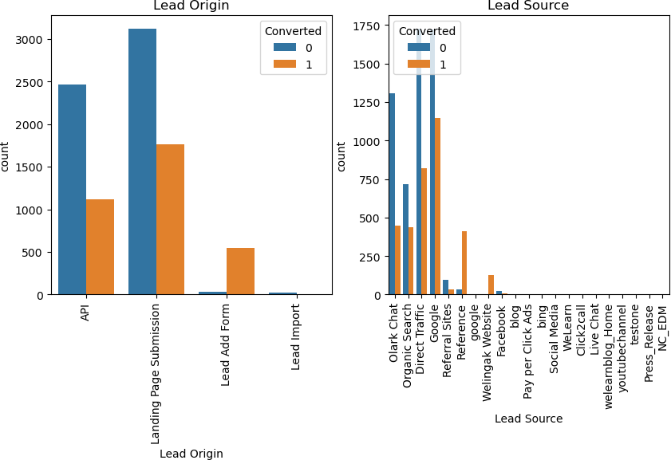
plt.figure(figsize=(10 ,5)) plt.subplot(1,2,1)
sns.countplot(x='Do Not Email', hue='Converted', data= Lead_data).tick_params(axis='x', rotation = 90) plt.title('Do Not Email')
plt.subplot(1,2,2)
sns.countplot(x='Do Not Call', hue='Converted', data= Lead_data).tick_params(axis='x', rotation = 90) plt.title('Do Not Call')
plt.show()

Slide 23
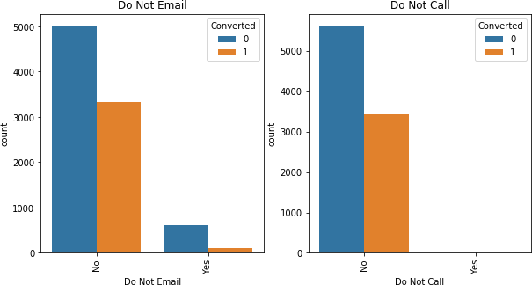
plt.figure(figsize = (10,5))
plt.subplot(1,2,1)
sns.countplot(x='Last Activity', hue='Converted', data= Lead_data).tick_params(axis='x', rotation = 90) plt.title('Last Activity')
plt.subplot(1,2,2)
sns.countplot(x='Country', hue='Converted', data= Lead_data).tick_params(axis='x', rotation = 90) plt.title('Country')
plt.show()

Slide 24
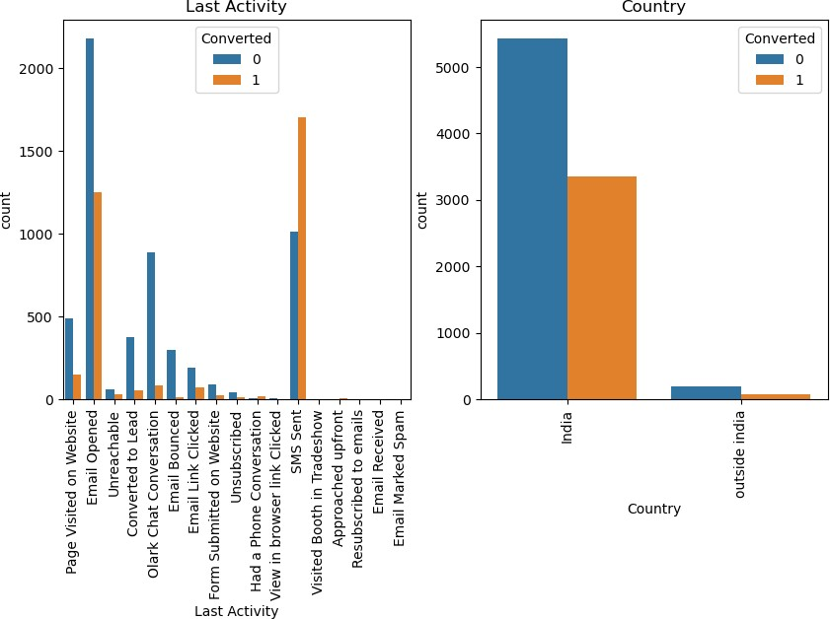
plt.figure(figsize = (10,5))
plt.subplot(1,2,1)
sns.countplot(x='Specialization', hue='Converted', data= Lead_data).tick_params(axis='x', rotation = 90) plt.title('Specialization')
plt.subplot(1,2,2)
sns.countplot(x='What is your current occupation', hue='Converted', data= Lead_data).tick_params(axis='x', rotation = 90) plt.title('What is your current occupation')
plt.show()

Slide 25
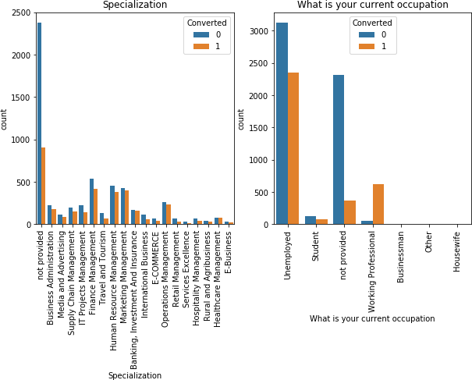
plt.figure(figsize = (10,5))
plt.subplot(1,2,1)
sns.countplot(x='What matters most to you in choosing a course', hue='Converted', data= Lead_data).tick_params(axis='x', rotation = 90) plt.title('What matters most to you in choosing a course')
plt.subplot(1,2,2)
sns.countplot(x='Search', hue='Converted', data= Lead_data).tick_params(axis='x', rotation = 90) plt.title('Search')
plt.show()

Slide 26
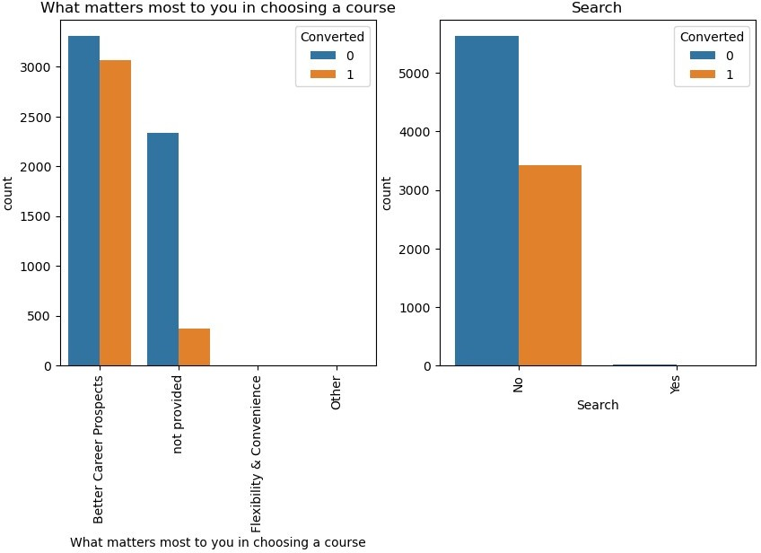
plt.figure(figsize = (10,5))
plt.subplot(1,2,1)
sns.countplot(x='Newspaper Article', hue='Converted', data= Lead_data).tick_params(axis='x', rotation = 90) plt.title('Newspaper Article')
plt.subplot(1,2,2)
sns.countplot(x='X Education Forums', hue='Converted', data= Lead_data).tick_params(axis='x', rotation = 90) plt.title('X Education Forums')
plt.show()

Slide 27
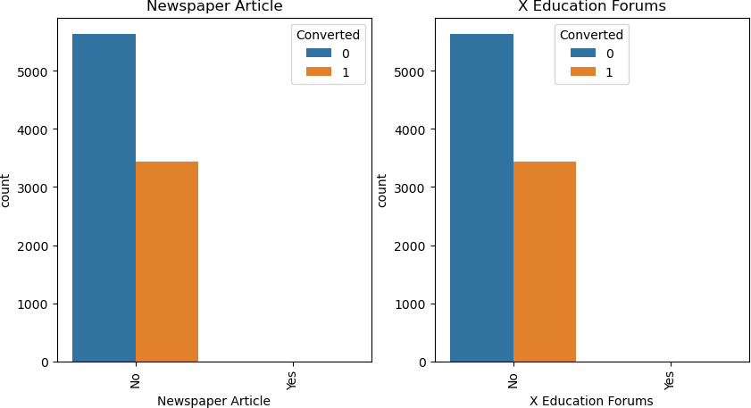
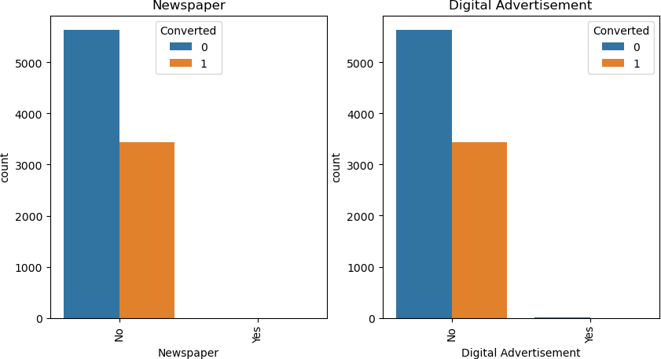
plt.figure(figsize = (10,5))
plt.subplot(1,2,1)
sns.countplot(x='Newspaper', hue='Converted', data= Lead_data).tick_params(axis='x', rotation = 90) plt.title('Newspaper')
plt.subplot(1,2,2)
sns.countplot(x='Digital Advertisement', hue='Converted', data= Lead_data).tick_params(axis='x', rotation = 90) plt.title('Digital Advertisement')
plt.show()

Slide 28
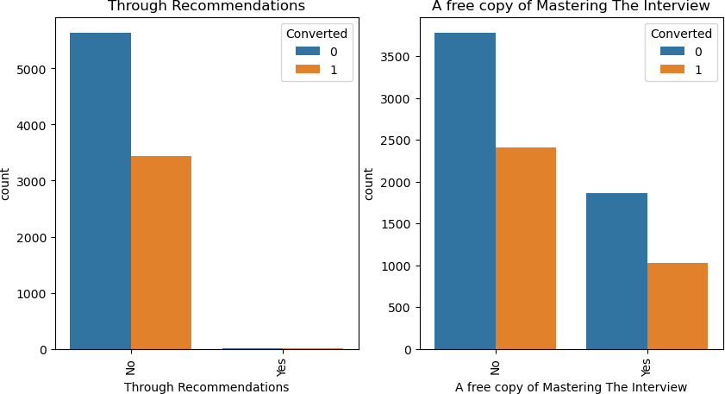
plt.figure(figsize = (10,5))
plt.subplot(1,2,1)
sns.countplot(x='Through Recommendations', hue='Converted', data= Lead_data).tick_params(axis='x', rotation = 90) plt.title('Through Recommendations')
plt.subplot(1,2,2)
sns.countplot(x='A free copy of Mastering The Interview', hue='Converted', data= Lead_data).tick_params(axis='x', rotation = 90) plt.title('A free copy of Mastering The Interview')
plt.show()
sns.countplot(x='Last Notable Activity', hue='Converted', data= Lead_data).tick_params(axis='x', rotation = 90)
plt.title('Last Notable Activity') plt.show()

Slide 29
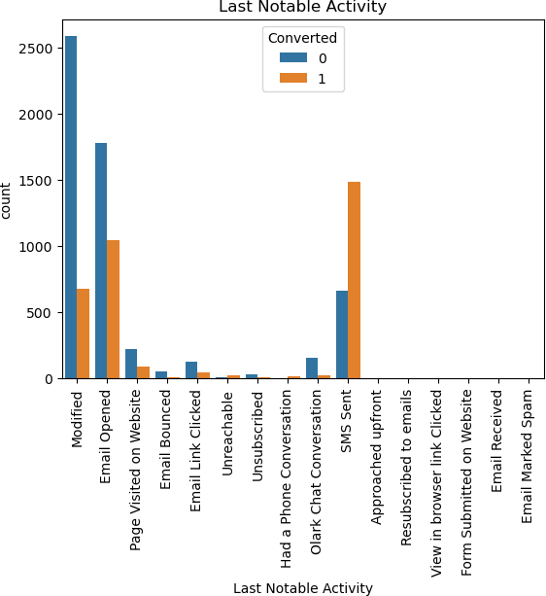
# To check the correlation among varibles plt.figure(figsize=(10,5)) sns.heatmap(Lead_data.corr())
plt.show()

Slide 30
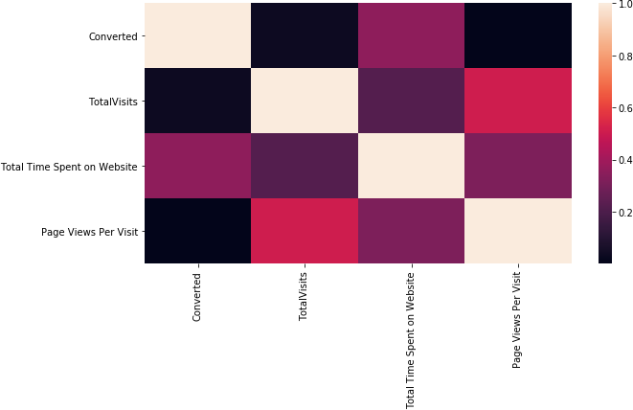
It is understandable from the above EDA that there are many elements that have very little data and so will be of less relevance to our analysis.
Outlier
numeric = Lead_data[['TotalVisits','Total Time Spent on Website','Page Views Per Visit']] numeric.describe(percentiles=[0.25,0.5,0.75,0.9,0.99])
 | TotalVisits | Total | Time | Spent on Website | Page Views Per Visit
count | 9074.000000 |  |  | 9074.000000 | 9074.000000
mean | 3.456028 |  |  | 482.887481 | 2.370151
std | 4.858802 |  |  | 545.256560 | 2.160871
min | 0.000000 |  |  | 0.000000 | 0.000000
25% | 1.000000 |  |  | 11.000000 | 1.000000
50% | 3.000000 |  |  | 246.000000 | 2.000000
75% | 5.000000 |  |  | 922.750000 | 3.200000
90% | 7.000000 |  |  | 1373.000000 | 5.000000
99% | 17.000000 |  |  | 1839.000000 | 9.000000
max | 251.000000 |  |  | 2272.000000 | 55.000000
plt.figure(figsize = (5,5)) sns.boxplot(y=Lead_data['TotalVisits']) plt.show()

Slide 31
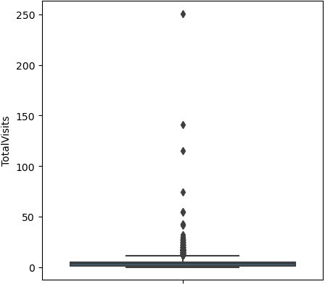
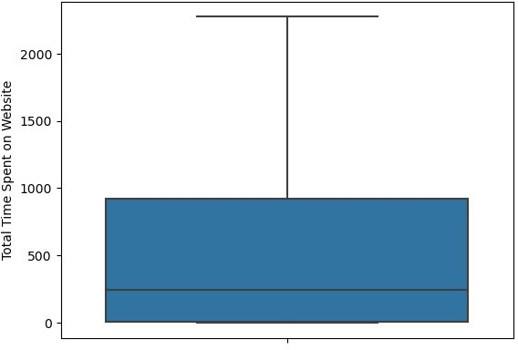
sns.boxplot(y=Lead_data['Total Time Spent on Website']) plt.show()

Slide 32
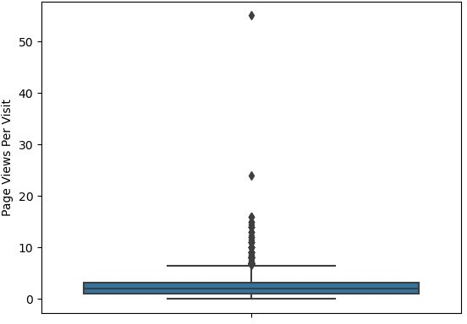
sns.boxplot(y=Lead_data['Page Views Per Visit']) plt.show()
We can see presence of outliers in TotalVisits
#Outlier Treatment: Remove top & bottom 1% of the Column Outlier values
Q3 = Lead_data.TotalVisits.quantile(0.99)
Lead_data = Lead_data[(Lead_data.TotalVisits <= Q3)] Q1 = Lead_data.TotalVisits.quantile(0.01)
Lead_data = Lead_data[(Lead_data.TotalVisits >= Q1)] sns.boxplot(y=Lead_data['TotalVisits'])
plt.show()

Slide 33
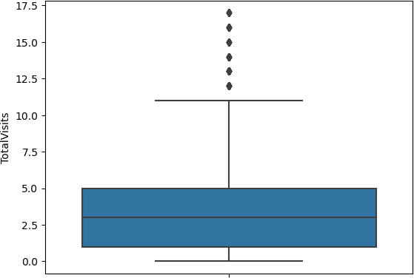
Dummy Variables
#list of columns to be dropped
cols_to_drop=['Country','Tags']
We can drop "Tags" ,As tags variable is generated by the sales sales team after the disscussion with student otherwise it will increase the model accuracy .
#dropping columns
Lead_data = Lead_data.drop(cols_to_drop,1) Lead_data.info()
<class 'pandas.core.frame.DataFrame'> Int64Index: 8991 entries, 0 to 9239 Data columns (total 21 columns):
# Column Non-Null Count
Dtype
0 Lead Origin
8991 non-null
object
1 Lead Source
8991 non-null
object
2 Do Not Email
8991 non-null
object
3 Do Not Call
8991 non-null

Slide 34
object
Converted int64
TotalVisits float64
Total Time Spent on Website int64
Page Views Per Visit float64
Last Activity object
Specialization object
What is your current occupation object
What matters most to you in choosing a course object
Search object
Newspaper Article object
X Education Forums object
Newspaper object
Digital Advertisement object
Through Recommendations object
City object
A free copy of Mastering The Interview object
Last Notable Activity object
dtypes: float64(2), int64(2), object(17) memory usage: 1.5+ MB
#getting a list of categorical columns
8991 non-null
8991 non-null
8991 non-null
8991 non-null
8991 non-null
8991 non-null
8991 non-null
8991 non-null
8991 non-null
8991 non-null
8991 non-null
8991 non-null
8991 non-null
8991 non-null
8991 non-null
8991 non-null
8991 non-null
cat_cols= Lead_data.select_dtypes(include=['object']).columns cat_cols
Index(['Lead Origin', 'Lead Source', 'Do Not Email', 'Do Not Call', 'Last Activity', 'Specialization', 'What is your current
occupation',
'What matters most to you in choosing a course', 'Search', 'Newspaper Article', 'X Education Forums', 'Newspaper', 'Digital Advertisement', 'Through Recommendations', 'City', 'A free copy of Mastering The Interview', 'Last Notable

Slide 35
Activity'],
dtype='object')
# Create dummy variables using the 'get_dummies'
dummy = pd.get_dummies(Lead_data[['Lead Origin','Specialization' ,'Lead Source', 'Do Not Email', 'Last
Activity', 'What is your current occupation','A free copy of Mastering The Interview', 'Last Notable Activity']], drop_first=True)
# Add the results to the master dataframe Lead_data_dum = pd.concat([Lead_data, dummy], axis=1) Lead_data_dum
\ 0
Lead Origin Lead Source Do Not Email Do Not Call
API Olark Chat No No
API Organic Search No No
1
2 | Landing | Page |  | Submission | Direct |  | Traffic |  | No |  | No
3 | Landing | Page |  | Submission | Direct |  | Traffic |  | No |  | No
4 | Landing | Page |  | Submission |  |  | Google |  | No |  | No
... |  |  |  | ... |  |  | ... |  | ... |  | ...
9235 | Landing | Page |  | Submission | Direct |  | Traffic |  | Yes |  | No
9236 | Landing | Page |  | Submission | Direct |  | Traffic |  | No |  | No
9237 | Landing | Page |  | Submission | Direct |  | Traffic |  | Yes |  | No
9238 | Landing | Page |  | Submission |  |  | Google |  | No |  | No
9239 | Landing | Page |  | Submission | Direct |  | Traffic |  | No |  | No
 | Converted |  | TotalVisits |  | Total | Time |  | Spent | on | Website | \
0 | 0 |  | 0.0 |  |  |  |  |  |  | 0
1 | 0 |  | 5.0 |  |  |  |  |  |  | 674
2 | 1 |  | 2.0 |  |  |  |  |  |  | 1532
3 | 0 |  | 1.0 |  |  |  |  |  |  | 305
4 ... 9235 | 1 ... 1 |  | 2.0 ... 8.0 |  |  |  |  |  |  | 1428 ... 1845
9236 | 0 |  | 2.0 |  |  |  |  |  |  | 238
9237 | 0 |  | 2.0 |  |  |  |  |  |  | 199
9238 | 1 |  | 3.0 |  |  |  |  |  |  | 499
9239 | 1 |  | 6.0 |  |  |  |  |  |  | 1279

Slide 36
0 | Page Views | Per Visit 0.00 | Page | Last Activity Visited on Website | \
1 |  | 2.50 |  | Email Opened
2 |  | 2.00 |  | Email Opened
3 |  | 1.00 |  | Unreachable
4 ... 9235 |  | 1.00 ... 2.67 |  | Converted to Lead ... Email Marked Spam
9236 |  | 2.00 |  | SMS Sent
9237 |  | 2.00 |  | SMS Sent
9238 |  | 3.00 |  | SMS Sent
9239 |  | 3.00 |  | SMS Sent
 | Specialization |  |  | ... \
0 | not provided |  |  | ...
1 | not provided |  |  | ...
2 | Business Administration |  |  | ...
3 | Media and Advertising |  |  | ...
4 | not provided |  |  | ...
... | ... |  |  | ...
9235 | IT Projects Management |  |  | ...
9236 | Media and Advertising |  |  | ...
9237 | Business Administration |  |  | ...
9238 | Human Resource Management |  |  | ...
9239 | Supply Chain Management |  |  | ...
0
1
2
3
4
... 9235
9236
9237
9238
9239
Last Notable Activity_Form Submitted on Website \
0
0
0
0
0
...
0
0
0
0
0
 | Last | Notable | Activity_Had a Phone Conversation | \
0 |  |  | 0
1 |  |  | 0
2 |  |  | 0
3 |  |  | 0
4 |  |  | 0
... |  |  | ...
9235 |  |  | 0
9236 |  |  | 0
9237 |  |  | 0

Slide 37
9238 |  |  | 0
9239 |  |  | 0
0 | Last | Notable | Activity_Modified \ 1
1 |  |  | 0
2 |  |  | 0
3 |  |  | 1
4 ... 9235 |  |  | 1 ... 0
9236 |  |  | 0
9237 |  |  | 0
9238 |  |  | 0
9239 |  |  | 1
0 | Last | Notable | Activity_Olark Chat Conversation 0 | \
1 |  |  | 0
2 |  |  | 0
3 |  |  | 0
4 ... 9235 |  |  | 0 ... 0
9236 |  |  | 0
9237 |  |  | 0
9238 |  |  | 0
9239 |  |  | 0
0 | Last | Notable | Activity_Page Visited on Website 0 | \
1 |  |  | 0
2 |  |  | 0
3 |  |  | 0
4 ... 9235 |  |  | 0 ... 0
9236 |  |  | 0
9237 |  |  | 0
9238 |  |  | 0
9239 |  |  | 0
0 | Last | Notable | Activity_Resubscribed to emails 0 | \
1 |  |  | 0
2 |  |  | 0
3 |  |  | 0
4 ... 9235 |  |  | 0 ... 0

Slide 38
9236 |  |  |  |  |  |  | 0
9237 |  |  |  |  |  |  | 0
9238 |  |  |  |  |  |  | 0
9239 |  |  |  |  |  |  | 0
\ | Last | Notable | Activity_SMS | Sent | Last | Notable | Activity_Unreachable
0 |  |  |  | 0 |  |  | 0
1 |  |  |  | 0 |  |  | 0
2 |  |  |  | 0 |  |  | 0
3 |  |  |  | 0 |  |  | 0
4 |  |  |  | 0 |  |  | 0
... |  |  |  | ... |  |  | ...
9235 |  |  |  | 0 |  |  | 0
9236 |  |  |  | 1 |  |  | 0
9237 |  |  |  | 1 |  |  | 0
9238 |  |  |  | 1 |  |  | 0
9239 |  |  |  | 0 |  |  | 0
0 | Last | Notable | Activity_Unsubscribed 0 |  |  | \
1 |  |  | 0
2 |  |  | 0
3 |  |  | 0
4 ... 9235 |  |  | 0 ... 0
9236 |  |  | 0
9237 |  |  | 0
9238 |  |  | 0
9239 |  |  | 0
0 | Last | Notable | Activity_View in browser link Clicked 0
1 |  |  | 0
2 |  |  | 0
3 |  |  | 0
4 |  |  | 0

Slide 39
... | ...
9235 | 0
9236 | 0
9237 | 0
9238 | 0
9239 | 0
[8991 rows x 101 columns]
Lead_data_dum = Lead_data_dum.drop(['City','What is your current occupation_not provided','Lead Origin', 'Lead Source', 'Do Not Email', 'Do Not Call','Last Activity', 'Specialization', 'Specialization_not provided','What is your current occupation','What matters most to you in choosing a course', 'Search','Newspaper Article', 'X Education Forums', 'Newspaper','Digital Advertisement', 'Through Recommendations','A free copy of Mastering The Interview', 'Last Notable Activity'], 1)
Lead_data_dum
 | Converted |  | TotalVisits |  | Total |  | Time | Spent | on | Website | \
0 | 0 |  | 0.0 |  |  |  |  |  |  | 0
1 | 0 |  | 5.0 |  |  |  |  |  |  | 674
2 | 1 |  | 2.0 |  |  |  |  |  |  | 1532
3 | 0 |  | 1.0 |  |  |  |  |  |  | 305
4 ... 9235 | 1 ... 1 |  | 2.0 ... 8.0 |  |  |  |  |  |  | 1428 ... 1845
9236 | 0 |  | 2.0 |  |  |  |  |  |  | 238
9237 | 0 |  | 2.0 |  |  |  |  |  |  | 199
9238 | 1 |  | 3.0 |  |  |  |  |  |  | 499
9239 | 1 |  | 6.0 |  |  |  |  |  |  | 1279
 | Page | Views | Per Visit |  | Lead | Origin_Landing Page Submission |  |  |  |  |  | \
0 |  |  | 0.00 |  |  | 0
1 |  |  | 2.50 |  |  | 0
2 |  |  | 2.00 |  |  | 1
3 |  |  | 1.00 |  |  | 1
4 ... 9235 |  |  | 1.00 ... 2.67 |  |  | 1 ... 1
9236 |  |  | 2.00 |  |  | 1
9237 |  |  | 2.00 |  |  | 1
9238 |  |  | 3.00 |  |  | 1
9239 |  |  | 3.00 |  |  | 1
 | Lead | Origin_Lead Add |  | Form |  | Lead Origin_Lead Import |  |  |  |  | \
0 |  |  |  | 0 |  | 0
1 |  |  |  | 0 |  | 0
2 |  |  |  | 0 |  | 0
3 |  |  |  | 0 |  | 0

Slide 40
4 ... | 0 ... |  |  | 0 ...
9235 | 0 |  |  | 0
9236 | 0 |  |  | 0
9237 | 0 |  |  | 0
9238 | 0 |  |  | 0
9239 | 0 |  |  | 0
Specialization_Business Business \ 0 |  | Administration 0 |  | Specialization_E-
0
1 |  | 0
0
2 |  | 1
0
3 |  | 0
0
4 |  | 0
0 ... . 9235 |  | ... 0 |  |  |  | ..
0
9236 |  | 0
0
9237 |  | 1
0
9238 |  | 0
0
9239 |  | 0
0
0 | Specialization_E-COMMERCE ... \ 0 ...
1 | 0 ...
2 | 0 ...
3 | 0 ...
4 | 0 ...
... | ... ...
9235 | 0 ...
9236 | 0 ...
9237 | 0 ...
9238 | 0 ...
9239 | 0 ...
0 | Last Notable Activity_Form |  | Submitted on | Website 0 | \
1 |  |  |  | 0
2 |  |  |  | 0

Slide 41
3 | 0
4 | 0
... | ...
9235 | 0
9236 | 0
9237 | 0
9238 | 0
9239 | 0
Last Notable Activity_Had a Phone Conversation \
0 |  |  |  |  | 0
1 |  |  |  |  | 0
2 |  |  |  |  | 0
3 |  |  |  |  | 0
4 ... 9235 |  |  |  |  | 0 ... 0
9236 |  |  |  |  | 0
9237 |  |  |  |  | 0
9238 |  |  |  |  | 0
9239 |  |  |  |  | 0
0 | Last | Notable | Activity_Modified 1 | \
1 |  |  | 0
2 |  |  | 0
3 |  |  | 1
4 ... 9235 |  |  | 1 ... 0
9236 |  |  | 0
9237 |  |  | 0
9238 |  |  | 0
9239 |  |  | 1
0 | Last | Notable | Activity_Olark Chat |  | Conversation 0 | \
1 |  |  |  |  | 0
2 |  |  |  |  | 0
3 |  |  |  |  | 0
4 ... 9235 |  |  |  |  | 0 ... 0
9236 |  |  |  |  | 0
9237 |  |  |  |  | 0
9238 |  |  |  |  | 0
9239 |  |  |  |  | 0
0 | Last | Notable | Activity_Page Visited on Website 0 |  |  | \

Slide 42
1 | 0
2 | 0
3 | 0
4 | 0
... | ...
9235 | 0
9236 | 0
9237 | 0
9238 | 0
9239 | 0
0 | Last | Notable | Activity_Resubscribed to emails 0 | \
1 |  |  | 0
2 |  |  | 0
3 |  |  | 0
4 ... 9235 |  |  | 0 ... 0
9236 |  |  | 0
9237 |  |  | 0
9238 |  |  | 0
9239 |  |  | 0
 | Last | Notable | Activity_SMS Sent Last Notable
Activity_Unreachable \
0 | 0
0
1 | 0
0
2 | 0
0
3 | 0
0
4 | 0
0
... | ...
.
9235 | 0
0
9236 | 1
0
9237 | 1
0
9238 | 1
0
9239 | 0
0
..
Last Notable Activity_Unsubscribed \

Slide 43
0 |  |  | 0
1 |  |  | 0
2 |  |  | 0
3 |  |  | 0
4 ... 9235 |  |  | 0 ... 0
9236 |  |  | 0
9237 |  |  | 0
9238 |  |  | 0
9239 |  |  | 0
0 | Last | Notable Activity_View in | browser | link Clicked 0
1 |  |  |  | 0
2 |  |  |  | 0
3 |  |  |  | 0
4 ... 9235 |  |  |  | 0 ... 0
9236 |  |  |  | 0
9237 |  |  |  | 0
9238 |  |  |  | 0
9239 |  |  |  | 0
[8991 | rows | x 82 columns]
Test-Train Split
#Import the required library
from sklearn.model_selection import train_test_split
X = Lead_data_dum.drop(['Converted'], 1) X.head()
0
1
2
3
4
TotalVisits
0.0
5.0
2.0
1.0
2.0
Total Time Spent on Website
0
674
1532
305
1428
Page Views Per Visit \
0.0
2.5
2.0
1.0
1.0
0
1
2
3
4
Lead Origin_Landing Page Submission
0
0
1
1
1
Lead Origin_Lead Add Form \
0
0
0
0
0
0
Lead Origin_Lead Import Specialization_Business Administration \
0 0

Slide 44
1 | 0 |  |  |  | 0
2 | 0 |  |  |  | 1
3 | 0 |  |  |  | 0
4 | 0 |  |  |  | 0
 | Specialization_E-Business | Specialization_E-COMMERCE |  | \
0 | 0 | 0
1 | 0 | 0
2 | 0 | 0
3 | 0 | 0
4 | 0 | 0
 | Specialization_Finance Management |  | ... \
0 | 0 |  | ...
1 | 0 |  | ...
2 | 0 |  | ...
3 | 0 |  | ...
4 | 0 |  | ...
0
1
2
3
4
Last Notable Activity_Form Submitted on Website \
0
0
0
0
0
0
1
2
3
4
Last Notable Activity_Had a Phone Conversation \
0
0
0
0
0
0
1
2
3
4
Last Notable Activity_Modified \
1
0
0
1
1
0
1
2
3
4
Last Notable Activity_Olark Chat Conversation \
0
0
0
0
0
0
Last Notable Activity_Page Visited on Website \
0

Slide 45
1 | 0
2 | 0
3 | 0
4 | 0
Last Notable Activity_Resubscribed to emails 0 0 |  | \
1 0
2 0
3 0
4 0
Last Notable Activity_SMS Sent Last Notable Activity_Unreachable \ 0 0 |  |  | 0
1 0 |  |  | 0
2 0 |  |  | 0
3 0 |  |  | 0
4 0 |  |  | 0
0 | Last | Notable Activity_Unsubscribed \ 0
1 |  | 0
2 |  | 0
3 |  | 0
4 |  | 0
0 | Last | Notable Activity_View in browser | link Clicked 0
1 |  |  | 0
2 |  |  | 0
3 |  |  | 0
4 |  |  | 0
[5 | rows | x 81 columns]
# Putting the target variable in y y = Lead_data_dum['Converted'] y.head()
0 | 0
1 | 0
2 | 1
3 | 0

Slide 46
4 1
Name: Converted, dtype: int64
# Split the dataset into 70% and 30% for train and test respectively X_train, X_test, y_train, y_test = train_test_split(X, y, train_size=0.7, test_size=0.3, random_state=10)
# Import MinMax scaler
from sklearn.preprocessing import MinMaxScaler
# Scale the three numeric features
scaler = MinMaxScaler()
X_train[['TotalVisits', 'Page Views Per Visit', 'Total Time Spent on Website']] = scaler.fit_transform(X_train[['TotalVisits', 'Page Views Per Visit', 'Total Time Spent on Website']])
X_train.head()
Visit | TotalVisits \ |  | Total | Time | Spent | on Website |  | Page | Views | Per
3523 | 0.117647 |  |  |  |  | 0.057218 |  |  |  | 0.0625
3267 | 0.000000 |  |  |  |  | 0.000000 |  |  |  | 0.0000
5653 | 0.117647 |  |  |  |  | 0.404049 |  |  |  | 0.1250
5072 | 0.000000 |  |  |  |  | 0.000000 |  |  |  | 0.0000
3704 | 0.235294 |  |  |  |  | 0.043134 |  |  |  | 0.2500
Form | Lead \ | Origin_Landing |  | Page | Submission |  | Lead | Origin_Lead |  | Add
3523 |  |  |  |  | 0 |  |  |  |  |  | 0
3267 |  |  |  |  | 0 |  |  |  |  |  | 1
5653 |  |  |  |  | 1 |  |  |  |  |  | 0
5072 |  |  |  |  | 0 |  |  |  |  |  | 0
3704 |  |  |  |  | 1 |  |  |  |  |  | 0
\ 3523
Lead Origin_Lead Import
Specialization_Business Administration
0
1
3267
0
0
5653
0
0

Slide 47
5072 | 0 | 0
3704 | 0 | 0
 | Specialization_E-Business | Specialization_E-COMMERCE |  |  | \
3523 | 0 | 0
3267 | 0 | 0
5653 | 0 | 0
5072 | 0 | 0
3704 | 0 | 0
3523 | Specialization_Finance Management ... \ 0 ...
3267 | 0 ...
5653 | 0 ...
5072 | 0 ...
3704 | 0 ...
3523 | Last Notable Activity_Form Submitted on Website 0 |  |  | \
3267 | 0
5653 | 0
5072 | 0
3704 | 0
3523 | Last Notable Activity_Had a Phone Conversation 0 |  | \
3267 | 0
5653 | 0
5072 | 0
3704 | 0
3523 | Last Notable Activity_Modified \ 1
3267 | 0
5653 | 0
5072 | 0
3704 | 0
3523 | Last Notable Activity_Olark Chat Conversation 0 |  | \
3267 | 0
5653 | 0
5072 | 0
3704 | 0
 | Last Notable Activity_Page Visited on Website |  | \

Slide 48
3523 | 0
3267 | 0
5653 | 0
5072 | 0
3704 | 0
3523 | Last Notable Activity_Resubscribed to emails 0 |  |  |  | \
3267 | 0
5653 | 0
5072 | 0
3704 | 0
Last Notable Activity_SMS Activity_Unreachable \ 3523 |  | Sent 0 | Last Notable
0
3267 |  | 1
0
5653 |  | 0
0
5072 |  | 0
0
3704 |  | 0
0
3523 | Last Notable Activity_Unsubscribed 0 |  |  | \
3267 | 0
5653 | 0
5072 | 0
3704 | 0
Last Notable Activity_View in browser link Clicked
3523 | 0
3267 | 0
5653 | 0
5072 | 0
3704 | 0
[5 rows x 81 columns]
Model Building
# Import 'LogisticRegression'
from sklearn.linear_model import LogisticRegression lr = LogisticRegression()

Slide 49
# Import RFE
from sklearn.feature_selection import RFE
# Running RFE with 15 variables as output rfe = RFE(lr, n_features_to_select=20) rfe = rfe.fit(X_train, y_train)
# Features that have been selected by RFE
list(zip(X_train.columns, rfe.support_, rfe.ranking_))
[('TotalVisits', True, 1),
('Total Time Spent on Website', True, 1), ('Page Views Per Visit', True, 1),
('Lead Origin_Landing Page Submission', False, 22), ('Lead Origin_Lead Add Form', True, 1),
('Lead Origin_Lead Import', False, 34), ('Specialization_Business Administration', False, 24), ('Specialization_E-Business', False, 18),
('Specialization_E-COMMERCE', False, 29), ('Specialization_Finance Management', False, 21), ('Specialization_Healthcare Management', False, 20), ('Specialization_Hospitality Management', False, 51), ('Specialization_Human Resource Management', False, 23), ('Specialization_IT Projects Management', False, 27), ('Specialization_International Business', False, 26), ('Specialization_Marketing Management', False, 19), ('Specialization_Media and Advertising', False, 46), ('Specialization_Operations Management', False, 30), ('Specialization_Retail Management', False, 59), ('Specialization_Rural and Agribusiness', False, 25), ('Specialization_Services Excellence', False, 43), ('Specialization_Supply Chain Management', False, 28), ('Specialization_Travel and Tourism', False, 31),
('Lead Source_Direct Traffic', True, 1), ('Lead Source_Facebook', False, 45), ('Lead Source_Google', True, 1),
('Lead Source_Live Chat', False, 56), ('Lead Source_NC_EDM', False, 17), ('Lead Source_Olark Chat', False, 12), ('Lead Source_Organic Search', True, 1),
('Lead Source_Pay per Click Ads', False, 42), ('Lead Source_Press_Release', False, 55), ('Lead Source_Reference', False, 11),
('Lead Source_Referral Sites', True, 1), ('Lead Source_Social Media', False, 10), ('Lead Source_WeLearn', False, 41),
('Lead Source_Welingak Website', True, 1), ('Lead Source_bing', False, 48),
('Lead Source_blog', False, 36), ('Lead Source_google', False, 32), ('Lead Source_testone', False, 39),

Slide 50
('Lead Source_welearnblog_Home', False, 61), ('Lead Source_youtubechannel', False, 60), ('Do Not Email_Yes', True, 1),
('Last Activity_Converted to Lead', False, 6), ('Last Activity_Email Bounced', True, 1),
('Last Activity_Email Link Clicked', False, 53), ('Last Activity_Email Marked Spam', False, 33), ('Last Activity_Email Opened', False, 40), ('Last Activity_Email Received', False, 54),
('Last Activity_Form Submitted on Website', False, 7), ('Last Activity_Had a Phone Conversation', False, 14), ('Last Activity_Olark Chat Conversation', True, 1), ('Last Activity_Page Visited on Website', False, 8), ('Last Activity_Resubscribed to emails', False, 16), ('Last Activity_SMS Sent', False, 15),
('Last Activity_Unreachable', False, 5), ('Last Activity_Unsubscribed', False, 49),
('Last Activity_View in browser link Clicked', False, 47), ('Last Activity_Visited Booth in Tradeshow', False, 50), ('What is your current occupation_Housewife', True, 1), ('What is your current occupation_Other', False, 2), ('What is your current occupation_Student', False, 4), ('What is your current occupation_Unemployed', False, 3),
('What is your current occupation_Working Professional', True, 1), ('A free copy of Mastering The Interview_Yes', False, 52),
('Last Notable Activity_Email Bounced', False, 44), ('Last Notable Activity_Email Link Clicked', True, 1), ('Last Notable Activity_Email Marked Spam', False, 35), ('Last Notable Activity_Email Opened', True, 1),
('Last Notable Activity_Email Received', False, 57),
('Last Notable Activity_Form Submitted on Website', False, 58), ('Last Notable Activity_Had a Phone Conversation', True, 1), ('Last Notable Activity_Modified', True, 1),
('Last Notable Activity_Olark Chat Conversation', True, 1), ('Last Notable Activity_Page Visited on Website', True, 1), ('Last Notable Activity_Resubscribed to emails', False, 13), ('Last Notable Activity_SMS Sent', False, 37),
('Last Notable Activity_Unreachable', False, 9), ('Last Notable Activity_Unsubscribed', False, 38),
('Last Notable Activity_View in browser link Clicked', False, 62)]
# Put all the columns selected by RFE in the variable 'col'
col = X_train.columns[rfe.support_]
All the variables selected by RFE, next statistics part (p-values and the VIFs)
# Selecting columns selected by RFE
X_train = X_train[col]
# Importing statsmodels
import statsmodels.api as sm

Slide 51
X_train_sm = sm.add_constant(X_train)
logm1 = sm.GLM(y_train, X_train_sm, family = sm.families.Binomial()) res = logm1.fit()
res.summary()
<class 'statsmodels.iolib.summary.Summary'> """
Generalized Linear Model Regression Results
======================================================================
========
Dep. Variable: |  |  | Converted | No. Observations:
6293
Model: |  |  | GLM | Df Residuals:
6272
Model Family: |  |  | Binomial | Df Model:
20
Link Function: |  |  | Logit | Scale:
1.0000
Method: |  |  | IRLS | Log-Likelihood:
-2573.2
Date: | Tue, | 28 | Feb 2023 | Deviance:
5146.4
Time: |  |  | 21:54:27 | Pearson chi2:
6.52e+03
No. Iterations: |  |  | 22 | Pseudo R-squ. (CS):
0.3984
Covariance Type: |  |  | nonrobust
======================================================================
==================================================
coef std
err z P>|z| [0.025 0.975]
const 0.101 |  | 3.876 | 0.000 | 0.194 | 0.590 | 0.3920
TotalVisits 0.301 |  | 6.405 | 0.000 | 1.339 | 2.520 | 1.9299
Total Time Spent on Website 0.170 27.617 0.000 |  |  |  | 4.370 | 5.037 | 4.7035
Page Views Per Visit 0.444 -4.558 0.000 |  |  |  | -2.895 | -1.154 | -2.0243
Lead Origin_Lead Add Form 0.256 11.896 0.000 |  |  |  | 2.543 | 3.547 | 3.0451
Lead Source_Direct Traffic |  |  |  |  |  | -1.5377
0.132 | -11.617 |  | 0.000 | -1.797 | -1.278
Lead Source_Google
-1.1120
0.129 -8.598 0.000
-1.366
-0.859
Lead Source_Organic Search
-1.4285

Slide 52
0.165 | -8.657 | 0.000 | -1.752 | -1.105
Lead Source_Referral 0.334 -4.049 |  | Sites 0.000 | -2.005 | -0.697 | -1.3511
Lead Source_Welingak 1.039 2.373 |  | Website 0.018 | 0.429 | 4.503 | 2.4662
Do Not Email_Yes 0.206 -6.916 |  | 0.000 | -1.832 | -1.023 | -1.4273
Last Activity_Email 0.396 -2.820 |  | Bounced 0.005 | -1.891 | -0.340 | -1.1159
Last Activity_Olark 0.193 -6.723 |  | Chat Conversation 0.000 -1.677 |  | -0.920 | -1.2987
What is your current occupation_Housewife
23.3558
2.89e+04 0.001 0.999 -5.66e+04 5.66e+04
What is your current occupation_Working Professional
2.7793
0.191 14.523 0.000 |  |  | 2.404 | 3.154
Last Notable Activity_Email |  |  | Link Clicked |  | -2.0672
0.266 -7.760 0.000 Last Notable Activity_Email |  |  | -2.589 Opened | -1.545 | -1.4274
0.090 | -15.864 | 0.000 | -1.604 | -1.251
Last Notable Activity_Had a Phone Conversation
22.3270
2.19e+04 0.001 0.999 -4.28e+04
4.29e+04
Last Notable Activity_Modified
-1.8466
0.099 -18.632 0.000
-2.041
-1.652
Last Notable Activity_Olark Chat Conversation
-1.6187
0.372 -4.347 0.000 -2.348
-0.889
Last Notable Activity_Page Visited on Website
-2.1305
0.216 -9.849 0.000 -2.554 -1.707
======================================================================
================================================== """
# Importing 'variance_inflation_factor'
from statsmodels.stats.outliers_influence import
variance_inflation_factor
# Make a VIF dataframe for all the variables present
vif = pd.DataFrame() vif['Features'] = X_train.columns
vif['VIF'] = [variance_inflation_factor(X_train.values, i) for i in
range(X_train.shape[1])] vif['VIF'] = round(vif['VIF'], 2)
vif = vif.sort_values(by = "VIF", ascending = False) vif
 | Features | VIF
2 | Page Views Per Visit | 6.32
0 | TotalVisits | 5.50
5 | Lead Source_Google | 3.56
4 | Lead Source_Direct Traffic | 3.15
6 | Lead Source_Organic Search | 2.43
1 | Total Time Spent on Website | 2.35

Slide 53
17 | Last Notable Activity_Modified | 2.34
9 | Do Not Email_Yes | 1.92
10 | Last Activity_Email Bounced | 1.86
11 | Last Activity_Olark Chat Conversation | 1.77
15 | Last Notable Activity_Email Opened | 1.70
3 | Lead Origin_Lead Add Form | 1.53
18 | Last Notable Activity_Olark Chat Conversation | 1.36
8 | Lead Source_Welingak Website | 1.34
19 | Last Notable Activity_Page Visited on Website | 1.18
13 | What is your current occupation_Working Profes... | 1.17
7 | Lead Source_Referral Sites | 1.15
14 | Last Notable Activity_Email Link Clicked | 1.03
12 | What is your current occupation_Housewife | 1.01
16 | Last Notable Activity_Had a Phone Conversation | 1.01
The VIF values seem fine but some p-values are 99 %. So removing ' What is your current occupation_Housewife','Last Notable Activity_Had a Phone Conversation'.
X_train.drop(['What is your current occupation_Housewife','Last Notable Activity_Had a Phone Conversation'], axis = 1, inplace = True)
# Refit the model with the new set of features
X_train_sm = sm.add_constant(X_train)
logm3 = sm.GLM(y_train, X_train_sm, family = sm.families.Binomial()) res = logm3.fit()
res.summary()
<class 'statsmodels.iolib.summary.Summary'> """
Generalized Linear Model Regression Results
======================================================================
========
Dep. Variable: |  |  | Converted | No. Observations:
6293
Model: |  |  | GLM | Df Residuals:
6274
Model Family: |  |  | Binomial | Df Model:
18
Link Function: |  |  | Logit | Scale:
1.0000
Method: |  |  | IRLS | Log-Likelihood:
-2579.1
Date: | Tue, | 28 | Feb 2023 | Deviance:
5158.3
Time: |  |  | 21:54:37 | Pearson chi2:
6.55e+03
No. Iterations: |  |  | 7 | Pseudo R-squ. (CS):
0.3973
Covariance Type: |  |  | nonrobust

Slide 54
======================================================================
==================================================
coef std
err z P>|z| [0.025 0.975]
const 0.101 |  | 3.918 | 0.000 | 0.198 | 0.594 | 0.3960
TotalVisits 0.300 |  | 6.461 | 0.000 | 1.351 | 2.528 | 1.9392
Total Time Spent on Website 4.7007
0.170 Page 0.443 | 27.634 Views Per Visit -4.582 |  | 0.000 0.000 | 4.367 -2.900 | 5.034 -1.162 | -2.0311
Lead 0.256 | Origin_Lead Add Form 12.020 0.000 |  |  | 2.572 | 3.574 | 3.0728
Lead 0.132 | Source_Direct Traffic -11.589 0.000 |  |  | -1.792 | -1.273 | -1.5326
Lead 0.129 | Source_Google -8.544 0.000 |  |  | -1.357 | -0.851 | -1.1040
Lead | Source_Organic Search |  |  |  |  | -1.4292
0.165 Lead 0.334 | -8.664 Source_Referral -4.048 |  | 0.000 Sites 0.000 | -1.753 -2.004 | -1.106 -0.697 | -1.3504
Lead 1.039 | Source_Welingak 2.348 |  | Website 0.019 | 0.403 | 4.477 | 2.4399
Do Not Email_Yes 0.206 -6.949 |  |  | 0.000 | -1.839 | -1.030 | -1.4347
Last Activity_Email 0.396 -2.816 |  |  | Bounced 0.005 | -1.890 | -0.339 | -1.1144
Last | Activity_Olark |  | Chat Conversation |  |  | -1.2999
0.193 | -6.730 |  | 0.000 -1.678 |  | -0.921
What is your current occupation_Working Professional 2.7758
0.191 14.506
0.000 2.401
3.151
Last Notable Activity_Email Link Clicked
-2.0624
0.265 -7.796 0.000 -2.581
-1.544
Last Notable Activity_Email Opened
-1.4328
0.090 -15.945 0.000 -1.609
-1.257
Last Notable Activity_Modified
-1.8512
0.099 -18.701 0.000 -2.045
-1.657
Last Notable Activity_Olark Chat Conversation
-1.6244
0.372 -4.362 0.000 -2.354
-0.894
Last Notable Activity_Page Visited on Website
-2.1410
0.216 -9.903 0.000 -2.565 -1.717
======================================================================
================================================== """
# Make a VIF dataframe for all the variables present
vif = pd.DataFrame()

Slide 55
vif['Features'] = X_train.columns
vif['VIF'] = [variance_inflation_factor(X_train.values, i) for i in
range(X_train.shape[1])] vif['VIF'] = round(vif['VIF'], 2)
vif = vif.sort_values(by = "VIF", ascending = False) vif
 | Features | VIF
2 | Page Views Per Visit | 6.32
0 | TotalVisits | 5.50
5 | Lead Source_Google | 3.56
4 | Lead Source_Direct Traffic | 3.15
6 | Lead Source_Organic Search | 2.43
1 | Total Time Spent on Website | 2.34
15 | Last Notable Activity_Modified | 2.34
9 | Do Not Email_Yes | 1.92
10 | Last Activity_Email Bounced | 1.86
11 | Last Activity_Olark Chat Conversation | 1.77
14 | Last Notable Activity_Email Opened | 1.70
3 | Lead Origin_Lead Add Form | 1.53
16 | Last Notable Activity_Olark Chat Conversation | 1.36
8 | Lead Source_Welingak Website | 1.34
17 | Last Notable Activity_Page Visited on Website | 1.18
12 | What is your current occupation_Working Profes... | 1.17
7 | Lead Source_Referral Sites | 1.15
13 | Last Notable Activity_Email Link Clicked | 1.03
X_train.drop('Page Views Per Visit', axis = 1, inplace = True)
# Refit the model with the new set of features
X_train_sm = sm.add_constant(X_train)
logm3 = sm.GLM(y_train, X_train_sm, family = sm.families.Binomial()) res = logm3.fit()
res.summary()
<class 'statsmodels.iolib.summary.Summary'> """
Generalized Linear Model Regression Results
======================================================================
========
Dep. Variable: | Converted | No. Observations:
6293
Model: | GLM | Df Residuals:
6275
Model Family: | Binomial | Df Model:
17
Link Function: | Logit | Scale:
1.0000
Method: | IRLS | Log-Likelihood:
-2589.8

Slide 56
Date: | Tue, | 28 | Feb 2023 | Deviance:
5179.6
Time: |  |  | 21:54:43 | Pearson chi2:
6.56e+03
No. Iterations: |  |  | 7 | Pseudo R-squ. (CS):
0.3953
Covariance Type: |  |  | nonrobust
======================================================================
==================================================
coef std
err z P>|z| [0.025 0.975]
const 0.100 3.558 0.000 |  |  | 0.161 | 0.554 | 0.3575
TotalVisits 0.249 4.688 0.000 |  |  | 0.679 | 1.655 | 1.1670
Total Time Spent on Website 0.170 27.604 0.000 |  |  | 4.351 | 5.016 | 4.6833
Lead Origin_Lead Add Form 0.256 12.074 0.000 |  |  | 2.585 | 3.588 | 3.0865
Lead Source_Direct Traffic 0.128 -13.325 0.000 |  |  | -1.949 | -1.450 | -1.6995
Lead Source_Google 0.124 -10.357 0.000 |  |  | -1.523 | -1.039 | -1.2811
Lead Source_Organic Search |  |  |  |  | -1.6653
0.157 Lead 0.333 | -10.607 Source_Referral -4.672 | 0.000 Sites 0.000 | -1.973 -2.205 | -1.358 -0.902 | -1.5536
Lead 1.039 | Source_Welingak 2.348 | Website 0.019 | 0.403 | 4.478 | 2.4405
Do Not Email_Yes 0.205 -7.156 |  | 0.000 | -1.871 | -1.066 | -1.4683
Last Activity_Email 0.393 -2.613 |  | Bounced 0.009 | -1.799 | -0.257 | -1.0281
Last 0.193 | Activity_Olark -6.632 | Chat Conversation 0.000 -1.659 |  | -0.902 | -1.2808
What is your current occupation_Working Professional
2.7694
0.191 14.489 0.000 2.395 3.144
Last Notable Activity_Email Link Clicked
-2.0150
0.263 -7.668 0.000 -2.530 -1.500
Last Notable Activity_Email Opened
-1.4049
0.089 -15.727 0.000 -1.580
-1.230
Last Notable Activity_Modified
-1.8221
0.099 -18.493 0.000 -2.015
-1.629
Last Notable Activity_Olark Chat Conversation
-1.5389
0.368 -4.177 0.000 -2.261
-0.817
Last Notable Activity_Page Visited on Website
-1.9535
0.210 -9.324 0.000 -2.364
-1.543

Slide 57
======================================================================
================================================== """
# Make a VIF dataframe for all the variables present
vif = pd.DataFrame() vif['Features'] = X_train.columns
vif['VIF'] = [variance_inflation_factor(X_train.values, i) for i in
range(X_train.shape[1])] vif['VIF'] = round(vif['VIF'], 2)
vif = vif.sort_values(by = "VIF", ascending = False) vif
 | Features | VIF
0 | TotalVisits | 3.68
4 | Lead Source_Google | 3.09
3 | Lead Source_Direct Traffic | 2.77
1 | Total Time Spent on Website | 2.34
14 | Last Notable Activity_Modified | 2.34
5 | Lead Source_Organic Search | 2.10
8 | Do Not Email_Yes | 1.91
9 | Last Activity_Email Bounced | 1.85
10 | Last Activity_Olark Chat Conversation | 1.77
13 | Last Notable Activity_Email Opened | 1.70
2 | Lead Origin_Lead Add Form | 1.53
15 | Last Notable Activity_Olark Chat Conversation | 1.36
7 | Lead Source_Welingak Website | 1.34
11 | What is your current occupation_Working Profes... | 1.17
16 | Last Notable Activity_Page Visited on Website | 1.14
6 | Lead Source_Referral Sites | 1.12
12 | Last Notable Activity_Email Link Clicked | 1.03
All the VIF values are good and all the p-values are below 0.05. So we can fix model.
Creating Prediction
# Predicting the probabilities on the train set y_train_pred = res.predict(X_train_sm) y_train_pred[:10]
3523 | 0.257438
3267 | 0.997225
5653 | 0.327989
5072 | 0.259734
3704 | 0.135660
1790 | 0.116880
2482 | 0.180653
1694 | 0.187767
8768 | 0.119395

Slide 58
9225 0.004629
dtype: float64
# Reshaping to an array
y_train_pred = y_train_pred.values.reshape(-1) y_train_pred[:10]
array([0.25743824, 0.99722548, 0.32798883, 0.2597343 , 0.1356595 ,
0.11687958, 0.18065264, 0.1877671 , 0.11939502, 0.00462932])
# Data frame with given convertion rate and probablity of predicted ones
y_train_pred_final = pd.DataFrame({'Converted':y_train.values, 'Conversion_Prob':y_train_pred})
y_train_pred_final.head()
0
1
2
3
4
Converted Conversion_Prob
0 0.257438
1 0.997225
1 0.327989
0 0.259734
0 0.135660
# Substituting 0 or 1 with the cut off as 0.5 y_train_pred_final['Predicted'] = y_train_pred_final.Conversion_Prob.map(lambda x: 1 if x y_train_pred_final.head()
> 0.5 else 0)
0
1
2
3
4
Converted Conversion_Prob Predicted 0 0.257438 0
1 0.997225 1
1 0.327989 0
0 0.259734 0
0 0.135660 0
Model Evaluation
# Importing metrics from sklearn for evaluation
from sklearn import metrics
# Creating confusion matrix
confusion = metrics.confusion_matrix(y_train_pred_final.Converted, y_train_pred_final.Predicted )
confusion
array([[3479, 436],
[ 708, 1670]], dtype=int64)
# Predicted # Actual | No | Yes
# No | 3498 | 417
# Yes | 837 | 1541

Slide 59
# Check the overall accuracy metrics.accuracy_score(y_train_pred_final.Converted, y_train_pred_final.Predicted)
0.8182107103130463
That's around 82% accuracy with is a very good value
# Substituting the value of true positive
TP = confusion[1,1]
# Substituting the value of true negatives
TN = confusion[0,0]
# Substituting the value of false positives
FP = confusion[0,1]
# Substituting the value of false negatives
FN = confusion[1,0]
# Calculating the sensitivity
TP/(TP+FN)
0.7022708158116064
# Calculating the specificity
TN/(TN+FP)
0.8886334610472542
With the current cut off as 0.5 we have around 82% accuracy, sensitivity of around 70% and specificity of around 88%.
Optimise Cut off (ROC Curve)
The previous cut off was randomely selected. Now to find the optimum one
# ROC function
def draw_roc( actual, probs ):
fpr, tpr, thresholds = metrics.roc_curve( actual, probs,
drop_intermediate =
False )
auc_score = metrics.roc_auc_score( actual, probs ) plt.figure(figsize=(5, 5))
plt.plot( fpr, tpr, label='ROC curve (area = %0.2f)' % auc_score ) plt.plot([0, 1], [0, 1], 'k--')
plt.xlim([0.0, 1.0])
plt.ylim([0.0, 1.05])
plt.xlabel('False Positive Rate or [1 - True Negative Rate]') plt.ylabel('True Positive Rate')
plt.title('Receiver operating characteristic example') plt.legend(loc="lower right")
plt.show()
return None

Slide 60
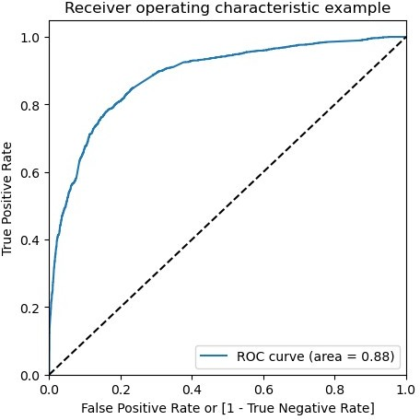
fpr, tpr, thresholds =
metrics.roc_curve( y_train_pred_final.Converted, y_train_pred_final.Conversion_Prob, drop_intermediate = False )
# Call the ROC function draw_roc(y_train_pred_final.Converted, y_train_pred_final.Conversion_Prob)
The area under ROC curve is 0.88 which is a very good value
# Creating columns with different probability cutoffs
numbers = [float(x)/10 for x in range(10)]
for i in numbers: y_train_pred_final[i]=
y_train_pred_final.Conversion_Prob.map(lambda x: 1 if x y_train_pred_final.head()
> i else 0)
Converted |  | Conversion_Prob | Predicted | 0.0 | 0.1 | 0.2 | 0.3 | 0.4 | 0.5
0.6 \
0 | 0 | 0.257438 | 0 | 1 | 1 | 1 | 0 | 0 | 0
0
1 | 1 | 0.997225 | 1 | 1 | 1 | 1 | 1 | 1 | 1
1
2 | 1 | 0.327989 | 0 | 1 | 1 | 1 | 1 | 0 | 0

Slide 61
0
3 | 0 | 0.259734 | 0 | 1 | 1 | 1 | 0 | 0 | 0
0
4 | 0 | 0.135660 | 0 | 1 | 1 | 0 | 0 | 0 | 0
0
0
1
2
3
4
0.7 0.8 0.9
0 0 0
1 1 1
0 0 0
0 0 0
0 0 0
# Creating a dataframe to see the values of accuracy, sensitivity, and specificity at different values of probabiity cutoffs
cutoff_df = pd.DataFrame( columns = ['prob','accuracy','sensi','speci'])
# Making confusing matrix to find values of sensitivity, accurace and specificity for each level of probablity
from sklearn.metrics import confusion_matrix num = [0.0,0.1,0.2,0.3,0.4,0.5,0.6,0.7,0.8,0.9]
for i in num:
cm1 = metrics.confusion_matrix(y_train_pred_final.Converted, y_train_pred_final[i] )
total1=sum(sum(cm1))
accuracy = (cm1[0,0]+cm1[1,1])/total1
speci = cm1[0,0]/(cm1[0,0]+cm1[0,1])
sensi = cm1[1,1]/(cm1[1,0]+cm1[1,1]) cutoff_df.loc[i] =[ i ,accuracy,sensi,speci]
cutoff_df
 | prob | accuracy | sensi | speci
0.0 | 0.0 | 0.377880 | 1.000000 | 0.000000
0.1 | 0.1 | 0.605911 | 0.961312 | 0.390038
0.2 | 0.2 | 0.757508 | 0.907906 | 0.666156
0.3 | 0.3 | 0.801367 | 0.829689 | 0.784163
0.4 | 0.4 | 0.817257 | 0.770395 | 0.845722
0.5 | 0.5 | 0.818211 | 0.702271 | 0.888633
0.6 | 0.6 | 0.794057 | 0.573591 | 0.927969
0.7 | 0.7 | 0.782616 | 0.501682 | 0.953257
0.8 | 0.8 | 0.763547 | 0.421362 | 0.971392
0.9 | 0.9 | 0.717623 | 0.269975 | 0.989527
# Plotting it
cutoff_df.plot.line(x='prob', y=['accuracy','sensi','speci']) plt.show()

Slide 62
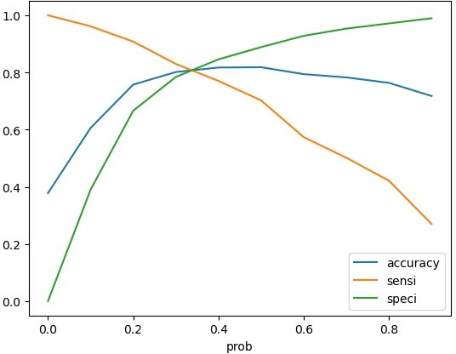
From the graph it is visible that the optimal cut off is at 0.35.
y_train_pred_final['final_predicted'] = y_train_pred_final.Conversion_Prob.map( lambda x: 1 if x > 0.35 else 0)
y_train_pred_final.head()
Converted
0.6 \
Conversion_Prob | Predicted | 0.0 | 0.1 | 0.2 | 0.3 | 0.4 | 0.5
0.257438 | 0 | 1 | 1 | 1 | 0 | 0 | 0
0.997225 | 1 | 1 | 1 | 1 | 1 | 1 | 1
0.327989 | 0 | 1 | 1 | 1 | 1 | 0 | 0
0.259734 | 0 | 1 | 1 | 1 | 0 | 0 | 0
0.135660 | 0 | 1 | 1 | 0 | 0 | 0 | 0
0
0
1
1
2
0
3
0
4
0
1
1
0
0
0 | 0.7 | 0.8 | 0.9 | final_predicted
0 | 0 | 0 | 0 | 0
1 | 1 | 1 | 1 | 1
2 | 0 | 0 | 0 | 0

Slide 63
3 | 0 | 0 | 0 | 0
4 | 0 | 0 | 0 | 0
# Check the overall accuracy metrics.accuracy_score(y_train_pred_final.Converted, y_train_pred_final.final_predicted)
0.8091530271730494
# Creating confusion matrix
confusion2 = metrics.confusion_matrix(y_train_pred_final.Converted, y_train_pred_final.final_predicted )
confusion2
array([[3191, 724],
[ 477, 1901]], dtype=int64)
# Substituting the value of true positive
TP = confusion2[1,1]
# Substituting the value of true negatives
TN = confusion2[0,0]
# Substituting the value of false positives
FP = confusion2[0,1]
# Substituting the value of false negatives
FN = confusion2[1,0]
# Calculating the sensitivity
TP/(TP+FN)
0.7994112699747687
# Calculating the specificity
TN/(TN+FP)
0.8150702426564496
With the current cut off as 0.35 we have accuracy, sensitivity and specificity of around 80%
Prediction on Test set
#Scaling numeric values
X_test[['TotalVisits', 'Page Views Per Visit', 'Total Time Spent on Website']] = scaler.transform(X_test[['TotalVisits', 'Page Views Per Visit', 'Total Time Spent on Website']])
col = X_train.columns
# Select the columns in X_train for X_test as well
X_test = X_test[col]
# Add a constant to X_test
X_test_sm = sm.add_constant(X_test[col]) X_test_sm
X_test_sm

Slide 64
 | const | TotalVisits | Total | Time Spent on Website |  | \
3308 | 1.0 | 0.117647 |  | 0.050176
4421 | 1.0 | 0.000000 |  | 0.000000
8855 | 1.0 | 0.058824 |  | 0.547975
5302 | 1.0 | 0.000000 |  | 0.000000
2169 ... 5655 | 1.0 ... 1.0 | 0.588235 ... 0.058824 |  | 0.390405 ... 0.218310
7836 | 1.0 | 0.588235 |  | 0.227113
8378 | 1.0 | 0.588235 |  | 0.179577
1263 | 1.0 | 0.117647 |  | 0.376320
8633 | 1.0 | 0.058824 |  | 0.150088
 | Lead | Origin_Lead Add | Form | Lead Source_Direct Traffic |  |  | \
3308 |  |  | 0 | 0
4421 |  |  | 0 | 0
8855 |  |  | 0 | 1
5302 |  |  | 0 | 0
2169 ... 5655 |  |  | 0 ... 0 | 1 ... 1
7836 |  |  | 0 | 0
8378 |  |  | 0 | 0
1263 |  |  | 0 | 1
8633 |  |  | 0 | 1
 | Lead | Source_Google | Lead | Source_Organic Search |  | \
3308 |  | 1 |  | 0
4421 |  | 0 |  | 0
8855 |  | 0 |  | 0
5302 |  | 0 |  | 0
2169 ... 5655 |  | 0 ... 0 |  | 0 ... 0
7836 |  | 1 |  | 0
8378 |  | 0 |  | 1
1263 |  | 0 |  | 0
8633 |  | 0 |  | 0
 | Lead | Source_Referral | Sites |  | Lead Source_Welingak | Website |  | \
3308 |  |  | 0 |  |  | 0
4421 |  |  | 0 |  |  | 0
8855 |  |  | 0 |  |  | 0
5302 |  |  | 0 |  |  | 0
2169 ... 5655 |  |  | 0 ... 0 |  |  | 0 ... 0
7836 |  |  | 0 |  |  | 0
8378 |  |  | 0 |  |  | 0
1263 |  |  | 0 |  |  | 0

Slide 65
8633
0
0
 | Do Not Email_Yes |  |  | Last Activity_Email |  | Bounced |  | \
3308 | 0 |  |  |  |  | 0
4421 | 0 |  |  |  |  | 0
8855 | 0 |  |  |  |  | 0
5302 | 0 |  |  |  |  | 0
2169 ... 5655 | 0 ... 0 |  |  |  |  | 0 ... 0
7836 | 0 |  |  |  |  | 0
8378 | 1 |  |  |  |  | 0
1263 | 0 |  |  |  |  | 0
8633 | 1 |  |  |  |  | 1
3308 | Last | Activity_Olark |  |  | Chat Conversation 0 | \
4421 |  |  |  |  | 0
8855 |  |  |  |  | 0
5302 |  |  |  |  | 1
2169 ... 5655 |  |  |  |  | 0 ... 0
7836 |  |  |  |  | 0
8378 |  |  |  |  | 0
1263 |  |  |  |  | 0
8633 |  |  |  |  | 0
3308 | What | is your | current occupation_Working |  |  |  | Professional 0 |  | \
4421 |  |  |  |  |  |  | 0
8855 |  |  |  |  |  |  | 0
5302 |  |  |  |  |  |  | 0
2169 ... 5655 |  |  |  |  |  |  | 0 ... 0
7836 |  |  |  |  |  |  | 1
8378 |  |  |  |  |  |  | 0
1263 |  |  |  |  |  |  | 1
8633 |  |  |  |  |  |  | 0
3308 | Last | Notable | Activity_Email Link Clicked 0 |  |  |  | \
4421 |  |  | 0
8855 |  |  | 0
5302 |  |  | 0
2169 ... 5655 |  |  | 0 ... 0
7836 |  |  | 1

Slide 66
8378 |  |  | 0
1263 |  |  | 0
8633 |  |  | 0
Last Notable Activity_Modified 3308 |  |  | Activity_Email \ | Opened 1 | Last | Notable
0
4421 |  |  |  | 0
0
8855 |  |  |  | 0
1
5302 |  |  |  | 0
1
2169 |  |  |  | 1
0 ... .. 5655 |  |  |  | ... 0
1
7836 |  |  |  | 0
0
8378 |  |  |  | 0
0
1263 |  |  |  | 0
0
8633 |  |  |  | 0
1
Last Notable Activity_Olark Chat Conversation \
3308 |  |  | 0
4421 |  |  | 0
8855 |  |  | 0
5302 |  |  | 0
2169 ... 5655 |  |  | 0 ... 0
7836 |  |  | 0
8378 |  |  | 0
1263 |  |  | 0
8633 |  |  | 0
3308 | Last | Notable | Activity_Page Visited on Website 0
4421 |  |  | 0
8855 |  |  | 0
5302 |  |  | 0
2169 ... 5655 |  |  | 0 ... 0
.

Slide 67
7836 | 0
8378 | 1
1263 | 0
8633 | 0
[2698 rows x 18 columns]
# Storing prediction of test set in the variable 'y_test_pred'
y_test_pred = res.predict(X_test_sm)
# Coverting it to df
y_pred_df = pd.DataFrame(y_test_pred) # Converting y_test to dataframe y_test_df = pd.DataFrame(y_test)
# Remove index for both dataframes to append them side by side y_pred_df.reset_index(drop=True, inplace=True) y_test_df.reset_index(drop=True, inplace=True)
# Append y_test_df and y_pred_df
y_pred_final = pd.concat([y_test_df, y_pred_df],axis=1)
# Renaming column
y_pred_final= y_pred_final.rename(columns = {0 : 'Conversion_Prob'}) y_pred_final.head()
0
1
2
3
4
Converted Conversion_Prob
0 0.123887
1 0.588440
1 0.370721
0 0.060348
0 0.442248
# Making prediction using cut off 0.35 y_pred_final['final_predicted'] = y_pred_final.Conversion_Prob.map(lambda x: 1 if x y_pred_final
> 0.35 else 0)
 | Converted | Conversion_Prob | final_predicted
0 | 0 | 0.123887 | 0
1 | 1 | 0.588440 | 1
2 | 1 | 0.370721 | 1
3 | 0 | 0.060348 | 0
4 | 0 | 0.442248 | 1
... | ... | ... | ...
2693 | 1 | 0.111744 | 0
2694 | 1 | 0.829332 | 1
2695 | 0 | 0.039085 | 0
2696 | 1 | 0.965347 | 1
2697 | 0 | 0.007473 | 0
[2698 rows x 3 columns]

Slide 68
# Check the overall accuracy metrics.accuracy_score(y_pred_final['Converted'], y_pred_final.final_predicted)
0.8002223869532987
# Creating confusion matrix
confusion2 = metrics.confusion_matrix(y_pred_final['Converted'], y_pred_final.final_predicted )
confusion2
array([[1350,
[ 212,
327],
809]], dtype=int64)
# Substituting the value of true positive
TP = confusion2[1,1]
# Substituting the value of true negatives
TN = confusion2[0,0]
# Substituting the value of false positives
FP = confusion2[0,1]
# Substituting the value of false negatives
FN = confusion2[1,0]
# Calculating the sensitivity
TP/(TP+FN)
0.7923604309500489
# Calculating the specificity
TN/(TN+FP)
0.8050089445438283
With the current cut off as 0.35 we have accuracy, sensitivity and specificity of around 80%
Precision-Recall
confusion = metrics.confusion_matrix(y_train_pred_final.Converted, y_train_pred_final.Predicted )
confusion
array([[3479, 436],
[ 708, 1670]], dtype=int64)
# Precision = TP / TP + FP
confusion[1,1]/(confusion[0,1]+confusion[1,1])
0.7929724596391263
#Recall = TP / TP + FN
confusion[1,1]/(confusion[1,0]+confusion[1,1])
0.7022708158116064

Slide 69
With the current cut off as 0.35 we have Precision around 79% and Recall around 70%
Precision and recall tradeoff
from sklearn.metrics import precision_recall_curve
y_train_pred_final.Converted, y_train_pred_final.Predicted
(0 | 0
1 | 1
2 | 1
3 | 0
4 | 0
 | ..
6288 | 1
6289 | 1
6290 | 1
6291 | 0
6292 | 1
Name: | Converted, | Length: 6293, dtype: int64,
0 | 0
1 | 1
2 | 0
3 | 0
4 | 0
 | ..
6288 | 1
6289 | 0
6290 | 1
6291 | 0
6292 | 1
Name: | Predicted, | Length: 6293, dtype: int64)
p, r, thresholds = precision_recall_curve(y_train_pred_final.Converted, y_train_pred_final.Conversion_Prob)
plt.plot(thresholds, p[:-1], "g-")
plt.plot(thresholds, r[:-1], "r-") plt.show()

Slide 70
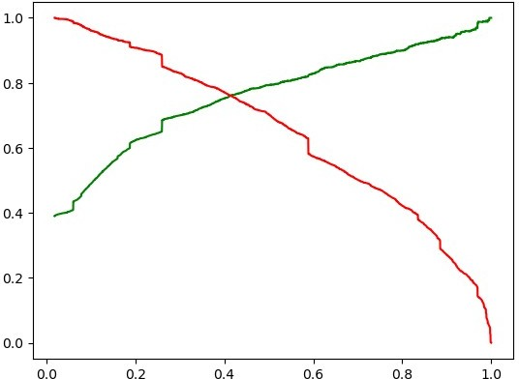
y_train_pred_final['final_predicted'] = y_train_pred_final.Conversion_Prob.map(lambda x: 1 if x > 0.41 else 0) y_train_pred_final.head()
Converted
0.6 \
Conversion_Prob | Predicted | 0.0 | 0.1 | 0.2 | 0.3 | 0.4 | 0.5
0.257438 | 0 | 1 | 1 | 1 | 0 | 0 | 0
0.997225 | 1 | 1 | 1 | 1 | 1 | 1 | 1
0.327989 | 0 | 1 | 1 | 1 | 1 | 0 | 0
0.259734 | 0 | 1 | 1 | 1 | 0 | 0 | 0
0.135660 | 0 | 1 | 1 | 0 | 0 | 0 | 0
0
0
1
1
2
0
3
0
4
0
1
1
0
0
0 | 0.7 | 0.8 | 0.9 | final_predicted
0 | 0 | 0 | 0 | 0
1 | 1 | 1 | 1 | 1
2 | 0 | 0 | 0 | 0
3 | 0 | 0 | 0 | 0
4 | 0 | 0 | 0 | 0

Slide 71
# Accuracy metrics.accuracy_score(y_train_pred_final.Converted, y_train_pred_final.final_predicted)
0.8180518035912919
# Creating confusion matrix again
confusion2 = metrics.confusion_matrix(y_train_pred_final.Converted, y_train_pred_final.final_predicted )
confusion2
array([[3333, 582],
[ 563, 1815]], dtype=int64)
# Substituting the value of true positive
TP = confusion2[1,1]
# Substituting the value of true negatives
TN = confusion2[0,0]
# Substituting the value of false positives
FP = confusion2[0,1]
# Substituting the value of false negatives
FN = confusion2[1,0]
# Precision = TP / TP + FP
TP / (TP + FP)
0.7571964956195244
#Recall = TP / TP + FN
TP / (TP + FN)
0.763246425567704
With the current cut off as 0.44 we have Precision around 76% and Recall around 76.3% and accuracy 82 %.
Prediction on Test set
# Storing prediction of test set in the variable 'y_test_pred'
y_test_pred = res.predict(X_test_sm)
# Coverting it to df
y_pred_df = pd.DataFrame(y_test_pred) # Converting y_test to dataframe y_test_df = pd.DataFrame(y_test)
# Remove index for both dataframes to append them side by side y_pred_df.reset_index(drop=True, inplace=True) y_test_df.reset_index(drop=True, inplace=True)
# Append y_test_df and y_pred_df
y_pred_final = pd.concat([y_test_df, y_pred_df],axis=1)
# Renaming column
y_pred_final= y_pred_final.rename(columns = {0 : 'Conversion_Prob'}) y_pred_final.head()

Slide 72
0
1
2
3
4
Converted Conversion_Prob
0 0.123887
1 0.588440
1 0.370721
0 0.060348
0 0.442248
# Making prediction using cut off 0.41 y_pred_final['final_predicted'] = y_pred_final.Conversion_Prob.map(lambda x: 1 if x y_pred_final
> 0.44 else 0)
 | Converted | Conversion_Prob | final_predicted
0 | 0 | 0.123887 | 0
1 | 1 | 0.588440 | 1
2 | 1 | 0.370721 | 0
3 | 0 | 0.060348 | 0
4 | 0 | 0.442248 | 1
... | ... | ... | ...
2693 | 1 | 0.111744 | 0
2694 | 1 | 0.829332 | 1
2695 | 0 | 0.039085 | 0
2696 | 1 | 0.965347 | 1
2697 | 0 | 0.007473 | 0
[2698 rows x 3 columns]
Check the overall accuracy
# Check the overall accuracy metrics.accuracy_score(y_pred_final['Converted'], y_pred_final.final_predicted)
0.8057820607857672
# Creating confusion matrix
confusion2 = metrics.confusion_matrix(y_pred_final['Converted'], y_pred_final.final_predicted )
confusion2
array([[1426,
[ 273,
251],
748]], dtype=int64)
# Substituting the value of true positive
TP = confusion2[1,1]
# Substituting the value of true negatives
TN = confusion2[0,0]
# Substituting the value of false positives
FP = confusion2[0,1]
# Substituting the value of false negatives
FN = confusion2[1,0]

Slide 73
# Precision = TP / TP + FP
TP / (TP + FP)
0.7487487487487487
#Recall = TP / TP + FN
TP / (TP + FN)
0.732615083251714
With the current cut off as 0.41 we have Precision around 75% , Recall around 73% and accuracy 80.5%.
The Model seems to predict the Conversion Rate very well and we should be able to give the CEO confidence in making good calls based on this model

