Slide 1

Airbnb NYC Case Study
Presented By:
Ajinkya Bandri, Barbie Choudhari, Sagar Barge

Slide 2
AGENDA
Objective
Background
Data Cleaning
Key Insights
Appendix

Slide 3
OBJECTIVE
Which type of hosts to acquire more and where?
The categorization of customers based on their preferences.
What are the neighborhoods they need to target?
What is the pricing ranges preferred by customers?
The various kinds of properties that exist w.r.t. customer preferences.
Adjustments in the existing properties to make it more customer-oriented.
What are the most popular localities and properties in New York currently?
How to get unpopular properties more traction?

Slide 4
BACKGROUND
Past few months, Airbnb has seen a major decline in revenue.
Now that the restrictions have started lifting and people have started to travel more, Airbnb wants to make sure that it is fully prepared for this change.
The different leaders at Airbnb want to understand some important insights based on various attributes in the dataset so as to increase the revenue.

Slide 5
DATA CLEANING

Slide 6
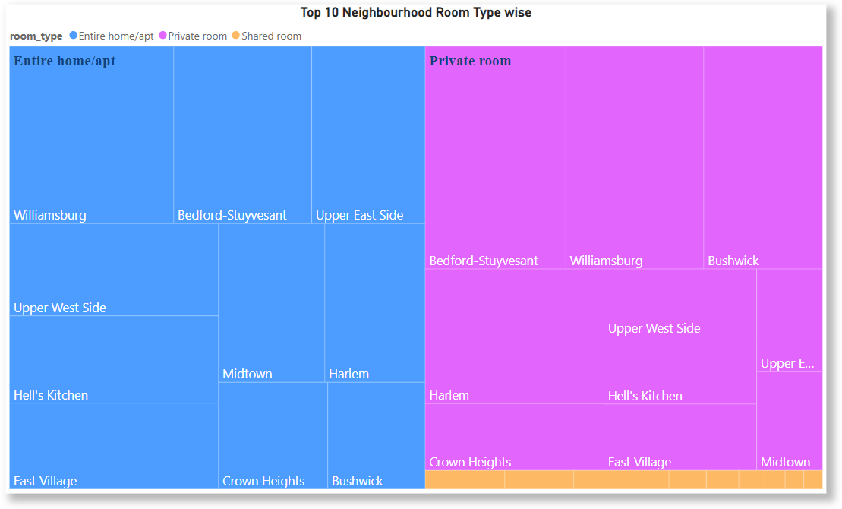
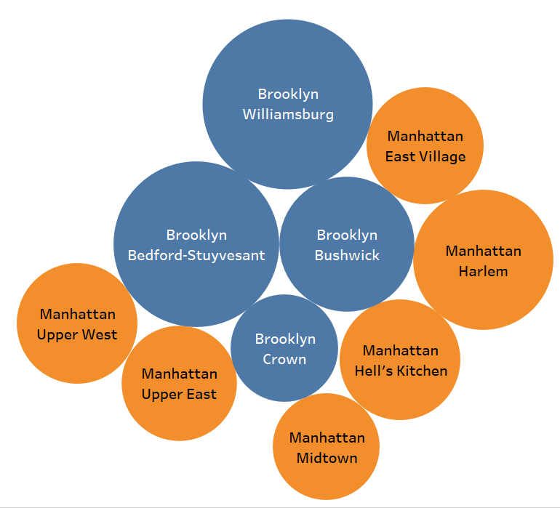
Type of Host to Acquire More and Where?
Top 10 Neighborhood

Slide 7
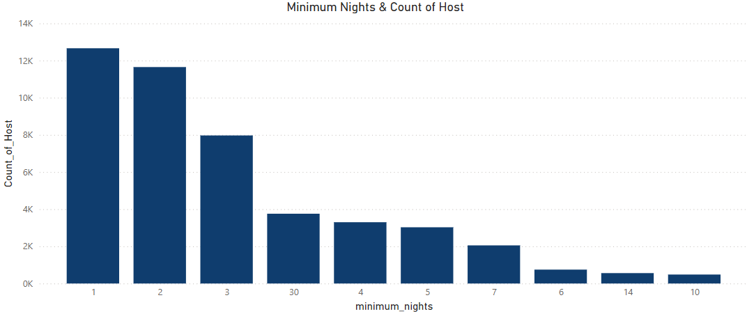
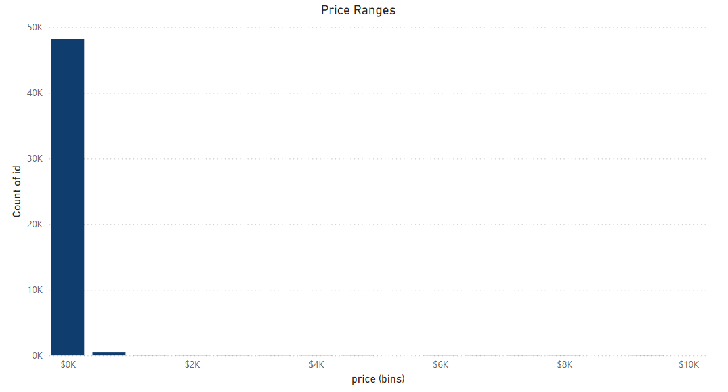
The categorization of customers based on their preferences

Slide 10
APPENDIX

