Slide 1

Airbnb NewYork Insights
Presented By:
Ajinkya Bandri, Barbie Choudhari, Sagar Barge

Slide 2
Agenda
Objective
Background
Data Cleaning
Key Insights
Appendix

Slide 3
Objective
Which type of hosts to acquire more and where?
The categorization of customers based on their preferences.
What are the neighborhoods they need to target?
What is the pricing ranges preferred by customers?
The various kinds of properties that exist w.r.t. customer preferences.
Adjustments in the existing properties to make it more customer-oriented.
What are the most popular localities and properties in New York currently?
How to get unpopular properties more traction?

Slide 4
Background
Past few months, Airbnb has seen a major decline in revenue.
Now that the restrictions have started lifting and people have started to travel more, Airbnb wants to make sure that it is fully prepared for this change.
The different leaders at Airbnb want to understand some important insights based on various attributes in the dataset so as to increase the revenue.

Slide 5
Data Cleaning and Data Preparation
Missing Value imputed by mean, median
Outlier identified using boxplot, treated using capping
Correlation matrix used to understand the relation between numerical values
New columns created to understand the feature better.

Slide 6
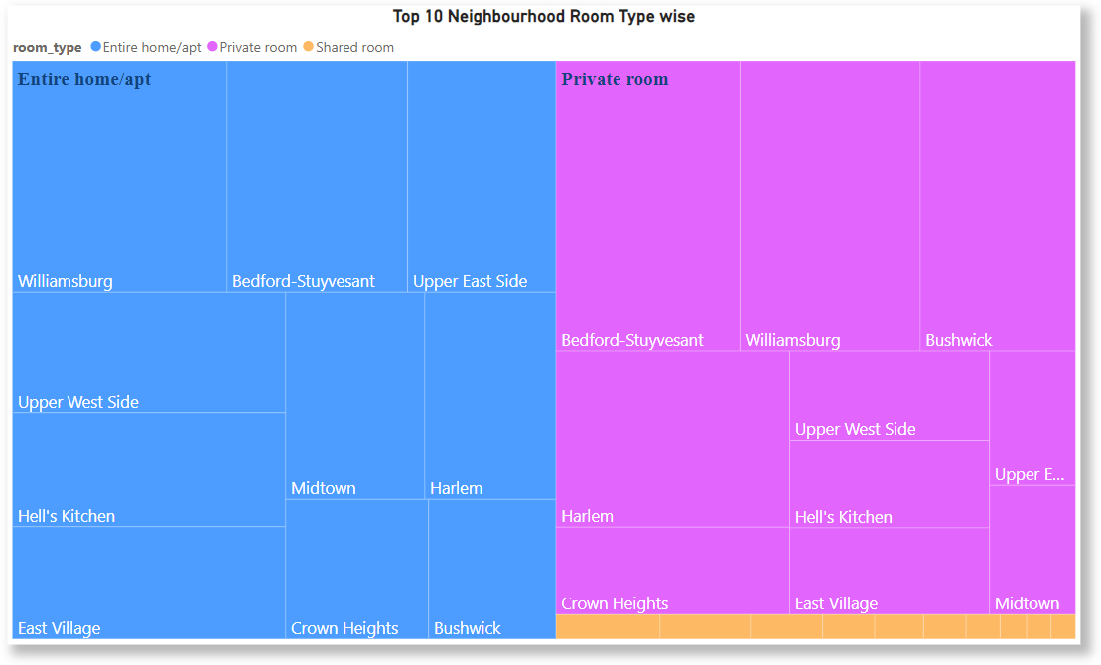
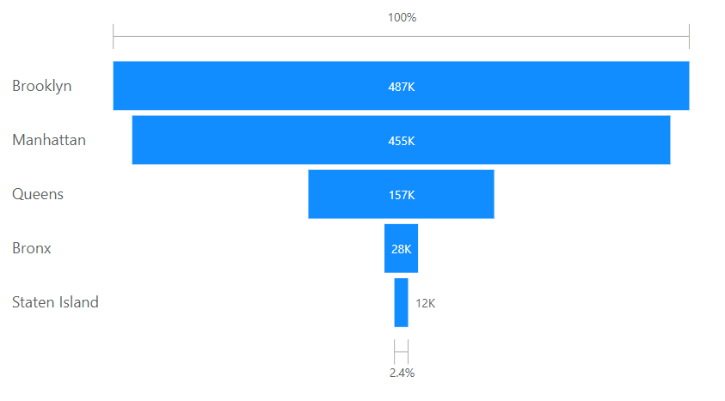
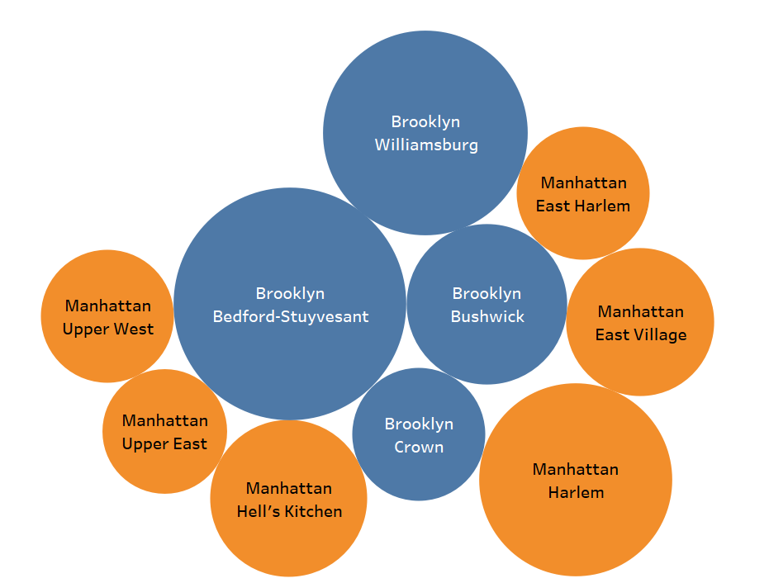

Type of Host & Location
Entire homes/apartments and private rooms are the dominant room types (98%) for Airbnb listings
Top Neighborhoods: Williamsburg, Bedford-Stuyvesant, Bushwick, East Village, Herlem
Brooklyn and Manhattan are the leading neighborhood groups.
Neighborhoods Group by Count of Listings
Top 10 Neighborhoods by Review Sum

Slide 7
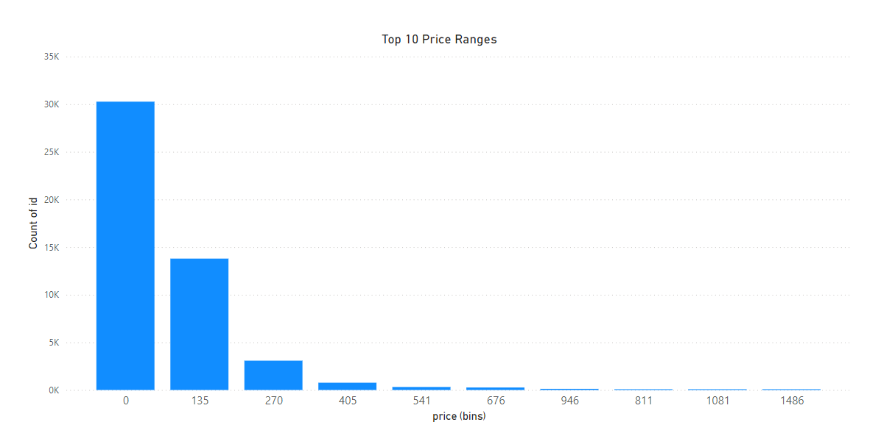
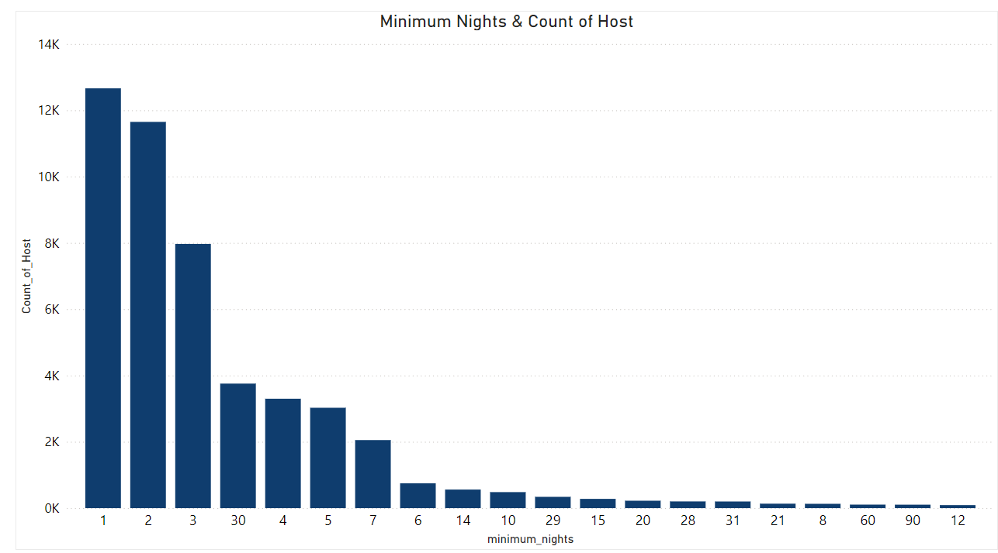
Categorization of customers based on their preferences
A preferred price range of $0 to $135 aligns with the project's objective to maximize booking potential.
Most common minimum night stay requirement is 1 to 2 days.

Slide 8
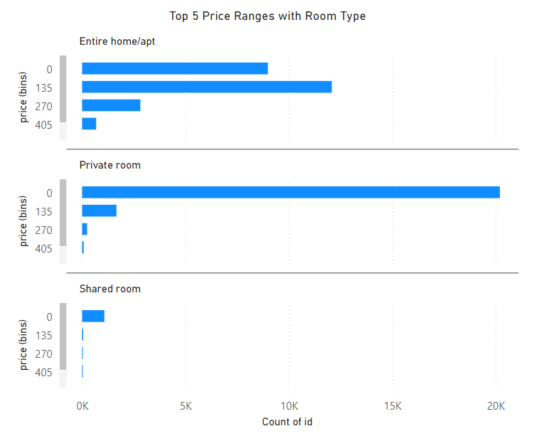
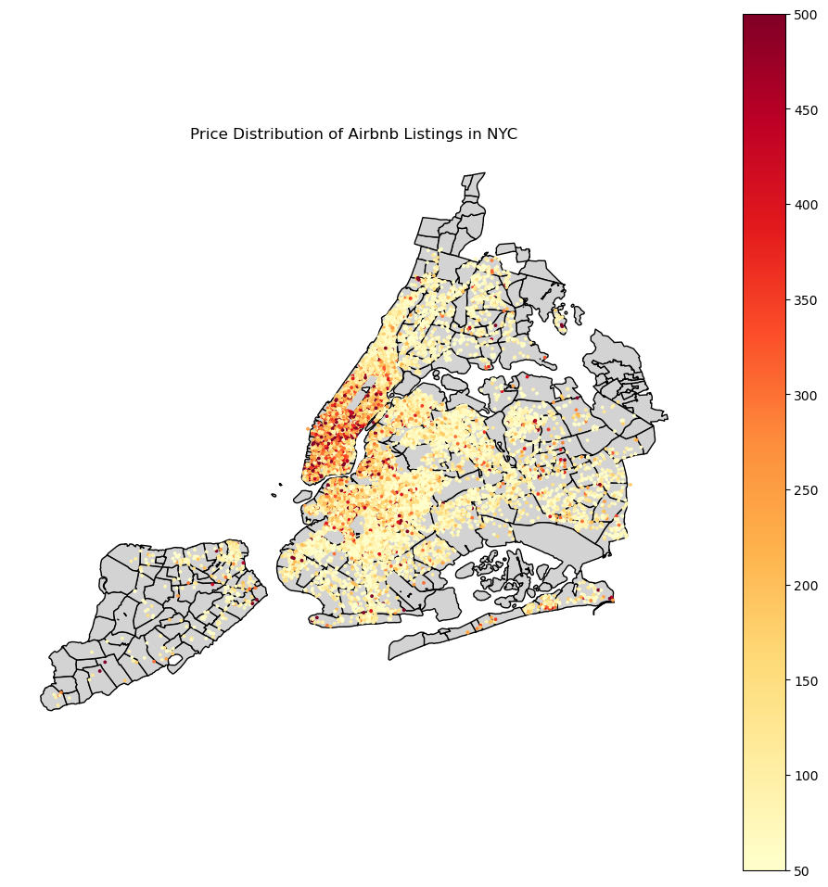
Pricing Ranges With Room Type & Location
Entire Home/Apt preferred price range is $135 to $270, with the second most popular range is below $135.
Private Room: Majority of listings are priced under $135.
Shared Rooms: Almost all listings are below $135.
Manhattan

Slide 9
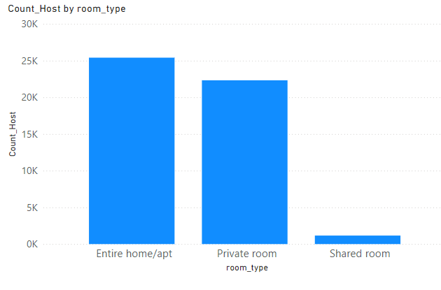
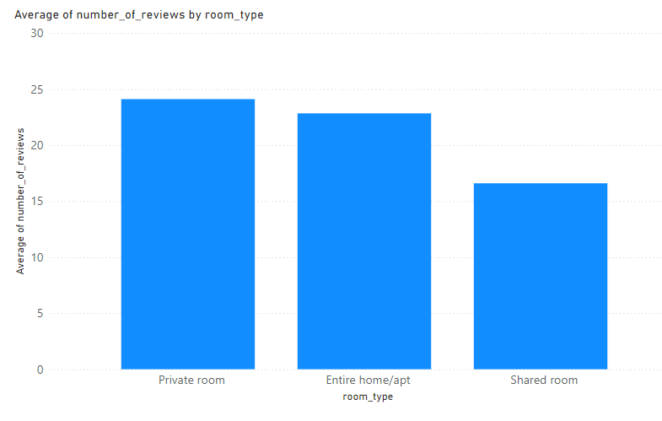
The various kinds of properties that exist w.r.t. customer preferences
In Room type Entire Home/apt are higher in number
Guests have a higher interest in private spaces
Shared Room is less preferred room type

Slide 10
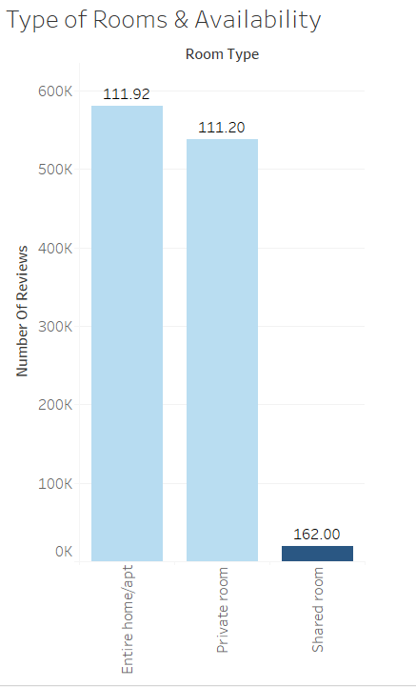

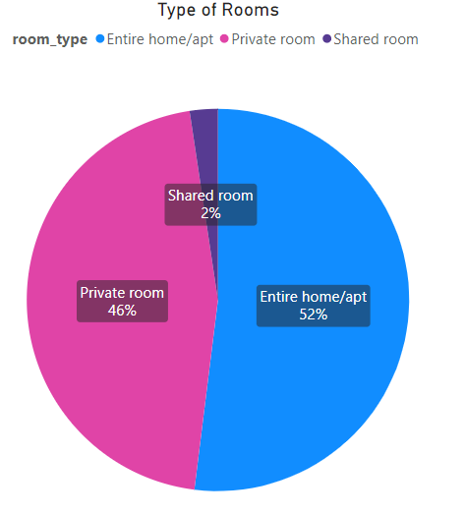
Adjustments In The Existing Properties
Entire Home/apt & Private Rooms have strong customer preference, Both contributing 98% room type.
But their average availability is very low (111days).
Shared room availability is high but demand is very low.
Average Room Availability

Slide 11
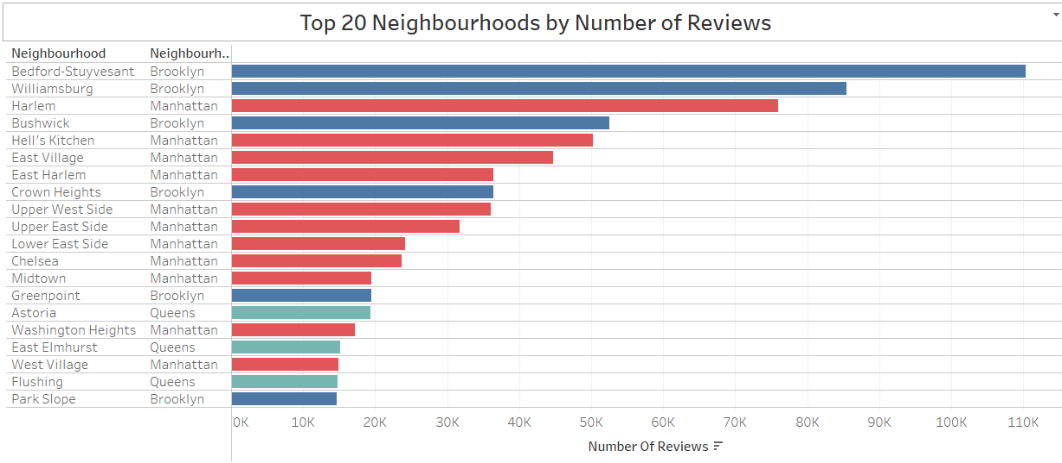
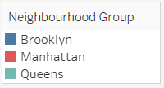
Most popular localities and properties in New York currently
Popular Neighborhoods: Bedford-Stuyvesant, Williamsburg, Harlem, Bushwick, Hell’s Kitchen
Popular Neighborhoods Groups: Brooklyn, Manhattan
Top Properties: Room near JFK Queen Bed, Great Bedroom in Manhattan, Beautiful Bedroom in Manhattan
Name Top 20 Properties in New York by number of reviews
Rank | name | neighbourhood_group | neighbourhood
1 | Room near JFK Queen Bed | Queens | Jamaica
2 | Great Bedroom in Manhattan | Manhattan | Harlem
3 | Beautiful Bedroom in Manhattan | Manhattan | Harlem
4 | Private Bedroom in Manhattan | Manhattan | Harlem
5 | Room Near JFK Twin Beds | Queens | Jamaica
6 | Steps away from Laguardia airport | Queens | East Elmhurst
7 | Manhattan Lux Loft.Like.Love.Lots.Look ! | Manhattan | Lower East Side
8 | Cozy Room Family Home LGA Airport NO CLEANING FEE | Queens | East Elmhurst
9 | Private brownstone studio Brooklyn | Brooklyn | Park Slope
10 | LG Private Room/Family Friendly | Brooklyn | Bushwick
11 | My Little Guest Room in Flushing | Queens | Flushing
12 | Park Slope Green Guest House | Brooklyn | South Slope
13 | Bright LARGE BED near Manhattan | Queens | East Elmhurst
14 | Only Steps away from LaGuardia arpt | Queens | East Elmhurst
15 | PRIVATE Room on Historic Sugar Hill | Manhattan | Harlem
16 | yahmanscrashpads | Queens | Jamaica
17 | Cozy Room in Lively East Village | Manhattan | East Village
18 | Room steps away from LaGuardia airport | Queens | East Elmhurst
19 | TriBeCa 2500 Sq Ft w/ Priv Elevator | Manhattan | Tribeca

Slide 12
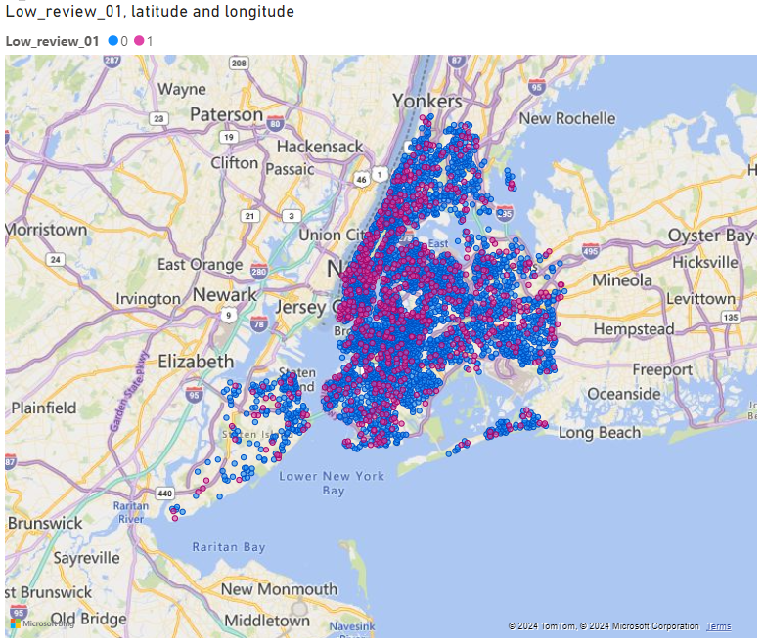
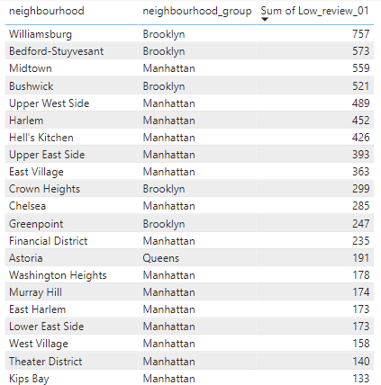
Unpopular Properties
Total Number of unpopular properties 10050
Localities with higher number of low-review properties: Manhattan
Unpopular Properties Location
Unpopular Neighbourhood Group
Top 20 Neighbourhood
Sr.No. | Neighbourhood Group | Total Number of Listings | Low Review Listings | % of Low Review
1 | Manhattan | 21661 | 5029 | 23.2
2 | Brooklyn | 20104 | 3657 | 18.2
3 | Queens | 5666 | 1092 | 19.3
4 | Bronx | 1091 | 215 | 19.7
5 | Staten Island | 373 | 59 | 15.8
Total |  | 48895 | 10052 | Avg. 20.6

Slide 13
Appendix
Data Source:
Airbnb Listings data: https://learn.upgrad.com/course/5701/segment/55499/338854/1024750/5125128
Geospatial data/shapefile of New York: https://data.cityofnewyork.us/City-Government/NTA-map/d3qk-pfyz
Methodology:
Data Acquisition
Understanding Problem, objective, data
Data Cleaning
Data Analysis using Python, Power BI, Tableau, Excel
Insights
recommendation
Assumptions:
Airbnb assumes that after covid-19 pandemic travel activity will increase.
Identified customer preferences using the number of reviews given by customers.

