Slide 1

Airbnb NewYork Insights
Presented By:
Ajinkya Bandri, Barbie Choudhari, Sagar Barge

Slide 2
Agenda
Background
Key Insights
Recommendation
Appendix

Slide 3
Objective
Which type of hosts to acquire more and where?
The categorization of customers based on their preferences.
What are the neighborhoods they need to target?
What is the pricing ranges preferred by customers?
The various kinds of properties that exist w.r.t. customer preferences.
Adjustments in the existing properties to make it more customer-oriented.
What are the most popular localities and properties in New York currently?
How to get unpopular properties more traction?

Slide 4
Background
Past few months, Airbnb has seen a major decline in revenue.
Now that the restrictions have started lifting and people have started to travel more, Airbnb wants to make sure that it is fully prepared for this change.
The different leaders at Airbnb want to understand some important insights based on various attributes in the dataset so as to increase the revenue.

Slide 5
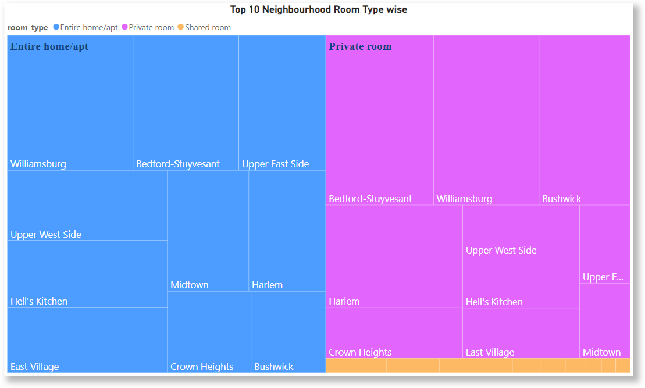
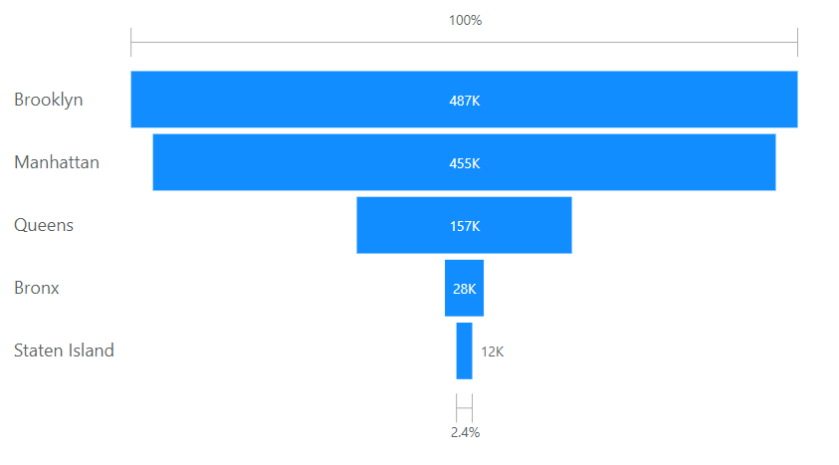
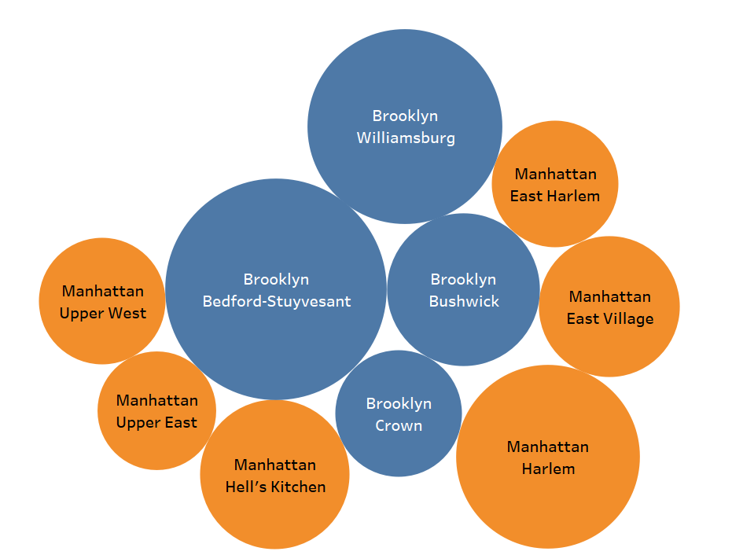

Type of Host to Acquire More and Where?
Major Room types: Entire Home/Apt & Private Room
Top Neighborhoods: Williamsburg, Bedford-Stuyvesant, Bushwick, East Village, Herlem
Top Neighborhoods group: Brooklyn, Manhattan where we can acquire more host
Neighborhoods Group by Count of Listings
Top 10 Neighborhoods by Review Sum

Slide 6
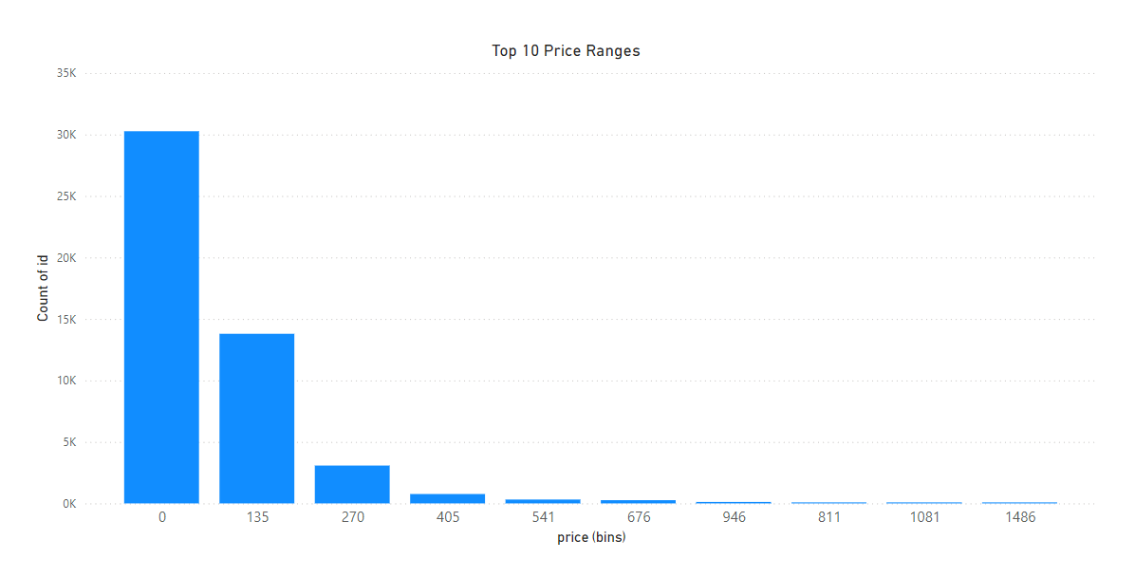
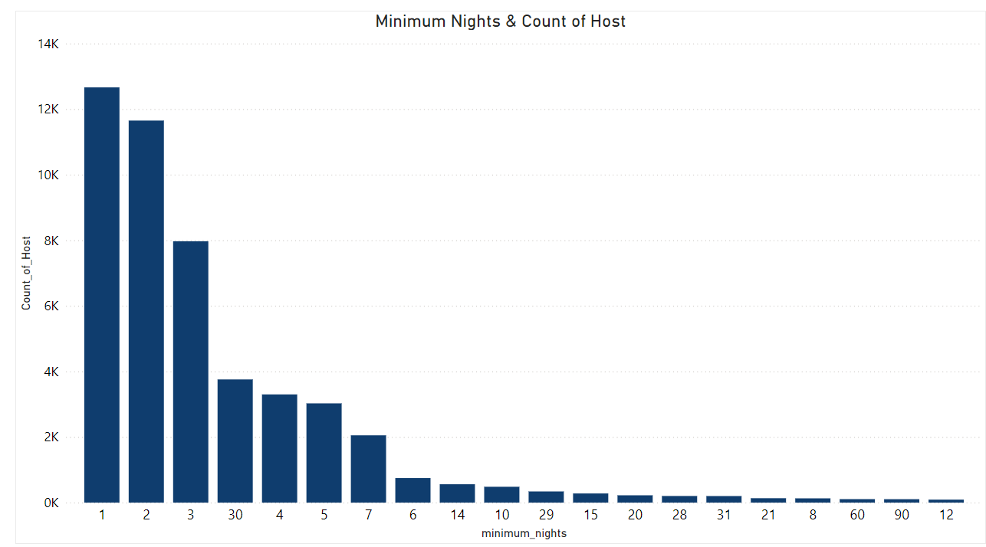
Categorization of customers based on their preferences
Preferred price ranges from $0 to $135, suggesting that budget-friendly options are popular among customers.
Most common minimum night stay requirement is 1 to 2 days, indicating flexibility and short-term booking preference.

Slide 7
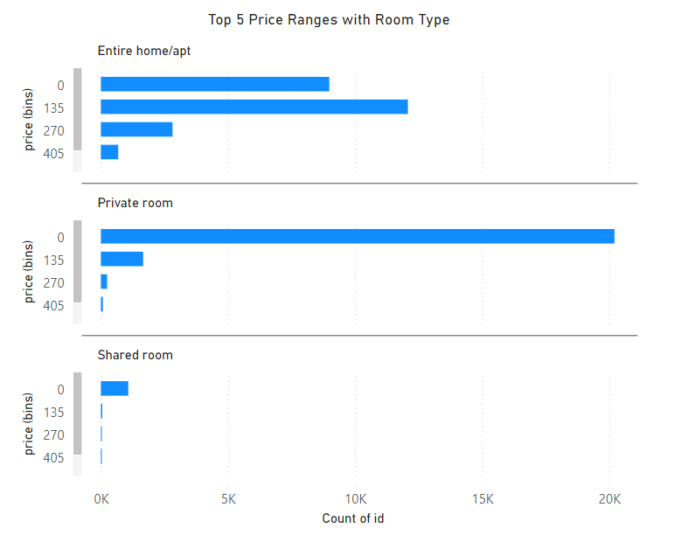
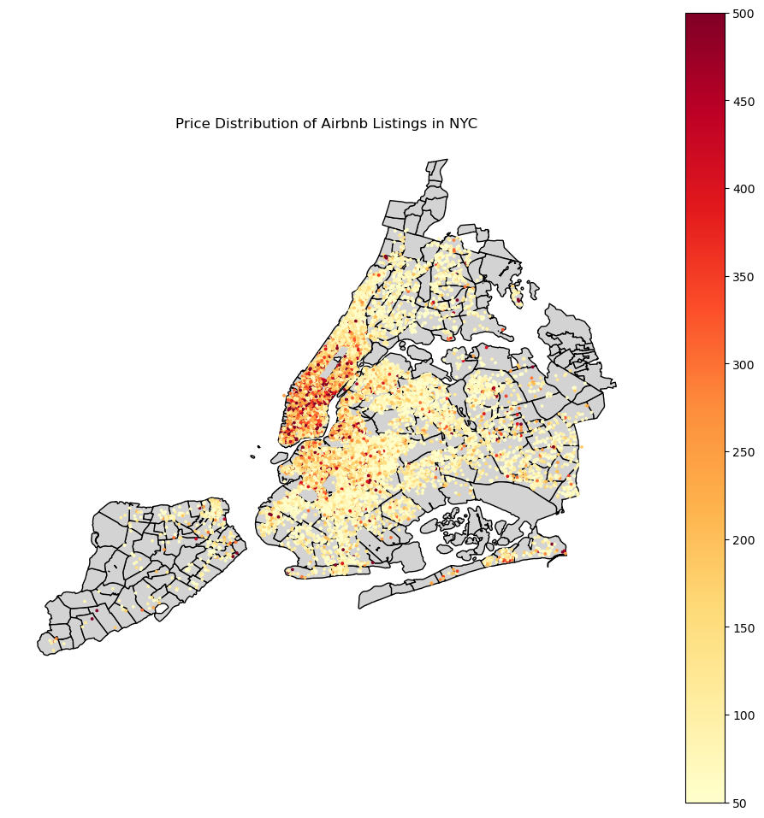
Pricing ranges preferred by customers
Entire Home/Apt: Preferred price range is $135 to $270, with a secondary concentration below $135.
Private Room: Most listings are priced under $135, catering to budget-conscious travelers.
Shared Room: Nearly all listings are below $135, making this the most affordable room type category.
Manhattan

Slide 8
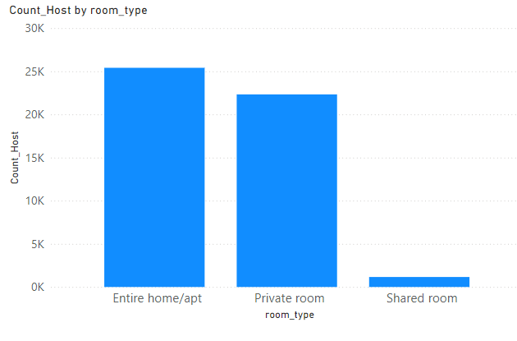
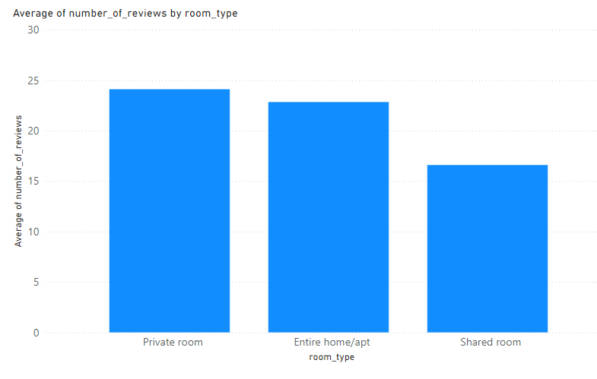
The various kinds of properties that exist w.r.t. customer preferences
Entire Home/Apt: This is the most prevalent room type, indicating a high supply in the market.
Private Room: Demonstrates strong guest interest, highlighting a preference for private yet affordable options.
Shared Room: The least preferred room type, with limited demand compared to other options.

Slide 9
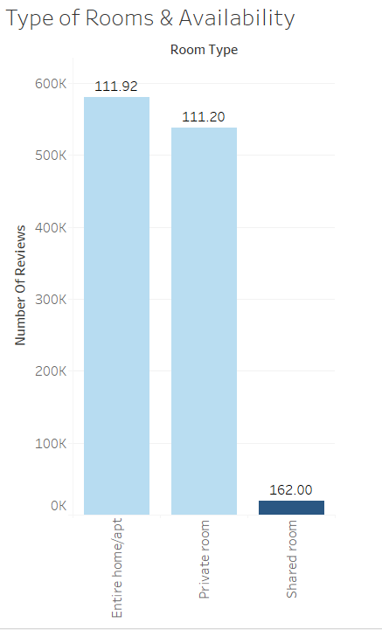

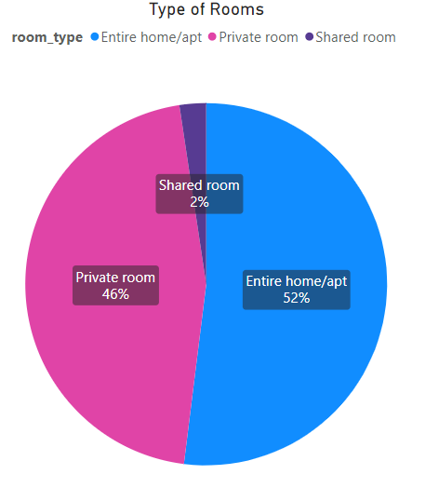
Adjustments in the existing properties to make it more customer-oriented
Entire Home/apt & Private Rooms have strong customer preference, Both contributing 98% room type.
But their average availability is very low (111days), we can increase availability.
Shared room availability is high but demand is very low.
Average Room Availability

Slide 10
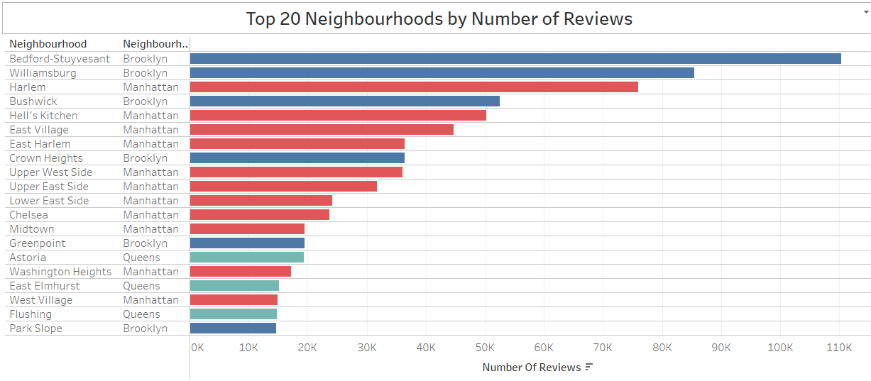
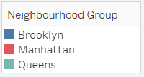
Most Popular Localities And Properties In New York Currently
Popular Neighborhoods: Bedford-Stuyvesant, Williamsburg, Harlem, Bushwick, Hell’s Kitchen are popular Neighborhoods
Popular Neighborhoods Groups: Listings in Brooklyn and Manhattan dominate in popularity.
Top Properties: Room near JFK Queen Bed, Great Bedroom in Manhattan, Beautiful Bedroom in Manhattan
reflecting the high demand for well-located, comfortable accommodations.
Name Top 20 Properties in New York by number of reviews
Rank | name | neighbourhood_group | neighbourhood
1 | Room near JFK Queen Bed | Queens | Jamaica
2 | Great Bedroom in Manhattan | Manhattan | Harlem
3 | Beautiful Bedroom in Manhattan | Manhattan | Harlem
4 | Private Bedroom in Manhattan | Manhattan | Harlem
5 | Room Near JFK Twin Beds | Queens | Jamaica
6 | Steps away from Laguardia airport | Queens | East Elmhurst
7 | Manhattan Lux Loft.Like.Love.Lots.Look ! | Manhattan | Lower East Side
8 | Cozy Room Family Home LGA Airport NO CLEANING FEE | Queens | East Elmhurst
9 | Private brownstone studio Brooklyn | Brooklyn | Park Slope
10 | LG Private Room/Family Friendly | Brooklyn | Bushwick
11 | My Little Guest Room in Flushing | Queens | Flushing
12 | Park Slope Green Guest House | Brooklyn | South Slope
13 | Bright LARGE BED near Manhattan | Queens | East Elmhurst
14 | Only Steps away from LaGuardia arpt | Queens | East Elmhurst
15 | PRIVATE Room on Historic Sugar Hill | Manhattan | Harlem
16 | yahmanscrashpads | Queens | Jamaica
17 | Cozy Room in Lively East Village | Manhattan | East Village
18 | Room steps away from LaGuardia airport | Queens | East Elmhurst
19 | TriBeCa 2500 Sq Ft w/ Priv Elevator | Manhattan | Tribeca

Slide 11
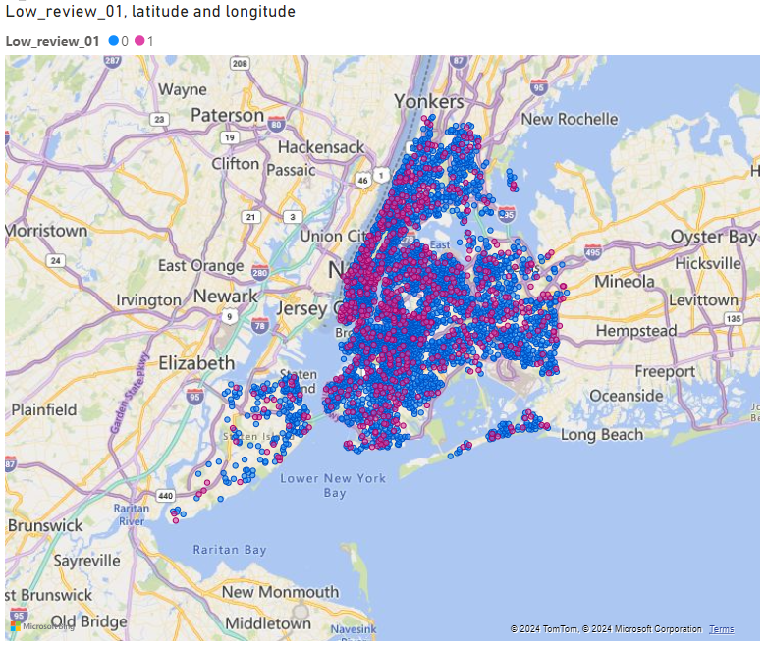
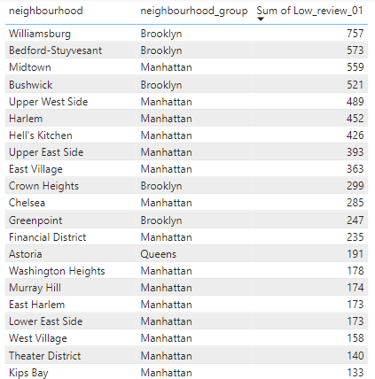
Unpopular Properties
Total Number of unpopular properties 10050
Localities with higher number of low-review properties: Manhattan
Unpopular Properties Location
Unpopular Neighbourhood Group
Top 20 Neighbourhood
Sr.No. | Neighbourhood Group | Total Number of Listings | Low Review Listings | % of Low Review
1 | Manhattan | 21661 | 5029 | 23.2
2 | Brooklyn | 20104 | 3657 | 18.2
3 | Queens | 5666 | 1092 | 19.3
4 | Bronx | 1091 | 215 | 19.7
5 | Staten Island | 373 | 59 | 15.8
Total |  | 48895 | 10052 | Avg. 20.6

Slide 12
Recommendation
Top Neighborhoods where need to focus: Williamsburg, Bedford-Stuyvesant, Bushwick, East Village, Herlem
Top Neighborhoods group: Brooklyn, Manhattan where we can acquire more host
Focus on High-Demand Neighbourhoods: Promote and expand listings in high-demand neighborhoods with strong booking rates and positive reviews to capture increased market interest.
Dynamic pricing: Based on seasonality, local events, and competitor pricing. Offering promotional discounts
Identify and Add Popular Amenities: Through reviews and customer preference data, identify essential amenities missing in these listings (like Wi-Fi, workspace, or basic kitchen items)
Targeted Marketing Campaigns: Market these listings on Airbnb’s social media channels, emphasizing their unique aspects (e.g., historic buildings, cozy spaces, scenic views)
Flexible Cancellation Policies: Encourage hosts of unpopular properties to adopt this option if feasible.
Use Guest Feedback: for Targeted Improvements & Encourage Reviews for Recent Guests.

Slide 13
Appendix
Data Source:
Airbnb Listings data: https://learn.upgrad.com/course/5701/segment/55499/338854/1024750/5125128
Geospatial data/shapefile of New York: https://data.cityofnewyork.us/City-Government/NTA-map/d3qk-pfyz
Methodology:
Data Acquisition
Understanding Problem, objective, data
Data Cleaning
Data Analysis using Python, Power BI, Tableau, Excel
Insights
recommendation
Assumptions:
Airbnb assumes that after covid-19 pandemic travel activity will increase.
Identified customer preferences using the number of reviews given by customers.

