Slide 1

Airbnb NYC Case Study
Presented By:
Ajinkya Bandri, Barbie Choudhari, Sagar Barge

Slide 2
AGENDA
Objective
Background
Data Cleaning
Key Insights
Appendix

Slide 3
OBJECTIVE
Which type of hosts to acquire more and where?
The categorization of customers based on their preferences.
What are the neighborhoods they need to target?
What is the pricing ranges preferred by customers?
The various kinds of properties that exist w.r.t. customer preferences.
Adjustments in the existing properties to make it more customer-oriented.
What are the most popular localities and properties in New York currently?
How to get unpopular properties more traction?

Slide 4
BACKGROUND
Past few months, Airbnb has seen a major decline in revenue.
Now that the restrictions have started lifting and people have started to travel more, Airbnb wants to make sure that it is fully prepared for this change.
The different leaders at Airbnb want to understand some important insights based on various attributes in the dataset so as to increase the revenue.

Slide 5
DATA CLEANING

Slide 6
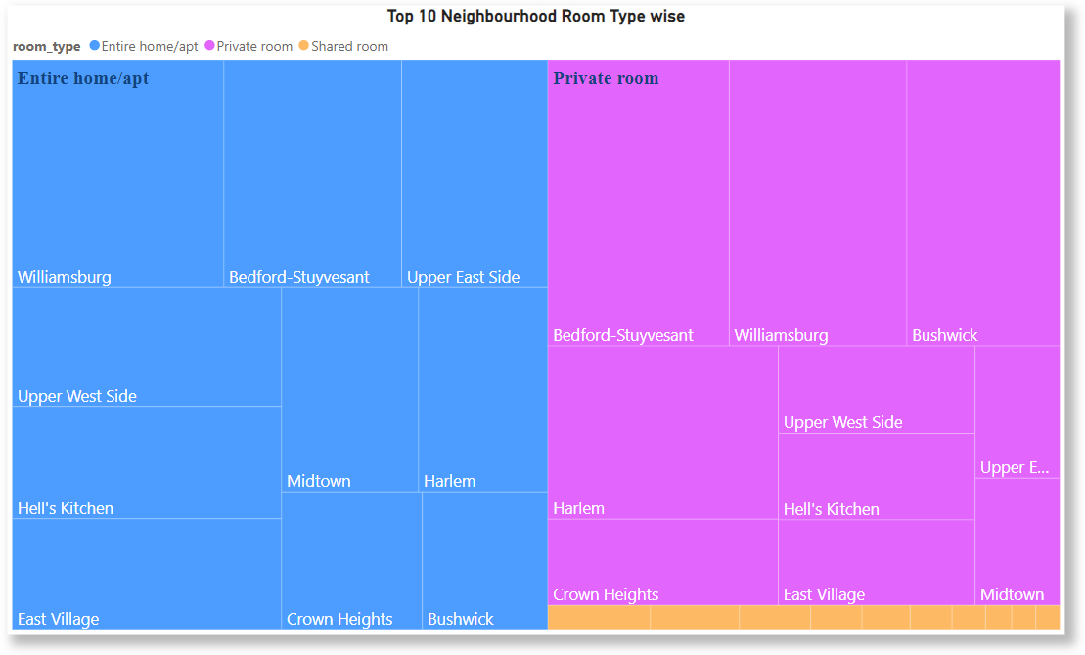
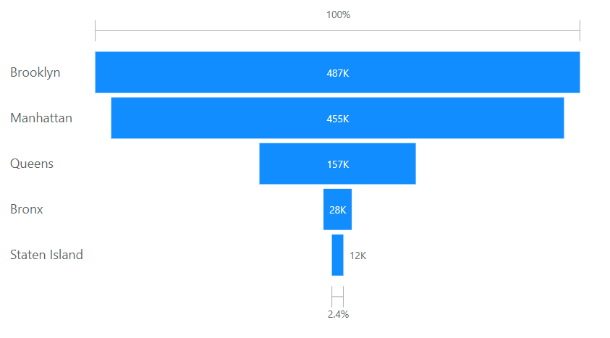
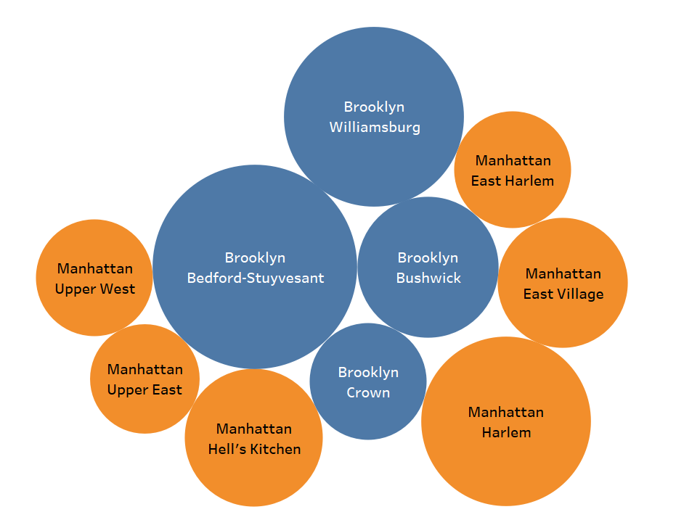

Type of Host to Acquire More and Where?
Major Room types: Entire Home/Apt, Private Room
Top Neighborhoods: Williamsburg, Bedford-Stuyvesant, Bushwick, East Village, Herlem
Top Neighborhoods group: Brooklyn, Manhattan
Neighborhoods Group by Count of Listings
Top 10 Neighborhoods by Review Sum

Slide 7
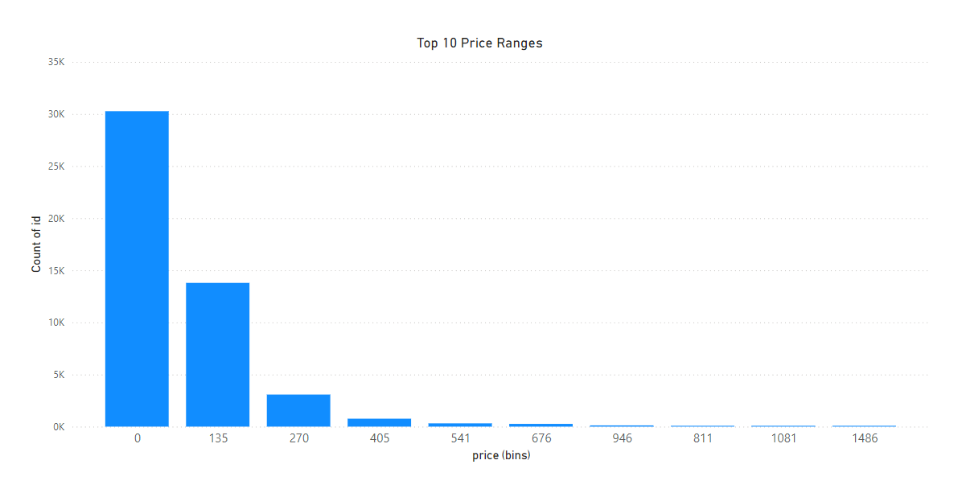
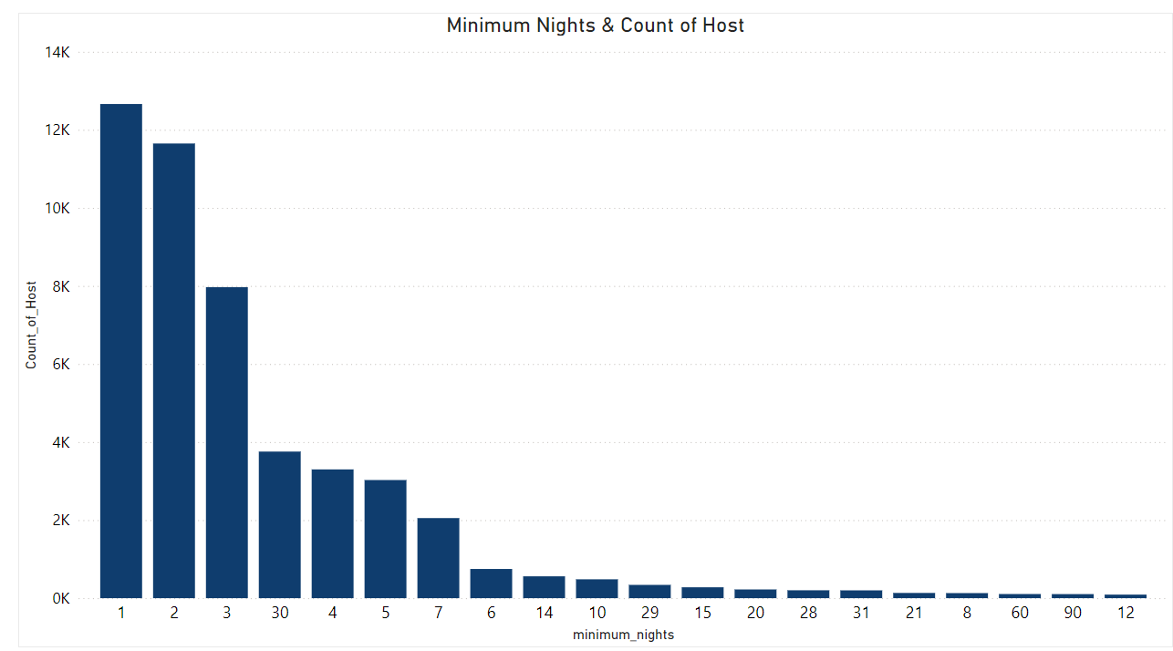
The categorization of customers based on their preferences
Preferred price ranges from $0 to $135, suggesting that budget-friendly options are popular among customers.
Most common minimum night stay requirement is 1 to 2 days, indicating flexibility and short-term booking preference.

Slide 8
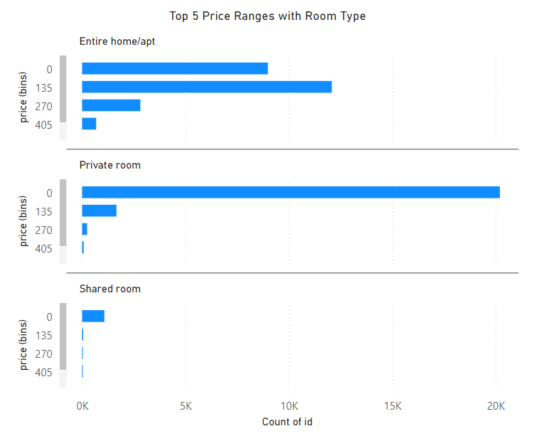
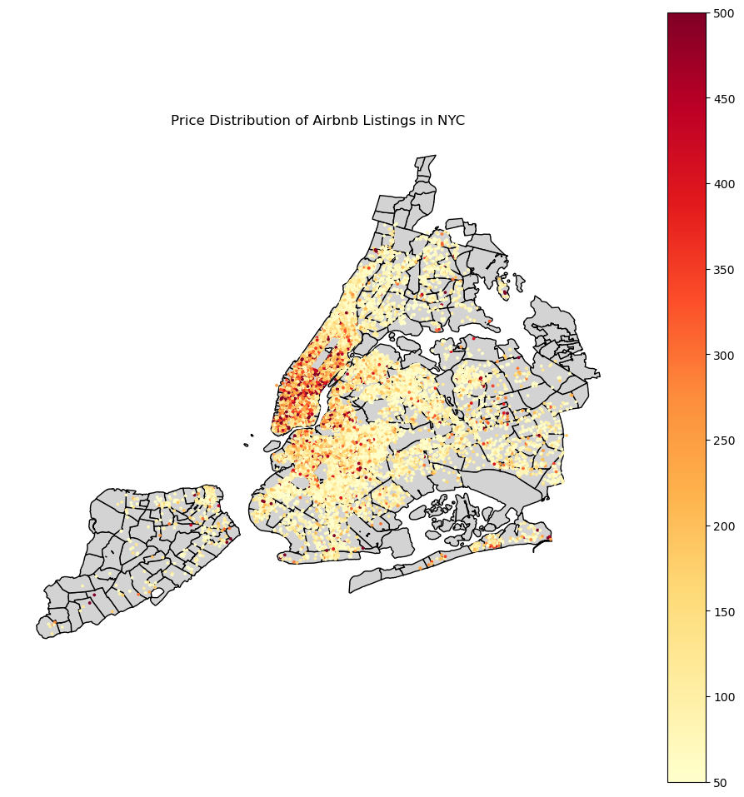
Pricing ranges preferred by customers
Entire Home/Apt preferred price range is $135 to $270, with the second most popular range is below $135.
Private Room: Majority of listings are priced under $135.
Shared Rooms: Almost all listings are below $135.
Manhattan

Slide 9
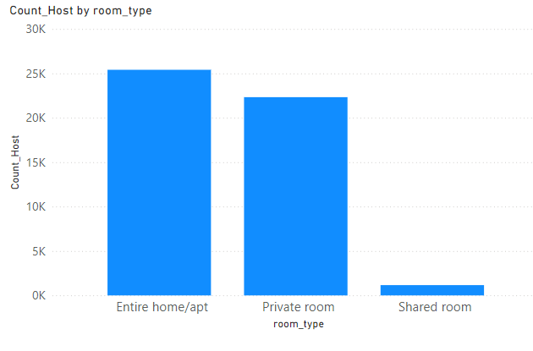
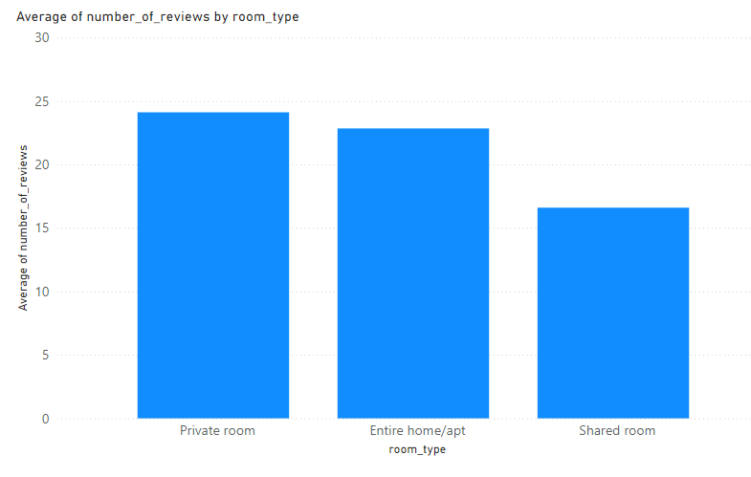
The various kinds of properties that exist w.r.t. customer preferences
In Room type Entire Home/apt are higher in number
guests have a higher interest in private spaces
A shared Room is less preferred room type

Slide 10
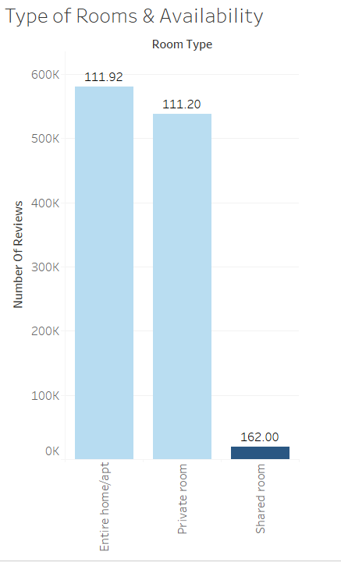

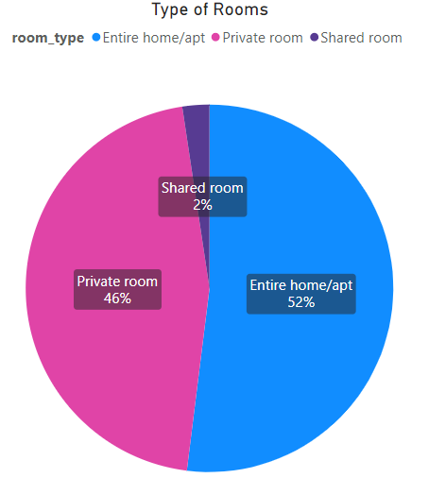
Adjustments in the existing properties to make it more customer-oriented
Entire Home/apt & Private Rooms have strong customer preference, Both contributing 98% room type.
But their average availability is very low (111days), we can increase availability.
Shared room availability is high but demand is very low.
Average Room Availability

Slide 11
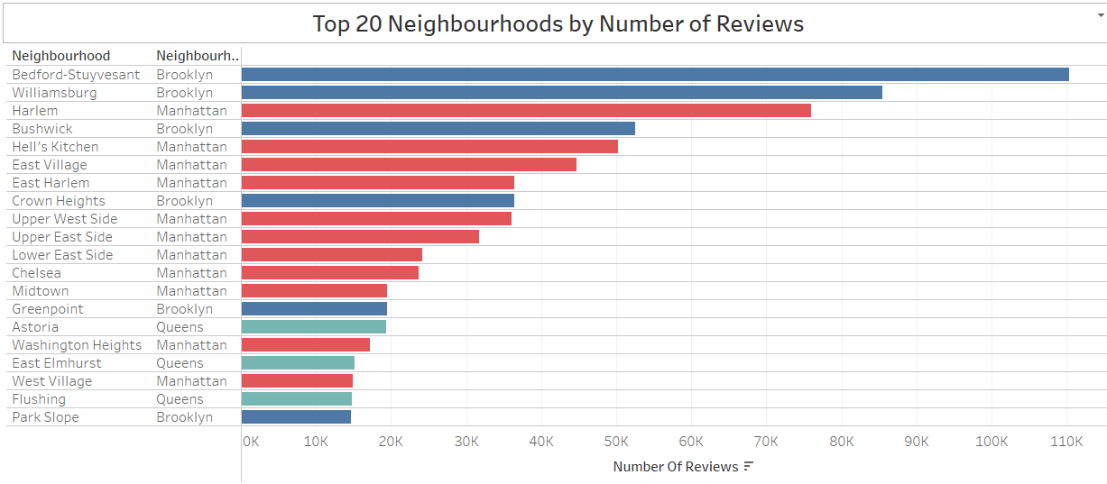
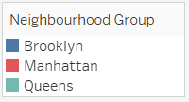
Most popular localities and properties in New York currently
Popular Neighborhoods: Bedford-Stuyvesant, Williamsburg, Harlem, Bushwick, Hell’s Kitchen
Popular Neighborhoods Groups: Brooklyn, Manhattan
Top Properties: Room near JFK Queen Bed, Great Bedroom in Manhattan, Beautiful Bedroom in Manhattan
Name Top 20 Properties in New York by number of reviews
Rank | name | neighbourhood_group | neighbourhood
1 | Room near JFK Queen Bed | Queens | Jamaica
2 | Great Bedroom in Manhattan | Manhattan | Harlem
3 | Beautiful Bedroom in Manhattan | Manhattan | Harlem
4 | Private Bedroom in Manhattan | Manhattan | Harlem
5 | Room Near JFK Twin Beds | Queens | Jamaica
6 | Steps away from Laguardia airport | Queens | East Elmhurst
7 | Manhattan Lux Loft.Like.Love.Lots.Look ! | Manhattan | Lower East Side
8 | Cozy Room Family Home LGA Airport NO CLEANING FEE | Queens | East Elmhurst
9 | Private brownstone studio Brooklyn | Brooklyn | Park Slope
10 | LG Private Room/Family Friendly | Brooklyn | Bushwick
11 | My Little Guest Room in Flushing | Queens | Flushing
12 | Park Slope Green Guest House | Brooklyn | South Slope
13 | Bright LARGE BED near Manhattan | Queens | East Elmhurst
14 | Only Steps away from LaGuardia arpt | Queens | East Elmhurst
15 | PRIVATE Room on Historic Sugar Hill | Manhattan | Harlem
16 | yahmanscrashpads | Queens | Jamaica
17 | Cozy Room in Lively East Village | Manhattan | East Village
18 | Room steps away from LaGuardia airport | Queens | East Elmhurst
19 | TriBeCa 2500 Sq Ft w/ Priv Elevator | Manhattan | Tribeca

Slide 12
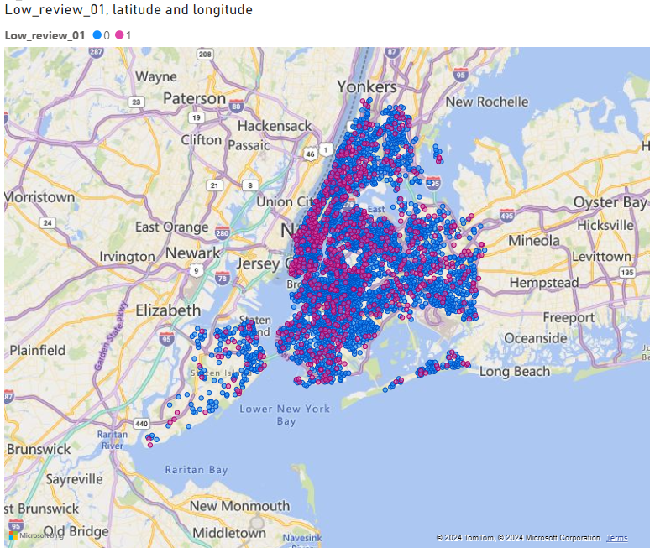
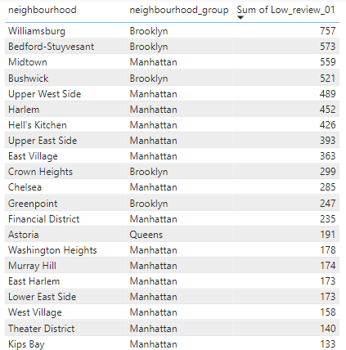
Unpopular Properties
Sorted Unpopular Properties with No Review
Total Number of unpopular properties 10050
Localities with higher number of low review properties: Manhattan
Unpopular Properties Location
Unpopular Properties
Top 20 Unpopular Properties
Sr.No. | Neighbourhood Group | Total Number of Listings | Low Review Listings | % of Low Review
1 | Manhattan | 21661 | 5029 | 23.2
2 | Brooklyn | 20104 | 3657 | 18.2
3 | Queens | 5666 | 1092 | 19.3
4 | Bronx | 1091 | 215 | 19.7
5 | Staten Island | 373 | 59 | 15.8
Total |  | 48895 | 10052 | Avg. 20.6

Slide 13
How to get unpopular properties more traction?
Identify and Add Popular Amenities: Through reviews and customer preference data, identify essential amenities missing in these listings (like Wi-Fi, workspace, or basic kitchen items) and suggest that hosts consider these upgrades.
Targeted Marketing Campaigns: Market these listings on Airbnb’s social media channels, emphasizing their unique aspects (e.g., historic buildings, cozy spaces, scenic views
Flexible Cancellation Policies: Properties with flexible cancellation options often attract more bookings; encourage hosts of unpopular properties to adopt this option if feasible.
Use Guest Feedback for Targeted Improvements & Encourage Reviews for Recent Guests

Slide 14
Clustered maps showing demand hotspots.

Slide 15
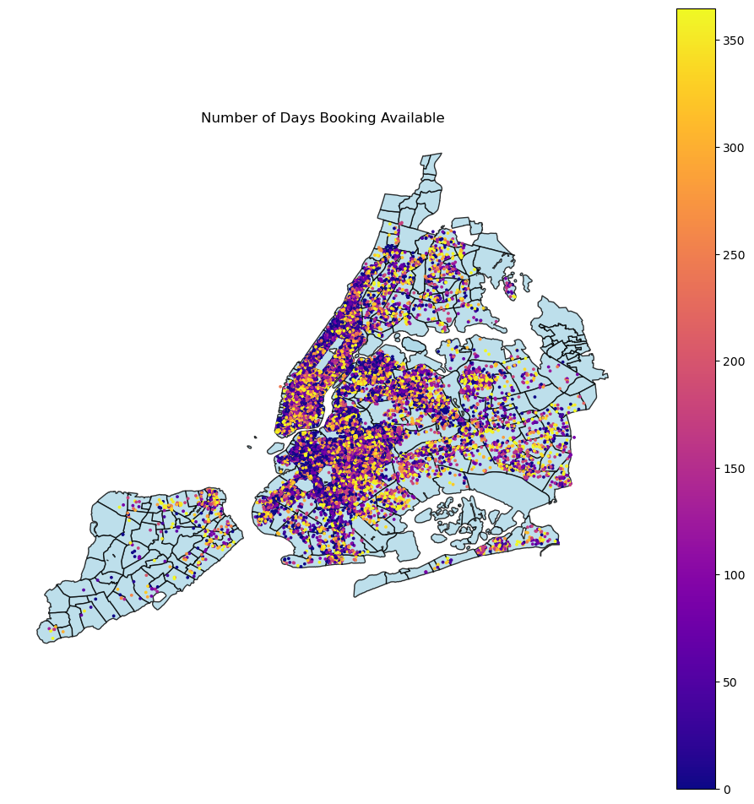

Slide 16
APPENDIX
Assumptions:

