Slide 1

Airbnb NYC Case Study
Presented By:
Ajinkya Bandri, Barbie Choudhari, Sagar Barge

Slide 2
AGENDA
Objective
Background
Data Cleaning
Key Insights
Appendix

Slide 3
OBJECTIVE
Which type of hosts to acquire more and where?
The categorization of customers based on their preferences.
What are the neighborhoods they need to target?
What is the pricing ranges preferred by customers?
The various kinds of properties that exist w.r.t. customer preferences.
Adjustments in the existing properties to make it more customer-oriented.
What are the most popular localities and properties in New York currently?
How to get unpopular properties more traction?

Slide 4
BACKGROUND
Past few months, Airbnb has seen a major decline in revenue.
Now that the restrictions have started lifting and people have started to travel more, Airbnb wants to make sure that it is fully prepared for this change.
The different leaders at Airbnb want to understand some important insights based on various attributes in the dataset so as to increase the revenue.

Slide 5
DATA CLEANING

Slide 6
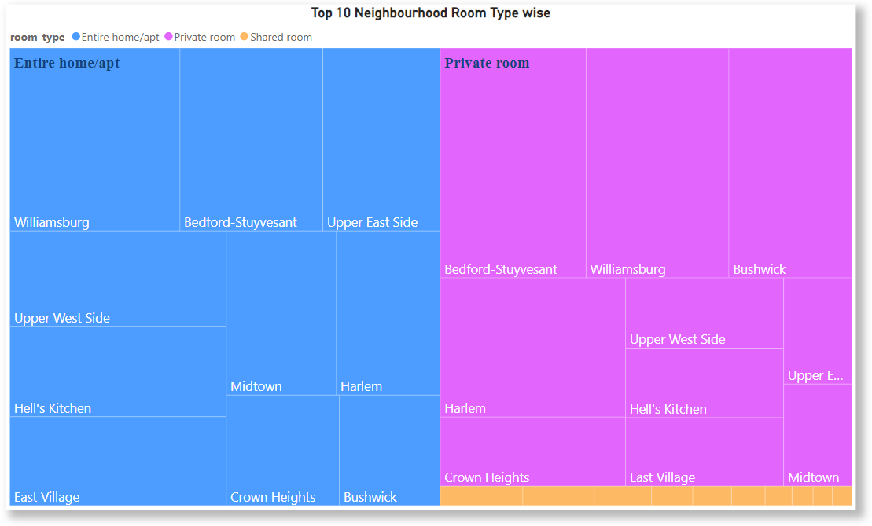
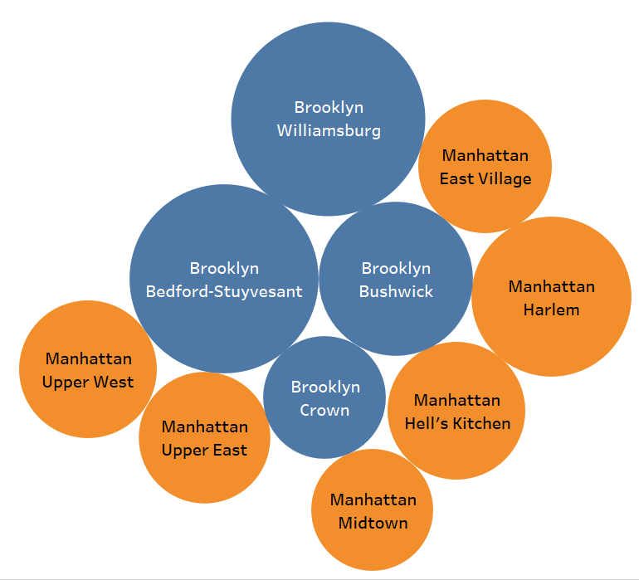
Type of Host to Acquire More and Where?
Top 10 Neighborhood

Slide 7
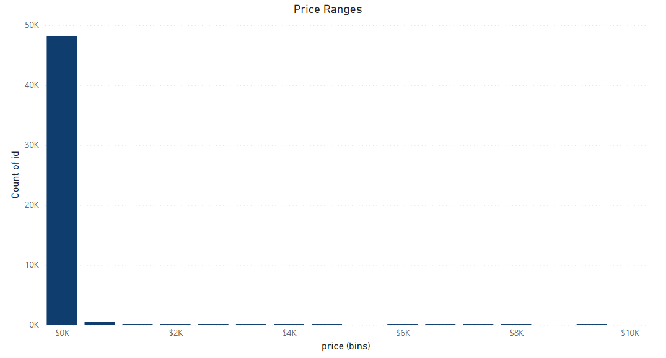
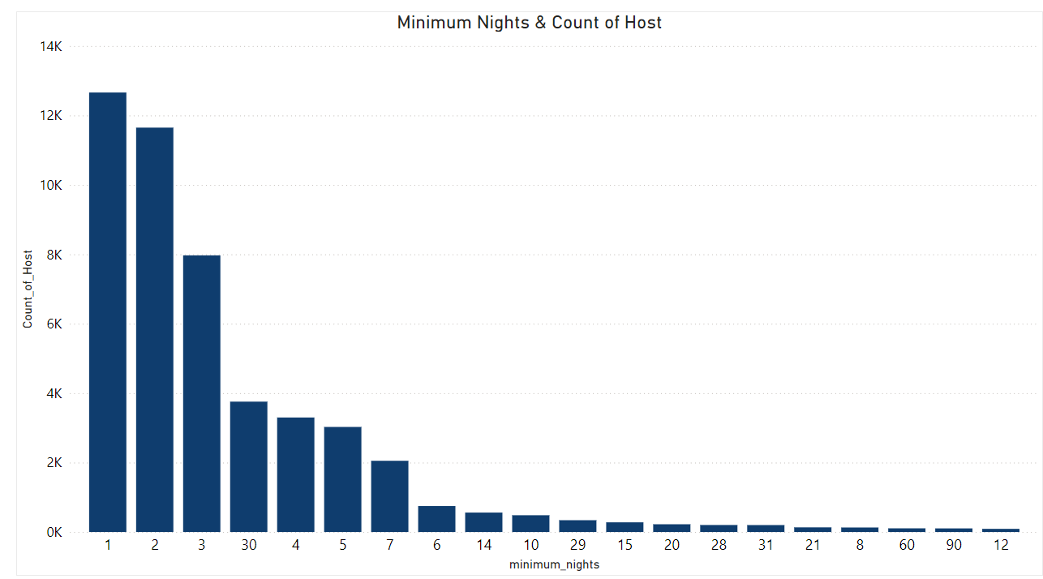
The categorization of customers based on their preferences

Slide 8
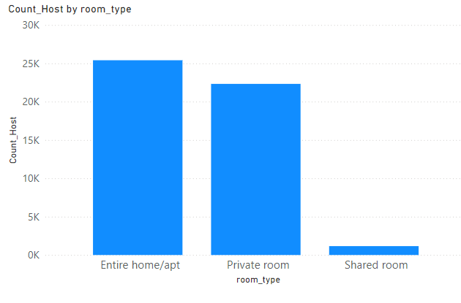
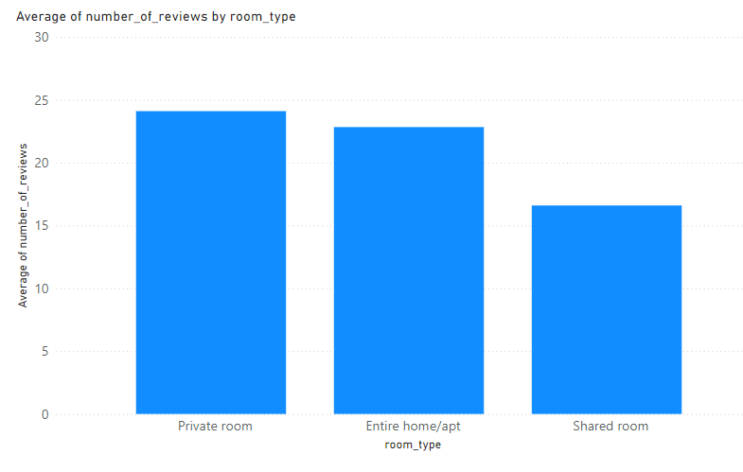
The various kinds of properties that exist w.r.t. customer preferences

Slide 9
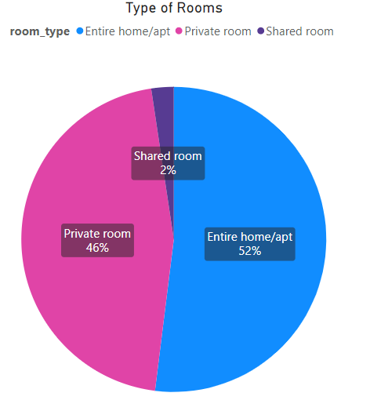
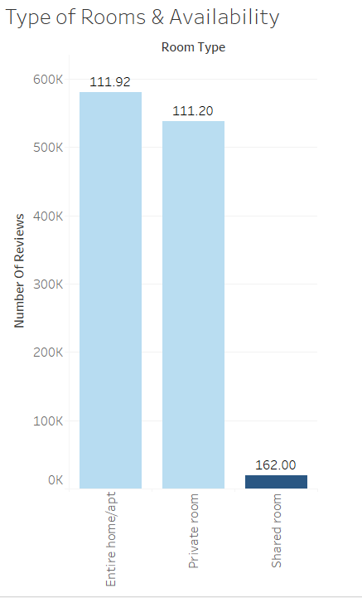

Adjustments in the existing properties to make it more customer-oriented
For Adjustment in existing properties in NewYork city for more customer oriented.
Average Room Availability

Slide 10
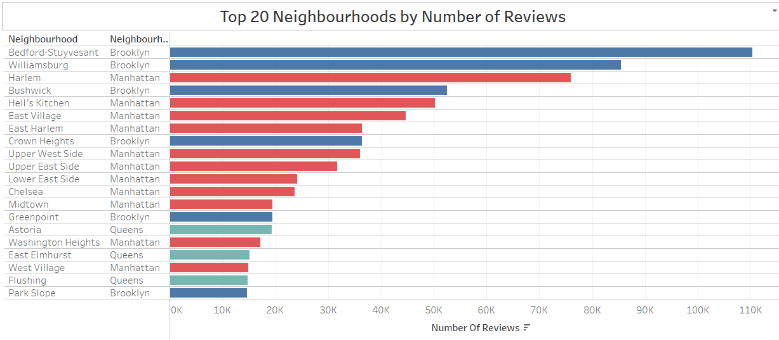
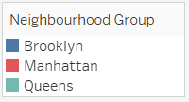
What are the most popular localities and properties in New York currently
Top 10 Properties in New York by number of reviews
name | neighbourhood_group | neighbourhood
Room near JFK Queen Bed | Queens | Jamaica
Great Bedroom in Manhattan | Manhattan | Harlem
Beautiful Bedroom in Manhattan | Manhattan | Harlem
Private Bedroom in Manhattan | Manhattan | Harlem
Room Near JFK Twin Beds | Queens | Jamaica
Steps away from Laguardia airport | Queens | East Elmhurst
Manhattan Lux Loft.Like.Love.Lots.Look ! | Manhattan | Lower East Side
Cozy Room Family Home LGA Airport NO CLEANING FEE | Queens | East Elmhurst
Private brownstone studio Brooklyn | Brooklyn | Park Slope
LG Private Room/Family Friendly | Brooklyn | Bushwick

Slide 11
Key Visuals:
Clustered maps showing demand hotspots.
Charts showing the distribution of listings across host types.
Price sensitivity and preference visualizations for targeted pricing strategies.

Slide 12
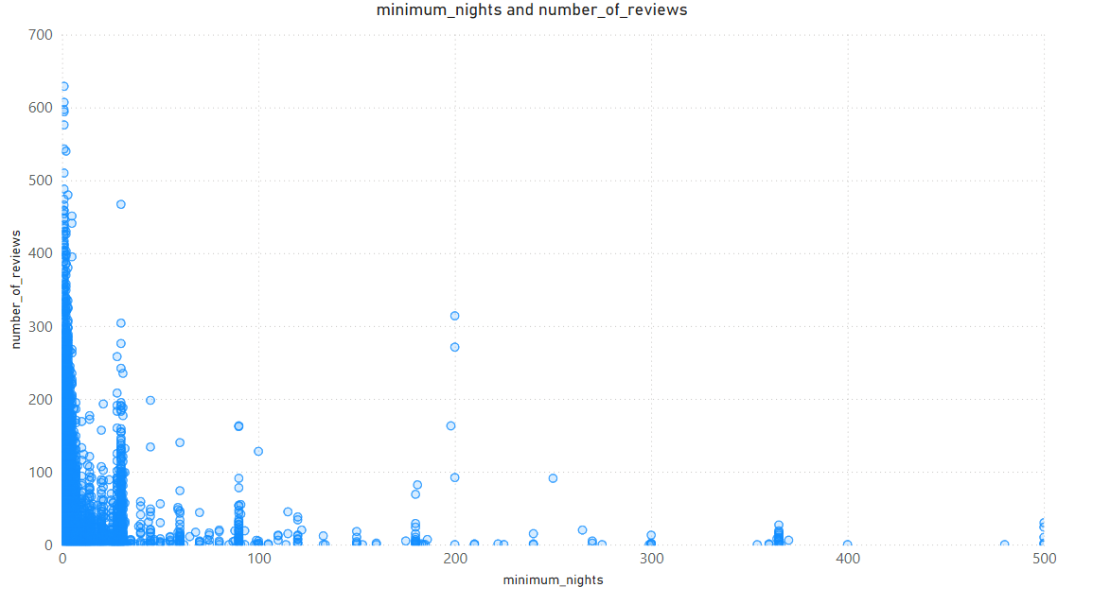

Slide 13
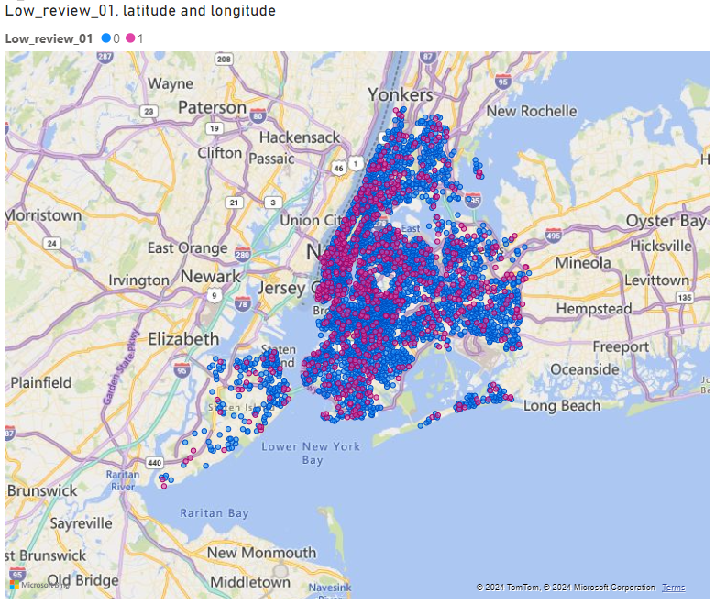
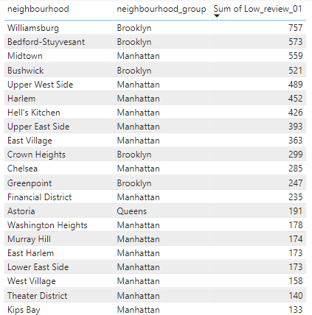
Unpopular Properties with No Review
Top 20 Unpopular Properties

Slide 14
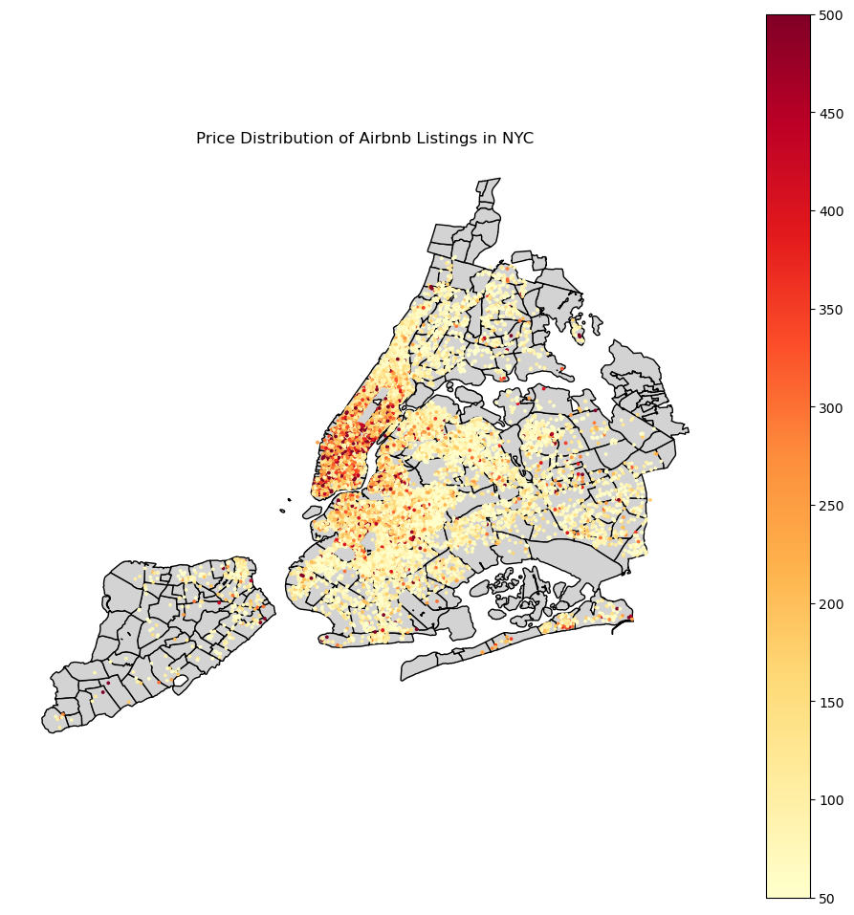
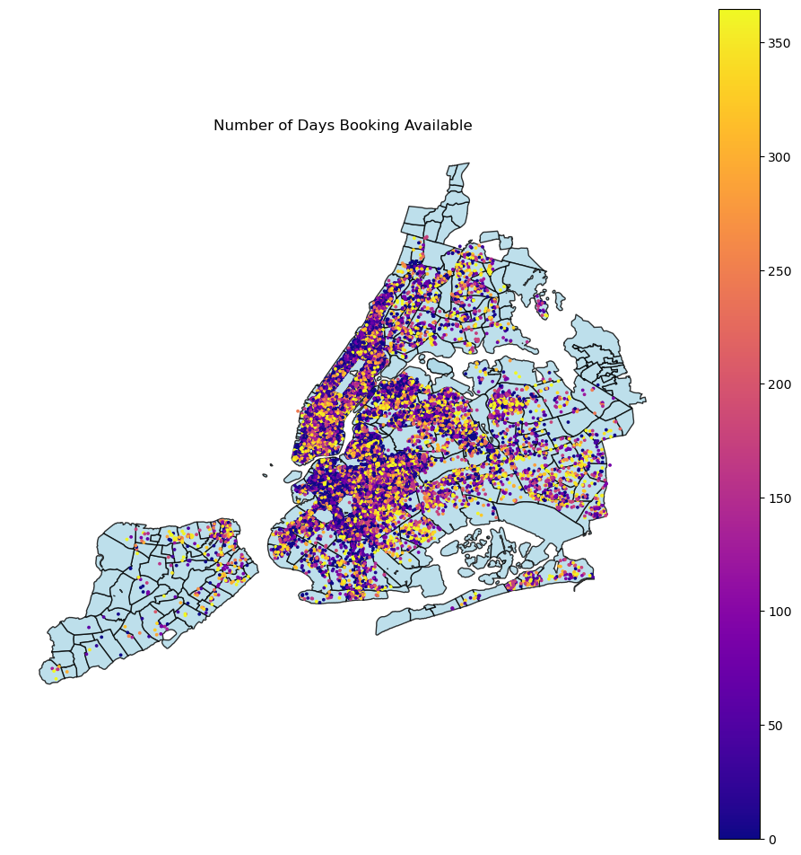

Slide 15
APPENDIX

