Slide 1
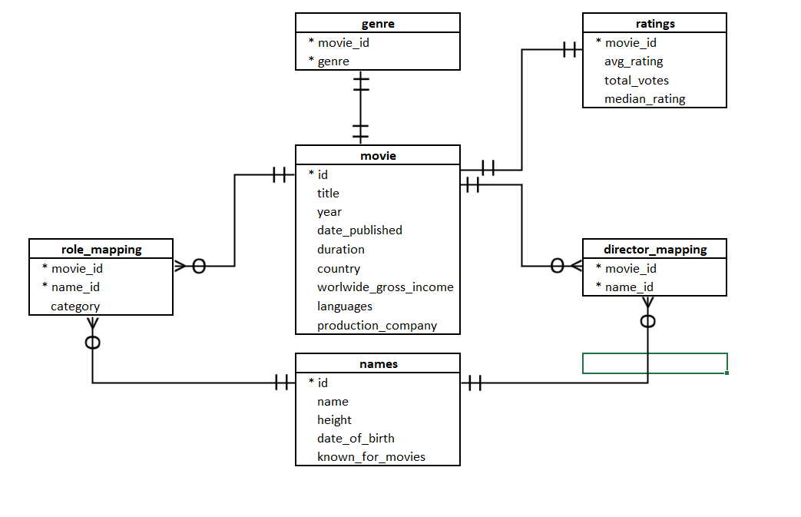







Adding Sequence
Steps:
Add table column with PK
Add .csv data using import vizard
Alter table & add FK
Getting Error

