Slide 1

Optimizing Insights:
OList Marketing and Retail Analytics
By:
Ajinkya Bandri, Barbiee Choudhary & Sagar Barge

Slide 2
Agenda
Background
Objective
Data Cleaning
Key Insights
Appendix
Conclusion
Recommendation
3
4
5
6-12
13
14
15

Slide 3
Background
Olist is an emerging e-commerce company, which is facing some heavy losses due to its inefficient inventory management system and costly products in their inventory
To overcome the above losses, they want to manage their inventory and reduce the unnecessary losses without affecting its operations
To meet the customers demand they are analyzing their Market Basket and determining the best-selling products and top revenue generating products
Also, they want to understand the Customers purchase behavior pattern to reduce the inefficiency in the inventory management system and to avoid future losses of the company

Slide 4
Objective
To identify the top revenue generating products which contributes to the top product category using Pareto Analysis
To better understand the analysis of Purchase Behavior of the customers with the help of Market Basket Analysis
Also, to understand which products are most likely or preferred by the customers while purchasing individually along with some of the other combination product which customers tends to purchase very often

Slide 5
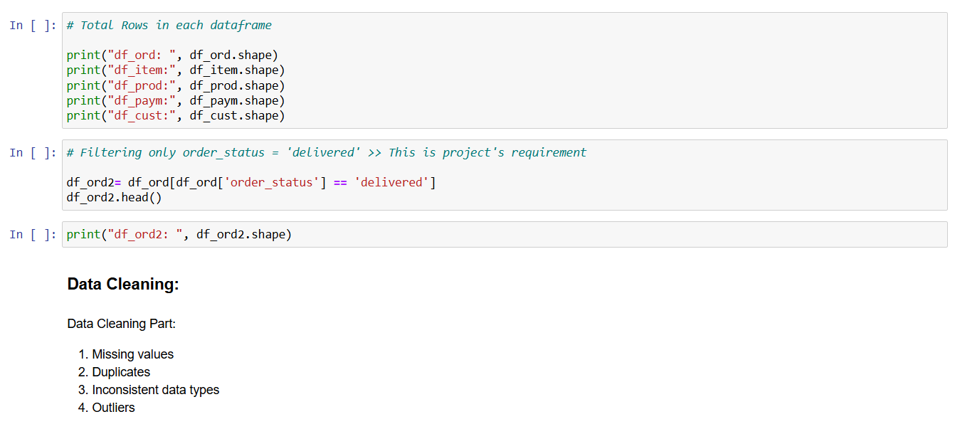
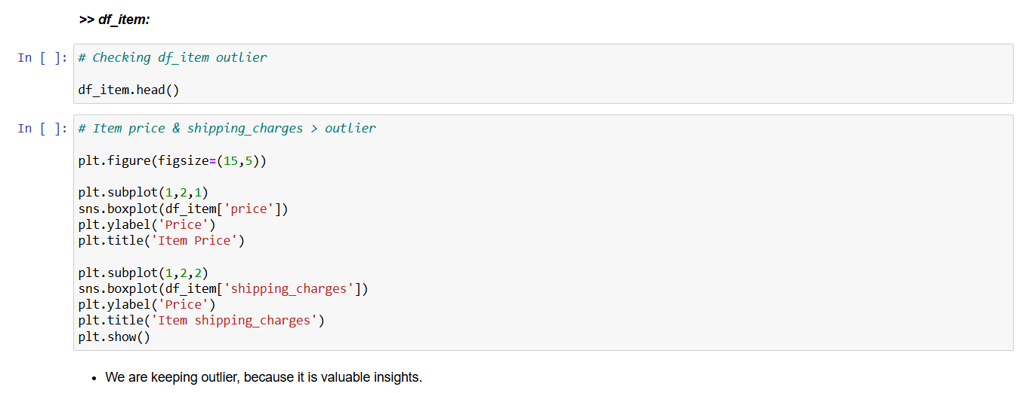
Data Cleaning and Data Preparation
With the help of python missing value imputed by mean, median
Also, outlier identified using boxplot and treated using capping
Handling of inconsistent data types and duplicates

Slide 6
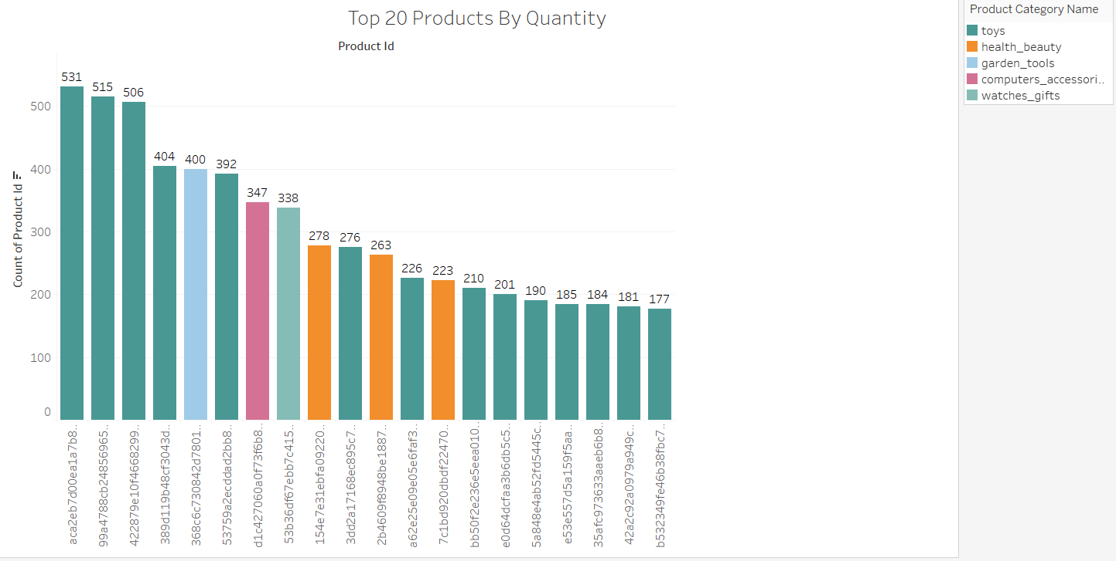
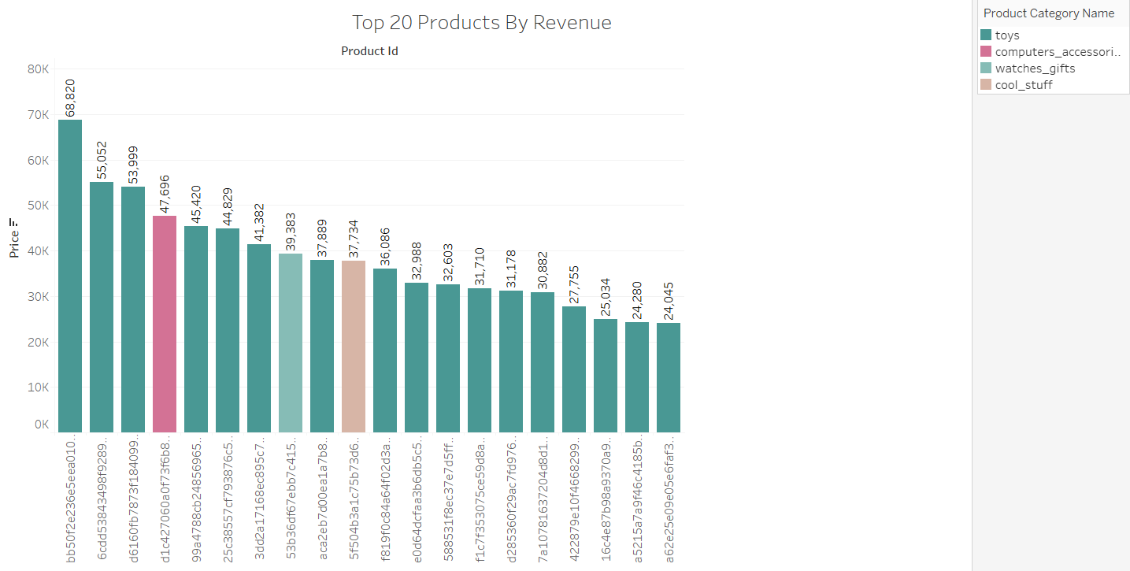
Key Insights
After analyzing the data, we found out that top 20 products sold are comprises of 5 categories which are Toys, Health beauty, Garden tools, Computer accessories, watches gifts, etc.
Also, the category is observed in the top 20 products sold by revenue are Toys, Computer accessories, Watches gifts, cool stuff, etc.

Slide 7
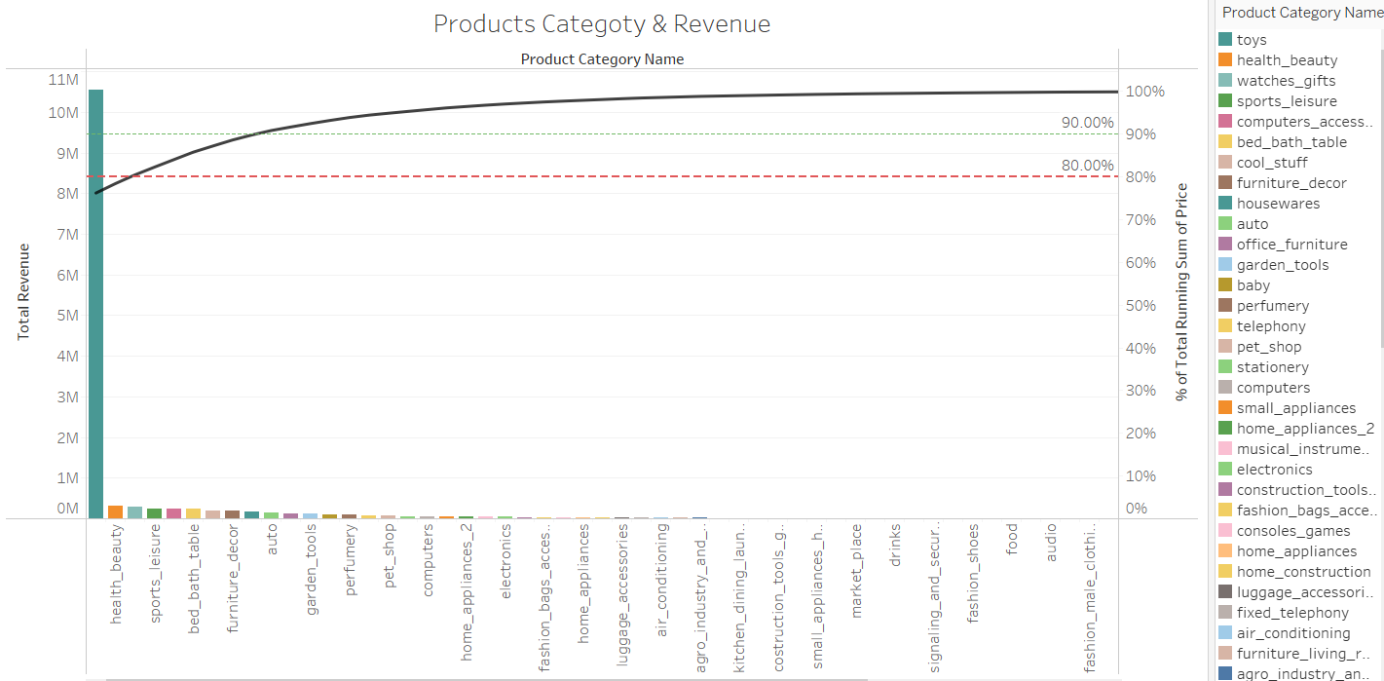
Key Insights
Upon analyzing the product categories and the corresponding graph, we observed that the Toys category accounts for the majority of products across the range
This is followed by Health & Beauty and Watches & Gifts
Additionally, the graph highlights that the Toys category alone contributes 76% of the total revenue generated through sales.

Slide 8
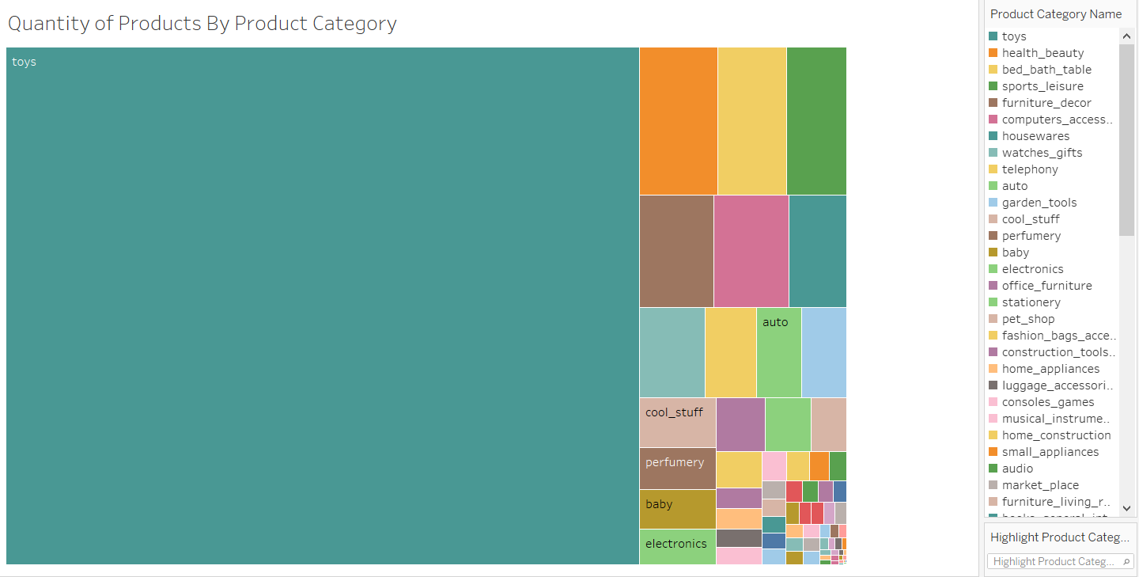
Key Insights
Analyzing the quantity of products by category, we observe that Toys have the highest sales volume However, upon further breakdown, we notice shifts in product trends, with categories such as Health & Beauty, Bed & Bath, Sports & Leisure, and Furniture & Décor also contributing significantly to sales

Slide 9
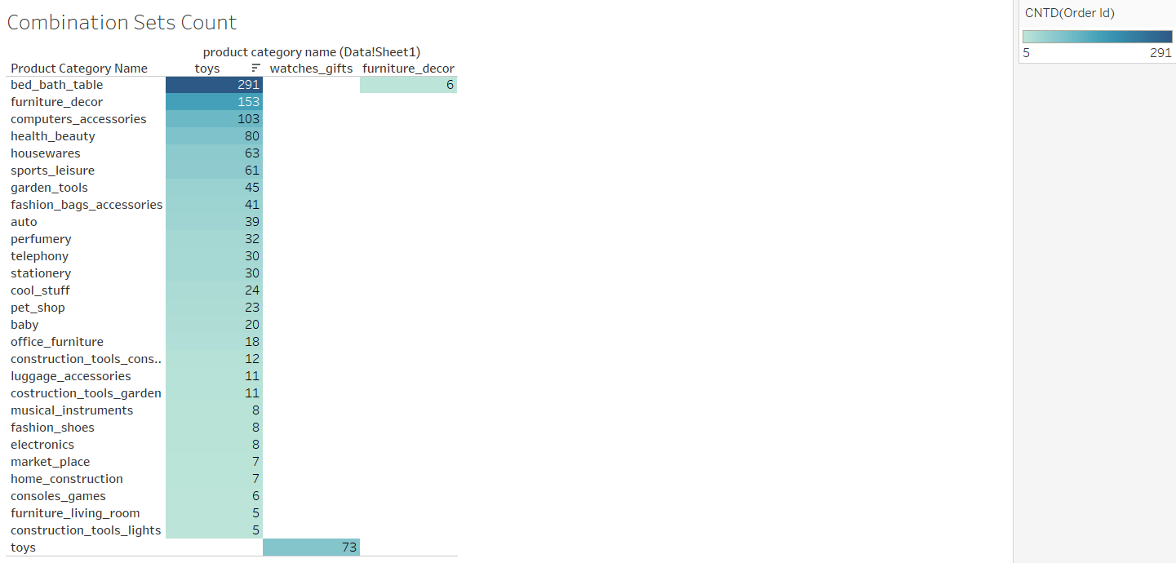
Key Insights
After analyzing the data, we identified specific product combinations that are frequently ordered within the same category
Notably, the Toys category often appears in combination with Bed & Bath, Furniture & Décor, and Computer Accessories

Slide 10
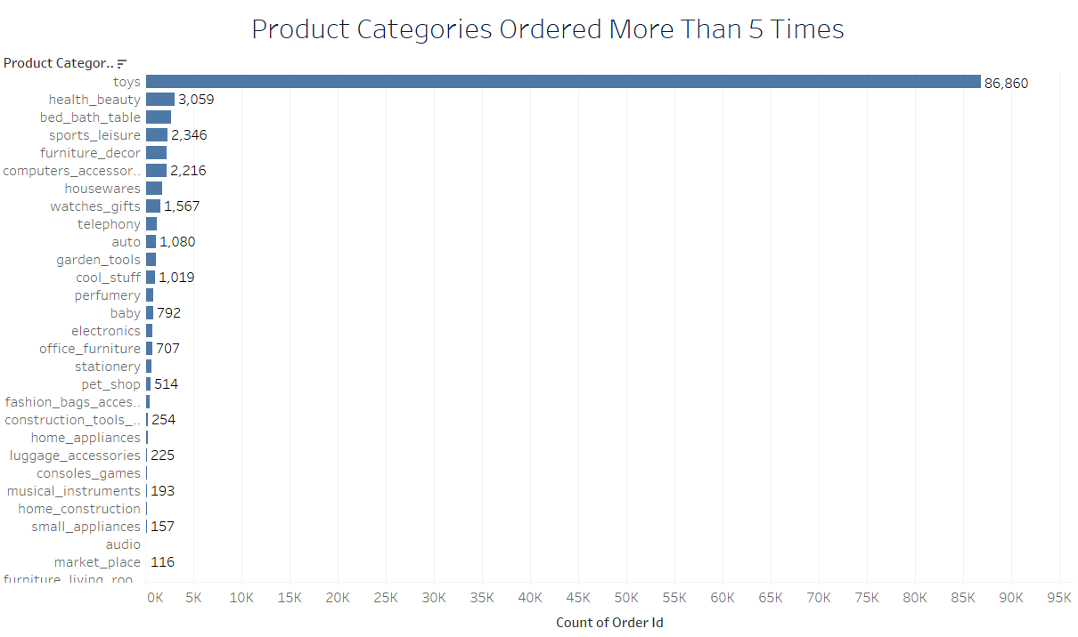
Key Insights
Additionally, we found that the Toys category has the highest number of orders where products were purchased more than five times, totaling 86,860 orders
This is followed by Health & Beauty, Bed & Bath, and other categories

Slide 11
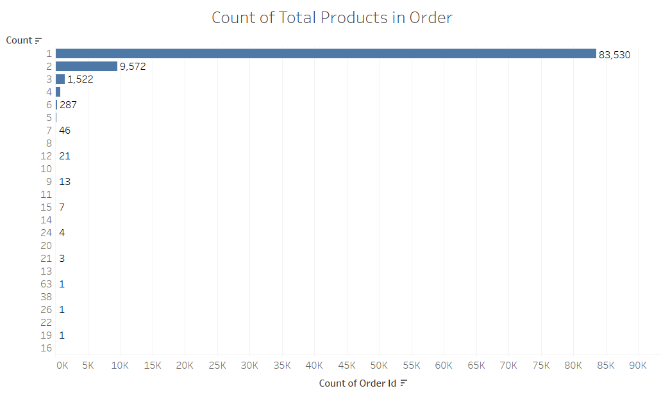
Key Insights
We analyzed the number of products ordered per transaction and found that orders containing a single product have the highest count, totaling 83,530
Similarly, orders with two products amount to 9,572, followed by orders with three products, which total 1,522

Slide 12
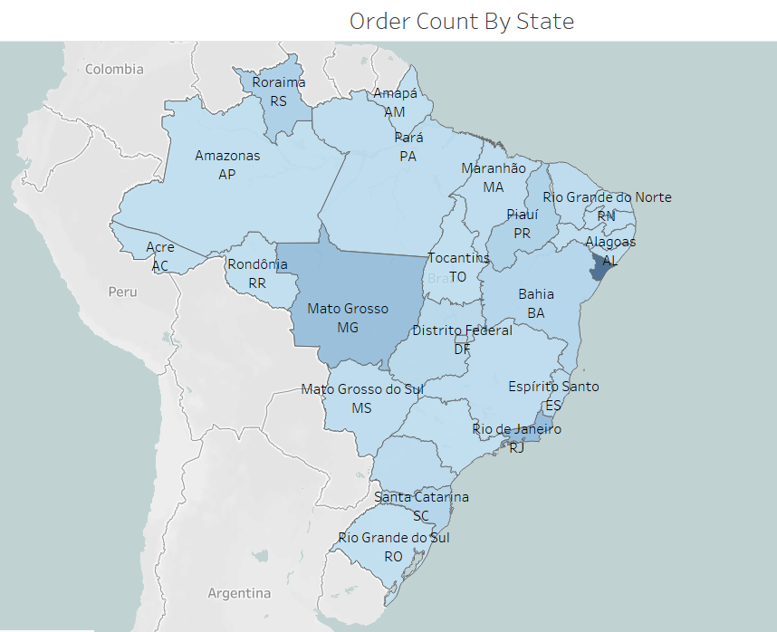
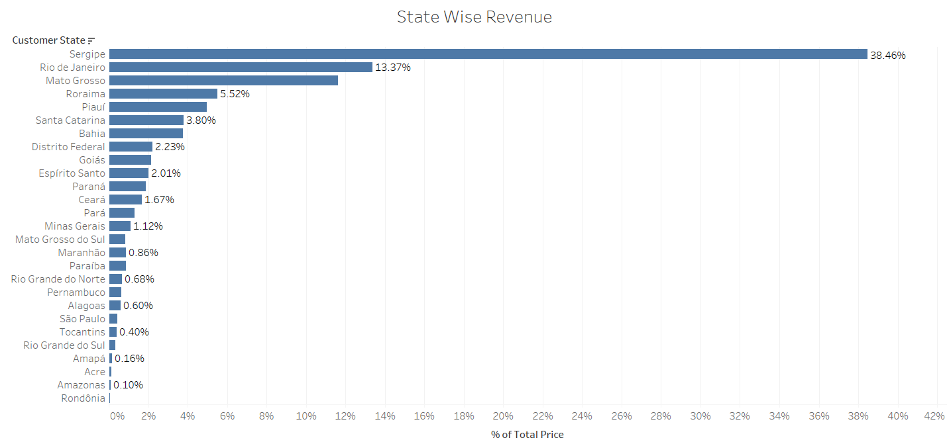
Key Insights
Upon analyzing the data by state, we found that Amazonas and Rondonia contribute the least in terms of revenue and order volume
Additionally, a closer look at the adjacent images reveals that 51% of the revenue comes from Sergipe and Rio de Janeiro

Slide 13
Conclusion
Efficient Inventory management is a crucial for the making any e-commerce company profitable, and given Olist approach to do the analysis of the sales data is a very sound strategy
Analyzing the sales data with help of Pareto Analysis will deliver us the requisite results any loss-making organization wants
Analyzing top 20% of the products which accounts for 80% of the revenue generation of the organization
After implementing the data driven inventory management strategies, businesses like Olist can improve their profitability margin by reducing cost on inventory, and enhance their overall customer experience

Slide 14
Recommendations
Consider reducing the number of infrequent products in the top selling category to optimize inventory management
Develop the target-based strategy for most selling products to increase the sales of the products
Develop some promotional campaign to highlight the infrequent selling product and offer some promotional discounts on the product to increase sales in that segment

Slide 15
Appendix
Data Source:
OList data: https://learn.upgrad.com/course/5701/segment/59386/358088/1079504/5388059
Geospatial data/shapefile of Brazil States: https://purl.stanford.edu/ys298mq8577
Methodology:
Data Acquisition
Understanding Problem, objective, data
Data Cleaning using Jupyter Notebook – Pandas, Numpy Library
Data Analysis using Python- Matplotlib, Seaborn, Tableau, Power BI, Excel
Visualization of data - Market Basket Analysis was conducted in Tableau
Insights
Recommendation
Assumptions:
Only the cases having order status as ‘delivered’ are considered.
We assume that company does not want to expand to new warehouses.

Slide 16
Thank You!

