Slide 1

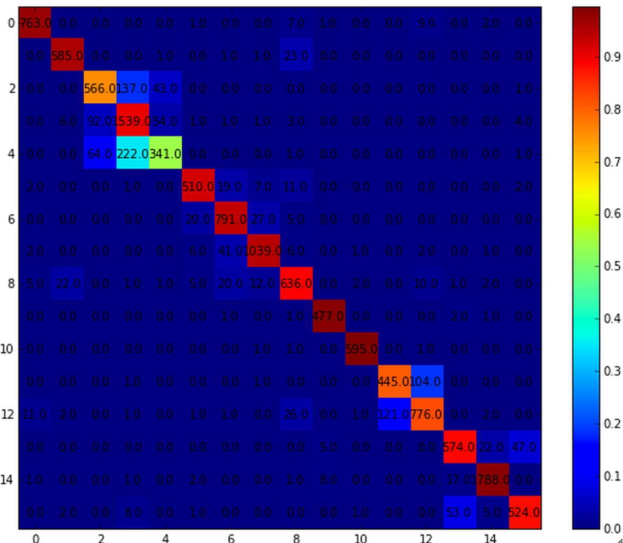
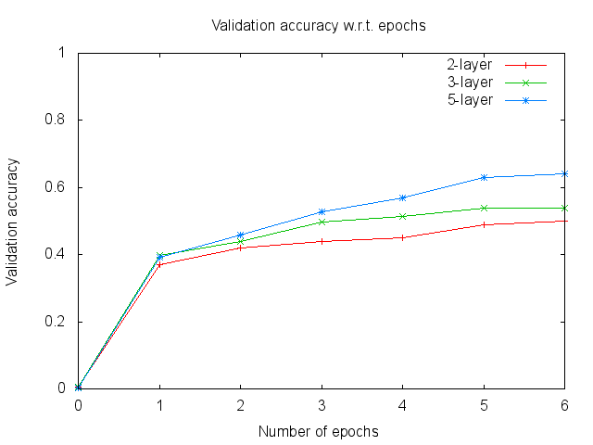
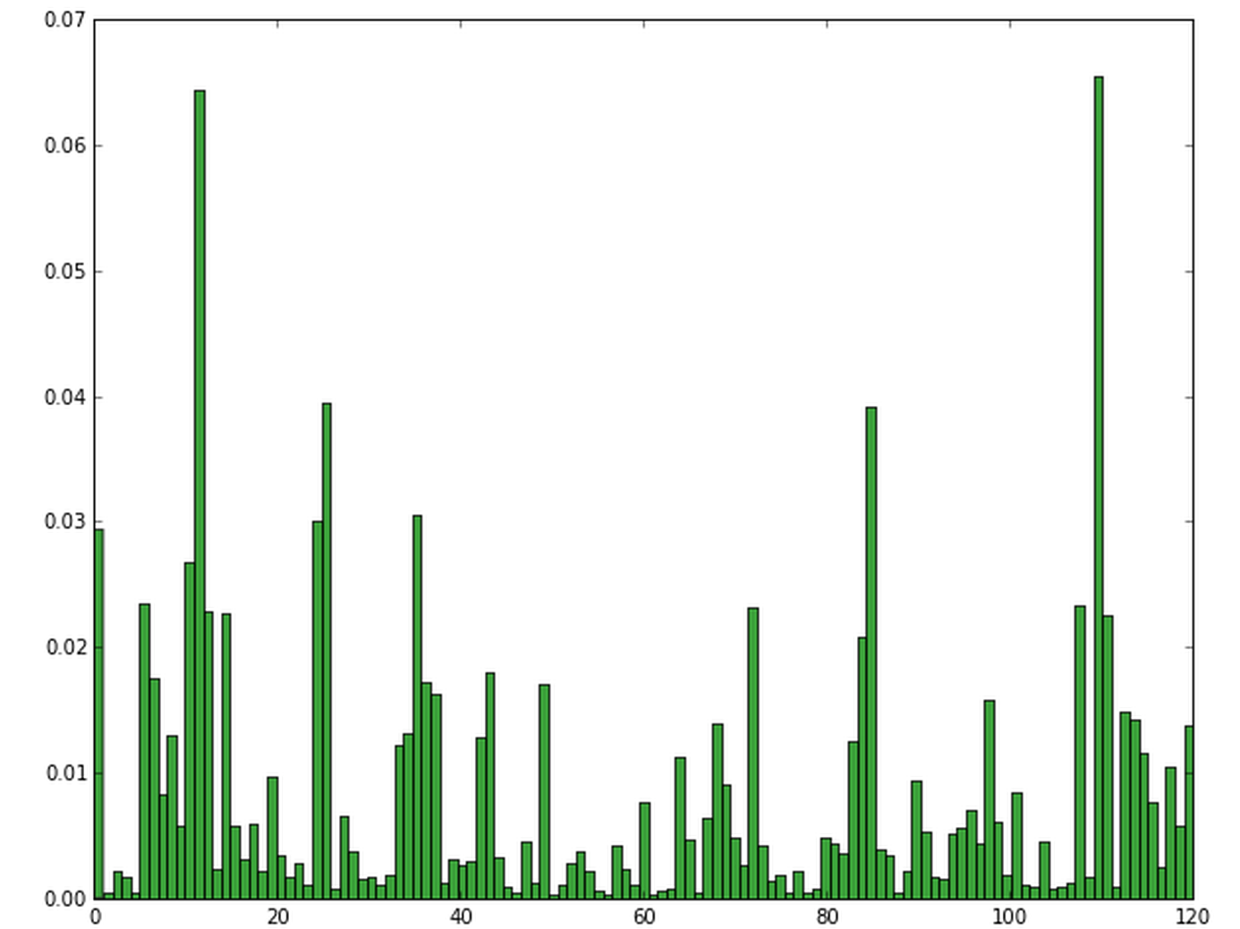
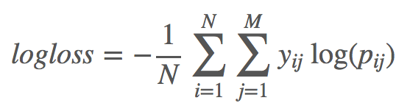
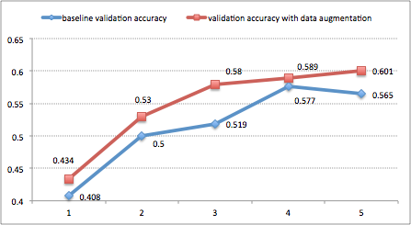
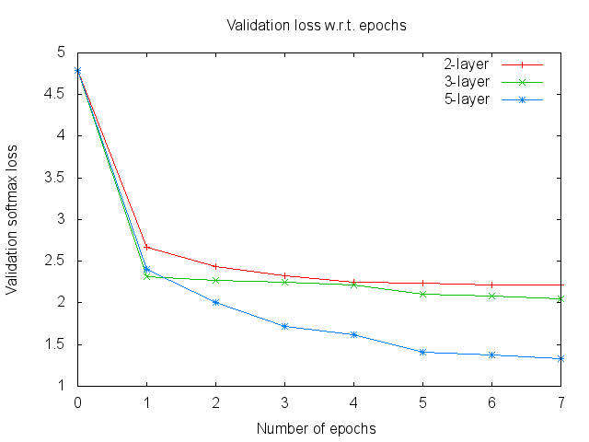
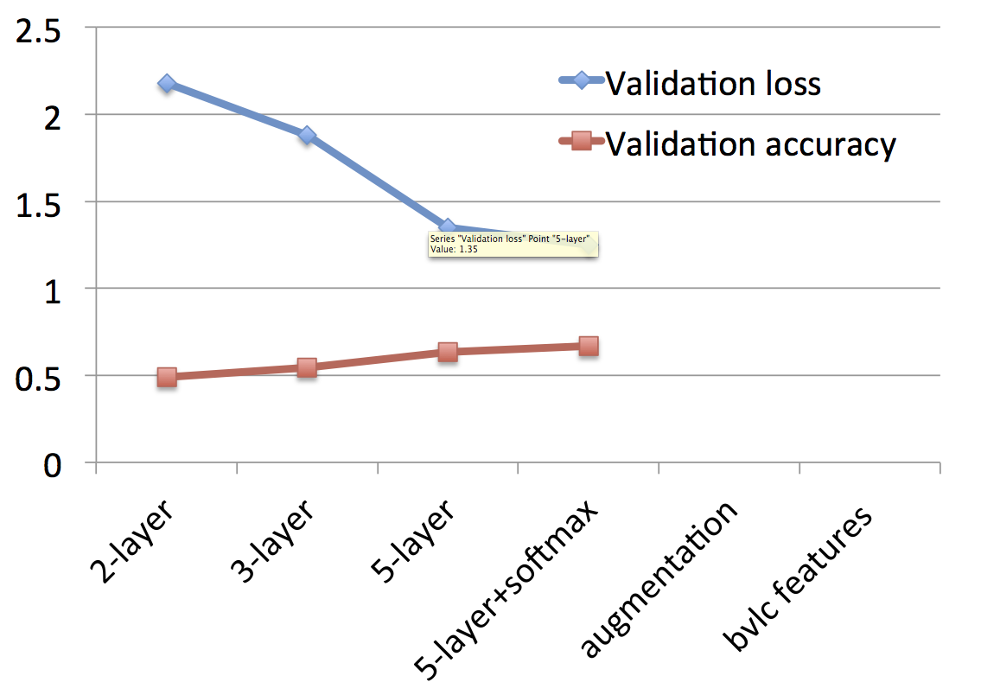
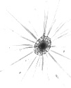


Plankton Classification using Convolutional Neural Networks
Sagar Chordia (sagarc14), Romil Verma (vermar)
CS 231N Project Winter 2015
Stanford University
Introduction
Approaches
[below] Valid_accuracy vs Epochs for approaches
Classifying an image manually by extracting features per class is infeasible. Convolutional Neural Networks automatically learn features from labelled dataset and have demonstrated high results. This poster attempts to improve classification of different types of Plankton populations in Oceans as part of National Data Science Bowl presented by kaggle.com
Train ConvNet and apply hyper-parameter fine tuning and data augmentation
Extract features (last relu activations) from trained net and train Softmax classifier on top of it. [Improves performance]
Extract similar features from other ConvNets such as AlexNet and train Softmax classifier on concatenated features from all ConvNets [curently no helping]
Dataset
Given 30,458 labelled images of 121 classes of plankton as part of training set.
The images have inconsistent pixel dimension
The images are in grayscale but for transfer learning we use equal valued RGB channels.
Performance Metric
[below] correlation between 15 plankton classes with most training images, given prediction (x-axis) and true label (y-axis)
Classes like chaetognath_sagitta and chaetognath_non_sagitta are highly correlated and misclassify consistently
The competition evaluates using multi-class classification loss using predicted probabilities for each class given an image
[below] augmenting train set with rotation of 50% of images gives 3% improvement on validation set per epoch
Challenges
Given N images and M classes, p_ij is predicted probability that observation i belongs to class j and y_ij is 1 if observation i is in class j else 0
Preliminary results are based on both validation accuracy and validation loss
Images are of different dimensions and hence were resized uniformly resulting in precision loss
Number of images per class is non-uniform causing overfitting for some classes
Features extracted from pre-trained architectures are very sparse because of grayscale and low quality images
Results and Analysis
Future Work
[below] Validation loss vs Epochs for approaches
[below] Accuracy and loss across different methods
PCA on extracted features
High capacity neural net, more epochs for training
Model Ensembles
k-fold Cross Validation
More data augmentation techniques
[above] distribution of images per class;
[below] sample image for 3 classes of plankton
References
https://www.kaggle.com/c/datasciencebowl
Krizhevsky, A., Sutskever, I., and Hinton, G. E. ImageNet clas- sification with deep convolutional neural networks. In NIPS, 2012.

