Slide 1
Librivox Audiobook
Presented By
Name: Sagar Pd Chaulagain Name: Srijana Shah CRN: 021-395 CRN: 021-384

Slide 2
Table of contents
01
03
05
02
04
06
INTRODUCTION
PROPOSED SYS
OBJECTIVES
You can describe the topic of the section here
You can describe the topic of the section here
You can describe the topic of the section here
EXISTING SYS
AIM
H&S REQ
You can describe the topic of the section here
You can describe the topic of the section here
You can describe the topic of the section here

Slide 3
Table of contents(Continued)
07
08
09
10
System Design
Advantages
Conclusion
References

Slide 4

INTRODUCTION
The "Librivox Audiobook" application is a free and open-source mobile app.
Provides access to over 19,000 free audiobooks via the Librivox API.
Developed using Flutter and Dart, powered by Firebase.
Offers an intuitive, feature-rich experience for audiobook enthusiasts.
Users can browse popular and latest audiobooks.
Features include playlist creation, offline downloads, and customizable playback.
1

Slide 5
EXISTING SYSTEM
Current systems for accessing audiobooks are paid.
Users rely on various websites and apps, many with ads and limited features.
Manual searching and limited offline capabilities are common drawbacks.
2

Slide 6
PROPOSED SYSTEM
Provide access to a vast library of audiobooks.
Offers a free, ad-free experience.
Integrates advanced features: offline downloads, playback customization, wishlist creation, playlist creation, and community sharing.
3

Slide 7
AIM
Create a comprehensive, user-friendly mobile application.
Provide free and open access to a large collection of audiobooks.
Enhance the user's listening experience with advanced features and customization options.
4

Slide 8
OBJECTIVES
Integrate Librivox API for access to a large collection of audiobooks.
Develop a seamless user interface using Flutter.
Implement advanced playback features like speed adjustment and silence skipping.
Allow users to download audiobooks for offline listening.
Enable playlist creation and sharing.
Provide robust user authentication and data management with Firebase.
Sync user’s details across all the devices seamlessly
5

Slide 9
HARDWARE AND SOFTWARE REQUIREMENTS
Hardware:
Smartphone or Tablet: Compatible with iOS or Android.
Internet Connection: Required for streaming and downloading audiobooks.
Software:
IOS 11.0 or later or Android 5.0 or later
AppStore or Google Play Services to download and use app
6

Slide 10
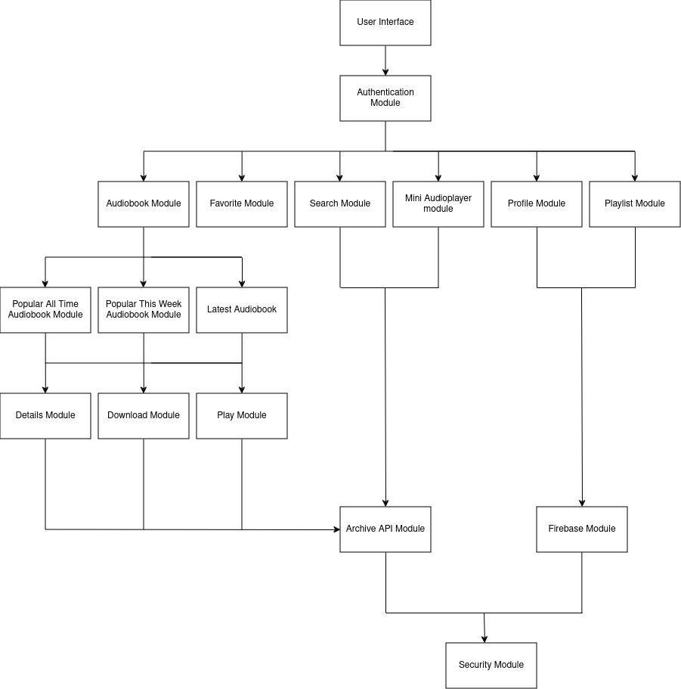
SYSTEM DESIGN
7

Slide 11
ADVANTAGES
Ad-Free Experience: Uninterrupted access to audiobooks without ads.
Offline Access: Download and listen to audiobooks offline.
Customizable Playback: Advanced audio controls for speed, pitch, and silence skipping.
Community Engagement: Create and share playlists.
Scalability: Modular design ensures easy maintenance and scalability.
8

Slide 12
CONCLUSION
The "Librivox Audiobook" app aims to provide access to thousands of audiobooks and enjoyment.
Provides an ad-free, feature-rich mobile application.
Benefits form modern mobile development frameworks and open-source technologies.
Democratizes access to literature and sets a new standard for user experience in audiobook applications.
9

Slide 13
REFERENCES
[1] "reading" The public domain: Narrating and listening to Librivox Audiobooks, Johns Hopkins University Press.
[2] A.Chesley, “A brief history of crowdsourced digital publishing at LibriVox.org,” vol. 1, 2017.
[3] D. W.Kinstch, Accessibility of Audiobooks for Individuals with Visual Impairments, vol. 52, 2017, pp. 345-360.
[4] M. Jones, The Convenience of Audiobooks, vol. 5, 2018, pp. 102-114
10

Slide 14
THANK YOU

