Slide 1
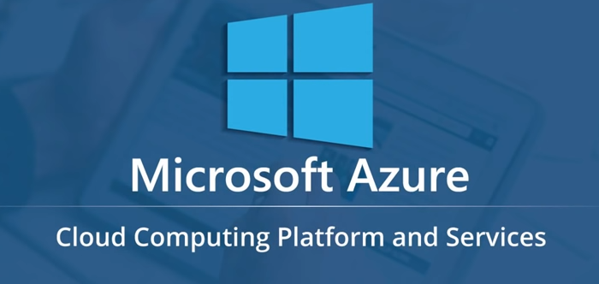
Unrestricted

Slide 2
Agenda
What is cloud computing?
What is Microsoft Azure?
Azure Services
Azure Management Portal
Azure Job Trends

Slide 3
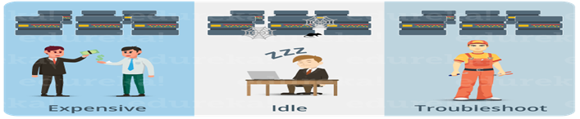
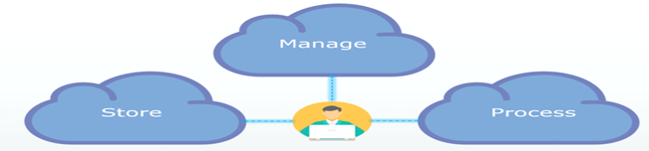
Cloud Computing
Why Cloud?
What is Cloud Computing?

Slide 4
Categories in cloud computing
SaaS (Software as a Service)
It allows companies to use software without purchasing them, which reduces the expenditure of the company drastically, since they are already installed on the cloud servers they can be quickly deployed and therefore saves time.
PaaS (Platform as a Service)
It allows developers to build applications, collaborate on projects without having to purchase or maintain infrastructure.
IaaS (Infrastructure as a Service)
It allows companies to rent servers, storage space, etc. from a cloud provider.

Slide 5
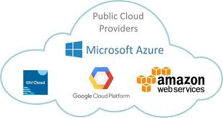
Cloud Provider

Slide 6
What is Microsoft Azure
Microsoft Azure is a cloud computing platform created by Microsoft which developers and IT professionals use to build, deploy and manage applications through their global network of datacenters.
Microsoft Azure Services:
Compute It is used to process data on the cloud by making use of powerful processors which serve multiple instances at a time.
Storage Services The storage as the name suggests, is used to store data in the cloud with the ability to scale as and when required. This data can be stored anywhere.
Database The database domain is used to provide reliable relational and non relational database instances managed by Azure.
Networking

Slide 7
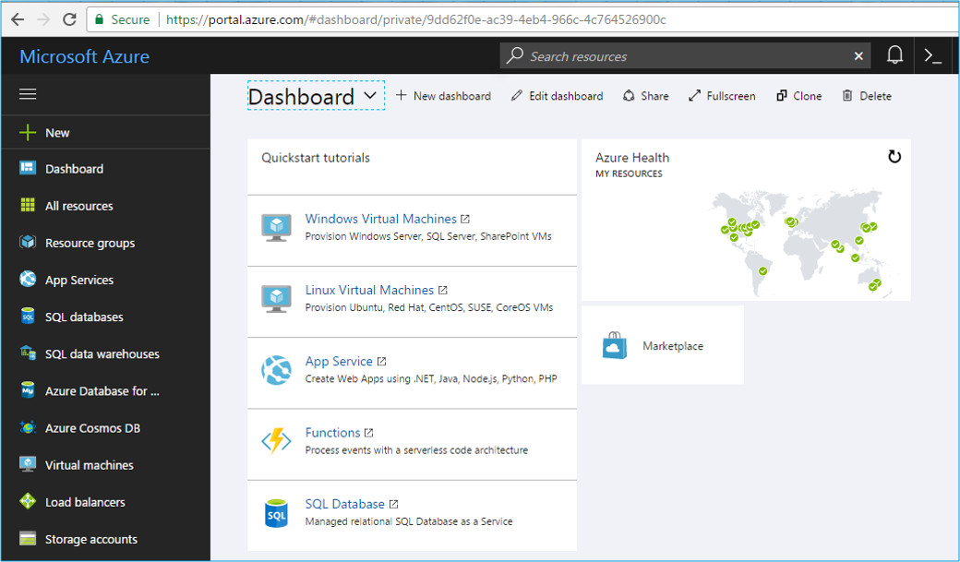
Azure Portal

Slide 8
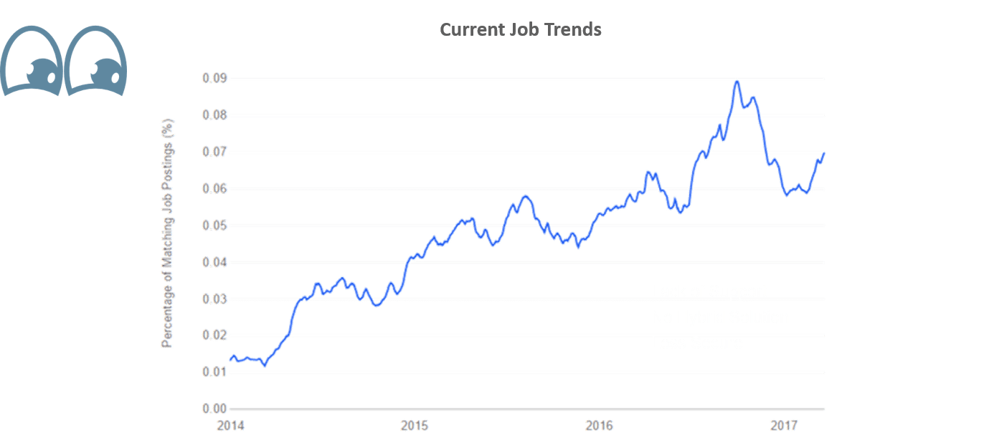
Azure Job Trends

