Slide 1
Scenario-Based Modeling
Scenario-Based elements are
1. Use case diagrams
2. Activity diagrams
3. Swim lane diagram
These courseware materials are to be used in conjunction with Software Engineering: A Practitioner’s Approach, 6/e and are provided with permission by R.S. Pressman & Associates, Inc., copyright © 1996, 2001, 2005

Slide 2
1.Use Case Diagram
Used for describing a set of user scenarios
Mainly used for capturing user requirements
Work like a contract between end user and software developers

Slide 3
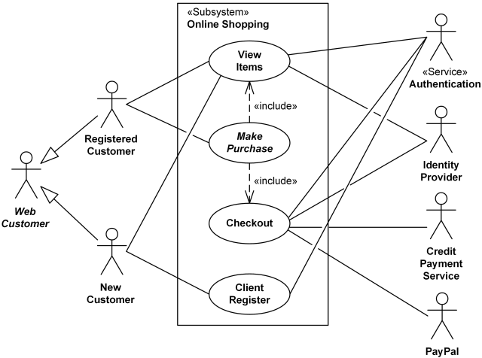
Use case diagram for online shopping system

Slide 4
2. Activity diagrams
Activity diagram is basically a flowchart to represent the flow from one activity to another activity.
The activity can be described as an operation of the system.
The control flow is drawn from one operation to another. This flow can be sequential, branched, or concurrent.
Activity diagrams deal with all type of flow control by using different elements such as fork, join, etc

Slide 5
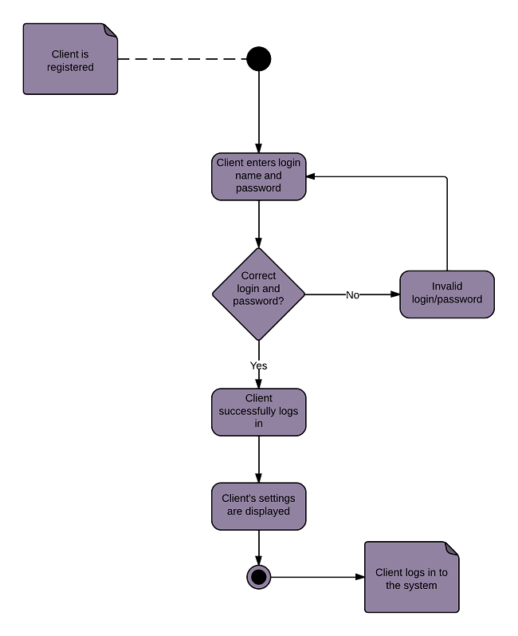
Activity diagram of login process

Slide 6
Swim lane diagram
A swim lane (also known as swim lane) diagram is a type of flowchart.
Like a flowchart, it diagrams a process from start to finish, but it also divides these steps into categories to help distinguish which departments or employees are responsible for each set of actions.
These lanes are columns that keep actions visually separated from others.

Slide 7
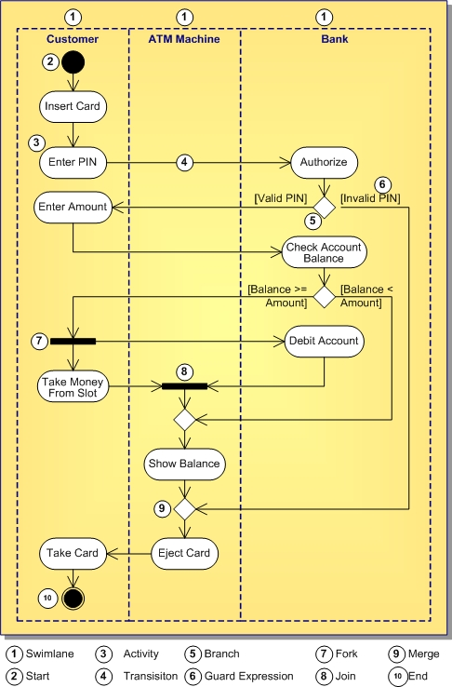

Slide 8
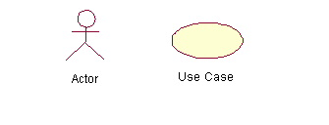
Use Case Diagram (core components)
Actors: A role that a user plays with respect to the system,including human users and other systems. e.g.,inanimate physical objects (e.g. robot); an external system that needs some information from the current system.
Use case: A set of scenarios that describing an interaction between a user and a system, including alternatives.
System boundary: rectangle diagram representing the boundary between the actors and the system.

Slide 9
Use-Cases
In software and systems engineering, a use case is a list of actions or event steps typically defining the interactions between a role and a system to achieve a goal.
actors represent roles people or devices play as the system functions
users can play a number of different roles for a given scenario
These courseware materials are to be used in conjunction with Software Engineering: A Practitioner’s Approach, 6/e and are provided with permission by R.S. Pressman & Associates, Inc., copyright © 1996, 2001, 2005

Slide 10
Use Case Diagram(core relationship)
Association: communication between an actor and a use case; Represented by a solid line.
Generalization: relationship between one general use case and a special use case (used for defining special alternatives)
Represented by a line with a triangular arrow head toward the parent use case.

Slide 11
Use Case Diagram(core relationship)
Include: a dotted line labeled <<include>> beginning at base use case and ending with an arrows pointing to the include use case. The include relationship occurs when a chunk of behavior is similar across more than one use case. Use “include” in stead of copying the description of that behavior.
<<include>>
Extend: a dotted line labeled <<extend>> with an arrow toward the base case. The extending use case may add behavior to the base use case. The base class declares “extension points”.
<<extend>>

Slide 12
Behavioral Modeling
The behavioral model indicates how software will respond to external events or stimuli. To create the model, the analyst must perform the following steps:
    Evaluate all use-cases to fully understand the sequence of interaction within the system.
    Identify events that drive the interaction sequence and understand how these events relate to specific objects.
    Create a sequence for each use-case.
    Build a state diagram for the system.
    Review the behavioral model to verify accuracy and consistency.

Slide 13
Behavioral Modeling
make a list of the different states of a system (How does the system behave?)
indicate how the system makes a transition from one state to another (How does the system change state?)
  indicate event
  indicate action
draw a state diagram or a sequence diagram

Slide 14
Sequence Diagram
Sequence diagrams demonstrate the behavior of objects in a use case
by describing the objects and the messages they pass.
The horizontal dimension shows the objects participating in the interaction.
The vertical arrangement of messages indicates their order.
The labels may contain the seq. # to indicate concurrency.

Slide 15
Sequence Diagram(make a phone call)
Caller
Phone
Recipient
Picks up
Dial tone
Dial
Ring notification
Ring
Picks up
Hello

Slide 16
Sequence Diagram:Object interaction
A
B
Self-Call: A message that an
Object sends to itself.
Condition: indicates when a message is sent. The message is sent only if the condition is true.
Synchronous
Asynchronous
Transmission delayed
Condition
[condition] remove()
Iteration
*[for each] remove()
Self-Call

Slide 17
Sequence Diagrams – Object Life Spans
Creation
  Create message
  Object life starts at that point
Activation
  Symbolized by rectangular stripes
  Place on the lifeline where object is activated.
  Rectangle also denotes when object is deactivated.
Deletion
  Placing an ‘X’ on lifeline
  Object’s life ends at that point
A
Create
B
Activation bar
X
Return
Deletion
Lifeline

Slide 18
Design modeling
Characteristics of good design:
The design must implement all of the explicit requirements and it must include all of the implicit requirements desired by the customer.
The design must be a readable.
The design must give complete idea or picture of software, addressing the data, functional and behavioral domains
These courseware materials are to be used in conjunction with Software Engineering: A Practitioner’s Approach, 6/e and are provided with permission by R.S. Pressman & Associates, Inc., copyright © 1996, 2001, 2005

