Slide 1
CSE 4120
Technical Writing & Seminar
Handwritten Document Recognition
Presented By:
Sagar Dutta
Roll : 1907085
Department of CSE, KUET
Supervised by:
Dr. K. M. Azharul Hasan
Professor
Department of CSE, KUET
Sunanda Das
Assistant Professor Department of CSE, KUET
Department of Computer Science and Engineering
Khulna University of Engineering & Technology

Slide 2
Source Details
Table 1: Source Details
Serial No | Title | Author | Source | Published Year
1 | Improving Handwritten Mathematical Expression Recognition via Similar Symbol Distinguishing | Zhe Li , Xinyu Wang , Yuliang Liu , Lianwen Jin , Yichao Huang, and Kai Ding | IEEE TRANSACTIONS ON MULTIMEDIA Vol-26 | 2024
2 | DAN: A Segmentation-Free Document Attention Network for Handwritten Document Recognition | Denis Coquenet , Clément Chatelain , and Thierry Paquet | IEEE TRANSACTIONS ON PATTERN ANALYSIS AND MACHINE INTELLIGENCE VOL. 45, NO. 7 | 2023
3 | End-to-End Handwritten Paragraph Text Recognition Using a Vertical Attention Network | Denis Coquenet , Clement Chatelain , and Thierry Paquet | IEEE TRANSACTIONS ON PATTERN ANALYSIS AND MACHINE INTELLIGENCE VOL. 45, NO. 1 | 2023

Slide 3
Outline
Introduction
Publication Details
Literature Review
Methodology
Result Analysis
Limitations
Comparative Discussion
Recommendation & Findings
Conclusion
References

Slide 4

Introduction
The Problem:
Handwritten documents in many Sector:-
Form Processing
Banking and Finance
Postal Service
Medical Records
Converting them manually in Digital is a big hazard.
The Solution:
Handwritten Document Recognition.

Slide 5
Introduction (Cont.)
What it is actually:
The process of converting handwritten text or characters into digital form using various techniques
The Techniques:
Image processing
Pattern recognition
Machine learning algorithms

Slide 6
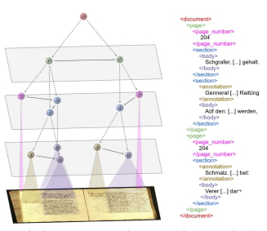
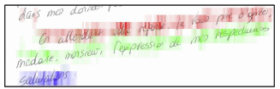
Introduction (Cont.)
Figure 1: Visualization of input
Figure 2: Document image with associated layout Graph

Slide 7
Literature Review
Handwritten document recognition research has evolved significantly, encompassing text and layout analysis. Traditional methods relied on grammar-based approaches, while recent advancements have seen a shift towards deep learning-based methodologies.
These modern techniques leverage sequence and graph modeling, including encoder-decoder frameworks and attention mechanisms, to achieve superior performance. Additionally, ensemble methods have emerged as a strategy to enhance model robustness.
The focus lies on developing end-to-end solutions that can accurately extract and understand textual and structural information from handwritten documents, marking a significant stride towards more efficient and effective document processing systems.

Slide 8
Literature Review
Traditional methods, as highlighted across the surveyed papers, often relied on grammar-based frameworks, such as graph and context-free grammars, to dissect handwritten documents.
Recent years have witnessed a surge in deep learning techniques, particularly sequence and graph modeling, which have revolutionized the field. These modern approaches, exemplified by encoder-decoder architectures, attention mechanisms, and graph neural networks.

Slide 9
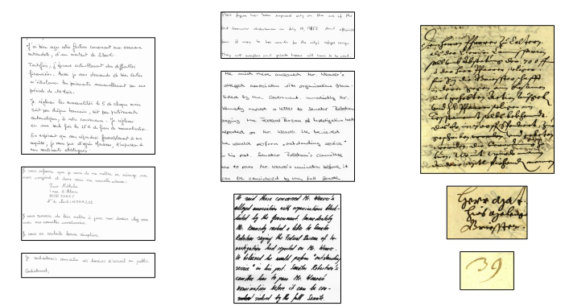
Methodology(Datasets)
Figure 3: Datasets

Slide 10
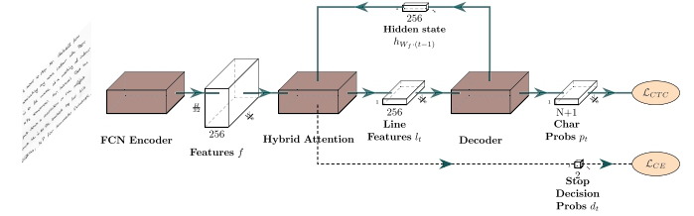
Methodology(Architecture)
Figure 4:Architecture Overview

Slide 11
Methodology Comparison
Table 3: Methodology
SL | Dataset | Preprocessing | Method
1. | CROHME 2014 Dataset | No preprocessing were done | Method was implemented in PyTorch and optimized on 6 Nvidia GTX 1080Ti GPUs distributional A 6-layer transformer encoder with eight heads was adopted The learning rate was initialized to 0.1 and decreased by 10 times every 20,000 iterations
2. | RIMES, and READ2016 Handwritten Dataset | Contrast enhancement and Noise reduction were used | Trained with 90% of synthetic documents. Increased both the length of the target sequence, through the number of text lines, and the input image size
3. | The IAM-database | The encoder and the last convolutional layer of the decoder of the VAN are pretrained on line-level images | Isolated text lines were avoided by using a pretrained VAN on another dataset Different stopping strategies were implemented on the IAM dataset

Slide 12
Methodology Cont.
Table 4: Model Comparison
SL | Paper | Model
1. | Improving Handwritten Mathematical Expression Recognition via Similar Symbol Distinguishing | CNN based encoder and DTW-based algorithm ensembled
2. | DAN: A Segmentation-Free Document Attention Network for Handwritten Document Recognition | Document Attention Network (DAN), an endto-end encoder-decoder architecture that jointly recognizes both text and layout, from whole documents
3. | End-to-End Handwritten Paragraph Text Recognition Using a Vertical Attention Network | CNN+MDLSTMa , RPN+CNN+BLSTM+LM

Slide 13
Result Analysis
Table 5: Result Analysis
SL | Paper | Result
1. | Improving Handwritten Mathematical Expression Recognition via Similar Symbol Distinguishing | Achieves a superior ExpRate of 60.34%, 59.98%, and 64.22% with a single model on all three CROHME test splits
2. | DAN: A Segmentation-Free Document Attention Network for Handwritten Document Recognition | Reached very satisfying results at page level for both text and layout recognition with a CER of 4.54%, a WER of 11.85%, a LOER of 3.82% and a mAPCER of 93.74%
3. | End-to-End Handwritten Paragraph Text Recognition Using a Vertical Attention Network | Line level model achieve higher accuracy of 90.5% than all other model

Slide 14
Limitations
Table 6: Limitations
SL | Paper | Limits
1. | Improving Handwritten Mathematical Expression Recognition via Similar Symbol Distinguishing | Lackings in Language Model Rectification Can’t predict implicit symbols
2. | DAN: A Segmentation-Free Document Attention Network for Handwritten Document Recognition | Lack of large-scale public datasets of documents including both layout annotation and text annotation
3. | End-to-End Handwritten Paragraph Text Recognition Using a Vertical Attention Network | Obtained results are very dependent on the quality of the synthetic data, as they must be close to the target dataset, notably in terms of layout

Slide 15
Comparative Discussion
Table 7: Discussion
Aspect | Paper 1 | Paper 2 | Paper 3
Key Contribution | End-To-End architecture for document-level recognition and layout labeling | Recognition of paragraph text without explicit segmentation | Implicit line segmentation for paragraph recognition
Approach | Unified statistical model, end-to-end architecture for data generation | Vertical attention mechanism, segmentation free neural network | Hybrid attention mechanism, implicit line segmentation, dropout strategies
Final Standing | Achieved state-of-the art levels at page and paragraph level | Achieved state-of-the art levels at paragraph level only | Achieved state-of-the art levels at page and paragraph level only

Slide 16
Recommendation and Findings
Among the three papers, "DAN: A Segmentation-Free Document Attention. Network for Handwritten Document Recognition“ this paper is found as the most promising
Reason behind:
Better Accuracy-> 93.74%(highest)
Potential for Document Understanding in a smooth way
Innovative Training Strategy
State-of-the-Art recognizing both text and layout

Slide 17
Conclusion
These three papers collectively represent significant advancements in handwritten document recognition
The Document Attention Network (DAN) introduced a groundbreaking segmentation-free architecture capable of recognizing text and layout information
The Vertical Attention Network (VAN) proposed an end-to-end approach for paragraph text recognition
These papers Offer efficient solutions that bridge the gap between text recognition and layout understanding.

Slide 18
References
Z. Li, X. Wang, Y. Liu, L. Jin, Y. Huang, and K. Ding, “Improving handwritten mathematical expression recognition via similar symbol distinguishing,” IEEE Transactions on Multimedia, 2023
J. Chung and T. Delteil, “A computationally efficient pipeline approach to full page offline handwritten text recognition,” in 2019 International conference on document analysis and recognition workshops (ICDARW), vol. 5. IEEE, 2019, pp. 35–40.
P. Voigtlaender, P. Doetsch, and H. Ney, “Handwriting recognition with large multidimensional long short-term memory recurrent neural networks,” in 2016 15th international conference on frontiers in handwriting recognition (ICFHR). IEEE, 2016, pp. 228–233.

Slide 19
References (Cont.)
D. Coquenet, C. Chatelain, and T. Paquet, “Span: a simple predict & align network for handwritten paragraph recognition,” in International Conference on Document Analysis and Recognition. Springer, 2021, pp. 70–84.
D. Coquenet, C. Chatelain, and T. Paquet, “Dan: a segmentation-free document attention network for handwritten document recognition,” IEEE transactions on pattern analysis and machine intelligence, 2023.
End-to-end handwritten paragraph text recognition using a vertical attention network,” IEEE Transactions on Pattern Analysis and Machine Intelligence, vol. 45, no. 1, pp. 508–524, 2022.

Slide 20
Thank You

