Slide 1
Research proposal on
An Application of Text Classification to Check a Product Review
Supervised by:
Md. Fazlul karim patwary
Professor, Iit, Ju

Slide 2
Presented By
Shuvashish Paul Sagar (Roll: 1127)

Slide 3
What is this research about?
This research is a proposed way to check a product whether it is good or not analyzing the reviews given by the users.
Basically it is a data mining technique. This research work deals with text mining.

Slide 4

Abstract

Slide 5
Where it can be used
As the rapid growth of e-commerce businesses the business owners are facing new challenges to attract the customers.
In this scenario this product review check mechanism would help them know the sentiment of the customers.

Slide 6
How I will proceed
My research work would be in three stages.
Build a system to collect data from different e-commerce sites.
Classify the data using best classifier algorithm.
Check a product whether it is good or not analyzing the user reviews.

Slide 7
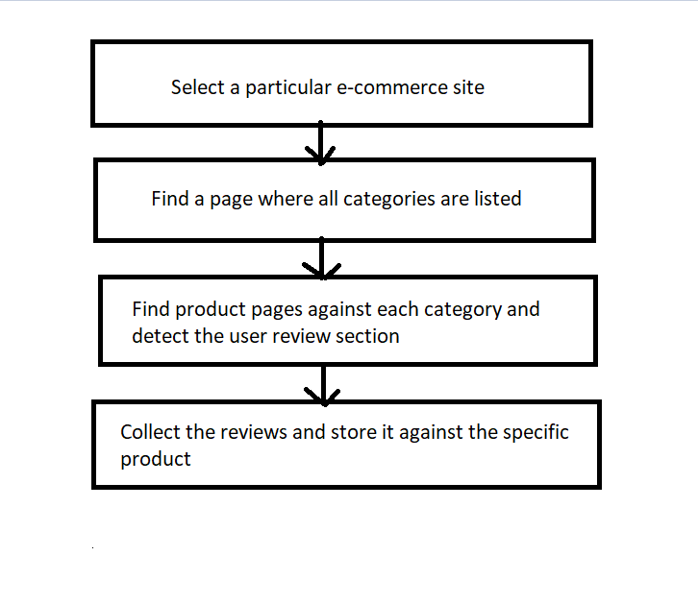
Steps of this work

Slide 8
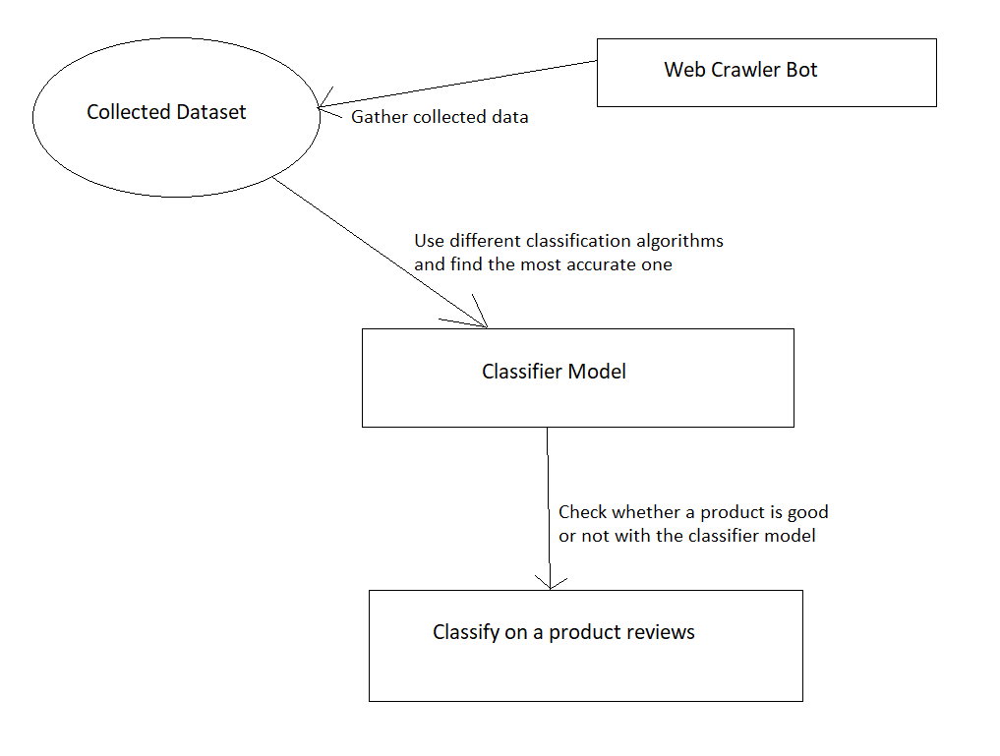
Methodology

Slide 9
Algorithms we will consider in classification
Naïve Bayers
K-nearest neighbor
Decision Tree/Random Forrest
Support Vector Machine (SVM)

Slide 10
Limitations & Future Work
This research work can not deal without English texts.
In future we will work with different non-English languages.
Some of the products in an e-commerce site don’t always have reviews. In this case this system can not comment on the product.

Slide 11
Thank You

