Slide 1
NodeJS

Slide 2
What is node.js ?
Created 2009
Server Side JavaScript
Runs on Google's V8 JavaScript Engine
Node Internals
  The code we write (100%)
  NodeJs (50% JS, 50% c++)
  V8 (30% JS, 70% C++)
  Libuv (100% C++)

Slide 3
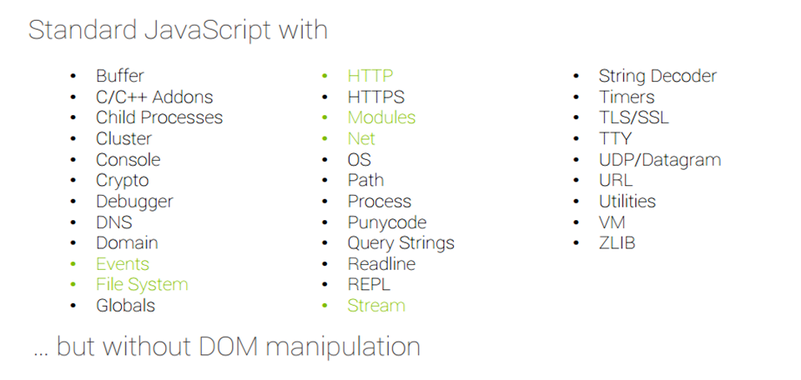
Why Use Node.js ?
Node's goal is to provide an easy way to build scalable network programs.

Slide 4
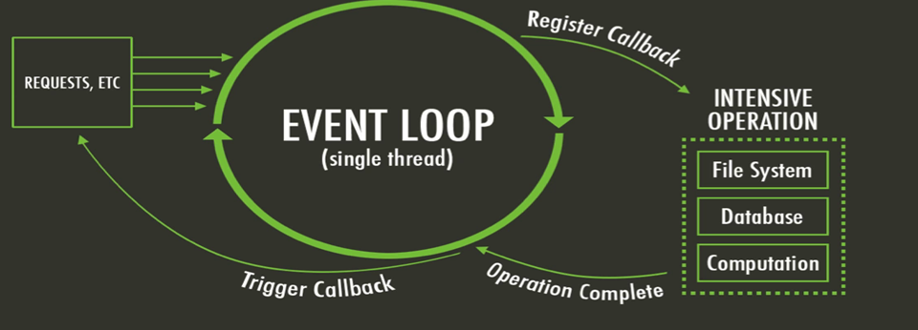
What is unique about Node.js?
JavaScript on server-side thus making communication between client and server will happen in same language
Servers normally thread based but Node.JS is “Event” based. Node.JS serves each request in a Evented loop that can handle simultaneous requests.
Notes:
Thread based servers like Apache server will serve each web request as individual threads which doesn’t fit well for concurrent connections.

Slide 5
What can you do with Node ?
It lets you Layered on top of the TCP library is a HTTP and HTTPS client/server.
The JS executed by the V8 JavaScript engine (the thing that makes Google Chrome so fast)
Node provides a JavaScript API to access the network and file system.

Slide 6
What can’t do with Node?
Node is a platform for writing JavaScript applications outside web browsers. This is not the JavaScript we are familiar with in web browsers. There is no DOM built into Node, nor any other browser capability.
Node can’t run on GUI, but run on terminal

Slide 7
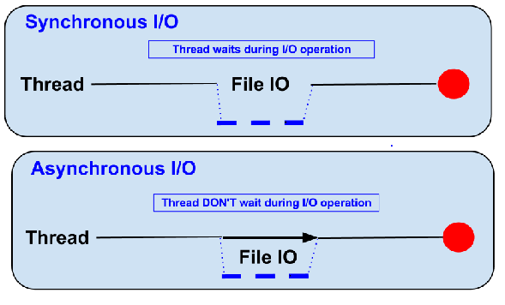
Blocking vs Non-Blocking……
Example :: Read data from file and show data

Slide 8
Blocking…..
Read data from file
Show data
Do other tasks
var data = fs.readFileSync( “test.txt” );
console.log( data );

Slide 9
Non-Blocking……
Read data from file
  When read data completed, show data
Do other tasks
fs.readFile( “test.txt”, function( err, data ) {
console.log(data);
});

Slide 10
Node.js VS Apache
  It's faster
  It can handle tons of concurrent requests
Platform | Number of request per second
PHP ( via Apache) | 3187,27
Static ( via Apache ) | 2966,51
Node.js | 5569,30

Slide 11
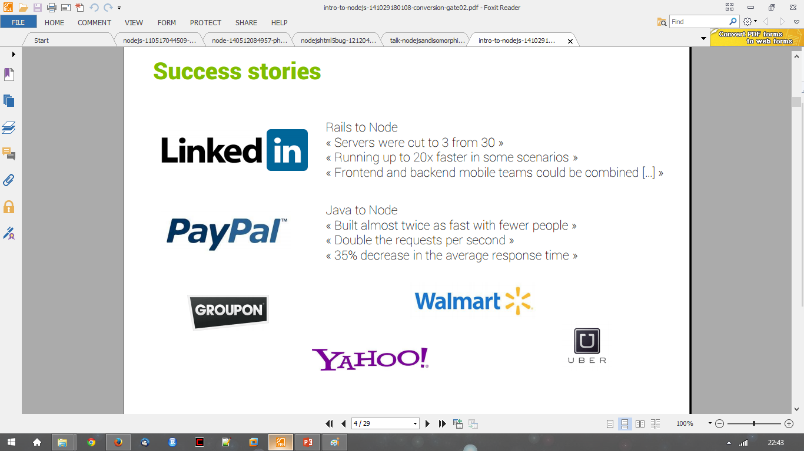
Success Stories…..

Slide 12
Supports HTTP Method……
GET
POST
PUT
DELETE

Slide 13
Node.js for….
Web application
Websocket server
Ad server
Proxy server
Streaming server
Fast file upload client
Any Real-time data apps
Anything with high I/O

Slide 14
In Built Modules
var http = require(‘http’);
var fs = require(‘fs’);

Slide 15
External Modules
var express = require(‘express’);
var mongoose = require(‘mongoose’);

Slide 16
ThanQ

