Slide 1
Cuckoo Hashing
By:
Aniketh – 17IT208
Amodh – 17IT108
Sagar - 17IT136
Akhil - 17IT106

Slide 2
Class Structure
Data Variables:
hashTables- Three tables maintained in a list
len – length of each hashTable
stash – stores elements which cause infinte loops
population – counts the number of elements stored

Slide 3
Functions:
insert()
delete()
lookup()
integerHashFunctions()
stringHashFunctions()
rehash()
Update()

Slide 4
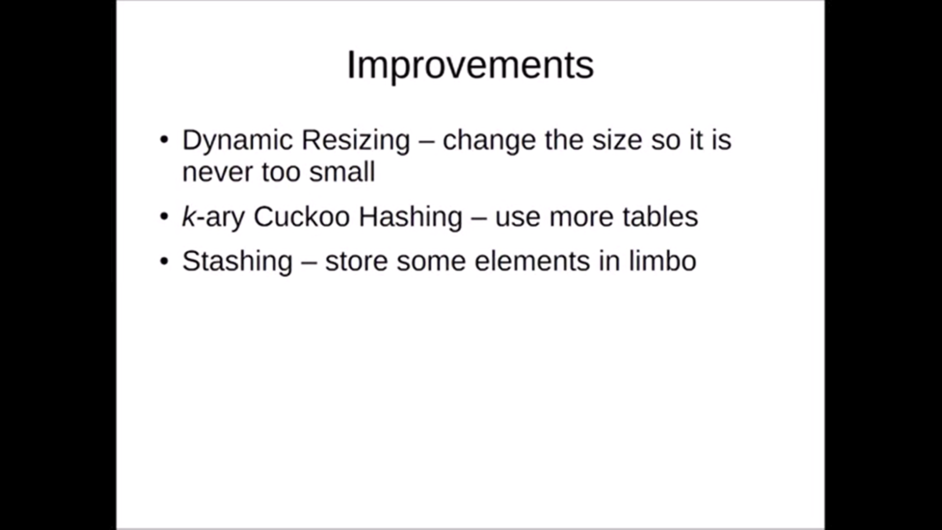

Slide 5
How insert() works:

Slide 6
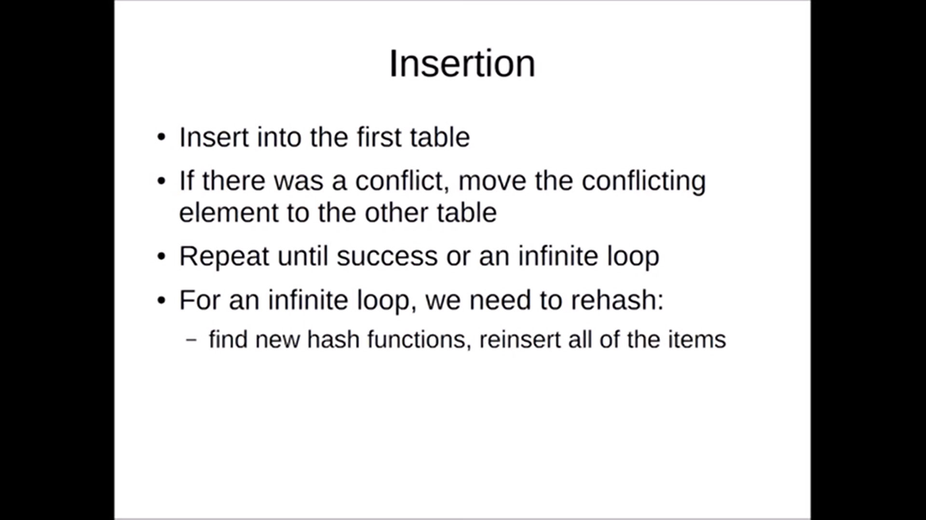

Slide 7
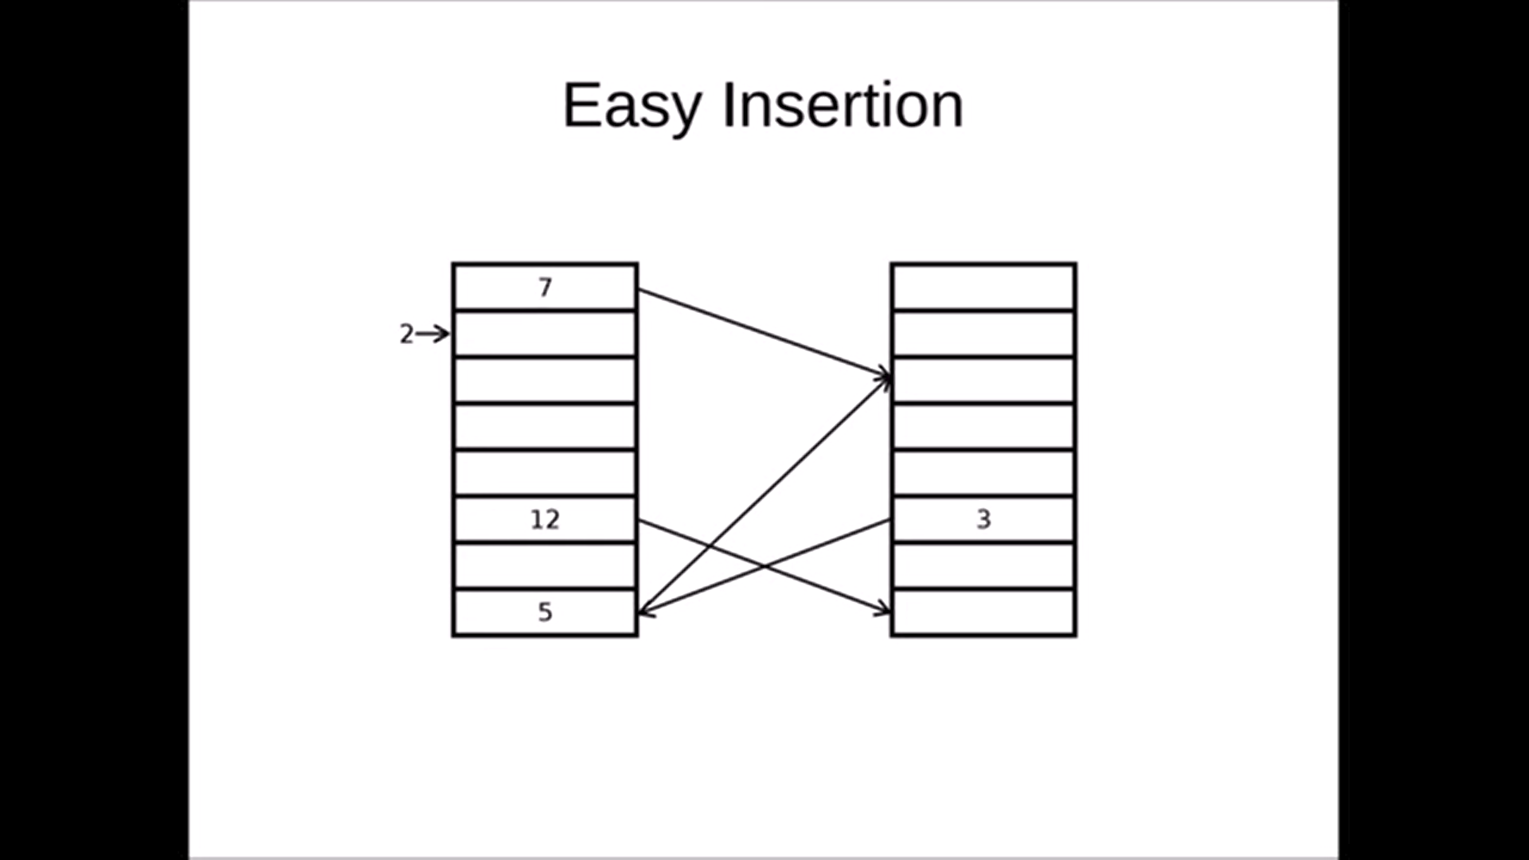

Slide 8
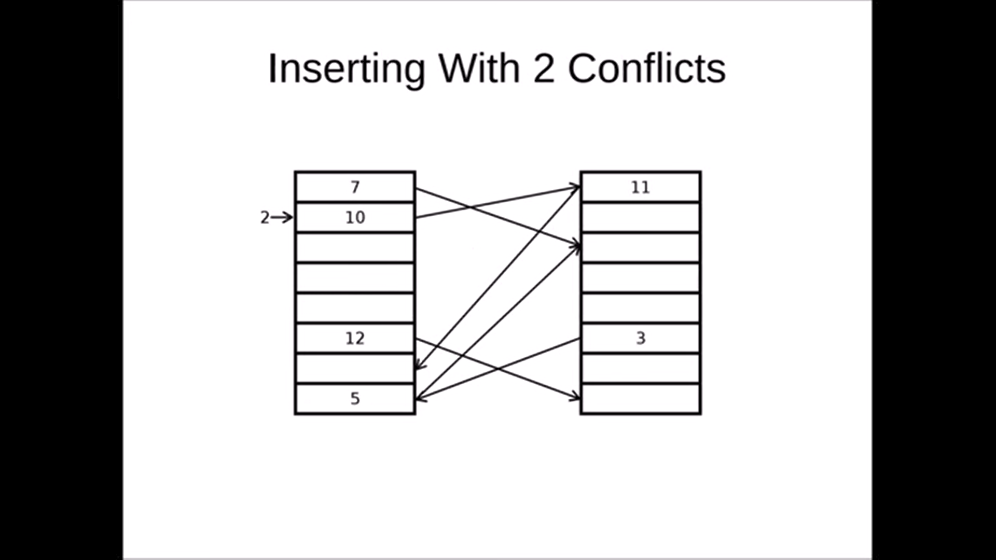

Slide 9
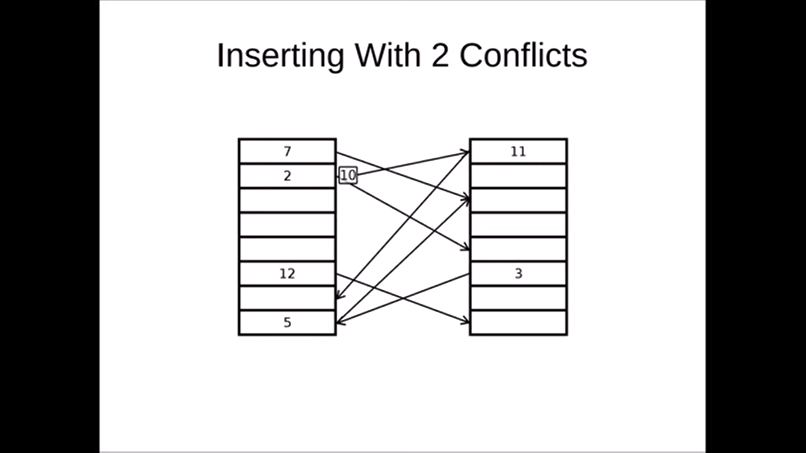

Slide 10
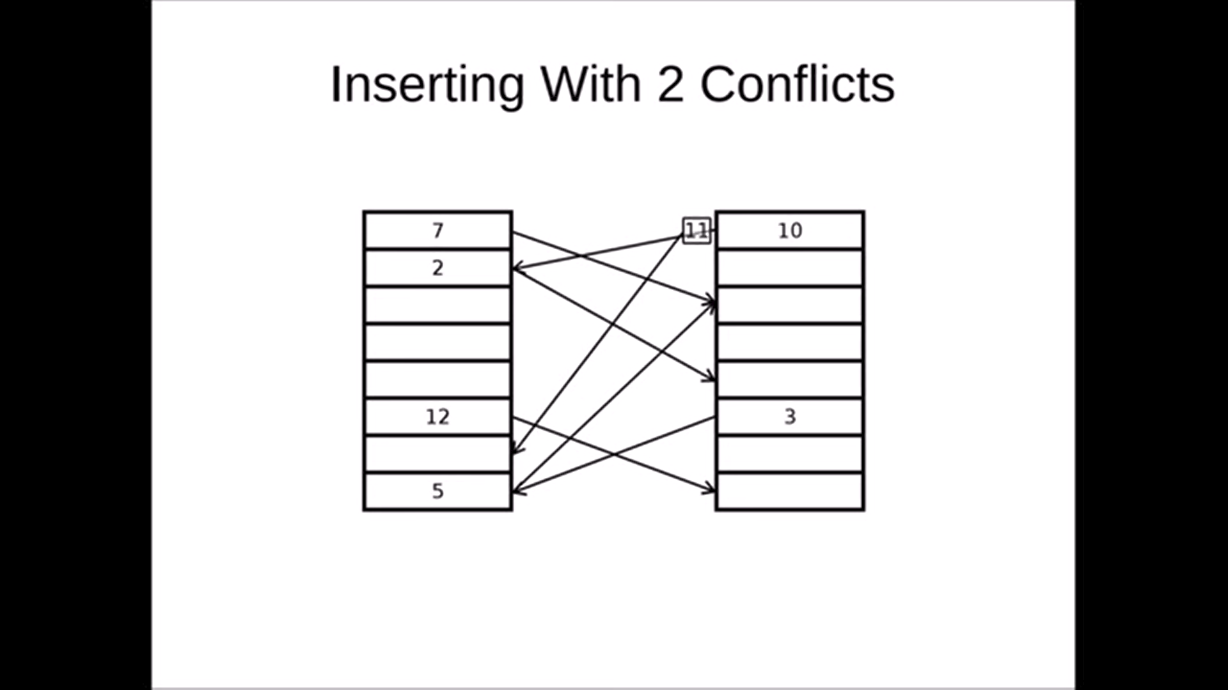

Slide 11
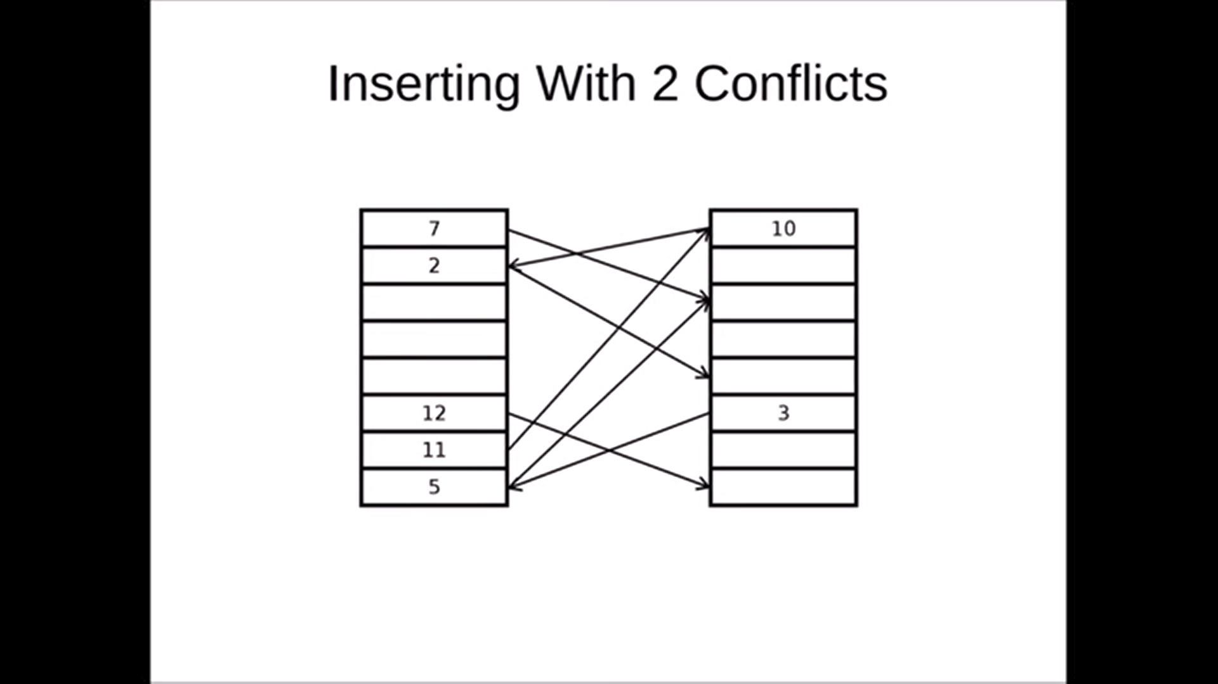

Slide 12
The case of The Infinite Loop

Slide 13
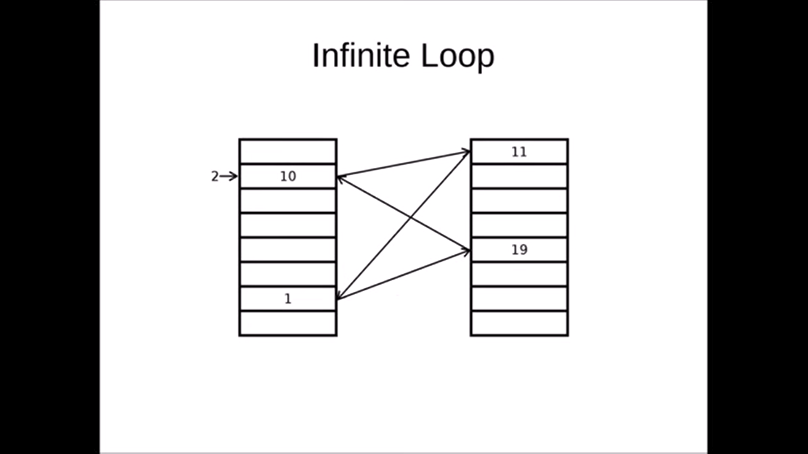

Slide 14
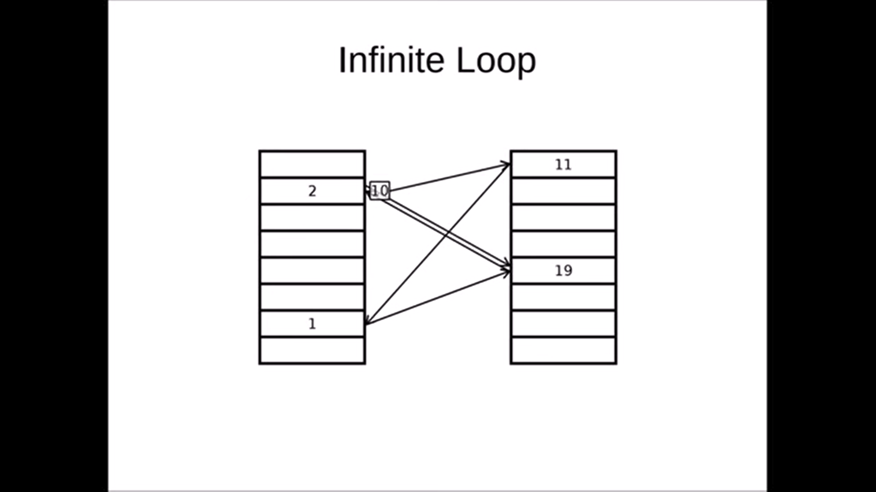

Slide 15
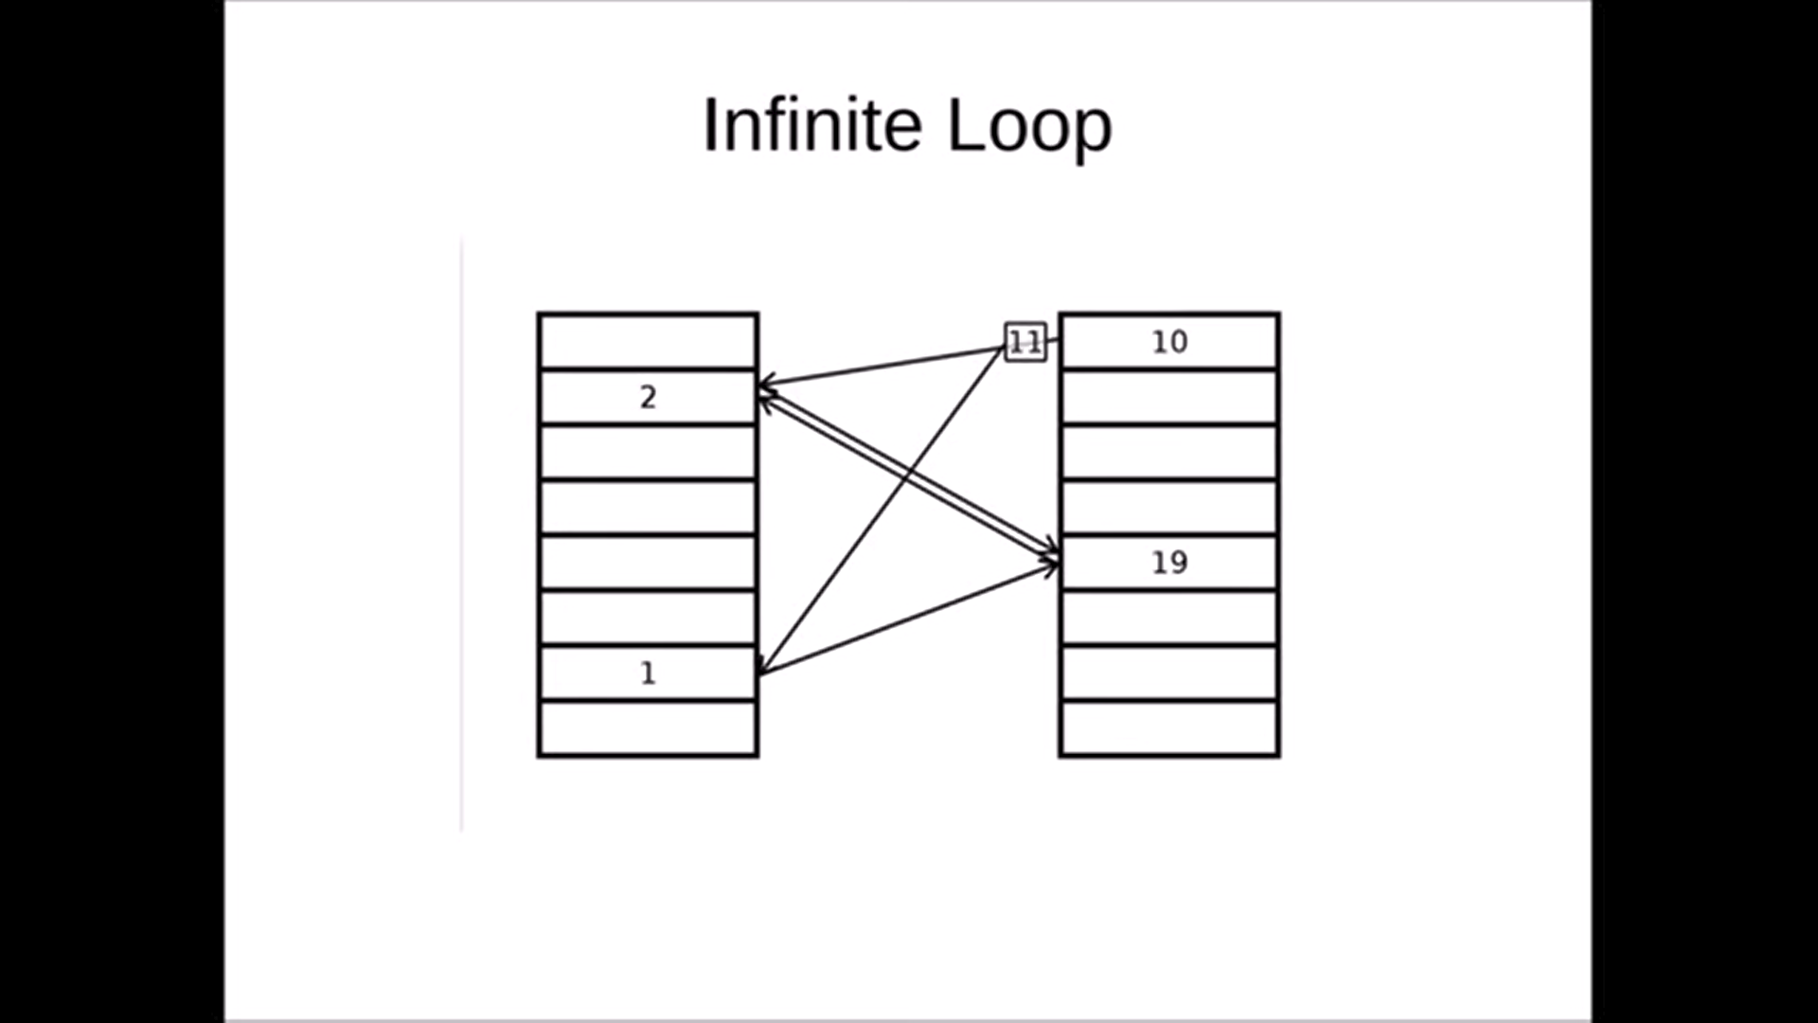

Slide 16


Slide 17


Slide 18


Slide 19
Expected Runtime
Insertion : O(1) time
Deletion : O(1) time
Lookup : O(1) time

Slide 20
Proof sketch
Probability of evicting more than t items is less than a decreasing exponential
Probability of rehash for each insertion is the order of 1/(n^2)
Rehash requires O(n) insertions

Slide 21
Application 1:Spell Checker
All valid words are read from a file and placed in a Cuckoo hash
Input is taken from user
We split the input and check if every word is present in the table

Slide 22
If text is not present in table, then we pass it to AutoCorrect() function, which returns a list of all possible replacements
The mispelt word and its replacement list are stored in a python dictionary, which is finally displayed

Slide 23
Application 2:
The trading stocks problem

Slide 24
Functions used:
Stocks( name_of_file, hash_table_object ):
Insert([CID, no._of_stocks])
Update(sign, CID, no._of_stocks)
lookup(CID)
DISPLAY( HASH_TABLE_OBJECT )

