Slide 1
CIM TRI 2
By Sagar Garg

Slide 2
EXTREME REDESIGN
Designed a USB and SD card holder
Holds up to 3 USB drives and 3 SD cards
Keeps USB’s and SD’s in a safe location

Slide 3
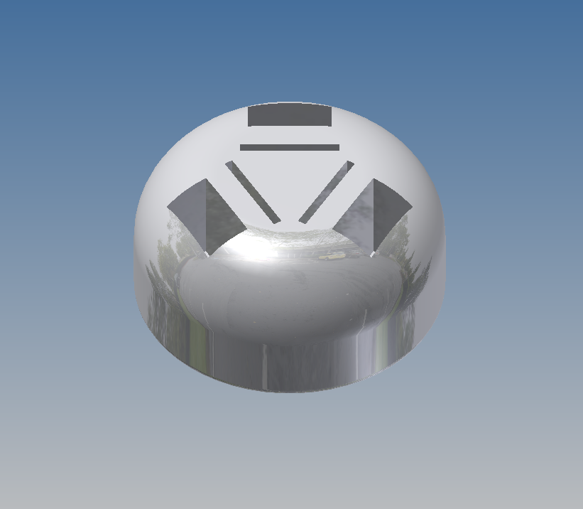
AutoDesk Inventor

Slide 4
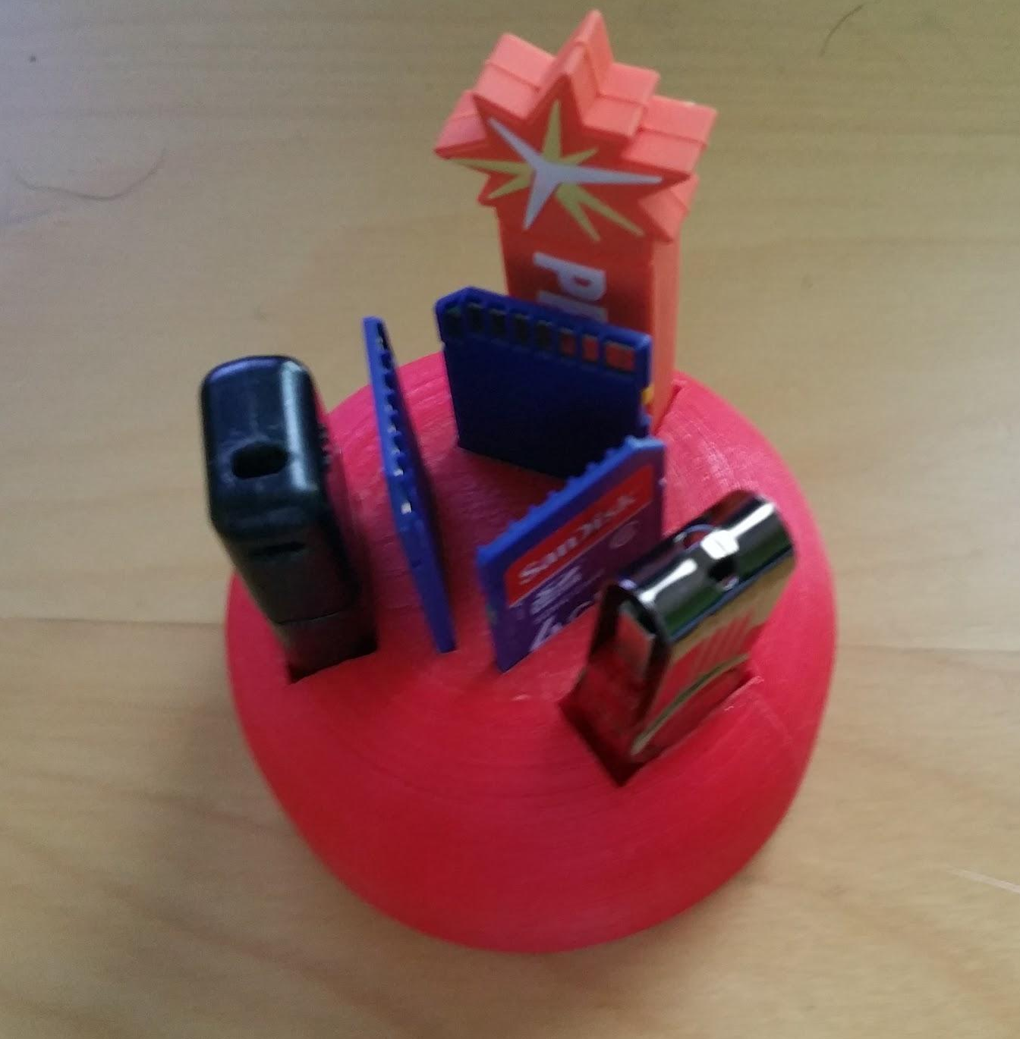
USB and SD Card Holder

Slide 5
WATER JET CUTTER
Learned how to use FlowCut
Learned how to use FlowPath
Learned how to use the water jet
Designed my initials in AutoDesk Inventor

Slide 6
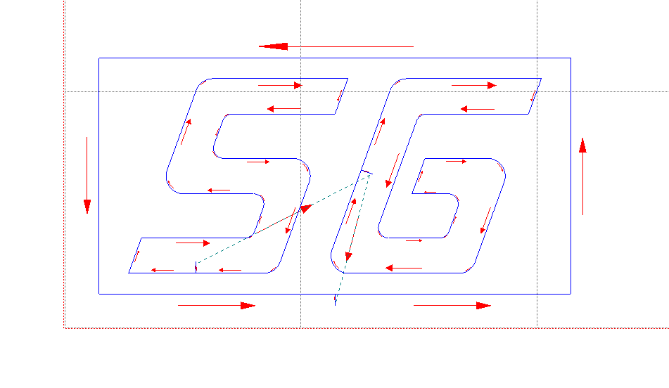
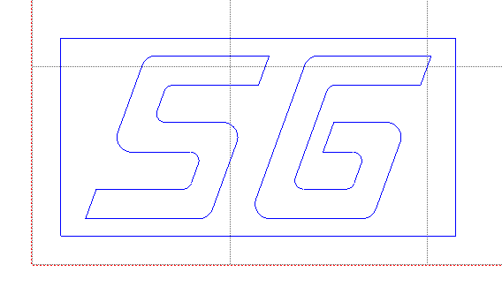
FlowPath

Slide 7
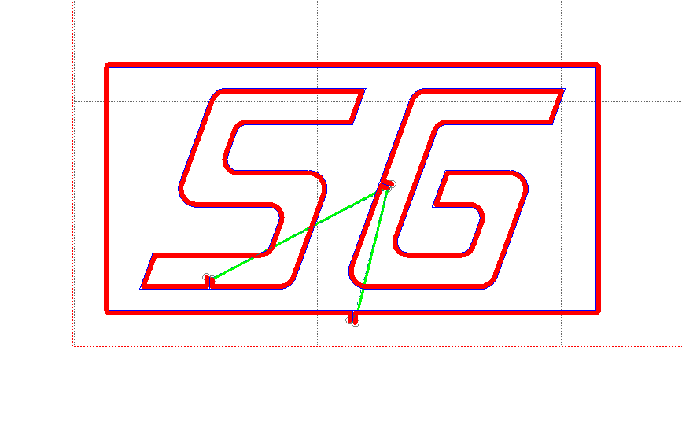
FlowCut

Slide 8
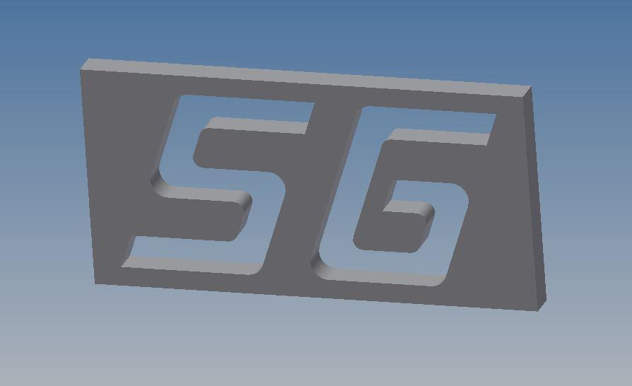
AutoDesk Inventor

Slide 9
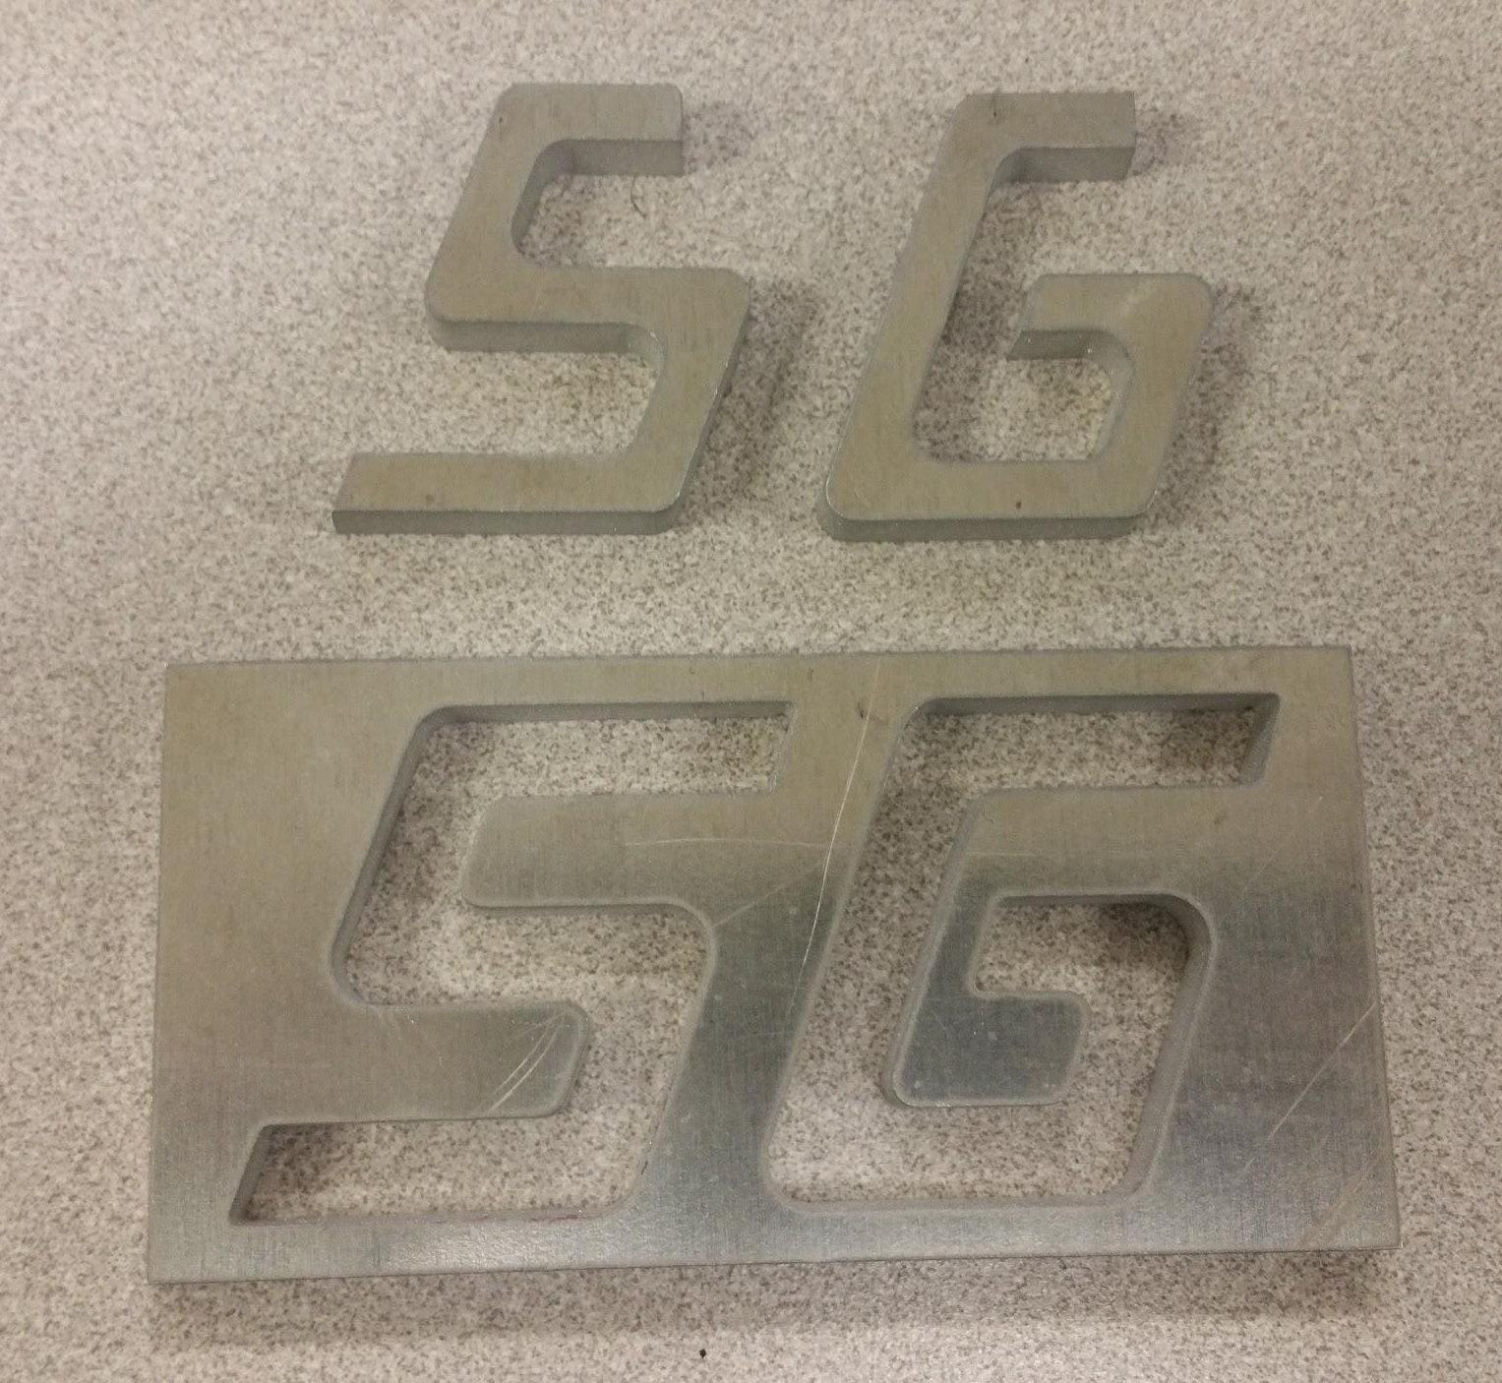
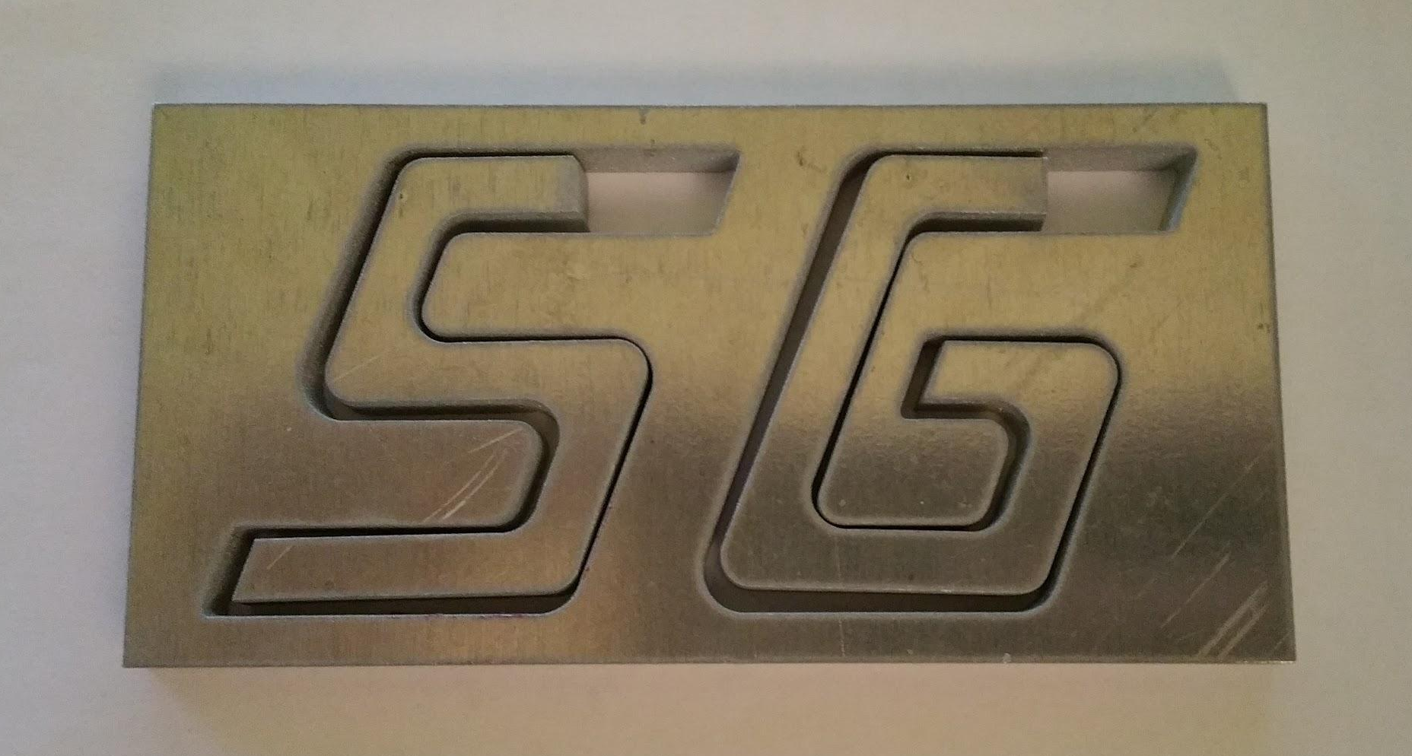
Water Jet Piece

