Slide 1
Project Presentation on “Student-Mentoring Management System” Submitted in partial fulfillment for the award of Post Graduate Diploma in Advanced Computing (PG-DAC) from C-DAC, IACSD (Akurdi) GROUP NO.46
Presented by:
1) 223063_SAGAR GAWALI
2) 223062_BHUSHAN GAWALI
PRN NAME

Slide 2
Introduction
The system mainly consists of SMMS Online system containing application server and web server. SMMS interacts with the database to get student and mentor information. Secondary information like courses and marks are stored in the database.
The “Student - Mentoring Management System” is a web-based application that helps people to gather and analyze data related to students and mentors and efficiently assigns students to the mentors depending upon the total number of students and available mentors. The application provides functionality to maintain relationships between the two. Users can provide their details as well as course enrolled information using the web portal. This information will act as the basis for the assignment process. All system information is maintained in a database. The application interacts with the MySQL database and performs insertion, update as well as deletion as directed by the user.

Slide 3
Project Objective
To Provide Easy and Simple User Interface
To Make Easy access for the beneficiers
To have easy and efficient documents
The system will have user friendly operations
Details are stored in database from where it can be easily updated or removed by the admin
Data stored in formed of Tables for better analysis

Slide 4
Project Description
Technology Stack
Backend
Category | Technology Name
Framework | Spring Boot
ORM Tool | Hibernate
Database | MySQL
Language | Java

Slide 5
Technology Stack
Frontend
Category | Technology Name
Library | ReactJS
Language | HTML, CSS, JavaScript

Slide 6
Architecture Diagram

Slide 7
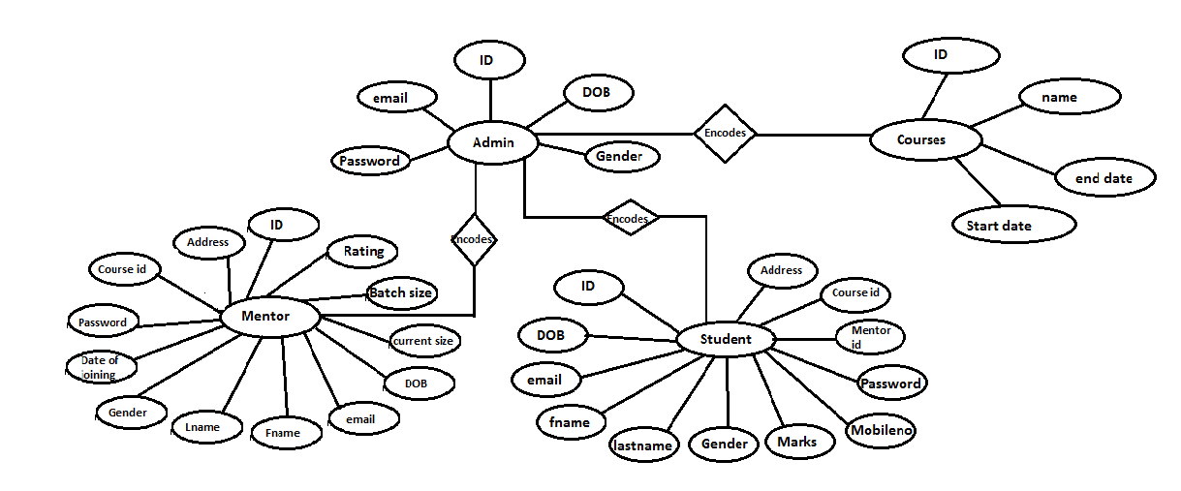
ER Diagram:

Slide 8
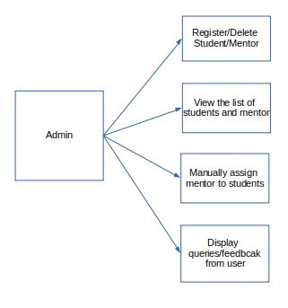
Admin Model:

Slide 9
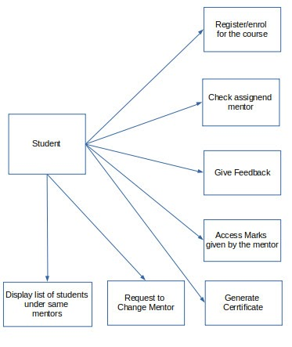
Student Model:

Slide 10
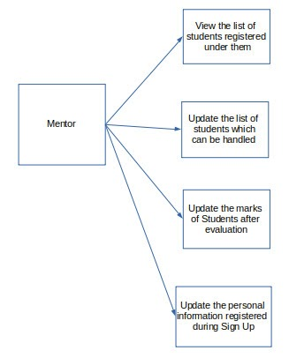
Mentor Model :

Slide 11
Data Flow Diagram: Data Flow Diagram represents a detailed and well-explained diagram of system components.
Level 1 - DFD Mentor Model:

Slide 12
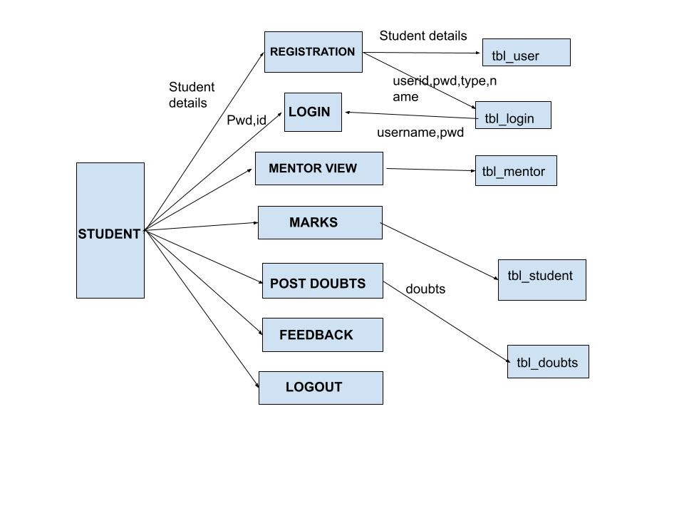
DFD: Data Flow Diagram represent detailed and well explained diagram of system components DFD Student Model:

Slide 13
DFD Admin Model:

Slide 14
Activity Diagram
Admin Activity Diagram

Slide 15
Mentor Activity Diagram

Slide 16
Student Activity Diagram

Slide 17
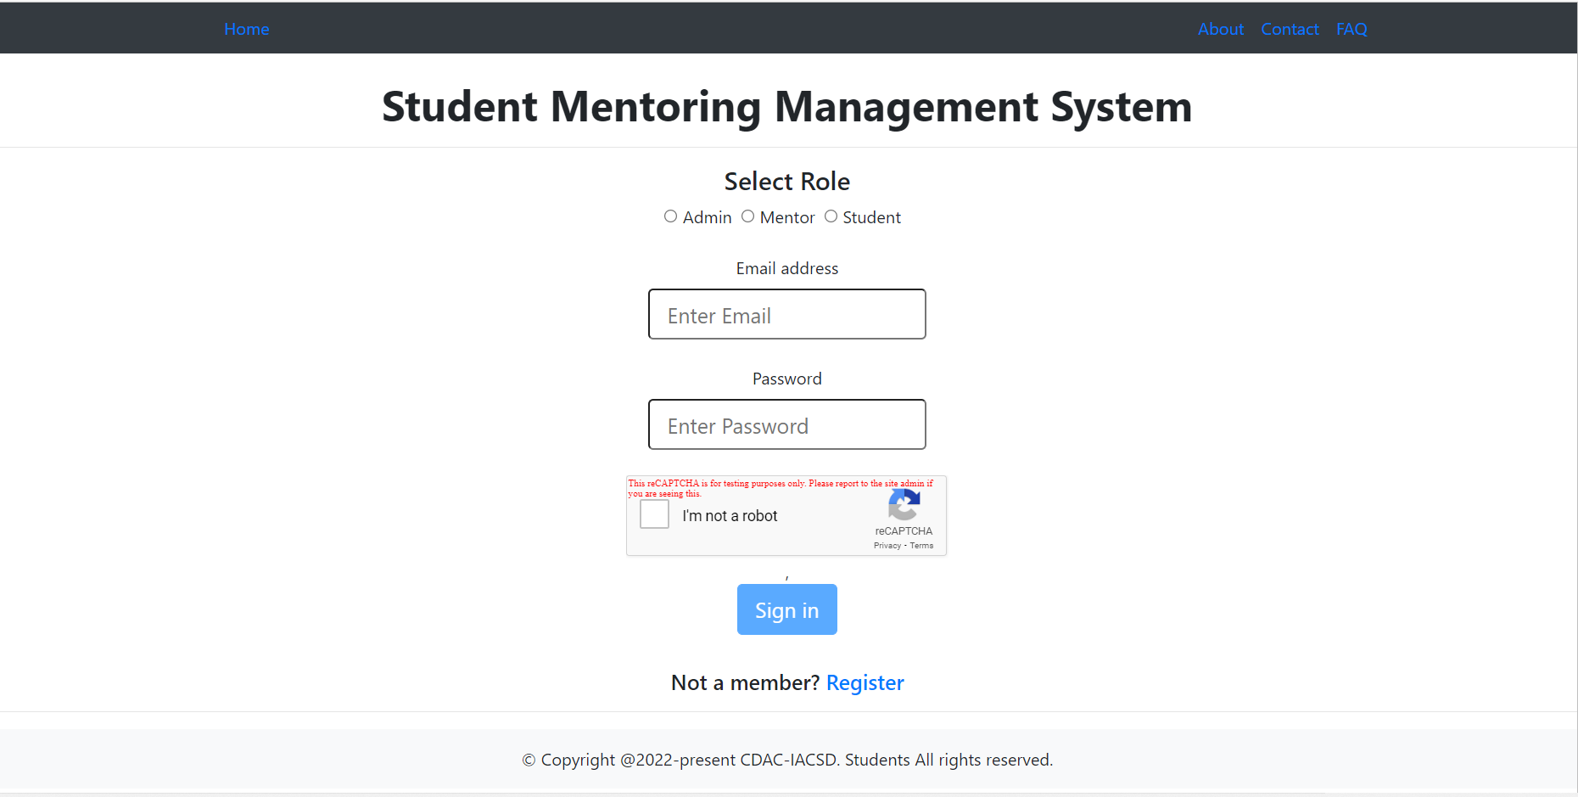
User Interface :LOGIN/HOME PAGE

Slide 18
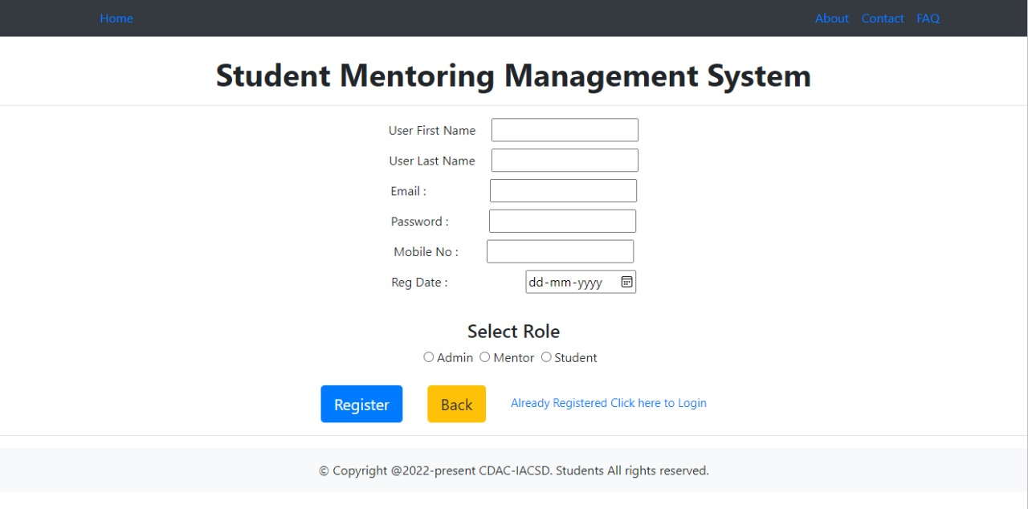
ADMIN/MENTOR/STUDENT Registration :

Slide 19
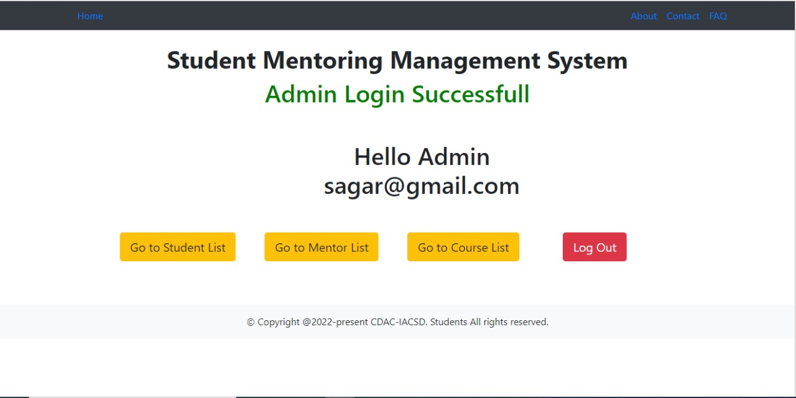
Admin Home Page :

Slide 20
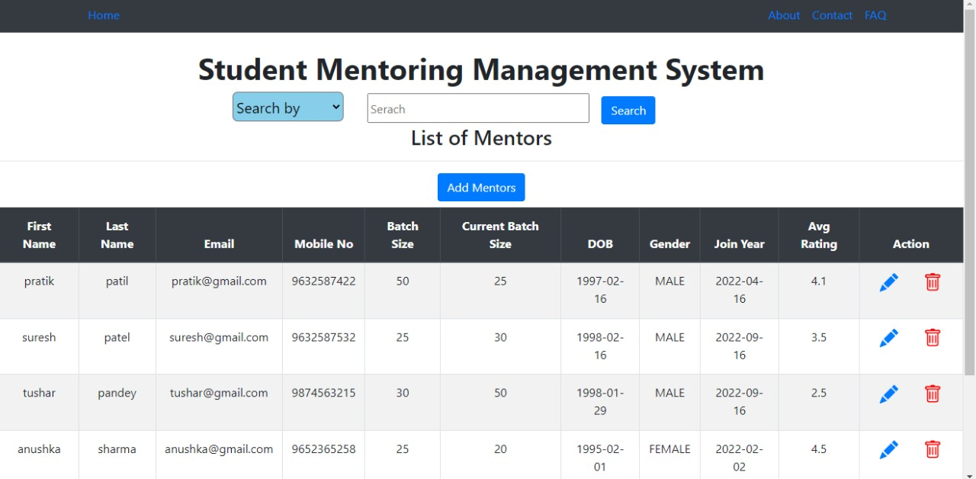
Mentor List:

Slide 21
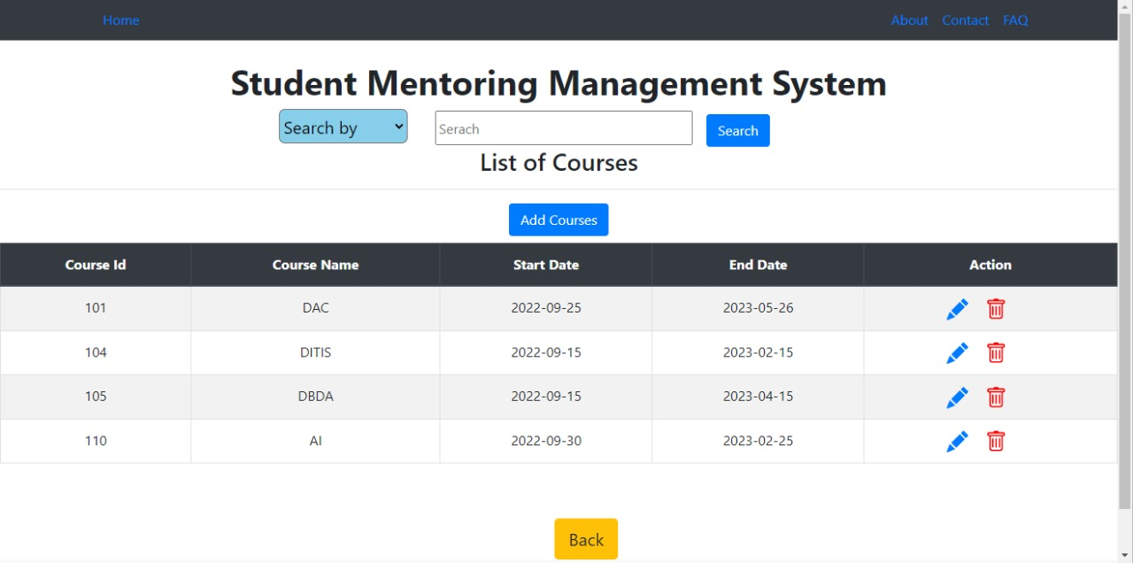
Course Details :

Slide 22
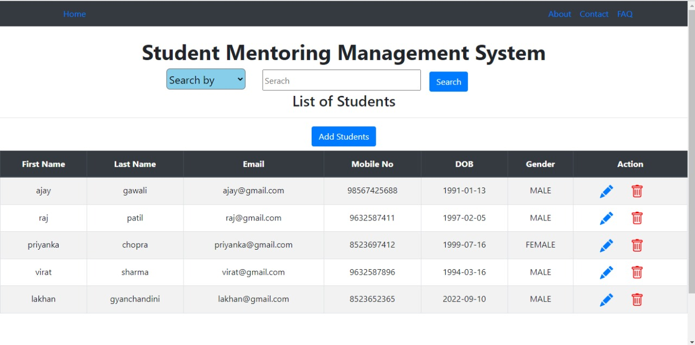
Student List :

Slide 23
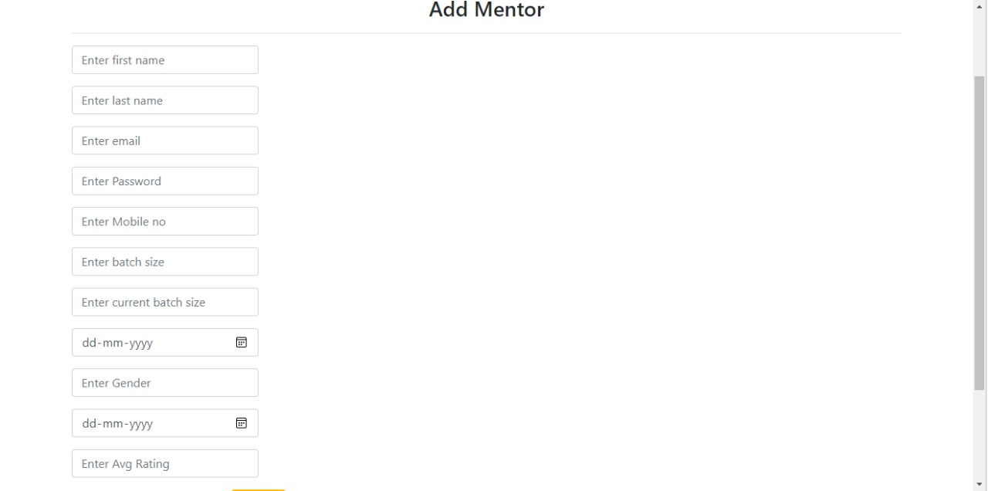
Add Mentor by Admin-

Slide 24
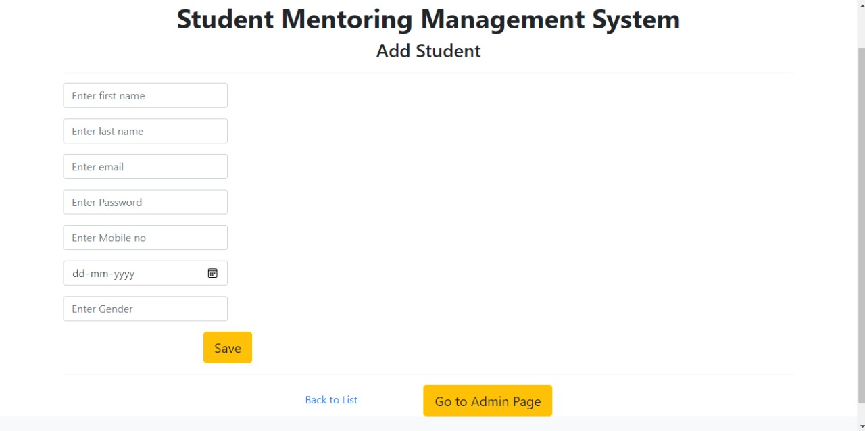
Add Student By Admin

Slide 25
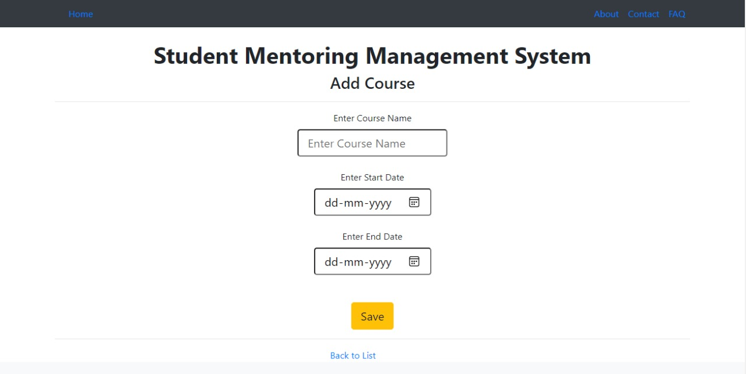
Add Course

Slide 26
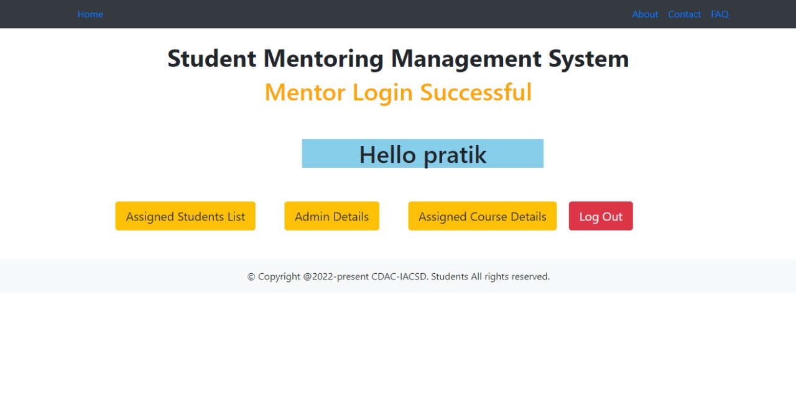
Mentor Home Page

Slide 27
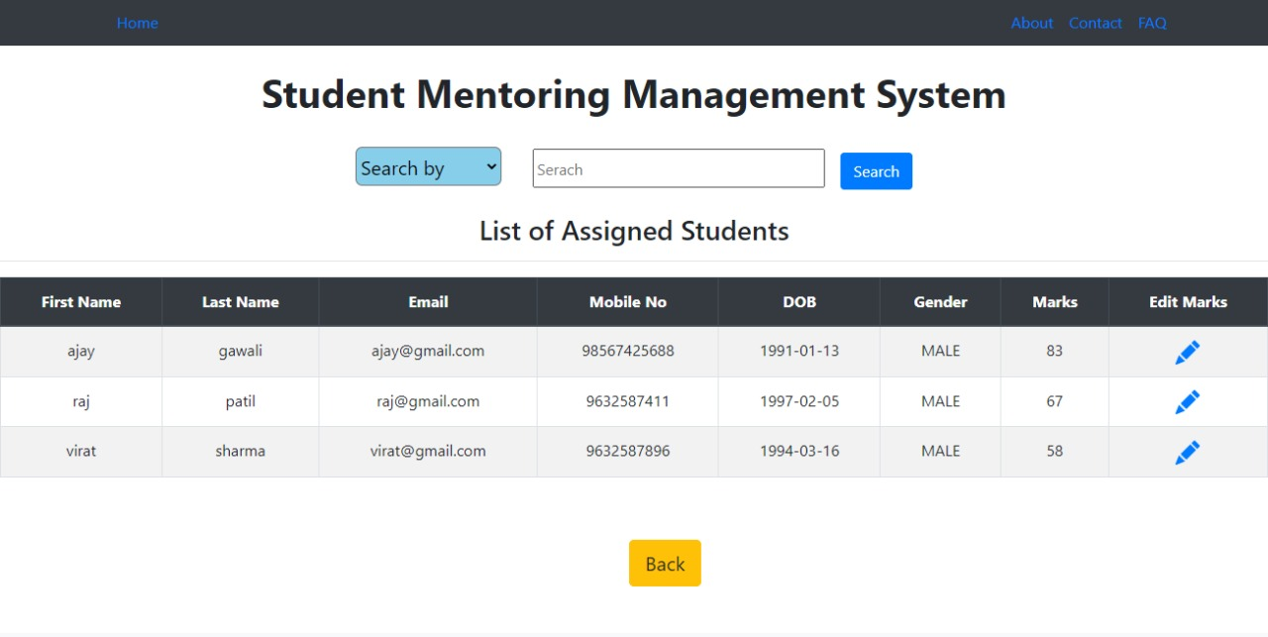
Mentor Assigned Students

Slide 28
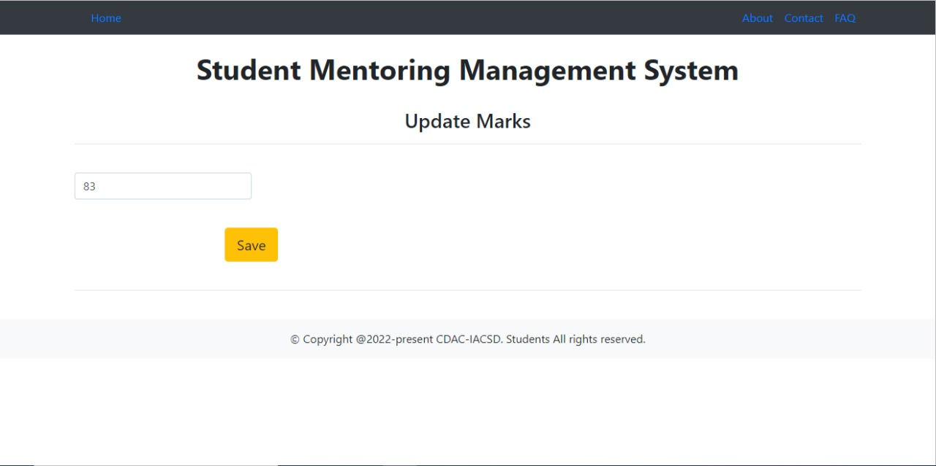
Mentor Update Marks

Slide 29
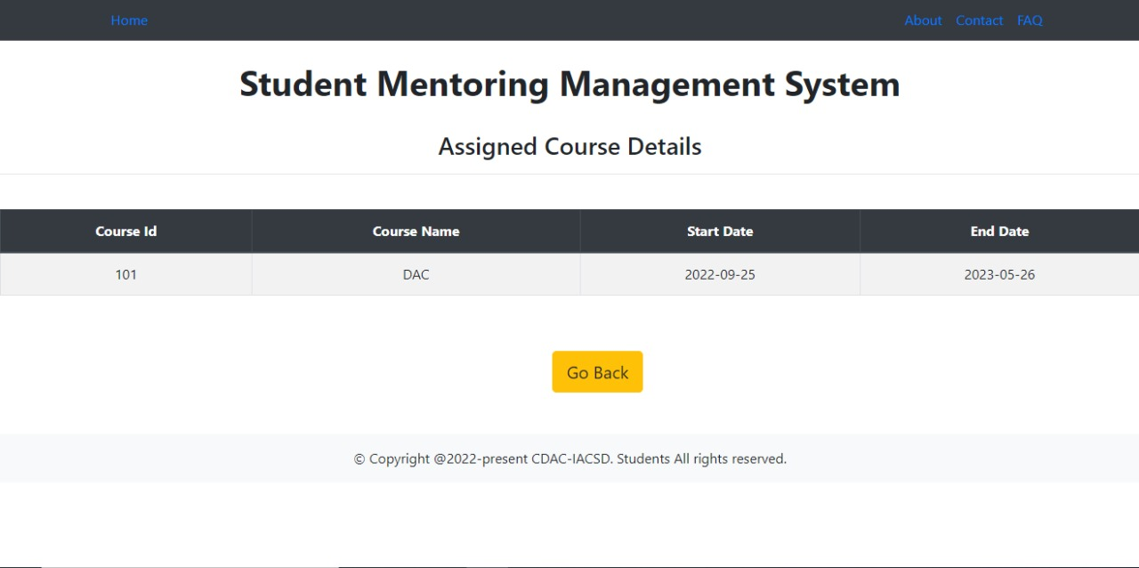
Mentor Assigned Course

Slide 30
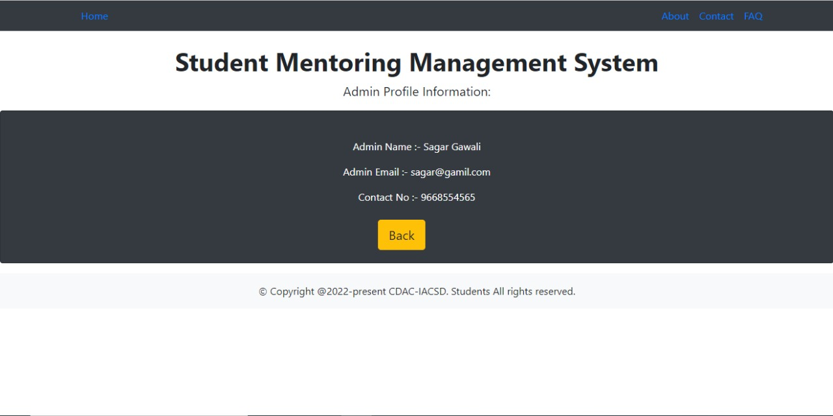
Admin Details

Slide 31
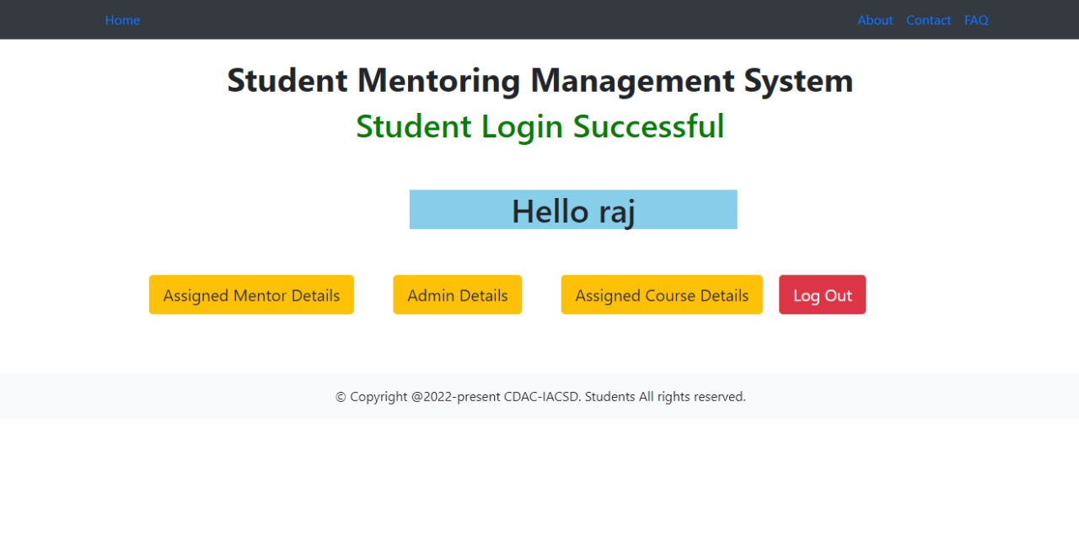
Student Home Page

Slide 32
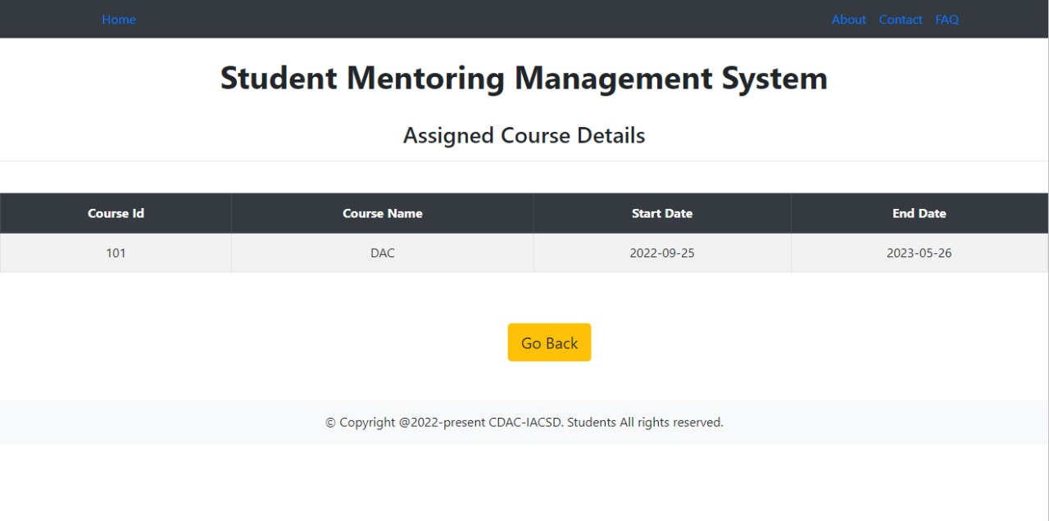
Student Assigned Course

Slide 33
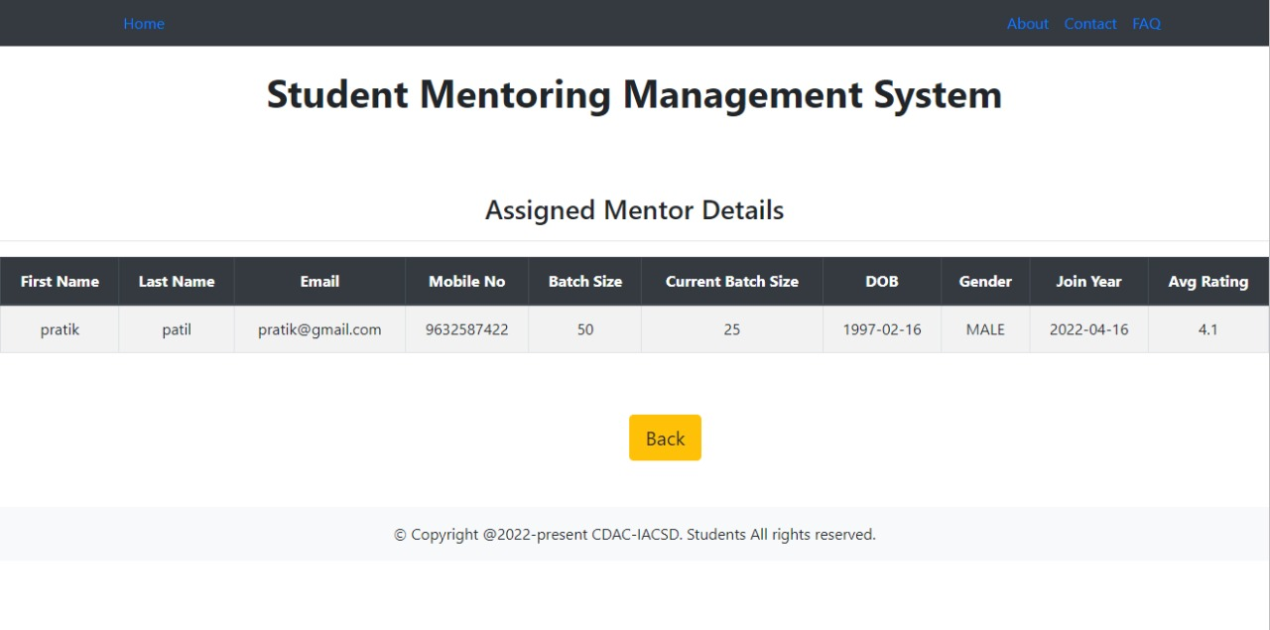
Student Assigned Mentor

Slide 34
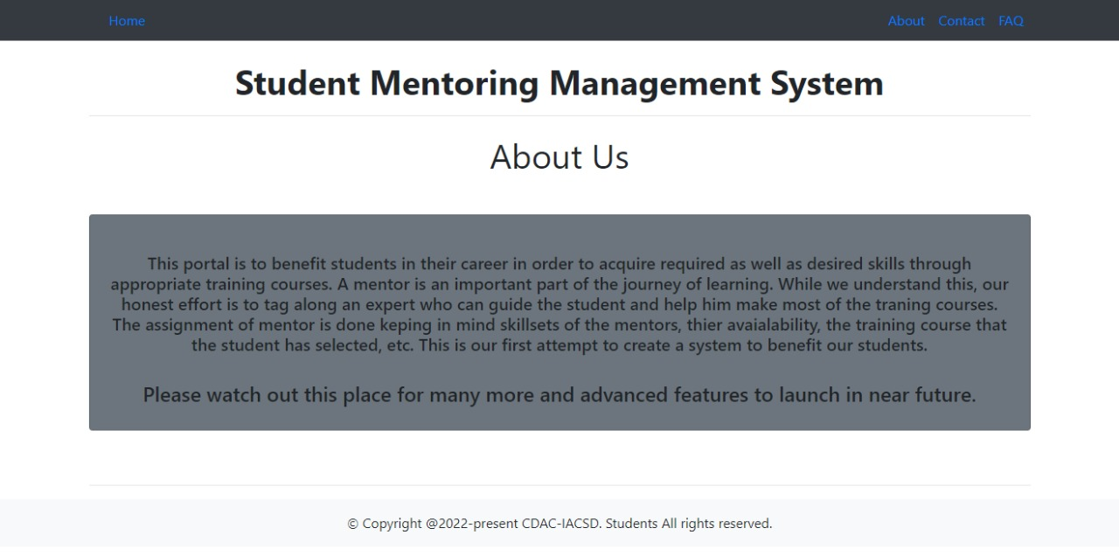
About Us

Slide 35
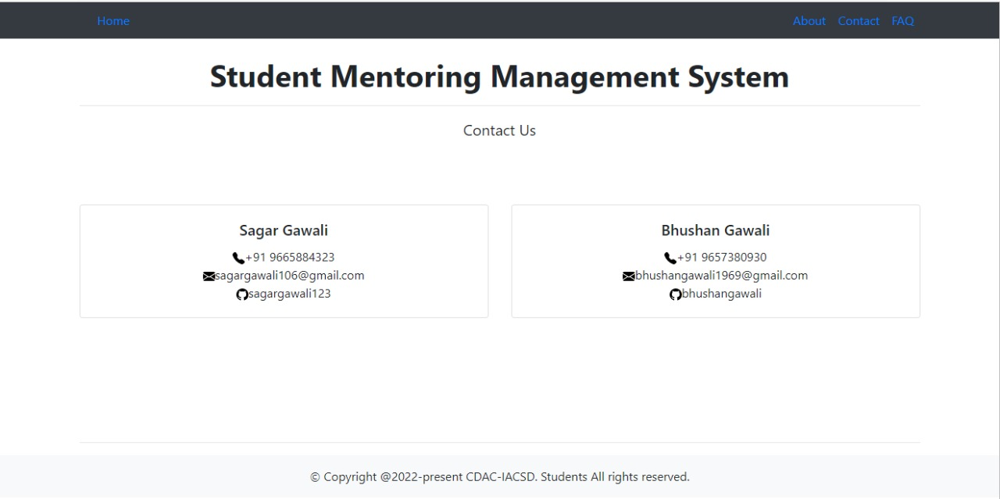
Contact US :

Slide 36
Future Scope:
As stated before, this project enhances the communication between student and mentor thereby improving the academic performances of the student. Each student is graded according to their Performances and they receive questions based on these grades. Their grades may improve or fall based on their performances. Hence varying levels of attention can be given to the students. By this work, we conclude that e-mentoring in an academic institute can be developed and tremendous System which is easily accessible to parents as well as mentors and students. Hence it will allow the mentors to dedicate more time whenever they wish and can give much precise feedback that will give proper guidance and the right solution to the problems of students.

Slide 37
Thank You

