Slide 1

Research Interests
Varun Dutt, M.S., Ph.D.
School of Computing and Electrical Engineering
School of Humanities and Social Sciences
Indian Institute of Technology Mandi, India
Scaling the Heights

Slide 2
Introduction: Education and Experience
Education:
B. Tech. in Computer Science and Engineering, Thapar University, India (2000-04).
Three M.S. degrees in Software Engineering, Engineering and Public Policy, and Rational Simulation (cognitive modeling; ACT-R framework) from Carnegie Mellon University (2005-2008).
Ph.D. in Engineering and Public Policy from Carnegie Mellon University (2011)
Post-doctoral fellowship at Carnegie Mellon University (2011-2012)
Working as an Assistant Professor at Indian Institute of Technology, Mandi, India (2012-Present)s
Experience:
Served as a Software Engineer in Tata Consultancy Services (TCS) and in MothersonSumi INfotech and Designs Ltd.
Served as a Lead Author on Chapter 2 on UN IPCC’s AR5 (WG III) report
Serves as a Knowledge Editor of a financial daily, Financial Chronicle
Serves as Advisor, Recruitments and Co-advisor, International Relations at IIT Mandi

Slide 3
Research Interests
Artificial Intelligence and Cognitive Modeling (modeling human behavior in dynamic tasks through computer algorithms)
Human-Computer Interaction (studying interaction between people and computers)
Environmental Decision Making (understanding human behavior in environmental problems)
Judgment and Decision Making (understanding human behavior in problems involving risk and uncertainty)
Situation Awareness (recognition, comprehension, and projection of a situation in the decision environment)
In general, how do we humans make decisions?

Slide 4
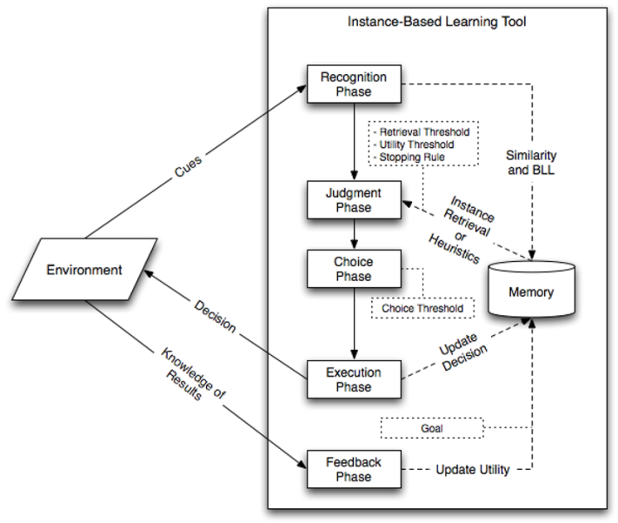
Instance-based Learning Theory (IBLT) (Dutt, & Kaur, 2013; Dutt & Gonzalez, 2012; Gonzalez & Dutt, 2011; 2012)
A Simulated Decision Maker
A Decision Task
Exchange of Information

Slide 5
IBLT (contd.)
IBLT is represented in a recently created modeling tool: IBLTool (Dutt & Gonzalez, 2012) (downloadable under academic license from: www.cmu.edu/ddmlab/ibltool.htm)
In fact, IBLT has been used to explain human behavior in several simulated tasks with diverse applications:
  Binary choice; information search; cyber security tasks; signal detection tasks (luggage screening); dynamic control tasks (dynamic climate change simulator); simulated mining emergencies; radar operator task; resource allocation in battlefield; 2x2 games (PD); market-entry task etc.

Slide 6
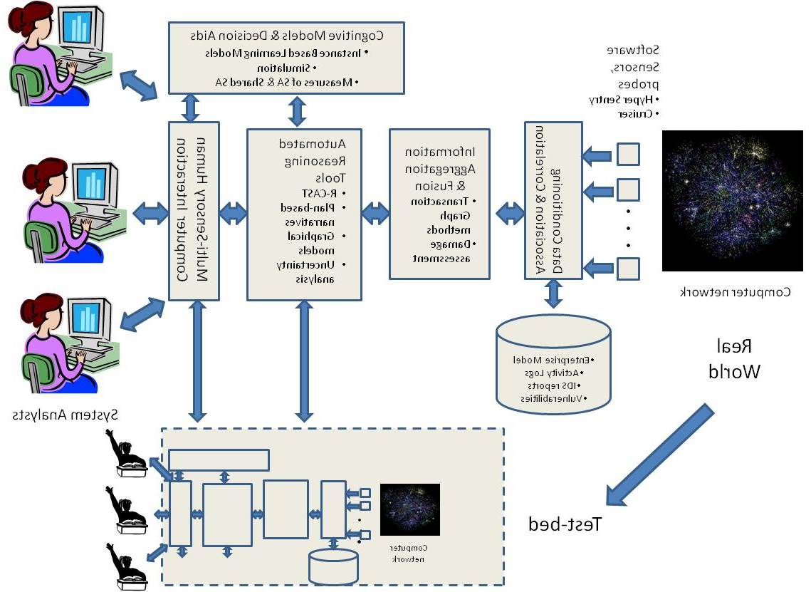
Methodology: Experimentation and modeling work well together
Experimentation
Computational Modeling
Decisions
Decisions
Decision
Task
Cognitive Model
Participant
Feedback
Feedback
Human Data
Model Data
Model Improvements
Human Experiments
Comparison

Slide 7
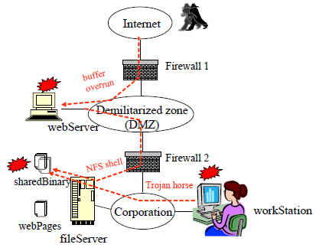
Cyber Security
Testing the effects of attack strategy, similarity, and experiences on cyber-attack detection.
Testing the effects of attacker’s attack strategy and defender’s tolerance on cyber-attack detection.
Testing the effects of recency and inertia in defender’s decisions on timely detection of cyber attacks.
Computationally modeling the strategies of an attacker and those of a defender on some common kinds of cyber-attacks (after investigating these strategies via experimentation) – game theoretic (Cyber Attack Game)

Slide 8
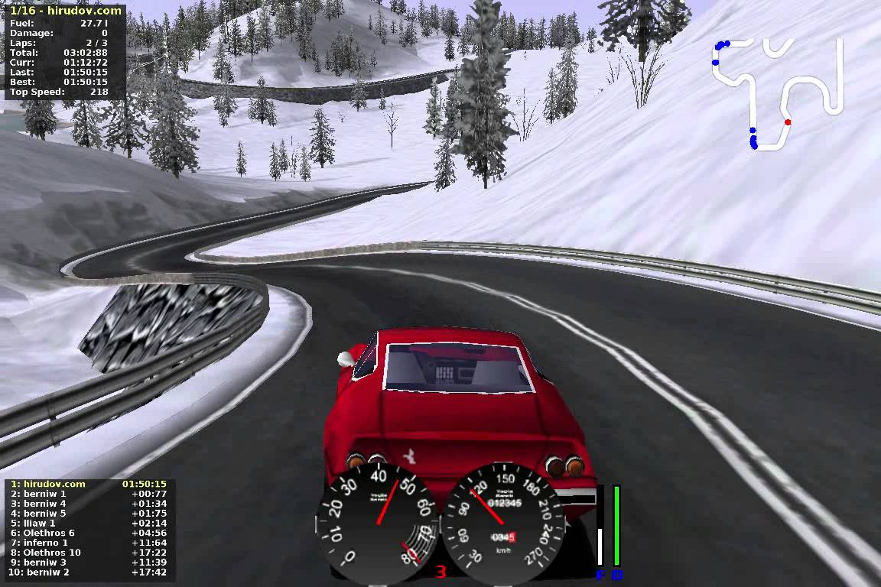
Driving Decisions
Modeling Effects of Track Complexity and Track elevation (in mountains) on driving decisions.
Evaluating the interaction of Demographic factors (driving experience, style, age) and Track Complexity on driving decisions.

Slide 9
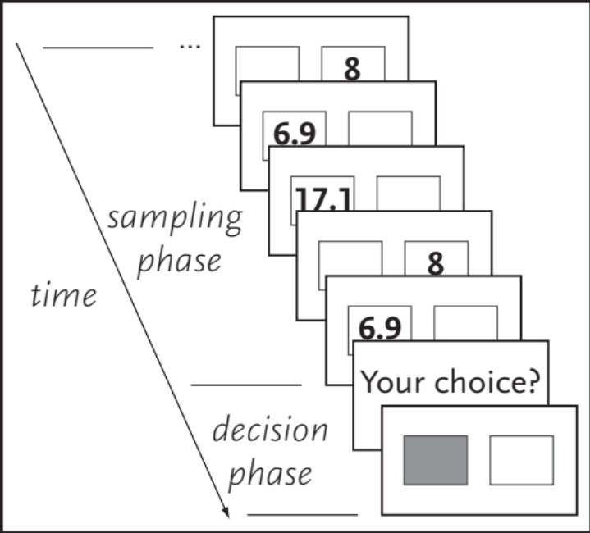
Decisions from Experience:
Information Search, Subsequent Choice, and Repeated Decisions
How people’s search for information search is affected by variability of information, experienced maximization, and timing of rewards.
How much information do we need before we stop our information search and make a choice?
What are the similarities and differences between repeated choices and sampling and then making a final choice?
How could we computationally model people’s search and subsequent choice behaviors?
What are the patterns of brain activations during people’s search for information?
How does information search map to the real world? (e.g., consumer purchasing decisions)

Slide 10
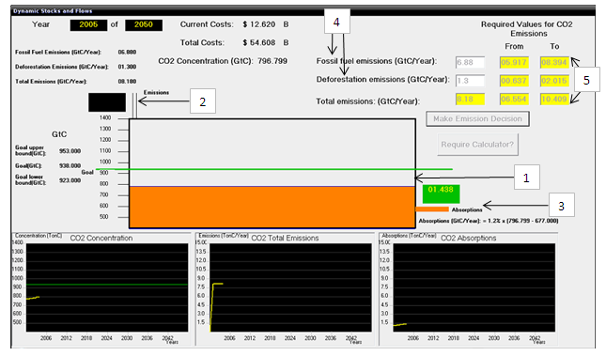
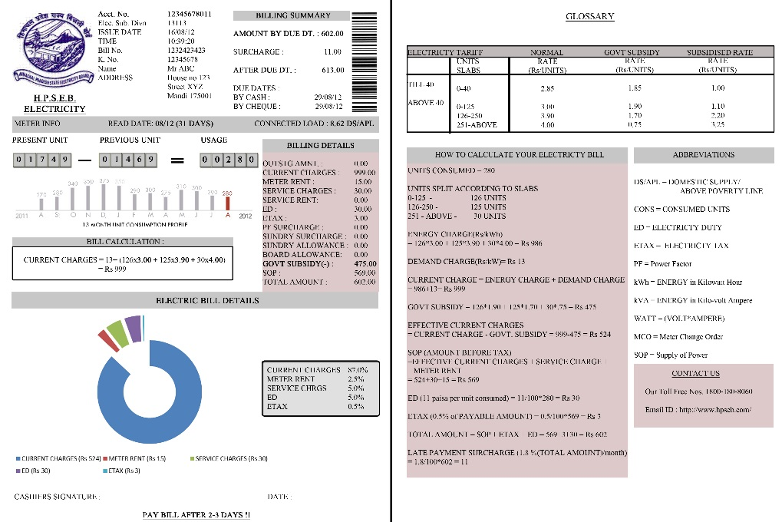
Environmental Decision Making
(Climate Change)
Common human understanding and misperceptions about climate change.
Effects of dynamic games, physical representation, and heuristic rules in alleviating human misperceptions about climate change.
Testing common misperceptions and understanding about climate change in the developing world (India).
Understanding people’s electric energy consumption patterns and how these patterns could be changed as a result of social norms and feedback in games.

Slide 11
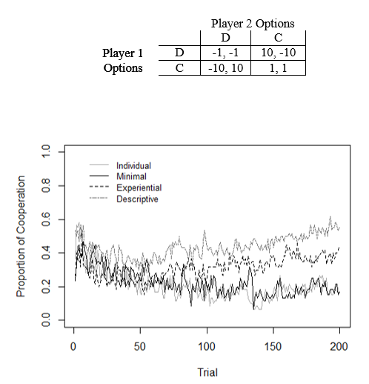
Behavioral Game Theory
Understanding and computationally modeling decision-making in 2x2 games (like Prisoner’s Dilemma and Chicken) with varying amounts of information known to the two players.
Modeling the effects of payoffs to each player in dynamic public-goods games.
How people transfer learning from one game to another game.
How people make decisions in public-goods games (particularly those where there are incentives to free ride – e.g., climate change)

Slide 12
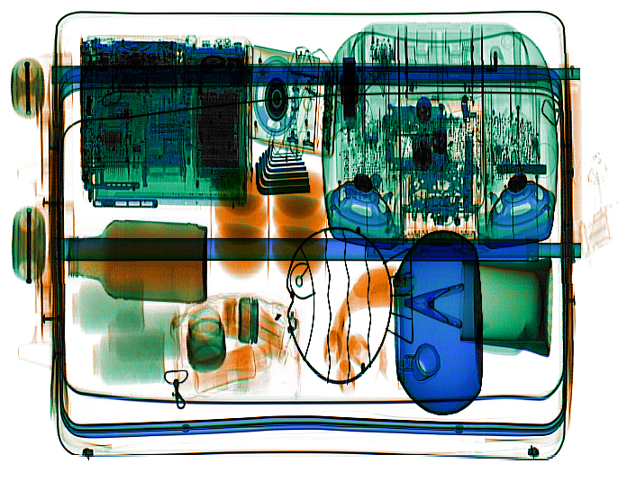
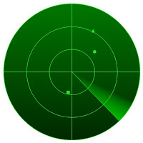
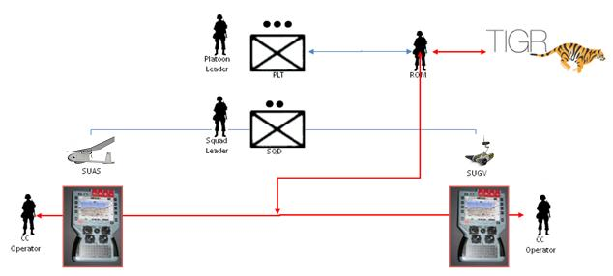
Decision Making in Radar Detection, Luggage Screening, and Resource Allocation on Battle field

Slide 13
Current Research Group at IIT
1 Post-doc
2 Ph.D. students (+1 joining over summer)
15 Undergraduate students
1 undergraduate student visiting from HEPIA, Switzerland

Slide 14
Thank You
Email: varun@iitmandi.ac.in
Phone: +91-862-797-4036 (India); +1-412-346-8005 (USA)

