Slide 1

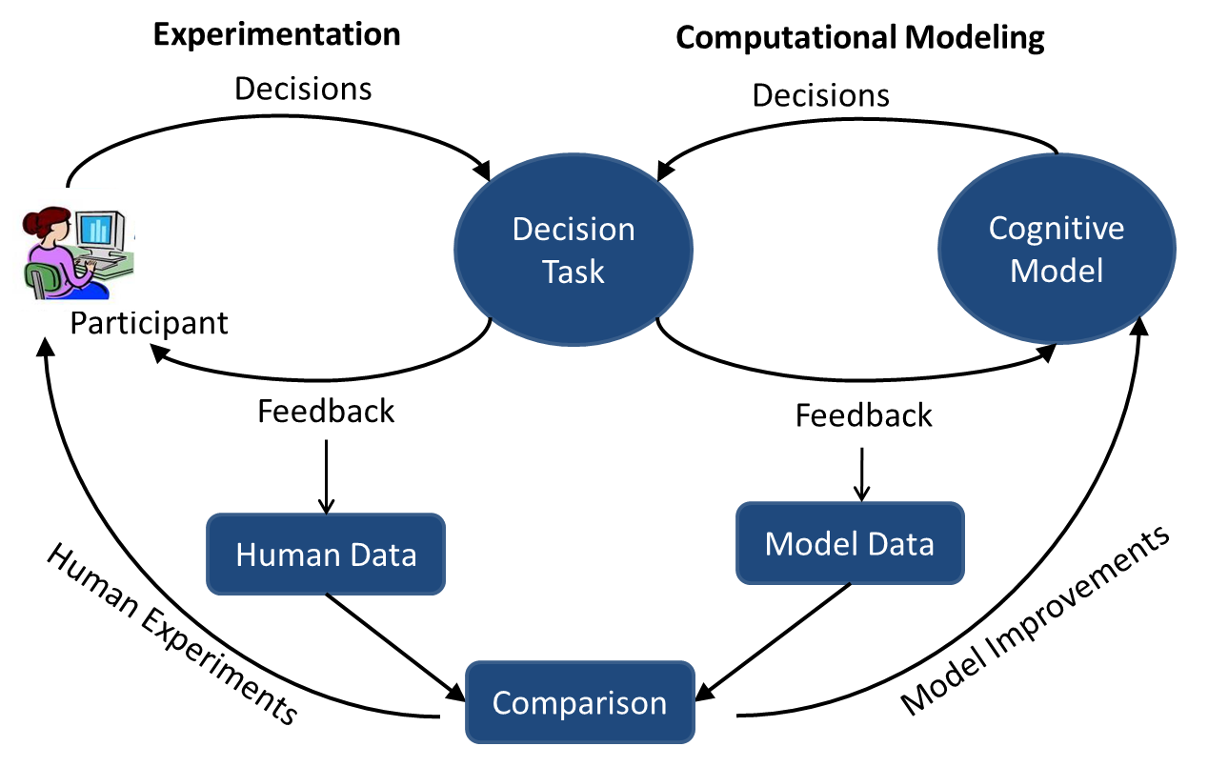
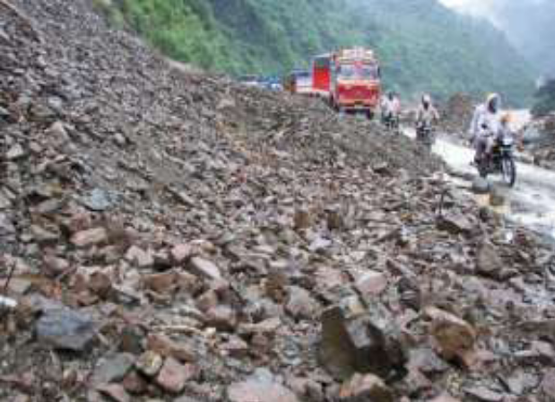
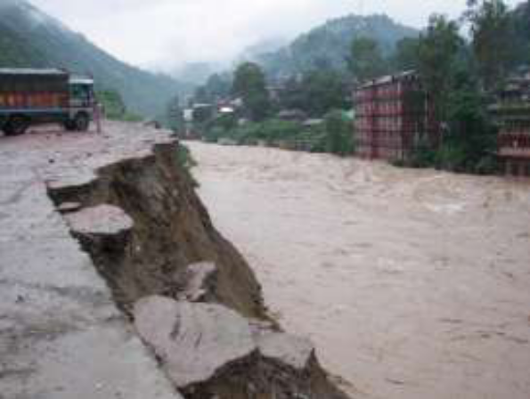
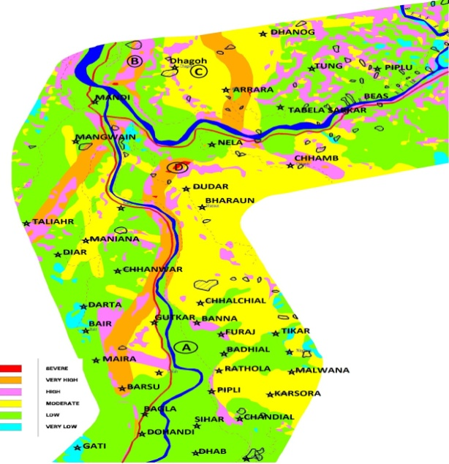
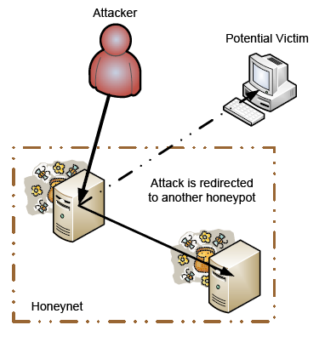
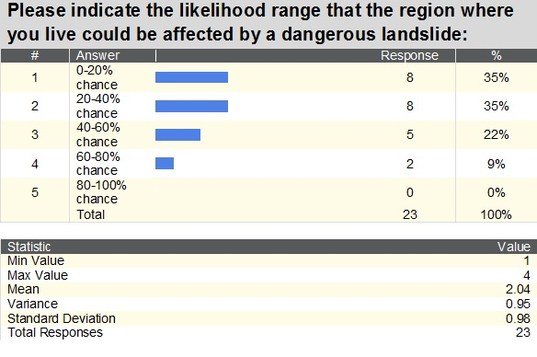
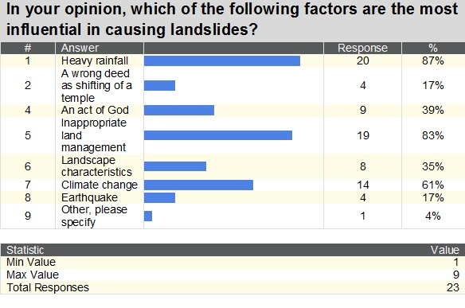
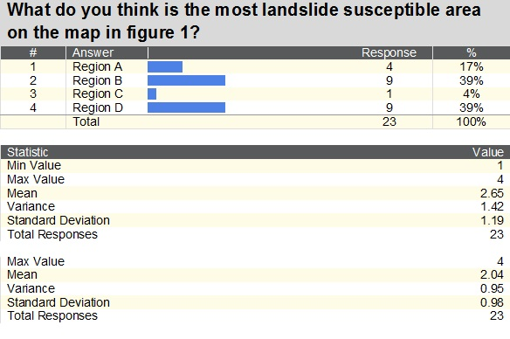
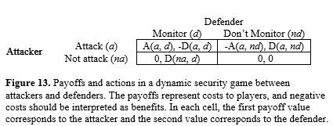
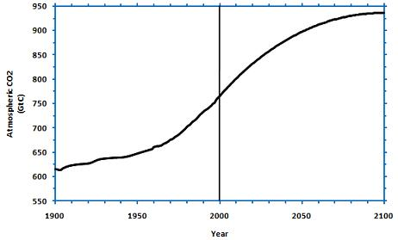
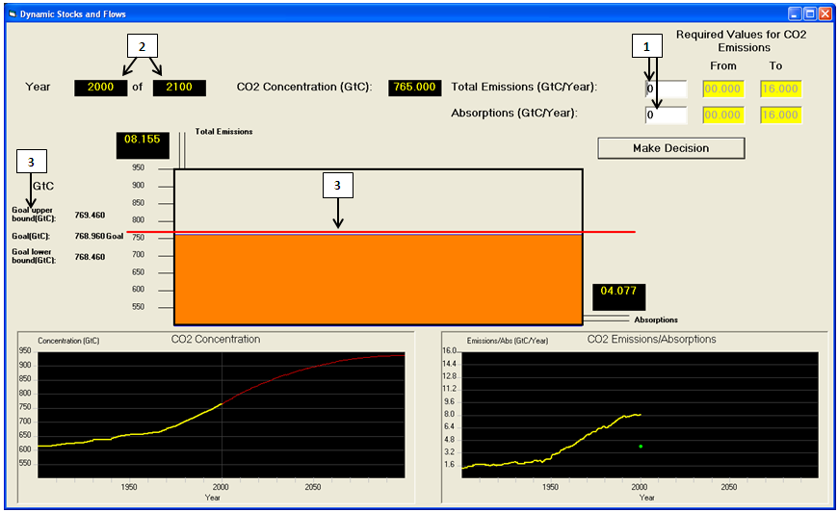
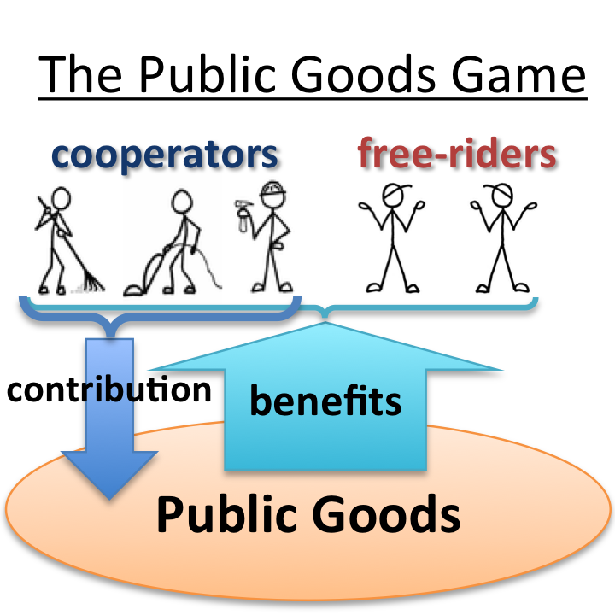
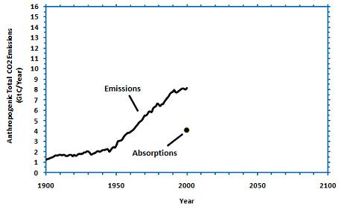
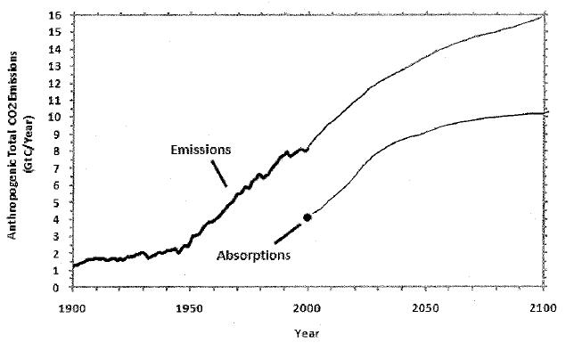
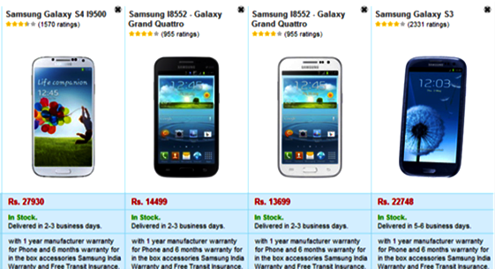
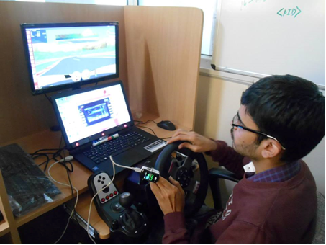
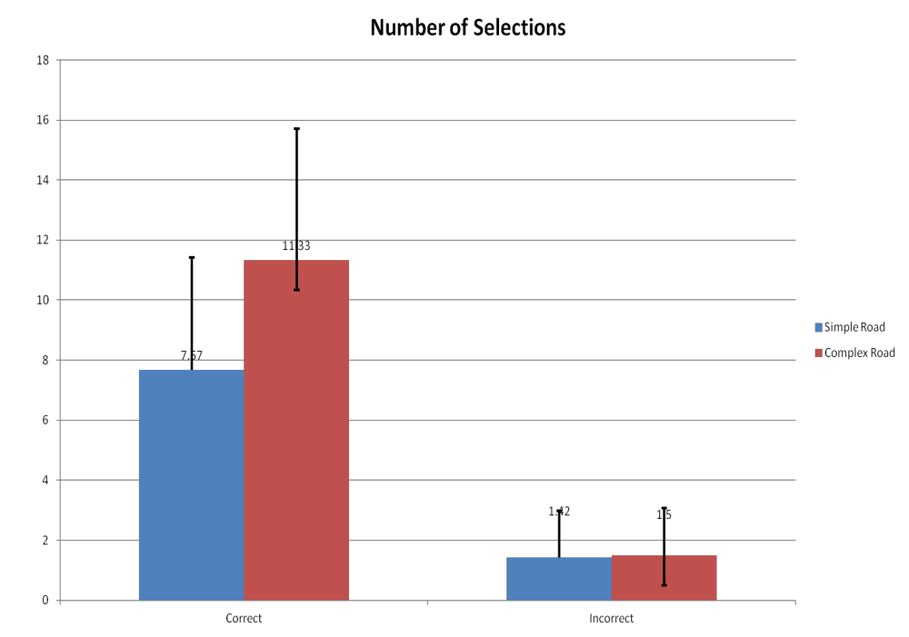
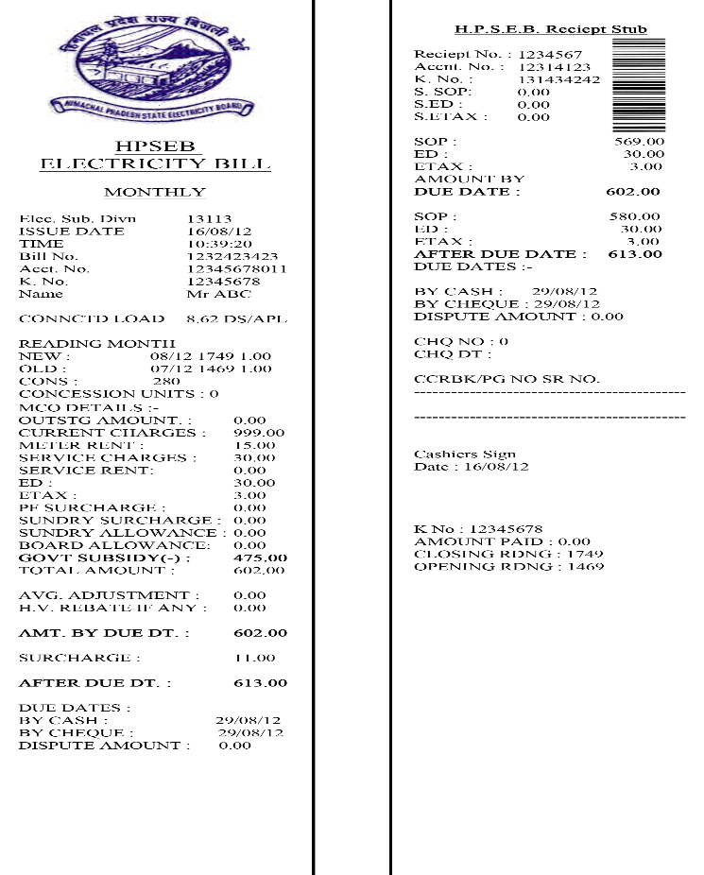
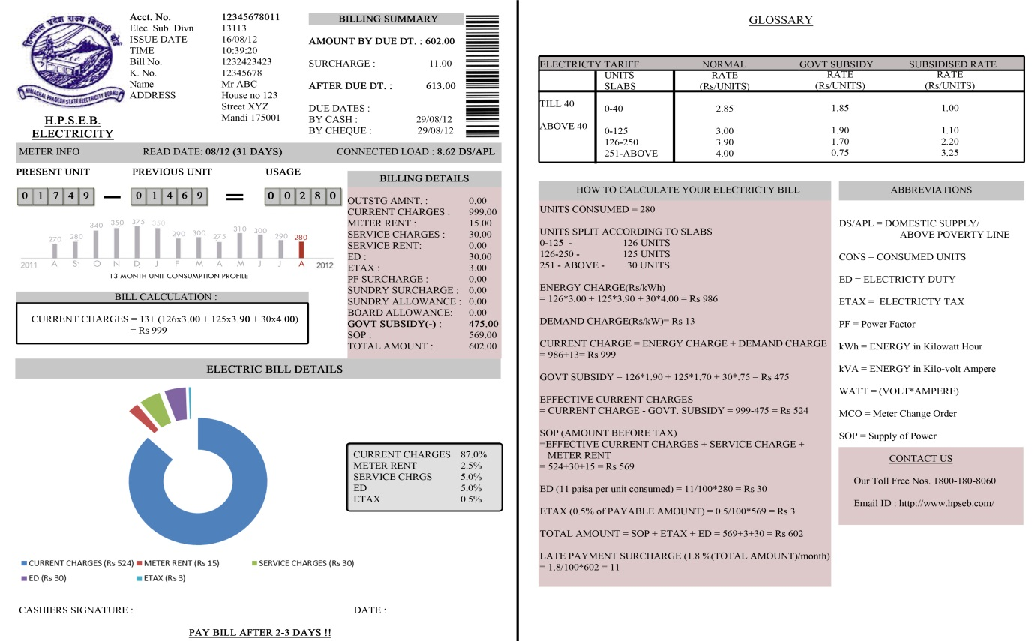
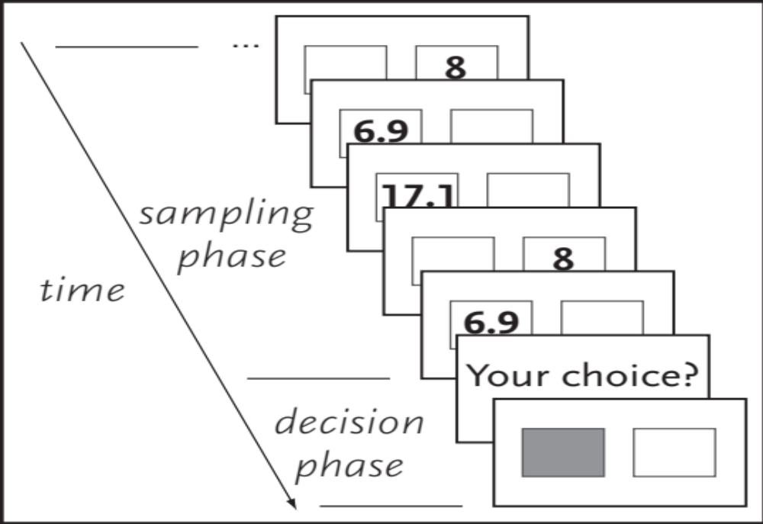
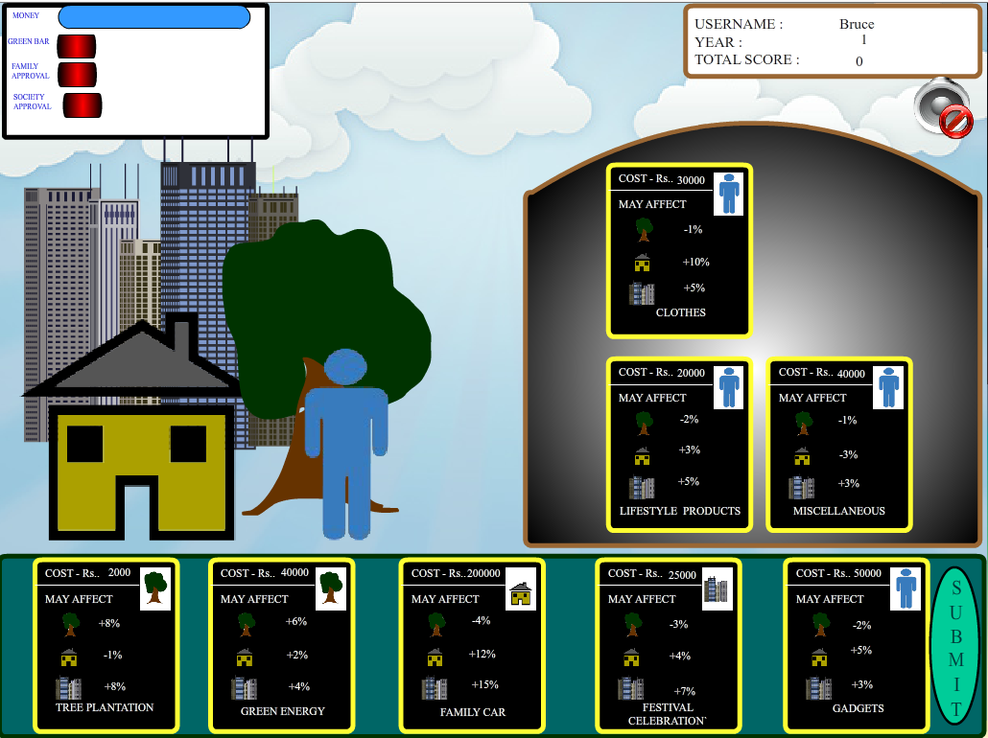
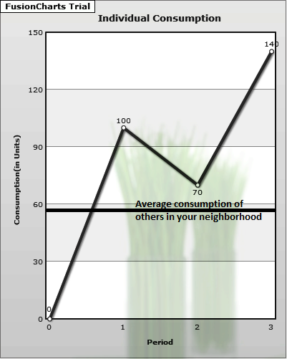
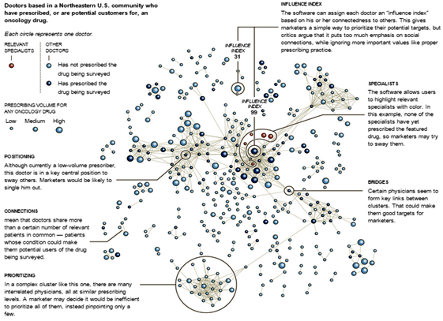
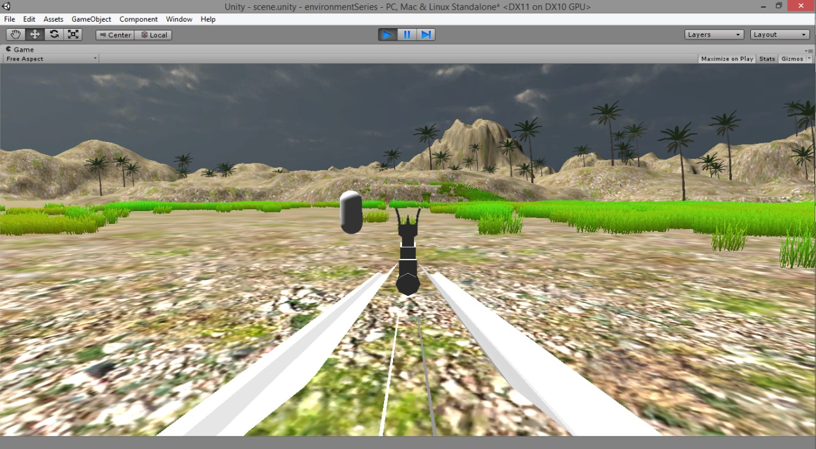
APPLIED COGNITIVE SCIENCE (ACS) LAB
Dr. Varun Dutt, Assistant Professor & Principal Investigator
IIT Mandi, H.P., India – 175005 Phone: +91-1905-267041 Email: varun@iitmandi.ac.in
Introduction to ACS Lab
Public perception of landslides in Himachal Pradesh
Cyber Security
Objective: The main focus of the lab is to investigate decision making and cognition in applied domains.
Methodology:
Applications: Understand the effects of existing designs on human cognition and how improvements in existing designs could enhance cognition. Develop training interventions in applied domains. For example, training security analysts against certain kinds of cyber-attacks helps to improve their on-job performance.
Resources: Human: post-doctoral fellows, graduate and undergraduate students, and student interns. Infrastructure: Air-conditioned (hot and cold) environment with state-of-the-art 7 AIO Desktops, 1 workstation, driving simulator, Oximeter, Emotiv® 14-channel EEG headsets, Tobii® Eye Tracker, and other accessories.
Objective: Main objectives of the study are: (1) To evaluate the public knowledge, risk perception, and attitude towards landslides. (2) To evaluate the influence of emotional appeal on knowledge, risk perception and attitude towards landslides. Applications: Improve risk perception and awareness among people and provide better decision support to policy makers in countering landslide risk.
Objective: Study the role of climate-change losses and information sharing among players on monitory contributions made against climate change in a public-goods game (Figure 8). Applications: Understanding how climate-change losses and informational sharing influences people’s negotiations against climate change.
Objective: Study how social network analysis and social media information could be used for finding prescribing histories and relationships among doctors, who are the best potential targets for marketing medicines. Applications: Develop efficient algorithms to identify critical agents in a social network for marketing products.
Role of deception in cyber attack detection
Objective: Explore decision-making of hackers and security-analysts in a cyber-infrastructure using deception (Figure 12). Applications: Help improve current technical solutions and provide effective decision support to analysts in countering cyber attacks via deception.
Researchers: Dr. Varun Dutt, PI; Palvi Aggarwal (graduate student). Support: DietY, GOI (Visvesvaraya PhD scheme)
Figure 5. The 2007 landslide in Khaliyar (Mandi)
Figure 6. Landslide Susceptibility Map of Mandi district, H.P.
Figure 12. Using Deception to lure an attacker into a honeypot and evade a potential victim
Building a secure and trustworthy cyberspace: A behavioral game-theoretic approach
Objective: Study the influence of motivational factors (e.g., costs and benefits of actions from the hacker’s and analyst’s viewpoint), environmental factors (e.g., information available to players about each other), and technology constraints (e.g., how network responds based upon the defender’s actions and network’s accuracy about reporting attacks) on the interaction between hackers and analysts. Applications: Help meet our nation’s cyber-security goals by evaluating the role of motivational, environmental, and technological factors on cyber attack detection.
Figure 7. Some results from a survey conducted at Mandi
Researchers: Dr. Varun Dutt, PI; Pratik Chaturvedi (graduate student), DTRL, DRDO. Support: IIT Mandi; DTRL, DRDO
Role of monetary losses and information sharing on negotiations against climate change
Research @ ACS Lab
Researchers: Dr. Varun Dutt, PI; Dr. V. S. Chandrasekhar Pammi, Co-PI (CBCS, Univ. of Allahabad); Dr. Debarati Bandyopadhyay (Post-doc); Zahid Maqbool (graduate student). Support: DST, GOI
Environmental Decision Making
Improving public understanding of climate change
Decisions from Description and Experience
A
Researchers: Dr. Varun Dutt, PI; in collaboration with Prof. Cleotilde Gonzalez (Carnegie Mellon University, USA). Medha Kumar (graduate student). Support: IIT Mandi
Decisions under Risk: Modeling Choices at the Individual Level in Decisions from Information Search
B
Figure 8. The Public Goods Game (Allen, 2011)
Objective: Test ability of computational models of aggregate choice to explain choices at the individual level in tasks involving choices after sampling information. Applications: Developing models that predict choices in a large class of decisions involving sampling before a choice (e.g., choosing careers, online or offline consumer choices, etc.).
C
Driving Decisions
Effect of road conditions on gaze-control interface in an automotive environment
Figure 1. The climate Stabilization (CS) Task. (A) Participants are given CO­₂ concentration stabilization scenario, and (B) they are required to sketch the CO₂ emissions and absorptions corresponding to the scenario. (C) A typical response showing reliance on the correlation heuristic (emissions similar in shape to CO₂ concentration) and mass balance violation (emissions > absorptions in 2100, i.e., when CO₂ concentration stabilizes).
Figure 2. The Dynamic Climate Change Simulator (DCCS) microworld. The microworld is a dynamic replica of the CS task. (1) Participants set yearly CO₂ emissions and absorptions and press Make Decision button. (2) The system now moves forward a certain number of years. (3) Participants need to maintain their CO₂ concentration at the red goal line in the tank (which represents the atmosphere) and follow the CO₂ concentration trajectory shown in the bottom left panel. The DCCS helps people improve their decisions in the CS task.
Researchers: Dr. Varun Dutt, PI; Neha Sharma (graduate student). Support: Tata Consultancy Services Ltd.
Figure 14. Buying a phone after sampling prices and customer rating.
Decisions under Ambiguity: Role of Set Size, Payoff Variability and Experienced Expected Value on the Description-Experience gap
Researchers: Dr. Varun Dutt, PI; in collaboration with Dr. Cleotilde Gonzalez (Carnegie Mellon University, USA). Support: IIT Mandi
Figure 9. A participant driving a vehicle while controlling a music system with his eyes
Figure 10. Number of selections in music-system task across different road conditions
Objective: Investigate the role of choice-set size, payoff variability and experienced utility on choices when decisions are made under ambiguity (unknown) conditions. Applications: Model ambiguity-aversion and ambiguity-seeking based on description and experience, respectively.
Improving public understanding of electric energy consumption patterns via social norms and feedback
Researchers: Dr. Varun Dutt, PI; in collaboration with Dr. Pradipta Biswas (Cambridge University, UK). Vinod Kumar (undergraduate student). Support: IIT Mandi, Cambridge University
Data Mining and Data Analytics
Machine Learning and Data Mining for Sales and Analytics in Pharma
Researchers: Dr. Varun Dutt, PI; Dr. Debarati Bandyopadhyay (Post-doc).
Support: IIT Mandi
Figure 15. The sampling paradigm as used in the TPT dataset (Erev et al., 2010).
Figure 3a. An example of the current HPSEB electric bill
Figure 3b. An example of an improved version of HPSEB electric bill
Decision Making for Defence Applications
Researchers: Dr. Varun Dutt, PI; Dr. Debarati Bandyopadhyay (Post-doc). Support: Purdue Pharma, USA
Understanding soldier’s cognition against adversaries in V-R Defense games
Objective: Study soldiers’ cognition in V-R defence games via simulation and modelling. Applications: Training soldiers for real-world combat situations.
Figure 11. Each circle represents a doctor with interconnections representing doctors sharing more than a certain number of relevant patients. Source: Activate Networks.
Researchers: Dr. Varun Dutt, PI; Chandan Satyarthi (undergraduate student); Support: Submitted for support
Figure 4. Left: The Eco-Game. A person could take different actions, namely, environmental, societal, and personnel. Right: The energy portal showing the historical consumption and average energy consumption in the neighbourhood.
Figure 16. A virtual battle field
Researchers: Dr. Varun Dutt, PI; Support: Submitted for support

