Slide 1

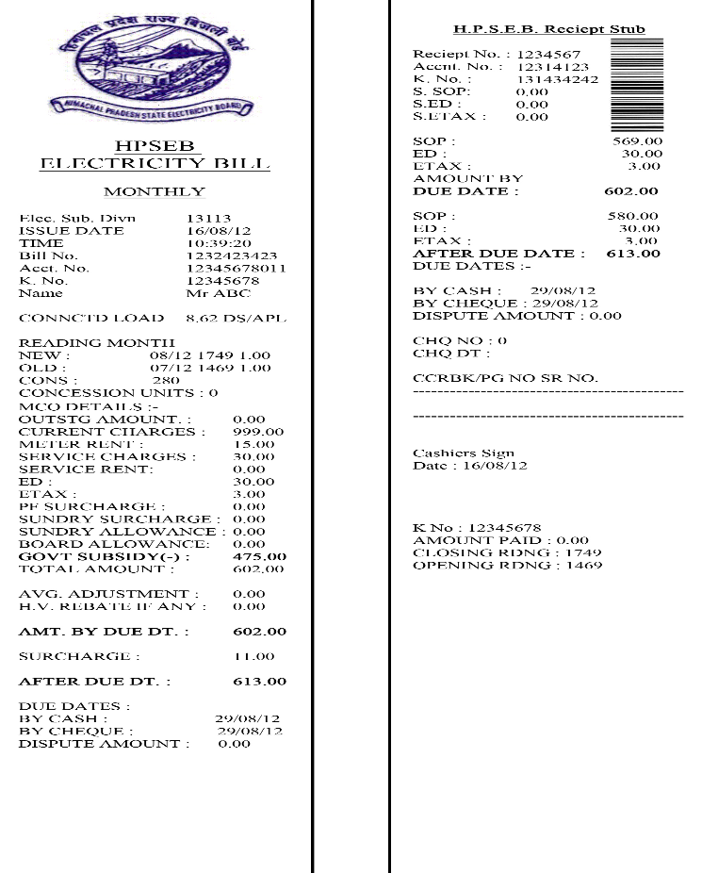
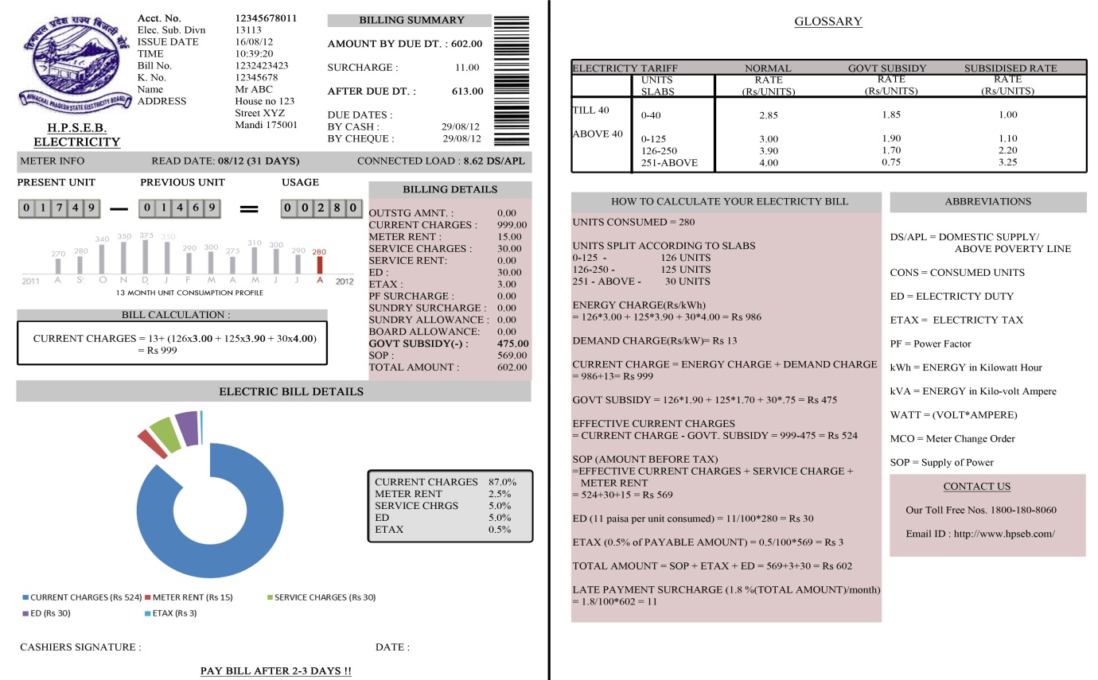
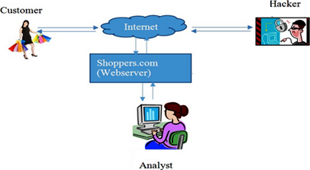
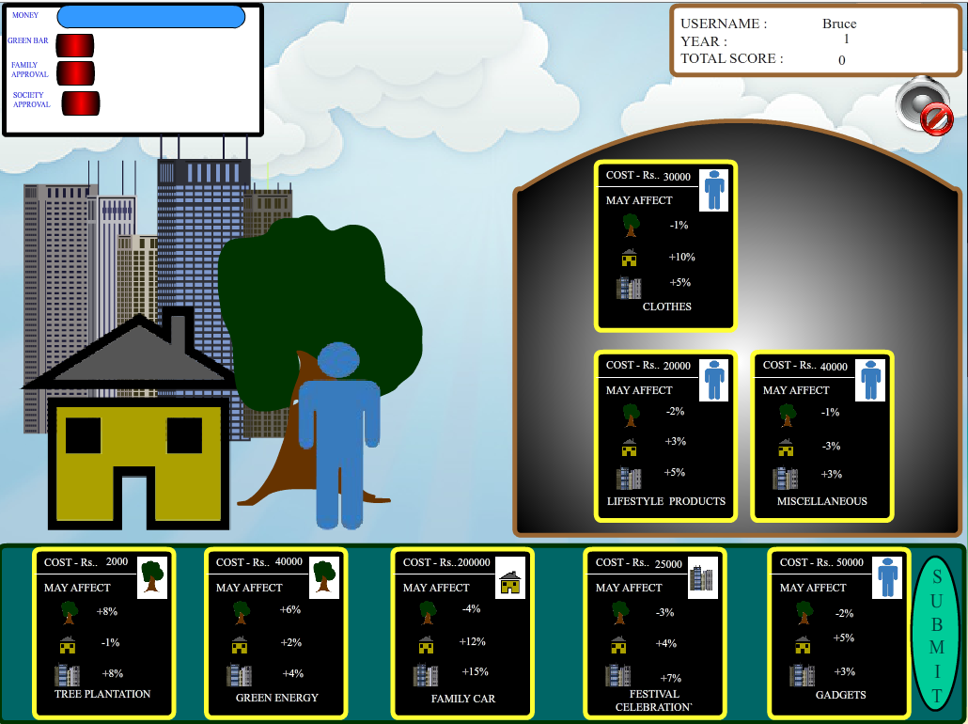
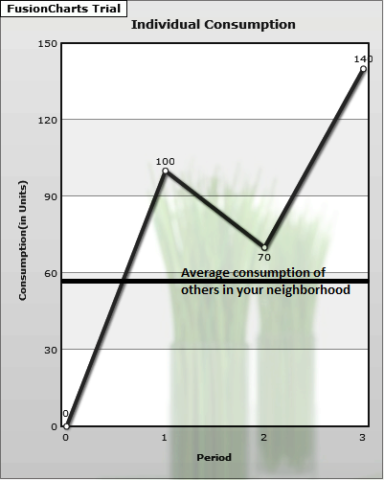
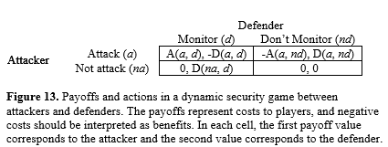
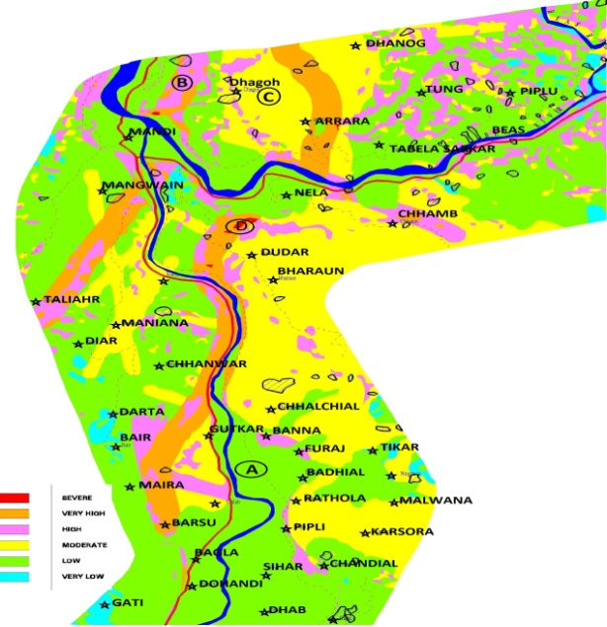
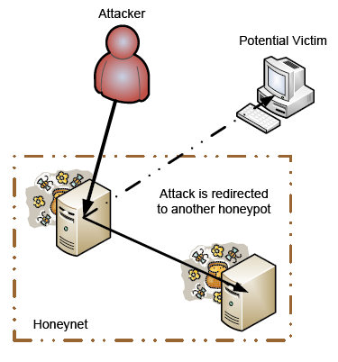
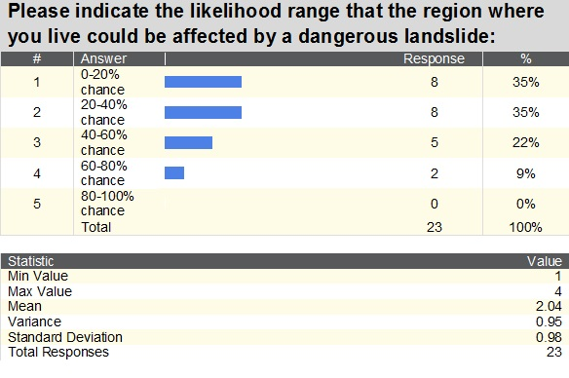
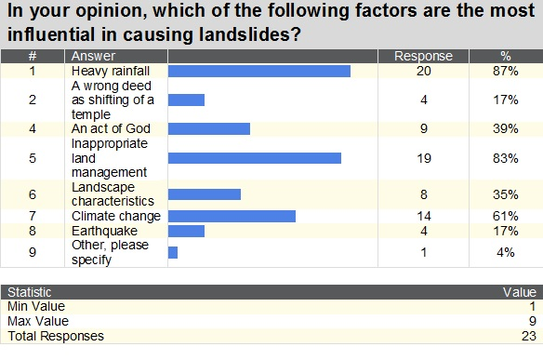
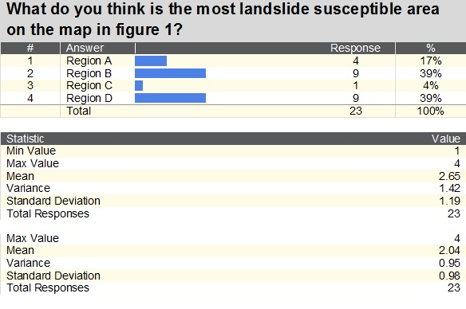
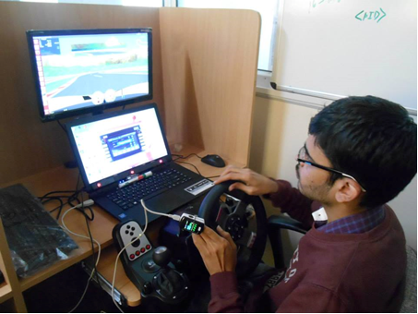

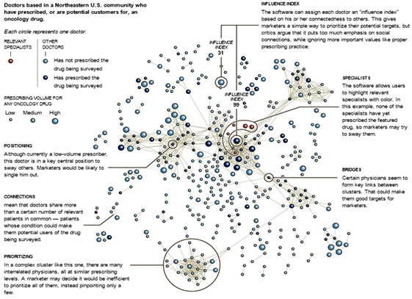

APPLIED COGNITIVE SCIENCE LAB
Dr. Varun Dutt, Assistant Professor & Principal Investigator
IIT Mandi, H.P., India – 175005 Phone: +91-1905-267041 Email: varun@iitmandi.ac.in
Improving public understanding of electric energy consumption patterns via social norms and feedback
Building a secure and trustworthy cyberspace: A behavioral game-theoretic approach
Objective: Influence of motivational factors, environmental factors, and technology constraints on the interaction between hackers and analysts. Applications: Help meet our nation’s cyber-security goals by making our networks more resilient against cyber attacks.
Figure 1a. An example of the current HPSEB electric bill
Figure 1b. An example of an improved version of HPSEB electric bill
Environmental
Decision Making
Figure 9.The cyber infrastructure at Shoppers.com. The Hacker tries to steal information and damage files on the webserver. The Analyst tries to protect the webserver from cyber-attacks from the Hacker.
Figure 2. Left: The Eco-Game. A person could take different actions, namely, environmental, societal, and personnel. Right: The energy portal showing the historical consumption and average energy consumption in the neighbourhood.
Researchers: Dr. Varun Dutt, PI; Dr. V. S. Chandrasekhar Pammi, Co-PI (CBCS, Univ. of Allahabad); Dr. Debarati Bandyopadhyay (Post-doc); Zahid Maqbool (graduate student). Support: DST, GOI
Cyber Security
Researchers: Dr. Varun Dutt, PI; Support: IIT Mandi; Submitted for support
Public perception of landslides in Himachal Pradesh
Objective: (1) To evaluate the public knowledge, risk perception, and attitude towards landslides. (2) To evaluate the influence of emotional appeal on knowledge, risk perception and attitude towards landslides. Applications: Improve risk perception and awareness among people and provide better decision support to policy makers in countering landslide risk.
Role of deception in cyber attack detection
Objective: Explore decision-making of hackers and security-analysts in a cyber-infrastructure using deception (Figure 11). Applications: Help improve current technical solutions and provide effective decision support to analysts in countering cyber attacks via deception.
Researchers: Dr. Varun Dutt, PI; Palvi Aggarwal (graduate student). Support: DietY, GOI (Visvesvaraya PhD scheme)
Figure 11. Using Deception to lure an attacker into a honeypot and evade a potential victim
Figure 3. The 2007 landslide in Khaliyar (Mandi)
Figure 4. Landslide Susceptibility Map of Mandi district, H.P.
Effect of road conditions on gaze-control interface in an automotive environment
Figure 5. Some results from a survey conducted at Mandi
Road Safety
Researchers: Dr. Varun Dutt, PI; Pratik Chaturvedi (graduate student), DTRL, DRDO. Support: IIT Mandi; DTRL, DRDO
Machine Learning and Data Mining for Sales and Analytics in Pharma
Figure 12. A participant driving a vehicle while controlling a music system with his eyes
Figure 13. Number of selections in music-system task across different road conditions
Objective: Study how social network analysis and social media information could be used for finding prescribing histories and relationships among doctors, who are the best potential targets for marketing medicines. Applications: Develop efficient algorithms to identify critical agents in a social network for marketing products.
Researchers: Dr. Varun Dutt, PI; in collaboration with Dr. Pradipta Biswas (Cambridge University, UK). Vinod Kumar (undergraduate student). Support: IIT Mandi, Cambridge University
Decisions from Description and Experience:
Decisions under Risk: Modeling Choices at the Individual Level in Decisions from Information Search
Decisions under Ambiguity: Role of Set Size, Payoff Variability and Experienced Expected Value on the Description-Experience gap
Decisions from Experience: An ERP Investigation of Decisions Based on Valuation of Outcomes and Probabilities
Decision Making for Defence Applications:
Understanding soldier’s cognition against adversaries in V-R Defense games
Data Mining & Data Analytics
Other Applications
Figure 7. Doctor-Medical Representative Relationship
Figure 8. Each circle represents a doctor with interconnections representing doctors sharing more than a certain number of relevant patients. Source: Activate Networks.
Researchers: Dr. Varun Dutt, PI; Dr. Debarati Bandyopadhyay (Post-doc). Support: Purdue Pharma, USA

