Slide 1
Pre-Project Presentation on BlogView
Presented By:
Krishna KC (610168)
Sagar Ghimire (610104)
Saroj Thapa (610138)
Yubraj Ghimire (610143)

Slide 2
Overview
Introduction
Problem Statement
System Architecture
Use Case Diagram
Sequence Diagrams

Slide 3
Introduction
Web Application
manages various blog posts belonging on several different categories
takes into account the user feedback and good content.

Slide 4
Problem Statement
Most of the existing blogs do not have reward based on the rating made by reader.
Rating system for every post by user
Payment based on rating and feedback
Category-wise blog system

Slide 5
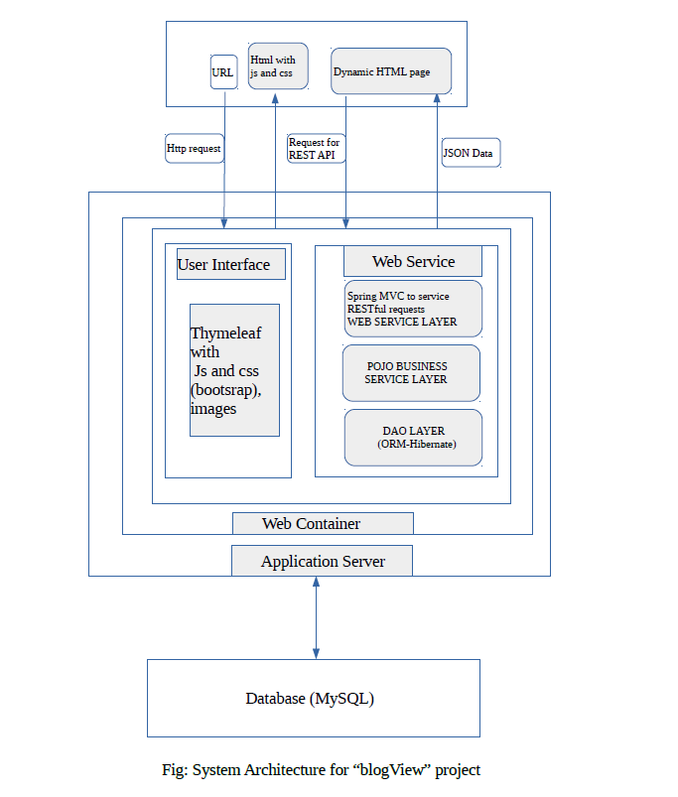
System Architecture

Slide 6
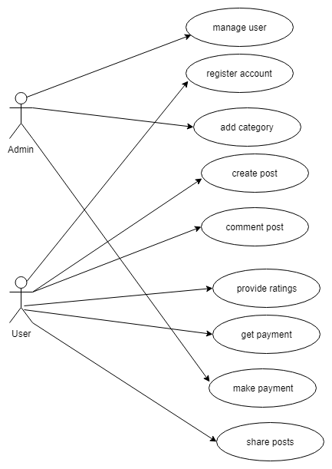
Use Case Diagram

Slide 7
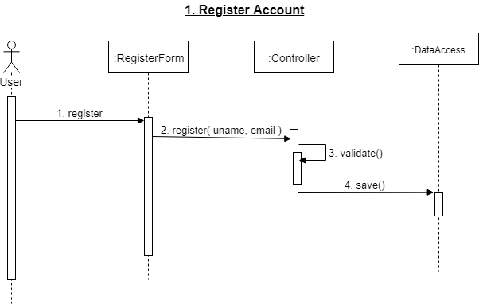
Sequence Diagram: Register Account

Slide 8
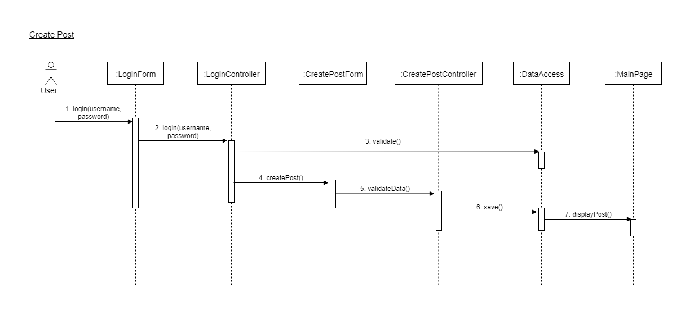
Sequence Diagram: Create Post

Slide 9
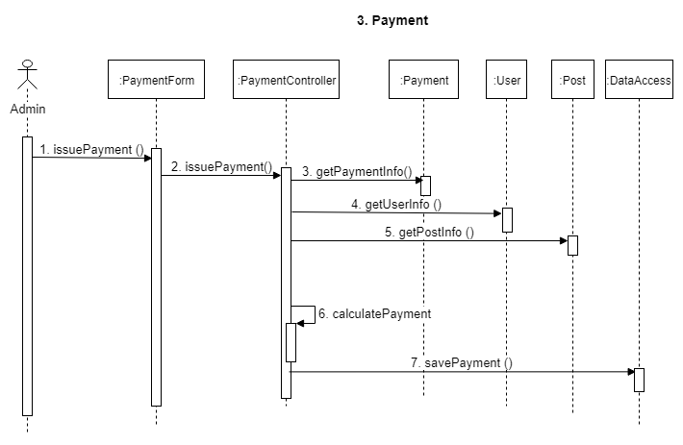
Sequence Diagram: Payment

Slide 10
Thank You

