Slide 1




SAGAR GIRADKAR
Introduction To JavaScript & TypeScript
Regional Centre 01

Slide 2
Introduction
Introduction
Introduction
1. TE IT Branch Student at PVG’s COET
2. Member of VLAB community from 1 year
3. Certified for GIMP,C++ and Java from Spoken tutorial of IIT Bombay
4. Completed VLAB Audit course
© MHRD Virtual Labs
Sagar Giradkar
PVG’s COET RNC 01

Slide 3
Agenda
Introduction to JavaScript
Introduction to Typescript
Input / Output
Comments
Variables var, const, let
Operators
Data Types
Scope
© MHRD Virtual Labs
Sagar Giradkar
PVG’s COET RNC 01

Slide 4
Introduction
JavaScript is a programming language.
JavaScript is Object Based and Object oriented Programming language.
JavaScript and JAVA are not same.
JavaScript is weakly typed, Client side Interpreted Language.
Designed by Brendan Eich for Netscape.
It was originally called Mocha, renamed to LiveScript, and then renamed to JavaScript. the official standard is just called ECMAScript
© MHRD Virtual Labs
Sagar Giradkar
PVG’s COET RNC 01

Slide 5
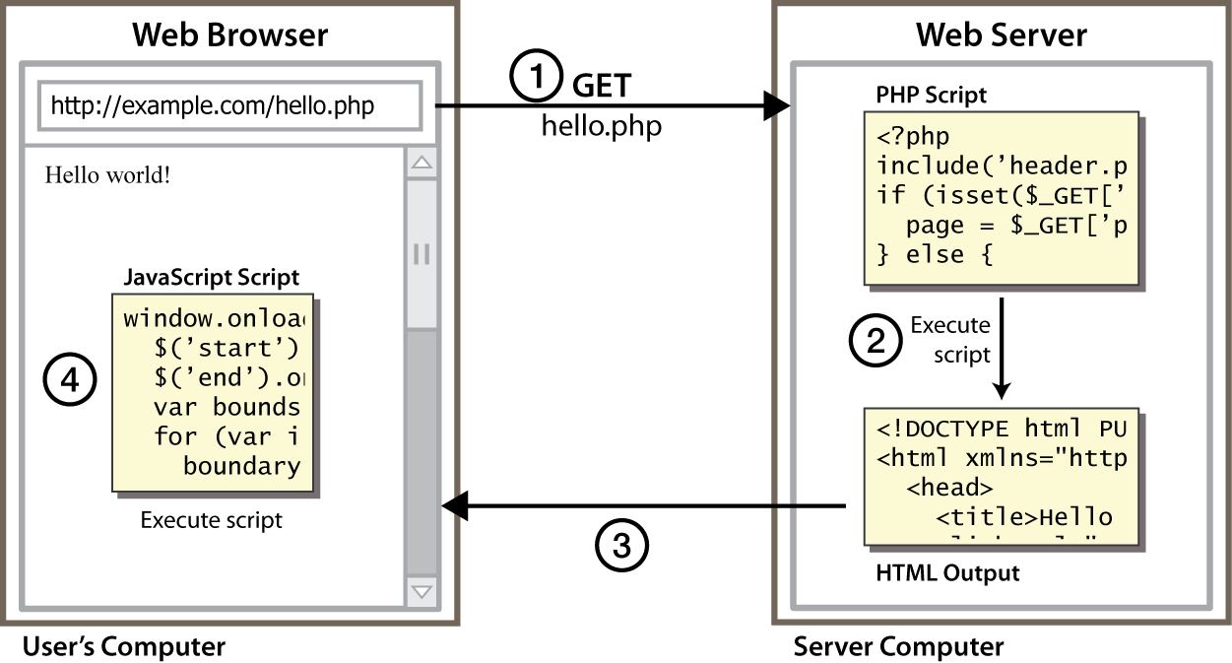
Client Side Scripting
© MHRD Virtual Labs
Sagar Giradkar
PVG’s COET RNC 01

Slide 6
Why use client-side programming?
server-side programming (PHP) benefits:
security: has access to server's private data; client can't see source code
compatibility: not subject to browser compatibility issues
power: can write files, open connections to servers, connect to databases, ...
© MHRD Virtual Labs
Sagar Giradkar
PVG’s COET RNC 01

Slide 7
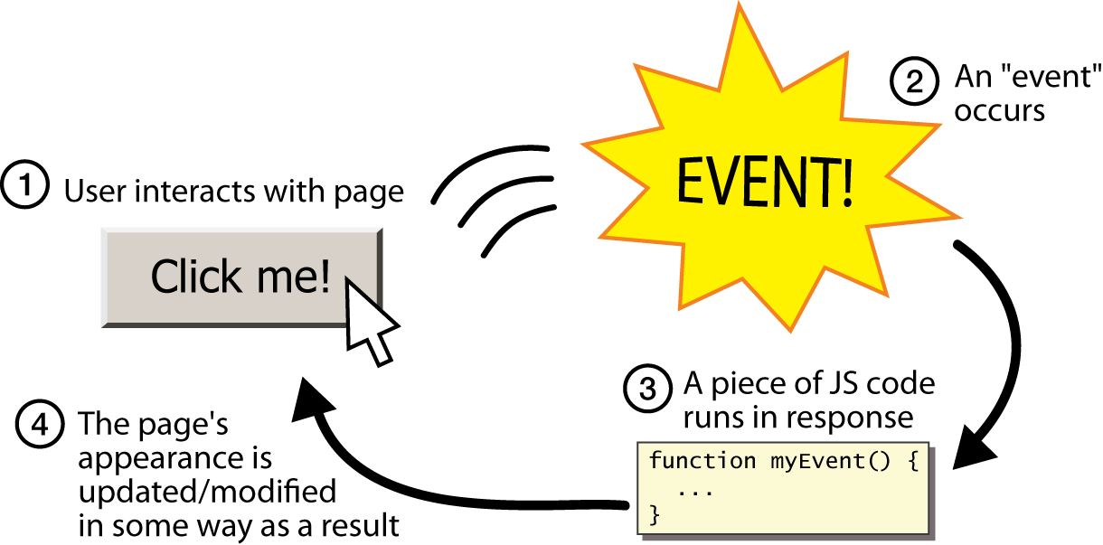
Event-driven programming
© MHRD Virtual Labs
Sagar Giradkar
PVG’s COET RNC 01

Slide 8
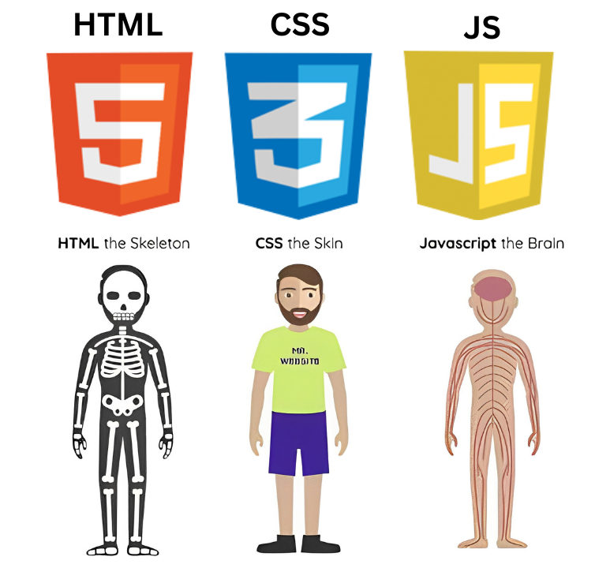
© MHRD Virtual Labs
Sagar Giradkar
PVG’s COET RNC 01

Slide 9
Linking to a JavaScript file: script
<script src="filename" type="text/javascript"> </script>
script tag should be placed in HTML page's head
script code is stored in a separate .js file
JS code can be placed directly in the HTML file's body or head (like CSS)
but this is bad style (should separate content, presentation, and behavior
© MHRD Virtual Labs
Sagar Giradkar
PVG’s COET RNC 01

Slide 10
How to use JavaScript?
Inline
Internal
External
<button type="button" onclick="document.getElementById('demo').style.display='none'">Click Me!</button>
<script> document.getElementById("demo").innerHTML = "My First JavaScript"; </script>
<script src="myScript.js"></script>
© MHRD Virtual Labs
Sagar Giradkar
PVG’s COET RNC 01

Slide 11
Typescript
TypeScript is a syntactic superset of JavaScript which adds static typing.
This basically means that TypeScript adds syntax on top of JavaScript, allowing developers to add types.
Why we used TypeScript in this course?
JavaScript is a loosely typed language. It can be difficult to understand what types of data are being passed around in JavaScript.
In JavaScript, function parameters and variables don't have any information! So developers need to look at documentation, or guess based on the implementation.
TypeScript allows specifying the types of data being passed around within the code, and has the ability to report errors when the types don't match.
For example, TypeScript will report an error when passing a string into a function that expects a number. JavaScript will not.
© MHRD Virtual Labs
Sagar Giradkar
PVG’s COET RNC 01

Slide 12
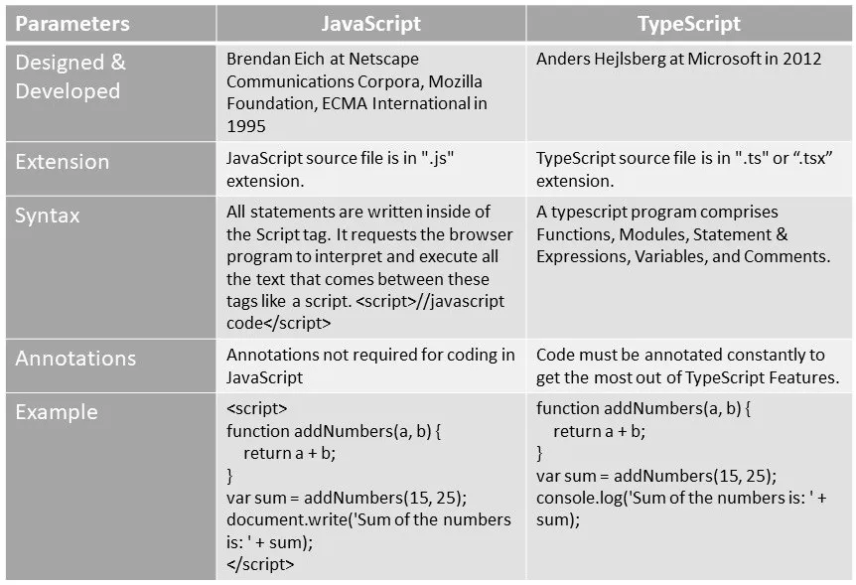
JavaScript vs TypeScript
© MHRD Virtual Labs
Sagar Giradkar
PVG’s COET RNC 01

Slide 13
Intsalltion Required
Node Js latest Version
Install Typescript Globally : npm install -g typescript
Create Project folder go to project folder create : tsconfig.json file
{
"compilerOptions": {
"target": "es5",
"module": "commonjs",
"sourceMap": true
}
}
Create file_name.ts
In terminal type: tsc --p tscconfig.json
tsc file_name.ts --watch
© MHRD Virtual Labs
Sagar Giradkar
PVG’s COET RNC 01

Slide 14
To Fix “Running scripts is disabled on this system” PowerShell Error
For Windows 11, Windows 10, Windows 7, Windows 8, Windows Server 2008 R2 or Windows Server 2012, run the following commands as Administrator:
x86 (32 bit)
Open C:\Windows\SysWOW64\cmd.exe
Run the command powershell Set-ExecutionPolicy RemoteSigned
x64 (64 bit)
Open C:\Windows\system32\cmd.exe
Run the command powershell Set-ExecutionPolicy RemoteSigned
You can check mode using
In CMD: echo %PROCESSOR_ARCHITECTURE%
In Powershell: [Environment]::Is64BitProcess
© MHRD Virtual Labs
Sagar Giradkar
PVG’s COET RNC 01

Slide 15
Input/Output
Writing into an HTML element, using innerHTML.
Writing into the HTML output using document.write().
Writing into an alert box, using window.alert().
Writing into the browser console, using console.log().
© MHRD Virtual Labs
Sagar Giradkar
PVG’s COET RNC 01

Slide 16
innerHTML /document.write()
<!DOCTYPE html>
<html>
<body>
<h1>My First Web Page</h1>
<p>My First Paragraph</p>
<p id="demo"></p>
<script>
document.getElementById("demo").innerHTML = 5 + 6;
</script>
</body>
</html>
<!DOCTYPE html>
<html>
<body>
<h1>My First Web Page</h1>
<p>My first paragraph.</p>
<script>
document.write(5 + 6);
</script>
</body>
</html>
© MHRD Virtual Labs
Sagar Giradkar
PVG’s COET RNC 01

Slide 17
window.alert() /console.log()
<!DOCTYPE html>
<html>
<body>
<h1>My First Web Page</h1>
<p>My first paragraph.</p>
<script>
window.alert(5 + 6);
</script>
</body>
</html>
<!DOCTYPE html>
<html>
<body>
<script>
console.log(5 + 6);
</script>
</body>
</html>
© MHRD Virtual Labs
Sagar Giradkar
PVG’s COET RNC 01

Slide 18
Comments
Single Line Comments
Single line comments start with //
let x = 5; // Declare x, give it the value of 5
let y = x + 2; // Declare y, give it the value of x + 2
Multi-line Comments
Multi-line comments start with /* and end with */.
/* The code below will change the heading with id = "myH" and the paragraph with
id = "myP" in my web page:
*/
© MHRD Virtual Labs
Sagar Giradkar
PVG’s COET RNC 01

Slide 19
Variables var, const, let
Variables are Containers for Storing Data
There are three types of variables
Using var
Using let
Using const
© MHRD Virtual Labs
Sagar Giradkar
PVG’s COET RNC 01

Slide 20
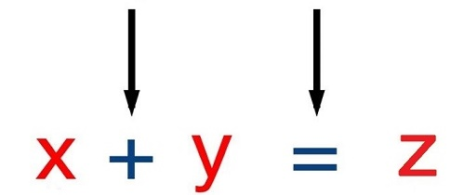
Operators
The Addition Operator + adds numbers:
The Assignment Operator = assigns a value to a variable.
© MHRD Virtual Labs
Sagar Giradkar
PVG’s COET RNC 01

Slide 21
Arithmetic Operators
Assignment Operators
Operator | Description
+ | Addition
- | Subtraction
* | Multiplication
/ | Division
% | Modulus (Division Remainder)
++ | Increment
-- | Decrement
Operator | Example | Same As
= | x = y | x = y
+= | x += y | x = x + y
-= | x -= y | x = x - y
*= | x *= y | x = x * y
/= | x /= y | x = x / y
%= | x %= y | x = x % y

Slide 22
Logical Operators
Comparison Operators
Operator | Description
&& | logical and
|| | logical or
! | logical not
Operator | Description
== | equal to
=== | equal value and equal type
!= | not equal
!== | not equal value or not equal type
> | greater than
< | less than
>= | greater than or equal to
<= | less than or equal to
? | ternary operator

Slide 23
Data Types
8 Datatypes
1. String
2. Number
3. Bigint
4. Boolean
5. Undefined
6. Null
7. Symbol
8. Object
The Object Datatype
The object data type can contain:
1. An object
2. An array
3. A date
© MHRD Virtual Labs
Sagar Giradkar
PVG’s COET RNC 01

Slide 24
Data Types
// Numbers:
let length = 16;
let weight = 7.5;
// Strings:
let color = "Yellow";
let lastName = "Johnson";
// Booleans
let x = true;
let y = false;
// Object:
const person = {firstName:"John", lastName:"Doe"};
// Array object:
const cars = ["Saab", "Volvo", "BMW"];
// Date object:
const date = new Date("2022-03-25");
© MHRD Virtual Labs
Sagar Giradkar
PVG’s COET RNC 01

Slide 25
Scope
Scope determines the accessibility (visibility) of variables.
3 types of scope:
Block scope
Function scope
Global scope
© MHRD Virtual Labs
Sagar Giradkar
PVG’s COET RNC 01

Slide 26
Scope
Scope determines the accessibility (visibility) of variables.
Block Scope
{
let x = 2;
}
Function scope
function myFunction() {
let carName = "local";
// code here CAN use carName
}
Global Variables
let carName = "Volvo";
// code here can use carName
function myFunction() {
// code here can also use carName
}
© MHRD Virtual Labs
Sagar Giradkar
PVG’s COET RNC 01

Slide 27
Thak You Questions And Ans
© MHRD Virtual Labs
Sagar Giradkar
PVG’s COET RNC 01

