Slide 1
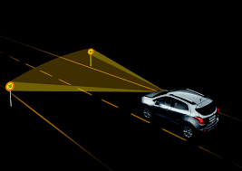

Traffic Sign Detection
Using Convolution Neural Network
Under the Esteemed Guidance of
Mrs. D PUSHPA(Asst .prof CSE)
Presented by C16-Batch:
G SAGAR 20W95A0509
K ROHITH 20W95A0512
M BHANU PRAKASH 20W95A0514
J SAI KUMAR 20W95A0511
Department : Computer Science & Engineering

Slide 2
CONTENTS
Abstract
Introduction
Existing System and its Limitations
Proposed System and its Advantages
S/W and H/W requirements
System Architecture
UML Diagrams
Modules
Code Explanation’s
Output Screens
Test Cases
Future Scope
Conclusion
References

Slide 3
ABSTRACT
Traffic signs play a significant role in managing the road traffic, avoiding any accidents, and ensuring safety by conveying different norms or rules that need to be followed on the road. There are several types of traffic signs like speed limits, no entry, traffic signals, turn to left or right, children crossing, no passing of heavy vehicles, etc. To make them easily readable and recognizable, traffic signs are often designed to be of a particular shape and color with symbols inside such that there is a significant difference between the sign and the background. Traffic sign classification is the process of identifying which class of a traffic sign.

Slide 4
In the automotive technology, employs ML enabled commercialized advanced driver assistance systems (ADAS) which include traffic sign recognition as a part. With the increasing demand for the intelligence of vehicles, and the advent of self-driving cars, it is extremely necessary to detect and recognize traffic signs automatically through computer technology. For this, neural networks can be applied for analyzing images of traffic signs for cognitive decision-making by autonomous vehicles. Neural networks are the computing systems which act as a means of performing ML.
In this work, a convolutional neural network (CNN) based ML model is built for recognition of traffic signs accurately for decision-making, when installed in driverless vehicles.

Slide 5
INTRODUCTION
Road sign recognition has become a major challenging field in academics as well as in industry. The major application of these systems can be mostly used in the upcoming Artificial Intelligence (AI) world to understand environment and also being one of the most important part in Advance Driver Assistance Systems (ADAS). Majorly, recognition process provides clear visual definition on the fact that every traffic sign may consists of different kinds of shapes, colors and graphics that will represent the environment and road constrains, which enables driver to recognize and prepare, for what he/she may face. Road Signs are not expected to be highly visible to drivers, there may be little confusion between signs or may be some signs are not recognizable by few drivers. This may lead to confusion and more chance for occurrence of accidents.

Slide 6
EXISTING SYSTEM
In the Existing system, an algorithm capable of recognizing the Stop, Yield, and Do-Not-Enter traffic warning signs. It consists of sixmodules:colour segmentation,edge localisation, RGB differencing, edge detection, histogram extraction, and classification .Colour segmentation is only used to localise red edge areas; the segmentation is performed sparsely; and interpixel segmentation distance is determined .Colour indexing is not ideal for real-time implementation. Camera captures images in RGB colour format of which is not suitable for image segmentation as the colour information varies greatly under different weather condition.

Slide 7
Limitations
It Will Identify Only, Stop, Yield, And Do-Not-Enter Traffic Warning
Signs Only.
2. Low Accuracy
3. Much Image Processing Steps

Slide 8
PROPOSED SYSTEM
To overcome the problems in existing system, this project introduces a concept named Traffic Sign Detection using CNN to extract the images and classify the traffic signs. Here, 2D-CNN model is built to improve overall accuracy and speed. The recognition rate varies quite significantly, this could be due to how well the networks are trained, and what network architecture are employed. Neural networks are more adaptable to changes, and more flexible.

Slide 9
Advantages
1. It Will Identify 40 types of Traffic Warning Signs.
2. High Accuracy as compared to existing system
3. Not Much Image Processing Steps

Slide 10
SOFTWARE REQUIREMENTS
Software requirements address the definition of software application requirements and prerequisites that require computer installation to provide System performance. These prerequisites or requirements are not usually included in the software installation package and need to be installed separately before the software can be installed.
Operating system : Windows 10.
Coding Language : Python.
Front-End : tkinter.
Back-End : Python
Data Base : csv

Slide 11
HARDWARE REQUIREMENTS
The most common set of requirements defined by any application or software application for virtual computer applications, also known as hardware, Hardware Requirements list is usually accompanied by a hardware compliance list (HCL), especially if there are applications. The HCL list checks hardware devices that are tested, compatible, and sometimes not compatible with a specific application or application. The following sections discuss various aspects of hardware requirements.
RAM: 4GB and Higher Processor: Intel i3 and above Hard Disk: 500GB: Minimum

Slide 12
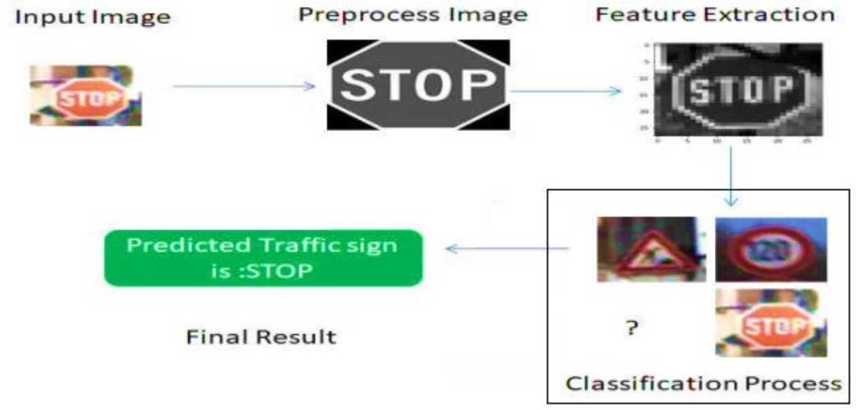
SYSTEM ARCHITECTURE

Slide 13
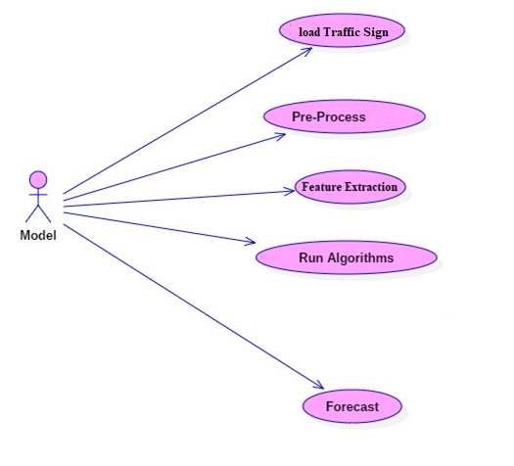
UML DIAGRAMS
Usecase diagram:

Slide 14
Class diagram:
Dataset | ___ | Model
+Location ♦Filename |  | ♦Name ♦Type
♦UploadDatasetQ ♦ReadDataQ ♦ParametersQ ♦TrainTestDataQ |  | ♦LoadDatasetQ +Pre-ProcessData() +ReadData() +RunAlgorithm() +CompareAlgorithm() ♦ForecastQ

Slide 15
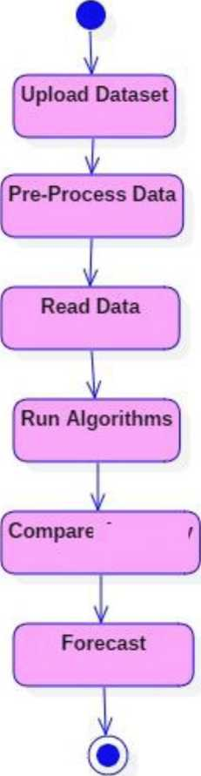
Activity diagram:

Slide 16
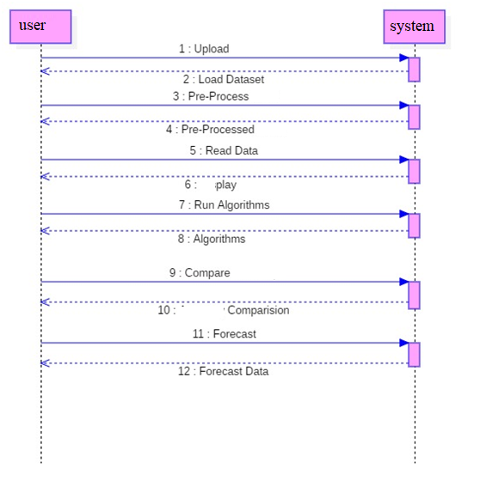
Sequence diagram

Slide 17
MODULES
• Feature Extraction
• Module building
• Prediction of traffic sign

Slide 18
Modules description
Feature Extraction
in This module, image preprocess is involved The image which has higher resolution is scaled down to small resolution and RGB image is converted into grayscale format , normalizing the images, histogram equalization , so that the image can be easily processed by the “Convolution Neural Networks”.

Slide 19
Building of the model:
After Feature Extraction, It is fed into CNN. It is then sampled and divided into small pieces and the obtained output is compared with the data set which we gave, and the corresponding output is given. Neural networks give the necessary information to the processor. addition of the layers to the model, train the model, get predictions on the test data set, and finally show some sample images with their traffic sign name and class ID as the output trine dataset.

Slide 20
Prediction of traffic sign
In this module Extract Features from given Image and it predicts the closest traffic sign name found pre-trained dataset and display.

Slide 21
CODE-EXPLAINATION’S
import os
import tkinter as tk
from tkinter import filedialog
from tkinter import *
from PIL import ImageTk, Image
import numpy
#load the trained model to classify sign
from keras.models import load_model
model = load_model('traffic_classifier.h5')

Slide 22
CODE-EXPLAINATION’S
#dictionary to label all traffic signs class.
classes = { 1:'Speed limit (20km/h)',
2:'Speed limit (30km/h)',
3:'Speed limit (50km/h)',
4:'Speed limit (60km/h)',
5:'Speed limit (70km/h)',
6:'Speed limit (80km/h)',
7:'End of speed limit (80km/h)',
8:'Speed limit (100km/h)',
9:'Speed limit (120km/h)',
10:'No passing',
11:'No passing veh over 3.5 tons',
12:'Right-of-way at intersection',
13:'Priority road',
14:'Yield',
15:'Stop',
16:'No vehicles',
17:'Veh > 3.5 tons prohibited',
18:'No entry',
19:'General caution',
20:'Dangerous curve left',

Slide 23
CODE-EXPLAINATION’S
21:'Dangerous curve right',
22:'Double curve',
23:'Bumpy road',
24:'Slippery road',
25:'Road narrows on the right',
26:'Road work',
27:'Traffic signals',
28:'Pedestrians',
29:'Children crossing',
30:'Bicycles crossing',
31:'Beware of ice/snow',
32:'Wild animals crossing',
33:'End speed + passing limits',
34:'Turn right ahead',
35:'Turn left ahead',
36:'Ahead only',
37:'Go straight or right',
38:'Go straight or left',
39:'Keep right',
40:'Keep left',
41:'Roundabout mandatory',
42:'End of no passing',
43:'End no passing veh > 3.5 tons' }

Slide 24
CODE-EXPLAINATION’S
#initialise GUI
top=tk.Tk()
top.geometry('800x600’)
top.title('Traffic sign classification’)
top.configure(background='#CDCDCD')
label=Label(top,background='#CDCDCD’,
font=('arial',15,'bold’))
sign_image = Label(top)

Slide 25
CODE-EXPLAINATION’S
def classify(file_path):
global label_packed
file_pat = os.path.splitext(file_path)[0]
image = Image.open(file_path)
image = image.resize((30,30))
image = numpy.expand_dims(image, axis=0)
image = numpy.array(image)
file_pt = int(file_pat[-1])
file_at = int(file_pat[-2])
file_pat=(file_pt+1+file_at*10)
print(image.shape)
#pred = model.predict(image[0])
sign = classes[file_pat]
print(sign)
label.configure(foreground='#011638', text=sign)

Slide 26
CODE-EXPLAINATION’S
def show_classify_button(file_path):
classify_b=Button(top,text="Classify Image",command=lambda: classify(file_path),padx=10,pady=5)
classify_b.configure(background='#364156', foreground='white',font=('arial',10,'bold’))
classify_b.place(relx=0.79,rely=0.46)

Slide 27
CODE-EXPLAINATION’S
def upload_image():
try:
file_path=filedialog.askopenfilename()
uploaded=Image.open(file_path) uploaded.thumbnail(((top.winfo_width()/2.25),(top.winfo_height()/2.25)))
im=ImageTk.PhotoImage(uploaded)
sign_image.configure(image=im)
sign_image.image=im
label.configure(text='')
show_classify_button(file_path)
except:
pass

Slide 28
upload=Button(top,text="Upload an image",command=upload_image,padx=10,pady=5)
upload.configure(background='#364156', foreground='white',font=('arial',10,'bold’))
upload.pack(side=BOTTOM,pady=50)
sign_image.pack(side=BOTTOM,expand=True)
label.pack(side=BOTTOM,expand=True)
heading = Label(top, text="Know Your Traffic Sign",pady=20, font=('arial',20,'bold’))
heading.configure(background='#CDCDCD',foreground='#364156')
heading.pack()
top.mainloop()

Slide 29
OUTPUT SCREENS

Slide 33
TEST CASES
Equivalence class | Input From User | Expected outcome | Original Outcome | Result
ImageCheck | Image:Traffic sign 1 Format:PNG File | Description about Image will be produced in text format | Description about Image will be produced in text format | Passed
ImageCheck | Image:Traffic sign 2 Format:PNG File | Description about Image will be produced in text format | Description about Image will be produced in text format | Passed
ImageCheck | Image:Traffic sign 3 Format:PNG File | Description about Image will be produced in text format | Description about Image will be produced in text format | Passed
ImageCheck | Image:Traffic sign 4 Format:PNG File | Description about Image will be produced in text format | Description about Image will be produced in text format | Passed

Slide 34
Future scope
With help of this Mechanism in the future, we can build a smart autonomous vehicle.

Slide 35
CONCLUSION
The proposed system is an effective method for performing the traffic sign detection system. This mechanism helps to detect traffic signs much faster. Among all the above algorithms, the CNN is only the best technique that can detect the traffic Sign much faster with better accuracy. These results can guide the way present On-road and provides information related to roads and improves safety mechanisms.

Slide 36
REFERENCES
1. Y. Aoyagi and T. Asakura, ”A study on traffic sign recognition in scene image using genetic algorithms and neural networks,” presented at The1996 IEEE IECON 22nd Inter. Conf. on Industrial Electronics, Control and Instrumentation, Taipei, Taiwan, 1996.
2. Y. Aoyagi and T. Asakura, ’’Detection and recognition of traffic sign in scene image using genetic algorithms and neural network,” presented at The 35th SICE Annual Conference (SICE ’96), Tottori, Japan, 1996.
3. G. Adorni, V. D’Andrea, G. Destri, and M. Mordonini, ’Shape searching in real world images: a CNN-based approach,” presented at Fourth IEEE Inter. Workshop on Cellular Neural Networks and Their Applications, Seville, Spain, 1996.
4. D. Gavrila, ’Multi-feature Hierarchical template matching using distance transforms,” presented at Fourteenth Inter. Conf. on Pattern Recognition, Brisbane, Qld Australia, 1998.
5. C. Schiekel, ”A fast traffic sign recognition algorithm for gray value images,” presented at 8th Inter. Conf. Computer Analysis of Images and Patterns, Ljubjana, Slovenia, 1999.

