Slide 1





INFOSYS SPRINGBOARD INTERNSHIP 6.0
FLEET MANAGEMENT
AND ROUTE
OPTIMIZATION SYSTEM
PRESENTED BY : SAGARIKA NAIK

Slide 2


PROBLEM STATEMENT
Managing a fleet efficiently is a major challenge for organizations handling numerous vehicles and drivers. Existing systems are often inadequate because they fail to provide:
  Unified access to vehicle and driver information.
  Real-time monitoring and route analysis.
  Actionable insights on vehicle condition and overall performance.

Slide 3
KEY FEATURES
Driver & Vehicle Management
Booking Module
Vehicle Condition Monitoring
Route Distance Tool
Analytics Dashboard
Add edit and view driver and vehicles details in one place with driver data sync with via Gmail.
Lets you schedule drivers manually using your email for each booking or trip request.
Calculate the straight line distance between two selected locations(not influenced by traffic conditions).
Provides visual insights through bar and pie charts that highlight driver activity and overall vehicle health.
Monitors key aspects like engine status, fuel and battery usage.
Phase 1
Phase 2
Phase 3
Phase 4
Phase 5

Slide 4
PROJECT MODULE OVERVIEW
Module 1
Module 2
Module 3
Module 4
Module 5
Authentication & Role Management
Fleet Inventory & Vehicle Telemetry
AI Route & Load Optimization Engine
Customer Booking & Smart Recommendations
Amin Dashboard & Urban Mobility Insights
The campaign begins with a concept that defines goals and audience needs.
A structured plan outlines channels, content focus, and measurable outcomes
All members are briefed, roles clarified, and collaboration tools set up for smooth coordination
Drafts, visuals, and messaging are refined, tested, and approved for distribution
A limited rollout is launched, performance monitored, and insights gathered for improvement

Slide 5
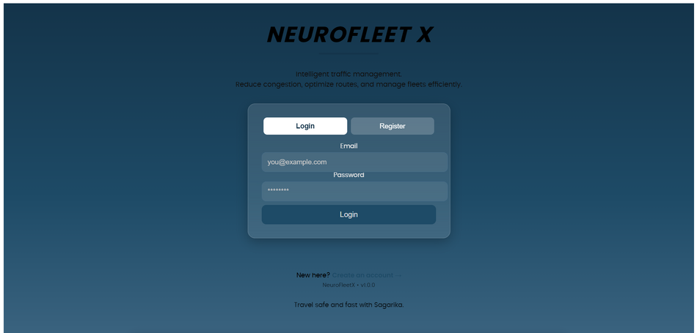
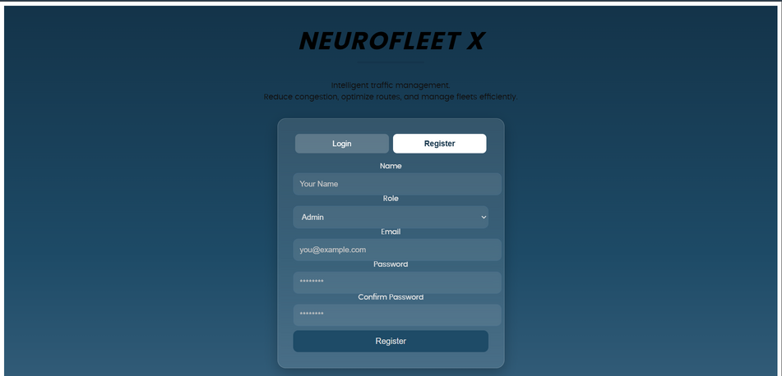
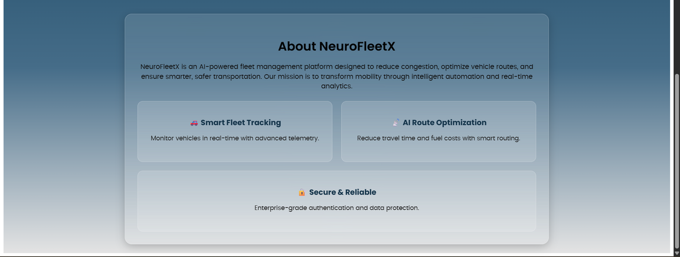
LOGIN & REGISTER PAGE
Authenticates and authorizes users.
Step 04

Slide 6
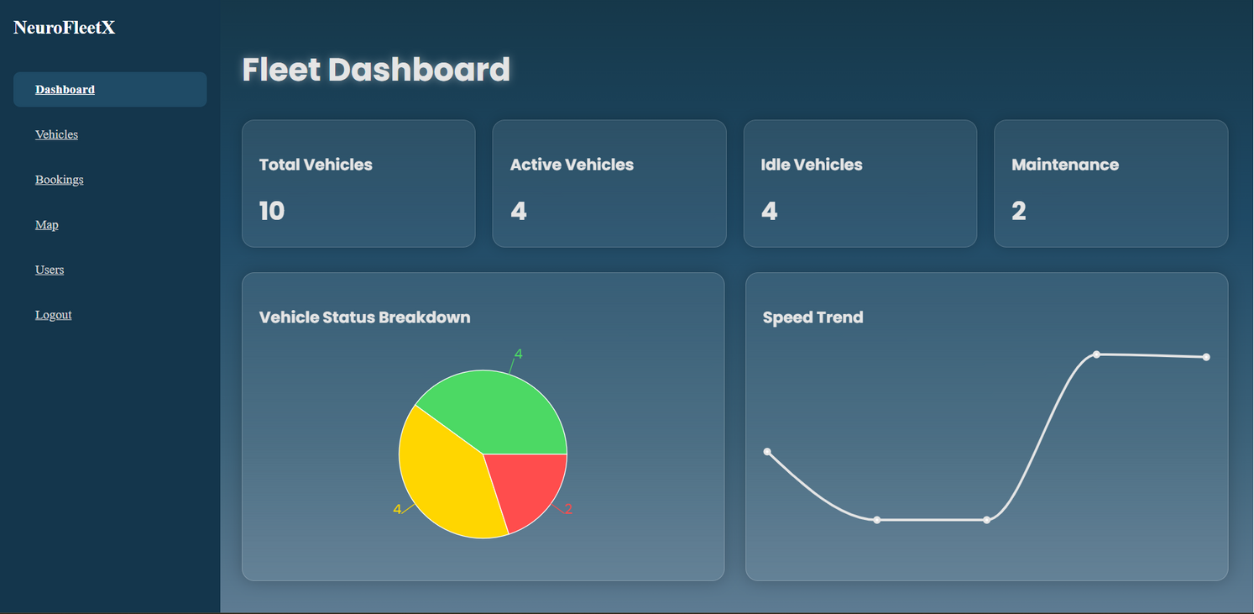
FLEET DASHBOARD
Displays vehicles availability through graphs.

Slide 7
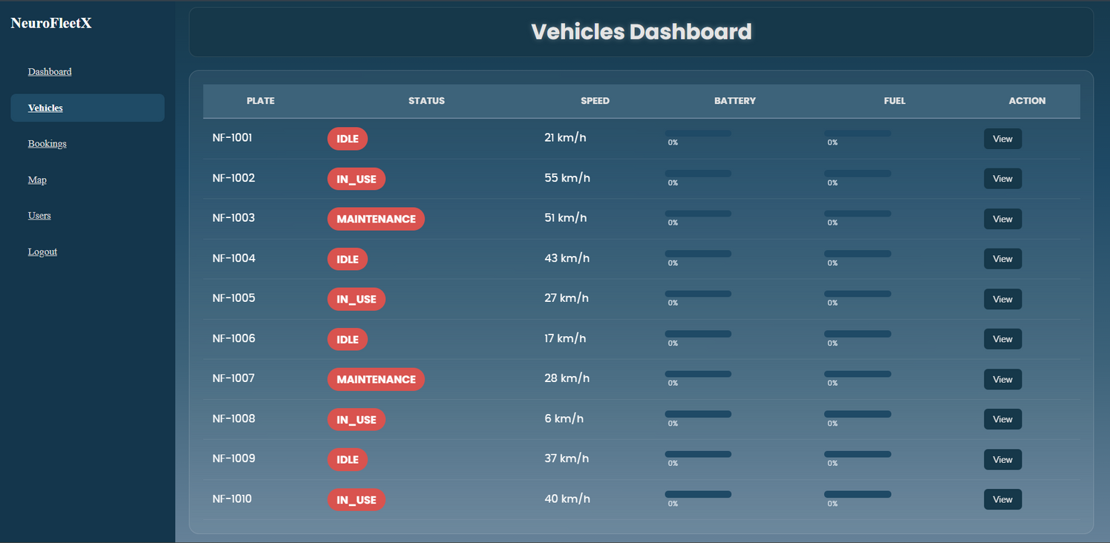
VEHICLE DASHBOARD
Displays all vehicles, add/remove functionality.

Slide 8
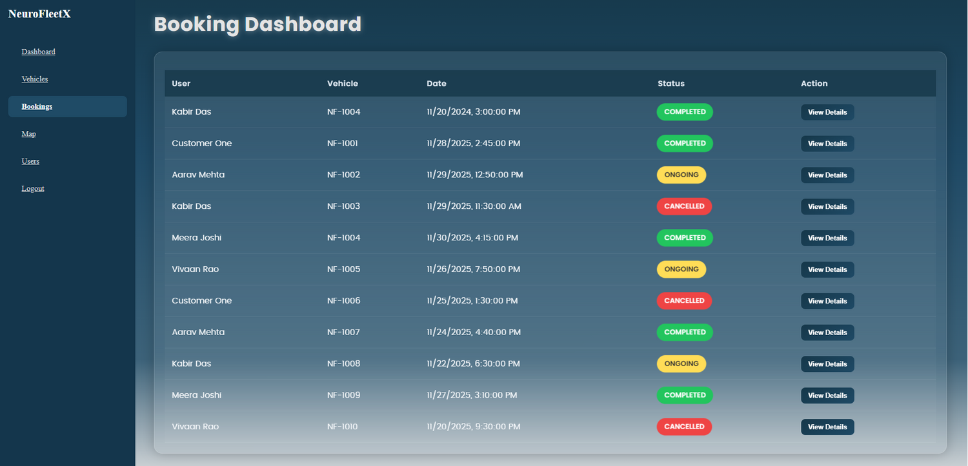
BOOKINGS DASHBOARD
Manual booking using Gmail ID

Slide 9
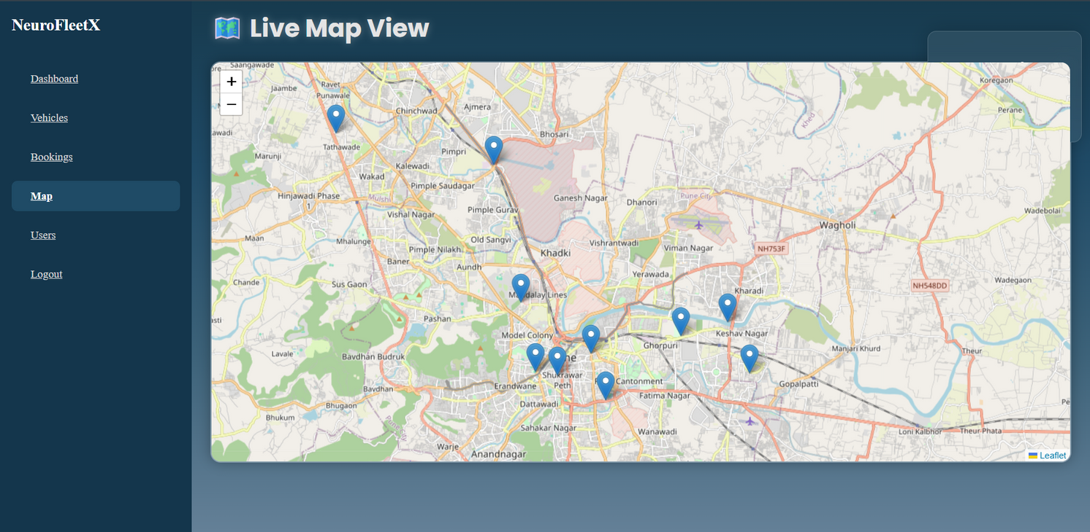
LIVE MAP VIEW
Optimizes routes

Slide 10
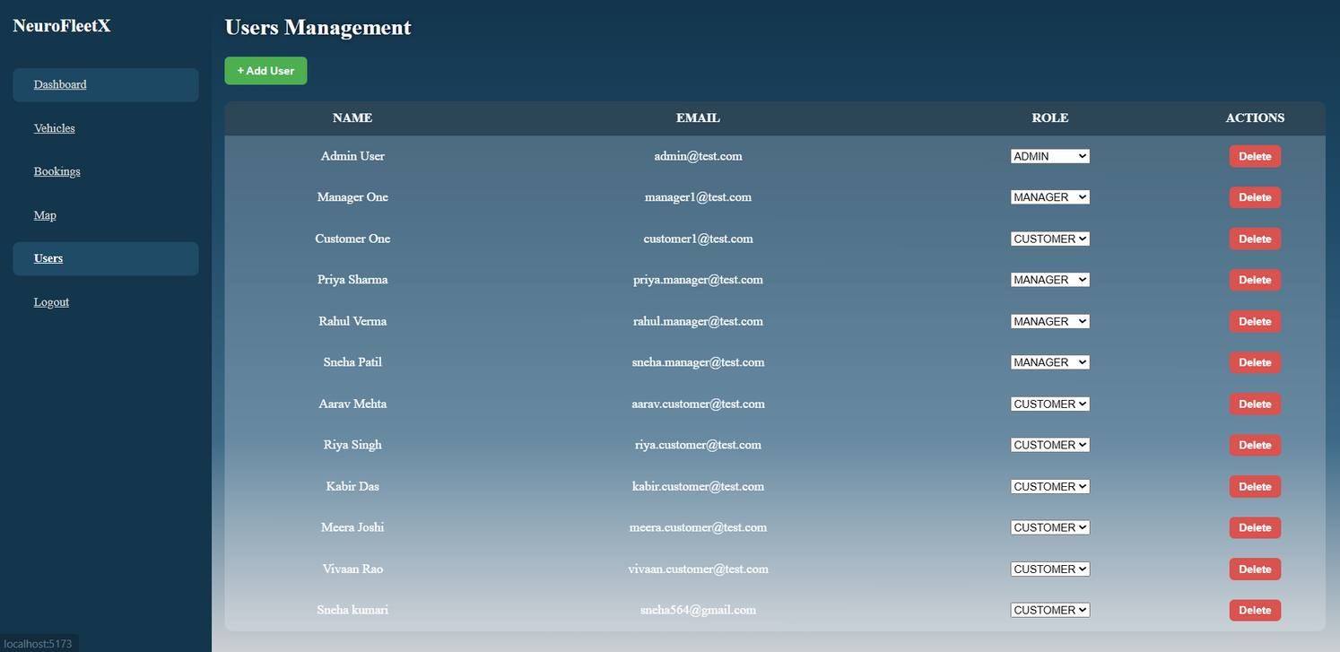
USER MANAGEMENT
Admin access the system

Slide 11

CONCLUSION
The Fleet Management and Route Optimization System effectively illustrates how a modular full-stack architecture can streamline fleet operations.
Key Outcomes
  Integrated management of drivers and vehicles
  Reliable static route planning and trip monitoring
  Data-driven insights through visual analytics
  Scalable architecture prepared for AI-driven enhancements

Slide 12




THANK YOU

