Slide 1



Design and Implementation of a FHIR-Compliant Questionnaire and Resource Profiles for Hypertension Management
Presented by:
Group 3: Sabita Dangi, Sagarika Thapa, Sudip Adhikari, Janak Lal Sah
HIMS 505: Telecare, Medical Signal and Imaging
Date : 29th June , 2025

Slide 2
Project Summary
Developed Structured Questionnaire
Created Reusable Framework
Used JSON and Python
Creating a digital questionnaire for hypertension management
Utilizing JSON format and Python for profile generation
Establishing a reusable framework for healthcare data systems
Map Clinical Fields to FHIR
Ensured Semantic Interoperability
Mapping clinical fields to HL7 FHIR resources
Ensuring semantic interoperability with validation tools

Slide 3
Background and Motivation
Digital Health Needs
Hypertension
A major health issue causing 10.8 millions of death annually
The demand for standardized and shareable health data formats
Data Systems
Traditional systems lacking interoperability and consistency

Slide 4
Why HL7 FHIR?
Standardized Coding Systems
Modular Resources
FHIR supports LOINC and SNOMED CT for coding.
HL7 FHIR uses modular resources like Patient and Medication.
Profiles and Extensions
RESTful APIs
FHIR allows custom profiles and extensions for localization.
FHIR utilizes RESTful APIs for data exchange.
JSON/XML
FHIR supports JSON and XML for data representation.

Slide 5
Project Objectives
FHIR Questionnaire
Semantic Interoperability
Resource Generation
Reusable Framework
Design a FHIR- compliant digital questionnaire for hypertension.
Create a reusable digital health framework for Nepal’s context.
Ensure semantic interoperability using custom profiles and value bindings.
Implement automated resource generation and validation.
1
2
3
4

Slide 6
METHODOLOGY
Questionnaire Design and Domain Mapping
Resource Definition and JSON Implementation
Automated Profile Generation with Python
Custom Profile Definition and Validation
Documentation and Traceability
Defining and validating custom profiles
Documenting the process and ensuring traceability
Creating a structured questionnaire and mapping domains
Defining resources and implementing them in JSON format
Using Python to automatically generate profiles

Slide 7
Questionnaire Design &Mapping
Map Fields to FHIR
Use an Excel schema to map questionnaire fields to FHIR resources, element paths, data types, and cardinality.
2
Design Questionnaire
Develop a comprehensive questionnaire covering demographics, clinical observations, medications, lifestyle, and follow-ups.
1

Slide 8
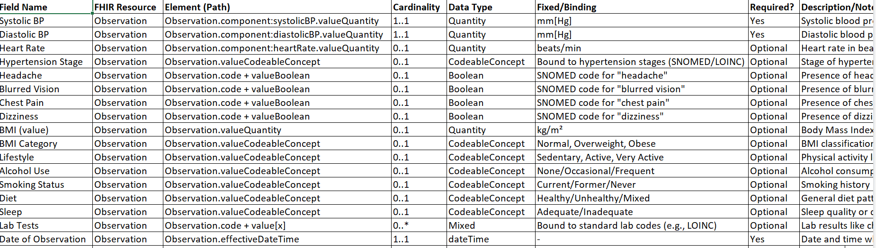
Questionnaire Design &Mapping
Map Fields to FHIR
Use an Excel schema to map questionnaire fields to FHIR resources, element paths, data types, and cardinality.
Design Questionnaire
Develop a comprehensive questionnaire covering demographics, clinical observations, medications, lifestyle, and follow-ups.
1

Slide 9
JSON Implementation
Enforce Constraints
Resource Files
FHIR resource files were created in VS Code. These included Patient, Observation, Practitioner, Medication, CarePlan and Procedure.
Constraints, value sets, and data types were enforced. This ensures data quality and consistency.
Structure Definition
The structure was defined using Structure Definition JSON from FHIR resource list. This provides a blueprint for the data. E.g., Observation.

Slide 10
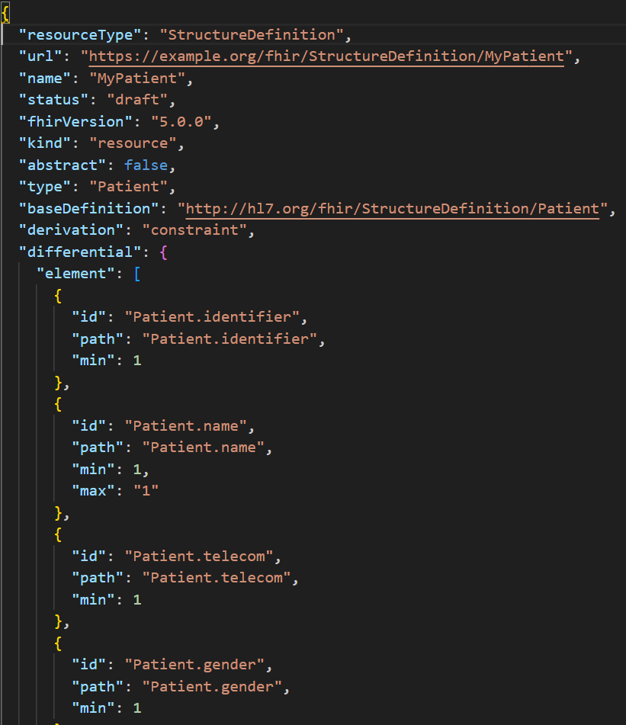
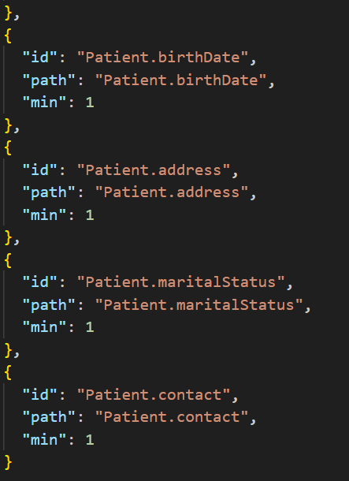
JSON Implementation

Slide 11
Python Automation for Profile Generation
Script Development
JSON Export
Exporting the profile data in JSON format
The creation of a Python script to automate tasks
Differential Population
Excel Data Input
Using Excel data to populate profile information
Filling in the 'differential' section of the profile

Slide 12
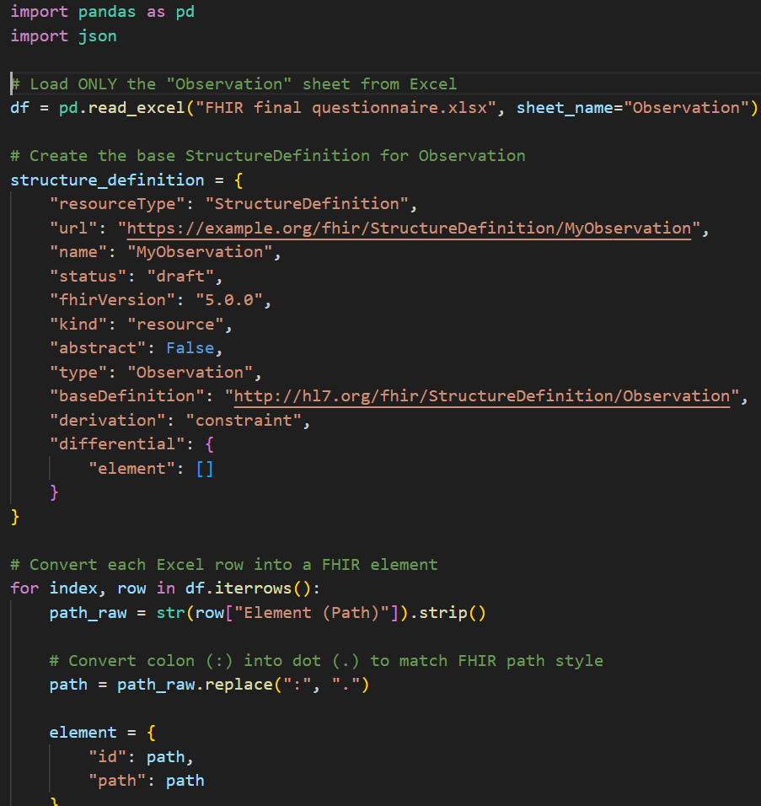
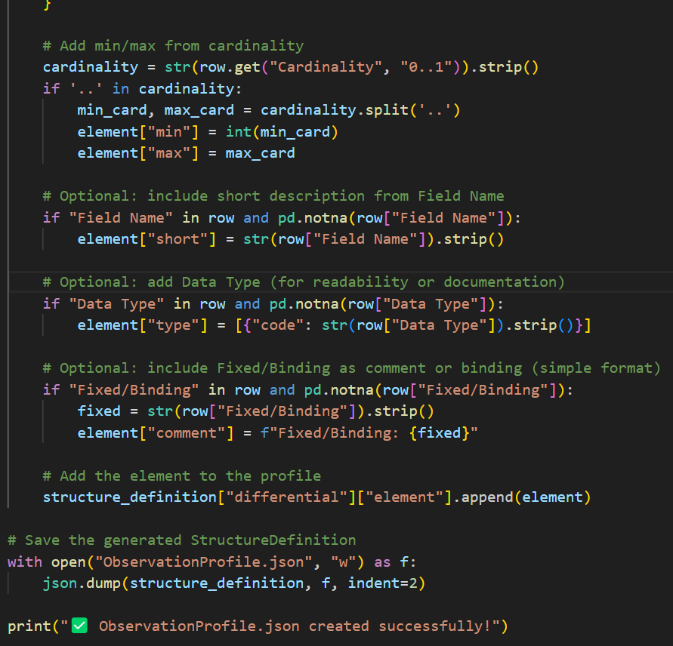
Python Automation for Profile Generation

Slide 13
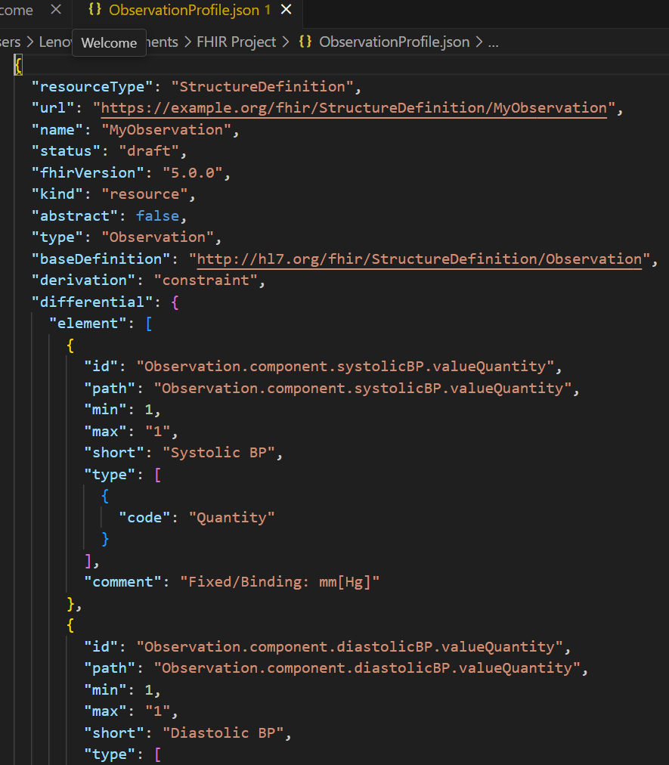
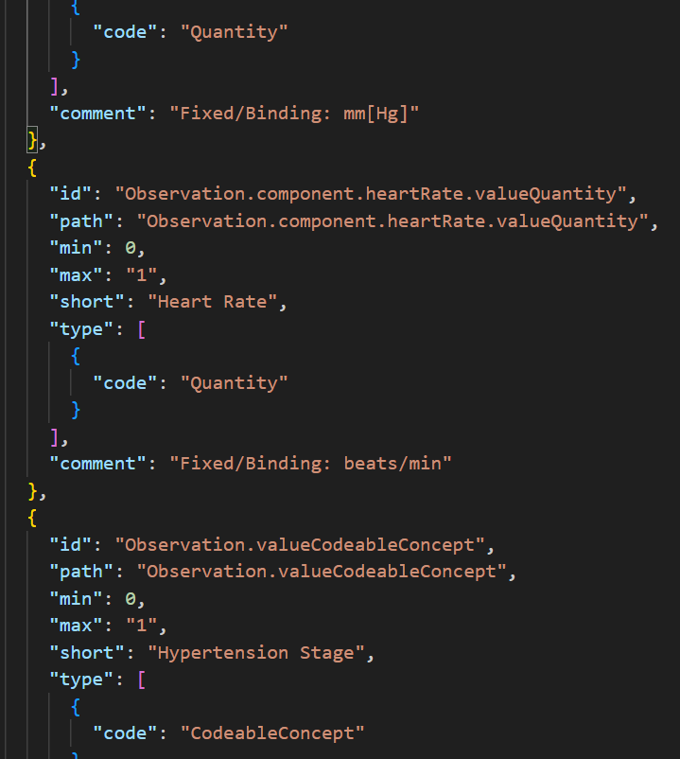
Observation Profile

Slide 14
Observation Profile Custom Elements and Constraints
Required Fields
Optional Fields
Fixed Units
Validated Data
Systolic and Diastolic BP are required fields for the observation profile.
Heart rate, symptoms, BMI and lifestyle are optional fields that can be added.
Units are fixed to mm[Hg], beats/min or kg/m2 as defined by UCUM for consistency.
Data is validated using HAPI FHIR Validator.

Slide 15
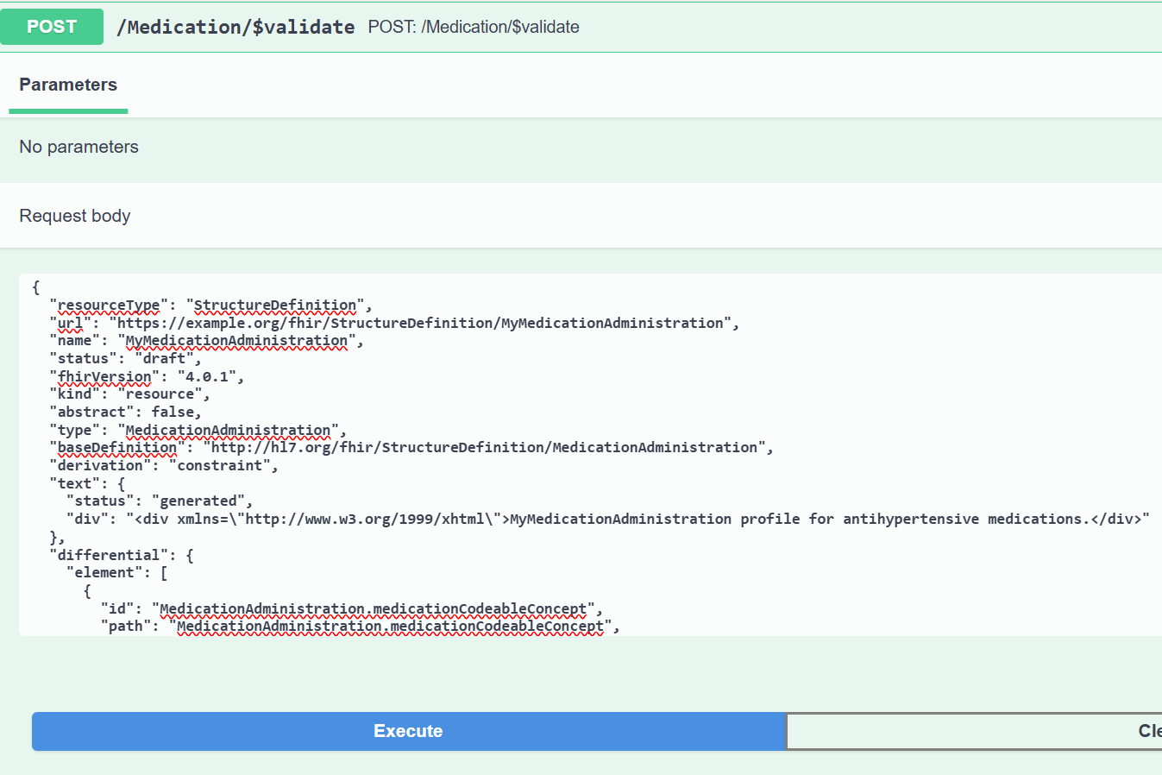
Validation Results

Slide 16
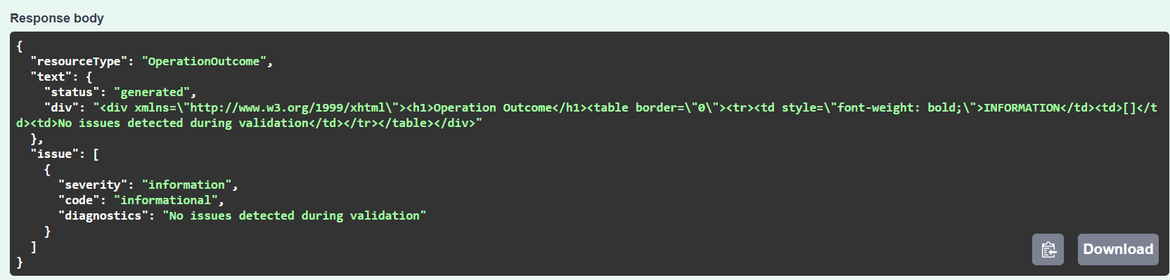
Validation Results

Slide 17
Validation Results
Resources Validated
Profiles Customized
Ensures
Ensures interoperability, semantic accuracy, and readiness for EHR integration.
All the resources are validated and JSON- ready.
Profiles are customized and harmonized across domains.

Slide 18
Challenges
Harmonizing codes/values across resources
Validation feedback loops
1
2
Validation loops are simple but crucial for data accuracy.
Harmonizing codes is complex and significantly impacts data consistency.
Deciding field constraints and cardinality
Data mapping complexity
3
4
Data mapping is complex but has limited immediate impact.
Field constraints are straightforward with minimal impact.

Slide 19
Lessons Learned
Iterative validation
Documentation
Balance Specificity
Modular approach
Comprehensive documentation is crucial for understanding and maintaining code. It serves as a valuable reference.
Validating code iteratively enhances the overall quality. This process helps catch errors early.
Balancing specificity and flexibility is important in design. It allows for adaptability and avoids rigidity.
A modular approach promotes code reusability and maintainability. It breaks down complex systems.

Slide 20
Relevance to Nepal
FHIR adoption
Hypertension prevalence
Supports national goals
Scalability
The approach can be scaled to address other chronic conditions or health programs in the country.
Nepal's digital health is in the early stages of adopting FHIR. This indicates potential for growth and standardization.
Hypertension affects approximately 25% of adults in Nepal, highlighting a significant health challenge.
Digital health supports national goals such as the eHealth Strategy and DHIS2 implementation.

Slide 21
Conclusion
A structured, validated FHIR questionnaire was successfully built.
Successful Build
Automation, validation, and extensibility have been demonstrated effectively.
Automation Demonstrated
A scalable model is available for structured data collection and sharing.
Scalable Model

Slide 22
References
HAPI FHIR Project. (2025). HAPI FHIR Test/Demo Server R4 Swagger UI. https://hapi.fhir.org/baseR4/swagger-ui/
HL7 International. (2024). FHIR Release 5.0.0. https://hl7.org/fhir/
HL7 International. (2022). FHIR Release 5 – Overview. https://hl7.org/FHIR/overview.html
Mandl, K. D., Gottlieb, D., Ellis, A., & Mandel, J. C. (2020). The evolution of APIs and health information sharing. JAMA, 324(15), 1539–1540. https://doi.org/10.1001/jama.2020.16221
Mills, K. T., Stefanescu, A., & He, J. (2020). The global epidemiology of hypertension. Nature Reviews Nephrology, 16(4), 223–237. https://doi.org/10.1038/s41581-019-0244-2
Vreeman, D. J., McDonald, C. J., & Huff, S. M. (2016). LOINC: A universal catalogue of individual clinical observations and uniform representation of lab results. Methods of Information in Medicine, 55(4), 349–355. https://doi.org/10.3414/ME15-01-0157
World Health Organization. (2021). Hypertension. https://www.who.int/news-room/fact-sheets/detail/hypertension

Slide 23
THANK YOU……
DATA THAT CANNOT MOVE
IS DATA THAT CANNOT
HELP

