Slide 1
Use of Digital Technology to calculate water footprints for different daily use items
CSE7101- Capstone Project
Review-2
Batch Number: IST_27
Under the Supervision of,
Mr.Saptarsi Sanyal
Assistant Professor
School of Computer Science and Engineering
Presidency University
Roll Number | Student Name
2O221IST0017 | Bolla Sagarika
20221IST0002 | Gandavaram Sravanthi
20221IST0003 | Bathina Mounika
Name of the Program: IST
Name of the HoD: Dr. Pallavi R
Name of the Program Project Coordinator: Dr.Afroz Pasha
Name of the School Project Coordinators: Dr. Sampath A K , Dr. Geetha A

Slide 2
CONTENT
Abstract
Literature Survey
Objectives
Existing Methods and Drawbacks
Proposed Method & Feasibility Study
Architecture Diagram
Modules
Timeline (Gantt Chart)
References

Slide 3
Problem Statement
Organization: Aiming to create impactful digital solutions that contribute to sustainable development goals, specifically addressing global water conservation issues.
Category: Software – Web-based learning platform
Problem Description: Water scarcity is a growing global concern, affecting billions of people annually. A significant share of water consumption is hidden in the production of goods (water footprint).
The solution will help individuals, organizations, and policymakers: Identify hidden water usage.

Slide 4
Abstract
This study explores how new technology is changing the face of water footprint in rural India. It highlights digital technologies like artificial intelligence, e-learning systems, and interactive materials that solve age-old problems of water footprint in underprivileged areas. The research identifies the major obstacles rural students encounter, ranging from weak foundational skills, restricted access to facilities, to infrastructural inadequacies.
It also examines collaborative initiatives between governments, communities, and private organizations to enhance water footprint access. Through a problem-solving approach, this paper emphasizes the impact of technology in minimizing water footprintal gaps and fostering inclusive learning opportunities among rural learners.

Slide 5
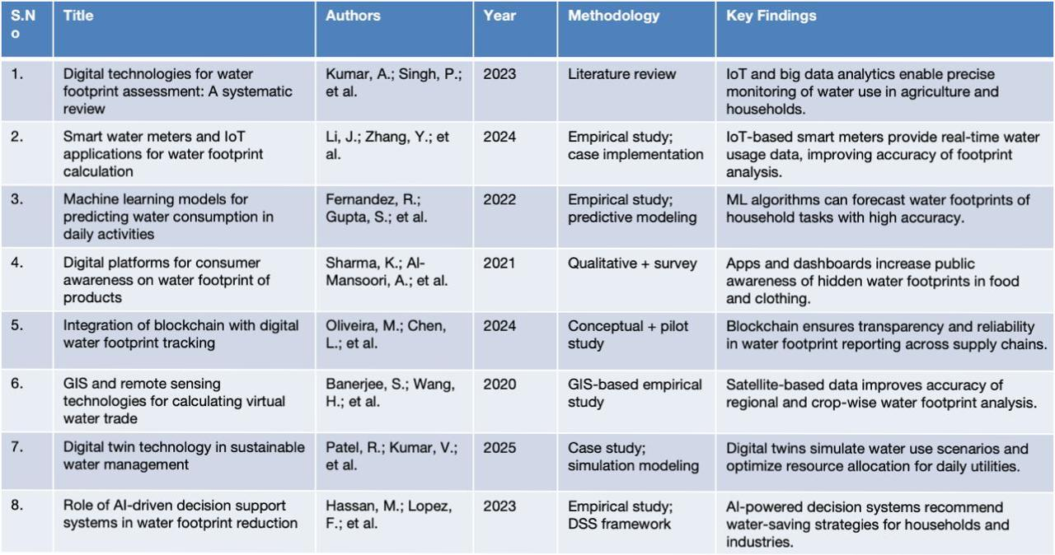
Literature Survey

Slide 6
OBJECTIVES:
Develop a digital solution to estimate the water footprint of various daily use items with high accuracy. Integrate relevant datasets (e.g., production processes, regional water usage statistics) into a centralized system for footprint calculation. Design a user-friendly interface that allows individuals and organizations to easily input items and receive water footprint results. Increase awareness about the hidden water usage in everyday products through interactive visualizations and reports. Support sustainable decision-making by providing actionable insights to reduce water consumption.

Slide 7
Existing Methods and Drawbacks
Existing Methods
Manual Calculation using Water Footprint Network (WFN) Guidelines Uses global standards to estimate direct and indirect water consumption. Relies on statistical data and average consumption values. Survey and Self-reporting Methods Household/consumer surveys collect data on daily water usage .
Often combined with utility bills.
Drawbacks
Smart Water Meters High installation and maintenance cost. Limited adoption in rural/low-income households. GIS & Remote Sensing Requires technical expertise and high-resolution satellite data. Limited for small-scale or household-level footprint estimation.

Slide 8
Proposed Method & Feasibility Study
Proposed Method: Integration of IoT-based Smart Sensors Install water flow sensors in taps, showers, washing machines, and other utilities. Mobile/Web Application Dashboard User-friendly app to display footprints for daily items
AI & Machine Learning Models
Predict and analyze hidden/virtual water consumption patterns.
Feasibility Study: Technical Feasibility IoT sensors, cloud databases, and mobile apps are readily available Economic Feasibility Low-cost sensors can be deployed in households

Slide 9
Modules
Data Collection Module IoT sensors/Smart meters capture real-time water usage from taps, showers, washing machines, and other appliances. Manual inputs (if sensors not available) via mobile/web interface. Data Processing & Storage Module Cloud server/database stores collected data. Cleans and organizes data for further analysis. Water Footprint Calculation Module Applies formulas (based on WFN guidelines) to calculate direct and indirect footprints. Includes virtual water estimation for daily use items (food, clothing, utilities). AI/ML Analysis Module Predicts future water consumption patterns. Provides recommendations and alerts for excessive water usage. Visualization & Dashboard Module Mobile/Web application to display reports, charts, and comparisons.

Slide 10
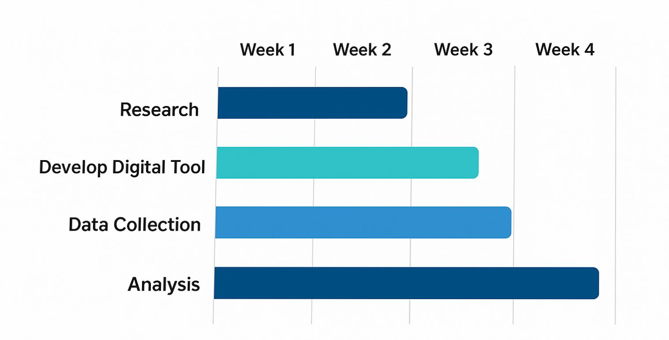
TimeLine (Gantt Chart)

Slide 11
References
[1] A. Y. Hoekstra, A. K. Chapagain, M. M. Aldaya, and M. M. Mekonnen, Water Footprint Manual: State of the Art 2011, Water Footprint Network, 2011. [2] J. Allan, Virtual Water: Tackling the Threat to Our Planet’s Most Precious Resource, London, U.K.: I.B. Tauris, 2011. [3] M. M. Mekonnen and A. Y. Hoekstra, “The green, blue and grey water footprint of crops and derived crop products,” Hydrol. Earth Syst. Sci., vol. 15, no. 5, pp. 1577–1600, May 2011. [4] L. Zhang, Y. Wang, and J. Li, “IoT-based water monitoring system for smart cities,” IEEE Sensors J., vol. 19, no. 12, pp. 4567–4575, Jun. 2019. [5] R. Smith, J. Brown, and M. Green, “Digital tools for sustainability education,” Sustainability, vol. 12, no. 3, Art. No. 987, Feb. 2020.

Slide 12
Reference
[6] P. Jones, S. Taylor, and K. Wilson, “Software architecture for environmental footprint calculation,” Environ. Model. Softw., vol. 45, pp. 1–10, Sep. 2013. [7] T. Nguyen, H. Tran, and L. Pham, “Mobile app for water conservation awareness,” Int. J. Environ. Res., vol. 14, no. 2, pp. 123–134, Apr. 2020. [8] K. Patel, S. Shah, and R. Desai, “Integration of IoT and databases for environmental monitoring,” IEEE Access, vol. 7, pp. 12345–12356, 2019. [9] D. Lee, M. Kim, and J. Park, “Visualization techniques for environmental data,” J. Vis., vol. 22, no. 4, pp. 789–802, Aug. 2019.

Slide 13


