Slide 1
Lending Club Case Study
Exploratory Data analysis
By Sagarika Tamavada & Dharmendra Singh Chouhan

Slide 2
Executive Summary
Data Background
The data contains information about past loan applicants and whether they ‘defaulted’ or not.
The dataset contains information starting from 2007 to 2011
Objective
The aim is to identify patterns which indicate if a person is likely to default, which may be used for taking actions such as denying the loan, reducing the amount of loan, lending (to risky applicants) at a higher interest rate, etc.
Analysis
Data Cleaning – Removing Columns with 100% null values, presence of extreme values, reclassifying existing column types
Univariate, Bi-variate analysis
Key Observations
Number of loans issued increased steadily by every year with a slight decrease in 2008.
Of settled loans, 83% were Fully Paid and 14% were Charged Off.
Income, Grade are key driving factors to identify charge-off accounts
Majority of loans were from A, B, and C grade.
There is an inverse relationship between interest rate and loan grade - lower grades(E,F,G) have higher interest rate.
2

Slide 3
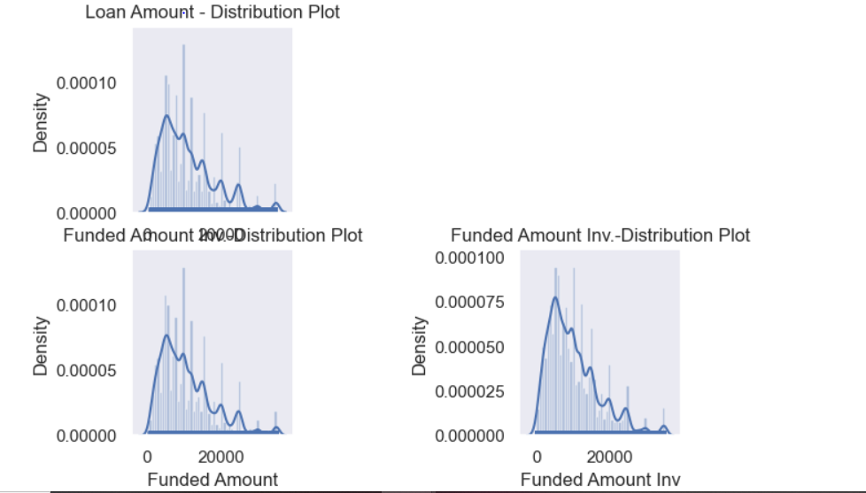
Distribution of loan amounts with Funded amount and Investor funded amount is same
Univariate Analysis

Slide 4
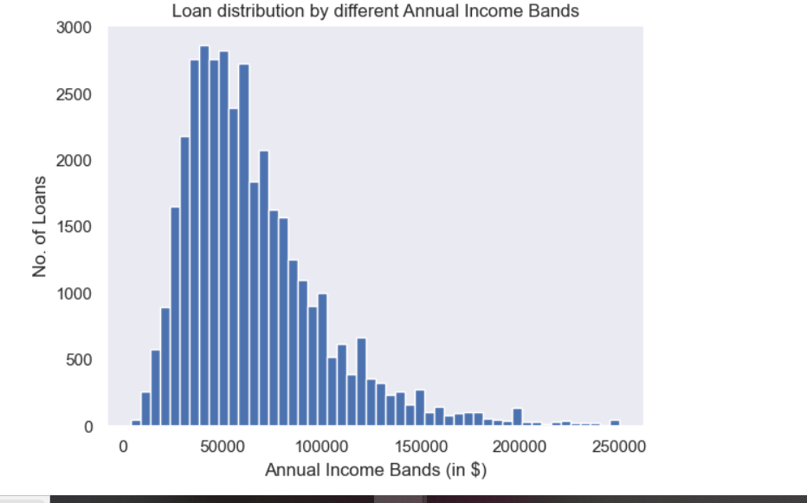
~95% of the loans are provided to the customers with annual income less than $150k
Most of the Annual Income are in the range 25000-75000
3

Slide 5
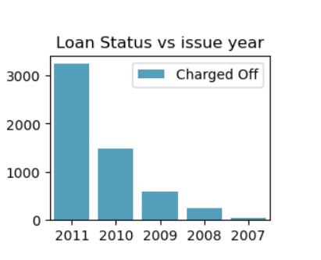
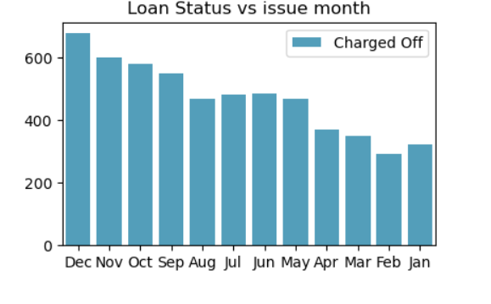
Key Observations:
It shows that greater number of loans that were charged off in month of Nov,Dec, the reasons could be Festivals(Thank’s giving Day, Christmas and New Year).
In 2011 Year, there was huge spike in charged off.
Number of loans issued increased steadily with slight decrease in 2008 year.

Slide 6
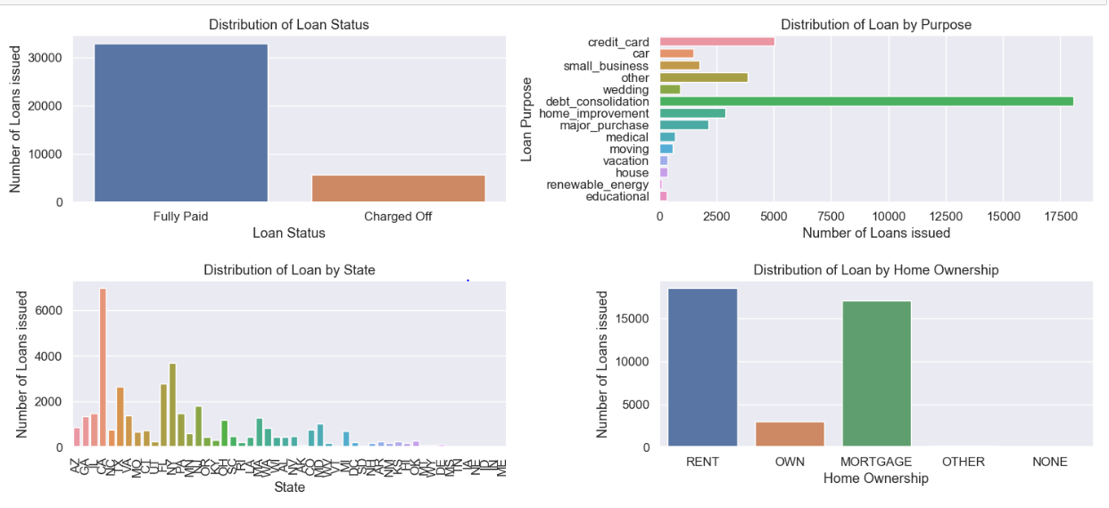
Observations: (Unordered Categorical variables)
From this dataset, we have more observations(85%) from "Fully Paid" status.
There are more loan Applicant's with purpose of debt consolidation.
There are more loan Applicant's from California state.
Most of the loan Applicant's are rented and mortgage.
Applicant numbers are high from these categories so charged off is high too.

Slide 7
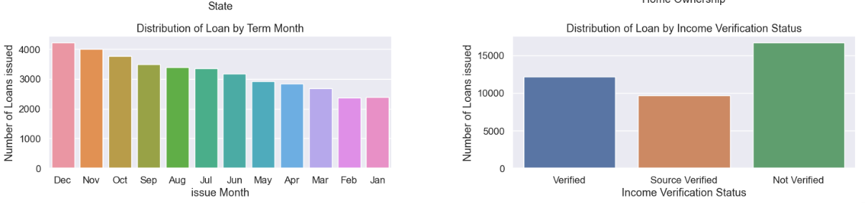
Observations: (Unordered Categorical variables)
Number of Loans issued increases by the end of year
Greater number of loans which have not verified the annual income.

Slide 8
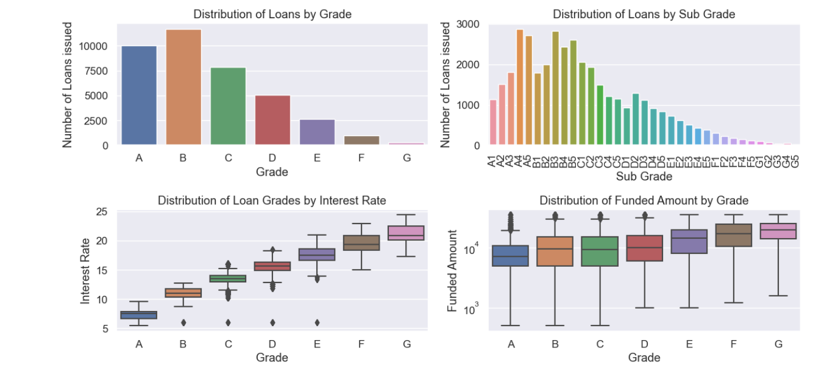
Observations: ( Ordered Categorical Variables)
From above plots, it shows that greater number of loans were from B,A and C grade's and least from G grade.
From Sub grades A4, B3 have greater number of loans.
From 3rd plot, it shows that A,B,C grade loans have less interest rate and E,F,G have high interest rate. From 1st, 2nd plots there are greater number of loans from A,B,C grade(granularity check from sub-grades). It might be the reason that the loan Applicant's from A,B,C grades have better credit score and lower.isk.
From 4th plot, it shows that there are high funded amount in A,B,C and D grades as the Applicant's from these grades have better credit score and lower risk.
6

Slide 9
Summary of Univariate Analysis
Number of loans issued increased steadily by every year with a slight decrease in 2008.
Of settled loans, 83% were Fully Paid and 14% were Charged Off.
Borrowers with own house and want to consolidate debt are not at much risk, but borrower with rent , mortgage and want to consolidate debt are high risk applicants.
Majority of loans were from A, B, and C grade.
There is an inverse relationship between interest rate and loan grade - lower grades have higher interest rate.

Slide 10
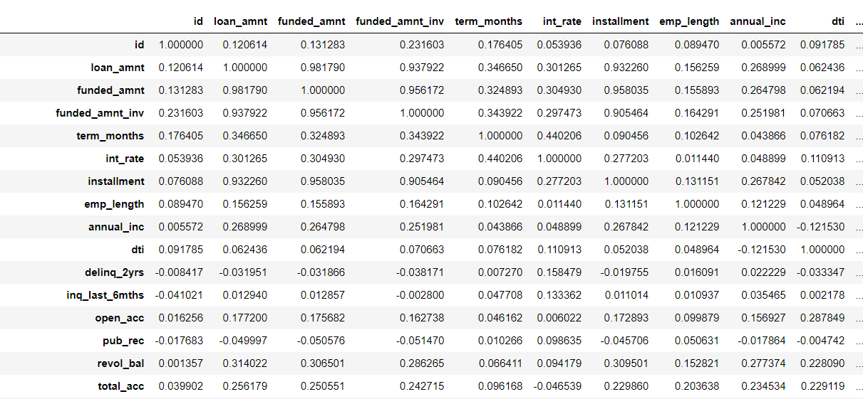
Bivariate Analysis
Correlation Matrix
1) There are no highly negative correlation between columns.
2) There are some highly correlated columns at top and middle left block.
3) There is 0.45 correlation between term_months and interest rate(int_rate).
4) There is 0.47 correlation between revol_util and interest rate(int_rate).
5) There is no much correlation between Annual Income, DTI with other columns.

Slide 11
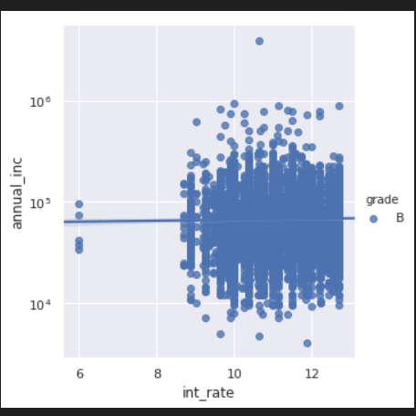
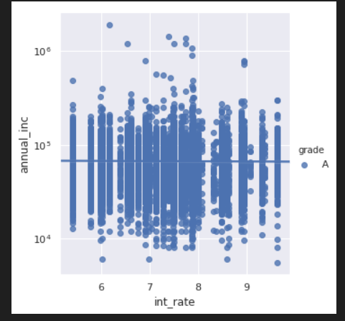
Categorical Variables: Annual Income Vs Interest Rate distribution by each grade
Observations:
1) Grade A has borrowers with interest rate between 5-10%.
2) Grade B has borrowers with interest rate between 8-13%, but few are there with near 6%.

Slide 12
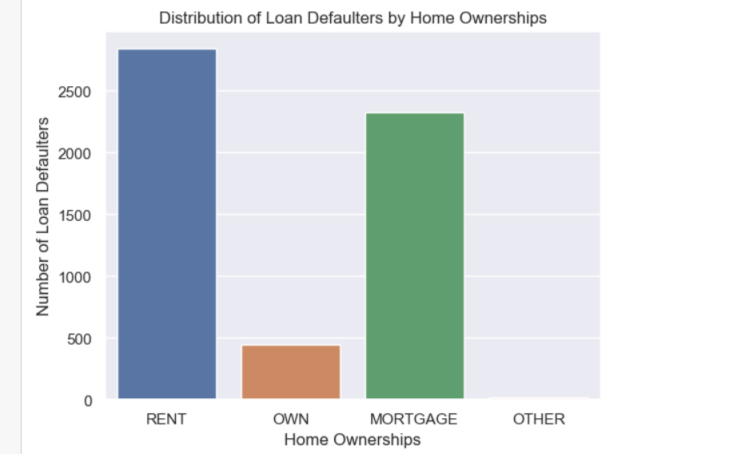
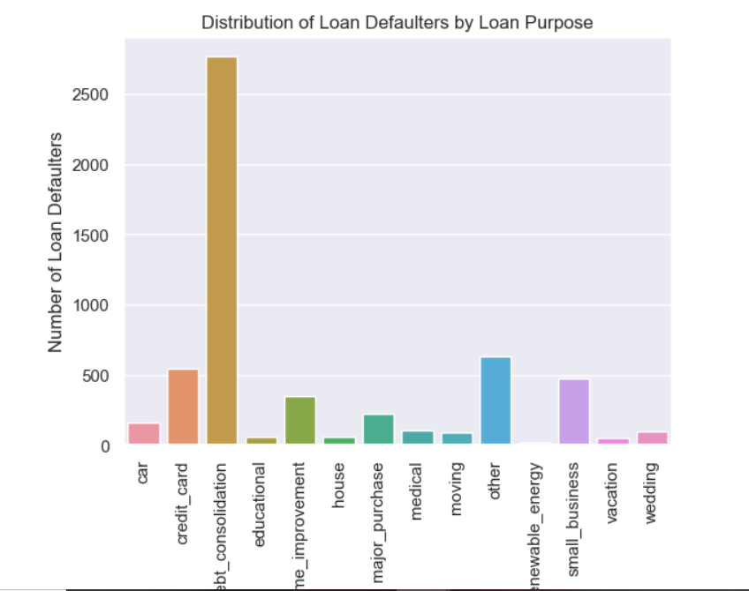
Loan Default Analysis
1) It shows there are more defaulters in RENT and MORTGAGE. let's check it in granular level.
2) There are more defaulters from 'debt_consolidation','other', 'credit_card' and 'small_business.

Slide 13
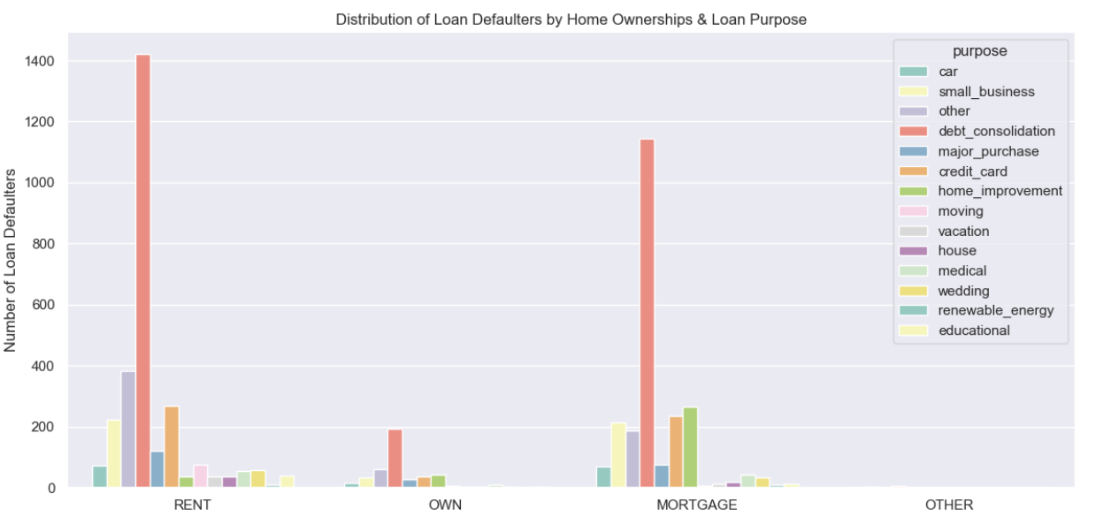
From RENT category, there are more defaulters from 'debt_consolidation','other', 'credit_card' and 'small_business'.
From MORTGAGE category, there are more defaulters from 'debt_consolidation','home_improvement', 'credit_card' and 'small_business'.
Overall, one should be carefull with 'debt_consolidation', 'credit_card' and 'small_business' loans when the borrowers don’t have own house.

Slide 14
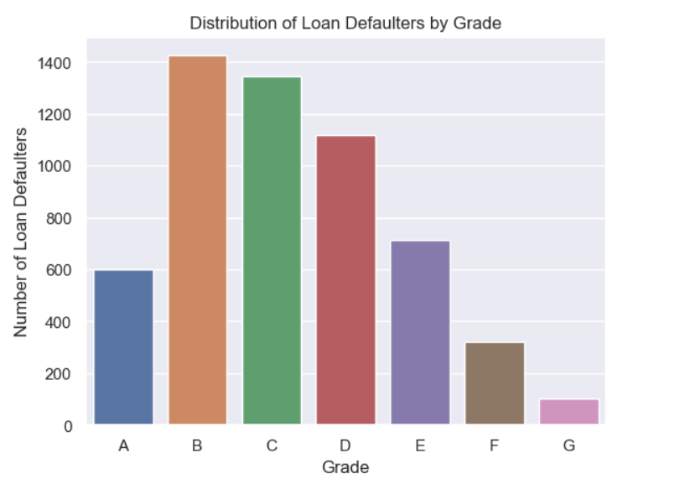
Observations:
It shows there are more defaulters in B,C and D grades.
Grades F,G(more interest rate grades) are having less defaulters which is a good indicator.

Slide 15
Summary of Bivariate Analysis
Bivariate Analysis on Continuous Variables:
#Correlation Plot:
a) There were no highly negative correlation between numerical columns.
b) 0.45 correlation between term_months and interest rate(int_rate).
c) 0.47 correlation between revol_util and interest rate(int_rate).
d) No much correlation between Annual Income, DTI with other numerical columns.
Loan Defaulters Analysis:
Distribution of Loan Defaulters by Loan Purpose: a) There are more defaulters from 'debt_consolidation','other', 'credit_card' and 'small_business.
Distribution of Loan Defaulters by Home Ownerships: a) By charts, it shows there are more defaulters in RENT and MORTGAGE.
Distribution of Loan Defaulters by Home Ownerships & Loan Purpose: a) There are more defaulters with 'debt_consolidation', 'credit_card' and 'small_business' purpose from Rent, Mortgage category and hence, should be carefull when borrowers don't have own house.
Distribution of Loan Defaulters by Grade: a) By charts, it shows there are more defaulters in B,C and D grades. b) Grades F,G(more intereste rate grades) are having less defaulters which is a good indicator.

Slide 16
Conclusion
1) Number of loans issued increased steadily by every year with a slight decrease in 2008.
2) Of settled loans, 83% were Fully Paid and 14% were Charged Off.
3) Borrowers with own house and the purpose of loan with consolidate debt, 'credit_card' and 'small_business' are not at much risk, but borrower with rent,mortgage are high risk applicants.
4) Majority of loans were from A, B, and C grade.
5) There is an inverse relationship between interest rate and loan grade - lower grades(E,F,G) have higher interest rate.
6) Overall, there are more defaulters from 'debt_consolidation', 'others', 'credit_card' and 'small_business' purpose loans from all grades.

