Slide 1
WISDOM
REASONING
Cognition
KNOWLEDGE
METRICS
With Meaning
INFORMATION
ABSTRACTIONS
With Purpose
DATA
RAW/SIGNALS

Slide 2
Trained Generator
Trained Classifier
Beauty Classifier
U_{N}
U₂
U₁
. . .
Beauty
Ugly
Up-Convolution
f
Beauty Maximized
Image

Slide 3
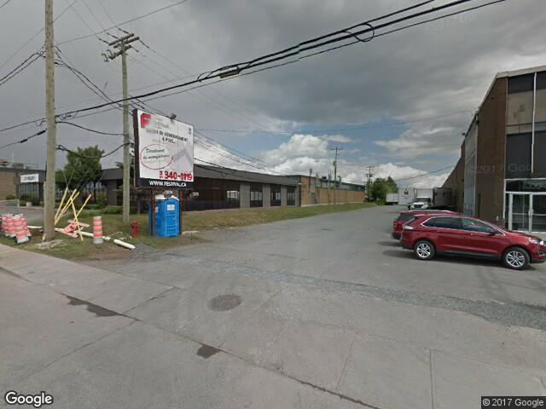
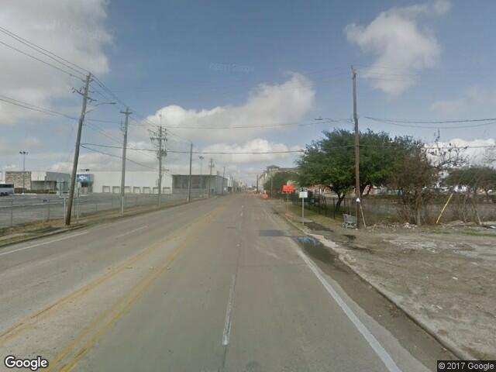
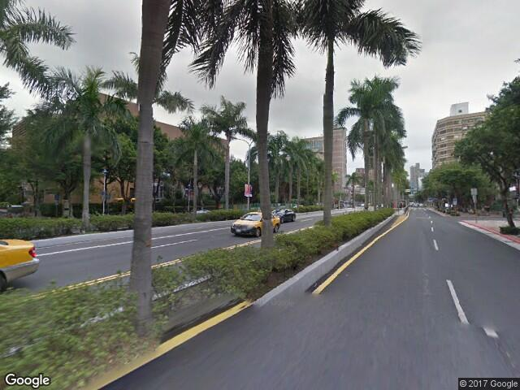
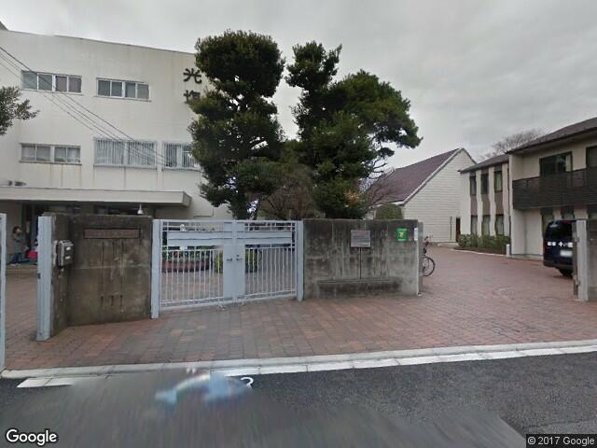
Classifier
Conv
Conv
Beauty
Max Pooling
Max Pooling
Max Pool
Max Pool
Ugly
Soft Max
Input Images
Convolution + Max pooling
Fully connected

