Slide 1
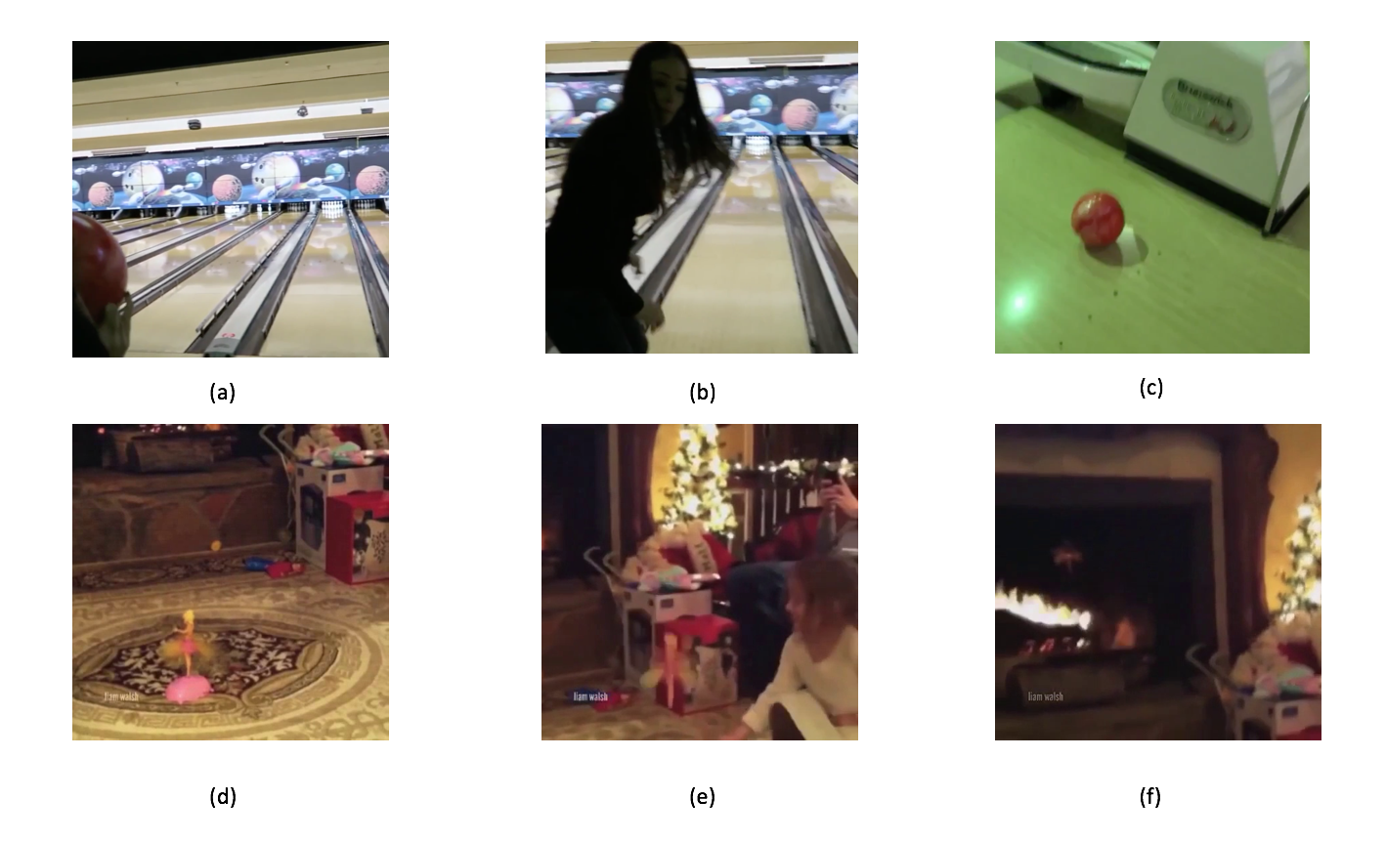
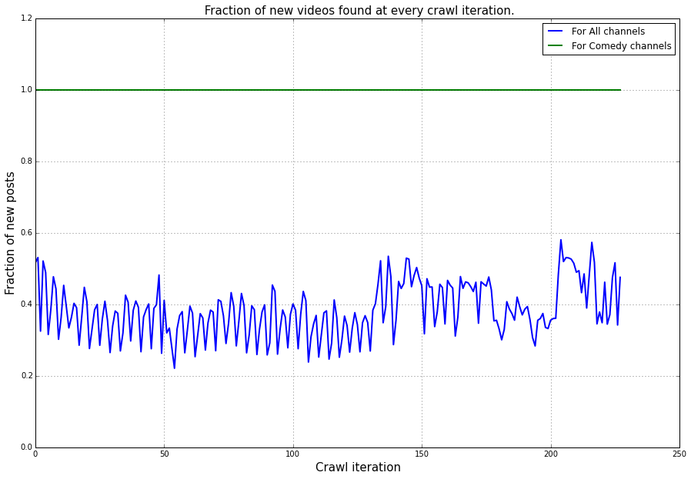
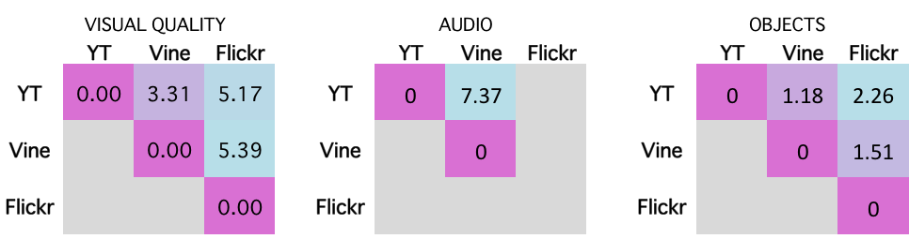
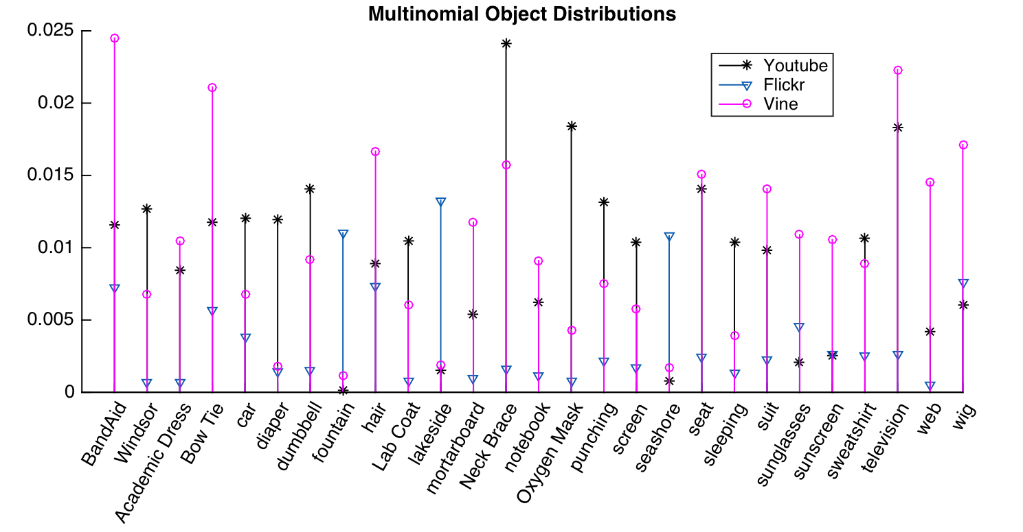
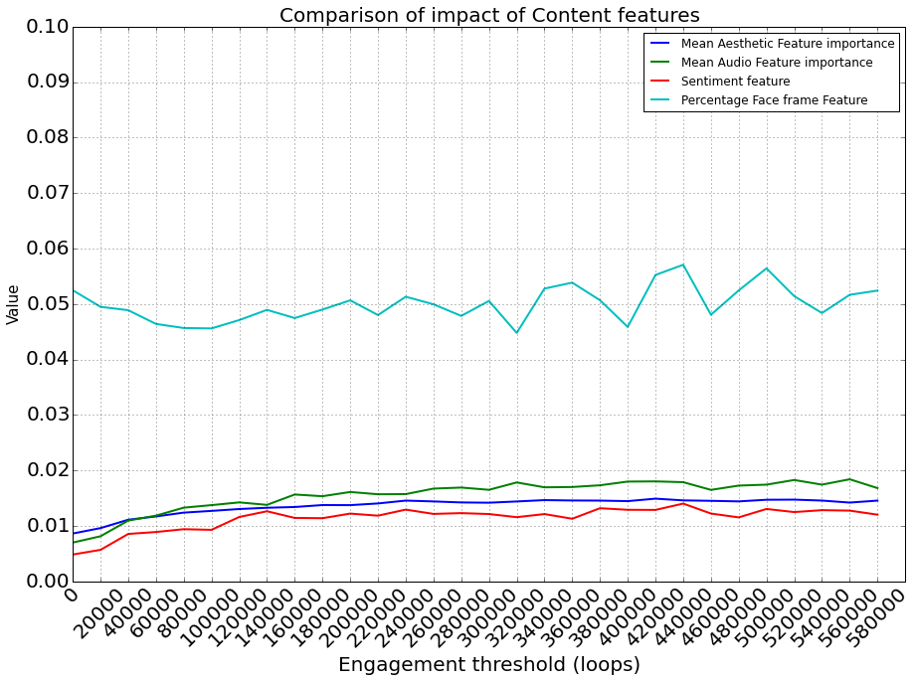
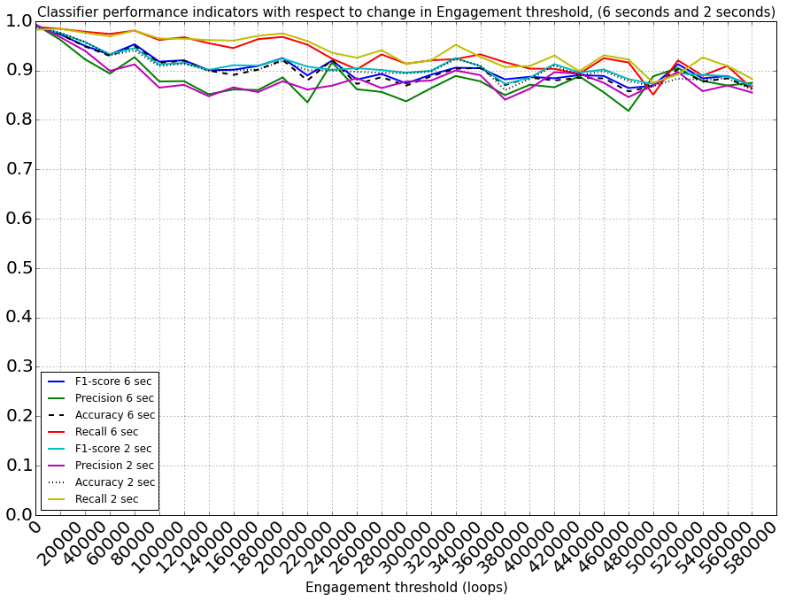
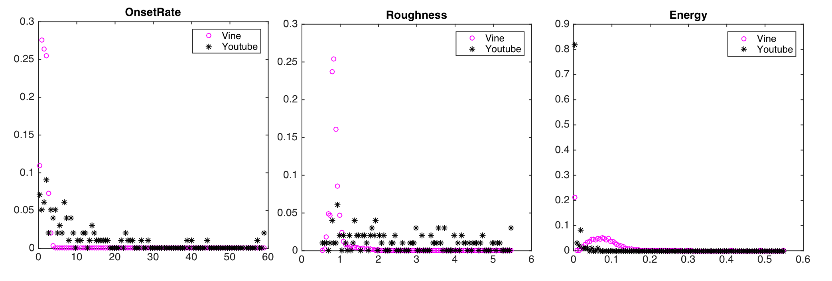
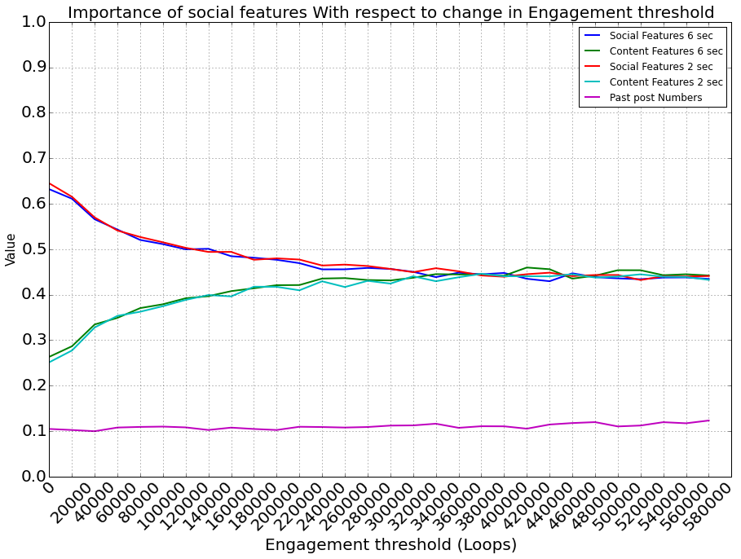
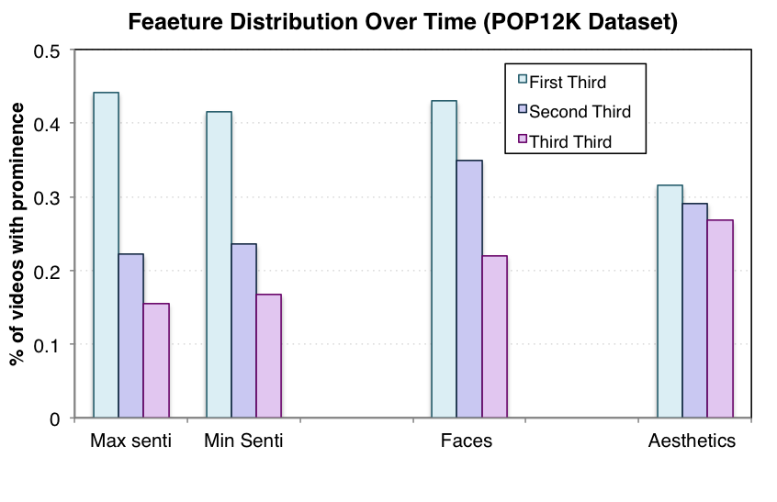
Like at First Sight
UNDERSTANDING USER ENGAGEMENT WITH THE WORLD OF MICRO-VIDEOS
Sagar Joglekar, Nishanth Sastry, Miriam Redi
King’s College London
Bell Labs UK
A DEEP UNDERSTANDING OF USER ENGAGEMENT IN MICRO-VIDEOS
DATASET COLLECTION
MICRO-VIDEOS: user-generated videos with maximum length of 6-15 seconds
POP-12K: 12,000 popular Vines
UNPOP120K: 120K
Non-popular vines from all channels.
Is micro-video a new form of expression?
How do content-related features affect user engagement (popularity)?
How do micro-video features change over time?
MICRO VIDEO FEATURE DESCRIPTION
VINE, A NEW FORM OF EXPRESSION:
A Quantitative Analysis
To understand characteristics of micro-videos, we characterize them with:
AESTHETIC FEATURES
Contrast, Sharpness, Rule Of Thirds … [18 Features]
SENTIMENT FEATURES
Multilingual Visual Sentiment Detectors
AUDIO FEATURES
Related to affect: Roughness, Mode, Rhythmical … [6 Features]
FACE FEATURES
Percentage of frames containing one or more faces
SOCIAL FEATURES
Number of followers and previous post of the video creator
Q: IS VINE SIMILAR TO IMAGES OR TO VIDEOS?
3 Datasets: Vine, Flickr, Youtube
3 Features: Aesthetics, Objects, Sound
Aggregation of features for each dataset
KL Divergence to measure Distance
A: MICRO VIDEOS ARE NOT IMAGE NOR VIDEOS!
PREDICTING USER ENGAGEMENT IN MICRO-VIDEOS
A novel approach
Q: WHICH FEATURES AFFECT USER ENGAGEMENT?
User Engagement = Popularity: number of loops on a micro-video
Classifier: Binary popularity prediction
Variable Popularity Threshold for popularity annotation binarization
Sensitivity Analysis by training a series of classifiers for different thresholds
A: CONTENT FEATURES MATTER FOR VERY POPULAR VIDEOS. FACES ENGAGE US.
Aggregated KL divergence across datasets
INITIAL SECONDS PREDICT ENGAGEMENT!
AN ENGAGEMENT PREDICTOR TRAINED ON FIRST VIDEO SECONDS IS AS ACCURATE AS A PREDICTOR TRAINED ON THE WHOLE VIDEO
MICRO-VIDEOS OVER TIME
The Primacy of the First Seconds
Q: HOW DO FEATURES CHANGE OVER TIME IN 6-SECOND VIDEOS?
3 Features: Sentiment, Faces, Aesthetics
3 Video Segments: 2-second thirds
Compute feature values at each third
For which third features have max value?
A: IMAGE QUALITY AND SENTIMENT DETERIORATE OVER TIME.

