Slide 1


E-Commerce Data Analytics Project
Group 6

Slide 2
PROJECT OVERVIEW
This project involves analyzing e-commerce data using SQL, Excel, and Power BI to derive insights and visualize key metrics.
The main objectives are to identify trends, track sales performance, and provide a comprehensive overview of business operations.

Slide 3
TOOLS AND TECHNOLOGIES
SQL: For querying the database to extract and manipulate data.
Excel: For creating pivot charts and analyzing data from SQL queries.
Power BI: For building interactive dashboards to visualize the data.
Tableau: For building interactive dashboards and visualizing data with charts, filters, KPIs, and reports.

Slide 4
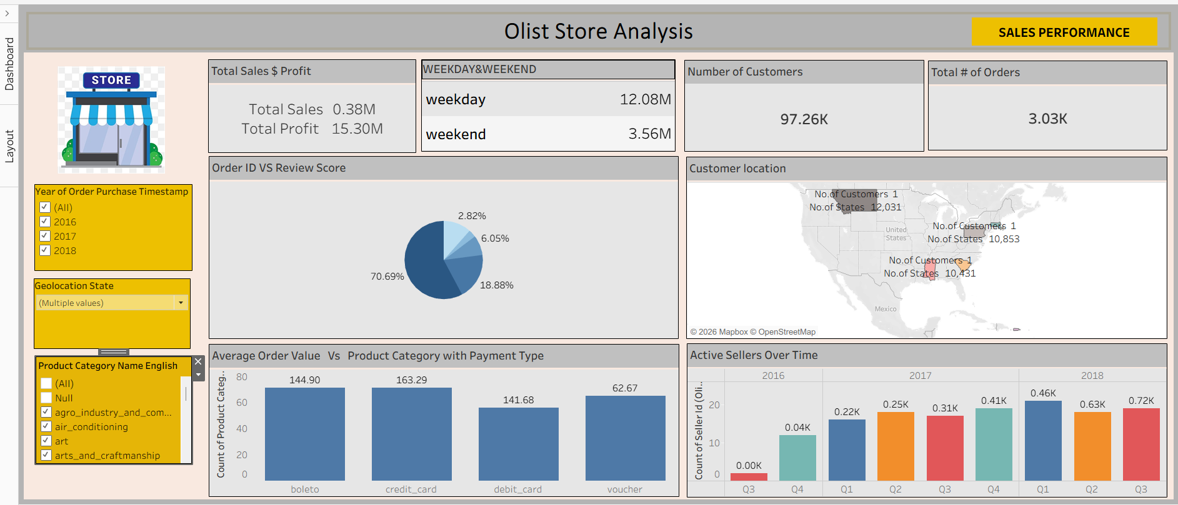
TABLEAU DASHBOARDS

Slide 5
DASHBOARD OBJECTIVE
Dashboard Objective
Explain the business problem.
Example:
Analyze sales performance
Identify top-selling products
Find profitable regions
Understand customer purchasing behavior

Slide 6
DASHBOARD COMPONENTS
KPI Cards
Total Sales
Total Profit
Total Orders
Average
Sales
Category Chart
Explain:
Which category has highest sales
Comparison between categories
Regional Analysis
Explain:
Best performing region
Lowest sales region
Monthly Trend Analysis
Explain:
Seasonal sales patterns
Growth trends
Customer Analysis
Explain:
Top customers
Customer segments
Filters & Interactivity
Show how filters work.
Explain:
Region filter
Category filter
Date filter

Slide 7
CONCLUSION
This project showcases the use of SQL, Excel, and Power BI to analyze and visualize e-commerce data effectively.
The insights derived can help in making informed business decisions.

Slide 8


