Slide 1
E-Recruitment
Team-2
Sagar K.
Divya Kamath

Slide 2
Agenda
Introduction
Types of Users
Demo of the Website

Slide 3
Introduction
An online service for potential candidates to search for Jobs, View Jobs details, Apply for Jobs and for employers to Screen Applications and Give feedback.

Slide 4
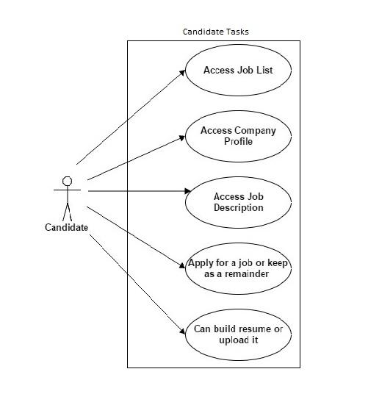
Types of Users
Candidates – Job seekers

Slide 5
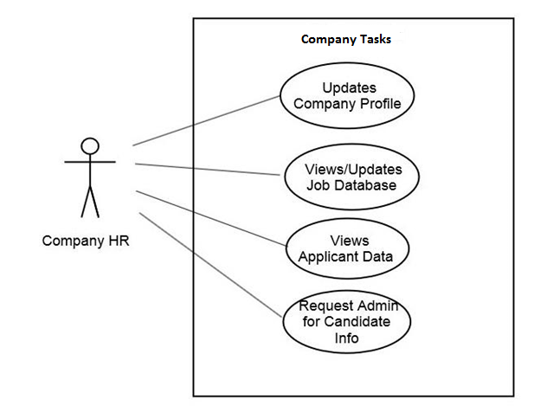
Types of Users
Companies – Employers

Slide 6
Demo of the Website

Slide 7
Thank You.

