Slide 1

National Institute Of Technology Silchar
OpenGL Project
Tic Tac Toe Game
Presented By:
Kumar Gaurav
Sagar Kar
Arujit Pradhan

Slide 2
Tic Tac Toe Game Play
Tic-tac-toe (also known as Noughts and crosses or Xs and Os) is a paper-and-pencil game for two players, X and O, who take turns marking the spaces in a 3×3 grid. The player who succeeds in placing three of their marks in a horizontal, vertical, or diagonal row wins the game. Let us enjoy it with Computer Graphics.

Slide 3
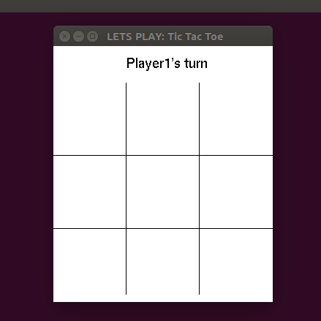
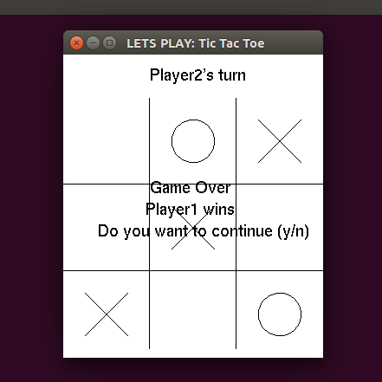
Game Screen shot

Slide 4
How we made it work!
The special components
Line Drawing
Circle Drawing
User Input Control (Keyboard and Mouse)
Text Display
Game Logic

Slide 5
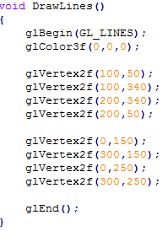
Line Drawing
We used glBegin(GL_LINES) which Treats each pair of consecutive vertices as an independent line segment. And draw the lines depending upon the coordinates provided.

Slide 6
Circle Drawing
We used the glBegin(GL_LINE_LOOP) that Draws a connected group of line segments from the first vertex to the last, then back to the first. This loop structure gives a complete circle when used around 15 vertices points.

Slide 7
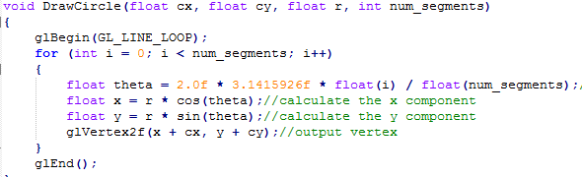
Code for Circle Drawing

Slide 8
User Input Control
Keyboard: We have used keyboard options for repeating the game play. It will wait for (y/n) any other key pressed will be taken to termination of game.
Mouse: We get the position of the mouse pointer and button press. Then depending upon the position it will draw either cross or circle upon turn and availability.

Slide 9
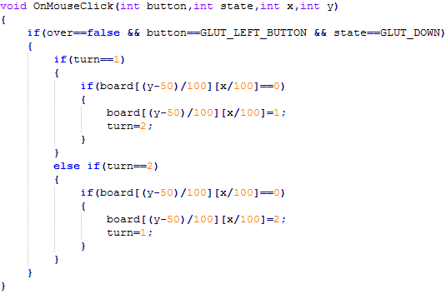
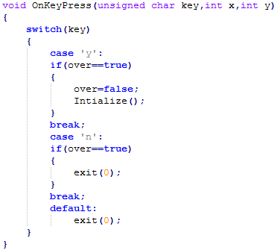
User Input Control

Slide 10
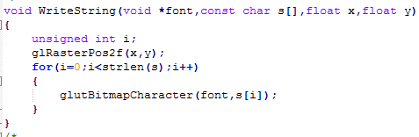
Text Display
We use the WriteString function to write text in the window in the form of bitmap which take only the font-style, string, position in screen as arguments.
Which uses the inbuilt function glutBitmapCharacter(font_style,ch) to render text in OpenGL.

Slide 11
Game Logic
The game finds result simply checking the horizontal, vertical and diagonal grids for a series of 3 same symbol. And declare a winner if any with the function CheckWinner(). If all the position are filled and still CheckWinner() return no winner then the function IsDraw() declare the game draw.

Slide 12
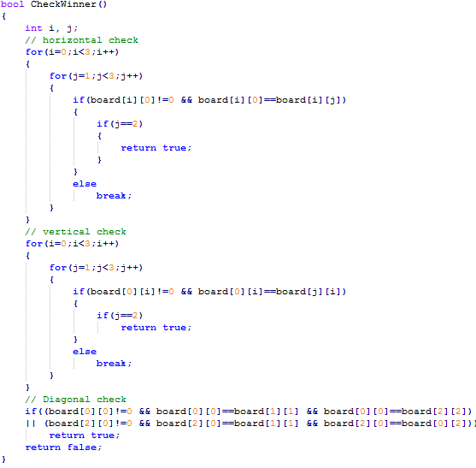
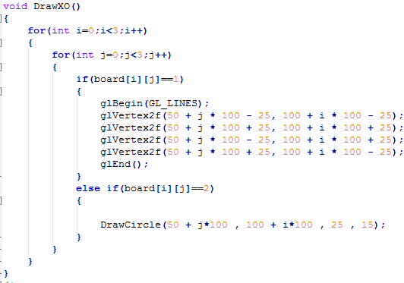
Checking and Drawing Logic

Slide 13
Putting Things Together
Display() takes care of the repeated display upon each event.
Here we:
Write strings using the WriteString().
Draw Line every time using DrawLines().
Draw X and O using DrawXO().
Check for winner using CheckWinner().
Decide Draw or winner using IsDraw().

Slide 14
The Main()
The main() do the basic initialization and calls to the appropriate functions to start their basic utility.
Finally it runs the Game Loop which keeps on running till terminated from inside a function or forcefully.

Slide 15
Play the game and contact us for hugs or bugs
THANK YOU

