Slide 1
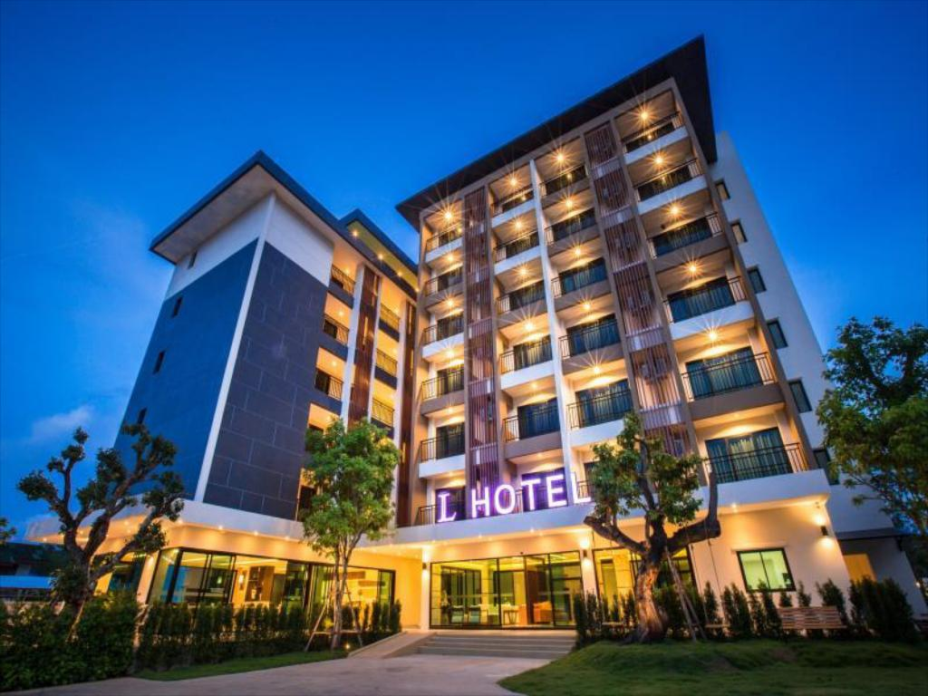
Capstone Project on hotel booking analysis

Slide 2

Capstone Project - 1 Hotel Booking Analysis
Made By-
Rutvina Liladhar Papadkar
Sagar Prabhakar Khairkar
Nayan Girdhar Rewatkar
Guided By-
ALMABETTER TRAINERS (COHORT AZADI)

Slide 3
Introduction
We are doing analysis on Hotel booking where dataset contains Resort hotel and City hotel data. Our data set contains booking information for a city hotel and a resort hotel, and includes information such as when the booking was made, length of stay, the number of adults, children, and/or babies, and the number of available parking spaces, among other things. All personally identifying information has been removed from the data.
The main objective of our project is to explore and analyze the data to discover important factors that govern the bookings, as it may help hotel management to increase their business.

Slide 4
Problem Statement
Have you ever wondered when the best time of year to book a hotel room is? Or the optimal length of stay in order to get the best daily rate?
What if you wanted to predict whether or not a hotel was likely to receive a disproportionately high number of special requests?
This hotel booking dataset can help you explore those questions!

Slide 5
Data Analysis
Hotel Booking Database including booking information for a city hotel and a resort hotel of various countries from 2015 – 2017.
Data Dimensions:
Rows – 119390
Column - 32

Slide 6
Data Description
Hotel : Includes city hotel and resort hotel.
is_canceled - 1:Canceled, 0:Not canceled
Lead_time - Time between booking & arrival
Arrival_date_year - year of arrival date
Arrival_date_month - month of arrival date
Arrival_date_week_number – Week number of year for arrival date
Arrival_date_day_of_month – Day of arrival date
Stays_in_weekend_nights – number of stay in weekend nights
stays_in_week_nights - Number of week nights.
adults - Number of adults.
children - Number of children.
babies - Number of babies.
meal - Type of meal booked.
country - Country of origin.

Slide 7
Market segment – A group of people who share one or more common characteristics used for business
distribution_channel –Chain of business through which a service passes until it reaches the final buyer
Previous_cancellations – previous cancellation by customer
Previous_booking_not_canceled- confirmed booked by customer
reserved_room_type – Pre-booked by customers
assigned_room_type – single / couple / family
booking_charges – booking charges we charged
deposit_type – No Deposit, Non Refund, Refundable
agent- ID of travel agency
company- ID of the company
days_in_waiting_list – Number of days in waiting
Required_car_parking_space – required car parking space by the customer
Total_of_special_request – number of special request requested

Slide 8
reservation_status - Canceled, Check out
reservation_status_date – Canceled / check out
Is_repeated_guest – contain data of repeated guest
Customer_type – Contract / Group / Transient

Slide 9
Contents
Cancellation Percentage
Calculating Special Requests
Booking ratio between City & Resort hotel
Country origin of most guests
Booking per year
Busiest month for hotels
Meal Type
Number of travelers in various month
Accommodation Room Type
Online vs offline booking
Number of people who booked the hotel
Ratio of Repeated Guest

Slide 10
Reservation Status
Weekends vs Weekdays
Checking Travelers
Satisfactory of Customers
Co-relation of Columns
Conclusion

Slide 11
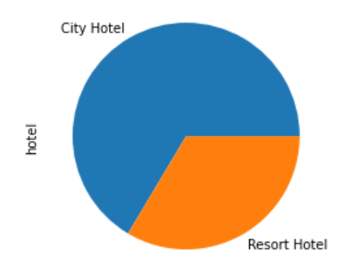
Booking Status
City hotel has booked in majority than Resort hotel

Slide 12
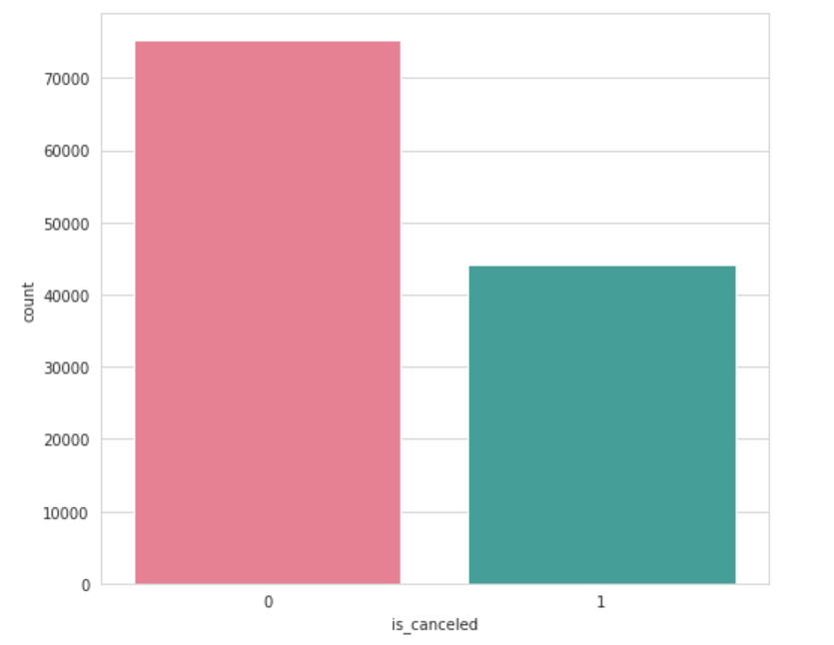
Calculate the booking cancellation percentages
We can conclude that the 47% of cancellation were done in a year

Slide 13
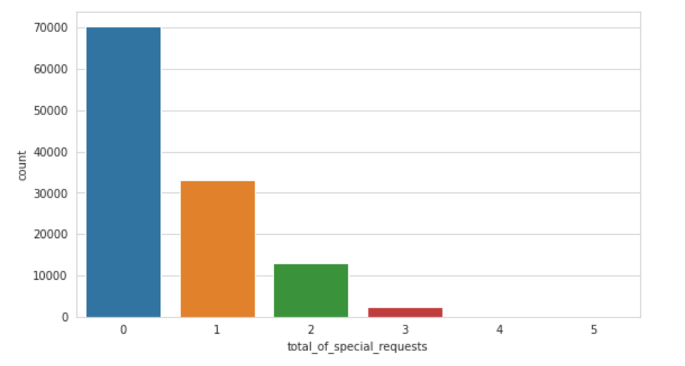
Special Request
we can see 1st special request has made 26% of total bookings. 2nd special request has made 10% among all and 1% for 3rd special request.

Slide 14
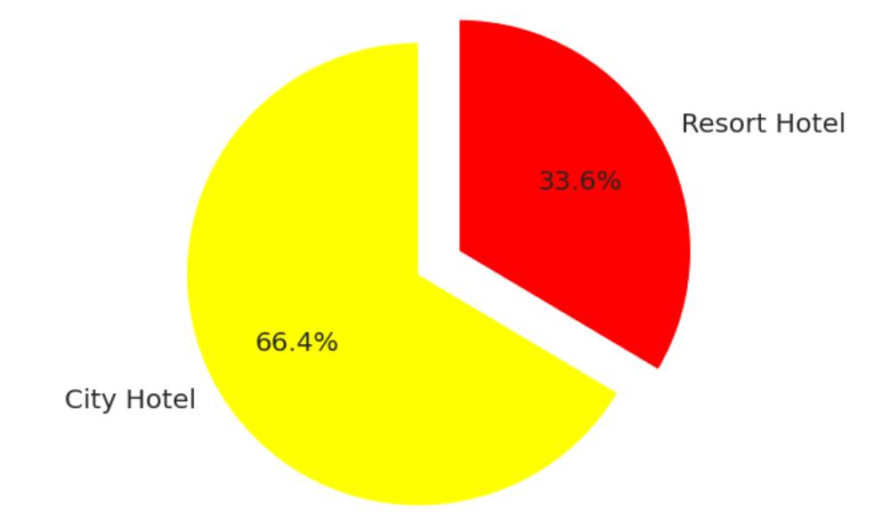
Booking ratio between City hotel and Resort hotel
City Hotel has highest ratio of booking compare to resort hotel

Slide 15
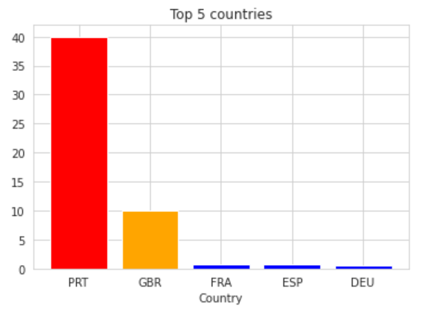
Country origin of most guest
Portugal has highest 40.69% of the guest, followed by Great Britain with 10.15%, France, Spain and Germany.
Majority of the guests are from European Countries.

Slide 16
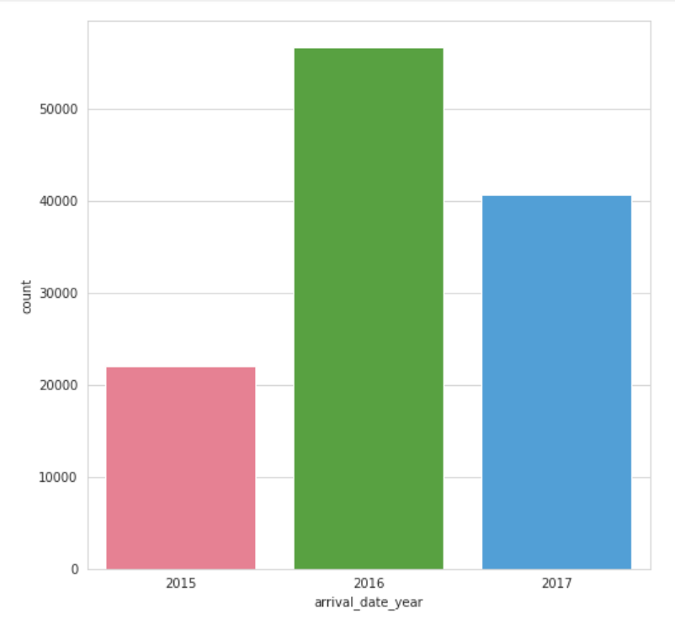
Booking Per Year
There has many arrivals in the year 2016 than any other year.

Slide 17
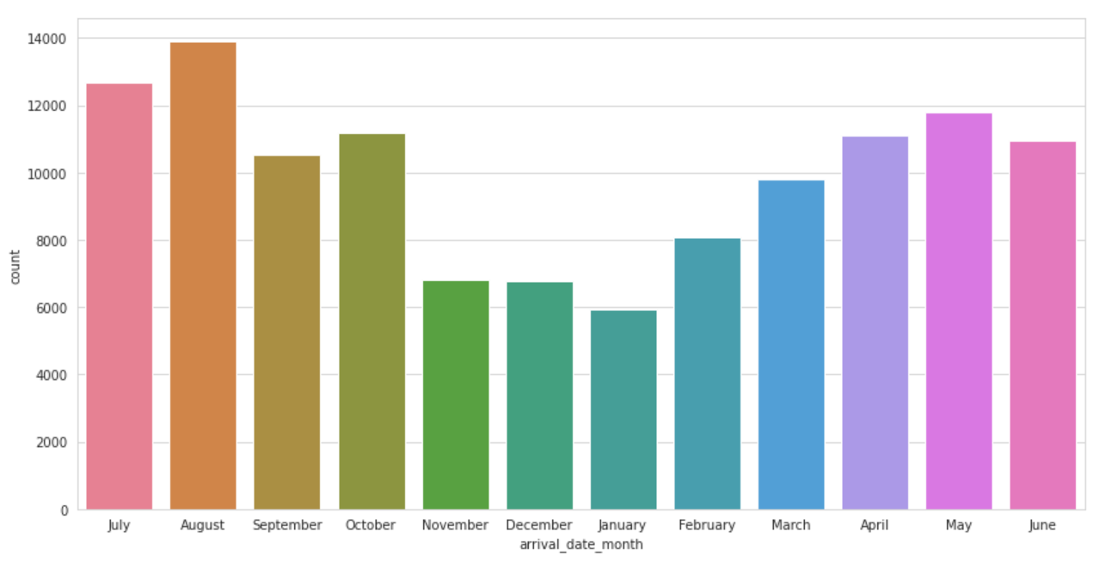
Busiest Month for Hotels
The Month with highest booking is August which has 11.62% reservation. The month with lowest booking is January which has 4.96% of reservation.
We can say that the busiest month for hotels is August which has 11.62% of reservation

Slide 18
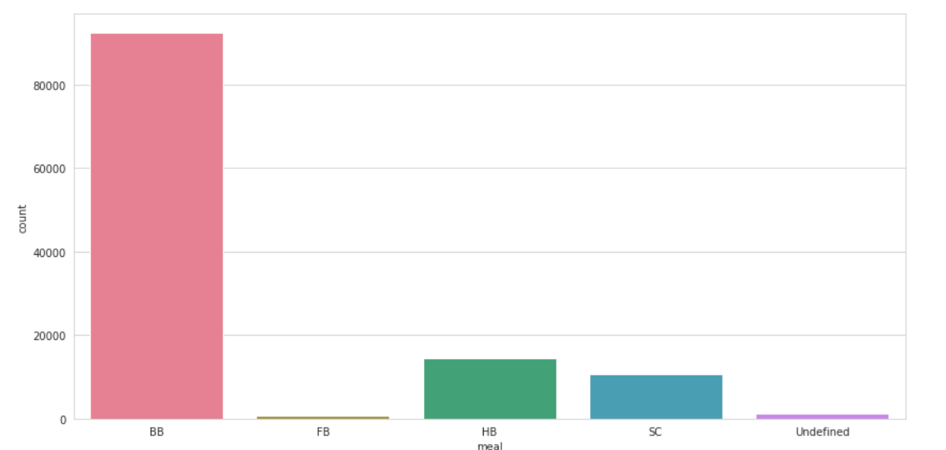
Meal Type
BB( Bed & Breakfast) is the most preferred type of meal by the guests.
Full Board i.e. FB is least preferred.
HB (Half Board) and SC(Self Catering) are equally preferred.

Slide 19
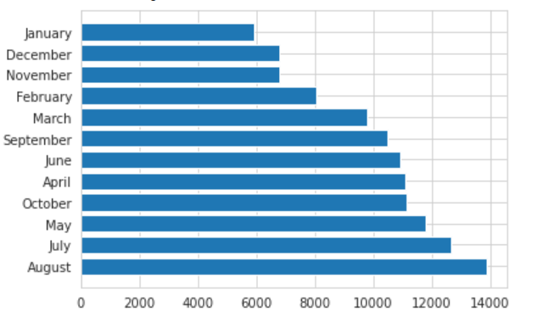
Number of travelers in various month
Maximum number of travellers travels in August month.
Minimum number of travellers travels in January month
Peak Months are August, July and May.

Slide 20
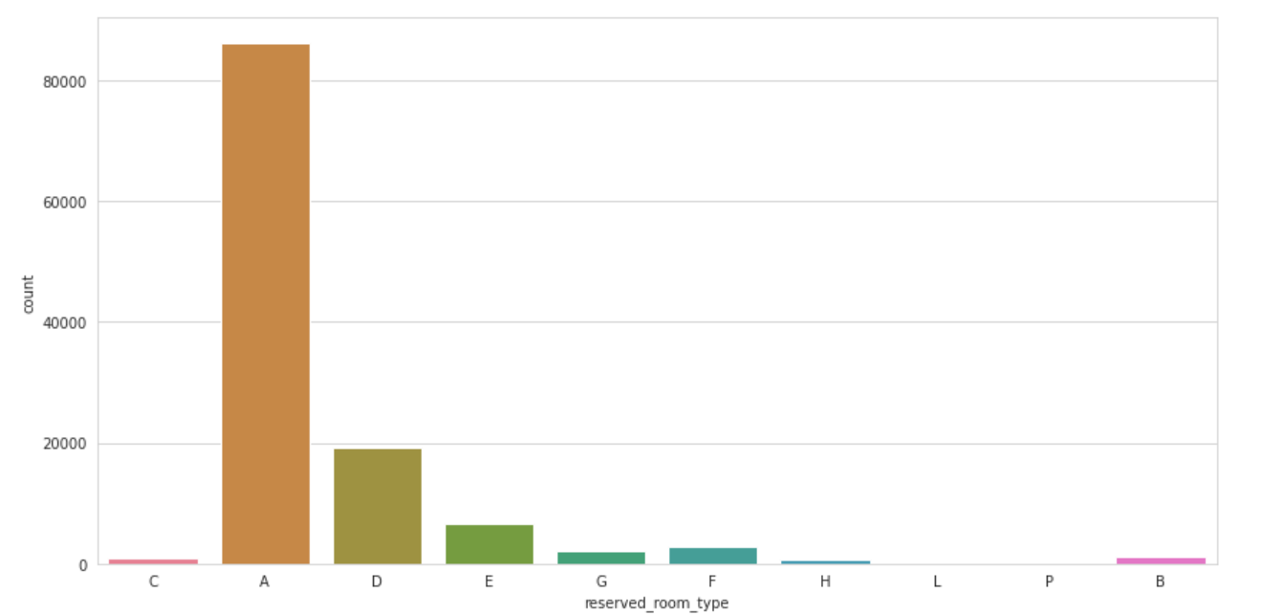
Room Types
The room type “A” is selected by most of the guest

Slide 21
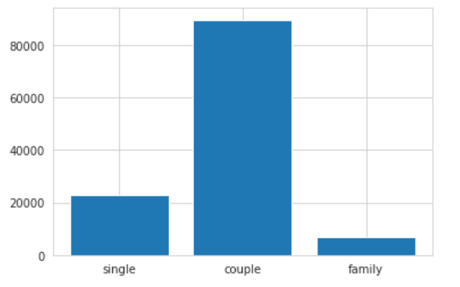
Room booked for family, couple and single
we can say that the majority of rooms are booked for couples

Slide 22
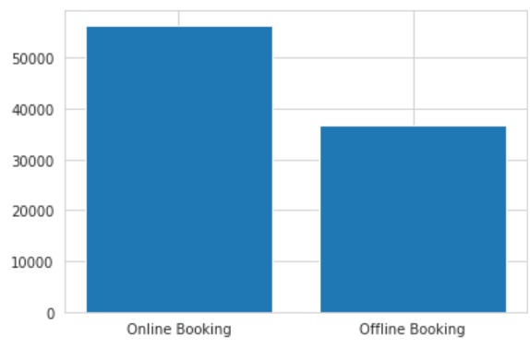
Online Vs Offline Booking
customers prefer to book online hotel rather than offline one

Slide 23
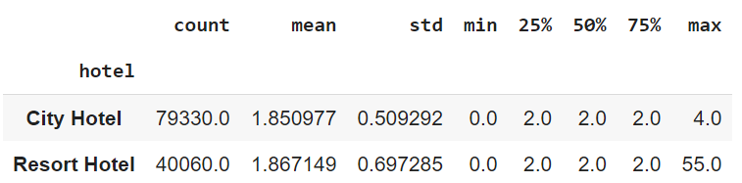
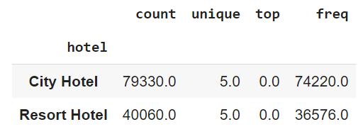
People who booked the hotel
Booked by Adults
Booked by Children's
● It seems that mean values for adults and children are higher.
● This means that resort hotels are better choice for large families.

Slide 24
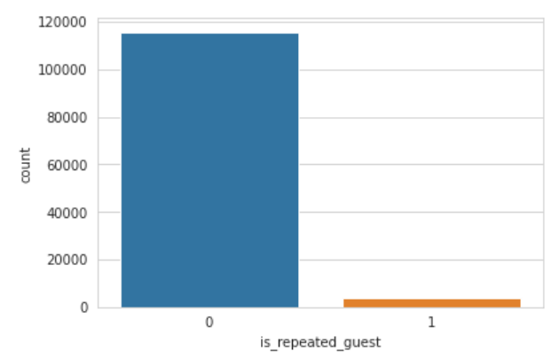
Repeated Guests
The number of guests rarely visited the same hotel

Slide 25
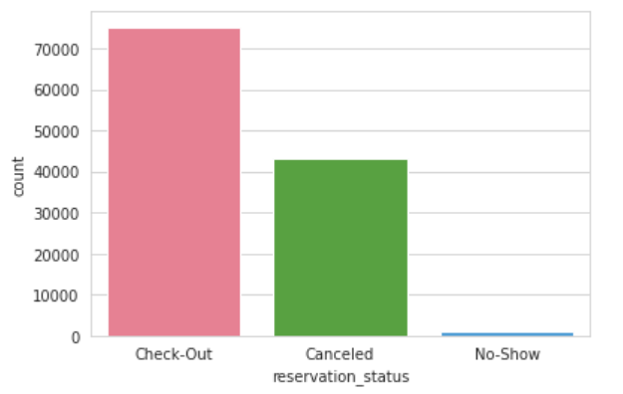
Reservation Status
50% of guest has canceled their booking which is very high.

Slide 26
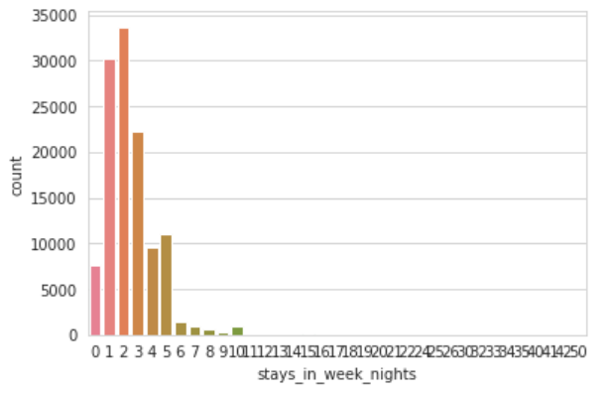
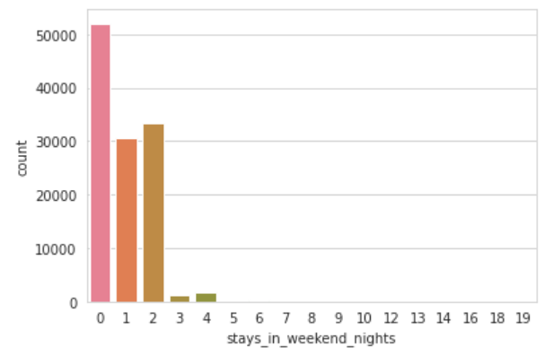
Weekend Vs Weekdays
Average stays on weekdays
Average stays on weekend
The count for booking on weekdays is higher than that of weekends with more than 50000.

Slide 27
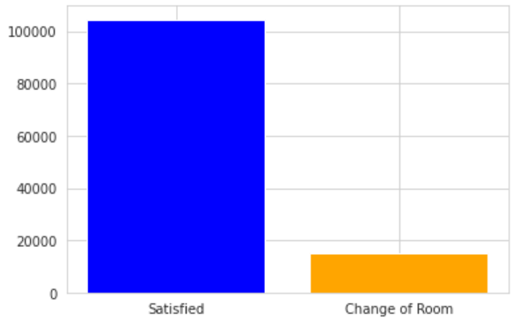
Customers satisfactory
Majority of the customers has got the room type they have booked

Slide 28
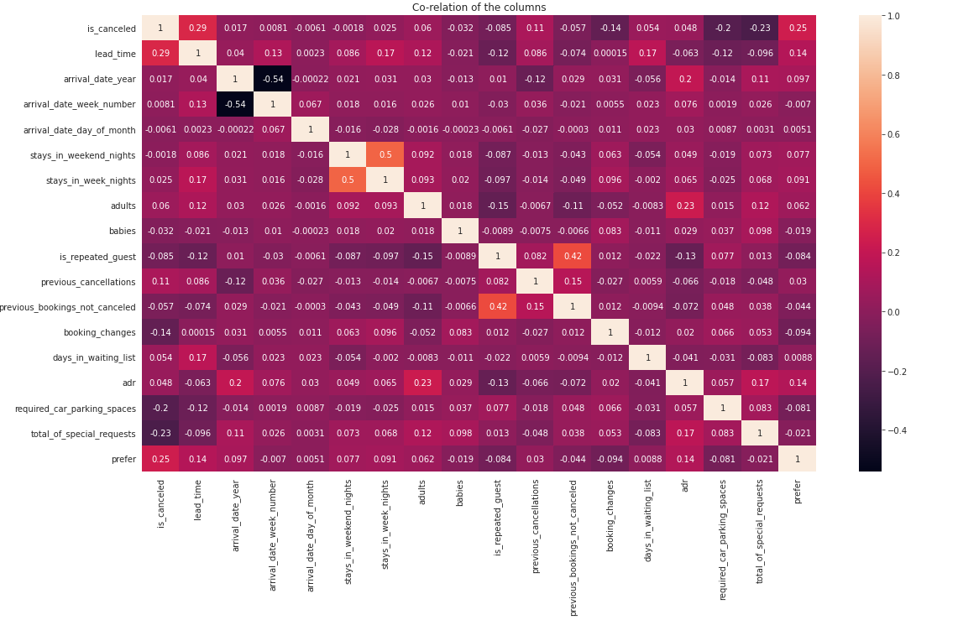
Co-relation of Columns
Is_canceled and same_room_alloted_or_not are negatively correlated. Not getting the same room as per reserved room is not the reason for booking cancellations.
lead-time and total stay is positively correlated means more is the stay of customer more will be the lead time.

Slide 29
Conclusion
Hence we conclude that the hotel bookings are expected to get increase in summer season than any other season. So, if you want to enjoy the family time then you can book in any other seasons except summer.
It seems like people are staying for mostly 1 to 3 days, so for increasing the business you can offer the discount on long stays.
Many bookings were done in online mode because there are many hotel booking applications are offering good discount and it is flexible to book remotely.

Slide 30


