Slide 1
Contents
ABSTRACT DESIGN FUNCTIONAL DESIGN CONTROL FLOW DESIGN PRESENTATION LAYER DESIGN IMPLEMENTATION

Slide 2
Abstract Design
Architectural Design
Datasets
Pre-processing Data
Features Extraction
Forged
RGB To Gray Scale
Removal of Noise
Centroid Calculation
Solidity Calculation
Real
Gray Scale
Resizing the image
Saving Features
Defining Path for both Forged and Real datasets
Display Outcome
CNN Model
Genuine
Signature Belongs to Genuine Image
Convolution Layer
Pooling
Outcome
Forged
Signature Belongs to Forged Image
Fully Connected Layer

Slide 3
Dataset Collection: Collect a dataset of genuine and forged signatures. The dataset should be diverse and should cover different types of signatures with various styles and fonts.
Data Pre-processing: Pre-process the dataset by resizing the images, normalizing the pixel values, and converting the images to grayscale
Dataset Splitting: Split the dataset into training, validation, and testing sets. You can use the training set to train the model, validation set to tune the hyperparameters and test the model's generalization capability on the testing set.
Model Architecture: The model architecture should consist of several convolutional layers followed by max-pooling layers to extract relevant features from the signature images. Add a few fully connected layers to classify the signatures as genuine or forged.

Slide 4
Use case diagram
Upload signature Image
Signature Analysis
Forgery Probability Display
Update Model
View Model Performance
Actor
Manage Users
Manage System

Slide 5
Functional Design
Start
Data Flow Diagram
Creation of
Dataset
Signature Image Pre
-
Processing
Segmentation of
Signature Image
Features Extraction
GLCM
D
etection
Detection
and
Classification
CNN
Classification
Implementation and
Framework using GUI
End
Fig: Data Flow diagram

Slide 6
User Interface Component: This component allows the user to upload the signature image and view the forgery probability score.
Data Pre-processing Component: This component pre-processes the signature image by normalizing pixel values, resizing, and converting to grayscale.
Convolutional Neural Network (CNN) Component: This component processes the preprocessed image to extract relevant features using a CNN model.
Post-Processing Component: This component applies post-processing techniques to the output probability score, such as thresholding, smoothing, or denoising.

Slide 7

Class Diagram
Signature Dataset
Feature Extraction
Y
Genuine
Identification and
Verification
ML
Signature Recognition using CNN
Final Decision
Accept
N
Reject

Slide 8
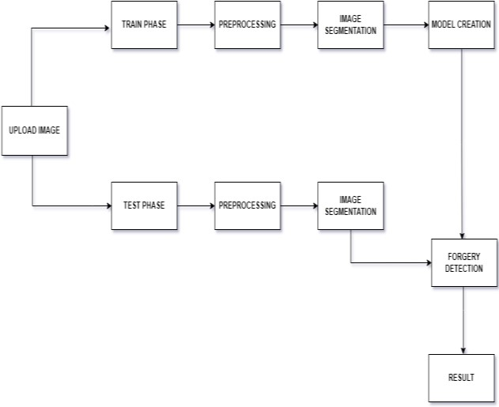
Control Flow Design
System Flow Diagram

Slide 9
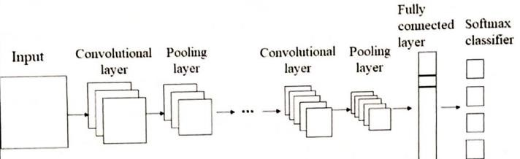
Algorithm for Logic Implementation
Convolution Layer : Convolutional layers are the layers the place filters are applied to the original image. This is the place most of the user-specified parameters are in the network. The most important parameters are the wide variety of kernels and the dimension of the kernels.
Pooling : Pooling layers are similar to convolutional layers, but they operate a specific feature such as max pooling, which takes the maximum cost in a filter region, or average pooling. These are typically used to limit the dimensionality of the network.
Fully Connected Layer : Fully Connected Layer is just, feed forward neural networks. Fully Connected Layers shape the remaining few layers within the network. The enter to the thoroughly linked layer is that the output from the last word Pooling or Convolutional layer.

Slide 10
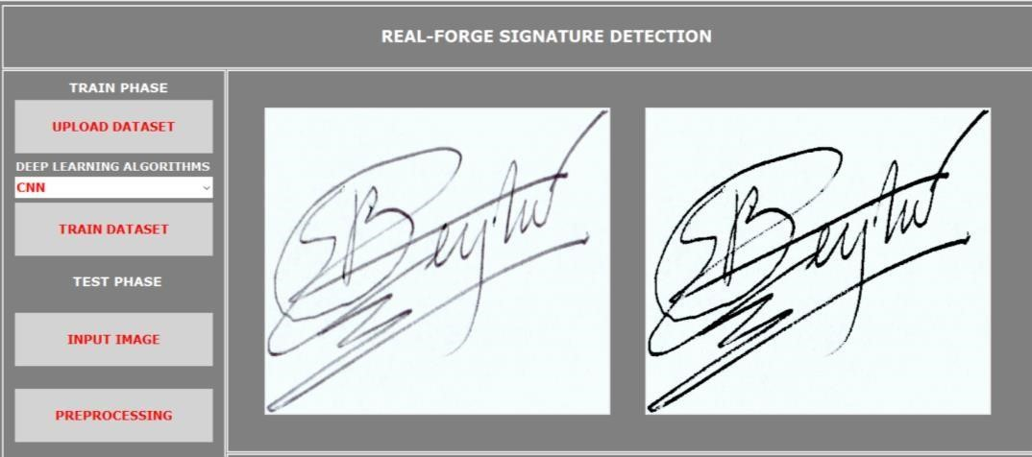
Presentation Layer Design
Interface Form Design

Slide 11
Implementation
Implementation Approaches
Transfer Learning: One approach is to use pre-trained CNN models for image classification and fine-tune them on the signature forgery detection task. Transfer learning allows the system to leverage pre-trained models' learned features and weights, reducing the amount of training data and time required to train a new model from scratch.
Custom CNN Model: Another approach is to design a custom CNN architecture that is optimized for the signature forgery detection task. The custom CNN model can be designed by using standard CNN architectures such as VGG, ResNet, or Inception as building blocks and adding additional layers to suit the specific needs of the task.
Ensemble Models: Ensemble models involve combining multiple models to improve the accuracy of the detection. One example of ensemble models is to use multiple CNN models and combine their output to generate a final decision. This approach can help overcome the limitations of a single model and improve the overall accuracy of the system.

Slide 12
Implementation Approaches Cont….
Hybrid Approaches: Hybrid approaches involve combining CNN models with other machine learning techniques such as support vector machines (SVMs), random forests, or decision trees. This approach can help improve the accuracy and robustness of the system by leveraging the strengths of multiple algorithms.
Online Learning: Online learning involves training the model on new data as it becomes available. This approach is useful in situations where new types of forgery may arise and need to be detected by the system.
Data Augmentation: Data augmentation involves generating new training data by applying various transformations to the original dataset. This approach can help increase the amount of data available for training and improve the model's generalization ability.

Slide 13
THANK YOU

