Slide 1


G H RAISONI UNIVERSITY, AMRAVATI School of Engineering & Technology Department of Electrical Engineering
VII-semester
SWITCH GEAR PROTECTION
UNIT NO. 2
Circuit Breaker & Fuses
By
Dr. S. K. Mishra

Slide 2
LECTURE 1:- circuit breaker
Air Break CB
Air Break Circuit Breaker
In air break circuit breaker the arc is initiated and extinguish in substantially static air in which the arc moves. Such breakers are used for low voltages, generally up to 15KV and rupturing capacities of 500MVA. Air circuit breaker has several advantages over the oil, as an arc quenching medium. The following properties are
Elimination of risk and maintenance associated with the use of oil.
The absence of mechanical stress that is set up by gas pressure and oil movement.
Elimination of the cost of regular oil replacement that arises due to deterioration of oil with the successive breaking operation.
In the air break circuit breaker, the contact separation and arc extinction take place in air at atmospheric pressure. In air break circuit breaker high resistance principle is employed. In this circuit breaker arc is expanded by means of arc runners, arc chutes. The arc resistance is increased by splitting, cooling and lengthening.
The arc resistance is increased to such an extent that the voltage drop across the arc becomes more than the system voltage, and the arc gets extinguished at the current zero of AC wave.
2
GHRCEM
2

Slide 3
LECTURE 1:- CIRCUIT BREAKER
Air break circuit breakers are employed in DC circuits and Ac circuits up to 12,000 voltages. Such breakers are usually of indoor type and installed on vertical panels or indoor draw out switch gear. AC circuit breakers are widely employed indoor medium voltage and low voltage switchgear.
Plain Break Type Air Break Circuit Breaker
It is the simplest one in which contacts are made in the shape of two horns. The air initially strikes across the shortest distance between the horns and is driven steadily upwards by the convection currents caused by heating of air during arcing and the interaction of the magnetic and the electric fields. The arc extends from one tip to the other when the horns are fully separated resulting in lengthening and cooling arc.
The relative slowness of the process and the possibility of arc spreading of adjacent metal works limits the application of about 500V and too low power circuits.
Magnetic Blow-Out Type Air Break Circuit Breaker
Some air circuit breakers are used in the circuits having voltage up to 11 KV, the arc extinction is accomplished using magnetic field provided by the current in blowout coils connected in series with the circuit being interrupted. Such coils are called blow out the coil. The magnetic field itself does not extinguish the arc. It simply moves the arc into chutes where the arc is lengthened, cooled and extinguished. The arc shields prevent arc spreading to an adjacent network.
3
GHRCEM
3

Slide 4
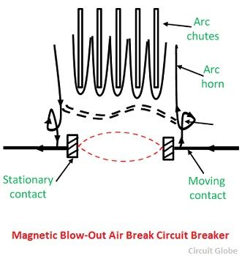
LECTURE 1:- circuit breaker
It is important to connect the coils at correct polarity so that the arc is directed upwards. As the breaking action becomes more effective with large currents, this principle has resulted in increasing the rupturing capacities of such breakers to higher values.
Arc chute is an efficient device for arc extinction in air and performs the following three interrelated functions
It confines the arc within a restricted space.
It provides magnetic control over the arc movement so as to make arc extinction within the devices.
It provides for the rapid cooling of arc gasses to ensures arc extinction by deionization.
4
GHRCEM
4

Slide 5
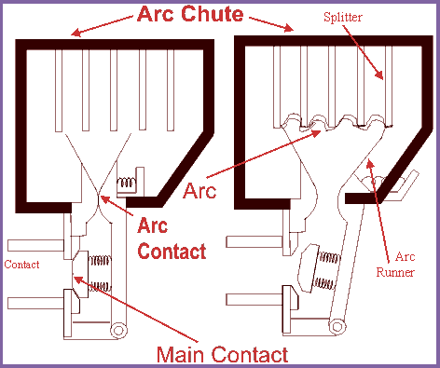
LECTURE 1:- circuit breaker
5
GHRCEM
5

Slide 6
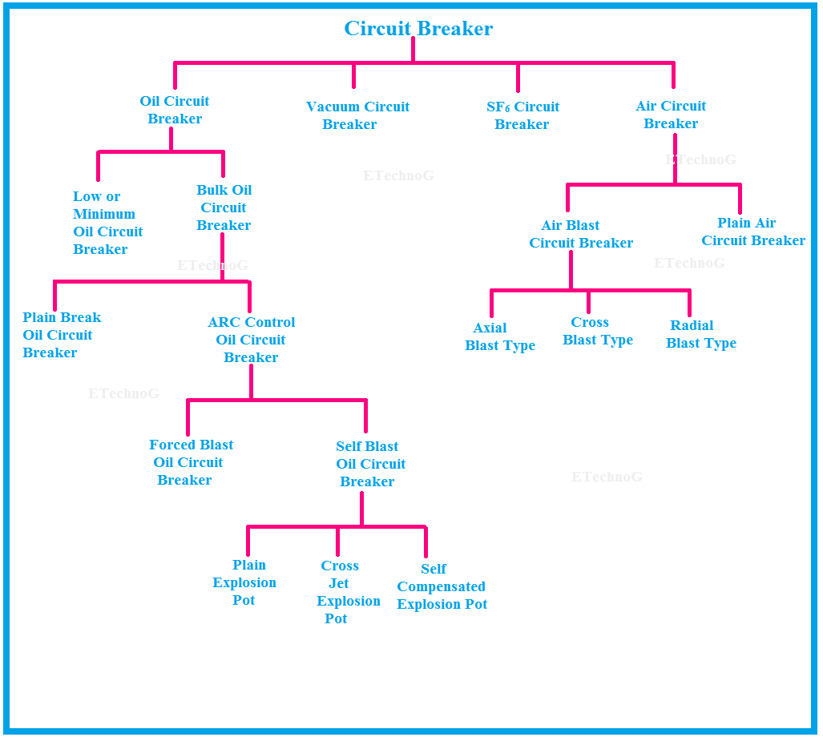
LECTURE 1:- circuit breaker
6
GHRCEM
6

Slide 7
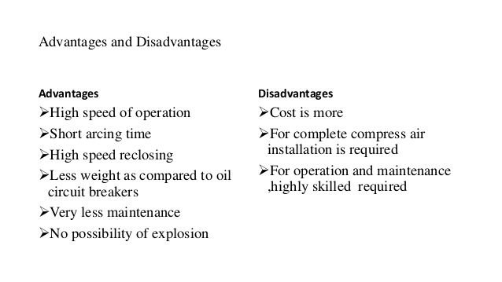
LECTURE 1:- circuit breaker
7
GHRCEM
7

Slide 8
LECTURE 1:- circuit breaker
Working Principle Air Break Circuit Breaker
When the fault occurs, the main contacts are separate first, and the current is shifted to the arcing contacts. Now the arcing contacts are separate, and the arc is drawn between them. This arc is forced upwards by the electromagnetic forces and thermal action. The arc ends travel along the arc runner. The arc moves upward and is split by the arc splitter plates. The arc is extinguished by lengthening, cooling, splitting, etc.
Applications of Air Break Circuit Breaker
Air break circuit breaker is suitable for the control of power station auxiliaries and industrial plants. They do not require any additional equipment such as compressors, etc. They are mainly used in a place where there are possibilities of fire or explosion hazards. Air break principle of lengthening of the arc, arc runners magnetic blow-up is employed for DC circuit breakers up to 15 KV.
Drawback of Air Break Circuit Breaker
A drawback of arc chute principle is its inefficiency at low currents where the electromagnetic fields are weak. The chute itself is not necessarily less efficient in its lengthening and deionizing action than at high currents, but the arc movement into the chute tends to become slower, and high-speed interruption is not necessarily obtained.
8
GHRCEM
8

Slide 9
LECTURE 1:- circuit breaker
Air Blast C.B
Air Blast Circuit Breaker
Air blast circuit breaker used compressed air or gas as the arc interrupting medium. In the air blast, circuit breaker compressed air is stored in a tank and released through a nozzle to produce a high-velocity jet; this is used to extinguish the arc. Air blast circuit breakers are used for indoor services in the medium high voltage field and medium rupturing capacity. Generally up to voltages of 15 KV and rupturing capacities of 2500 MVA. The air blast circuit breaker is now employed in high voltage circuits in the outdoors switch yard for 220 KV lines
Though gasses such as carbon dioxide, nitrogen, freon or hydrogen are used as the arc interrupting medium, compressed air is the accepted circuit breaking medium for gas blast circuit breakers. The reasons are given below.
The circuit breaking capacities of nitrogen are similar to compressed air and hence no advantage of using it. Carbon dioxide has the drawback of its being difficult to control owing to freezing at valves and other restricted passages. Feron has high dielectric strength and good arc extinguishing properties, but it is expensive, and it is disintegrated by the arc into acid-forming elements. The desirable features to be found in air blast circuit breaker are
9
GHRCEM
9

Slide 10
LECTURE 1:- circuit breaker
High-Speed Operation – It is very necessary on large interconnected networks so that the system stability can be maintained. This is achieved in circuit breaker because the time interval between the discharge of triggering impulse and contacts separation are very short.
Suitability for frequent operation – Repeated switching by an air blast circuit is possible simply because of the absence of oil, which rapidly carbonizes with the frequent operation and because there is an insignificant amount of wear and tear at the current-carrying contact surfaces. But it must be remembered that if frequent switching is anticipated, then the maintenance of a sufficient air supply is essential
Negligible Maintenance – The ability of the air blast circuit breaker to deal with repeated switching also mean that negligible maintenance is required.
Elimination of Fire Hazard – Because of the absence of oil the risk of fire is eliminated
Reduced Size – The growth of dielectric strength is so rapid in air blast circuit breakers that final gap required for arc extinction is very small. This reduces the sizes of the devices.
10
GHRCEM
10

Slide 11
LECTURE 1:- circuit breaker
Principle of Arc Extinction in Circuit Breaker
The air blast needs an additional compressed air system which supplies air to the air receiver. When opening air is required, compressed air is admitted to the arc extinction chamber. It pushes away the moving contacts. In doing so, the contacts are pulled apart, and the air blast moves away the ionized gas along with it and assists arc extinction.
Air blast extinguishes the arc within one or more cycles, and the arc chamber is filled with high-pressure air, which prevents restrikes. The air blast circuit breakers fall under the category of external extinguishing energy type. The energy supplied for arc quenching is achieved from the high-pressure air, and it is free from the current to be interrupted.
Types of Air Blast Circuit Breaker
All air blast circuit breakers follow the principle of separating their contacts in a flow of arc established by the opening of a blast valve. The arc which is drawn is usually rapidly positioned centrally through a nozzle where it is kept to a fixed length and is subjected to the maximum range by the air flow. The air blast circuit breakers according to the type of flow of blast of compressed around the contacts are of three types namely axial, radial and cross blast
11
GHRCEM
11

Slide 12
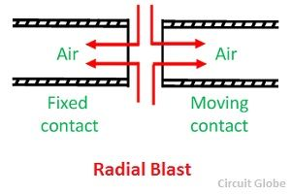
LECTURE 1:- circuit breaker
Radial Blast C.B
Axial blast Air Circuit Breaker – In the air blast circuit breaker, the flow of air is longitudinal along the arc. Air blast circuit breaker may be a single blast or double blast. Breaking employing double blast arrangement are sometimes called radial blast circuit breakers as the air blast flows radially into the nozzle or space between the contacts.
The fixed and moving contacts are kept in a closed position by spring pressure under normal operating conditions. The air reservoir tank is connected to the arc chamber through an air valve, which is opened by a triple impulse.
12
GHRCEM
12

Slide 13
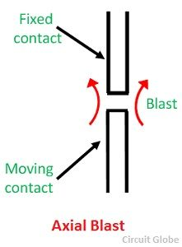
LECTURE 1:- circuit breaker
Axial Blast C.B
When the fault occurs, the tripling impulse causes opening of the air valve connecting the reservoir to the arcing chamber. The air entering the arc chamber exerts pressure on the moving contacts which moves when the air pressure exceeds the spring force.
13
GHRCEM
13

Slide 14
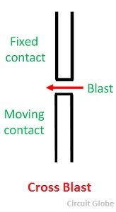
LECTURE 1:- circuit breaker
Cross Blast C.B
Cross Blast Air Circuit Breaker – In such breaker, an arc blast is directed at right angles to the arc. The schematic representation of the cross principle of cross blast air circuit breaker is given in the figure below. A moving contact arm is operated in close spaces to draw an arc which is forced by a transverse blast of air into the splitter plates, thereby lightening it to the point when it cannot restrike after zero current.
14
GHRCEM
14

Slide 15
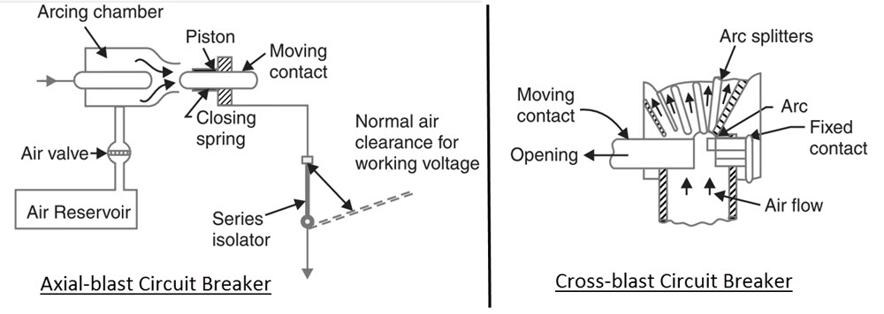
LECTURE 1:- circuit breaker
Cross Blast C.B
15
GHRCEM
15

Slide 16
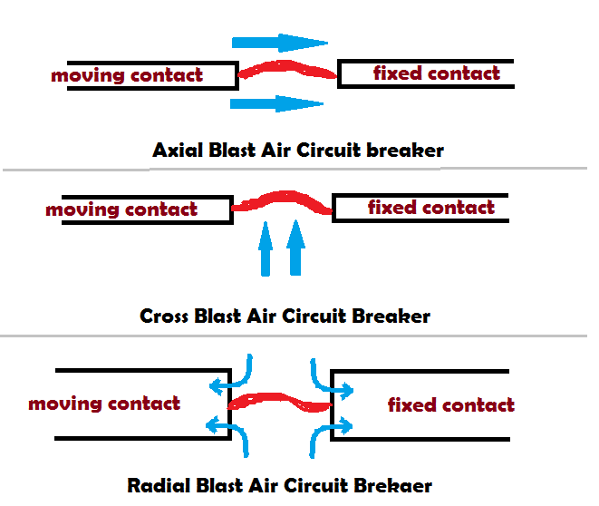
LECTURE 1:- circuit breaker
Cross Blast C.B
16
GHRCEM
16

Slide 17
LECTURE 1:- circuit breaker
Bulk Oil C.B
DRAWBACK OF AIR BLAST CIRCUIT BREAKER
In the air blast circuit breaker, it is necessary that the compressed air at the correct pressure must be available all the times, involving in the largest installation of a plant with two or more compressors. The maintenance of this plant and the problem of air leakages at the pipe fittings are some factors which operate against air blast circuit breaker and it costly for low voltage as compared to oil or air break circuit breaker.
Bulk Oil and Minimum Oil Circuit Breaker
A breaker which uses a large quantity of oil for arc extinction is called a bulk oil circuit breaker. Such type of circuit breaker is also known as dead tank-type circuit breaker because their tank is held at ground potential. The quantity of oil requires in bulk oil circuit breaker depends on the system voltage. If the output rating of the voltage is 110 KV, then it requires 8 to 10 thousand kg of oil, and if their output rating is 220 KV, then breakers need 50 thousand Kg of oil.
In bulk oil circuit breaker, oil performs mainly two functions. Firstly, it acts as an arc extinguishing medium and secondly, it insulates the live parts of the breaker from earth. The quantity of oil requires for arc extinction is only about one-tenth of the total and the rest being used for the insulation.
17
GHRCEM
17

Slide 18
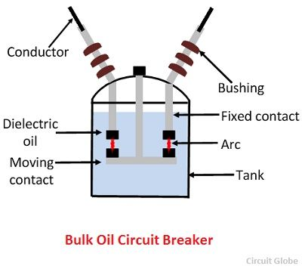
LECTURE 1:- circuit breaker
These large quantities of oil are subject to the carbonisation, sludging, etc., which occurs due to arc interruption and other causes reducing the insulating properties and requires regular maintenance.
Bulk oil circuit breaker needs a large tank which increases expenses and also increases the weight of the circuit breaker. Because of the following disadvantage the low oil circuit breaker is developed which use minimum oil for arc extinction.
18
GHRCEM
18

Slide 19
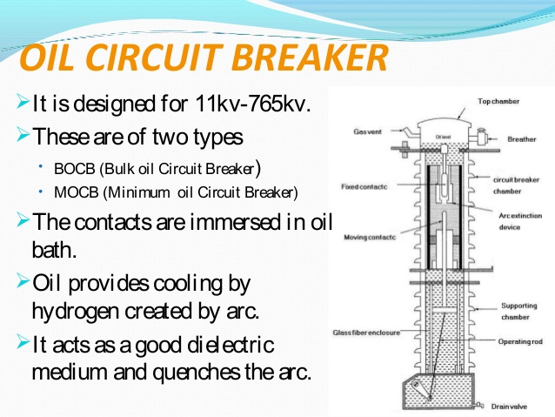
LECTURE 1:- circuit breaker
19
GHRCEM
19

Slide 20
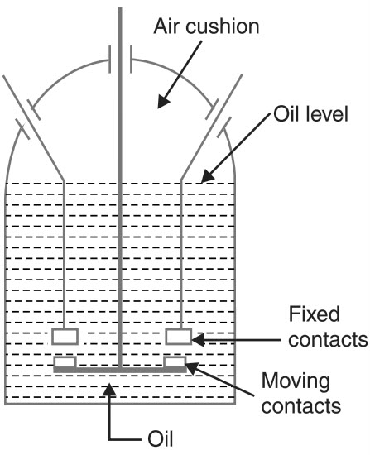
LECTURE 1:- circuit breaker
20
GHRCEM
20

Slide 21
LECTURE 1:- circuit breaker
Minimum Oil C.B
Minimum Oil Circuit Breaker
In this type of circuit breaker minimum oil is used as an arc quenching medium and it is mounted on a porcelain insulator to insulate it from the earth. The arc chamber of such type of circuit breaker is enclosed in a bakelised paper. The lower portion of this breaker is supported by the porcelain and the upper porcelain enclosed the contacts.
This circuit breaker is of the single breaker type in which a moving contact tube moves in a vertical line to make or break contact with the upper fixed contacts mounted within the arc control devices.
A lower ring of fixed contacts is in permanent contact with the moving arm to provide the other terminal of the phase unit. Within the moving contact, the tube is a fixed piston. When the moving contact moves downwards, it forces the insulating oil to enter into the arc control devices . Thus, the arc gets extinguished.
Minimum oil circuit breaker requires less space as compared to bulk oil circuit breaker which is an important feature in large installations. But it is less suitable in places where the frequent operation is required because the degree of carbonisation produced in the small volume of oil is far more dangerous than in the conventional bulk oil circuit breakers and this also decreases the dielectric strength of the material.
21
GHRCEM
21

Slide 22
LECTURE 1:- circuit breaker
Minimum oil circuit breaker requires less space as compared to bulk oil circuit breaker which is an important feature in large installations. But it is less suitable in places where the frequent operation is required because the degree of carbonisation produced in the small volume of oil is far more dangerous than in the conventional bulk oil circuit breakers and this also decreases the dielectric strength of the material.
The low oil circuit breakers have the advantages of a requirement of the lesser quantity of oil, smaller space requirement, smaller tank size, smaller weight, low cost, reduced risk of fire and reduced maintenance problems. Minimum oil circuit breaker suffers from the following drawbacks when compared with the bulk oil circuit breakers
Increased degree of carbonisation due to a smaller quantity of oil.
The dielectric strength of oil decreases due to a high degree of carbonisation.
Difficulty in removal of gases from the contact space-time
22
GHRCEM
22

Slide 23
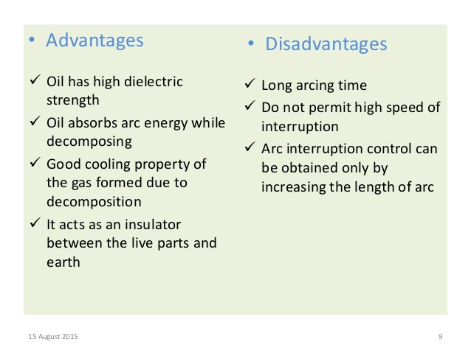
LECTURE 1:- circuit breaker
23
GHRCEM
23

Slide 24
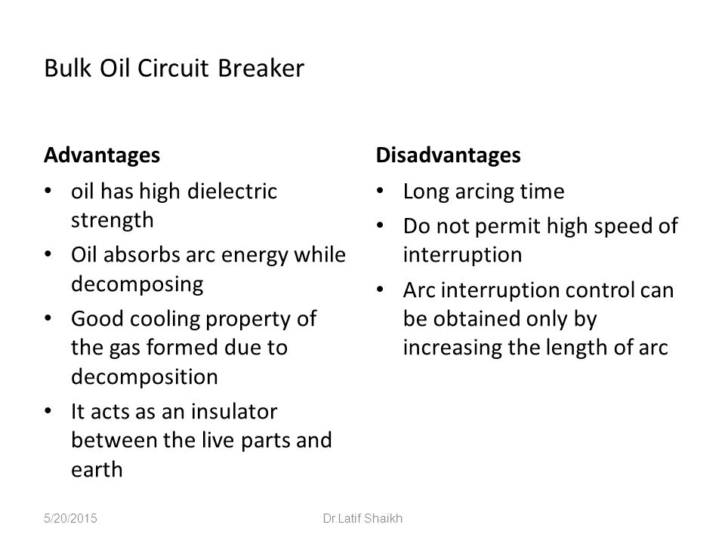
LECTURE 1:- circuit breaker
24
GHRCEM
24

Slide 25
LECTURE 1:- circuit breaker
Vacuum C.B
Vacuum Circuit Breaker
A breaker which used vacuum as an arc extinction medium is called a vacuum circuit breaker. In this circuit breaker, the fixed and moving contact is enclosed in a permanently sealed vacuum interrupter. The arc is extinct as the contacts are separated in high vacuum. It is mainly used for medium voltage ranging from 11 KV to 33 KV.
Vacuum circuit breaker has a high insulating medium for arc extinction as compared to the other circuit breaker. The pressure inside the vacuum interrupter is approximately 10⁻⁴ torrent and at this pressure, very few molecules are present in the interrupter. The vacuum circuit breaker has mainly two phenomenal properties.
High insulating strength: In comparison to various other insulating media used in circuit breaker vacuum is a superior dielectric medium. It is better than all other media except air and SF₆, which are employed at high pressure.
When an arc is opened by moving apart the contacts in a vacuum, an interruption occurs at the first current zero. With the arc interruption, their dielectric strength increases up to a rate of thousands time as compared to other breakers.
The above two properties make the breakers more efficient, less bulky and cheaper in cost. Their service life is also much greater than any other circuit breaker, and almost no maintenance are required.
25
GHRCEM
25

Slide 26
LECTURE 1:- circuit breaker
Construction of Vacuum Circuit Breaker
It is very simple in construction as compared to any other circuit breaker. Their construction is mainly divided into three parts, i.e., fixed contacts, moving contact and arc shield which is placed inside the arc interrupting chamber.
Working Vacuum Circuit Breaker
When the fault occurs in the system, the contacts of the breaker are moved apart and hence the arc is developed between them. When the current carrying contacts are pulled apart, the temperature of their connecting parts is very high due to which ionization occurs. Due to the ionization, the contact space is filled with vapour of positive ions which is discharged from the contact material.
The density of vapour depends on the current in the arcing. Due to the decreasing mode of current wave their rate of release of vapour fall and after the current zero, the medium regains its dielectric strength provided vapour density around the contacts reduced. Hence, the arc does not restrike again because the metal vapour is quickly removed from the contact zone.
26
GHRCEM
26

Slide 27
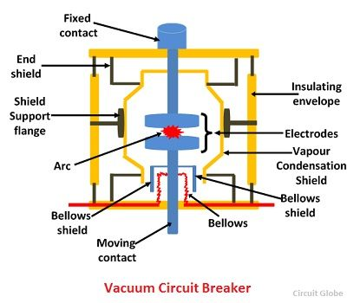
LECTURE 1:- circuit breaker
27
GHRCEM
27

Slide 28
LECTURE 1:- circuit breaker
Current Chopping in C.B
Current Chopping in Vacuum Circuit Breaker
Current chopping in vacuum circuit breaker depends on the vapour pressure and the electron emission properties of the contact material. The chopping level is also influenced by the thermal conductivity–lower the thermal conductivity, lower is the chopping level.
It is possible to reduce the current level at which chopping occurs by selecting a contact material which gives out sufficient metal vapour to allow the current to come to a very low value or zero value, but this is rarely done as it affects the dielectric strength adversely.
Vacuum Arc recovery of Vacuum Circuit Breaker
High vacuum possesses extremely high dielectric strength. At zero current the arc is extinguished very quickly, and the dielectric strength is established very quickly. This return of dielectric strength is because of the vaporized metal which is localized between the contacts diffuses rapidly due to the absence of gas molecules. After arc interruption, the recovery strength during the first few microseconds is 1 kV/µs second for an arc current of 100A.
Because of the above-mentioned attribute of vacuum circuit breaker, it is capable of handling the severe recovery transients associated with short-line faults without any difficulty.
28
GHRCEM
28

Slide 29
LECTURE 1:- circuit breaker
Property of contact material
The contact material of the vacuum circuit breaker should have the following property.
The material should have high electrical conductivity so as to pass normal load currents without overheating.
The contact material should have low resistance and high density.
The material should possess high thermal conductivity so as to dissipate rapidly the large heat generated during arcing.
The material should have a high arc withstand ability and low current chopping level.
Advantages of Vacuum Circuit Breaker
Vacuum circuit breaker does not require any additional filling of oil or gas. They do not need periodic refilling.
Rapid recovery of high dielectric strength on current interruptions that only a half cycle or less arcing occurs after proper contact separation.
Breaker unit is compact and self-contained. It can be installed in any required orientation.
Because of the above reasons together with the economic advantage offered, vacuum circuit breaker has high acceptance.
29
GHRCEM
29

Slide 30
LECTURE 1:- circuit breaker
Disadvantage of Vacuum Circuit Breaker
Requirements of high technology for production of vacuum interrupters.
It needs additional surge suppressors for the interruption of low magnetizing currents in a certain range.
Loss of vacuum due to transit damage or failure makes the entire interrupter useless, and it cannot be repaired on site.
Applications of Vacuum Circuit Breaker
Because of the short gap and excellent recovery of vacuum circuit breaker, they are very useful as very high speed making switches in many industrial applications.
When the voltage is high and current to be interrupted is low these breakers have definite superiority over the other breakers.
For low fault interrupting capacities the cost is low in comparison to other interrupting devices.
Because of the least requirements of maintenance, these breakers are very suitable for the system which requires voltage from 11 to 33 kV
30
GHRCEM
30

Slide 31
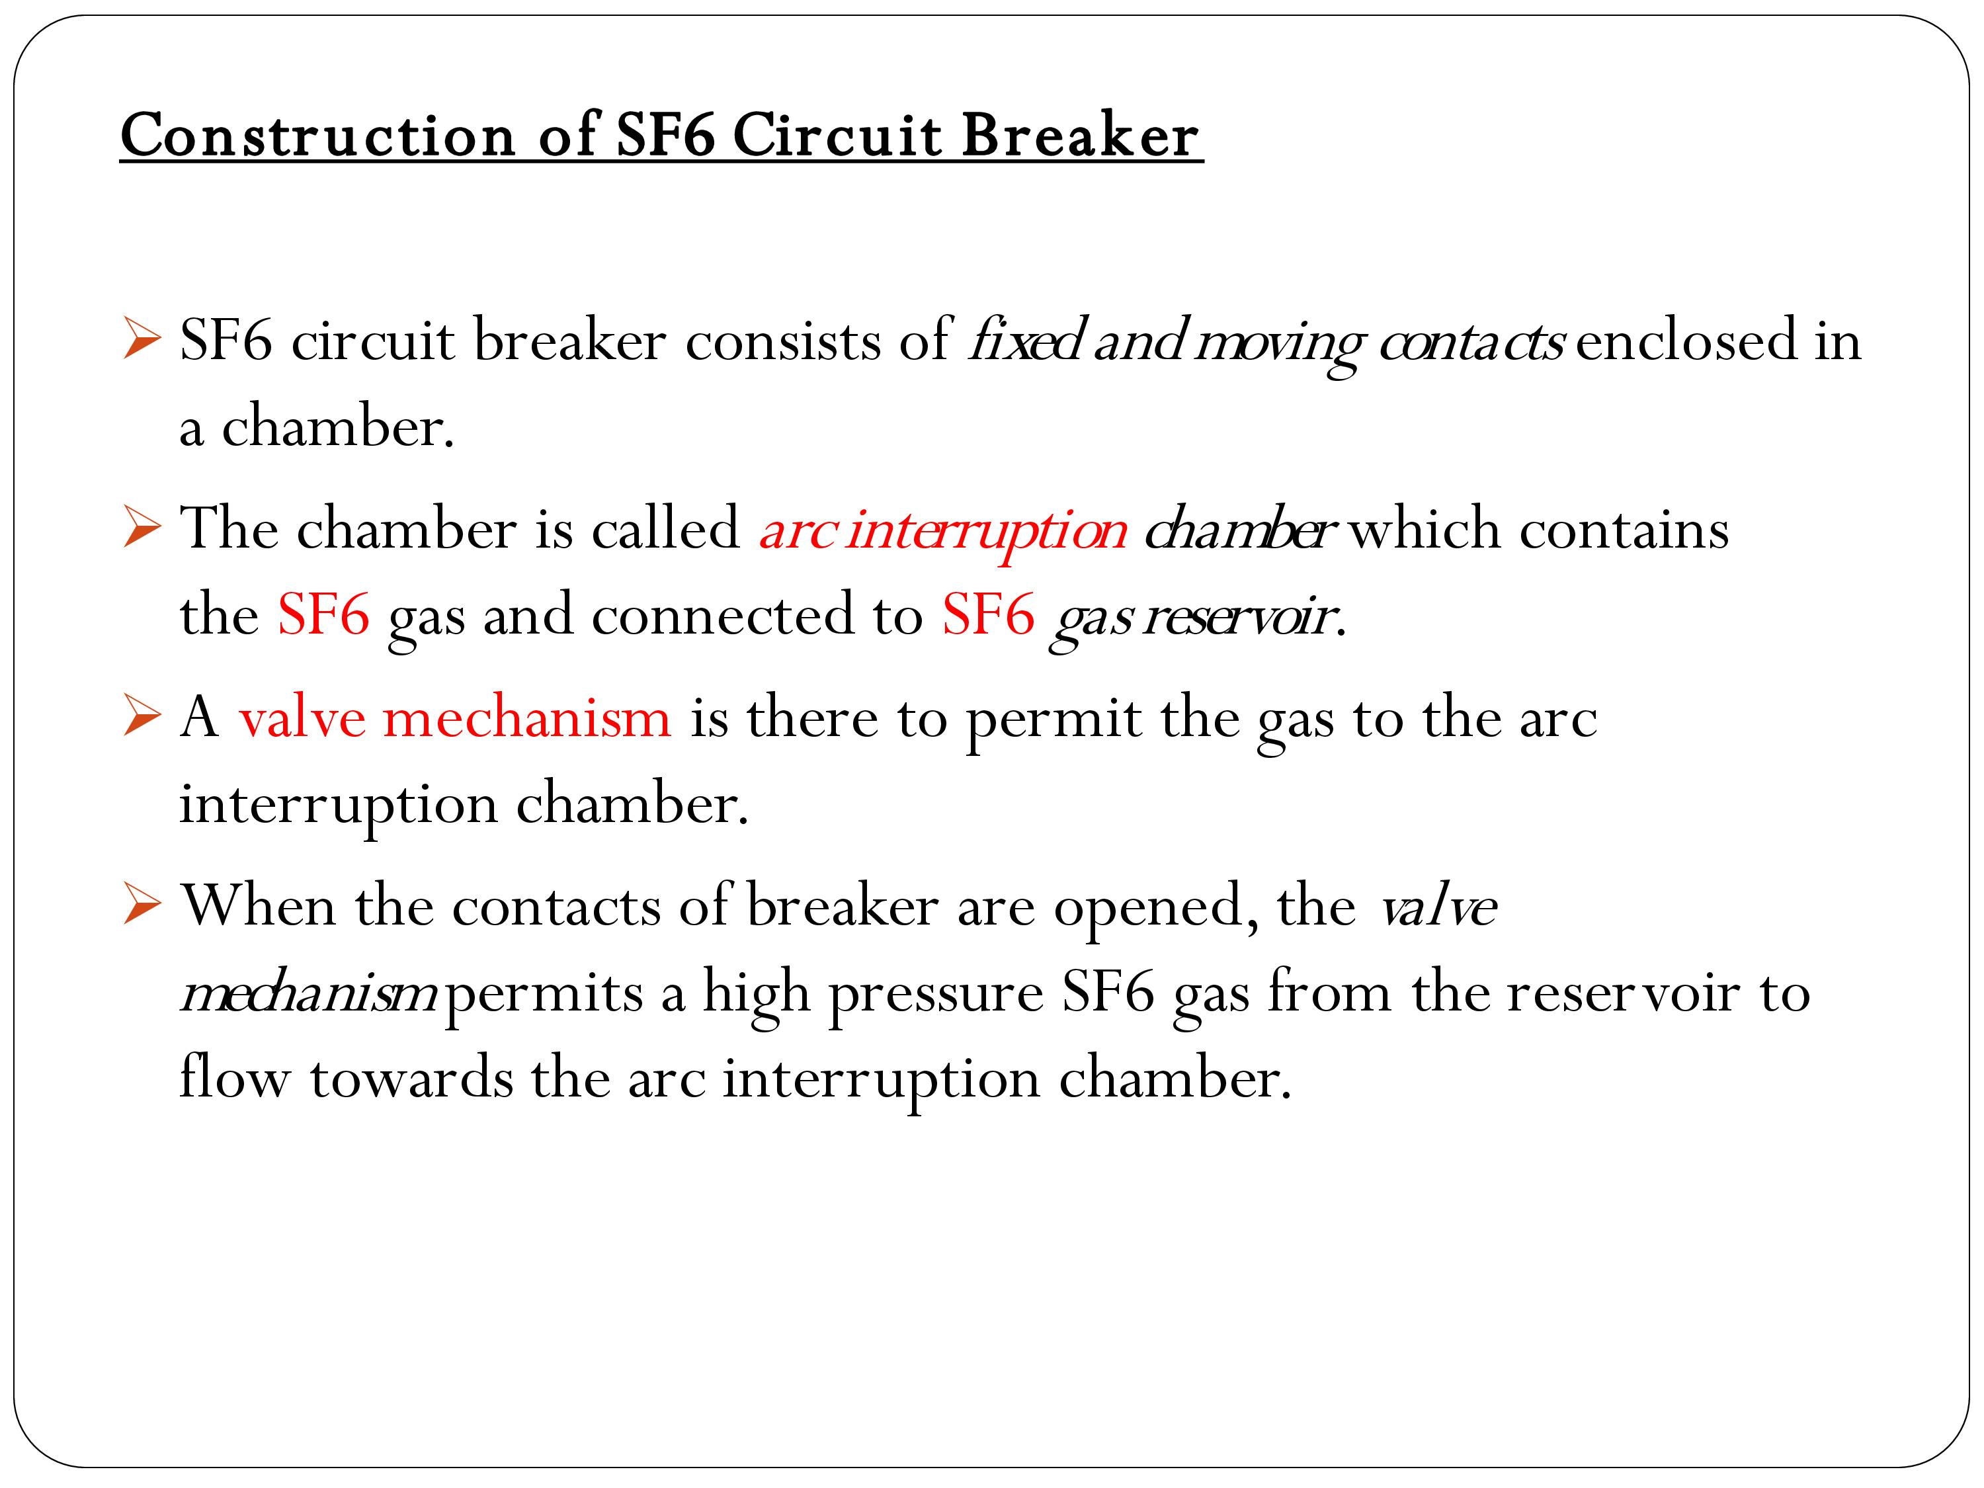
LECTURE 1:- circuit breaker
31
GHRCEM
31

Slide 32
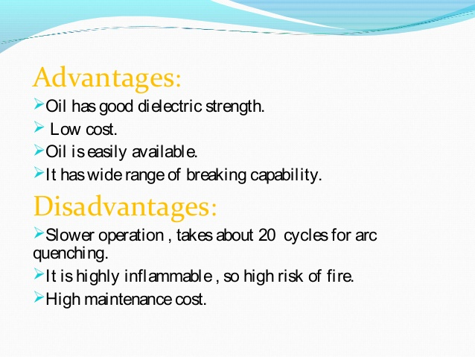
LECTURE 1:- circuit breaker
32
GHRCEM
32

Slide 33
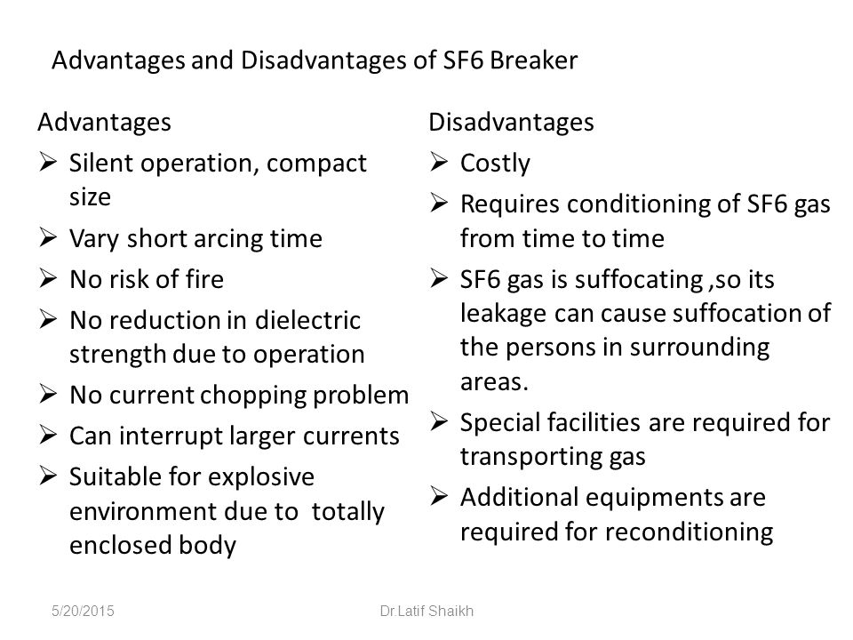
LECTURE 1:- circuit breaker
33
GHRCEM
33

Slide 34
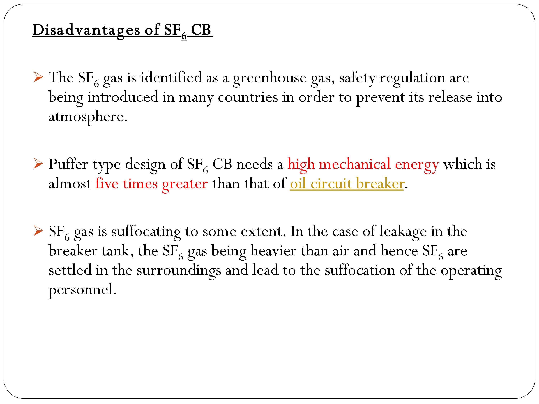
LECTURE 1:- circuit breaker
34
GHRCEM
34

Slide 35
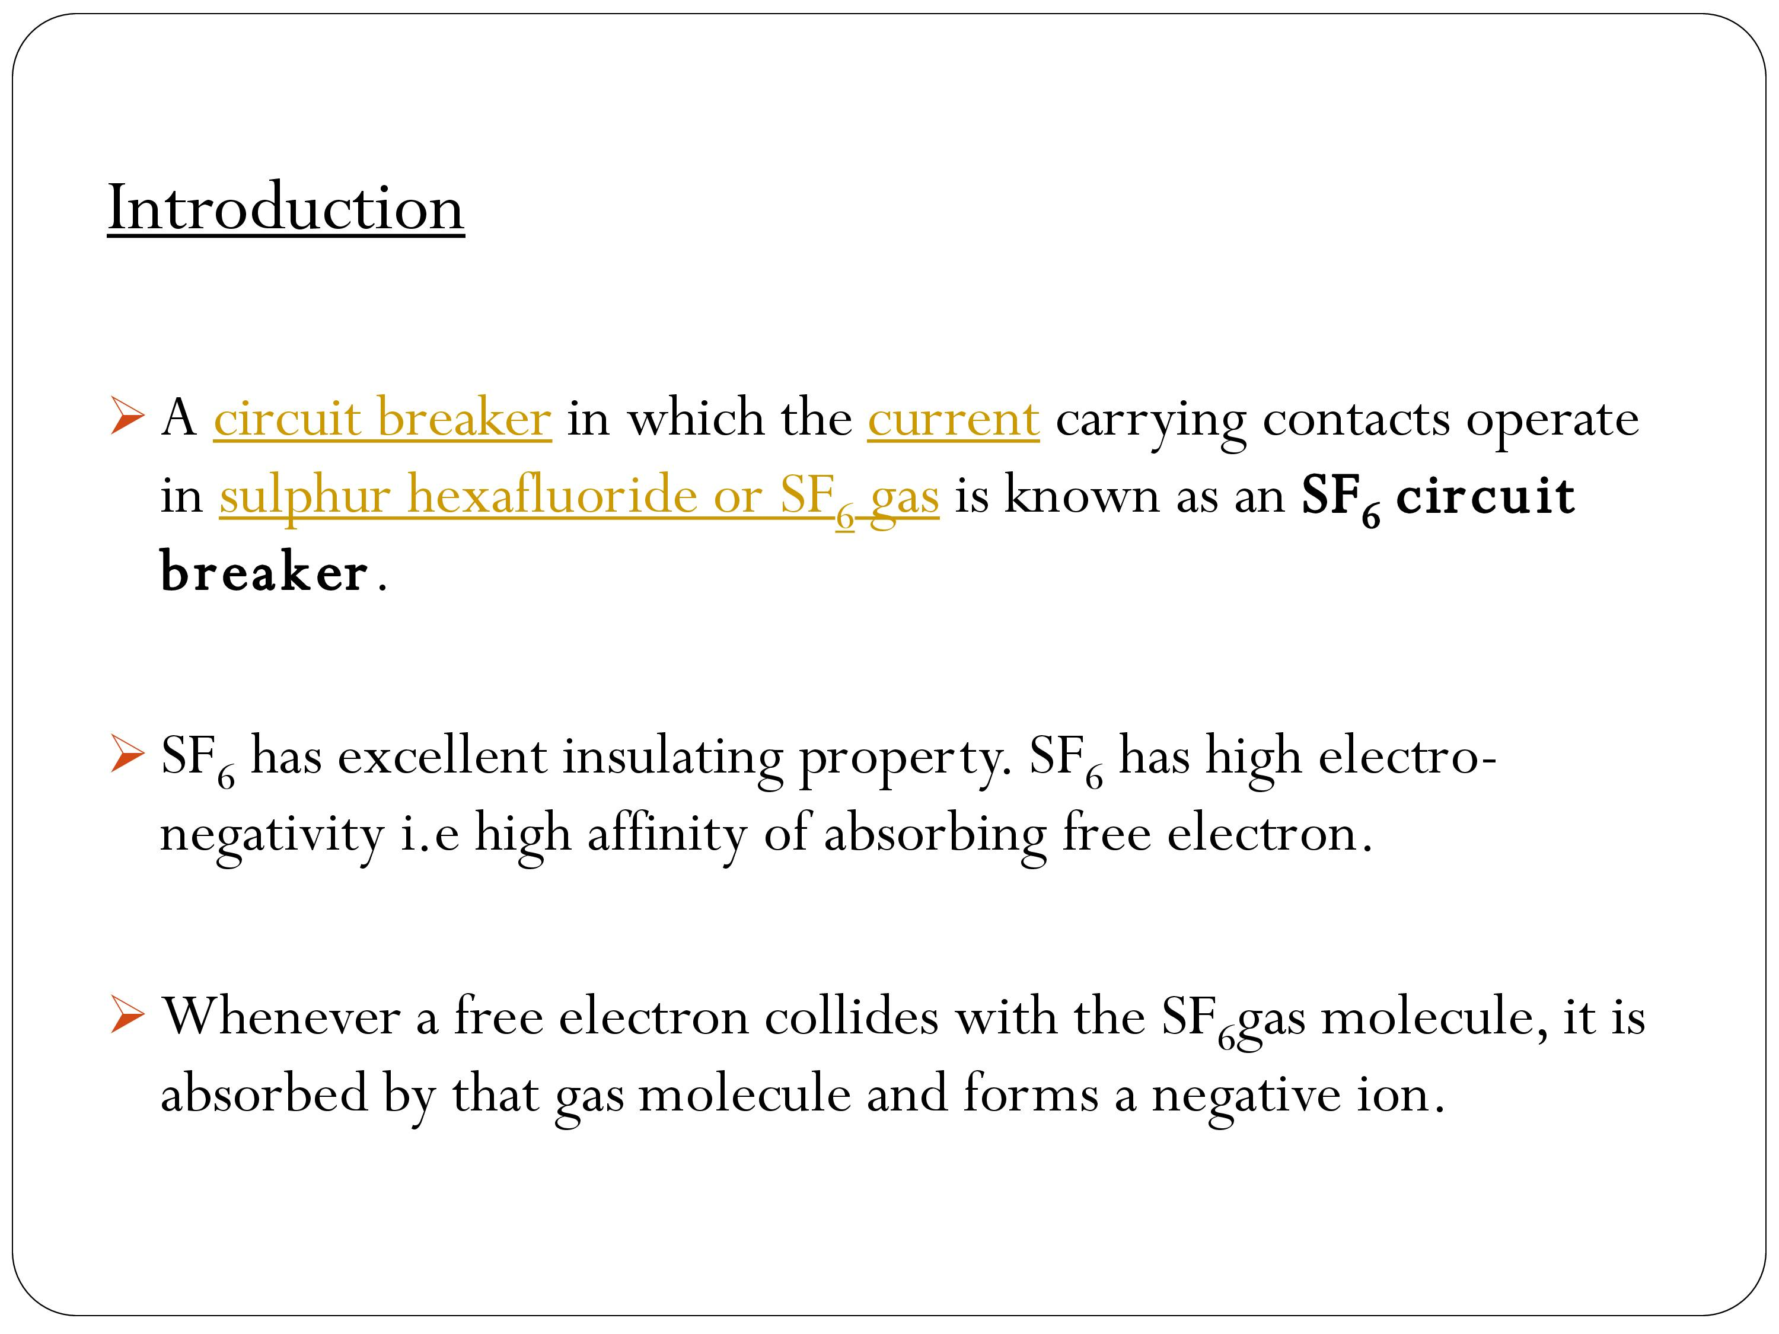
LECTURE 1:- circuit breaker
35
GHRCEM
35

Slide 36
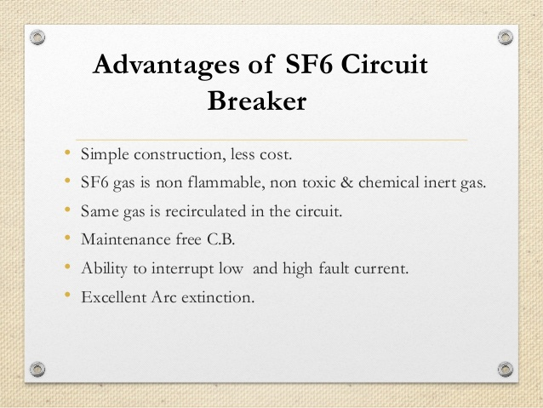
LECTURE 1:- circuit breaker
36
GHRCEM
36

Slide 37
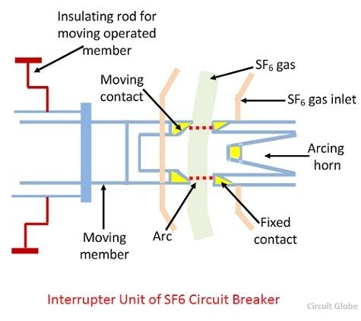
LECTURE 1:- circuit breaker
37
GHRCEM
37

Slide 38
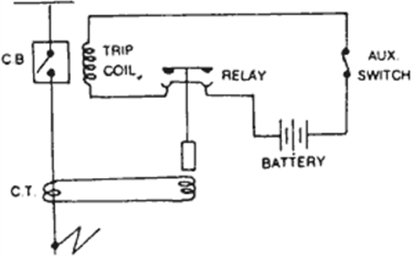
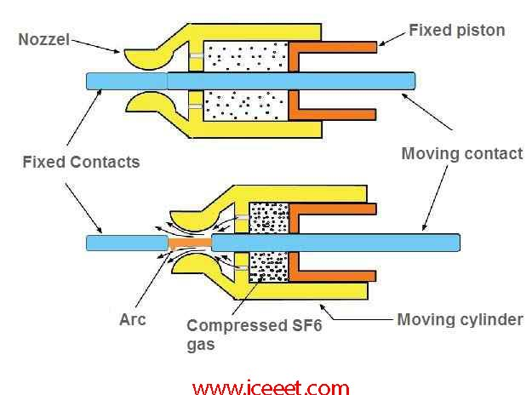
LECTURE 1:- circuit breaker
38
GHRCEM
38

Slide 39
LECTURE 1:- circuit breaker
SF6 C.B
Sulphur Hexafluoride (SF6) Circuit Breaker
A circuit breaker in which SF₆ under pressure gas is used to extinguish the arc is called SF₆ circuit breaker. SF₆ (sulphur hexafluoride) gas has excellent dielectric, arc quenching, chemical and other physical properties which have proved its superiority over other arc quenching mediums such as oil or air. The SF₆ circuit breaker is mainly divided into three types
Non-puffer piston circuit breaker
Single- puffer piston circuit breaker.
Double-puffer piston circuit breaker.
The circuit breaker which used air and oil as an insulating medium, their arc extinguishing force builds up was relatively slow after the movement of contact separation. In the case of high voltage circuit breakers quick arc extinction properties are used which require less time for quick recovery, voltage builds up. SF₆ circuit breakers have good properties in this regards compared to oil or air circuit breakers. So in high voltage up to 760 kV, SF₆ circuit breakers is used.
Properties of Sulphur hexafluoride Circuit Breaker
Sulphur hexafluoride possesses very good insulating and arc quenching properties. These properties are
39
GHRCEM
39

Slide 40
LECTURE 1:- circuit breaker
Properties of SF6 C.B
It is colourless, odourless, non-toxic, and non-inflammable gas.
SF₆ gas is extremely stable and inert, and its density is five times that of air.
It has high thermal conductivity better than that of air and assists in better cooling current carrying parts.
SF₆ gas is strongly electronegative, which means the free electrons are easily removed from discharge by the formation of negative ions.
It has a unique property of fast recombination after the source energising spark is removed. It is 100 times more effective as compared to arc quenching medium.
Its dielectric strength is 2.5 times than that of air and 30% less than that of the dielectric oil. At high pressure the dielectric strength of the gas increases.
Moisture is very harmful to SF₆ circuit breaker. Due to a combination of humidity and SF₆ gas, hydrogen fluoride is formed (when the arc is interrupted) which can attack the parts of the circuit breakers.
40
GHRCEM
40

Slide 41
LECTURE 1:- circuit breaker
Construction of SF₆ Circuit Breakers
SF₆ circuit breakers mainly consist of two parts, namely (a) the interrupter unit and (b) the gas system.
Interrupter Unit – This unit consists of moving and fixed contacts comprising a set of current-carrying parts and an arcing probe. It is connected to the SF₆gas reservoir. This unit consists slide vents in the moving contacts which permit the high-pressure gas into the main tank.
Gas System – The closed circuit gas system is employed in SF₆ circuit breakers. The SF₆ gas is costly, so it is reclaimed after each operation. This unit consists low and high-pressure chambers with a low-pressure alarm along with warning switches. When the pressure of the gas is very low due to which the dielectric strength of gases decrease and an arc quenching ability of the breakers is endangered, then this system gives the warning alarm.
Working Principle of SF₆ Circuit Breaker
In the normal operating conditions, the contacts of the breaker are closed. When the fault occurs in the system, the contacts are pulled apart, and an arc is struck between them. The displacement of the moving contacts is synchronised with the valve which enters the high-pressure SF₆ gas in the arc interrupting chamber at a pressure of about 16kg/cm^2.
41
GHRCEM
41

Slide 42
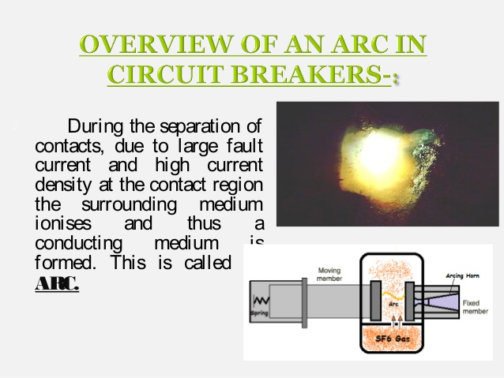
LECTURE 1:- circuit breaker
The SF₆ gas absorbs the free electrons in the arc path and forms ions which do not act as a charge carrier. These ions increase the dielectric strength of the gas and hence the arc is extinguished. This process reduces the pressure of the SF₆ gas up to 3kg/cm^2 thus; it is stored in the low-pressure reservoir. This low-pressure gas is pulled back to the high-pressure reservoir for re-use.
42
GHRCEM
42

Slide 43
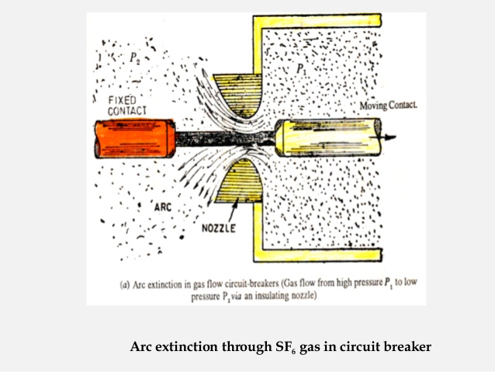
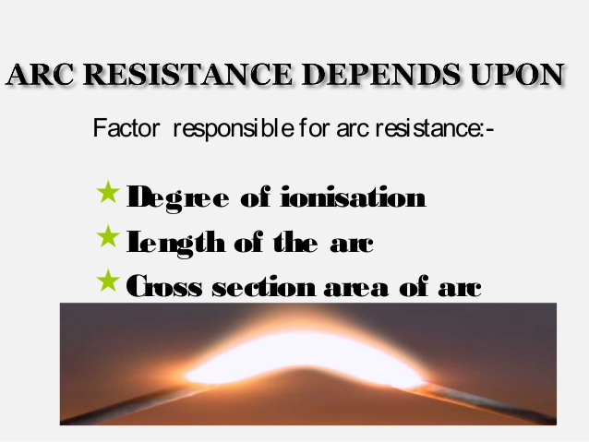
LECTURE 1:- circuit breaker
43
GHRCEM
43

Slide 44
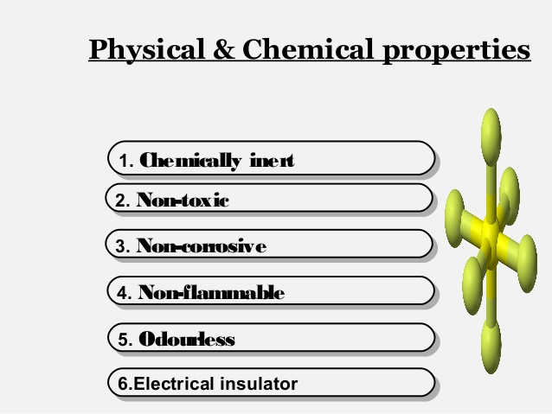
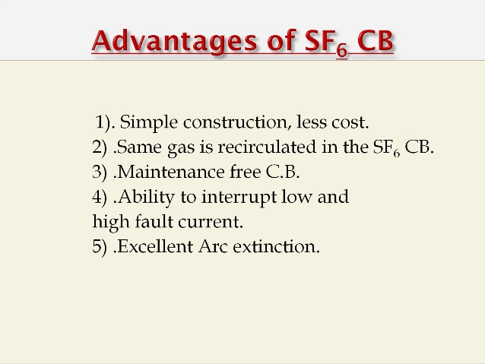
LECTURE 1:- circuit breaker
Chemical Properties of SF6 C.B
44
GHRCEM
44

Slide 45
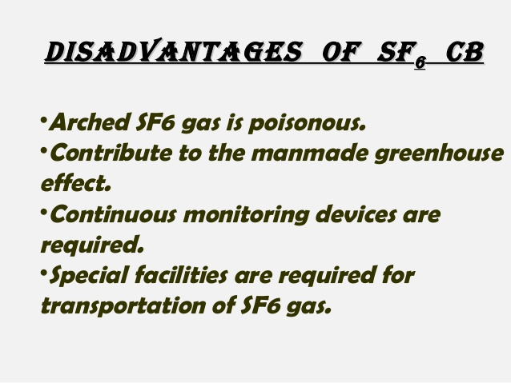
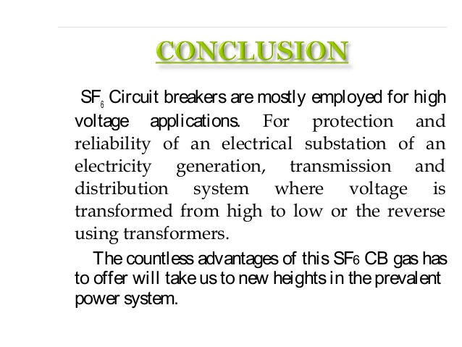
LECTURE 1:- circuit breaker
Disadvantages of SF6
45
GHRCEM
45

Slide 46
LECTURE 1:- circuit breaker
Earth-Leakage Circuit Breakers
Earth leakage circuit breaker: ELCB is a moulded case circuit breaker used in a low voltage AC circuit to provide electrical shock protection and prevent fires from leakage current.
A moulded case circuit breaker (MCCB) is a type of electrical protection device that is used to protect the electrical circuit from excessive current, which can cause overload or short circuit. With a current rating of up to 2500A, MCCBs can be used for a wide range of voltages and frequencies with adjustable trip settings. These breakers are used instead of miniature circuit breakers (MCBs) in large scale PV systems for system isolation and protection purposes
How the MCCB operates
The MCCB uses a temperature sensitive device (the thermal element) with a current sensitive electromagnetic device (the magnetic element) to provide the trip mechanism for protection and isolation purposes. This enables the MCCB to provide:
Overload Protection,
Electrical Fault Protection against short circuit currents, and
Electrical Switch for disconnection.
46
GHRCEM
46

Slide 47
LECTURE 1:- circuit breaker
MCCB
Overload Protection
Overload protection is provided by the MCCB via the temperature sensitive component. This component is essentially a bimetallic contact: a contact which consists of two metals that expand at different rates when exposed to high temperature. During the normal operating conditions, the bimetallic contact will allow the electric current to flow through the MCCB. When the current exceeds the trip value, the bimetallic contact will start to heat and bend away due to the different thermal rate of heat expansion within the contact. Eventually, the contact will bend to the point of physically pushing the trip bar and unlatching the contacts, causing the circuit to be interrupted.
The thermal protection of the MCCB will typically have a time delay to allow a short duration of overcurrent which is commonly seen in some device operations, such as inrush currents seen when starting motors. This time delay allows the circuit to continue to operate in these circumstances without tripping the MCCB.
Electrical Fault Protection against short circuit currents
MCCBs provides an instantaneous response to a short circuit fault, based on the principle of electromagnetism. The MCCB contains a solenoid coil which generates a small electromagnetic field when current passes through the MCCB. During normal operation, the electromagnetic field generated by the solenoid coil is negligible. However, when a short circuit fault occurs in the circuit, a large current begins to flow through the solenoid and, as a result, a strong electromagnetic field is established which attracts the trip bar and opens the contacts.
47
GHRCEM
47

Slide 48
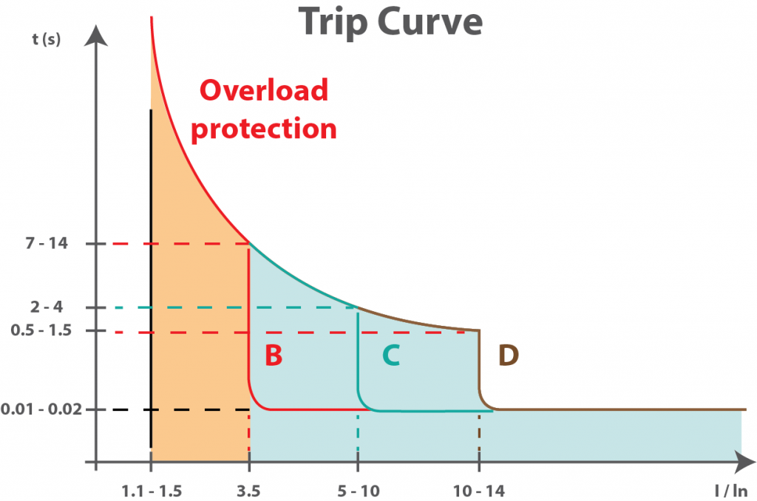
LECTURE 1:- circuit breaker
Electrical Switch for disconnection
In addition to tripping mechanisms, MCCBs can also be used as manual disconnection switches in case of emergency or maintenance operations. An arc can be created when the contact opens. To combat this, MCCBs have internal arc dissipation mechanisms to quench the arc.
48
GHRCEM
48

Slide 49
LECTURE 1:- circuit breaker
MCCB Maintenance
MCCBs are subjected to high currents; therefore maintenance of MCCBs is critical for reliable operation. Some of the maintenance procedures are discussed below:
1. Visual Inspection
During the visual inspection of a MCCB, it is important to look out for deformed contacts or cracks in casing or insulation. Any burn marks on contact or casing should be treated with caution.
2. Lubrication
Some MCCBs require adequate lubrication to ensure the smooth operation of the manual disconnection switch and internal moving parts.
3. Cleaning
The dirt deposits on MCCBs can deteriorate the MCCB components. If the dirt includes any conducting material it may create a path for current and cause an internal fault.
4. Testing
There are three main tests that are carried out as a part of maintenance procedure of a MCCB.
Insulation Resistance Test:
The tests for a MCCB should be conducted by disconnecting the MCCB and testing the insulation between the phases and across the supply and load terminals. If the measured insulation resistance is lower than the manufacturer’s recommended insulation resistance value then the MCCB will not be able to provide adequate protection.
49
GHRCEM
49

Slide 50
LECTURE 1:- circuit breaker
The NEMA AB 4 document has the following MCCB inspections and test procedures listed and explained in details //
Inspection of MCCB enclosure
Preventative maintenance //
Environmental evaluation
Interchangeable trip units
Wire connectors and connections
Mechanical operation tests
Insulation resistance tests
Individual pole resistance test (Millivolt drop test)
Inverse time overcurrent trip test (Overload current injection test)
Instantaneous overcurrent trip test (High current injection test)
Rated hold-in test (Full load injection test)
Accessary device tests //
Shunt trip release
Under voltage trip release
Electrical operator breaker assembly
Auxiliary switch
Alarm switch
But, generally, maintenance on molded case circuit breakers (MCCB) is limited to three basic actions:
50
GHRCEM
50

Slide 51
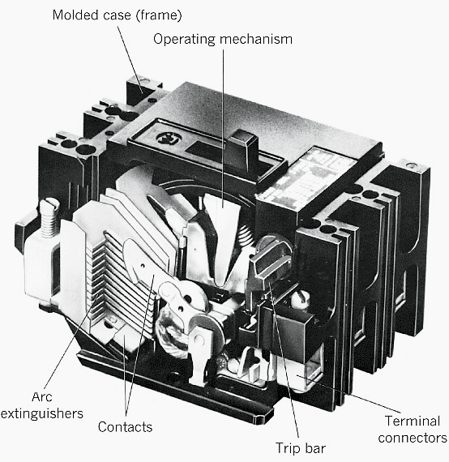
LECTURE 1:- circuit breaker
Many problems can occur when proper maintenance is not performed and the breaker fails to open under fault conditions. This combination of events can result in fires, damage to equipment, or injuries to personnel.
Common sense, as well as manufacturers’ literature, must be used when maintaining circuit breakers. Most manufacturers, as well as NFPA 70B, recommend that if a molded case circuit breaker has not been operated, opened or closed, either manually or by automatic means, within as little as six months time, it should be removed from service and manually exercised several times.
51
GHRCEM
51

Slide 52
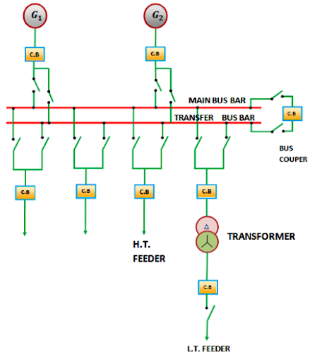
LECTURE 1:- circuit breaker
52
GHRCEM
52

Slide 53
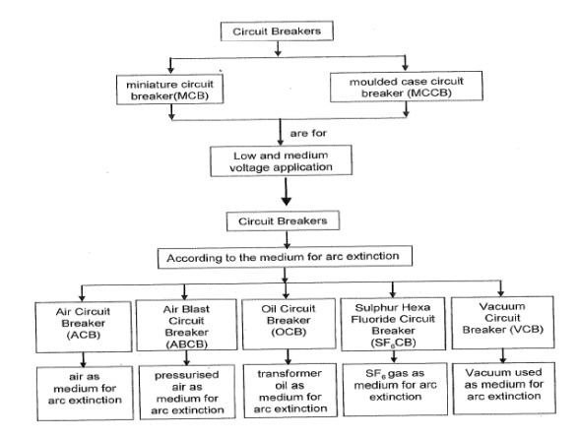
LECTURE 1:- circuit breaker
53
GHRCEM
53

Slide 54
THANK YOU
GHRUA
54

