Slide 1


G H RAISONI UNIVERSITY, AMRAVATI School of Engineering & Technology Department of Electrical Engineering
VII-semester
SWITCH GEAR PROTECTION
UNIT NO. 2
Circuit Breaker & Fuses
By
Dr. S. K. Mishra

Slide 2
LECTURE 1:- circuit breaker
Vacuum C.B
Vacuum Circuit Breaker
A breaker which used vacuum as an arc extinction medium is called a vacuum circuit breaker. In this circuit breaker, the fixed and moving contact is enclosed in a permanently sealed vacuum interrupter. The arc is extinct as the contacts are separated in high vacuum. It is mainly used for medium voltage ranging from 11 KV to 33 KV.
Vacuum circuit breaker has a high insulating medium for arc extinction as compared to the other circuit breaker. The pressure inside the vacuum interrupter is approximately 10⁻⁴ torrent and at this pressure, very few molecules are present in the interrupter. The vacuum circuit breaker has mainly two phenomenal properties.
High insulating strength: In comparison to various other insulating media used in circuit breaker vacuum is a superior dielectric medium. It is better than all other media except air and SF₆, which are employed at high pressure.
When an arc is opened by moving apart the contacts in a vacuum, an interruption occurs at the first current zero. With the arc interruption, their dielectric strength increases up to a rate of thousands time as compared to other breakers.
The above two properties make the breakers more efficient, less bulky and cheaper in cost. Their service life is also much greater than any other circuit breaker, and almost no maintenance are required.
2
GHRCEM
2

Slide 3
LECTURE 1:- circuit breaker
Construction of Vacuum Circuit Breaker
It is very simple in construction as compared to any other circuit breaker. Their construction is mainly divided into three parts, i.e., fixed contacts, moving contact and arc shield which is placed inside the arc interrupting chamber.
Working Vacuum Circuit Breaker
When the fault occurs in the system, the contacts of the breaker are moved apart and hence the arc is developed between them. When the current carrying contacts are pulled apart, the temperature of their connecting parts is very high due to which ionization occurs. Due to the ionization, the contact space is filled with vapour of positive ions which is discharged from the contact material.
The density of vapour depends on the current in the arcing. Due to the decreasing mode of current wave their rate of release of vapour fall and after the current zero, the medium regains its dielectric strength provided vapour density around the contacts reduced. Hence, the arc does not restrike again because the metal vapour is quickly removed from the contact zone.
3
GHRCEM
3

Slide 4
LECTURE 1:- circuit breaker
Current Chopping in C.B
Current Chopping in Vacuum Circuit Breaker
Current chopping in vacuum circuit breaker depends on the vapour pressure and the electron emission properties of the contact material. The chopping level is also influenced by the thermal conductivity–lower the thermal conductivity, lower is the chopping level.
It is possible to reduce the current level at which chopping occurs by selecting a contact material which gives out sufficient metal vapour to allow the current to come to a very low value or zero value, but this is rarely done as it affects the dielectric strength adversely.
Vacuum Arc recovery of Vacuum Circuit Breaker
High vacuum possesses extremely high dielectric strength. At zero current the arc is extinguished very quickly, and the dielectric strength is established very quickly. This return of dielectric strength is because of the vaporized metal which is localized between the contacts diffuses rapidly due to the absence of gas molecules. After arc interruption, the recovery strength during the first few microseconds is 1 kV/µs second for an arc current of 100A.
Because of the above-mentioned attribute of vacuum circuit breaker, it is capable of handling the severe recovery transients associated with short-line faults without any difficulty.
4
GHRCEM
4

Slide 5
LECTURE 1:- circuit breaker
Property of contact material
The contact material of the vacuum circuit breaker should have the following property.
The material should have high electrical conductivity so as to pass normal load currents without overheating.
The contact material should have low resistance and high density.
The material should possess high thermal conductivity so as to dissipate rapidly the large heat generated during arcing.
The material should have a high arc withstand ability and low current chopping level.
Advantages of Vacuum Circuit Breaker
Vacuum circuit breaker does not require any additional filling of oil or gas. They do not need periodic refilling.
Rapid recovery of high dielectric strength on current interruptions that only a half cycle or less arcing occurs after proper contact separation.
Breaker unit is compact and self-contained. It can be installed in any required orientation.
Because of the above reasons together with the economic advantage offered, vacuum circuit breaker has high acceptance.
5
GHRCEM
5

Slide 6
LECTURE 1:- circuit breaker
Disadvantage of Vacuum Circuit Breaker
Requirements of high technology for production of vacuum interrupters.
It needs additional surge suppressors for the interruption of low magnetizing currents in a certain range.
Loss of vacuum due to transit damage or failure makes the entire interrupter useless, and it cannot be repaired on site.
Applications of Vacuum Circuit Breaker
Because of the short gap and excellent recovery of vacuum circuit breaker, they are very useful as very high speed making switches in many industrial applications.
When the voltage is high and current to be interrupted is low these breakers have definite superiority over the other breakers.
For low fault interrupting capacities the cost is low in comparison to other interrupting devices.
Because of the least requirements of maintenance, these breakers are very suitable for the system which requires voltage from 11 to 33 kV
6
GHRCEM
6

Slide 7
LECTURE 1:- circuit breaker
SF6 C.B
Sulphur Hexafluoride (SF6) Circuit Breaker
A circuit breaker in which SF₆ under pressure gas is used to extinguish the arc is called SF₆ circuit breaker. SF₆ (sulphur hexafluoride) gas has excellent dielectric, arc quenching, chemical and other physical properties which have proved its superiority over other arc quenching mediums such as oil or air. The SF₆ circuit breaker is mainly divided into three types
Non-puffer piston circuit breaker
Single- puffer piston circuit breaker.
Double-puffer piston circuit breaker.
The circuit breaker which used air and oil as an insulating medium, their arc extinguishing force builds up was relatively slow after the movement of contact separation. In the case of high voltage circuit breakers quick arc extinction properties are used which require less time for quick recovery, voltage builds up. SF₆ circuit breakers have good properties in this regards compared to oil or air circuit breakers. So in high voltage up to 760 kV, SF₆ circuit breakers is used.
Properties of Sulphur hexafluoride Circuit Breaker
Sulphur hexafluoride possesses very good insulating and arc quenching properties. These properties are
7
GHRCEM
7

Slide 8
LECTURE 1:- circuit breaker
Properties of SF6 C.B
It is colourless, odourless, non-toxic, and non-inflammable gas.
SF₆ gas is extremely stable and inert, and its density is five times that of air.
It has high thermal conductivity better than that of air and assists in better cooling current carrying parts.
SF₆ gas is strongly electronegative, which means the free electrons are easily removed from discharge by the formation of negative ions.
It has a unique property of fast recombination after the source energising spark is removed. It is 100 times more effective as compared to arc quenching medium.
Its dielectric strength is 2.5 times than that of air and 30% less than that of the dielectric oil. At high pressure the dielectric strength of the gas increases.
Moisture is very harmful to SF₆ circuit breaker. Due to a combination of humidity and SF₆ gas, hydrogen fluoride is formed (when the arc is interrupted) which can attack the parts of the circuit breakers.
8
GHRCEM
8

Slide 9
LECTURE 1:- circuit breaker
Construction of SF₆ Circuit Breakers
SF₆ circuit breakers mainly consist of two parts, namely (a) the interrupter unit and (b) the gas system.
Interrupter Unit – This unit consists of moving and fixed contacts comprising a set of current-carrying parts and an arcing probe. It is connected to the SF₆gas reservoir. This unit consists slide vents in the moving contacts which permit the high-pressure gas into the main tank.
Gas System – The closed circuit gas system is employed in SF₆ circuit breakers. The SF₆ gas is costly, so it is reclaimed after each operation. This unit consists low and high-pressure chambers with a low-pressure alarm along with warning switches. When the pressure of the gas is very low due to which the dielectric strength of gases decrease and an arc quenching ability of the breakers is endangered, then this system gives the warning alarm.
Working Principle of SF₆ Circuit Breaker
In the normal operating conditions, the contacts of the breaker are closed. When the fault occurs in the system, the contacts are pulled apart, and an arc is struck between them. The displacement of the moving contacts is synchronised with the valve which enters the high-pressure SF₆ gas in the arc interrupting chamber at a pressure of about 16kg/cm^2.
9
GHRCEM
9

Slide 10
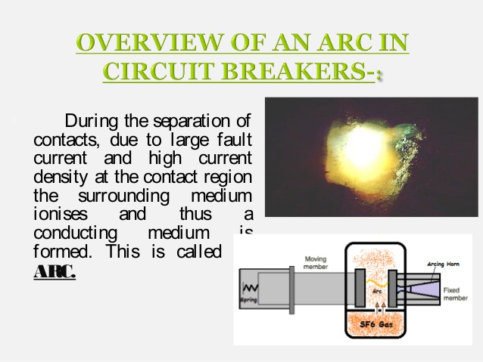
LECTURE 1:- circuit breaker
The SF₆ gas absorbs the free electrons in the arc path and forms ions which do not act as a charge carrier. These ions increase the dielectric strength of the gas and hence the arc is extinguished. This process reduces the pressure of the SF₆ gas up to 3kg/cm^2 thus; it is stored in the low-pressure reservoir. This low-pressure gas is pulled back to the high-pressure reservoir for re-use.
10
GHRCEM
10

Slide 11
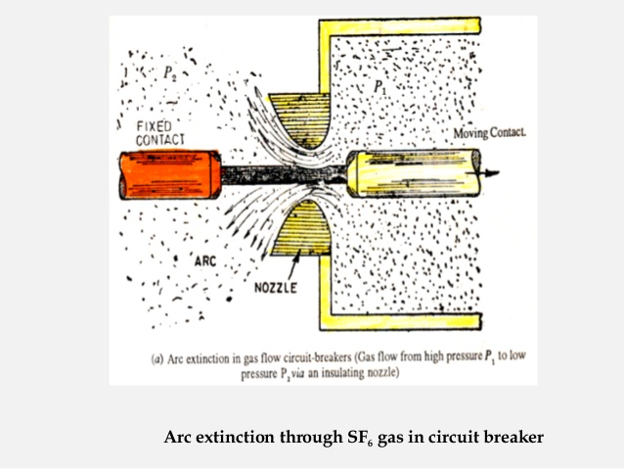
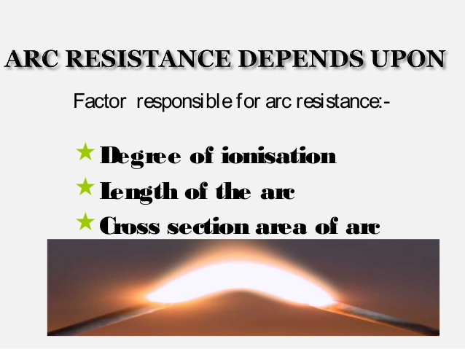
LECTURE 1:- circuit breaker
11
GHRCEM
11

Slide 12
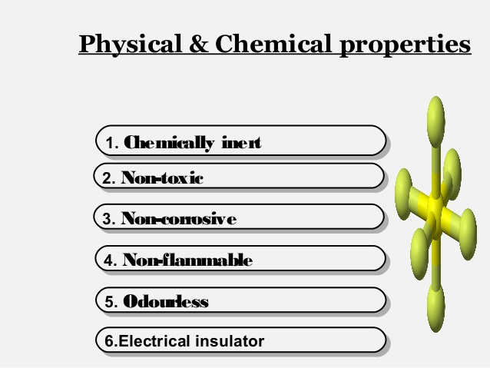
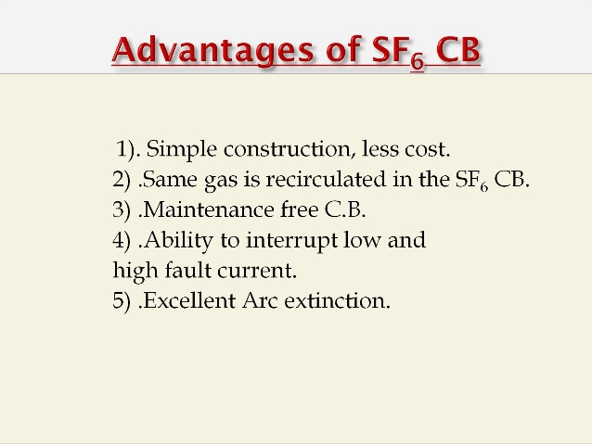
LECTURE 1:- circuit breaker
Chemical Properties of SF6 C.B
12
GHRCEM
12

Slide 13
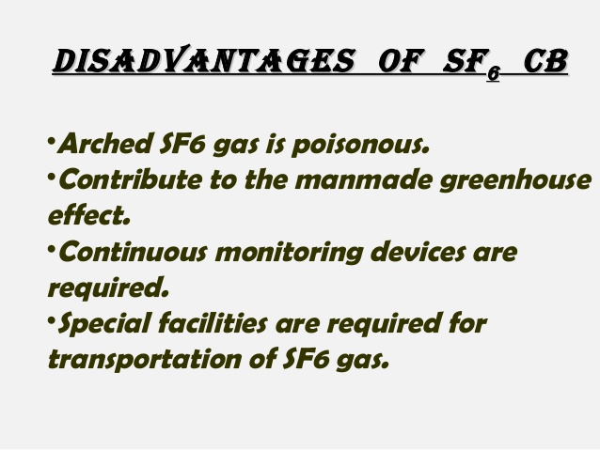
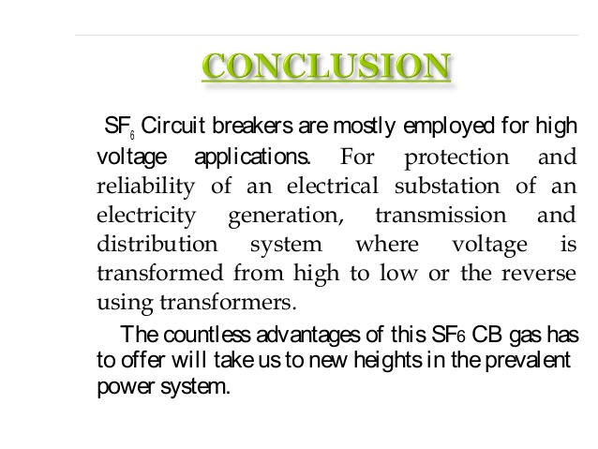
LECTURE 1:- circuit breaker
Disadvantages of SF6
13
GHRCEM
13

Slide 14
LECTURE 1:- circuit breaker
Earth-Leakage Circuit Breakers
Earth leakage circuit breaker: ELCB is a moulded case circuit breaker used in a low voltage AC circuit to provide electrical shock protection and prevent fires from leakage current.
A moulded case circuit breaker (MCCB) is a type of electrical protection device that is used to protect the electrical circuit from excessive current, which can cause overload or short circuit. With a current rating up to 2500A, MCCBs can be used for a wide range of voltages and frequencies with adjustable trip settings. These breakers are used instead of miniature circuit breakers (MCBs) in large scale PV systems for system isolation and protection purposes
How the MCCB operates
The MCCB uses a temperature sensitive device (the thermal element) with a current sensitive electromagnetic device (the magnetic element) to provide the trip mechanism for protection and isolation purposes. This enables the MCCB to provide:
Overload Protection,
Electrical Fault Protection against short circuit currents, and
Electrical Switch for disconnection.
14
GHRCEM
14

Slide 15
LECTURE 1:- circuit breaker
MCCB
Overload Protection
Overload protection is provided by the MCCB via the temperature sensitive component. This component is essentially a bimetallic contact: a contact which consists of two metals that expand at different rates when exposed to high temperature. During the normal operating conditions, the bimetallic contact will allow the electric current to flow through the MCCB. When the current exceeds the trip value, the bimetallic contact will start to heat and bend away due to the different thermal rate of heat expansion within the contact. Eventually, the contact will bend to the point of physically pushing the trip bar and unlatching the contacts, causing the circuit to be interrupted.
The thermal protection of the MCCB will typically have a time delay to allow a short duration of overcurrent which is commonly seen in some device operations, such as inrush currents seen when starting motors. This time delay allows the circuit to continue to operate in these circumstances without tripping the MCCB.
Electrical Fault Protection against short circuit currents
MCCBs provides an instantaneous response to a short circuit fault, based on the principle of electromagnetism. The MCCB contains a solenoid coil which generates a small electromagnetic field when current passes through the MCCB. During normal operation, the electromagnetic field generated by the solenoid coil is negligible. However, when a short circuit fault occurs in the circuit, a large current begins to flow through the solenoid and, as a result, a strong electromagnetic field is established which attracts the trip bar and opens the contacts.
15
GHRCEM
15

Slide 16
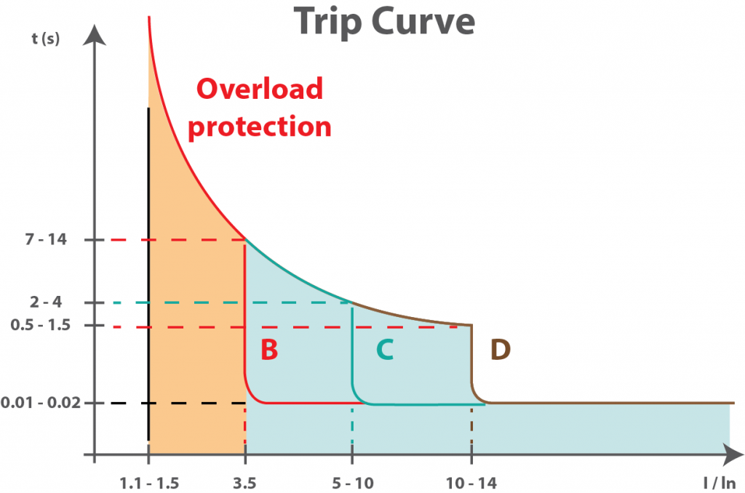
LECTURE 1:- circuit breaker
Electrical Switch for disconnection
In addition to tripping mechanisms, MCCBs can also be used as manual disconnection switches in case of emergency or maintenance operations. An arc can be created when the contact opens. To combat this, MCCBs have internal arc dissipation mechanisms to quench the arc.
16
GHRCEM
16

Slide 17
LECTURE 1:- circuit breaker
MCCB Maintenance
MCCBs are subjected to high currents; therefore maintenance of MCCBs is critical for reliable operation. Some of the maintenance procedures are discussed below:
1. Visual Inspection
During the visual inspection of a MCCB, it is important to look out for deformed contacts or cracks in casing or insulation. Any burn marks on contact or casing should be treated with caution.
2. Lubrication
Some MCCBs require adequate lubrication to ensure the smooth operation of the manual disconnection switch and internal moving parts.
3. Cleaning
The dirt deposits on MCCBs can deteriorate the MCCB components. If the dirt includes any conducting material it may create a path for current and cause an internal fault.
4. Testing
There are three main tests that are carried out as a part of maintenance procedure of a MCCB.
Insulation Resistance Test:
The tests for a MCCB should be conducted by disconnecting the MCCB and testing the insulation between the phases and across the supply and load terminals. If the measured insulation resistance is lower than the manufacturer’s recommended insulation resistance value then the MCCB will not be able to provide adequate protection.
17
GHRCEM
17

Slide 18
LECTURE 1:- circuit breaker
The NEMA AB 4 document has the following MCCB inspections and test procedures listed and explained in details //
Inspection of MCCB enclosure
Preventative maintenance //
Environmental evaluation
Interchangeable trip units
Wire connectors and connections
Mechanical operation tests
Insulation resistance tests
Individual pole resistance test (Millivolt drop test)
Inverse time overcurrent trip test (Overload current injection test)
Instantaneous overcurrent trip test (High current injection test)
Rated hold-in test (Full load injection test)
Accessary device tests //
Shunt trip release
Under voltage trip release
Electrical operator breaker assembly
Auxiliary switch
Alarm switch
But, generally, maintenance on molded case circuit breakers (MCCB) is limited to three basic actions:
18
GHRCEM
18

Slide 19
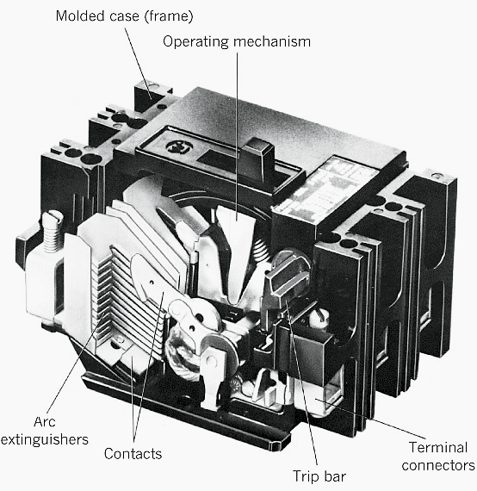
LECTURE 1:- circuit breaker
Many problems can occur when proper maintenance is not performed and the breaker fails to open under fault conditions. This combination of events can result in fires, damage to equipment, or injuries to personnel.
Common sense, as well as manufacturers’ literature, must be used when maintaining circuit breakers. Most manufacturers, as well as NFPA 70B, recommend that if a molded case circuit breaker has not been operated, opened or closed, either manually or by automatic means, within as little as six months time, it should be removed from service and manually exercised several times.
19
GHRCEM
19

Slide 20
THANK YOU
GHRUA
20

