Slide 1


G H RAISONI UNIVERSITY, AMRAVATI School of Engineering & Technology Department of Electrical Engineering
VII-semester
SWITCH GEAR PROTECTION
UNIT NO. 3
BASICS OF RELAY
By
Dr. S. K. Mishra

Slide 2
CHAPTER 1 :- SYLLABUS
1
Relay Components
.
2
Essential Features of Relay
3
Characteristics of relay
4
Relay Terminology
5
CT’s and PT’s
.
GHRCEM
2

Slide 3
CHAPTER 1 :- SYLLABUS contd..
6
Relay classifications
.
7
Overcurrent Relay
8
Directional types and constructional features, operation, characteristics and application
9
Distance types and constructional features, operation, characteristics and application
10
Differential types and constructional features, operation, characteristics and application
GHRCEM
3

Slide 4
CHAPTER-1 SPECIFIC Objective / course outcome
The student will know:
The basic concept of Introduction of static and
numerical relays
1
2
Various application of Relays
GHRCEM
4

Slide 5
LECTURE 1:-relay introduction
Introduction
Relays are the switches which aim at closing and opening the circuits electronically as well as electromechanically. It controls the opening and closing of the circuit contacts of an electronic circuit. When the relay contact is open (NO), the relay isn't energize with the open contact. Relays are normally used in the control panels, manufacturing and building automation to control the power along with switching the smaller current values in a control circuit. However, the supply of amplifying effect can help control the large amperes and voltages because if low voltage is applied to the relay coil, a large voltage can be switched by the contacts. If preventive relays are being used, it can detect overcurrent, overload, undercurrent, and reverse current to ensure the protection of electronic equipment. Last but not the least, it is used to heat the elements, switch on audible alarms, switch the starting coils, and pilots the lights.
5
GHRCEM
5

Slide 6
LECTURE 1:-Relays
Introduction
In addition to the electromechanical and electromagnetic relay, there is a wide variety of relays with different working principles; principles of operation and polarity.
Electro-thermal Relay – When two different material gets in contact, bimetallic strip is formed, and when it is energized, it bends. This bending allows the users to make contact connections
Electromechanical Relay – When different mechanical parts are connected on the basis of the electromagnet, contact connection is established
Solid State Relay –This relay uses semiconductor devices to make a connection to ensure the effectiveness, efficiency, and easiness of the switching speed. This is commonly used for two reasons; faster-switching process and durability
Hybrid Relay – It is the name given to the solid-state and electromechanical relays
6
GHRCEM
6

Slide 7
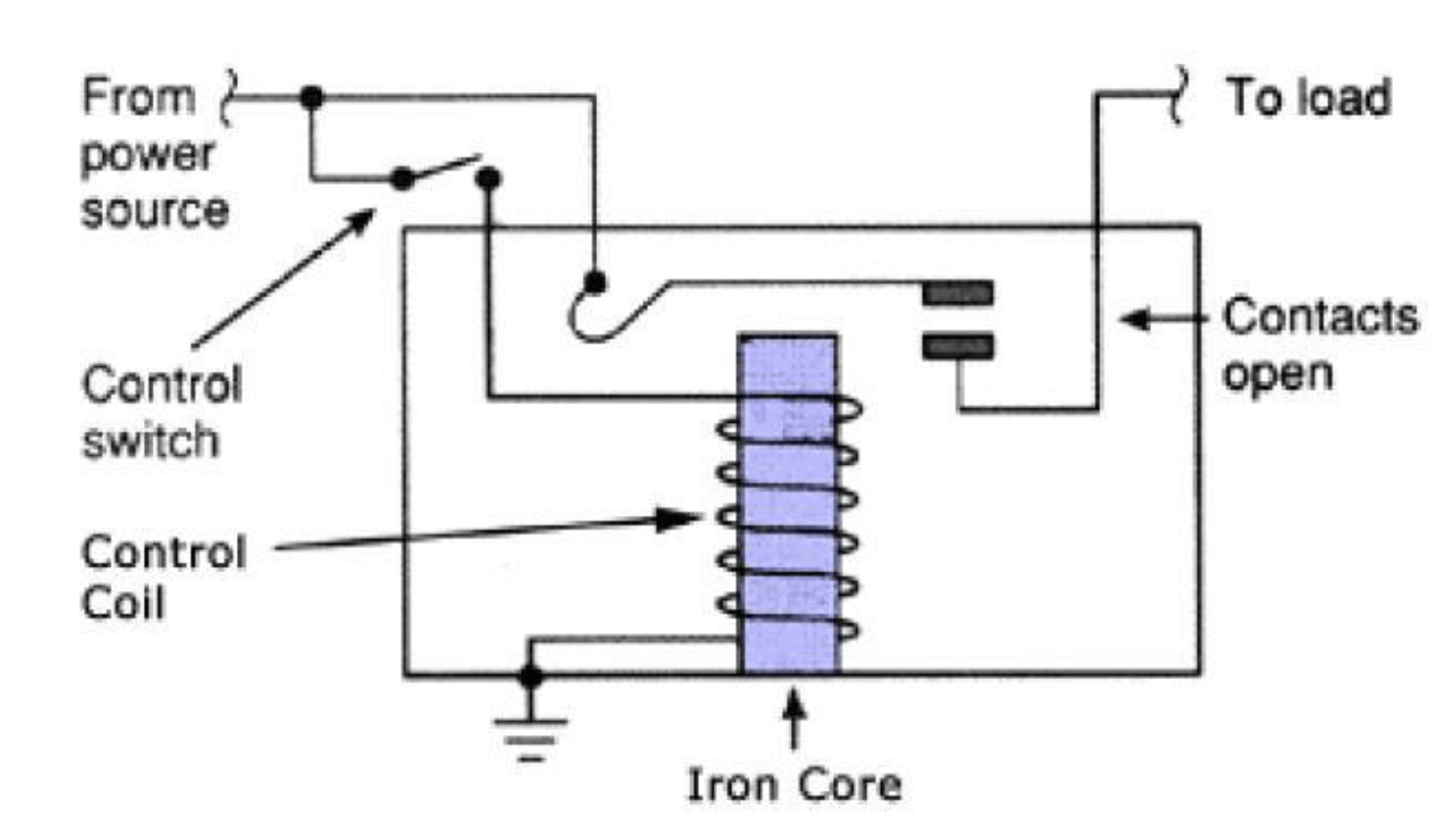
LECTURE 1:- relays
7
GHRCEM
7

Slide 8
LECTURE 1:-Relay
Test Method
The diagram sheds focus on the internal section of the relay in the circuit. There is an iron core delimited with the control coil. The power source connects with electromagnet through load contacts and a control switch. When energy is supplied to the circuit through the control coil, magnetic field intensifies given the commencement of energizing. This way, upper contact arms gets attracted by the lower fixed arm which closes the contacts leading to the short circuit. However, if the relay was de-energized, an open circuit is created with the opposite movement of the contact. Once the coil current goes off, a movable armature is force back to the initial position, and the force is equal to half of the magnetic force and electric strength. The main reasons behind this force include gravity and spring.
The relays perform two basic functions, such as high voltage application and low voltage application. In the case of high voltage, arcing is reduce while in the low voltage applications, overall circuit noise is reduce to a minimum.
8
GHRCEM
8

Slide 9
LECTURE 1:-relay
Operation
Working Principle of Relay
Relays are used in a wide variety application. It works on the principle of an electromagnetic attraction. When the circuit of the relay senses the fault current, it energises the electromagnetic field which produces the temporary magnetic field. This magnetic field moves the relay armature for opening or closing the connections.
variety of applications throughout industry, such as in telephone exchanges, digital computers and automation systems. ... All relays contain a sensing unit, the electric coil, which is powered by AC or DC current.
9
GHRCEM
9

Slide 10
LECTURE 1:- relays
Purpose
A relay is a form of electrical switch that is operated by electromagnet which changes over the switching when current is applied to the coil. These relays may be operated by switch circuits where the switch cannot take the high current of the electrical relay, or they may be operated by electronic circuits, etc. In either circumstance they provide a very simple and attractive proposition for electrical switching. Relays have a number of basic parts that form the relay.
Frame: A mechanical frame is required to hold the components in place. This frame is normally quite robust so that it can firmly support the additional elements of the electromechanical relay without relative movement.
Coil: A coil wound round an iron core to increase the magnetic attraction is needed. The coil of wire causes an electromagnetic field to be created when the current is switched on an causes the armature to be attracted. Armature: This is the moving part of the relay. This element of the relay opens and closes the contacts and it has a ferromagnetic metal to be attracted by the electromagnet. The assembly has an attached spring which returns the armature to its original position.
Contacts: The contacts are operated by the action of the armature movement. Some of the electrical switching contacts may close the circuit when the relay is activated where as others may open a circuit. These are known as normally open and normally closed.
10
GHRCEM
10

Slide 11
LECTURE 1:-relays
Purpose
Relay design involves a number of aspect. It is a key element of the design to obtain the required magnetic flux to attract the armature sufficiently quickly, without consuming excessive current. Also it is necessary to ensure that the relay can open quickly once the energising current is removed. Magnetic retention in the materials needs to be low. When a current flows through the coil an electro-magnetic field is set up. The field attracts an iron armature, whose other end pushes the contacts together, completing the circuit. When the current is switched off, the contacts open again, switching the circuit off. When specifying electromechanical relays, it will be seen that the electrical switch contacts come in a variety of formats. Like ordinary electrical switches, electromechanical relays are defined in terms of breaks, poles and throws that the device has.
Break: Whilst may of the terms applied to electromechanical relays also apply to low power electrical switches, this one is more applicable to higher power switching. It is the number of separate places or contacts where a switch is used to open or close a single-electrical circuit. All relays are either single break or double break. A single break, SB contact breaks an electrical circuit in only one place. Then as the name indicates, a double break, DB contact breaks the circuit in two places. Single break contacts are normally used when switching lower power devices, possibly electronic circuits or low power electrical switching applications. Double break contacts are used for the electrical switching of high power devices. If one of the contacts sticks, then the other one is likely to still switch and break the circuit.
11
GHRCEM
11

Slide 12
LECTURE 1:-relays
Purpose
Pole: The number of poles that an electrical switch posses is the number of different sets of switching contacts that it has. A single pole switch can only switch one circuit, whereas a double pole switch can switch two different and isolated circuits at the same time. A single pole switch is often denoted by the letters SP, and a double pole by DP. Relays can have one, two or more poles.
Throw: The number of throws on an electrical switch is the number of positions that are available. For an electromechanical relay, there are normally only one or two throws. A single throw relay will make and break a circuit, whereas a double throw relay will act as a changeover routing a connection from one end point to a different one. Single throw and double throw are often denoted by the letters ST and DT.
For example an electrical relay specification may quote a single pole, single throw: SPST or one may be described as double pole single throw: DPST, etc. These terms enable the number of sets of switch contacts and whether they are an open / close or whether they provide a change-over function.
12
GHRCEM
12

Slide 13
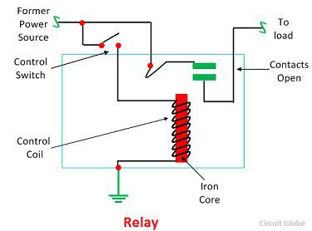
LECTURE 2:- Relays
13
GHRCEM
13

Slide 14
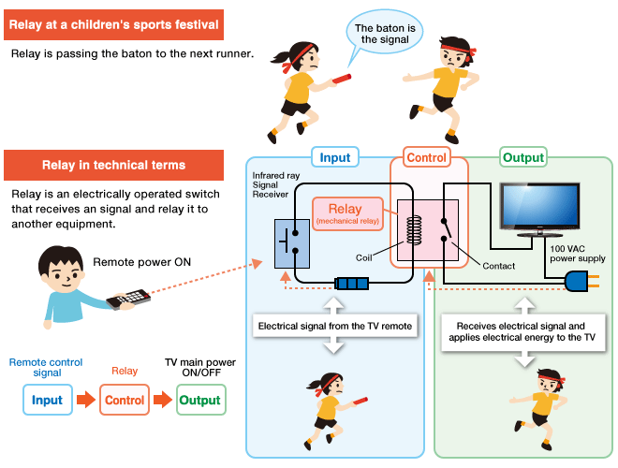
LECTURE 1:- relays
SUBSTATION GRID
14
GHRCEM
14

Slide 15
LECTURE 1:- relays
15
GHRCEM
15

Slide 16
LECTURE 1:- Relays
16
GHRCEM
16

Slide 17
LECTURE 1:- Relays
17
GHRCEM
17

Slide 18
LECTURE 1:- Relays
18
GHRCEM
18

Slide 19
LECTURE 1:- Relays
19
GHRCEM
19

Slide 20
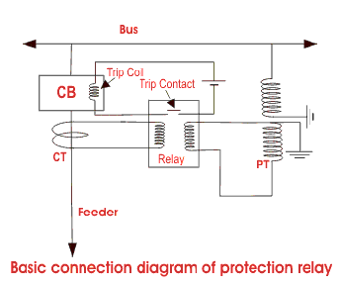
LECTURE 1:- protection Relays
20
GHRCEM
20

Slide 21
LECTURE 1:- Relays
In interconnected Power System network , a good protection scheme is necessary for reliable operation. So, which qualities needed for good protective relay?
A protective relaying scheme should have certain important qualities such as;
Reliability
Speed and Time
Sensitivity
Selectivity and discrimination
Stability
Simplicity
Economy
Adequateness
These qualities must have protective relays for better protection of the power system network.
Reliability
It is the ability of a protective relays to operate under predetermined conditions. The reliability of the protection system depends on the reliability of various components like a circuit breaker, relays, current transformer (CT), potential transformer (PT), trip coils, connecting cables and many more.
There are many components to operate before the operation of the relay. And the operation of the relaying scheme is also depending on the component which plays a role in the operation of the relay.
21
GHRCEM
21

Slide 22
LECTURE 2 :- Relays
The reliability of the system can be judged from the statistical data but cannot be expressed in terms of mathematical operation.
Proper maintenance also plays an important role in improving the reliable operation of the system. It is also depending on the design of the system.
Speed and Time
The protective scheme must disconnect the faulty part of the system as soon as possible. If the faulty part takes more time to disconnect. It may damage the component which is carrying faulty current. The system voltage will decrease. And low-voltage may affect the motors and generators running on the consumer side. In worst condition, if the fault persists a long time, subsequently other faults may get generated and it results in a blackout.
Therefore, very high-speed protection relays are used in the power system network. The relay time is the time taken from the instant of the fault and the instant of the closure of contact of the relay. The circuit breaker time is the time taken by a circuit breaker to operate and open the contacts and extinguish the arc.
The total time required between the instant of the fault and the instant of final arc interruption in the circuit breaker is called fault clearing time. It includes the relay time and circuit breaker time. In high-speed operation of the relaying scheme, the fault clearing time is very small.
22
GHRCEM
22

Slide 23
LECTURE 1:- Relays
Sensitivity
The protective scheme operates if the value of the actuating quantity is not in the predefined range. The sensitivity is the ability to operate with a low value of actuating quantity. In a protected zone, the sensitivity indicates the smallest value of the actuating quantity at which the protection starts operating in relation to the minimum value of fault current
Selectivity and Discrimination
Selectivity is the ability of the protective scheme to identify the fault part of the system. It must operate only for the faulty part without affecting the rest of a healthy system. Discrimination is the ability of the protective scheme to identify between the normal condition and abnormal condition. The relaying scheme must operate under abnormal conditions only.
Therefore, the protective scheme selects the faulty part from the healthy system and disconnect in abnormal condition for faulty part only without disturbing the healthy system. One more thing to mention here is that the relaying scheme must not operate beyond their protective zone. If the system is not selective, it operates for the fault beyond its protective zone and unnecessary tripping occurs. By which it will disconnect large areas compared to a faulty area.
23
GHRCEM
23

Slide 24
LECTURE 1:- Relays
Stability
The power system network must remain stable under the condition of transient, disturbance, and faults. The stability of power system is the quality of a protective scheme due to which the system remains inoperative and stable under abnromal conditions. To achieve stable operation of the system, time delay, a filter circuit, mechanical and electrical bias are provided.
Simplicity
To maintain and install easy, the protective scheme must be simple in operation. The complex systems are difficult while maintenance and installation. The simpler the system it will more reliable. Therefore, the protective scheme must simple.
24
GHRCEM
24

Slide 25
LECTURE 1:- Relays
Adequateness
There are varieties of faults and disturbances that exist in the power system network. It may be impossible to provide protection against each and every abnormal condition. But the protective system must provide adequate protection for the element of the system. The adequateness of the system can be evaluated by considering the following factors.
Cost
Rating
Location
Probability of abnormal condition
Discontinuity of supply due to the failure of the equipment.
25
GHRCEM
25

Slide 26
LECTURE 1:- Relays
26
GHRCEM
26

Slide 27
LECTURE 1:- Relays
27
GHRCEM
27

Slide 28
LECTURE 1:- Relays
28
GHRCEM
28

Slide 29
LECTURE 1:- Relays
29
GHRCEM
29

Slide 30
LECTURE 1:- Relays
30
GHRCEM
30

Slide 31
LECTURE 1:- Relays
31
GHRCEM
31

Slide 32
THANK YOU
GHRCEM
32

