Slide 1
The Stability of Meaning in Language Models: Assessing Contextual Influence in Causal LMs’ Gendered Pronoun Selection
Sagar Kumar
Alt (more clickbait) Title:
Deconstructing AI: Measuring the Stability of Meaning in LLMs via Gendered Pronoun Selection

Slide 2
Paper Outline
Introduction
Existing work on gender in language models
Lit review on ordering, priming, and framing effects in LLMs suggests results may be highly unstable
Most of these only look at the generation, we want to see both to see whether the effects exist ”in the model” or emerge through the stochasticity of generation
Motivate contextuality as thing in Cog Sci used when such effects appear, as a way to discern whether it is truly single construct being measured, or if that construct is irreducibly coupled to context
In LLMs, we translate this to whether the meaning of a lexeme is “stable”
Methods
Dataset
Masked Language modeling in Causal LMs
Prompting, Metaprompting, and probability extraction
Calculating distances
Calculating contextuality-by-default
Results
Difference between belief and generation
Difference between orders
Difference when priming
Difference with framing / does framing help?
Contextuality
Discussion and Conclusion

Slide 3
Open Questions
Is the use of contextuality sufficiently motivated and are its ramifications clear?
What should be done about the fact that only two gendered pronouns are being used? (there is currently a justification I have outlined)
How strongly do we feel about the framing effects because that would effectively double the number of runs (and time/resources)?
Is it necessary to compare the individual sentences against biases/norms? (i.e. “she” in reference to a CEO is good vs. “she” in reference to some misogynistic occupation)
Clearly important, but it seems that story here is more about the massive variability
How can the results for several models be clearly and concisely presented?
Does anything feel unnecessary?
Does anything feel missing?

Slide 4
Basics about Language Models
Modern language models are causal. This means that, unlike BERT of the past, these models only look in one direction—forward.
The model has an internal state, predicting the value of the next token, conditioned on all the past tokens.
It also has a generation head, which adds stochasticity to the internal state and generates the next token based on the past tokens it has generated, acting sort of like a state-space machine.

Slide 5
Basics About Linguistic Meaning
The meaning of an utterance is ascertained by its semantics
Classically, this has been on the basis of a sentence’s truth-conditions
In language models, it is on the basis of a sentence’s place in statistical distributions
Pragmatic effects (such as inflect, intonation, framing) can lead two semantically equivalent sentences to have completely different meanings
e.g.
I didn’t say she stole the money → Someone else said it.
I didn’t say she stole the money → Denial of having said it.
I didn’t say she stole the money → Maybe implied it, but didn’t state it.
I didn’t say she stole the money → Someone else might have stolen it.
I didn’t say she stole the money → She might have borrowed it.
I didn’t say she stole the money → She stole something else.
The goal of this work is to study how structural, contextual, and interactional features of language presentation modulate meaning beyond literal semantics
As an area which has historically shown to be concerning in these model, we test these w.r.t meanings built around gender in the model to see if new supposed “improvements” are robust to these modulations of meaning

Slide 6
Llama 3.2 1B Results

Slide 7
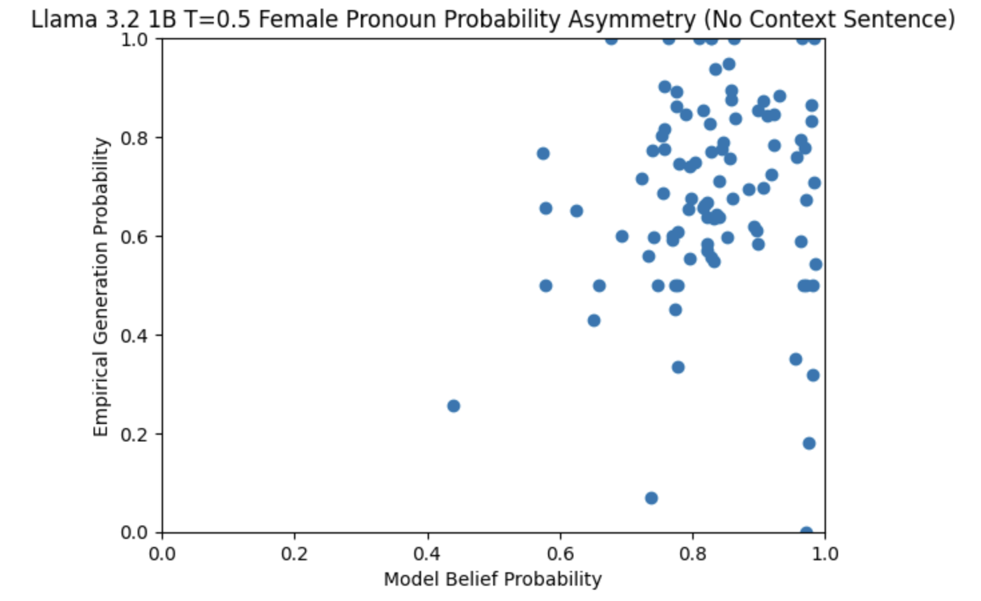
Belief vs. Generation
Model beliefs generally make female pronoun more probable than male. Generation, however is all over the place.

Slide 8
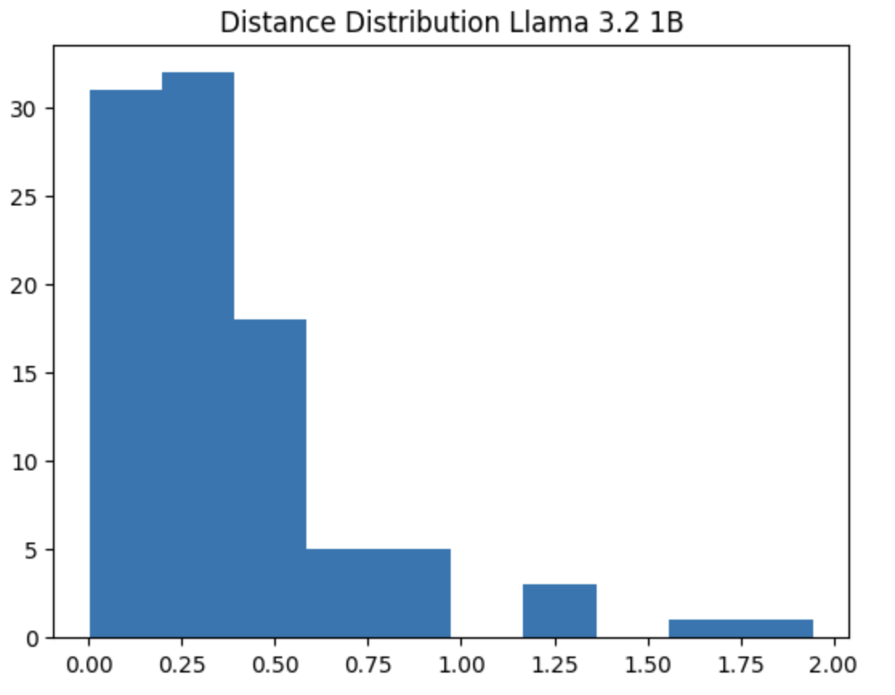
Belief vs. Generation
This is the distribution of the L1-distance between the internal probabilities and the generated probabilities.
The peak on the left suggests that most items in the Winogender dataset stay consistent between the two, but there are some instances where are nearly maximally different at a temperature of only 0.5.

Slide 9
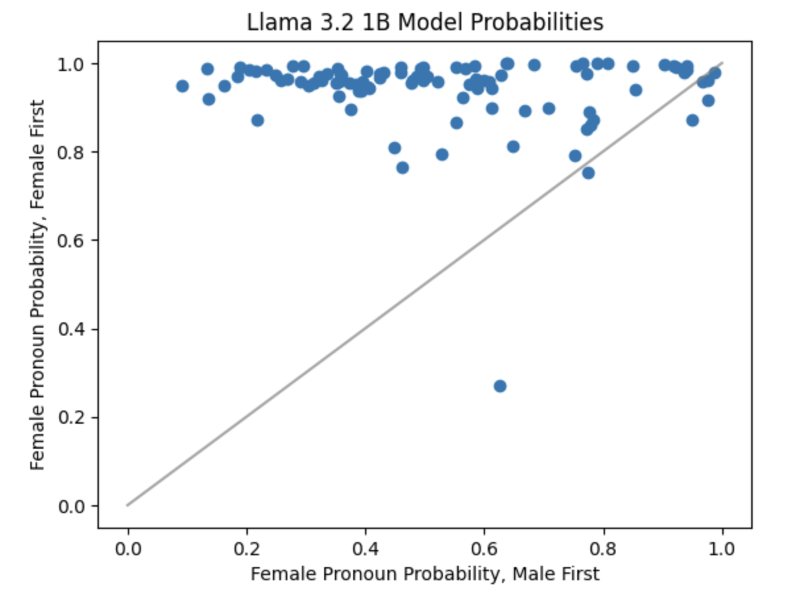
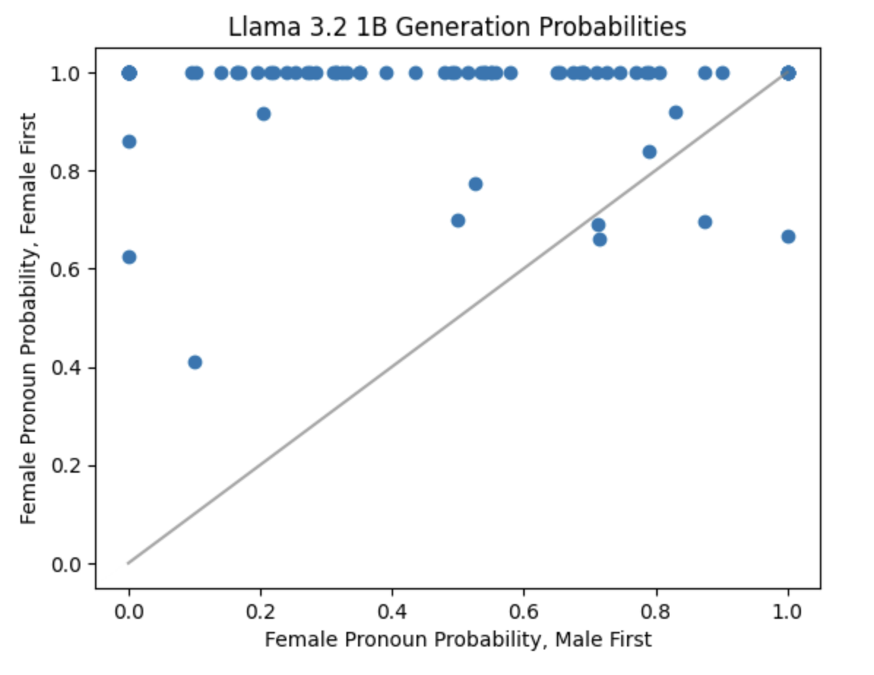
Ordering Effects
In both the model beliefs and in generation, using the female pronoun all but guarantees the female pronoun will be chosen, regardless of the utterance.

Slide 10
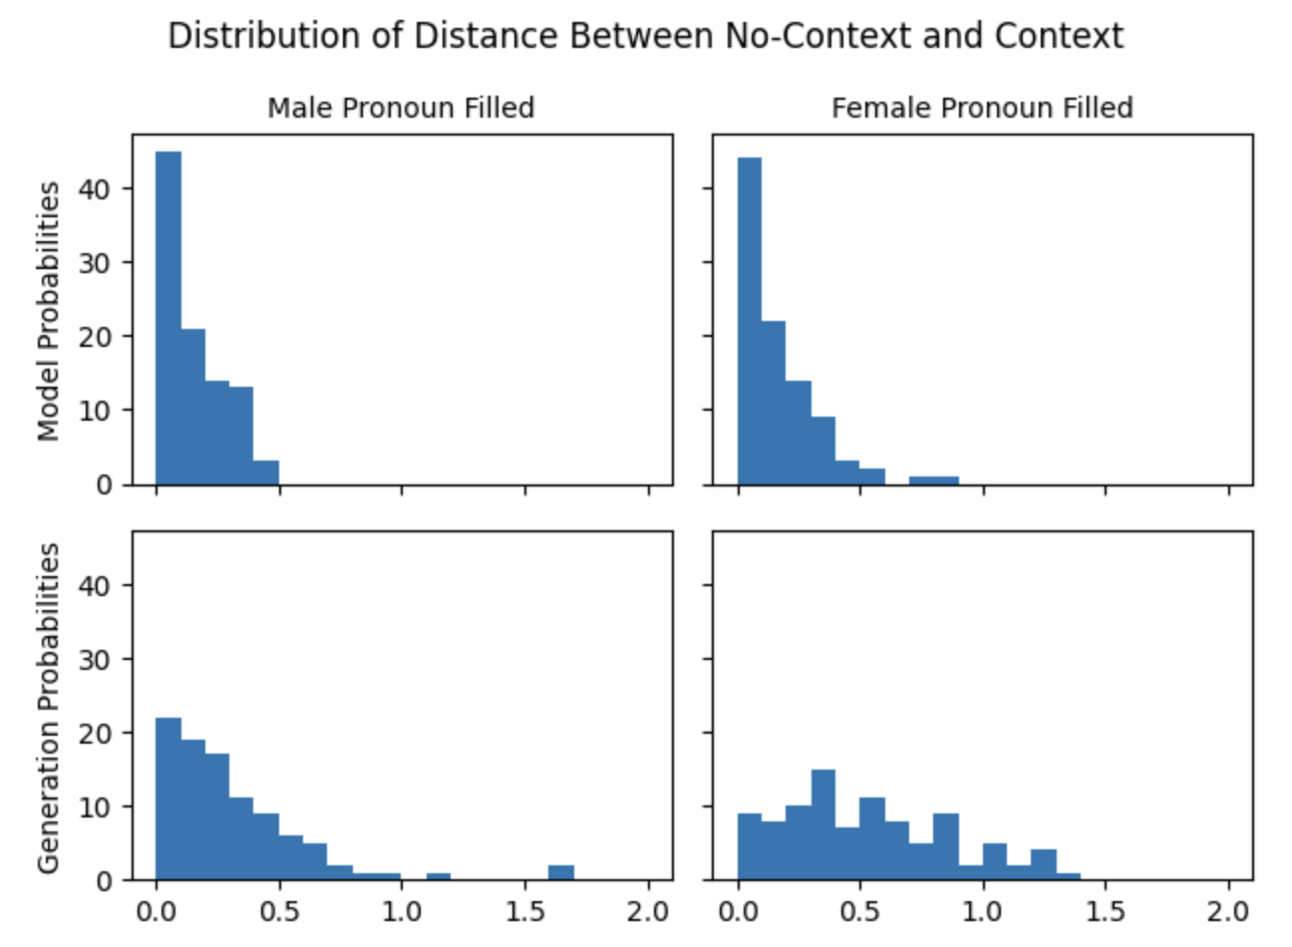
Priming Effects
In every instance in the dataset, there is are two characters. In this test, we provide a “priming” sentence which provides a gendered pronoun for the other character. Hypothetically, this should be irrelevant to the resolution of the pronoun requested. Here, we show the L1-distance between the primed (context) and un-primed (no context) prompts.
The differences are increased when the priming sentence is filled with a female pronoun. This is especially pronounced for generation.

Slide 11
Framing Effects
Naming game framing—very much follows the cooperative principles of Grice and Habermas
Results currently being collected

Slide 12
Contextuality
How do we know if we are, in fact, measuring the same construct/factor/dimension when we get different values from all of these effects? → Contextuality
Contextuality requires at least two measurements can be interpreted in several ways.
If we ask a model to resolve the pronoun for sentence A and the pronoun for sentence B and we find that this sentence is contextual, it means:
There is (logically) no way we can create a model of B which does not depend on A
In LLMs, we might think of this as saying that there is no “latent dimension” for B which is not a function of A
For gendered pronouns, this would be to say that if the model resolves the pronoun “her,” for B this is not coming from some “gender axis” but rather, is a function of the pronoun it ascribed A
In psychology, this is the “selectiveness of influences” which answers the question of whether, logically, the measurements can be attributed to the same latent construct
In language, we frame this as the stability of the meaning of the lexeme

Slide 13
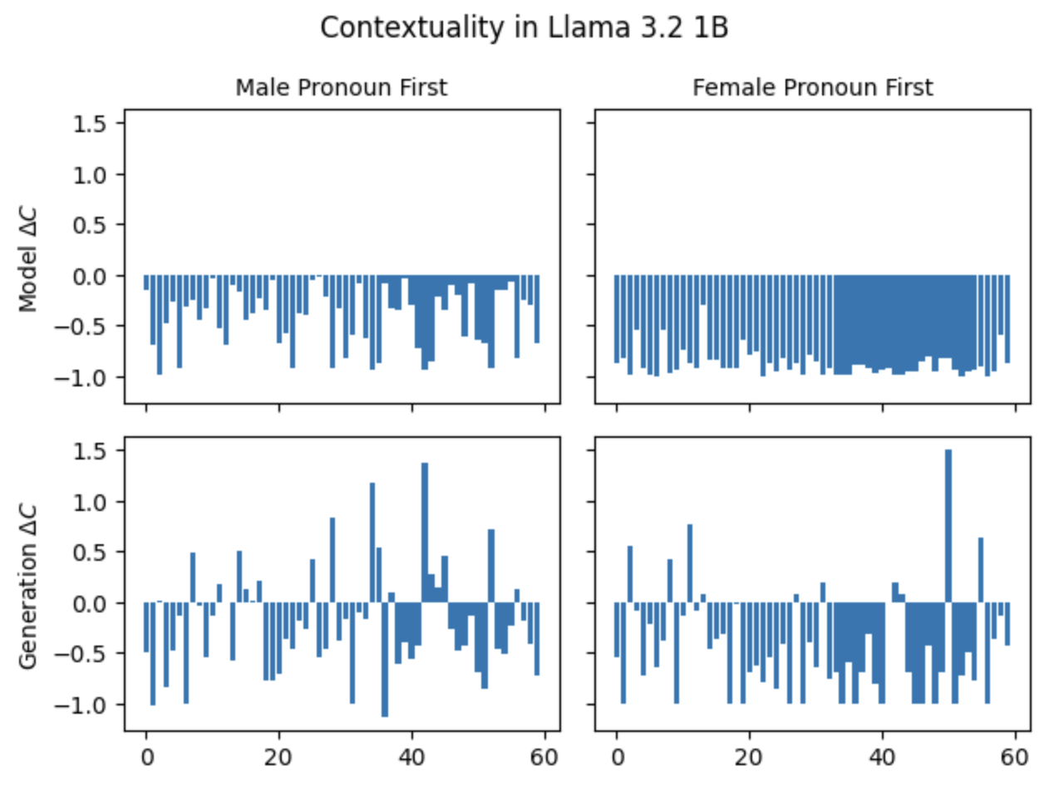
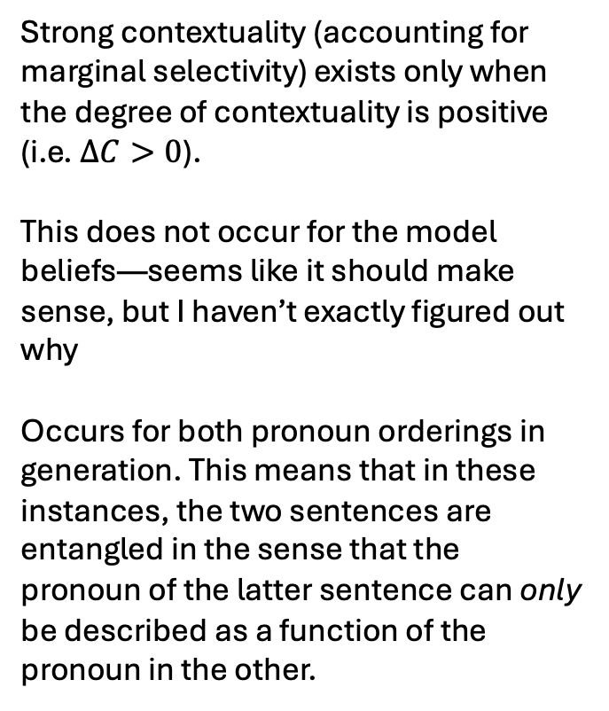
Strong contextuality (accounting for marginal selectivity) exists only when the degree of contextuality is positive (i.e. $ΔC>0$).
This does not occur for the model beliefs—seems like it should make sense, but I haven’t exactly figured out why
Occurs for both pronoun orderings in generation. This means that in these instances, the two sentences are entangled in the sense that the pronoun of the latter sentence can only be described as a function of the pronoun in the other.

Slide 14
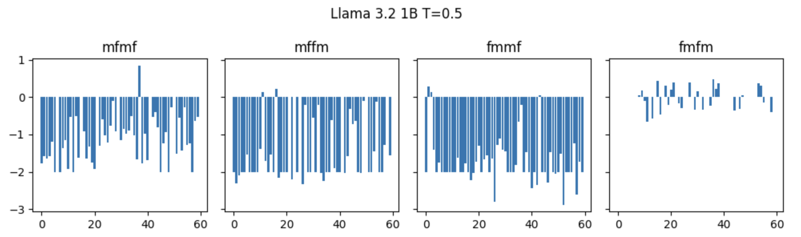
Contextuality in Llama 3.2 1B
LOTS of contextual instances!

Slide 15
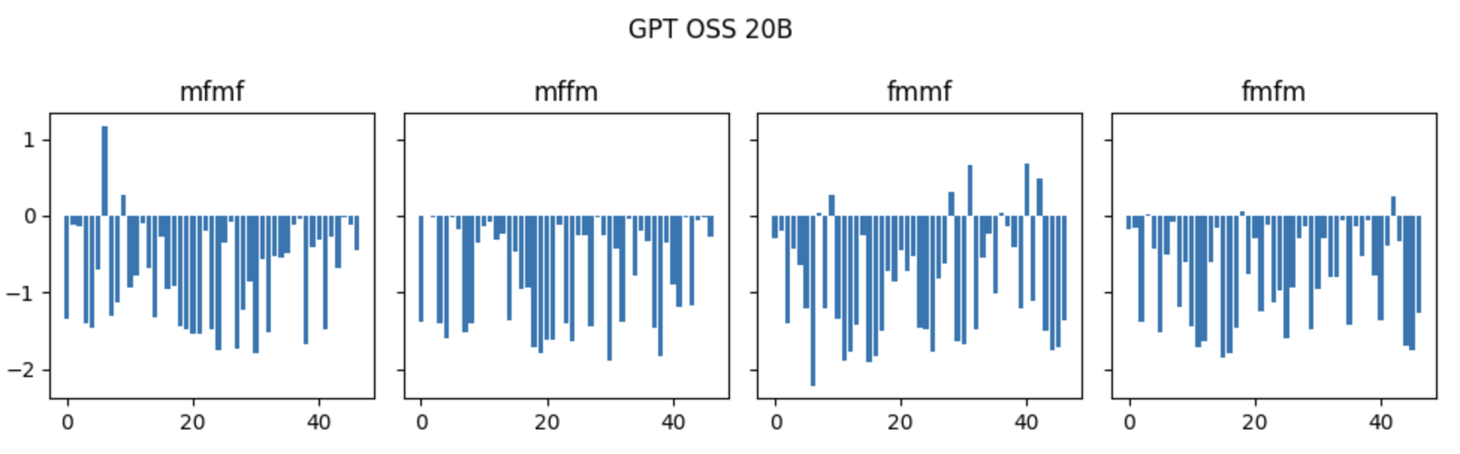
Contextuality in GPT-OSS 20B
Even the latest and greatest models exhibit contextuality!

Slide 16
Qwen 1.5 0.5B Results

Slide 17
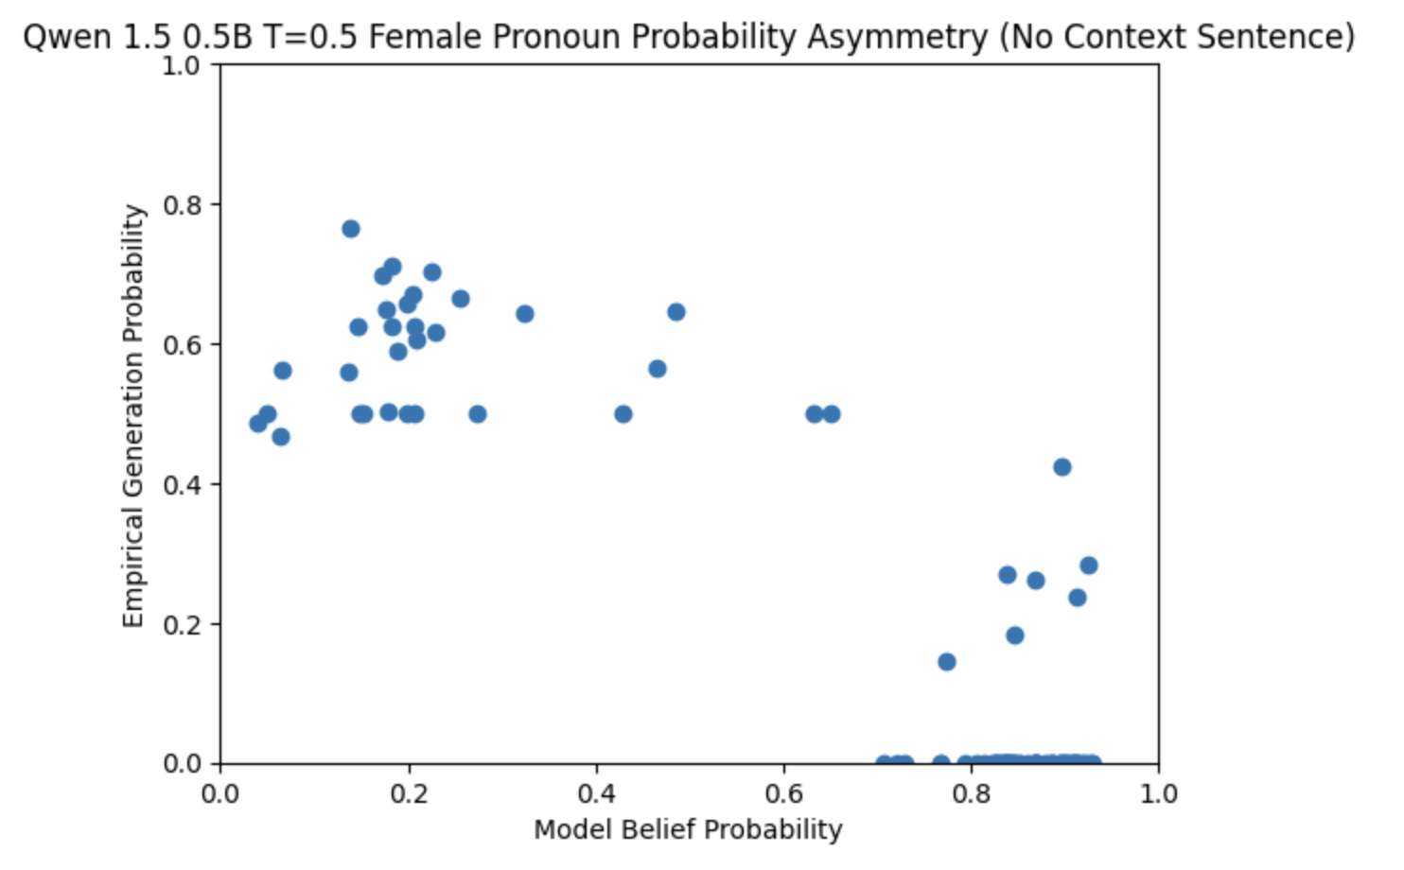
Belief V. Generation

Slide 18
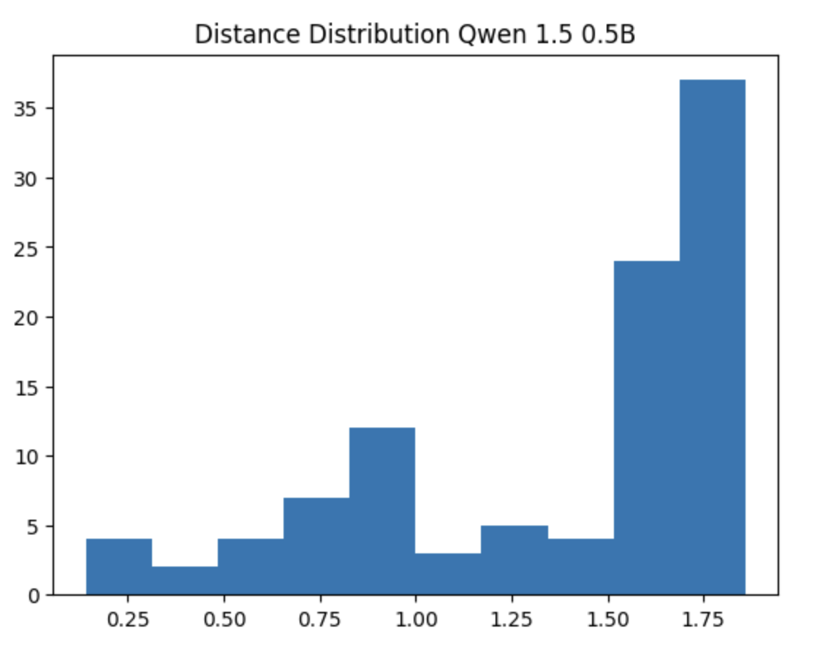
Belief v. Generation

Slide 19
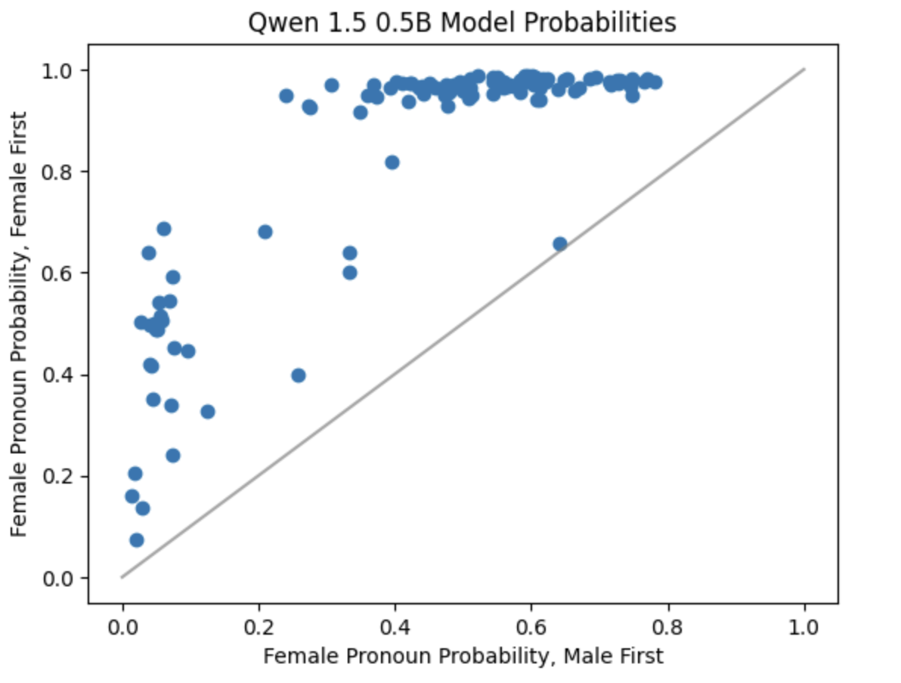
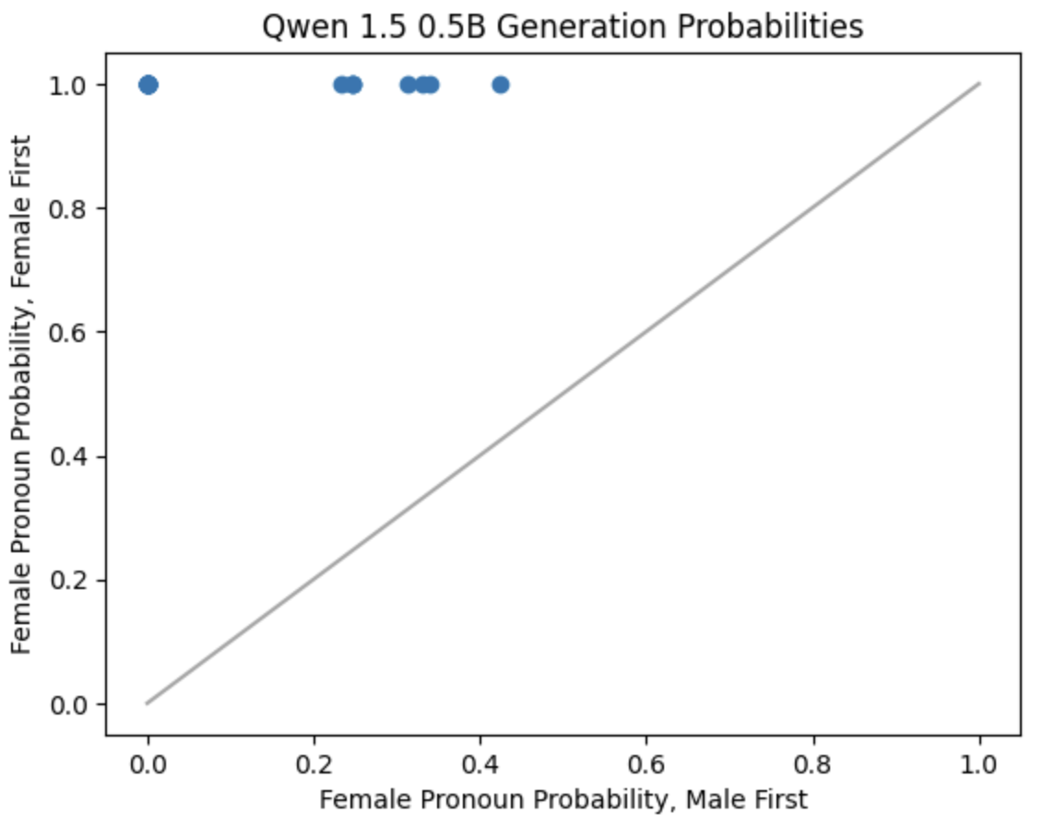
Ordering Effects

Slide 20
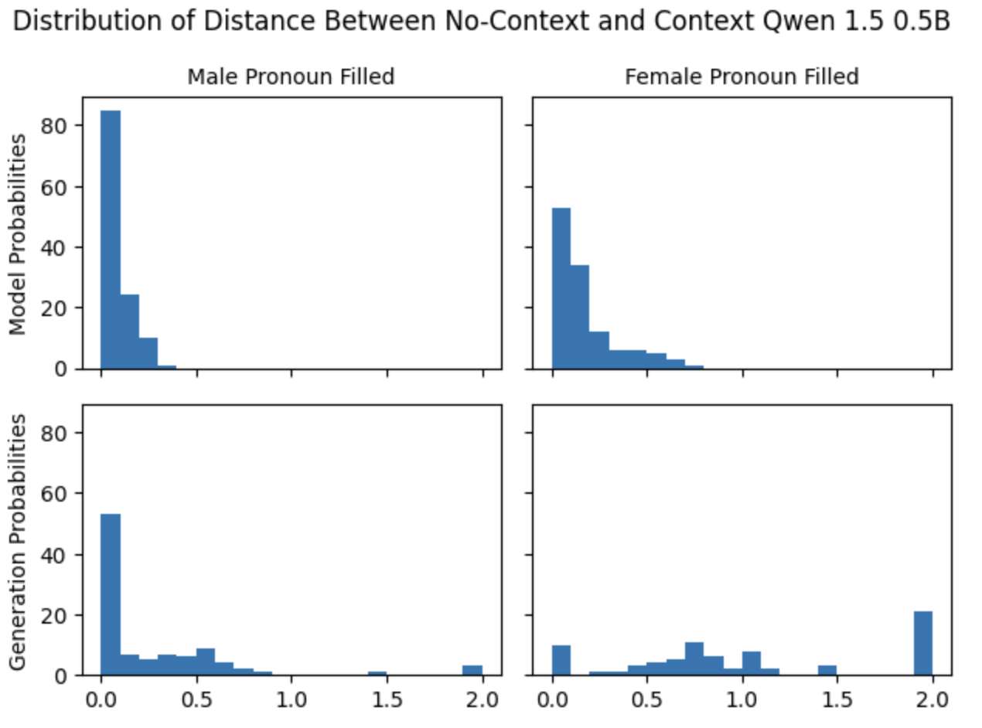
Priming Effects

Slide 21
Framing Effects
Results currently being collected

Slide 22
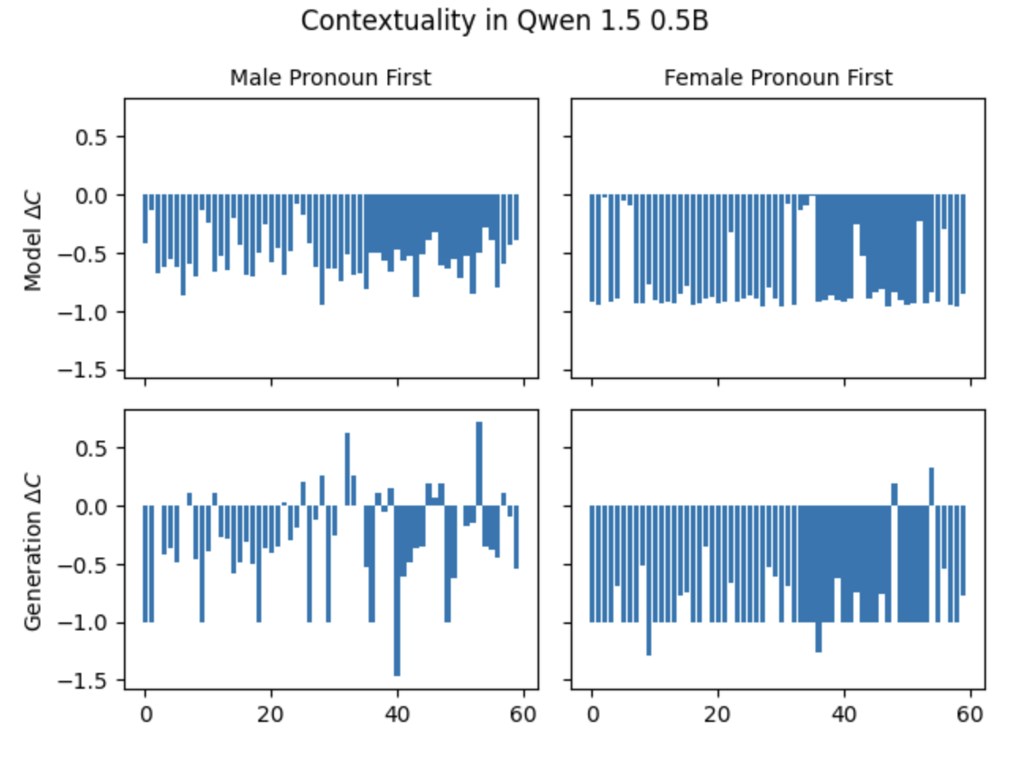
Fewer instances than Llama 3.2 1B (a bigger model) but still very much present.

Slide 23
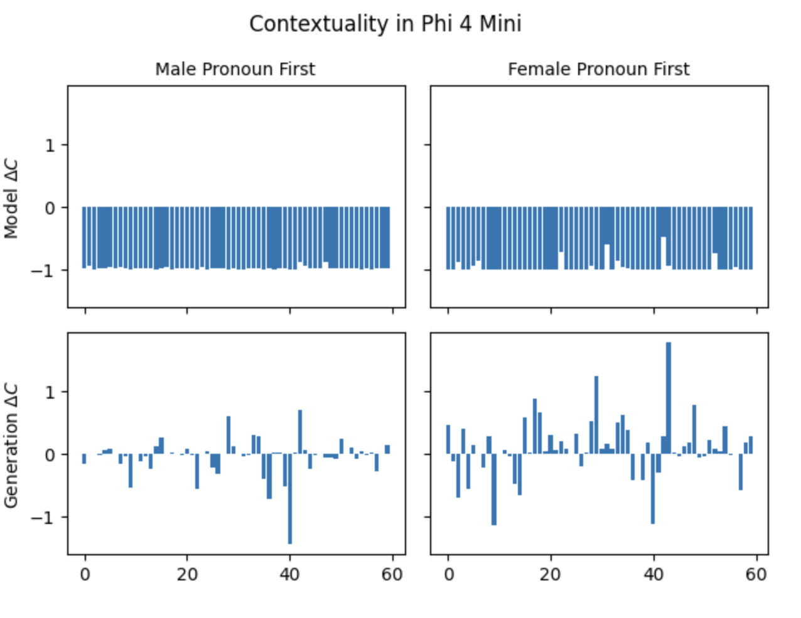
Soooo much contextuality

Slide 24
What this means
When the model fills in a blank in a sentence, the answer isn’t just about the word itself — it depends on the situation we create with an earlier sentence. The very meaning of the pronoun, “she” (or any others) is only defined in the context of the pair of sentences. The meaning of the pronoun can’t be treated as having been “fixed” ahead of time. It’s like how a joke only makes sense after the setup: the context completely changes the response. That’s what we mean when we say the task is ‘contextual.’

Slide 25
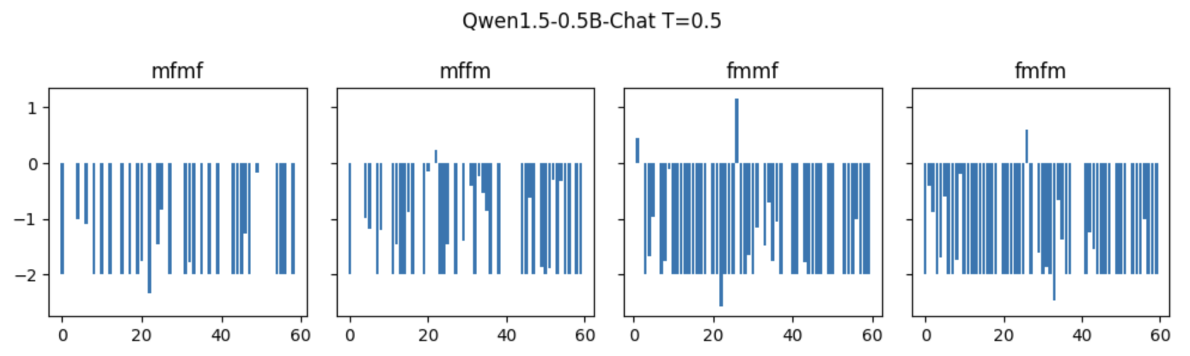
Contextuality in Qwen 1.5 0.5B

Slide 26
Takeaways
A two part story is forming:
testing pragmatic effects (order, priming, and framing)
determining whether the meaning of “he/she/his/her/etc.” is stable
Some difficulties trying to work out how to explain this and its consequences, so a conversation would be good
So far, there seem to be important results w.r.t gender in prompting.
Female-pronoun-first options lead to heavy skews in the responses
Female character in priming sentences lead to skews especially in generation
No models thus far have shown option-order contextuality, but all have shown sentence-order contextuality contingent on option ordering
Still need to show the effect of temperature
Contextuality may feel like a nuance in application, but could likely prove to be important for linguistic theory

