Slide 1
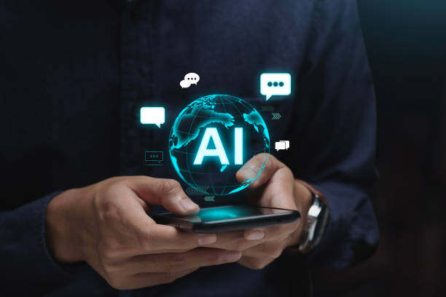
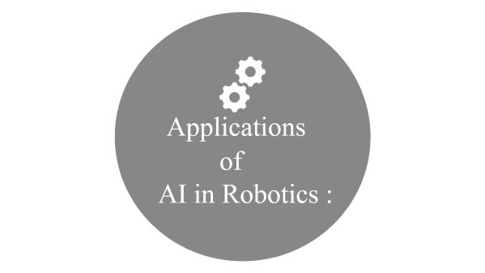
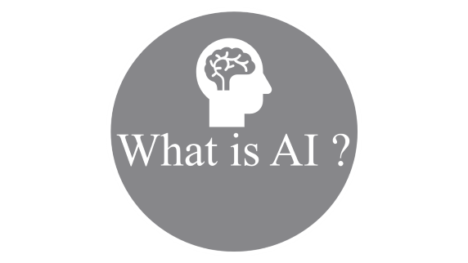
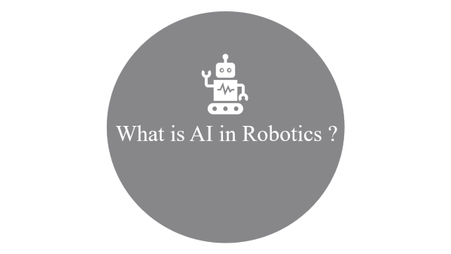


Slide 2

What is AI ?

Slide 3


What is AI ?
AI is a field of study that involves the development of computer programs and systems that can perform tasks that would typically require human intelligence to accomplish.
This involves the use of various types of machine learning algorithms, such as supervised learning, unsupervised learning, and reinforcement learning, to enable the robot to learn from data and improve its performance over time.
AI in robotics also involves the use of computer vision techniques to enable robots to perceive and interpret the environment around them, and natural language processing (NLP) techniques to enable robots to understand and respond to human language.
What is AI ?

Slide 4

What is AI in Robotics ?

Slide 5
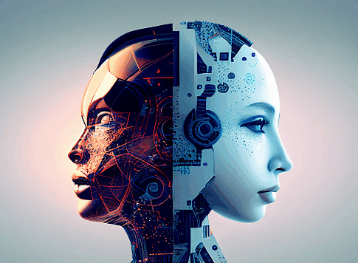
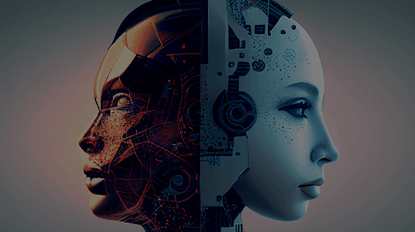
What is AI in Robotics ?
Artificial intelligence (AI) in robotics is the integration of advanced software and hardware systems that enable robots to perform a wide range of tasks autonomously. AI-driven robots use sensors, cameras, and other advanced technologies to gather data, interpret it, and make decisions based on that data.
The field of robotics has been advancing at a rapid pace in recent years, and AI has played a significant role in this progress. By incorporating AI into robots, engineers and developers can create machines that are capable of adapting to new environments, learning from experience, and making decisions based on complex data.

Slide 6

Applications
of
AI in Robotics :

Slide 7
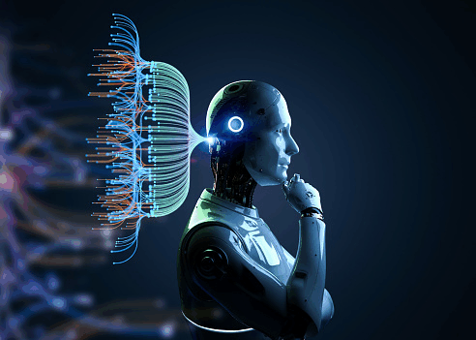
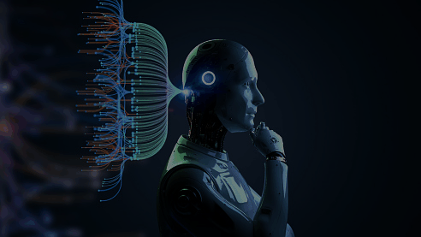





Applications of AI in Robotics :
Autonomous Navigation
Object Recognition
Speech and Language Recognition
Predictive Maintenance
Collaborative Robots

Slide 8

Autonomous
Navigation

Slide 9
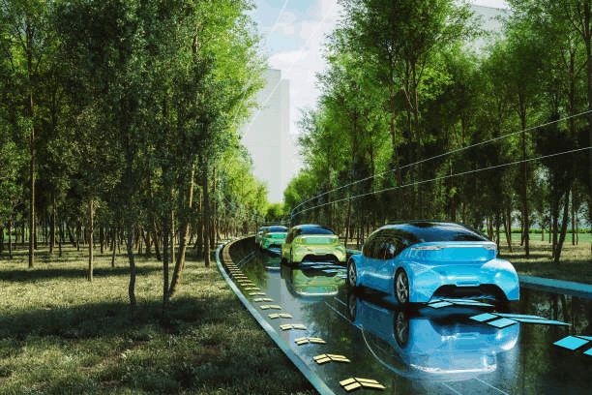
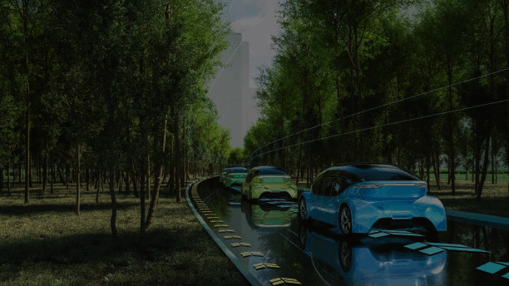
Autonomous Navigation :
One of the most important applications of AI in robotics is autonomous navigation. Autonomous navigation involves developing robots that can move around and interact with their environment without human intervention. This technology has a wide range of applications in industries such as manufacturing, logistics, and healthcare.
To enable autonomous navigation, robots are equipped with sensors and cameras that allow them to perceive their environment. These sensors capture data such as images, sounds, and other sensory inputs. This data is then analyzed by AI algorithms that allow the robot to make decisions about its movements and interactions with the environment.
For example, self-driving cars use AI algorithms to analyze data from cameras and sensors to navigate roads and avoid obstacles.

Slide 10

Object
Recognition

Slide 11
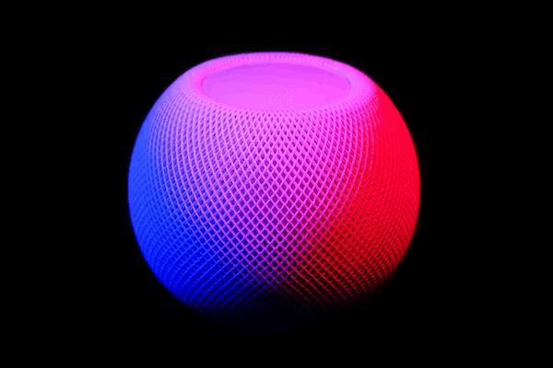
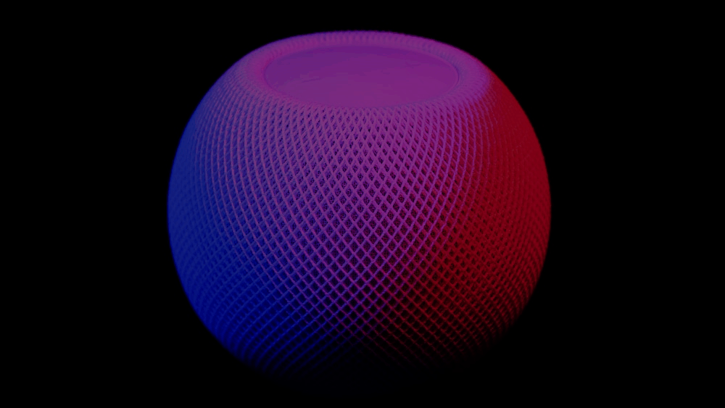



Object Recognition :
Object recognition involves developing robots that can identify and classify objects in their environment. This technology has a wide range of applications in industries such as manufacturing, retail, and healthcare.
To enable object recognition, robots are equipped with cameras and sensors that allow them to capture images of objects in their environment. These images are then analyzed by AI algorithms that can identify and classify objects based on their shape, color, and other characteristics.
For example, robots in warehouses use object recognition algorithms to identify and locate specific items on shelves. Similarly, robots in hospitals use object recognition algorithms to identify medical instruments and equipment.
Example (made by us) : AIHandDetector , AIVirtualKeyboard

Slide 12

AIHandDetector

Slide 13


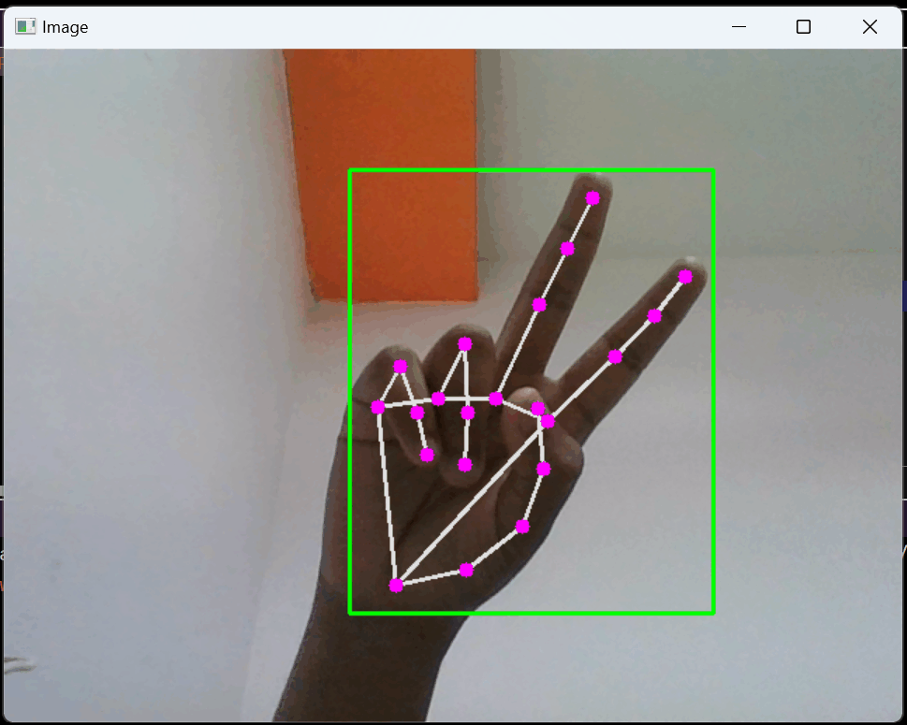
AIHandDetector

Slide 14

AIVirtualKeyboard

Slide 15


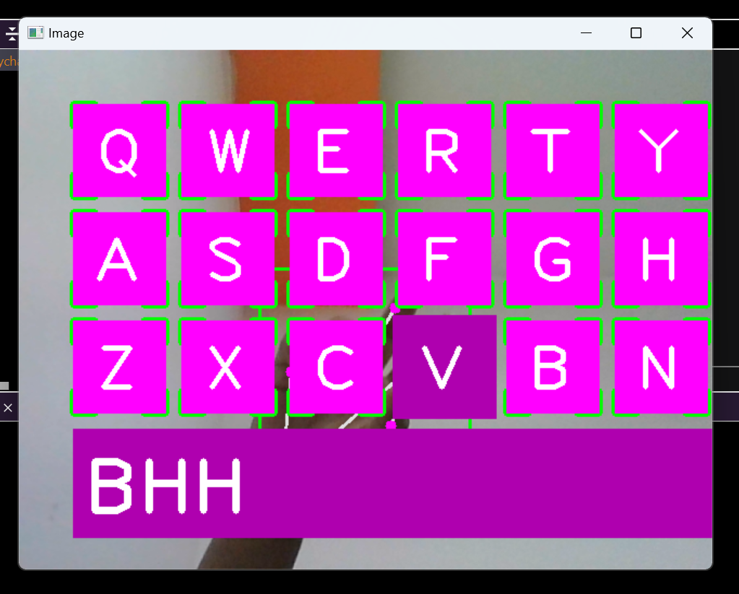
AIVirtualKeyboard :

Slide 16

Speech and Language
Recognition

Slide 17


Speech and Language Recognition :
Speech and language recognition is another important application of AI in robotics. Speech and language recognition involves developing robots that can understand and respond to human speech. This technology has a wide range of applications in industries such as customer service, healthcare, and education.
To enable speech and language recognition, robots are equipped with microphones and software that can capture and analyze human speech. This software uses AI algorithms to recognize words and phrases, and then respond appropriately.
For example, customer service robots can use speech and language recognition to understand customer inquiries and provide appropriate responses. Similarly, robots in healthcare settings can use speech and language recognition to communicate with patients and provide instructions.

Slide 18

Predictive Maintenance

Slide 19
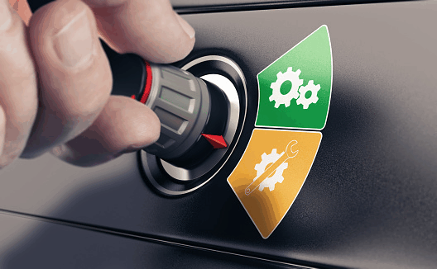

Predictive Maintenance :
Predictive maintenance involves developing robots that can predict when maintenance is needed and schedule maintenance before a problem occurs. This technology has a wide range of applications in industries such as manufacturing and energy.
To enable predictive maintenance, robots are equipped with sensors and software that can detect changes in performance or potential problems. This data is then analyzed by AI algorithms that can predict when maintenance is needed and schedule maintenance accordingly.
For example, robots in manufacturing plants can use predictive maintenance algorithms to detect when a machine is beginning to show signs of wear and schedule maintenance before a breakdown occurs.

Slide 20

Collaborative Robots

Slide 21


Collaborative Robots :
Collaborative robots, also known as cobots, are robots that work alongside humans to perform tasks. This technology has a wide range of applications in industries such as manufacturing, healthcare, and agriculture.
To enable collaborative robots, robots are equipped with sensors and software that can detect the presence of humans and adjust their behavior accordingly. These robots are designed to work safely alongside humans, performing tasks that are difficult or dangerous for humans to perform alone.
For example, collaborative robots in manufacturing plants can work alongside humans to perform tasks

Slide 22


Conclusion

Slide 23


Conclusion :
In conclusion, the future of AI in robotics is exciting and promising. As AI and robotics continue to evolve and improve, we can expect to see even more advanced and capable robots that can perform complex tasks and adapt to new situations and environments. While there are challenges and limitations to the development and deployment of AI in robotics, these challenges can be addressed through ongoing research and development and collaboration between experts in AI, robotics, and related fields. Overall, the integration of AI and robotics is likely to be a key driver of innovation and progress in the years to come.
References :
https://www.google.com/
https://chat.openai.com/
https://www.istockphoto.com/
https://www.youtube.com/
https://en.wikipedia.org/wiki/Artificial_intelligence
https://en.wikipedia.org/wiki/Robotics

