Slide 1
FIFA 15_20 Analysis
Sagar Limbu

Slide 2



Slide 3
OBJECTIVES:
Data analysis of FIFA players from FIFA 15 to FIFA 20

Slide 4
Potential Analysis/Findings on players statistics:
We can perform different statistical analysis on the given data sets that can determine or at least show co-relationship between the different attributes of players.
Relationship of players and their skill levels over time
Relationship between players age and their overall rating. Here, overall determines the rating of FIFA for individual players
Players meeting their potentials who plays for top clubs over time
Players from different internationals who meets their potential over time
Oldest players who are still playing on professional level

Slide 5
Analyzing the Player Statistics
There are several features of individual players which includes the following attributes:
Fifa id
Name
Age
DOB
Club
Height, weight
Skil_moves
Playing position
Potential
Work rate

Slide 6
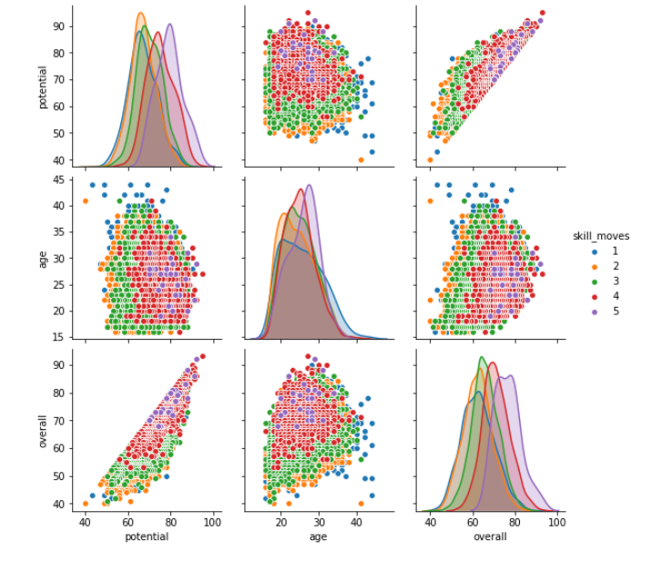
Overview of stats based on skills level

