Slide 1

Note: The data and information in this document is reflective of a hypothetical situation and client. This document is to be used for KPMG Virtual Internship purposes only.
Sprocket Central Pty Ltd
Data analytics approach
Sagar Limbu

Slide 2
Note: The data and information in this document is reflective of a hypothetical situation and client. This document is to be used for KPMG Virtual Internship purposes only.
Agenda
Introduction
Data Exploration
Model Development
Interpretation

Slide 3
Note: The data and information in this document is reflective of a hypothetical situation and client. This document is to be used for KPMG Virtual Internship purposes only.
Introduction
Analysis on the new customers datasets of Sprocket Central Pty Ltd.
To determine the long-term potential customers, our objective is to determine the customers from the given 1000 new customers.
We need to select the best features from the new customer dataset to determine the targeted customers. The analysis of the data will help boost strategies for the marketing team.
Total numbers of new customers: 1000
Total columns of data set:
'first_name', 'last_name', 'gender',
'past_3_years_bike_related_purchases', 'DOB', 'job_title',
'job_industry_category', 'wealth_segment', 'deceased_indicator',
'owns_car', 'tenure', 'address', 'postcode', 'state', 'country',
'property_valuation', 'Rank', 'Value'

Slide 4
Note: The data and information in this document is reflective of a hypothetical situation and client. This document is to be used for KPMG Virtual Internship purposes only.
Data Exploration
Feature Engineering
We can analyze the data distributions based on different features that allow to demonstrate underlying findings that can help build better model.
After cleaning the dataset, we can narrow down the most significant features that will yield the most crucial understanding of the customer behavior.
After analyzing and extracting that the most significant features from the data sets, following features best describes customer behavior and the likely hood of potential benefits in the future.
Purchases made within 3 years
DOB
Property-valuation
Job Category

Slide 5
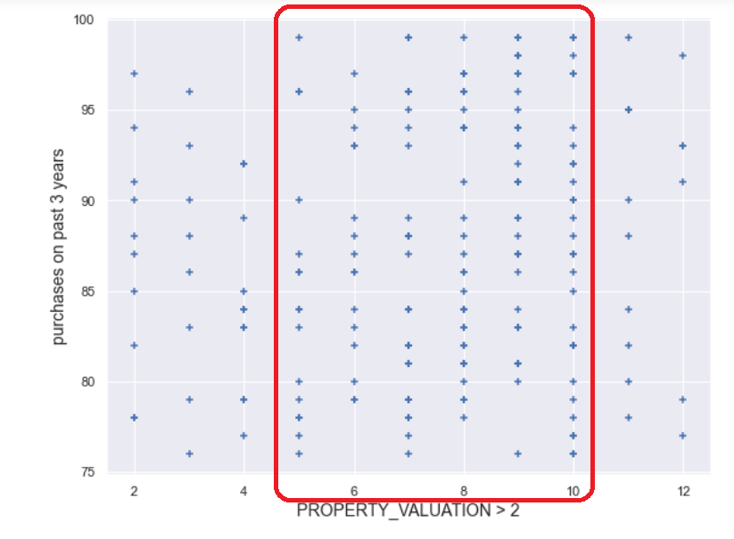
Note: The data and information in this document is reflective of a hypothetical situation and client. This document is to be used for KPMG Virtual Internship purposes only.
Model Development
Customers Property Valuation (Scale 1 to 12) and their recent purchases in 3 years of time
We will calculate and analyze the customer purchases within three-year period time based on customers property valuation:
Total customers: 213
Maximum purchases: 99
Minimum purchases: 76
We can see the high volume of purchases made by customers who have the property valuation between the range of 5 and 10

Slide 6
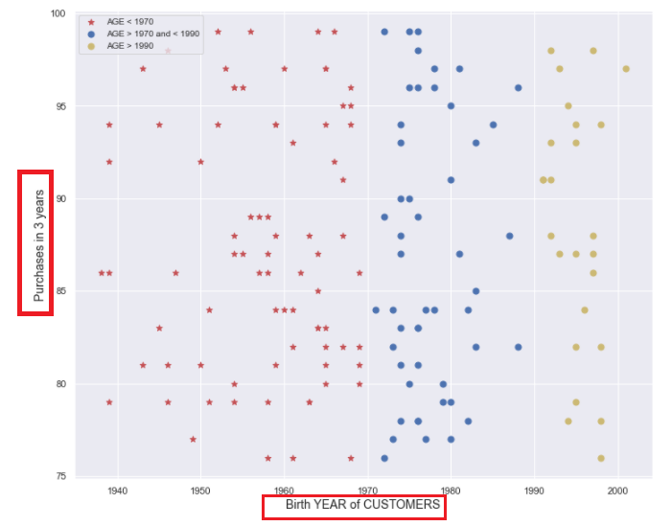
Note: The data and information in this document is reflective of a hypothetical situation and client. This document is to be used for KPMG Virtual Internship purposes only.
Model Development (contd.)
Customer demographics based on different Age Group
Customers based on different age group and the purchases made within 3 years of time.
Age <1970
Age between 1970 and 1990
Age > 1990
We can view the age group of the customers who are continuously purchasing products in three-year period of time.

Slide 7
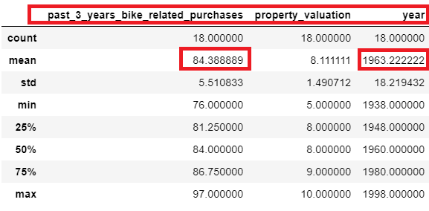
Note: The data and information in this document is reflective of a hypothetical situation and client. This document is to be used for KPMG Virtual Internship purposes only.
Interpretation
Potential customers without holding any job title
There are handful of 18 customers who have been purchasing the products throughout the years. But they don’t hold any job title.
Based on the age group of the customers and their property valuation, we can consider these customer to be part of future targeted customers.

Slide 8
Note: The data and information in this document is reflective of a hypothetical situation and client. This document is to be used for KPMG Virtual Internship purposes only.
Appendix

Slide 9
Note: The data and information in this document is reflective of a hypothetical situation and client. This document is to be used for KPMG Virtual Internship purposes only.
Appendix
This is an optional slide where you may place any supporting items.

