Slide 1

Note: The data and information in this document is reflective of a hypothetical situation and client. This document is to be used for KPMG Virtual Internship purposes only.
Sprocket Central Pty Ltd
Data analytics approach
Sagar Limbu

Slide 2
Note: The data and information in this document is reflective of a hypothetical situation and client. This document is to be used for KPMG Virtual Internship purposes only.
Agenda
Introduction
Data Exploration
Model Development
Interpretation

Slide 3
Note: The data and information in this document is reflective of a hypothetical situation and client. This document is to be used for KPMG Virtual Internship purposes only.
Introduction
Analysis on the new customers datasets of Sprocket Central Pty Ltd.
To determine the long-term potential customers, our objective is to determine the customers from the given 1000 new customers.
We need to select the best features from the new customer dataset to determine the targeted customers. The analysis of the data will help boost strategies for the marketing team.
Total numbers of new customers: 1000
Total columns of data set:
'first_name', 'last_name', 'gender',
'past_3_years_bike_related_purchases', 'DOB', 'job_title',
'job_industry_category', 'wealth_segment', 'deceased_indicator',
'owns_car', 'tenure', 'address', 'postcode', 'state', 'country',
'property_valuation', 'Rank', 'Value'

Slide 4
Note: The data and information in this document is reflective of a hypothetical situation and client. This document is to be used for KPMG Virtual Internship purposes only.
Data Exploration
Feature Engineering
We can analyze the data distributions based on different features that allow to demonstrate underlying findings that can help build better model.
After cleaning the dataset, we can narrow down the most significant features that will yield the most crucial understanding of the customer behavior.
After analyzing and understand the most significant features from the data sets. We can also see the following features best describes customer behavior, customer segmentation, and customer’s purchasing capability.
Purchases made within 3 years
DOB
Property-valuation
Job Category

Slide 5
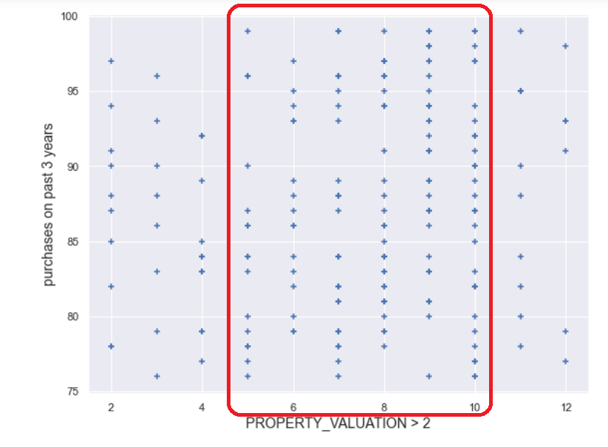
Note: The data and information in this document is reflective of a hypothetical situation and client. This document is to be used for KPMG Virtual Internship purposes only.
Model Development
Property Valuation (Scale 1 to 12) and the recent purchases in 3 years of time
After calculating and analyzing the customer purchases within three-year period time based on customers property valuation:
Total customers: 213
Maximum purchases: 99
Minimum purchases: 76
The high volume of purchases made by customers who has the property valuation between the range of 5 and 10

Slide 6
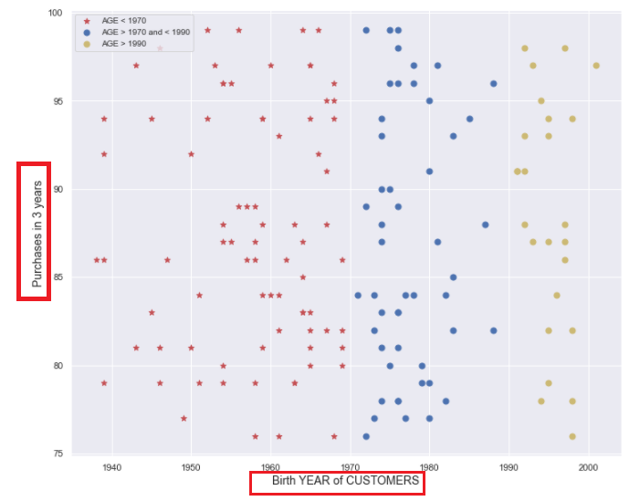
Note: The data and information in this document is reflective of a hypothetical situation and client. This document is to be used for KPMG Virtual Internship purposes only.
Customer Segmentation
Customer demographics based on different Age Group
Customers based on different age groups and the purchases made within 3 years of time.
Age <1970
Age between 1970 and 1990
Age > 1990
Findings suggests that age group of each customers between the age group of 1950 and 2000 have purchased more than other age group.

Slide 7
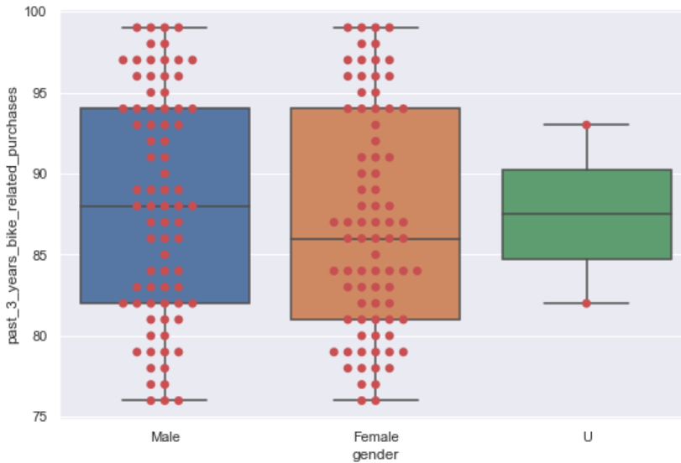
Note: The data and information in this document is reflective of a hypothetical situation and client. This document is to be used for KPMG Virtual Internship purposes only.
Customer Segmentation
Customer purchases in three years based on Gender
Based on the customer segmentation by the dataset, we can analyze that the purchases made by each gender demographics. This includes:
Male
Female
U- Unidentified

Slide 8
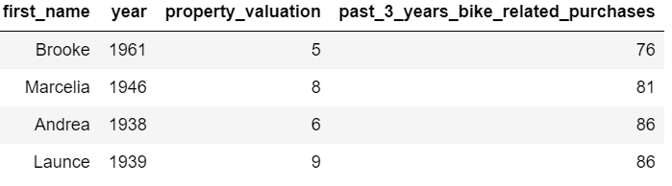
Note: The data and information in this document is reflective of a hypothetical situation and client. This document is to be used for KPMG Virtual Internship purposes only.
Interpretation
Potential and Long-term customers without job title and job industry category
There are handful of customers who have been purchasing the products throughout the years. But these few customers don’t hold any job title or they have any job category.
However, based on the spending criteria and property valuation, these customers have been spending and purchasing the products in large volumes.

Slide 9
Note: The data and information in this document is reflective of a hypothetical situation and client. This document is to be used for KPMG Virtual Internship purposes only.
Appendix

