Slide 1
Student Demographics Analysis
Sagar Limbu

Slide 2
Objectives/Goals Problem 3:
Test1 is the test students took the first day they began using the software to set their benchmark level
Comp Score is the overall grade level equivalent of the score the student earned on the progress test
Hours used is how many hours the student has used the software
Note: The dates, scores, and hours used are real data, but all the names of students, schools, and classes are fake. None of this is FERPA-protected data.

Slide 3
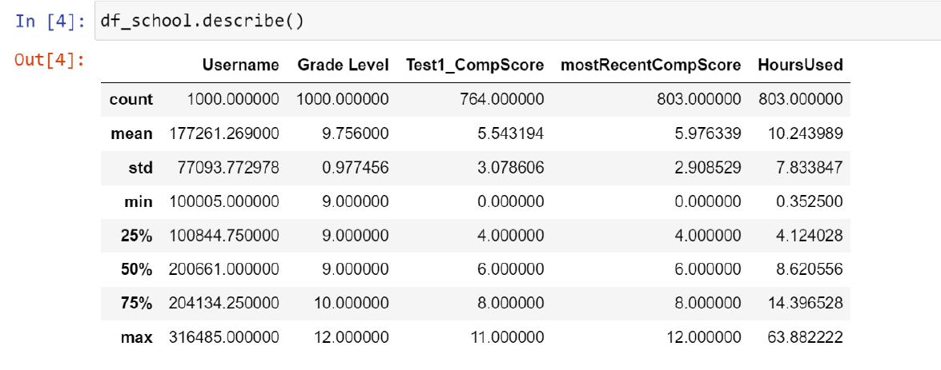
Distributions of Students Data

Slide 4
Possible Analysis and Findings:
What are the FEATURES on the data set
What FEATURES can give insight of the student data
Types of data
Exploratory Analysis on Students who has both Start of Software Date and Comp Scores
Students with NO start of Software Date but have used Software
Software Starting Date by MONTH
Performance between Different Grade Levels
Performance based on Different Schools

Slide 5
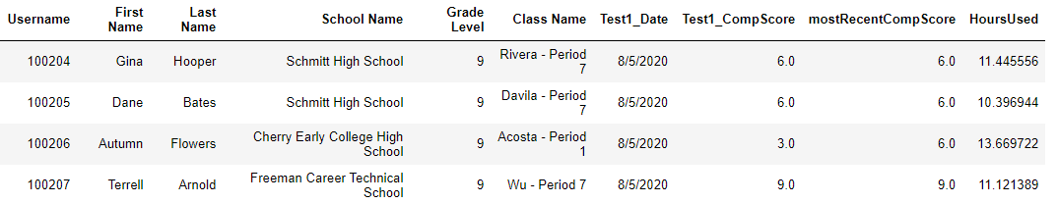
Columns/Features:

Slide 6
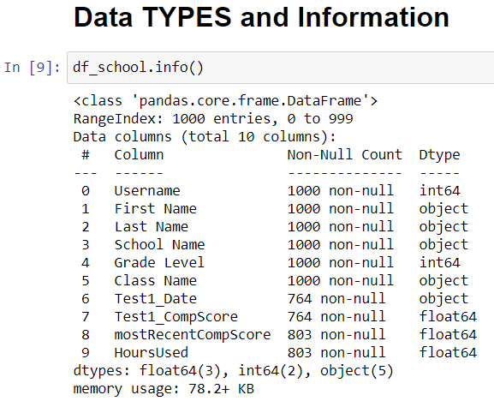
Exploring Data:

Slide 7
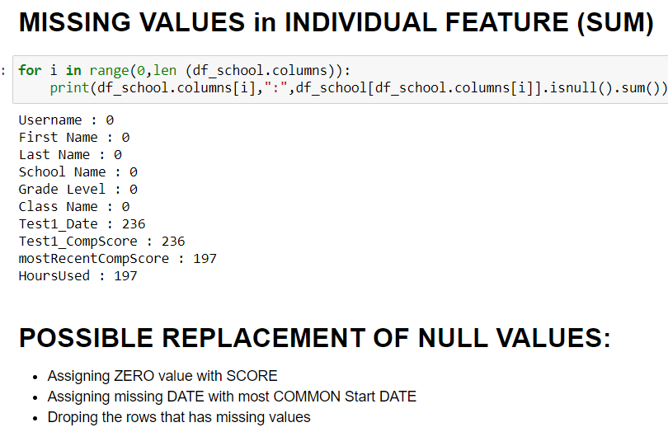

Slide 8
Approach:
Upcoming slides show data analysis from students who has the Test1_Date Recorded .i.e. Test1_Date= NOT NULL
The three ending slides will show analysis on the missing data for students i.e. Test1_Date and Test1_CompScore is not recorded or missing

Slide 9
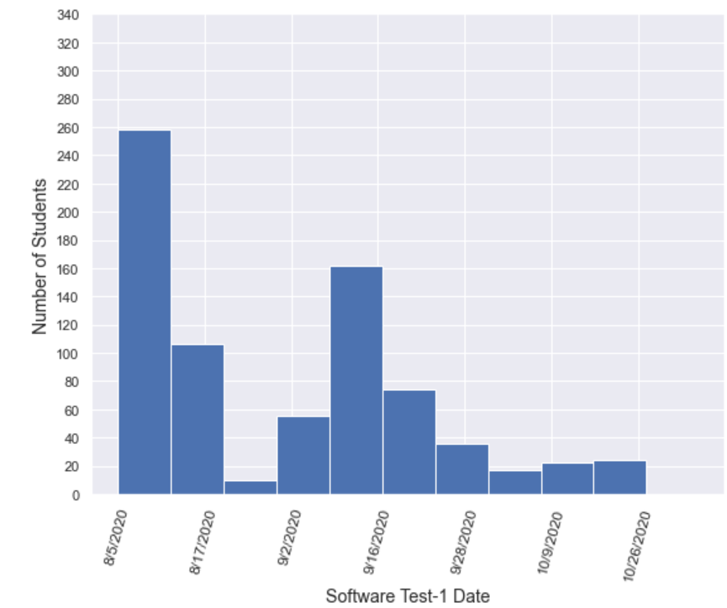
Total Number of Students starting Software Test-1 Date (month-day-year)
Total Students by Grade Level:
Grade 9= 539
Grade 10= 256
Grade 11=115
Grade 12= 90

Slide 10
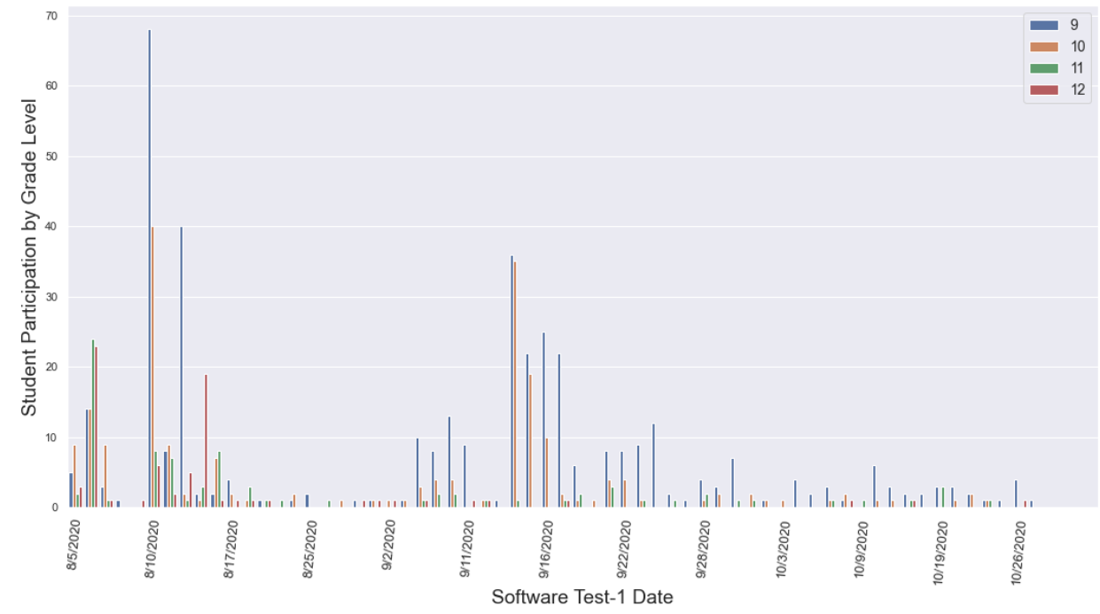
GRADE LEVEL:

Slide 11
Result/Findings:
Previous Graph shows that large numbers of students from GRADE 9 started Early using the software than rest students from different grade Levels
In the next Box Plot Graph, we can see the Scores of students on First Test-1 CompScore and Recent Comp Score

Slide 12
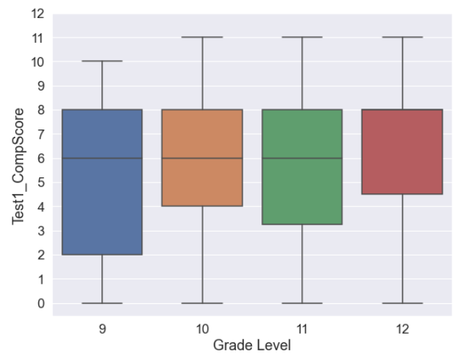
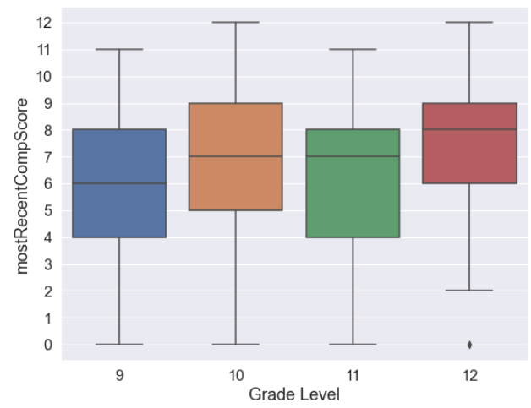
Box Plot: First Test Score and Most Recent Test Score by different Grade Level
First Test Score
Most Recent Test Score

Slide 13
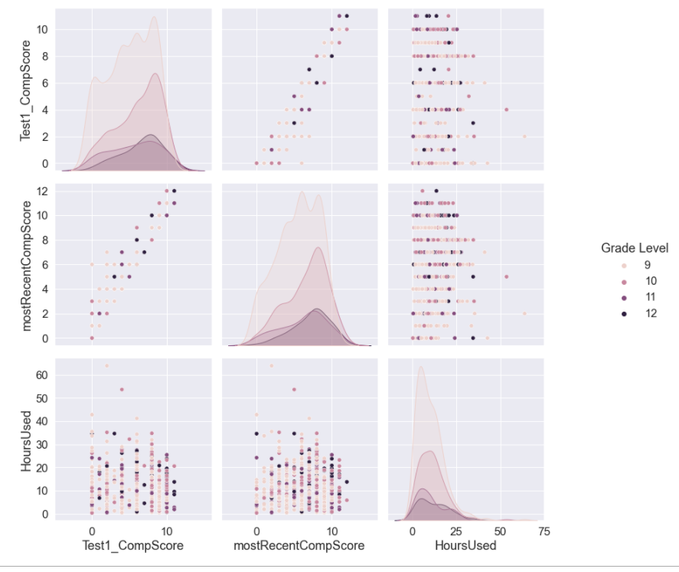
Students Performance Metrics based on Grade Levels:
By Test1_CompScore
Most Recent Comp Score
Software Usage (Hrs)
Findings:
EG: we can see the Software usage by hours and the Scores level at the Test-1 and Most Recent Score

Slide 14
TEST Score difference: First Test1_CompScore and Most Recent CompScore

Slide 15
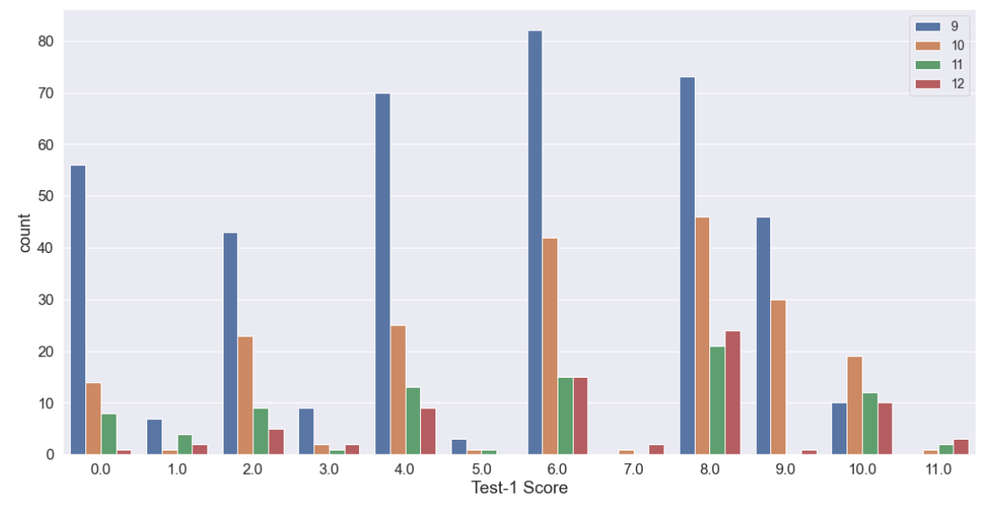
First Test-1 CompScore
Grade Levels:

Slide 16
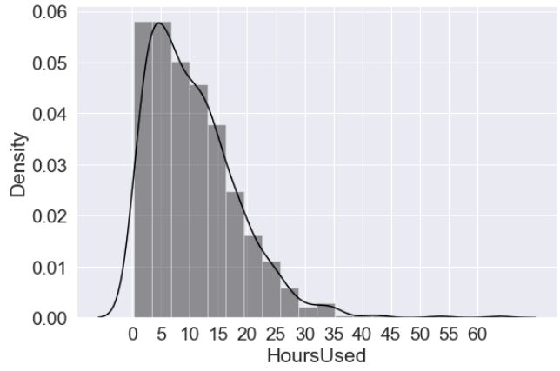
Frequency Distribution of Software Usage: Students using the Software Usage by hours Findings: - Not Normally distributed

Slide 17
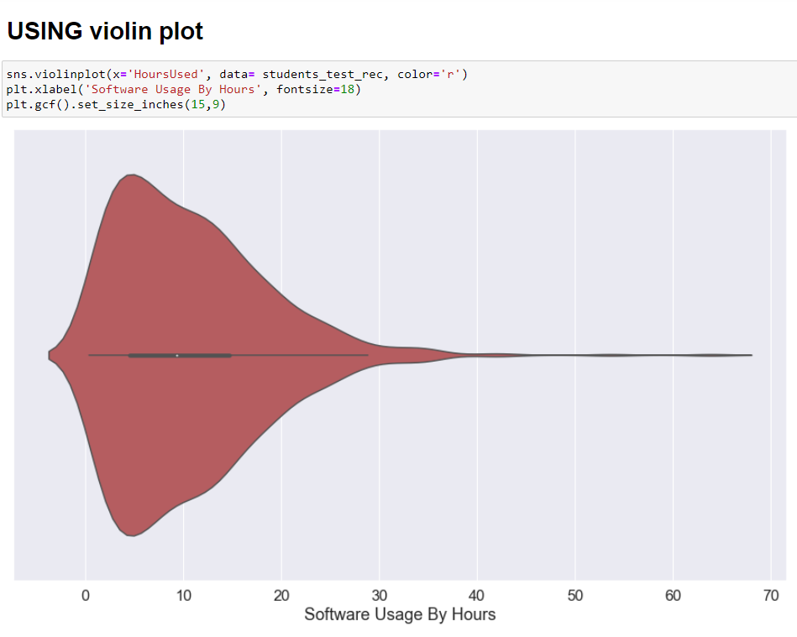
Frequency Distribution of Software Usage: Total Students using the Software Usage by hours

Slide 18
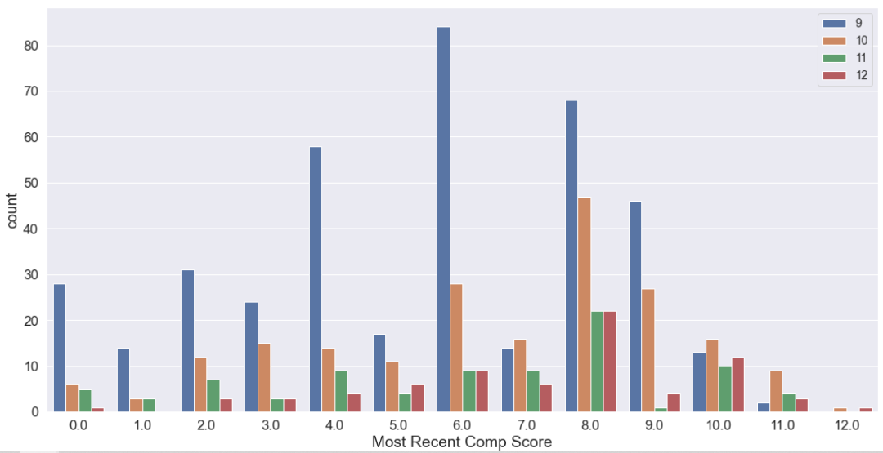
Most Recent CompScore
Grade Levels:

Slide 19
EXTRA TESTS: To Analyze the Scores based on different School Names
STEPS:
- Using Label Encoder() function

Slide 20
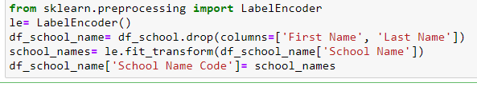
STEPS:
Using the ‘sklearn’ preprocessing Library to ENCODE each School Names. Since the code requires numerical values and not strings. Here, I have assigned a UNIQUE CODE to each school name.
By passing the school names to Label Encoder function which transforms the Strings into Unique Code
School Name | School Code
Brooks High School | 0
Cherry Early College High School | 1
Douglas High School | 2
Foley Arts Focus High School | 3
Freeman Career Technical School | 4
Jacobs High School | 5
Lawson High School | 6
Schmitt High School | 7

Slide 21
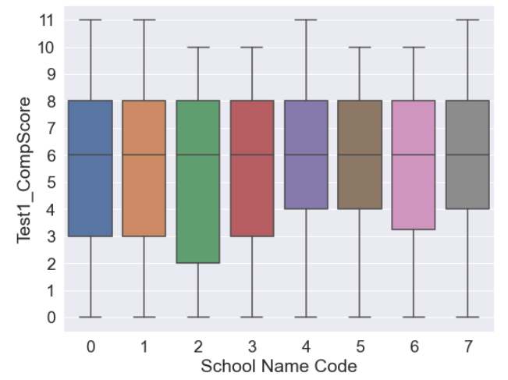
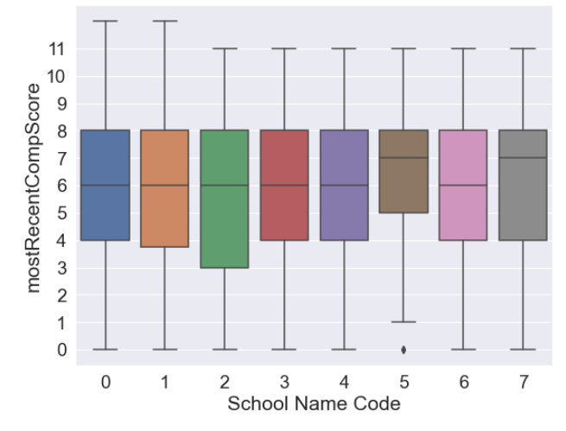
FINDINGS: Most Recent SCORE Level show improvements of Students from each School.
School Name | School Code
Brooks High School | 0
Cherry Early College High School | 1
Douglas High School | 2
Foley Arts Focus High School | 3
Freeman Career Technical School | 4
Jacobs High School | 5
Lawson High School | 6
Schmitt High School | 7
TEST-1_CompScore
Most Recent CompScore

Slide 22
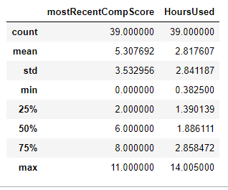
THINGS to CONSIDER
Students with NO ‘Starting Software Date (Test Date)’ also have’ NO ‘ComP SCORE
Total Students= 236
FINDINGS:
However, a handful number of students have SCORES on ‘MostRecentScore’ and also have used SOFTWARE for several of Hours
Total Students= 39

Slide 23
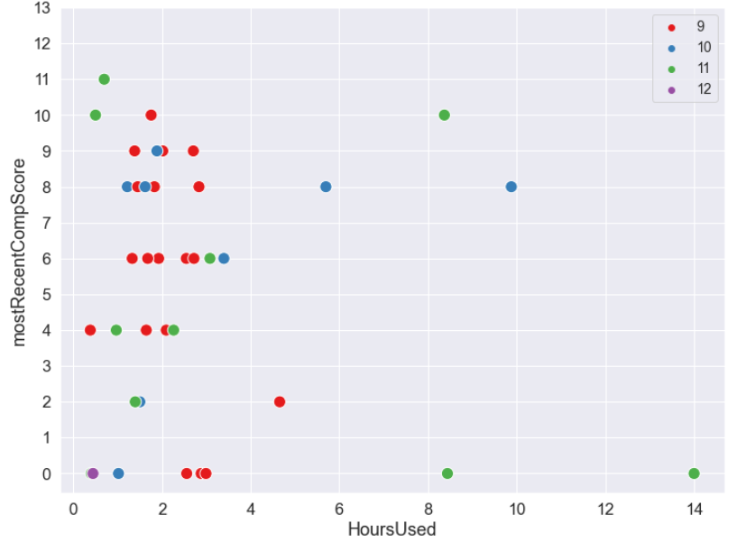
Grade Level:
Students with NO ‘Starting Software Date (Test Date)’ also have’ NO ‘ComP Score
But, 39 Students have mostRecentCompScore and have used Software for couple of hours
The next Bar Graph shows the Most Recent Scores of same students by Grade Level

Slide 24
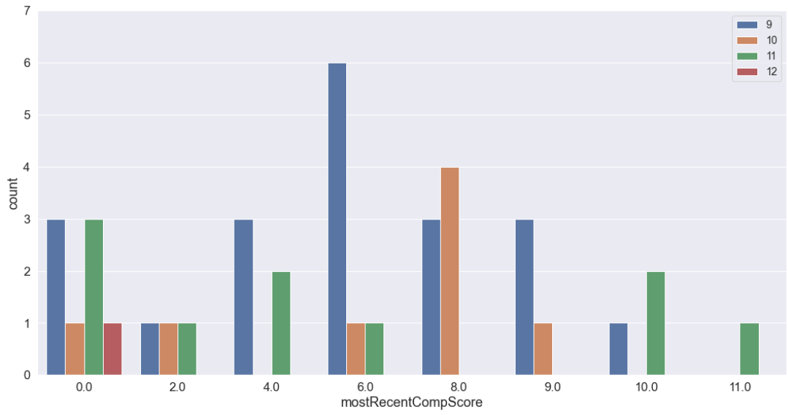
Grade Level:

