Slide 1

Web Scraping and Analysis on Trending Stocks
Sagar Limbu

Slide 2
Why Web Scraping?
Using automation tools like ‘Selenium’ we can collect data from websites
I have used Selenium to scrap information from the stock website which provides forecasting on price target, weight, etc. and other factors that drive the stock up/ down
Because not all websites offer API (Application Program Interface)
Some websites require Subscription Fees to check the forecasting information from Analyst’s research

Slide 3
Objectives:
Extracting the info on Trending stocks from the popular website to perform analysis
Using Selenium Web Driver for web scraping
Data Cleaning, Feature Engineering and Analysis
NOTE: The Sole purpose of this project is to showcase the skills on Web Scraping with no intention of any illegal act

Slide 4
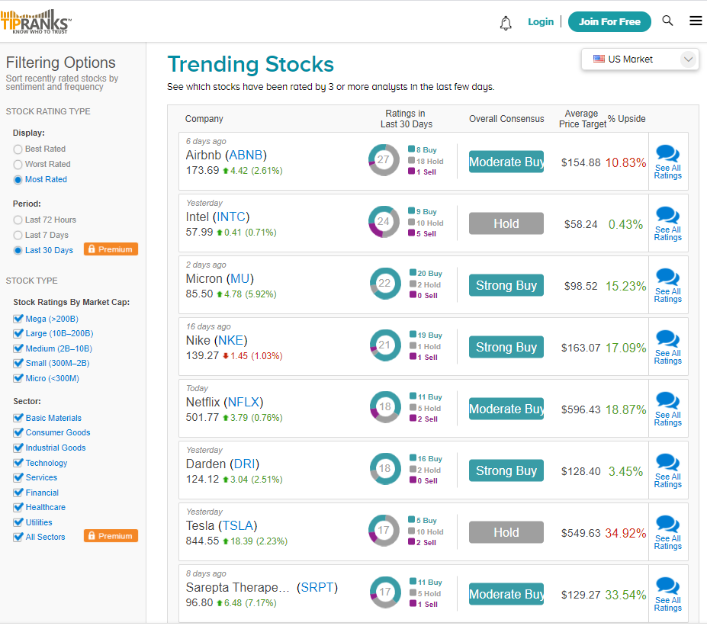
Analysis:
I’m sure lot of people have got involved on Stock Trading more than before in these past few months. Especially when the market was down by more than S&P500(-33%), Nasdaq (-26%) in mid March.
Investing money on the right stock can be daunting. Thus, many investors look for websites where analysts make predictions and give insights on the stocks.
Here, you can see one of the top websites (Tipranks) with the information on Analyst’s research on the Trending Stocks (ETFs)

Slide 5
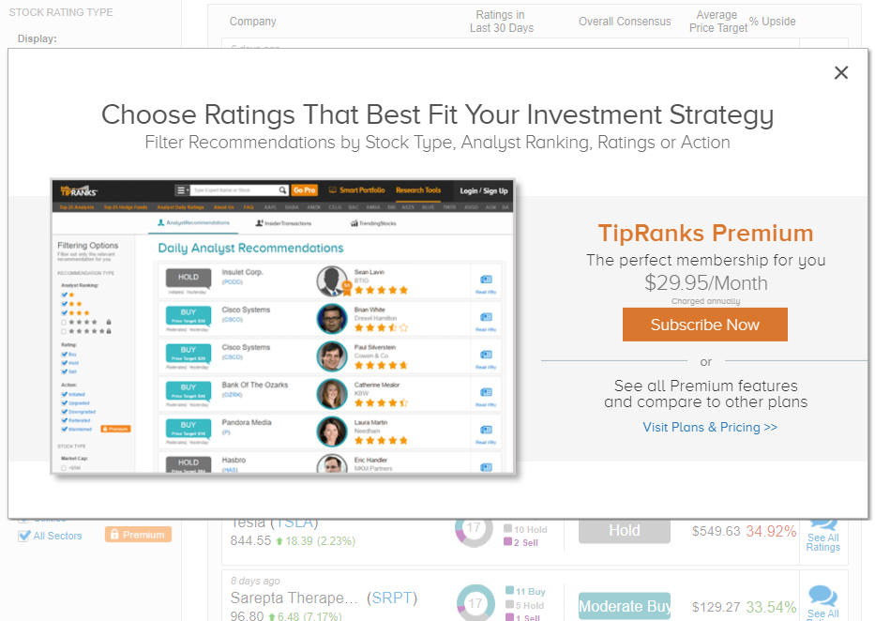
PROBLEM: It requires Subscription Fee to FILTER the Stocks based on Rating, Stock-Cap Size, Sectors, etc.

Slide 6
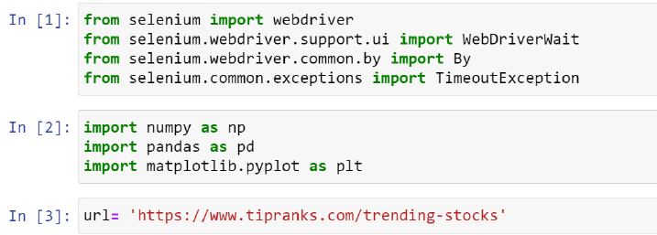
Approach:
Scraping data from the website to retrieve information on stocks to manipulate, study, and filter the data (which requires subscription from website)
Libraries used for Web Scraping & Analysis:

Slide 7
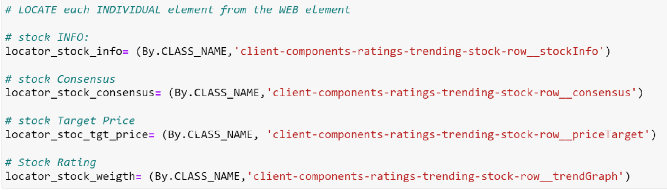
Locating Web Elements:
It is an important step to browse the webpage first and locate the web elements before performing Web Scraping
Following example shows data extraction from the web element ‘Class Name’ using ‘By’ method. Using the same method for different Class Names

Slide 8
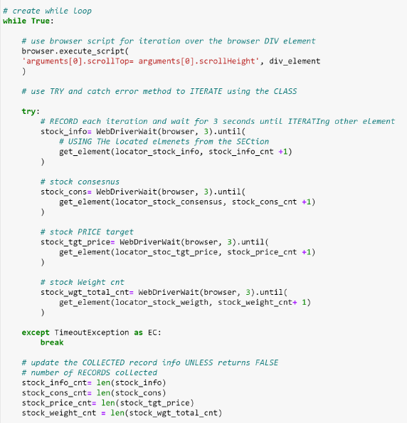
Iteration over the Web Element using ‘browser_execute Script’ to extract the Text field (Unstructured Raw Data)
Full Code on GitHub:
https://github.com/sagarlimbu0/My_project/blob/main/WEB-SCRAPING_tutorial_exercise/Trending_stocks_webscraping/Trending_stocks_webscraping.ipynb

Slide 9
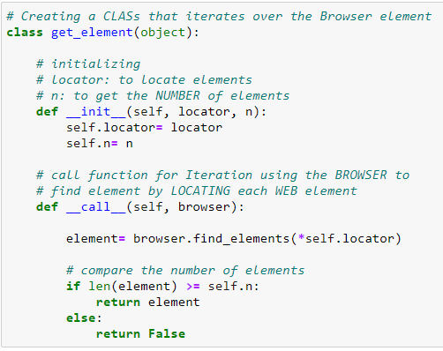
Creating a Class Objects
Class ‘get_element’ is used in the previous page for iterating the web elements
It uses the call function after object is instantiated over the browser element

Slide 10
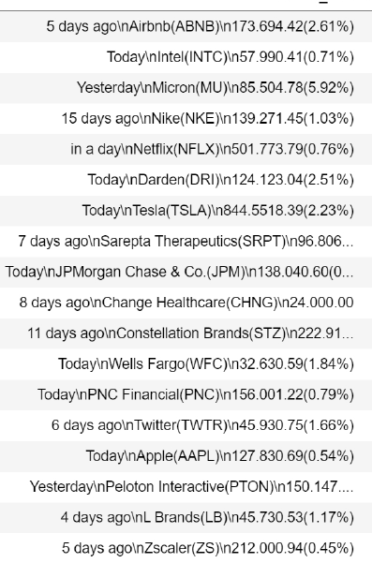
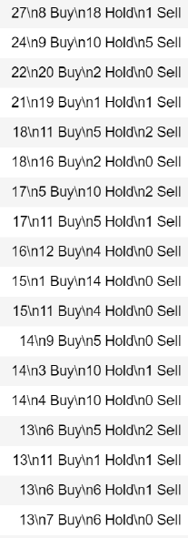
Feature Engineering
After extracting the data from webpage, we can see Unstructured Raw Data.
Thus, it requires Feature Engineering and Data Preprocessing technique to make a clean data

Slide 11
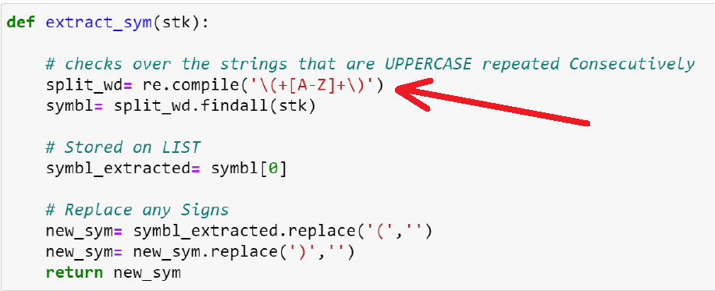
Feature Engineering (contd.)
Compiling the Strings and Data Extraction using Python Regular Expression (re.compile) module

Slide 12
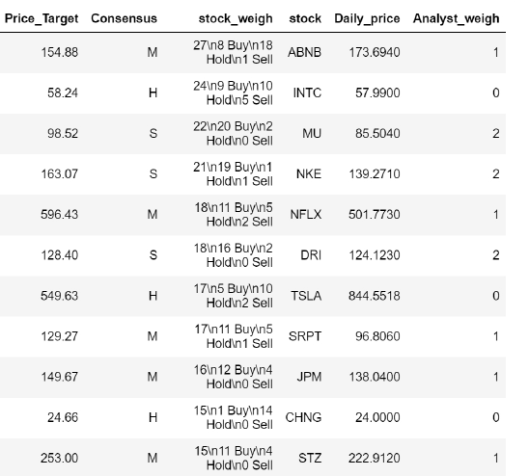
Cleaned Dataset after compiling

Slide 13
