Slide 1
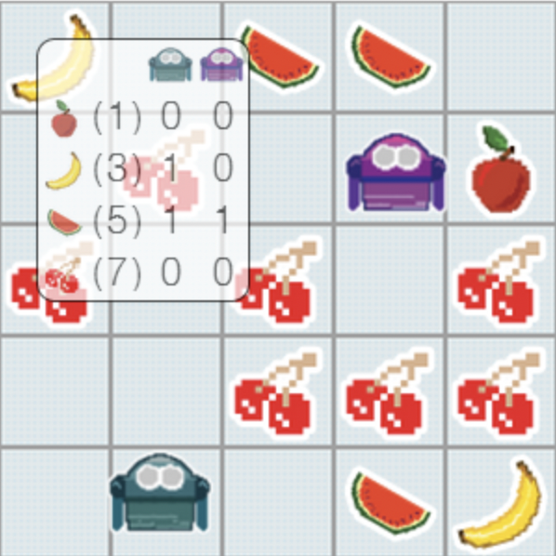
FruitBots
Shubham Mishra & Aaron Bockmiller

Slide 2
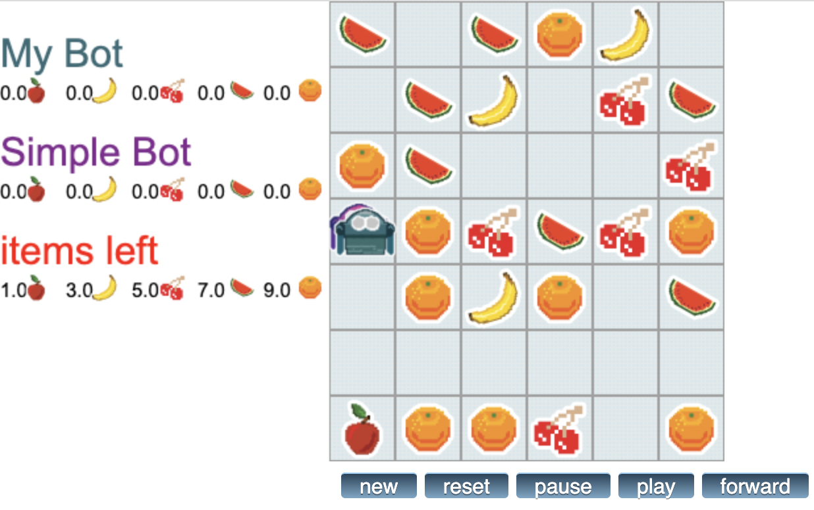
About the game!!!
Over 1300 user-created bots
Simple rules
Time & Memory constraints
The game is based upon two different set of values that is fruit rarity and fruit proximity.
Once the board is all set for the bots to hunt for fruits, the decision is taken considering the best value of the combined of the above two.
Aim to take all the fruits which are available in less number.
Once the play button is hit, the bot starts moving in direction best suitable with the combination of fruits.

Slide 3
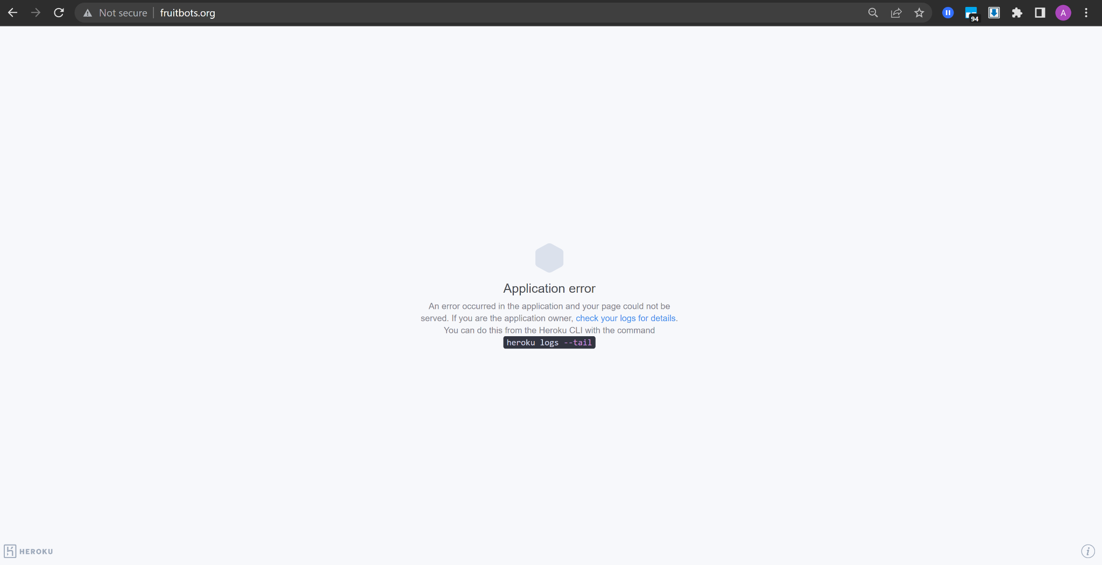
Uh-Oh!!

Slide 4
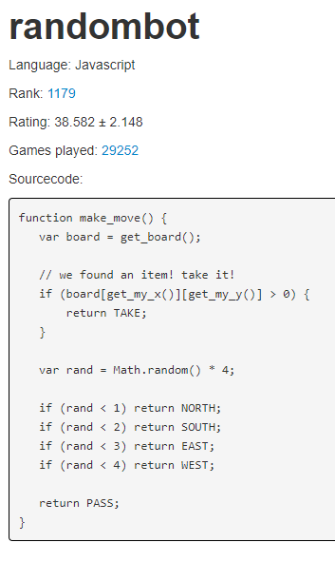
Algorithm choices
Random
Logic/Strategy (LogicBot and 'themonkeytoucher_bot1')
Simple search
Adversarial Search (ExpectimaxBot and MinimaxBot)
Reinforcement Learning / Neural Networks

Slide 5
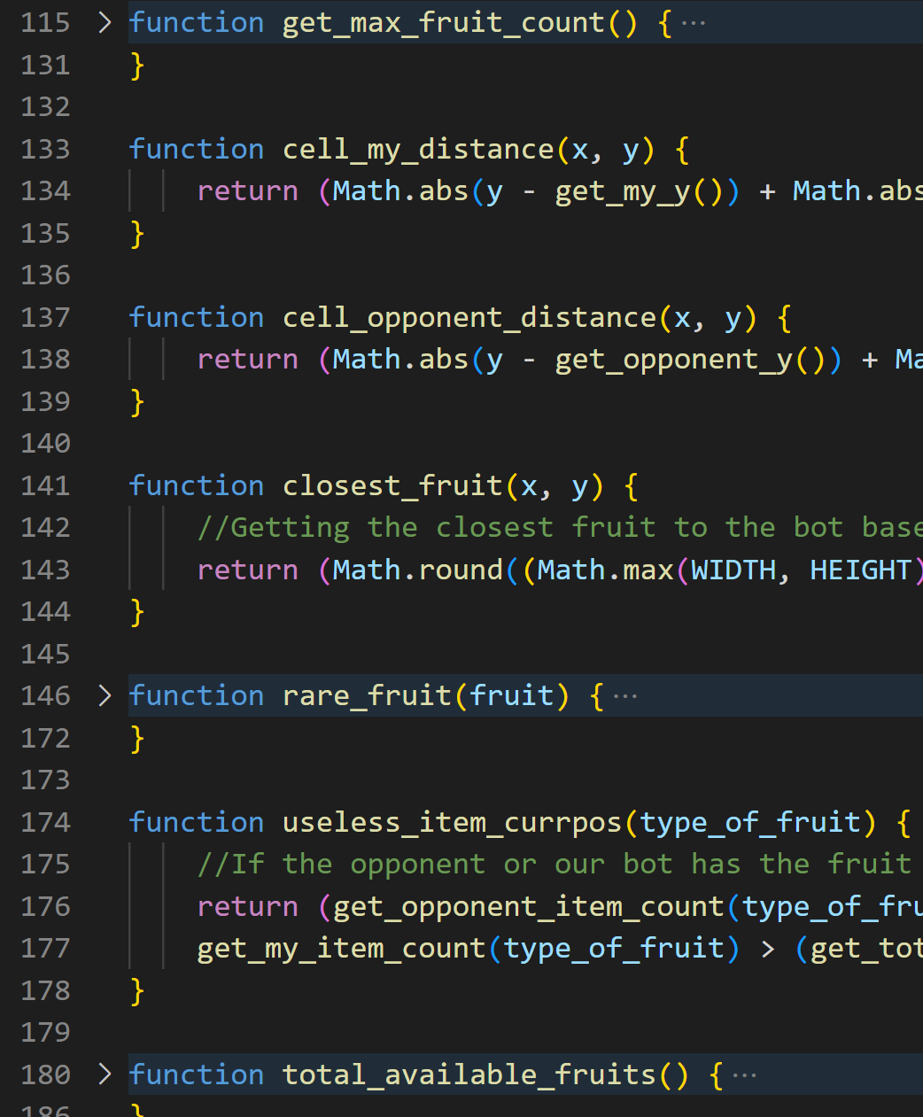
LogicBot
The algorithm is fairly very simple and uses the game rules and scoring to optimize bot performance
The algorithm that I am dealing with is based on points evaluation for each fruit collection.
The more rare the fruit, the more the points.
Its pathing tries to pick the most efficient route to collect the most rare fruit in the smallest distance

Slide 6
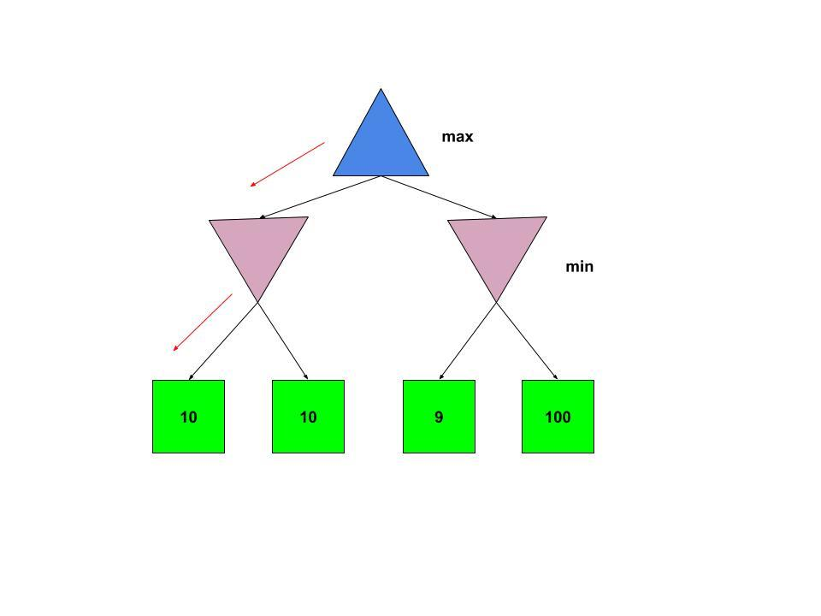
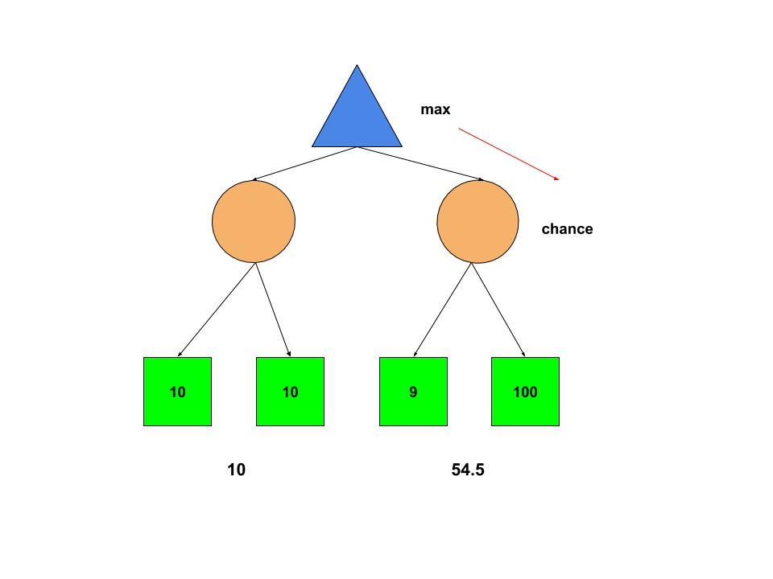
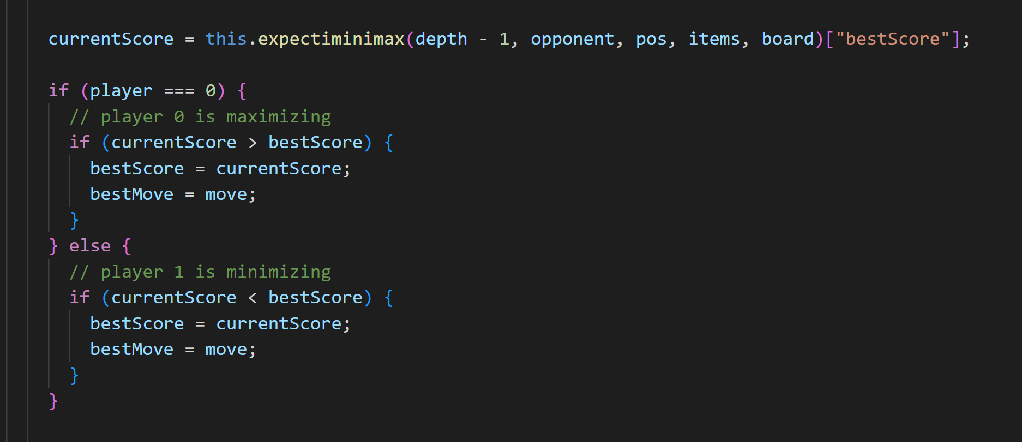
ExpectimaxBot
Adversarial Search algorithm
Tries to maximize its own score and minimize opponents
Like Minimax, but assumes sub-optimal play from opponent (uses expected score)
Depth-limited (compare to time-limited Minimax)
Notes:
- Competitive, deterministic, zero-sum game

Slide 7
Collected Data
 | Many items |  |  | Medium items |  |  | Few items
Bot / Board | Small board | Medium board | Large board | Small board | Medium board | Large board | Small board | Medium board | Large board
Random | L | L | L | L | L | L | L | L | L
LogicBot | W | L | W | W | W | W | T | W | T
themonkeytoucher_bot1 | W | L | T | W | L | T | L | L | L
ExpectiMax (depth=8) | W | L | L | T | L | L | T | L | L
ExpectiMax (depth=10) | W | W | L | T | L | L | T | T | L
Minimax | W | W | W | W | T | T | W | W | W
* Bolded items represent the most dominant wins or losses, respectively

Slide 8
Takeaway conclusions!!!
Logical or strategy-based algorithms are very powerful when under constraint!
ExpectiMax can sometimes work better if assuming sub-optimal play
Adversarial algorithms scale poorly with depth (aka size of board) vs simpler solutions

Slide 9
Thank for Listening!!!
Hope to see you all in future as well!!!

