Slide 1
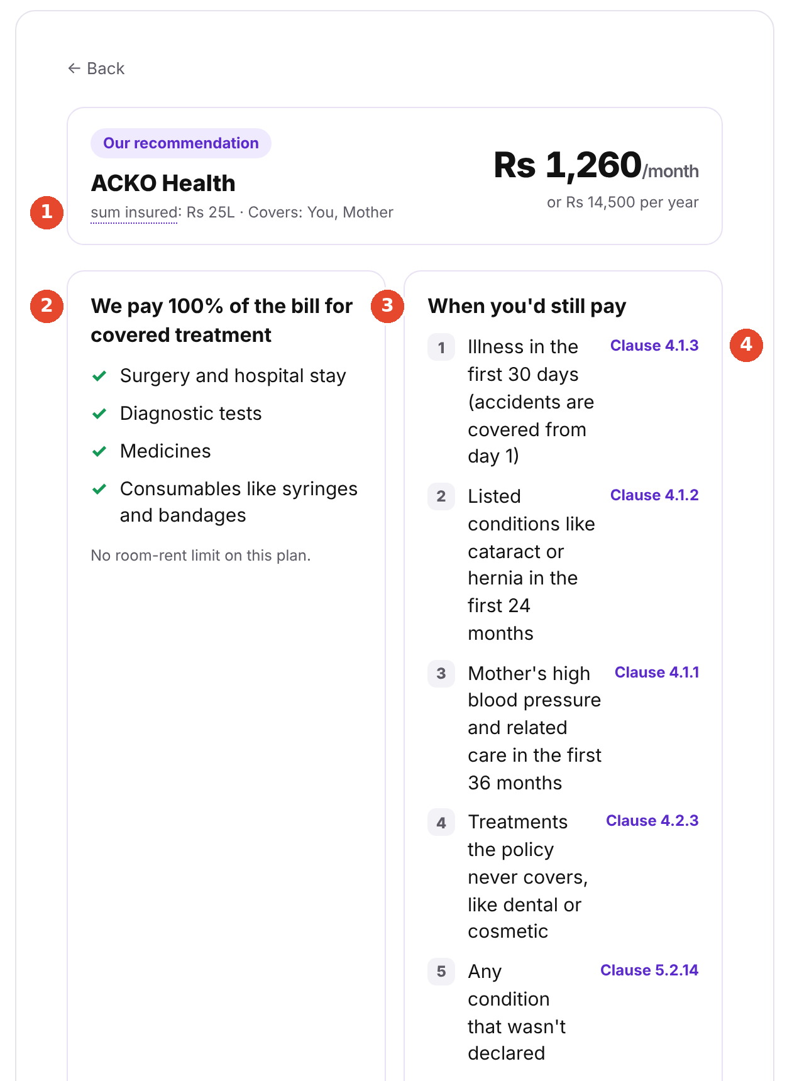
BOARD REVIEW · RETAIL HEALTH
From a price
to a decision
Lifting the 14-day confirmed purchase rate of first-time health buyers from 12% to 26% in six months, with nothing hidden to get there
Sagar R Naivaruni
Product Manager, Retail Health · November 2026
Redesigned plan page: the 100% promise beside when you'd still pay
Notes:
I'm Sagar, PM for Retail Health. Only 12% of first-time buyers who get a quote buy within 14 days. The goal is 26% in six months, without hiding anything. I'll give you the recommendation first, then the evidence, the solution, how we'll prove it, and the four decisions I need from you.

Slide 2
EXECUTIVE SUMMARY
Recommendation: turn the quote into a decision buyers understand
The goal Lift first-time buyers' 14-day confirmed purchase rate from 12% to 26% in six months, with no buried fine print and every IRDAI disclosure intact.
WHAT WE FOUND
WHAT WE'LL BUILD
WHAT IT'S WORTH
WHAT WE NEED
53%
2
+1,400
Week 10
misread a basic waiting-period case
solutions, no new mandatory step
policies per 10,000 quote-holders
A/B test on parent buyers
Buyers accept the price but can't predict when the plan pays. 15 of 21 non-buyers doubted cover; only 2 of 68 questioned the price.
A · Know what you'll pay, and when: limits beside the '100%' promise, outcomes per member, loadings explained up front.
B · Decide together: a family share pack in 4 languages.
+₹2.1 cr first-year premium and +₹5.6 cr over three years at 89% renewal. Two assumptions to replace with Acko data.
Approve the test. Underwriting exposes counteroffer data by week 8. Compliance signs off 4 languages by week 10.
55%
retail health growth, FY26: Acko's fastest segment
0%
GST on individual health cover since Sep 2025
61%
of ombudsman complaints are health (11% of premium)
H2 2026
confidential IPO filing: confusion is a listed-company risk
WHY NOW
Sources: Acko capstone brief (FY26 figures); survey n=68; 7 interviews; teardown of 4 journeys (10 Nov 2026); Dept of Financial Services; Business Standard, Jun 2026 (FY25 ombudsman data)
Notes:
The whole story on one slide. Buyers accept our price; what they can't do is predict when the plan pays. So we show outcomes and limits where the decision happens, and let the family decide in their language. At target, that's 1,400 more policies per 10,000 quote-holders. I'm asking for a controlled test from week 10.

Slide 3
STEP 1 · RESEARCH PLAN
We surveyed 68 people, spoke to 17 and walked four buying journeys
WHO WE HEARD FROM (BUYER SEGMENTS)
Segment | Survey | Interviews | Why it matters
Got a quote, didn't buy | 12 | 1 | The exact cohort behind the 12%
Looked, then postponed | 14 | 4 | Where intent turns into stalling
Bought a plan | 15 | 1 | What tipped them; what they still misread
Haven't looked yet | 16 | 1 | Inertia: 'office cover is enough'
Already had a personal plan | 11 | 0 | Comparison group
TIMELINE: 5 TO 12 NOV 2026
5–8 Nov
Survey live: 68 responses
8 Nov
~10 informal conversations, field notes
by 9 Nov
7 recorded interviews transcribed
10 Nov
Teardown of 4 sites; policy wording reviewed
15 respondents got an Acko quote · 37 of 68 buy for family · plus ~10 informal conversations
12 Nov
Follow-up calls counted (48 hours)
HOW (METHODS)
Method | Size | What it answers
Survey, 13 questions | 68 | How common each doubt and blocker is, by segment
Recorded interviews (JTBD, Mom Test) | 7 | Why buyers stall, in their own words
Informal conversations | ~10 | Whether themes hold outside an interview
Product teardown | 4 journeys | What a buyer actually sees, step by step
Acko Health II policy wording | By clause | Ground truth for every claim and design line
LIMITS, AND HOW WE HANDLED THEM
Self-selected sample: 38% bought vs Acko's 12%. Used to compare groups, not to estimate Acko's rates
4 interviewees heard Acko's offer before reacting: those reactions are discounted
Teardown used one profile (27, Bengaluru)
Sources: survey Q1, Q2, Q5 (n=68); interview log and field notes (Evidence 1); survey form (Evidence 3); Guest, Bunce & Johnson (2006) on saturation at 6–12 interviews
Notes:
Segments were chosen to mirror the brief's cohort: people who got a quote and didn't buy, people who postponed, and people who bought, so we can see what tipped them. Survey for breadth, interviews for the why, teardown for what buyers actually see, and the policy wording as ground truth.

Slide 4
STEP 1 · QUESTIONS & HYPOTHESES
Research backed our core hypothesis: buyers can't predict when the plan pays
Core hypothesis First-time buyers stall after the quote because they can't predict what the plan will pay in their situation, not because of price.
# | Research question | Hypothesis | What the research showed | Verdict
1 | What makes a first-time buyer start looking? | A health or family trigger, not a plan | Mixed: health scares, COVID, peer pressure. Only 3 of 68 acted on a parent's age; 7 felt office cover was enough | Partly
2 | After the price, what do buyers still need to know? | Whether the plan will pay, not more options | Top doubts: will it pay (20), what's not covered (15), which plan (12). Price fairness: 2 of 68 | Supported
3 | Do buyers read the terms that decide a claim? | Most misread waiting periods and assume full cover | 53% wrong or unsure on the cataract case; 16 said the plan pays in full; 5 of 7 interviewees missed it | Supported
4 | How do family and language shape the decision? | The buyer can't explain the plan at home, so it stalls | 37 of 68 buy for family; family discussion is the top non-buyer blocker (8 of 21); 21 of 68 prefer a non-English language | Supported
5 | Where do buyers go for help? | They leave the insurer to get it explained | Family or friends (20), agent or bank (12), comparison sites (10); insurer apps 9. Interviewees use ChatGPT and Gemini | Supported
6 | How do sales pressure and trust affect it? | Lead capture brings spam; low prices trigger suspicion | 10 of 68 named sales calls; all 4 sites ask for a phone number first. 'Too good to be true' arose only after a pitch | Partly
7 | Is price the main barrier? | No: it's secondary to understanding | Real for about a third of non-buyers (7 of 21 stalled on premium), but cover doubts outnumber it | Partly refuted
Sources: survey Q7, Q8, Q9, Q10, Q12 (n=68; non-buyers who got a quote n=21); 7 recorded interviews; teardown of 4 journeys. 'Partly refuted' for RQ7: price matters more than we assumed, but stays secondary
Notes:
Seven research questions, each with a hypothesis written before fieldwork, tested against the evidence. Four held fully, two partly. The one that matters most for strategy: price is real but secondary. That's why the solution is about understanding, not discounts.

Slide 5
STEP 1 · TEARDOWN & COMPETITION
Acko already leads on clarity; no one shows when you'd still pay
We compared Acko's direct, app-first model with the two routes a first-time buyer actually weighs: an aggregator and a traditional insurer. Walked quote-to-payment on 10 Nov 2026.
What a buyer sees before paying | Acko · direct, digital | Policybazaar · aggregator | HDFC ERGO / ICICI Lombard · traditional
How it sells | Direct in app, no agent | Many insurers, advisor calls | Own site plus agents and banks
Room rent and co-pay visible | Yes | No | No
Waiting periods in plain language | Yes | Yes | No
Taps to reach exclusions | 15 | 9 | Not before payment
Languages | 4 | 1 | 1
Example of when you'd still pay | No: pop-up says 'you don't have to pay anything' | No | No
Share the plan with family | No | No | No
Phone number before price | Yes, plus OTP | Yes | Yes, on screen 1
Follow-up calls within 48 hours | One, next day | Yes, several | Yes, several
WHAT THIS TELLS US
Acko's edge is real: the only site showing room rent and co-pay, plain-language terms and 4 languages.
The gap is shared: nobody shows an outcome or lets the family in. That's open ground for Acko.
Our own pop-up over-promises: '100%' with no limits beside it is what buyers misread.
WHERE BUYERS ACTUALLY DECIDE
Family or friends 20 · agent or bank 12 · comparison site 10 · insurer app 9 · YouTube 7 (of 68)
Source: teardown of 4 purchase journeys, 10 Nov 2026, one profile (27, Bengaluru; ₹25L on Acko, ₹10L elsewhere, so prices aren't compared); survey Q10 (n=68). HDFC ERGO and ICICI Lombard gave identical results
Notes:
Acko isn't a traditional insurer, so the right comparison is our direct model against the two other routes a buyer actually takes: an aggregator and a traditional insurer's own site. Acko wins on transparency at the top of the page and on languages. But every player, us included, shows rules, not outcomes, and nobody lets the family in.

Slide 6
STEP 1 · PERSONAS
Three buyers stall in different places, but misread the same terms
A
The family buyer
B
The overwhelmed self-buyer
C
Confident but wrong
Covering self plus parents or in-laws
Young professional, often with office cover
Bought, or felt 'clear' after the price
31 of 68
31 of 68
16 felt clear
WHERE THEY STALL
WHERE THEY STALL
WHERE THEY STALL
At home: needs parents or spouse to agree
At comparison: too many plans, then spam calls
They don't: they convert
WHAT THEY MISREAD
WHAT THEY MISREAD
WHAT THEY MISREAD
17 of 31 wrong or unsure on the cataract case
16 of 31 wrong or unsure on the cataract case
9 of 16 'clear' respondents and 5 of 15 buyers
WHAT THEY NEED
WHAT THEY NEED
WHAT THEY NEED
Something to show their parents, in the family's language
A short list of what matters, and an honest view of office cover
To see when they'd still pay, before paying
RISK TO ACKO
RISK TO ACKO
RISK TO ACKO
Lost sale
Lost sale, or a sale to an agent
Free-look cancellation or claim dispute later
“How do you know how much of the bill will I be able to pay through the insurance?”
Interviewee buying for her parents
“There was so much online, too much to compare. I felt it was honestly overstimulating.”
Interviewee who switched to an agent
A respondent who bought on Acko said the plan pays in full during a waiting period.
Survey Q8 observation
Sources: survey Q5, Q7, Q8 (n=68); 7 recorded interviews (Evidence 1). Persona sizes overlap: a respondent can cover self and parents
Notes:
Three personas from the survey and interviews. The family buyer and the self-buyer stall and we lose the sale. The third, confident-but-wrong, is the one that keeps me up: they convert today, then cancel or dispute at claim time. Any design that just removes friction grows that group.

Slide 7
STEP 1 · ANTICIPATED BARRIERS
The barrier is understanding, not price
After you saw the price, what were you most unsure about?
TOP 5 BARRIERS TO A CONFIDENT PURCHASE, RANKED
All respondents, n=68
1
Can't predict what the plan will pay
35 unsure about payout or exclusions after the price; 6 of 7 interviews
In scope
2
Can't explain or defend the plan to family
14 named family discussion; 21 prefer a non-English language
In scope
3
Too many options, no criteria to choose by
9 couldn't compare; 12 unsure which cover fits
In scope, no advice
4
Sales pressure and low trust
10 named sales calls; all 4 sites ask for a phone number first
Partly
53%
misread cataract surgery 10 months into a 2-year wait. Cataract is item 1 on Acko Health II's own list (clause 4.1.2). Even 4 of 13 buyers got it wrong.
5
Price feels high, especially adding parents
9 named price; 11 want cheaper plans for the young
Explain only
Sources: survey Q7, Q8, Q9, Q13 (n=68); buyers n=13; 7 interviews; teardown. Pricing, underwriting and claims operations are out of scope per the brief; explaining the price is in scope
Notes:
When we asked what people were most unsure about after seeing the price, the top three answers are all about cover. Price fairness comes second last at 2 of 68. And it's not just a feeling: 53% got a basic waiting-period case wrong, and that case is clause 4.1.2 of our own wording. These five barriers, ranked by evidence, set up everything that follows.

Slide 8
STEP 2 · FUNNEL DEEP-DIVE
We lose buyers after they accept the price, not before
SCREENS 1–3
SCREENS 4–5
SCREEN 6
QUOTE PAGE
15 TAPS IN
OUTSIDE THE APP
BEFORE PAYMENT
Members, ages, pincode
Mobile number + OTP
See the quote
Read plan features
Find exclusions and wording
Decide with family
Declare health, pay
Drop-off: Low
Drop-off: Medium
Drop-off: Low
Drop-off: High
Drop-off: High
Drop-off: Highest
Drop-off: Medium
None raised
10 of 68 named sales calls
2 of 68 questioned price
10 of 21 non-buyers unsure about exclusions
11 of 21 non-buyers misread cataract
8 of 21: the top blocker; nothing to share
3 of 21 unsure about existing illness
Steepest drop: after the quote, while buyers try to understand the plan and get the family's agreement
8 of 21
13 of 21
BUSINESS IMPACT OF FIXING THIS BARRIER
12% → 26% means +14 buyers per 100 quote-holders (2.2x). If Acko's non-buyers look like ours, about 63 of every 88 stall on a coverage or payout doubt. Reaching 26% means converting 14 of them: 1 in 5 of those held back by understanding, without winning a single price objection.
non-buyers needed to discuss with family first: the most common blocker
non-buyers were still undecided or past day 14: a stall rarely recovers
Sources: teardown stages (10 Nov 2026) mapped to survey Q3, Q7, Q8, Q9 (non-buyers who got a quote n=21; all n=68). Acko's internal stage data isn't available; the brief gives the end point only
Notes:
Acko's stage data isn't public, so this funnel maps the teardown stages to where real buyers stopped in the survey. The phone and OTP step loses some people; price loses very few. The steepest drop is after the quote: understanding the plan, then getting the family to agree outside the app. And a stall rarely recovers within 14 days.

Slide 9
STEP 2 · PROBLEM & PRIMARY BARRIER
Problem: buyers can't predict when the plan will and won't pay
First-time buyers who get an Acko quote see the price and plain-language terms, but can't work out what the plan would actually pay in their own situation, especially during waiting periods and for excluded treatment. So they can't choose with confidence or explain the choice at home: they stall, look elsewhere, or buy without understanding.
“
How do you know how much of the bill will I be able to pay through the insurance?
Interviewee buying for her parents: the question her family asked that she couldn't answer. She expected ~80% of a family bill to be paid and got 40–50%.
“
I just want someone who can explain to me all the clauses, terms and conditions very clearly, so that I don't face any problem in future.
Interviewee with office cover who plans to buy 'very soon'
SYMPTOMS (WHAT BUYERS SAY OR DO)
ROOT CAUSE: THE PRIMARY BARRIER
WHY THIS BARRIER, NOT PRICE
'Will it pay?': 15 of 21 non-buyers
'Need to discuss with family': 8 of 21
'Couldn't compare': 6 of 21
Leaving for agents, YouTube, ChatGPT
Buying without understanding: 4 of 13
Terms are shown as rules, apart from the promise, not as outcomes.
Today: '2-year waiting period' and 'we cover 100%, you don't pay anything'.
Needed: 'If Mother needs cataract surgery in month 10, you pay. In month 25, the plan pays.'
Size: 15 of 21 non-buyers doubted cover; 2 of 68 doubted the price
Reach: the only barrier that also hits buyers, so it drives regret too
Scope: how terms are shown is ours to fix; pricing isn't
Sources: interview transcripts 3 and 6 (Evidence 1); survey Q7, Q8, Q9 (non-buyers n=21; buyers n=13); teardown; Acko Health II clause 4.1.2
Notes:
Here's the refined problem in one sentence, in our users' words. The cause isn't missing information: Acko already explains its terms in plain language. It's that we show rules, apart from the 100% promise, and never as outcomes in situations the buyer recognises. The family stall and comparison paralysis are symptoms of that one cause.

Slide 10
STEP 3 · IDEATION & PRIORITISATION
15 ideas scored with RICE; the top four ship as two solutions
RICE score by idea
Solution A · Know what you'll pay, and when
Ideas 1 + 6 + 5 (+ 7 as an optional check)
Hits the primary barrier for all three personas. Built from content already in the wording, CIS and quote. No dependency.
Solution B · Decide together
Ideas 3 + 9
Hits the top non-buyer blocker (8 of 21). Reuses A's content and Acko's 4 languages, so it ships second.
Strategic bet · Voice policy assistant
Idea 4, prototyped (slide 19)
Serves two must-haves at once: languages and family. Nobody asked for voice, and a wrong spoken answer is costly, so it's de-risked first.
Not now: price before phone number and claim walkthrough (25 each) become cheap v1.1 tests.
Rejected: guided cover chooser (that's advice), claim stories (needs claims data), scenario simulator (covered by A).
Solution A
Solution B
Strategic bet
v1.1 test
Later or rejected
RICE = Reach (% of quote-holders, from the survey) × Impact (0.5–3) × Confidence ÷ Effort (person-months). Scores are PM estimates for ranking, not measured data. Full scoring table in the capstone document, Step 3
Notes:
We generated 15 ideas against the barriers and scored them with RICE. Ideas 1, 6 and 5 answer the same question on the same screens, so they ship as Solution A. Idea 3, with save-and-resume, is Solution B. Voice is a strategic bet: RICE favours cheap, proven ideas, so instead of inflating its score we built a prototype. Anything that tells a buyer what to buy was rejected as advice.

Slide 11
STEPS 3 & 7 · TRADE-OFFS
We trade a little speed for a purchase the buyer understands
 | Solution A · Know what you'll pay, and when | Solution B · Decide together
Optimises for | An informed purchase: the buyer knows what they'll pay, including any loading, and when the plan won't pay | A family decision the buyer can defend, in the family's language
Sacrifices | Some speed; some buyers will rightly walk away once they see the limits | Immediacy: sharing invites a pause that can push past day 14
Clarity vs speed | No new step: the panel sits on the existing quote page, collapsed to 5 lines (~20 seconds); timeline and examples expand on tap | One-tap, optional share; 'Continue this quote' returns to the same quote, so leaving isn't starting over
Simplicity vs full disclosure | Shows the 5 situations you'd still pay, not all 16 listed conditions. Every line links to its clause: nothing hidden, only ordered | Short summary with the same 'when you'd still pay' list and links to the full wording and CIS. Plan terms only, never health data
Guardrail | Free-look cancellations and disputes must fall; time to pay may rise by at most 1 minute | 30-day purchase rate tracked beside the 14-day rate, so a delay isn't misread as a loss
WHAT WE CONSCIOUSLY CHOSE NOT TO OPTIMISE FOR
Understanding
over speed to pay
Cost: fast buyers may drop (5% = 60 policies per 10k)
Revisit if time to pay rises > 1 min
Honest limits
over a clean '100%' headline
Cost: a less striking promise
Never: it's the brief's condition
Explaining
over recommending
Cost: buyers wanting to be told still go to agents
Revisit if Acko adds licensed advice
Text now
over voice in v1
Cost: listeners wait for phase 2
Revisit when voice passes its accuracy bar
One change at a time
over fixing lead capture too
Cost: spam-wary buyers still drop at OTP
Revisit in the v1.1 price-before-phone test
Sources: Step 3 and Step 7 of the capstone document; friction cost from the business impact model (slide 16); brief condition: 'no fine print buried to lift conversion'
Notes:
This is where the brief's two tensions get resolved. Clarity versus speed: nothing new blocks payment, the panel sits on a screen buyers already see, and the summary replaces the review step. Simplicity versus full disclosure: we show the five situations where you'd still pay, not all sixteen conditions, but every line links to its clause, so nothing is hidden, only ordered. Below are the choices I consciously made not to optimise for.

Slide 12
STEP 4 · USER JOURNEY MAP
Same flow, six moments changed, no new mandatory step
1 Enter details
2 Health questions
3 Quote and plan
4 Choose cover
5 Decide with family
6 Before payment
7 Pay
8 After applying
BUYER IS ASKING
'Will I get spam calls?'
'If I declare Mom's BP, what happens?'
'Will it actually pay when I need it?'
'Why this price? Will it change?'
'How do I explain this at home?'
'What exactly am I buying?'
'Is this safe?'
'Why is it costlier now?'
TODAY
Phone + OTP before any price
Consequences not explained
'We cover 100%, you don't pay anything'; exclusions 15 taps in
One total price
Outside the app; nothing to share
Plain review screen
Payment and autopay
Loading by letter; 7 days to respond
WITH A + B
No change in v1; price before phone is a v1.1 test
Explainer: what declaring leads to; 5-year moratorium (A5)
'When you'd still pay' beside the promise; timeline; examples (A1–A3)
Per-member price; 'may change after health review' tag (A4)
Share pack in 4 languages, no login; resume link (B1–B3)
One screen, limits first; optional quick check (A7, A8)
No change: IRDAI consent untouched
Itemised loading in app; accept, or decline and refund (A6)
Changed (6)
Unchanged (2)
No new mandatory step · no change to pricing, underwriting or IRDAI disclosures · every line generated from the policy wording
Sources: Acko teardown (10 Nov 2026); Acko Health II clause 5.2.14 (counteroffer, 7 working days); requirement codes from the PRD (slide 14)
Notes:
This is Acko's real quote-to-purchase flow. We keep it, and change what the buyer sees at six moments. Two stages don't change at all in v1: lead capture, which we'll test separately, and payment, where IRDAI consent stays untouched. Codes like A1 map to the PRD requirements.

Slide 13
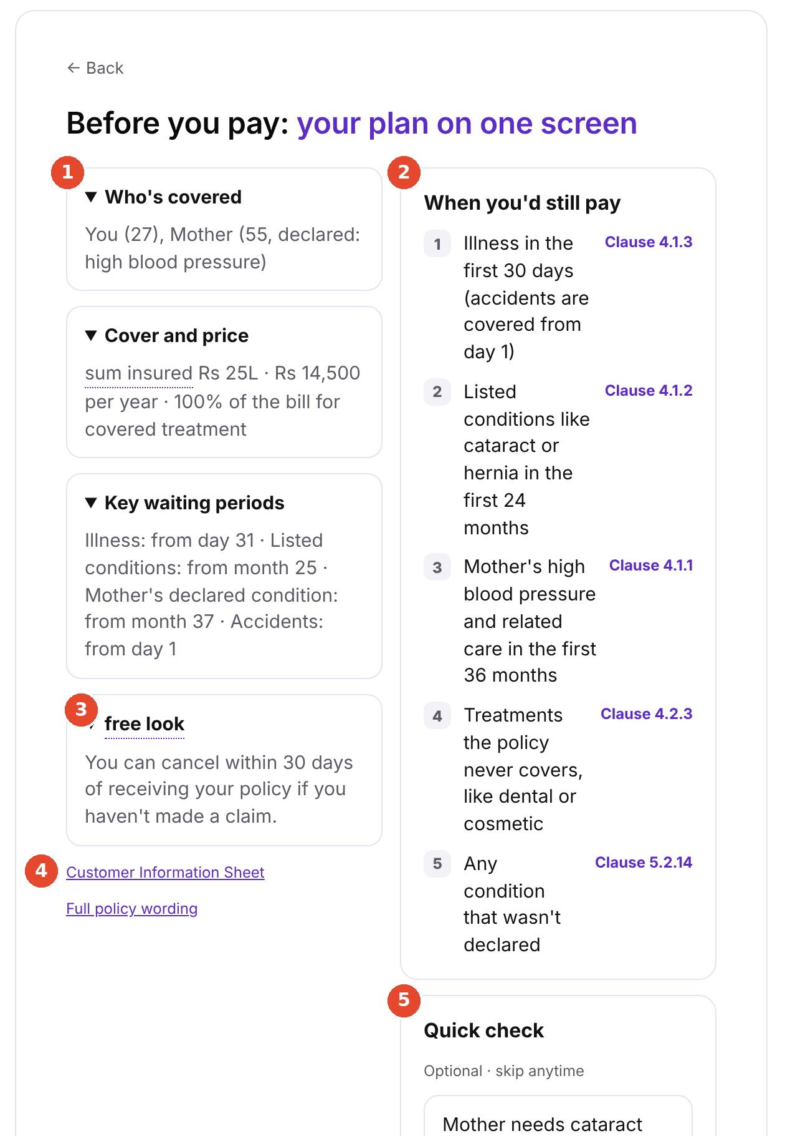
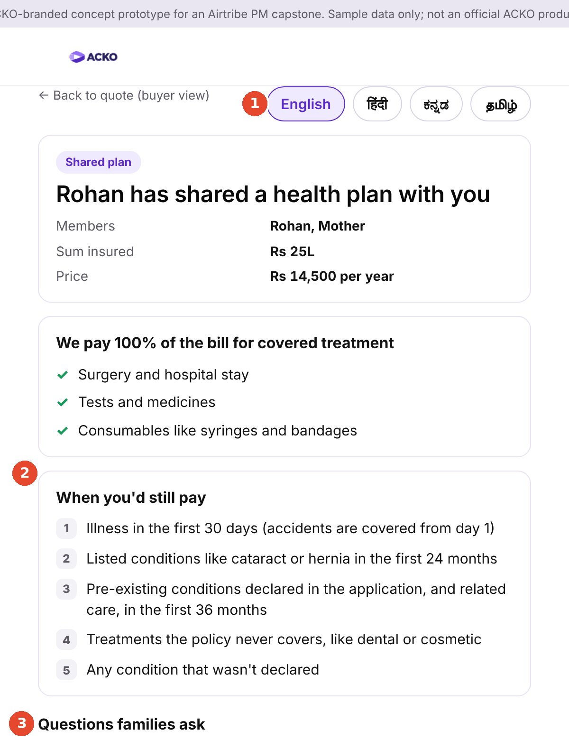
STEP 4 · PROTOTYPE
Prototype: every limit sits where the decision happens
Jargon, explained
Terms like 'sum insured' and 'free look' are underlined; tap for a one-line definition. Limits are told as everyday situations: 'Mother needs cataract surgery in month 10: you pay.'
Exclusions, shown honestly
The promise never appears without its limits. Every line cites its clause; the full list is one tap away. Pre-declaration card says what not declaring can lead to.
Flow, kept quick
No new screen. The panel is collapsed to 5 lines; the summary replaces the review step, with Pay on the same screen.
S13 · Plan page
S17 · Before you pay
Shared family page
'100% for covered treatment' beside 5 lines on when you'd still pay, each linked to its clause
Limits first, on the screen that replaces the review step; quick check is optional
Same limits, 4 languages, no login; 'Continue this quote' brings the buyer back
Clickable prototype: sagarn9918.github.io/Acko-Health-Insurance · Also built: S10 pre-declaration explainer and S19 itemised loading screen
Notes:
Three of the prototype screens, annotated. The plan page now reads 100% for covered treatment, with the five situations where you'd still pay right beside it, each linked to its clause. The summary before payment puts the limits first and replaces the old review screen, so it costs no step. And the family page carries the same limits, in the family's language, with no login.

Slide 14
STEP 4 · PRD
PRD: what v1 ships, for whom, and how we'll judge it
PROBLEM
USERS
SUCCESS METRIC
Only 12% of first-time quote-holders make a confirmed purchase within 14 days. They can't predict when the plan pays, or what a declared condition will cost; a loading arrives by letter after they apply (clause 5.2.14).
First-time buyers of individual and family floater plans, app and web.
A · family buyer B · overwhelmed self-buyer C · confident-but-wrong
Launch segment: buyers covering a parent.
Primary: 14-day confirmed purchase rate, 12% → 26% in 6 months (buyer's own selections, no agent override).
Guardrails: free-look cancellations, disputes, 0% paying without seeing limits, time to pay ≤ +1 min.
SCOPE: V1 REQUIREMENTS (P0)
OUT OF SCOPE
BRIEF MUST-HAVES, MET
A1 'When you'd still pay' panel A2 per-member timeline
A3 worked examples A4 per-member price
A5 pre-declaration explainer A6 itemised loading
A7 one-screen summary B1 share pack B2 no-login viewer
P1: A8 quick check, B3 resume link. Every line generated from a policy map keyed by UIN and clause; Compliance signs off all 4 languages.
Underwriting rules, premium pricing, claims operations, agent and partner distribution, payment gateway.
Non-goals: recommending a plan or cover; discounts, urgency or fear; shortening any IRDAI disclosure. Voice assistant is phase 2.
✓ First-time buyers, no jargon: terms told as situations
✓ Understand, compare, choose: outcomes per member, not checkout
✓ Exclusions told honestly: '100%' always beside its limits
✓ IRDAI intact, no advice: views added; nothing removed
✓ Vernacular and family: 4 languages; share pack
✓ No discounts or fear: none used; no referral rewards
Full PRD (requirements with acceptance criteria, edge cases, hypotheses H1–H4, milestones, dependencies) is in the capstone document, Step 4
Notes:
The PRD on one page. Problem and users come from the research. Scope is nine P0 requirements across the two solutions. Success is the 14-day confirmed purchase rate with guardrails. And the bottom right shows how v1 meets each of the brief's must-haves.

Slide 15
STEP 5 · GO-TO-MARKET & ROLLOUT
Launch to parent buyers first, then widen through gated cohorts
LAUNCH SEGMENT: BUYERS COVERING A PARENT
LANGUAGES
CHANNEL
MESSAGE
Bought, of those who looked at buying
English, Hindi, Kannada and Tamil at launch. Telugu and Konkani only if Acko's data shows demand.
Existing quote traffic, no new spend, so the test compares cleanly with 12%. Motor customers after rollout.
“Know what you'll pay, and when.” No discounts, urgency or fear. The follow-up call uses the same list.
Widest gap, and they use every feature: outcomes, loadings, family sign-off. If it works for them, it works for everyone.
COHORT ROLLOUT: EACH COHORT MUST PASS ITS GATE
0 · Prototype
Weeks 3–6
5–6 research participants
Gate: 4 of 5 pass usability tasks
1 · Parent buyers
Week 10, readout week 14
50/50 A/B; ~2,036 per arm detects 12% → 15%
Gate: significant lift, no guardrail breached
2 · All first-time
Weeks 14–18
50/50; self-only buyers added
Gate: lift holds; time to pay ≤ +1 min
3 · Full rollout
Week 18 to month 6
95% new, 5% holdout; v1.1 tests
Gate: 26% vs holdout at month 6
4 · Phase 2
After month 6
Voice assistant; loop features
Gate: voice passes accuracy test
Sources: survey Q1 by Q5 (respondents who looked at buying); Q11 for languages. Sample size: two-sided test of proportions, 80% power, 5% significance. A feature flag turns everything off at once if a guardrail trips
Notes:
We launch to buyers covering a parent. Their gap between intent and purchase is the widest, 25% against 56%, and they use every part of the design. No new marketing during the test so the comparison with 12% stays clean. Then five cohorts, each with a gate, and a 5% holdout to month six so we can prove the 26% came from the design and not the season.

Slide 16
STEP 5 · GROWTH LOOP & IMPACT
+1,400 policies per 10,000 quote-holders, and it compounds
GROWTH LOOP: A CONFIDENT PURCHASE BRINGS THE NEXT ONE
BUSINESS IMPACT MODEL, PER 10,000 FIRST-TIME QUOTE-HOLDERS
 | Today (12%) | Target (26%) | Change
Policies | 1,200 | 2,600 | +1,400
First-year premium | ₹1.80 cr | ₹3.90 cr | +₹2.10 cr
Renewed in year 2 (89%) | 1,068 | 2,314 | +1,246
Three-year premium | ₹4.83 cr | ₹10.46 cr | +₹5.63 cr
First-time quote
Understands the plan (A)
Decides with family (B)
Confident purchase
1 · Renewal
No surprises in year one, so they renew; waiting-period credit shown. Benchmark: 89%.
2 · Family add-on
31 of 68 cover only themselves. Add a parent at renewal, waiting periods shown first.
3 · Referral
Family is the most trusted source (20 of 68). Shared page adds 'Get my own quote'. No cash rewards (s.41).
Rule of thumb: ₹25,200 a year for every first-time quote-holder Acko sees in a month. Even at 80% renewal, the three-year gain is ₹5.1 cr.
WHAT IT COSTS IF COMPREHENSION SLOWS THE FLOW
Every 5% of today's buyers lost to extra reading = 60 policies and ₹9 lakh per 10,000. To still net +14 points, the design must win 14.6. So: no mandatory step, and time to pay is a guardrail. Regret costs too: 2% free-look cancellations at 26% = 52 policies refunded.
Next year, next family member, next buyer: back into the quote
Assumptions to replace with Acko data: ₹15,000 average first-year premium (interviewee range); 89% renewal (Policybazaar online benchmark, Mar 2026 quarter); premium flat at renewal, so value is understated. Loops not counted until cohort 1 measures them.
Sources: survey Q5, Q10 (n=68); Policybazaar health renewal persistency (Mar 2026 quarter); Insurance Act 1938, s.41 (no inducements)
Notes:
At the target, every 10,000 first-time quote-holders bring 1,400 more policies and about 2.1 crore of first-year premium, 5.6 crore over three years. The premium figure is my assumption from interviews and should be replaced with Acko's number. The other side of the ledger: if extra reading loses 5% of today's buyers, that's 60 policies, which is why time to pay is a guardrail. The loops reuse what A and B already build.

Slide 17
STEP 6 · METRICS
One North Star that can't rise with regret
NORTH STAR · CONFIDENT PURCHASE RATE
26%
First-time quote-holders who make a confirmed purchase within 14 days, saw the key limits before paying, and keep the policy past the 30-day free look
by month 6, vs a 5% holdout. Baseline ≤ 12%, measured in week 1
LEADING · MOVES IN DAYS
LAGGING · MOVES IN WEEKS
GUARDRAILS · STOP THE ROLLOUT
'When you'd still pay' panel or timeline opened
Worked example viewed
Share rate; share-to-resume within 14 days
Pre-declaration explainer opened
Quick-check accuracy (53% wrong today)
14-day and 30-day confirmed purchase rates
Counteroffer acceptance (declared conditions)
Renewal rate; members added at renewal
Quotes started from a shared page
First-year premium per 10,000
Free-look cancellations: no rise vs control
Post-purchase confusion contacts: no rise
Claim disputes on misunderstood terms: fall (12 months)
Purchases that never saw key limits: 0%
Time to pay: ≤ +1 min · health-question drop-off: no rise
EVENT TRACKING · 27 EVENTS, KEY ONES BELOW
quote_created · health_explainer_viewed · limits_panel_expanded · worked_example_viewed · clause_opened · share_sent · shared_page_opened · quote_resumed · summary_viewed · payment_succeeded · counteroffer_accepted · free_look_cancelled · claim_decided
Every event carries quote ID, cohort and variant, language and platform. Analytics record whether a condition was declared, never which one (DPDP Act 2023).
Full metric definitions and the event specification are in the capstone document, Step 6. Readouts at week 14, week 18 and month 6; dispute guardrail at month 12
Notes:
The North Star is the confident purchase rate. It's the brief's 14-day purchase, but it only counts a buyer who saw the limits and kept the policy past the free look, so it can't rise with regret. Because it's stricter, today's value is at most 12% and we measure it exactly in week 1. Leading metrics tell us in days whether people read and share; guardrails stop the rollout if conversion rises with cancellations, confusion or disputes.

Slide 18
STEP 7 · RISKS & CONSTRAINTS
The real risk is lifting conversion the wrong way
Risk | Type | Early signal | Mitigation
A simplified line drops or changes a limit: mis-selling | Regulatory | Complaints tagged 'not told'; Compliance spot checks | Every line generated from the wording by clause; Compliance signs off all 4 languages, with back-translation
New copy reads as advice | Regulatory | Copy review; support transcripts | Banned phrases ('you should', 'best for you'); explain, never recommend
A worked example is wrong for one buyer | Wrong or simplified | Support contacts about timelines | Built from the buyer's own schedule; no months shown if it's missing; 'subject to policy terms'
Conversion rises alongside regret | Regret | Free-look cancellations vs control | North Star excludes free looks; dispute guardrail runs 12 months; 5% holdout
Honest limits put off good buyers | Friction | Time to pay; lost-buyer cost | No mandatory step; panel collapsed; ≤ +1 min guardrail
WHAT WE WILL NOT BUILD
A 'best plan for you' engine: that's advice
Cross-insurer comparison: that's Bima Sugam's job
Discounts, urgency or fear
Pricing, underwriting or claims changes
Referral rewards (Insurance Act s.41)
Live voice in v1
Not an advisor: we explain what the policy says and cite the clause; we never say what to buy. Personal questions go to a person.
CONSTRAINTS THAT SHAPE V1, AND ASSUMPTIONS WE'LL VALIDATE
Regulatory
IRDAI disclosures, CIS and consent can't be shortened; waiting periods ≤ 36 months; 30-day free look; DPDP: no health data in shares or analytics
Underwriting
Loadings are decided after application (clause 5.2.14), so v1 explains what can happen, tags the member and itemises the outcome
Assumptions
₹15,000 premium; 89% renewal; ~45% of quote-holders declare a condition; time to pay can rise 1 min. All checked in weeks 1–2
Sources: Step 7 of the capstone document; IRDAI health regulations; Insurance Act 1938 s.41; DPDP Act 2023; Acko Health II policy wording
Notes:
The biggest risk isn't failing to lift conversion. It's lifting it the wrong way: a simplified line that drops a limit, an example that's wrong for one buyer, or buyers who pay because the screens felt reassuring. Each has an early signal and a mitigation. And we won't build anything that tells a buyer what to buy.

Slide 19
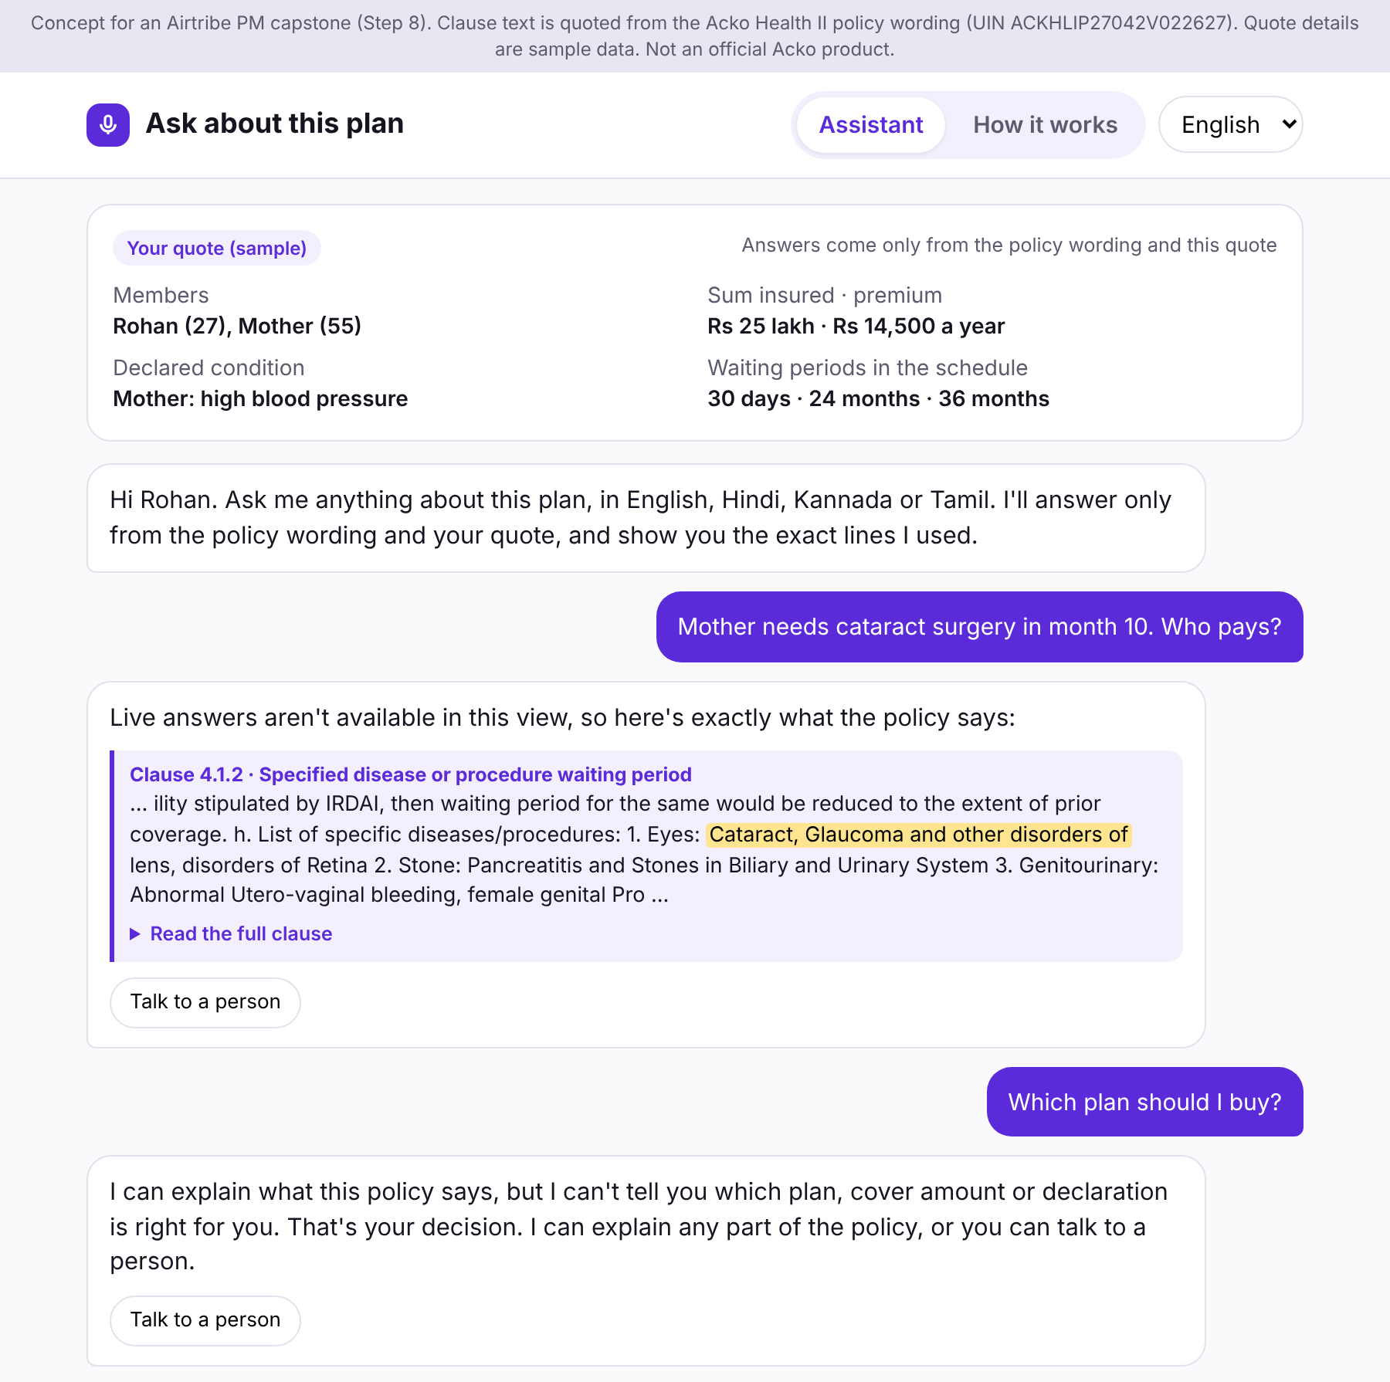
STEP 8 · AI ARTIFACT
Strategic bet, built: an assistant that can't say what the policy doesn't
HOW EVERY ANSWER STAYS INSIDE THE POLICY WORDING
1 · Route
Advice and medical questions get a fixed reply and a handover
2 · Draft
Claude answers only from 20 policy clauses and the quote
3 · Check in code
Exact quotes; every number traceable; no advice words
4 · Fall back
Any failed check: the buyer sees the clause itself
TESTED: 4 DRAFTS FOR 'MOTHER NEEDS CATARACT SURGERY IN MONTH 10. WHO PAYS?'
Draft | Result | Caught by
Correct answer quoting clause 4.1.2 | Shown | Passed all checks
Adds 'the wait is 18 months for knees' | Replaced by clause | Number check: 18 isn't in any source
Starts 'You should buy the higher cover' | Replaced by clause | Advice check
Cites a made-up line from the policy | Replaced by clause | Quote check: not in clause 4.1.2
Where it fits: 'Ask about this plan' on screens S13 to S17, by voice or text, in 4 languages. v1 ships the button only, to measure demand. It goes live in phase 2 only after a 100-question test across all 4 languages with zero unsupported answers.
Live demo: claude.ai/artifact/YKXkpG1EW1oS8ZBZxpptm2 · prompts and checks: capstone document, Step 8
Sources: Acko Health II policy wording (UIN ACKHLIP27042V022627, 20 clauses word for word); interviews (buyers already use ChatGPT, Gemini and YouTube to decode clauses)
Notes:
This is the strategic bet, built. Buyers already ask ChatGPT and YouTube to explain clauses; this brings that conversation back to Acko. Claude answers only from 20 clauses of the real policy and the buyer's quote, and the page checks every draft in code before showing it. If any check fails, the buyer sees the clause itself. In testing, it caught an invented number, an advice phrase and a fake quote.

Slide 20
WHAT NEXT
Four decisions to start the 10-week build
1 · Approve the cohort 1 test
2 · Underwriting
3 · Compliance
4 · Data
A/B test on parent buyers from week 10, about 2,036 quote-holders per arm
Counteroffer data available to the app by week 8, for the itemised loading screen
Templates in 4 languages signed off by week 10, mapped by product UIN and clause
Acko's average premium and monthly quote volume, to replace our two assumptions
THE NEXT 14 WEEKS
Weeks 1–2
Weeks 3–6
Weeks 5–9
Week 10
Week 14
Policy content map; compliance review; validate assumptions
Build A1–A4 and A7; usability test (cohort 0)
A5 and A6 with Underwriting; B1–B3; translations
Compliance sign-off; A/B test goes live
Readout and rollout decision
A quote is a price, not a decision. We'll turn it into a decision the buyer understands, with nothing hidden to get there.
Prototype: sagarn9918.github.io/Acko-Health-Insurance · AI assistant: claude.ai/artifact/YKXkpG1EW1oS8ZBZxpptm2
Notes:
To start, I need four decisions: approve the test on parent buyers, Underwriting to make counteroffer data available by week 8, Compliance to sign off the templates by week 10, and Acko's real premium and volume numbers to replace my two assumptions. A quote is a price, not a decision. This turns it into one the buyer understands. Thank you.

