Slide 1
Presentation on
eYANTRA THEME
NUTTY SQUIRREL
Presented by:
Sagar Narkhede 3. Ashlesha Borade
Omkar Sutar 4. Pooja Katkar
Guided by: Reference by:
Dr.N.P. Futane eYantra Robotics Competition

Slide 2
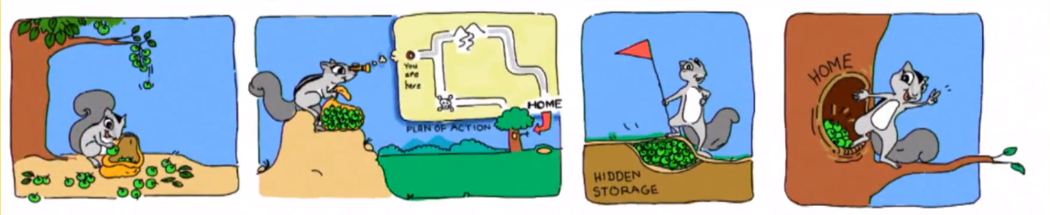
INTRODUCTION
In this theme, a robot and a lift mechanism is designed that depicts Squirrel that sorts, carries and places Nuts at different places on land and in trees.
The challenges in this theme include Path Planning, building a Lift Mechanism and Simulation.
A configuration image is given to teams. The arena consists of thermocol Nuts of different colors that are placed randomly.
The robot traverses the arena to pick up a Nut and place it in designated sections S1 or S2.
The team needs to make a lift mechanism to lift the bot to certain height to place Nuts at the designated section S3.

Slide 3
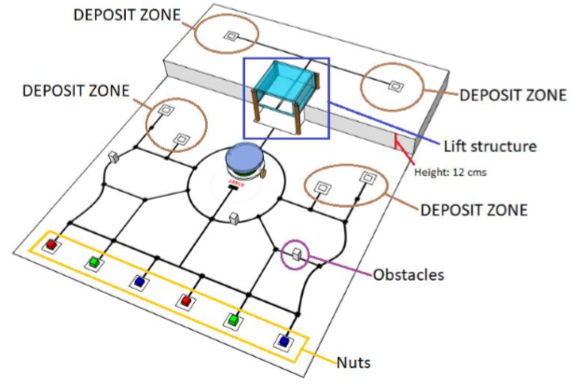
BLOCK DIAGRAM :
1.ARENA

Slide 4
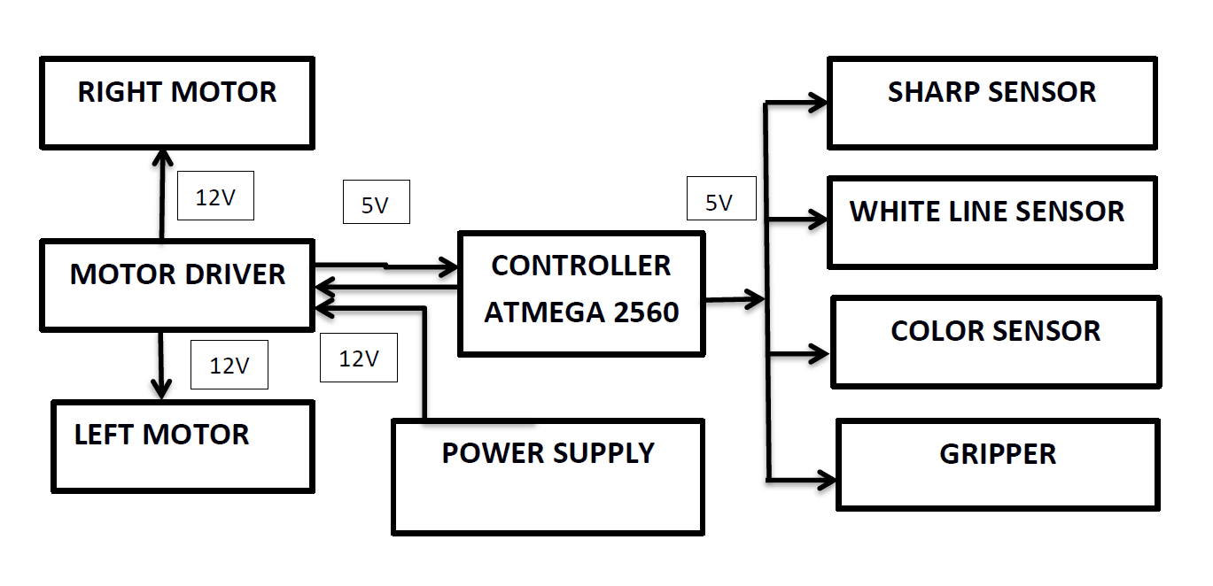
2.ROBOT

Slide 5
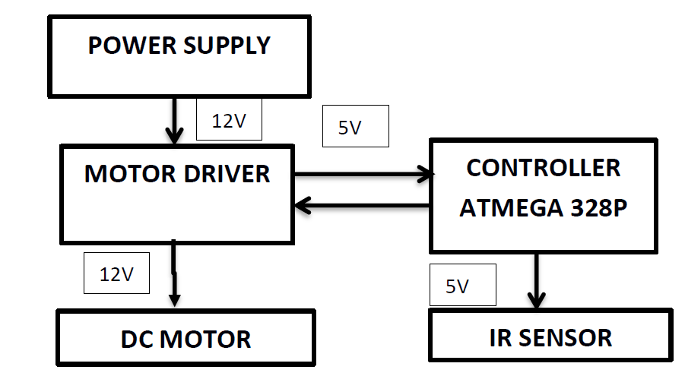
3.LIFTING MECHANISM

Slide 6
THEORETICAL DESIGN
1.HARDWERE SPECIFICATION
I. ROBOT:
Electronic system:
1. Color sensor TCS3200: It is used to detect the appropriate color of the nuts.
2. Sharp sensor: It is used to detect the obstacle at a particular distance.
3. Line following sensor: To follow the black line to traverse the complete arena 4
Mechanical System:
1. DC motor (100 rpm): for the locomotion of the robot through wheels.
2. RGB led: to glow the appropriate color of RGB led when respective color is detected by color sensor

Slide 7
II. LIFTING MECHANISM:
Electronic system:
IR sensor: to detect the presence of robot.
Mechanical system:
1.DC Motor (60 rpm): It rotates in anticlockwise direction
for upward lift & clockwise direction for downward lift.

Slide 8
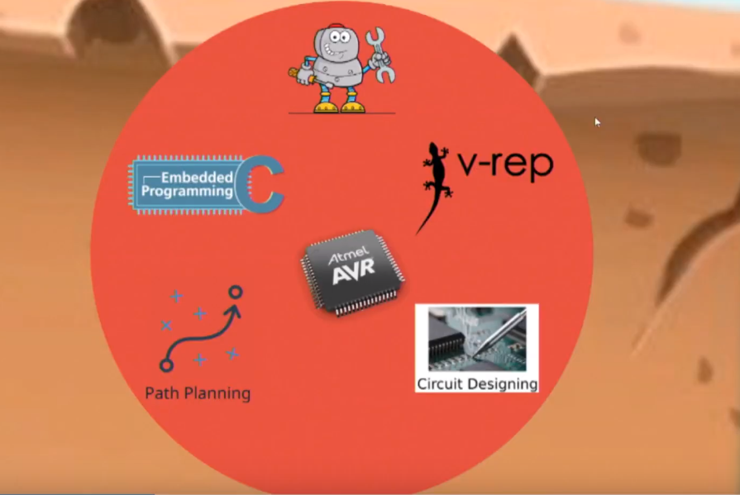
2. SOFTWERE SPECIFICATION :

Slide 9
THANK YOU!

